Slide 1
Creating a Global High-Resolution Convective or Stratiform Type Product
Jackson Tan
University of Maryland Baltimore County & NASA Goddard Space Flight Center
jackson.tan@nasa.gov
Veljko Petković, Daniel Watters, Pierre Kirstetter, George J. Huffman, Marko Orescanin

Slide 2
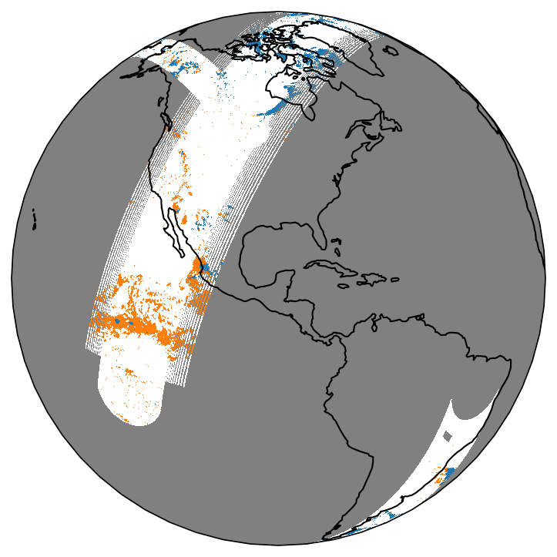
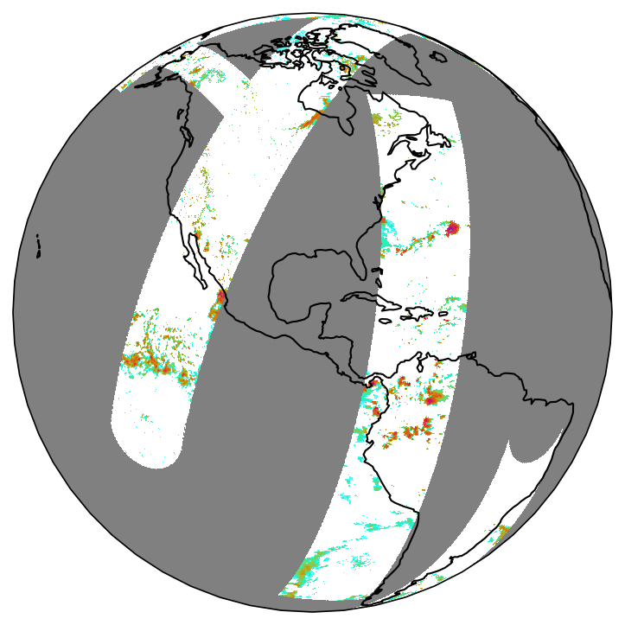
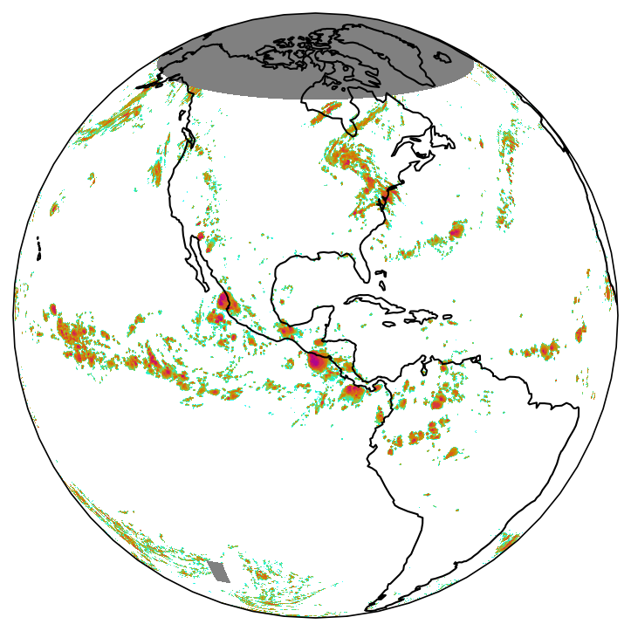
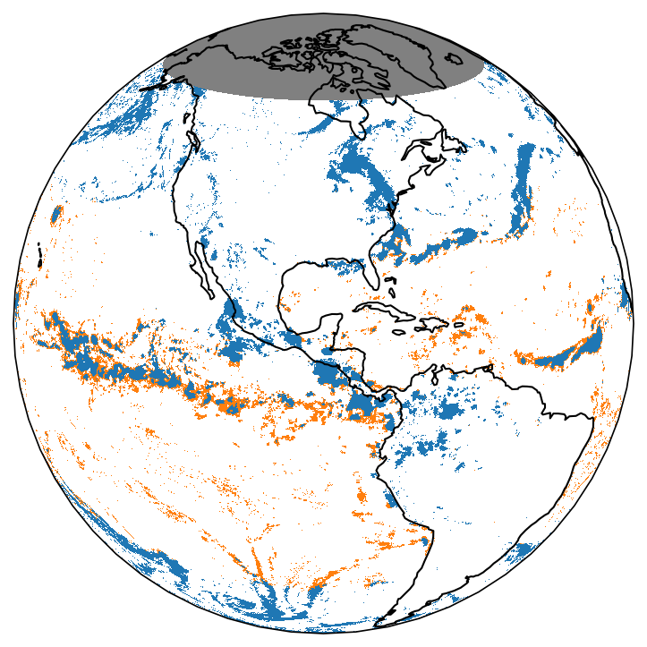
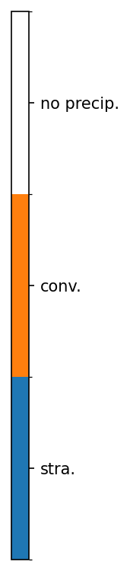
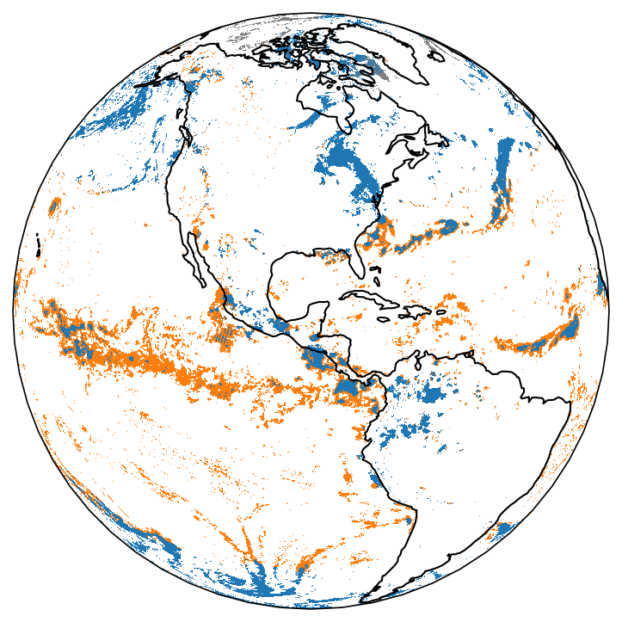
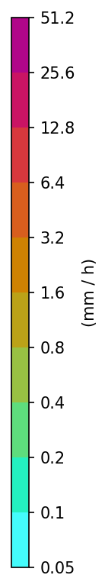
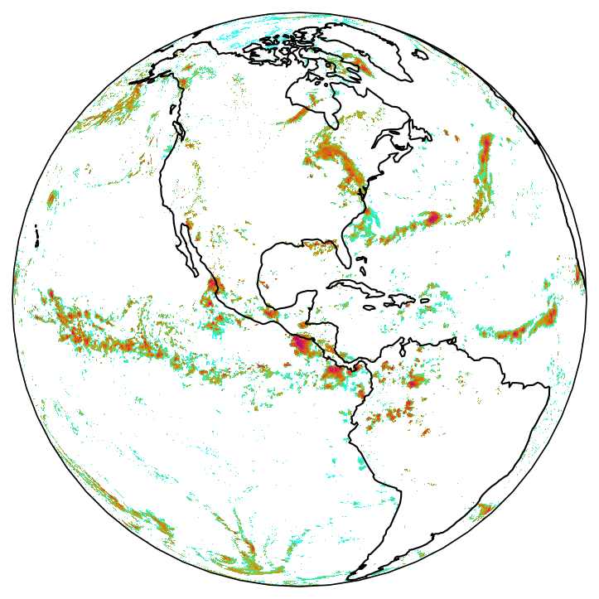
Project Overview
IMERG combines PMW and IR retrievals of precipitation rates at a high resolution.
This project aims to build an observation-based companion product to IMERG, using a similar approach to provide convective/stratiform type information.
Why C/S type? Classify storm types, tracking MCS, computing latent heating profiles, evaluating numerical models, studying retrieval biases.
So far, there are two sources of C/S type observations:
  Ground-based radars: regional
  TRMM PR and GPM DPR: very limited sampling
Similar to IMERG, this project leverages LEO PMW retrievals with GEO IR retrievals to produce a suite of C/S type product:
  Level 2 PMW-based C/S type
  Level 3 IR-based C/S type
  Level 3 merged C/S type

Slide 3
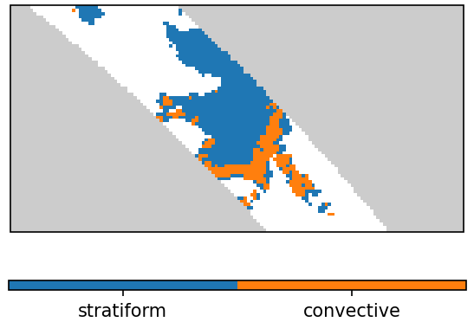
General Approach
We use the C/S type retrievals in GPM DPR as our reference.
  DPR: based on horizontal texture and vertical profile of reflectivity (presence of bright bands, convective cores).
  Generally considered reliable though disagreements exist compared to ground radars.
Our products provide estimates of the probability that the precipitation is convective (as opposed to stratiform).
  Can be converted to a binary C/S type class using a threshold.
  Retrievals are performed everywhere. Users can apply the precipitation mask using their preferred precipitation rate product.
Spatial scale of our C/S type estimate is 5 km or 0.05°.
  ML inference depends on the training reference, and DPR footprints are about 5 km in size.
  Change in mindset! Our C/S type retrievals are representative of a 5-km pixel regardless of the resolution of the inputs.
    Any spatial scale mismatch between the sensor FOV and the DPR footprint is represented as retrieval uncertainties, allowing us to directly compare the limited-information IR retrievals with the coarse-footprint PMW retrievals.
Temporal scale of the merged product is ½ h.
DPR overpass over CONUS on 2015 07 13 07:00 UTC

Slide 4
PMW C/S Type Retrievals
Retrieving C/S type from the rich PMW information has been demonstrated (Petković et al. 2019).
Inputs: Level 1C calibrated brightness temperatures from the GPM constellation.
Architecture: Unet with Bayesian deep learning (patch-to-patch).
Also see Veljko Petković’s presentation (#7.6, Wed at 14:45 pm).

Slide 5
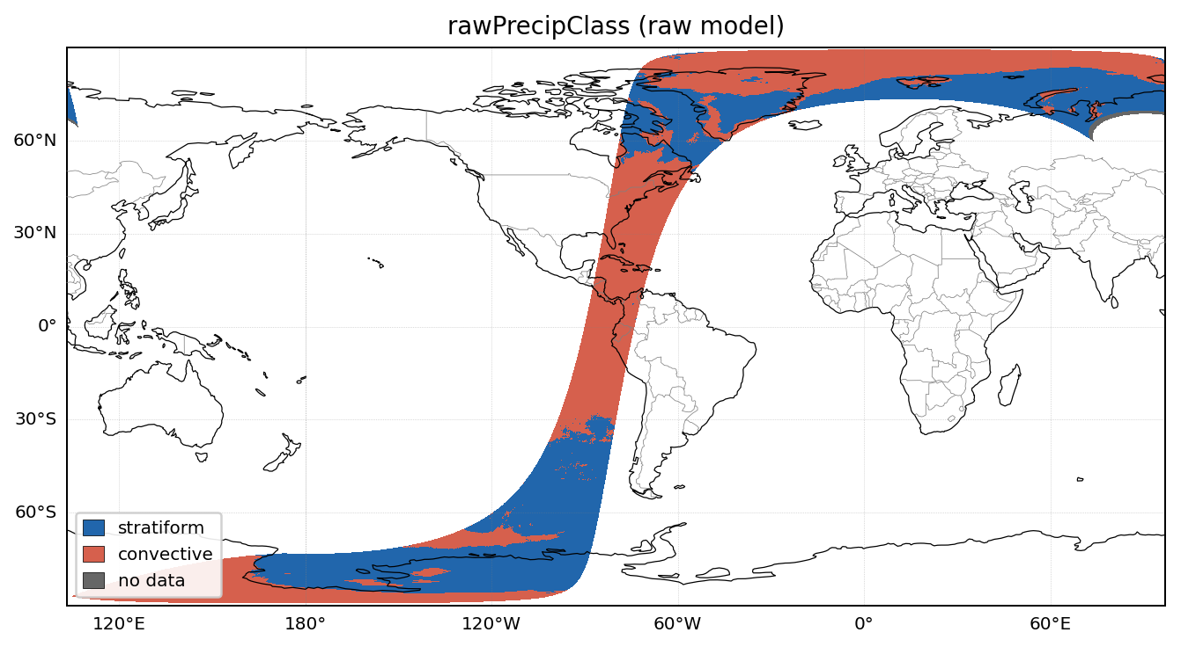
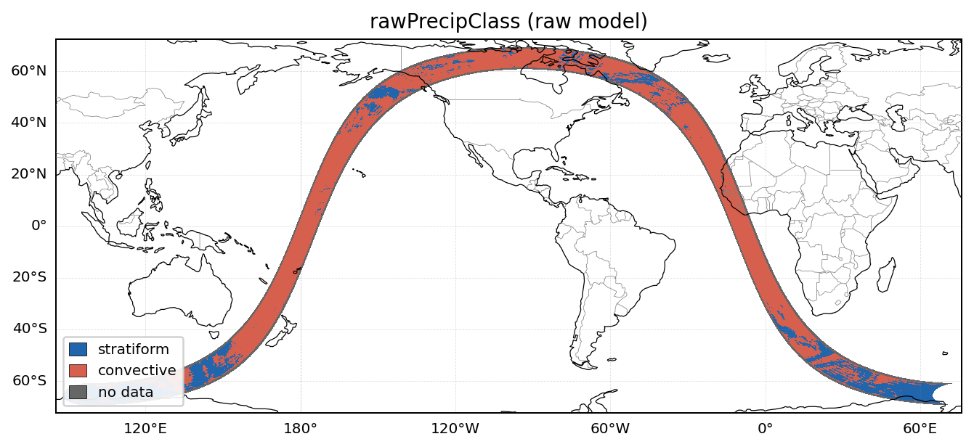
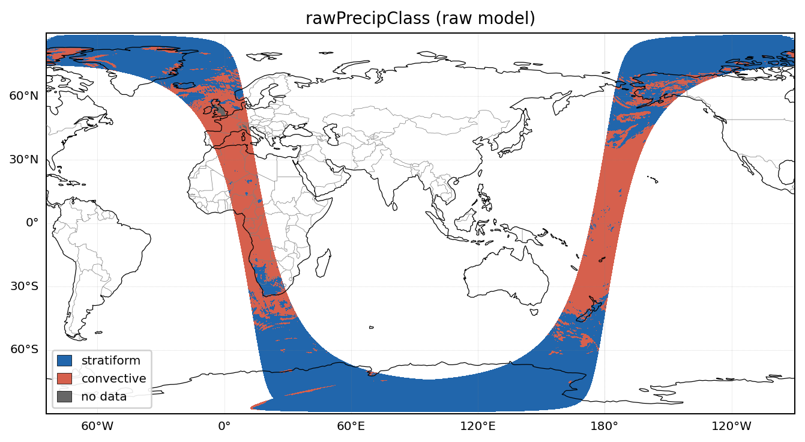
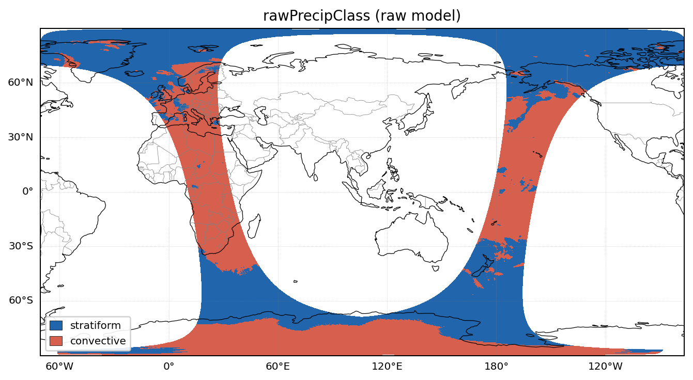
Snapshots of PMW C/S Retrievals
SSMIS
GMI
AMSR2
ATMS

Slide 6
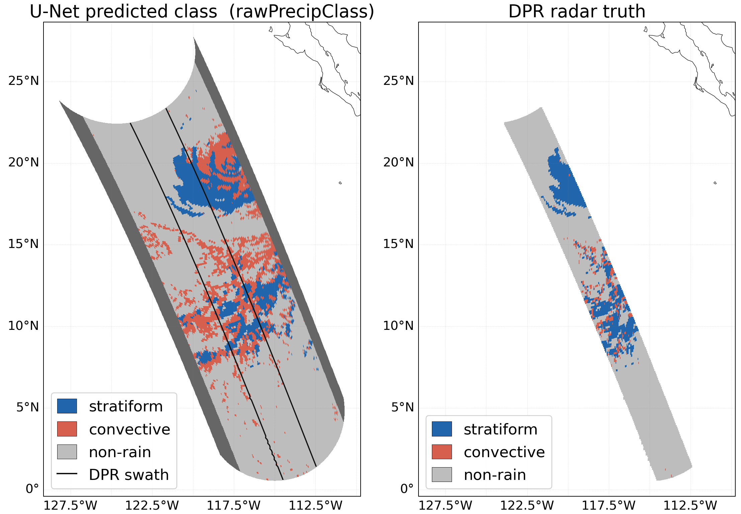
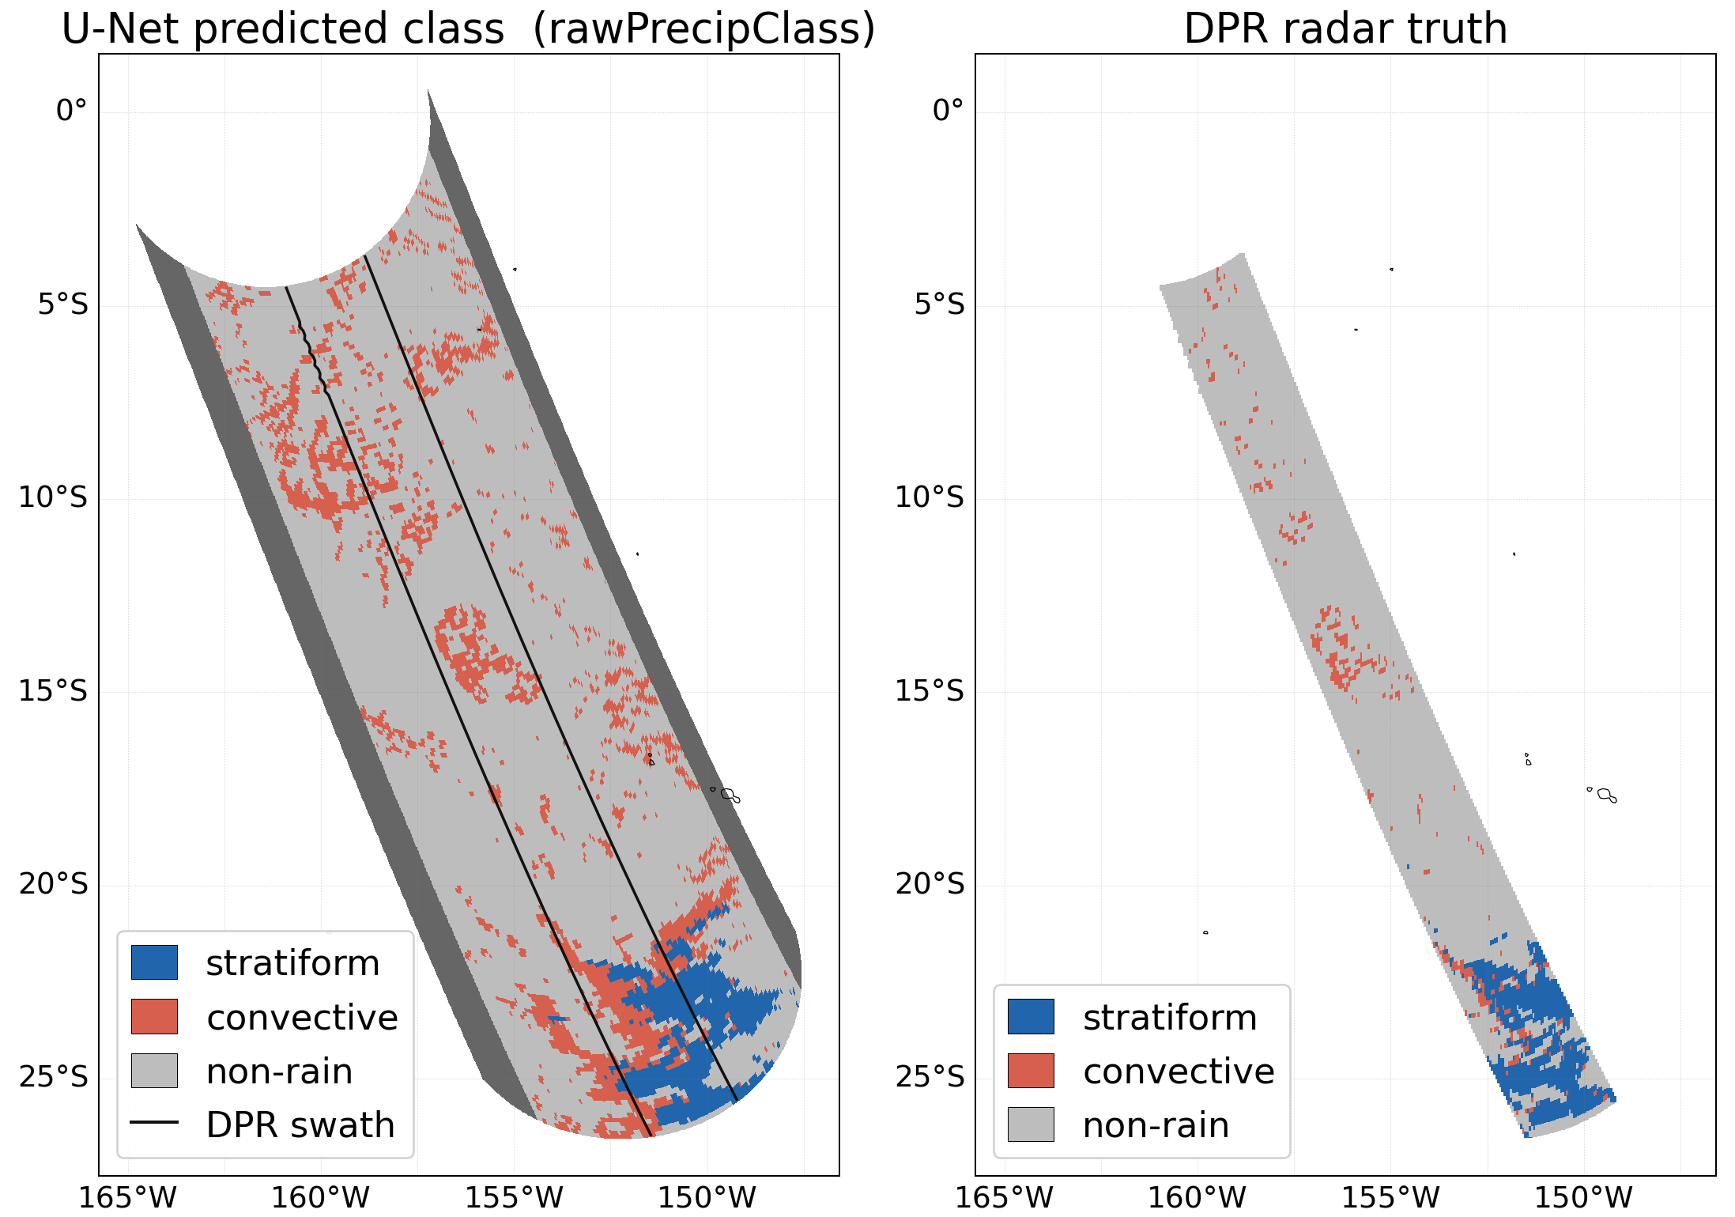
Comparisons of PMW C/S Snapshots against DPR

Slide 7
IR C/S Type Retrievals
Retrieving C/S type from IR information is less established.
We explore two efforts in parallel, eventually choosing the best approach.
  Effort #1: look-up table & decision tree—see Daniel Watters’s presentation (#6.15, Wed at 11:15 am).
  Effort #2: convolutional neural network with Bayesian deep learning (patch-to-pixel)—this presentation.
Inputs:
  NOAA CPC 4-km merged IR product but designing our algorithm with GEO-Ring in mind.
  IMERG precipitation rates.
  All inputs are interpolated using nearest neighbor resampling to 0.05°.

Slide 8
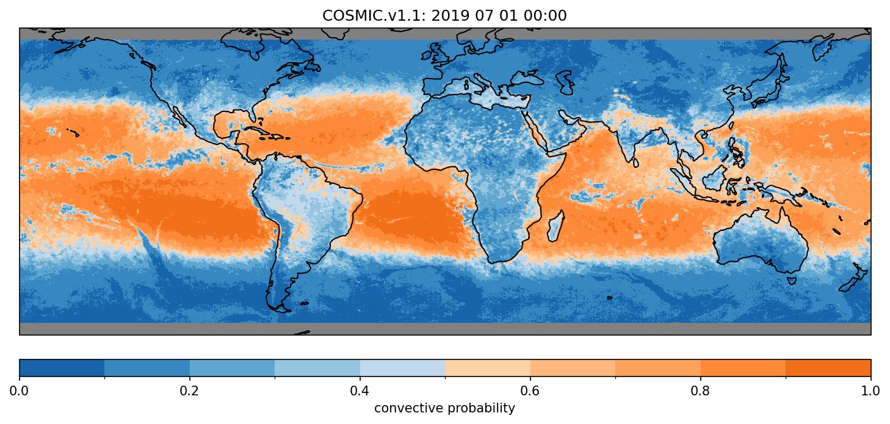
Snapshot of IR C/S Probability

Slide 9
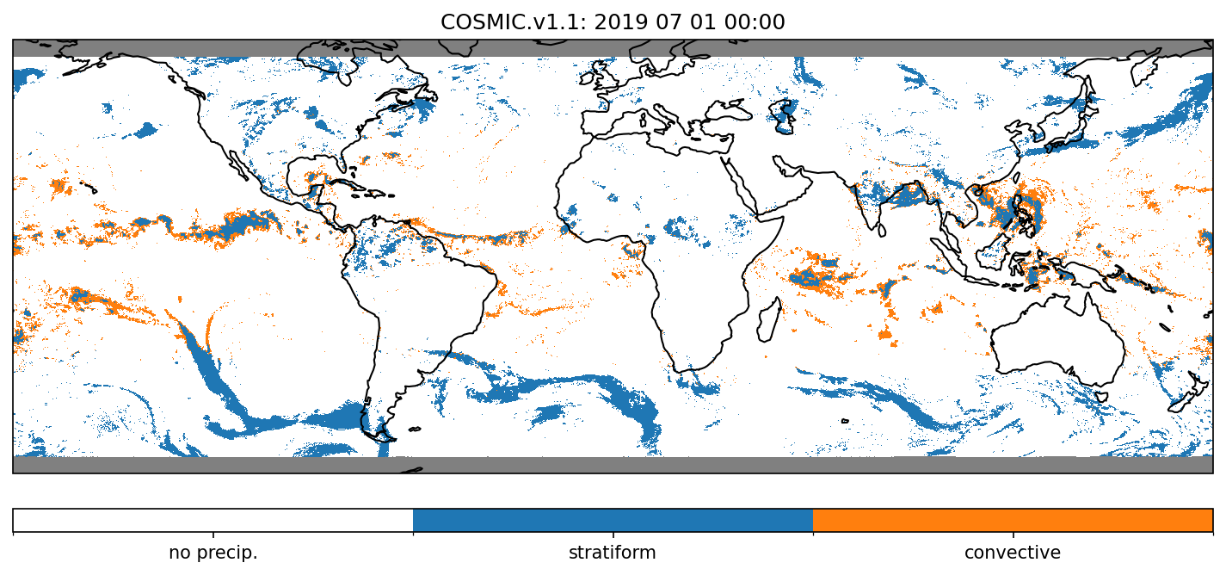
Snapshot of IR C/S Class

Slide 10
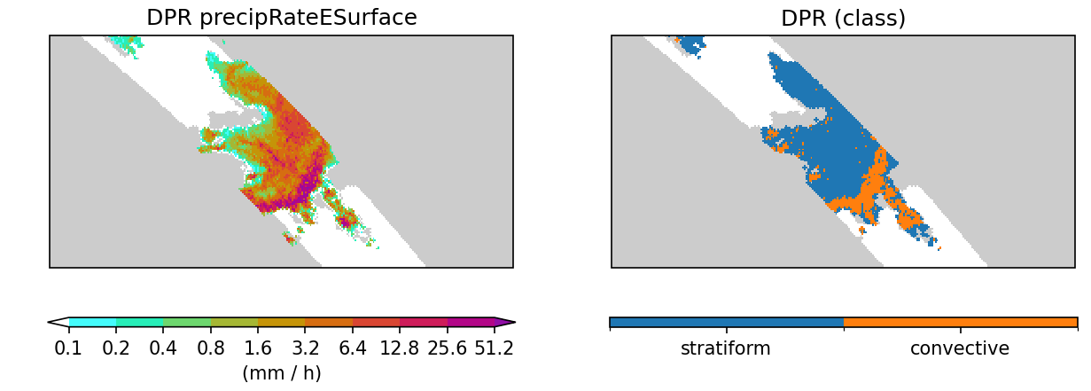
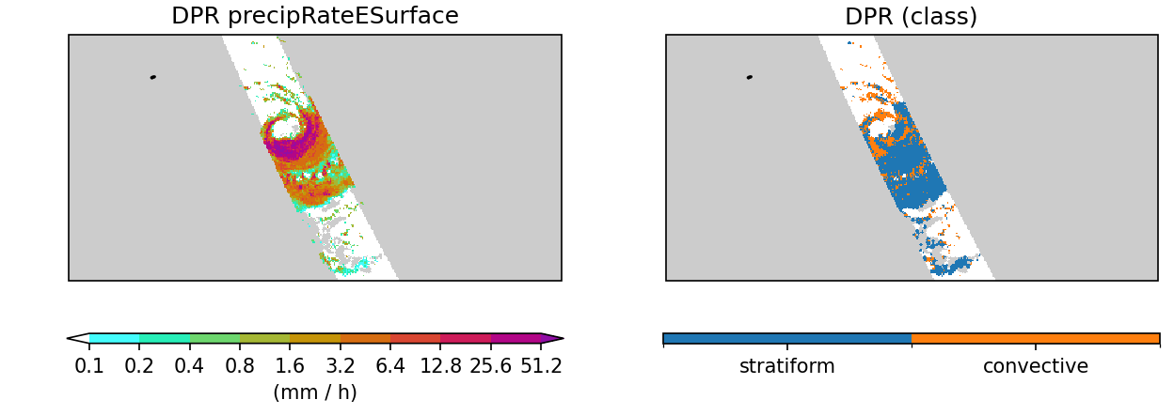
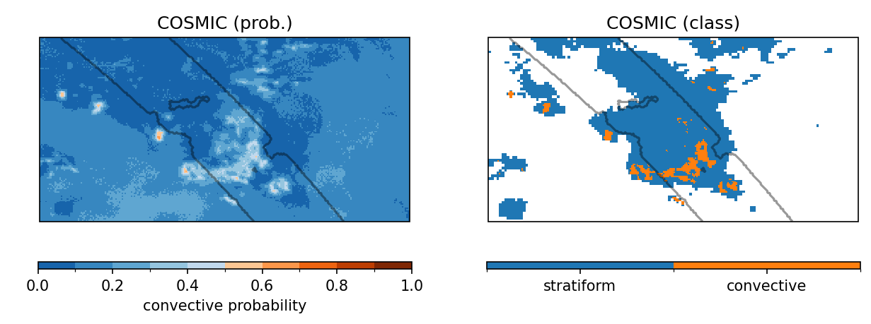
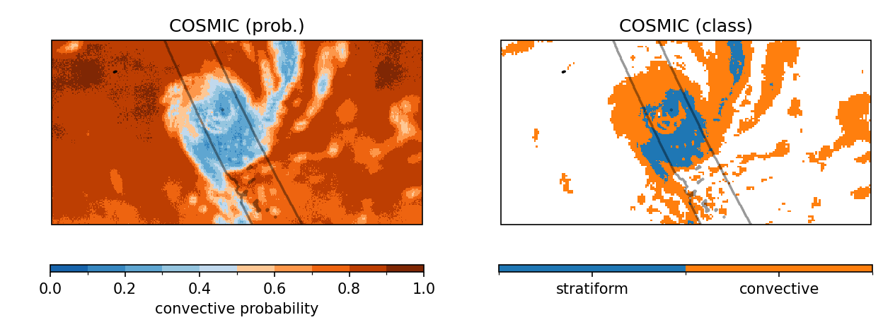
Comparisons of IR C/S Snapshots against DPR

Slide 11
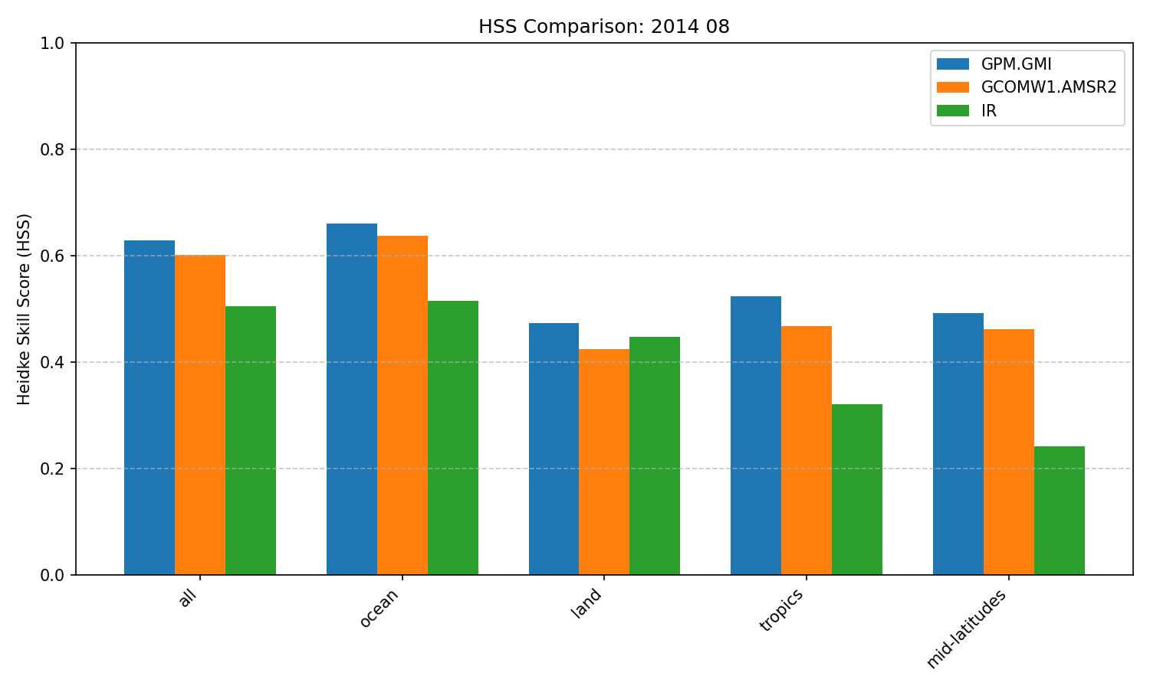
Evaluation of PMW and IR Retrievals against DPR
As with precipitation rate, PMW-based C/S type retrievals are better than IR-based C/S type retrievals.

Slide 12
C/S Retrievals Include Uncertainties
Our algorithms are designed with uncertainty quantification in mind.
Bayesian deep learning produces ensemble estimates representing uncertainties.
But managing uncertainties is a significant challenge!
  Compute: 100 ensemble members = 100x compute!—exploring code refactoring, Unet architecture.
  Storage: 100 ensemble members = 100x storage!—providing logit quartiles.
    Our investigations suggested that the logits are approximately Gaussian in their distribution.
      But the reconstruction would need to respect spatial coherence—work in progress.
  Instructions: how can users best make use of this uncertainty information?—future work.

Slide 13
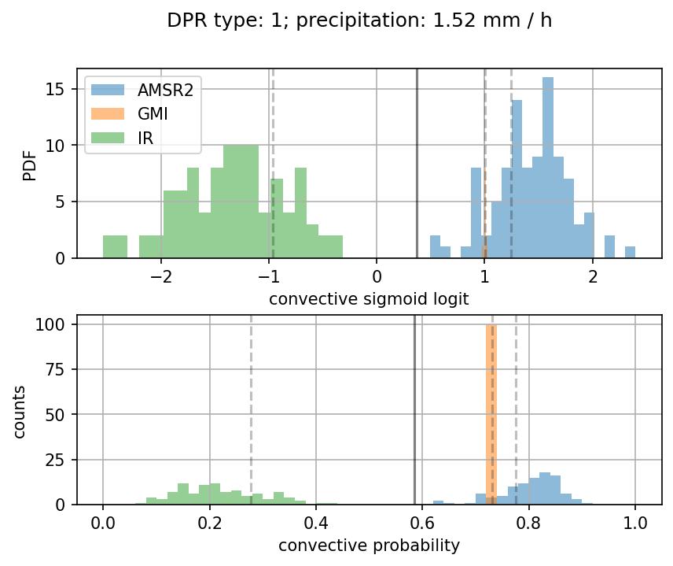
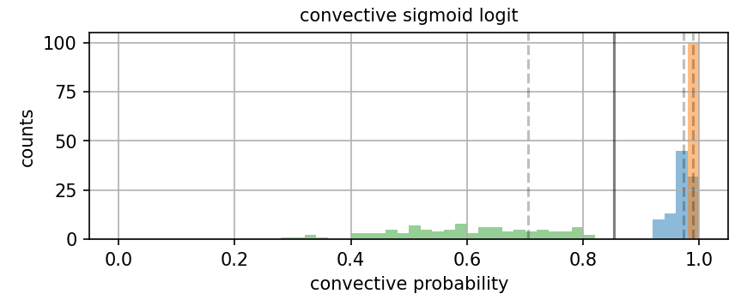
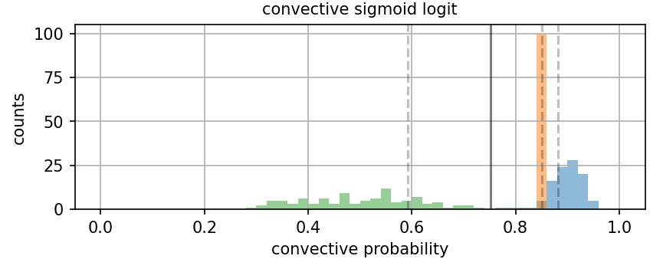
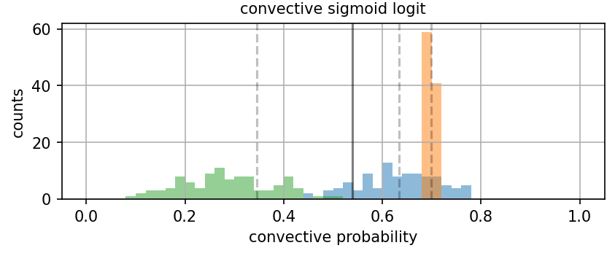
Examples of Logit Uncertainties for Convective Pixels
DPR: convective

Slide 14
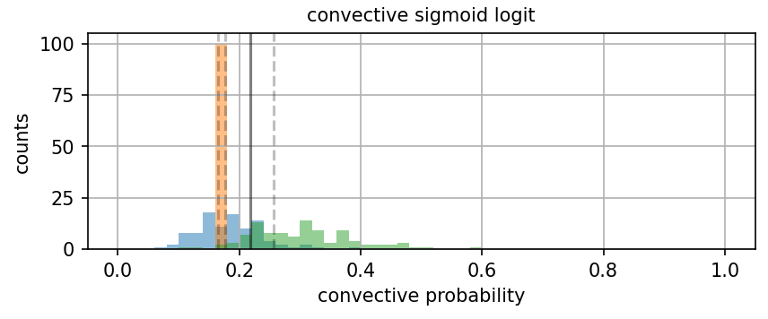
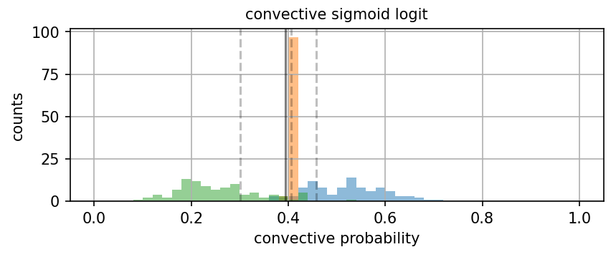
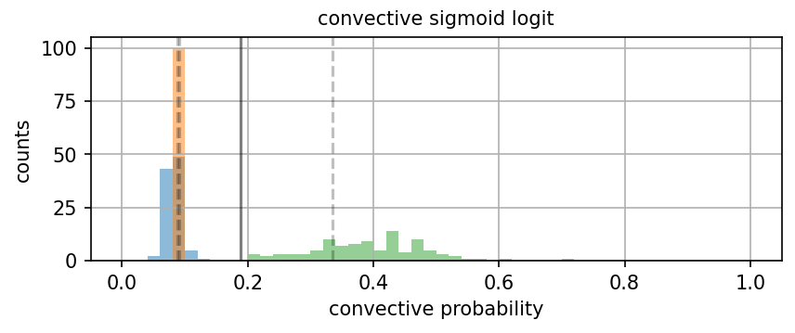
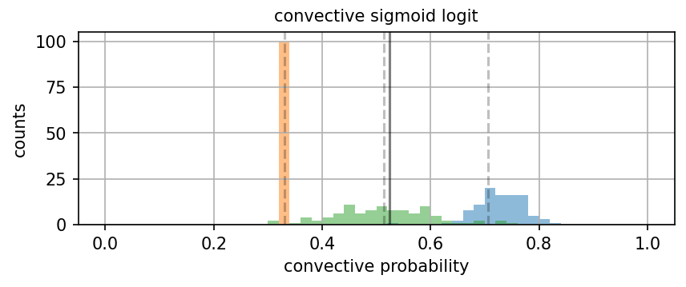
Examples of Logit Uncertainties for Stratiform Pixels
DPR: stratiform

Slide 15
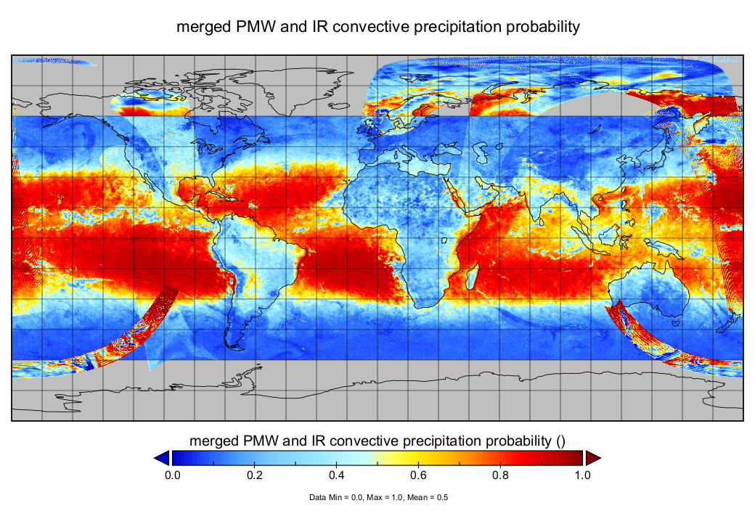



Combining PMW and IR into a Merged Product (WIP)
Since we have Gaussian uncertainties (in logit space), we can use inverse-variance weighting to produce a merged estimate from multiple sources:
Just as with IMERG, we are adapting some form of Lagrangian interpolation—work in progress!
$$μ_{\text{merged}}= \sum_{i}{w_{i}×μ_{i}}$$
$$w_{i}= \frac{1}{σ_{i}^{2}}$$
$$σ_{\text{merged}}=\frac{1}{\sqrt{\sum_{i}{w_{i}}}}$$

Slide 16

Conclusions
The goal of this project is to produce an observational-based C/S type product (including uncertainties) at a high resolution (0.05°, 90°S–90°N; ½ h, 1998–2027) complementing IMERG.
Progress:
  Completed/Production: GPM-era PMW retrievals, CNN-based IR retrievals.
  Work in progress: TRMM-era PMW retrievals, LUT-based IR retrievals, Lagrangian interpolation, merging.
  Future work: Selection of IR algorithm, GV-MRMS evaluation, directions to users.
Draft products for the PMW retrievals and the CNN-based IR retrievals are available.
Link to these slides:
Any questions or feedback: jackson.tan@nasa.gov
https://umbc.box.com/s/pz5nigphvd9ysfmnynsewi3ohossmalt

