Slide 1
Deep Learning Radar Nowcasting over the Upper Tyrrhenian Sea
A. Antonini, M. Passeri, F. Fibbi, L. Fibbi, S. Melani, A. Mazza, A. Ortolani

Slide 2

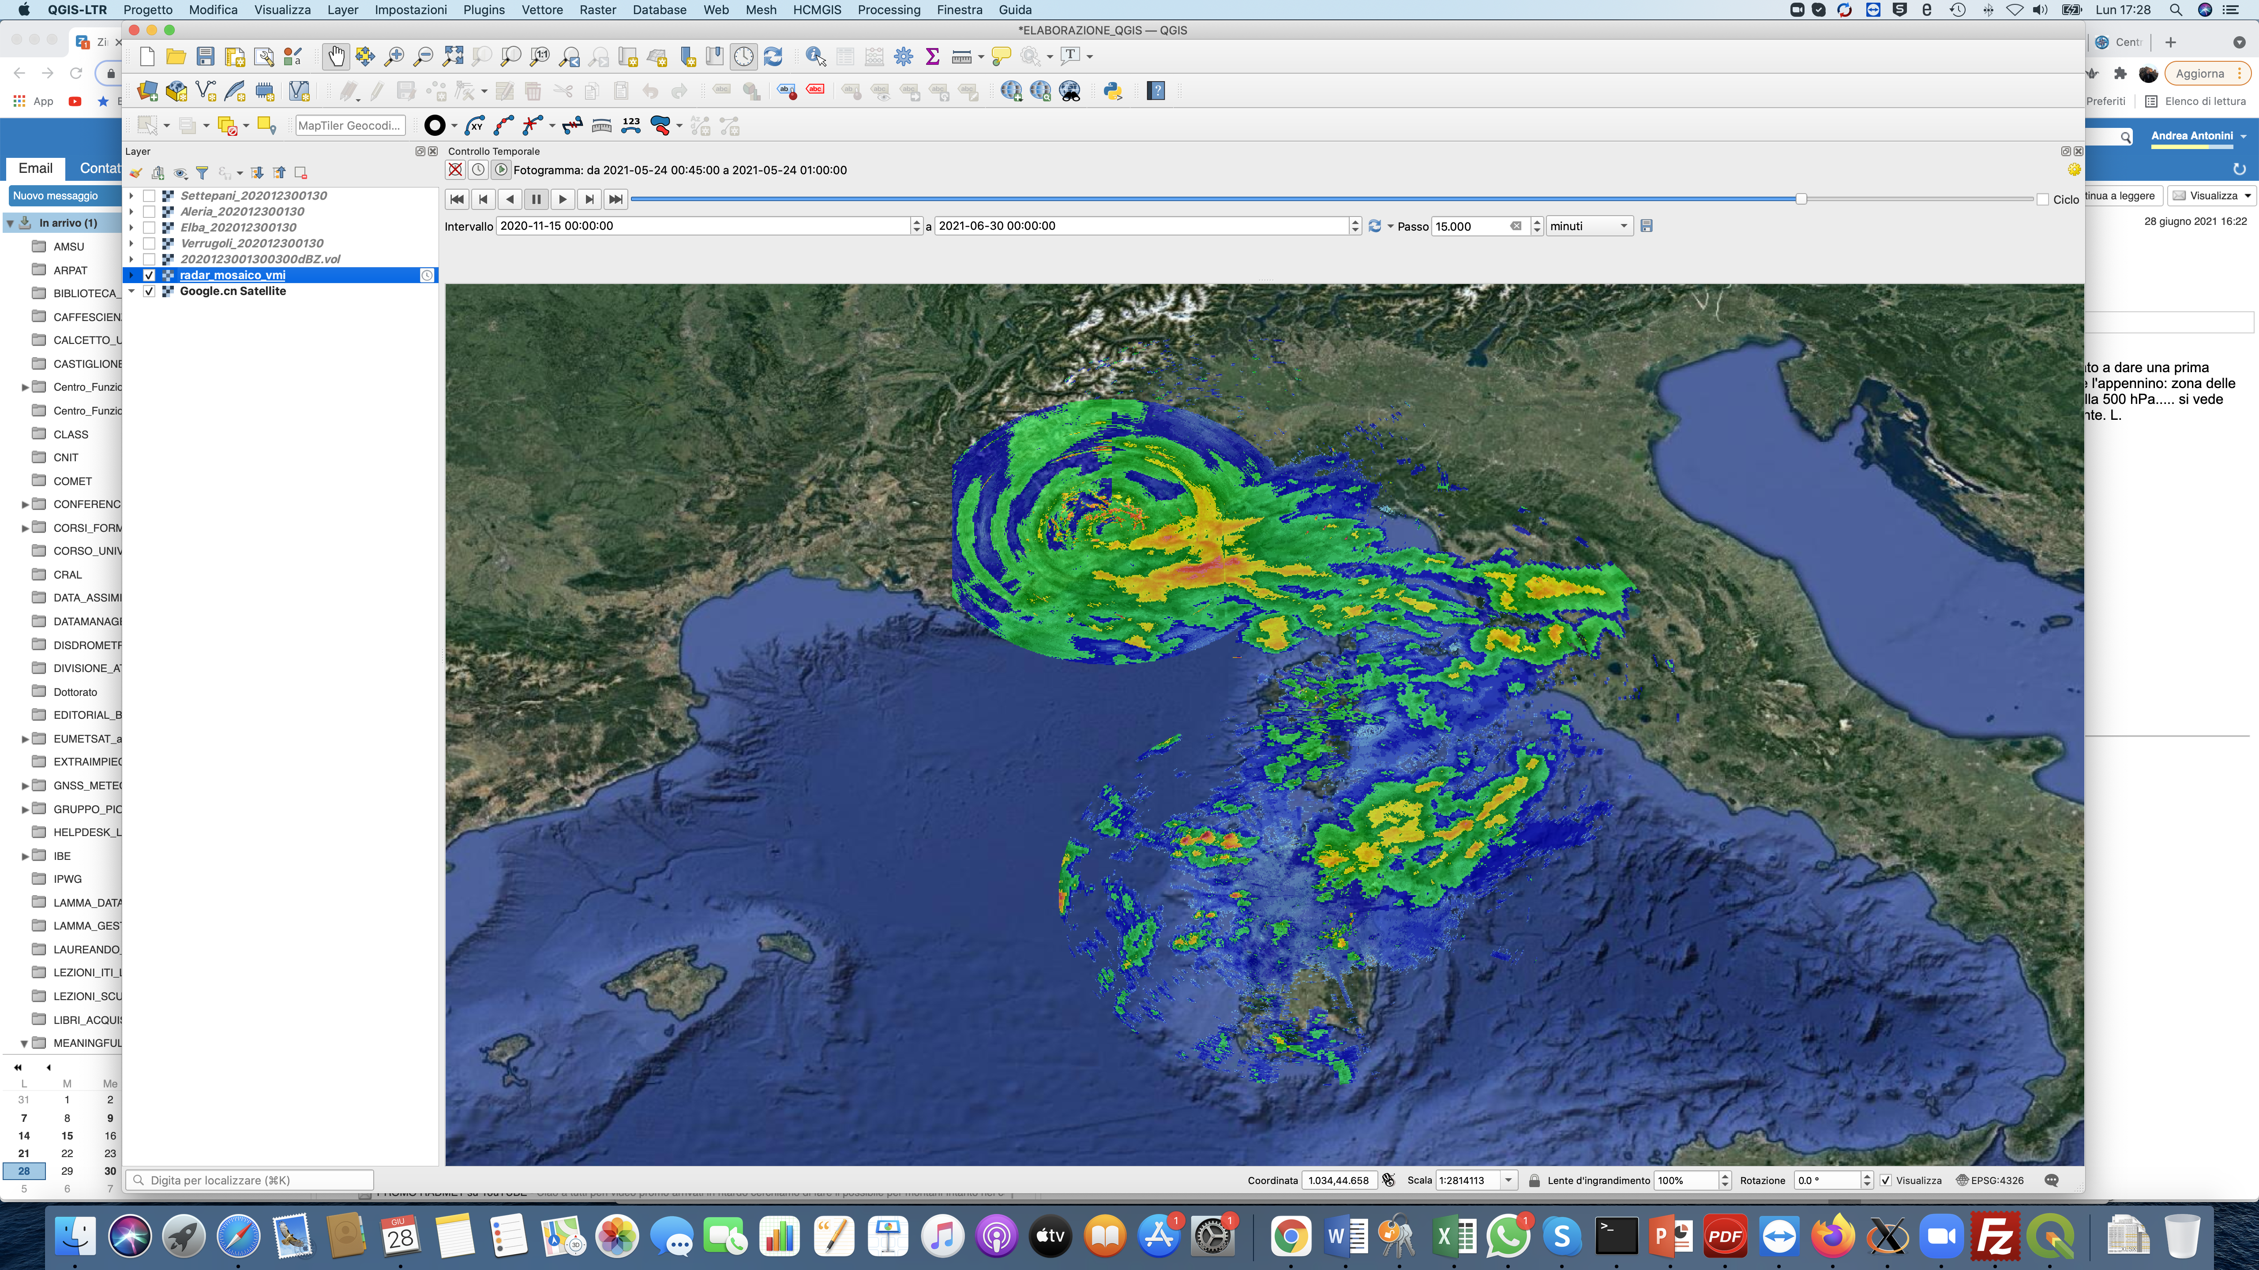



UPPER TYRRHENIAN CROSS-BORDER RADAR COMPOSITE

Slide 3
UPPER TYRRHENIAN CROSS-BORDER RADAR COMPOSITE
Monte Settepani (C-band pol)
Monte Verrugoli (X-band)
Mont Vial (X-band pol)
Elba (X-band)
Aleria (S-band)
Monte Rasu (C-band pol)

Slide 4
UPPER TYRRHENIAN CROSS-BORDER RADAR COMPOSITE
WEATHER RADAR DATA ACQUISITION
DATA HOMOGENEIZATION
DATA FILTERING:
NO DATA
SPECKLE
RADIAL SPIKE
FILTERED REFLECTIVITY RECONSTRUCTION
RADAR COMPOSITE GENERATION
PROJECTION TO A COMMON GRID
VERTICAL MAXIMUM INTENSITY

Slide 5
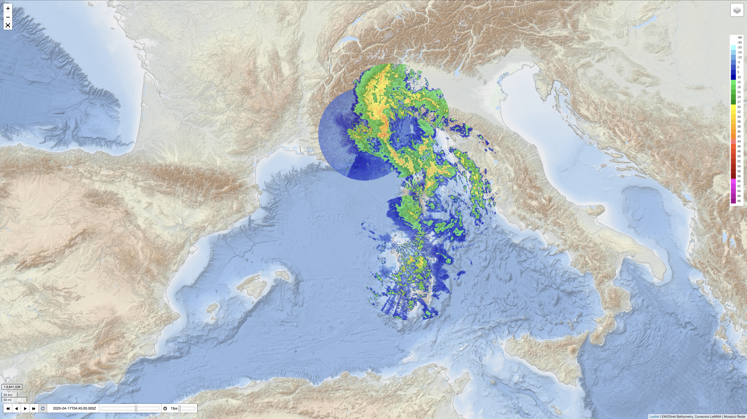
UPPER TYRRHENIAN CROSS-BORDER RADAR COMPOSITE
https://geoportale.lamma.rete.toscana.it/radar_mosaico/index.html

Slide 6
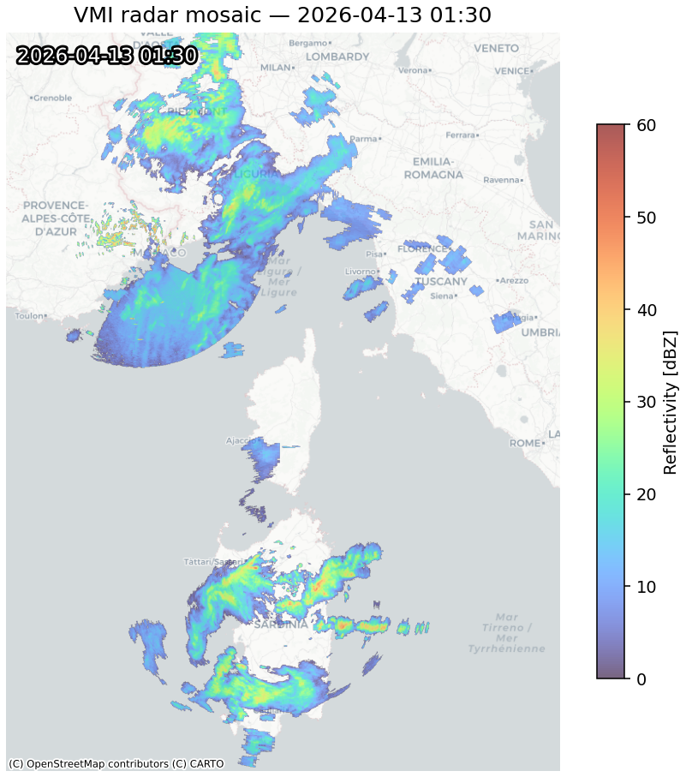
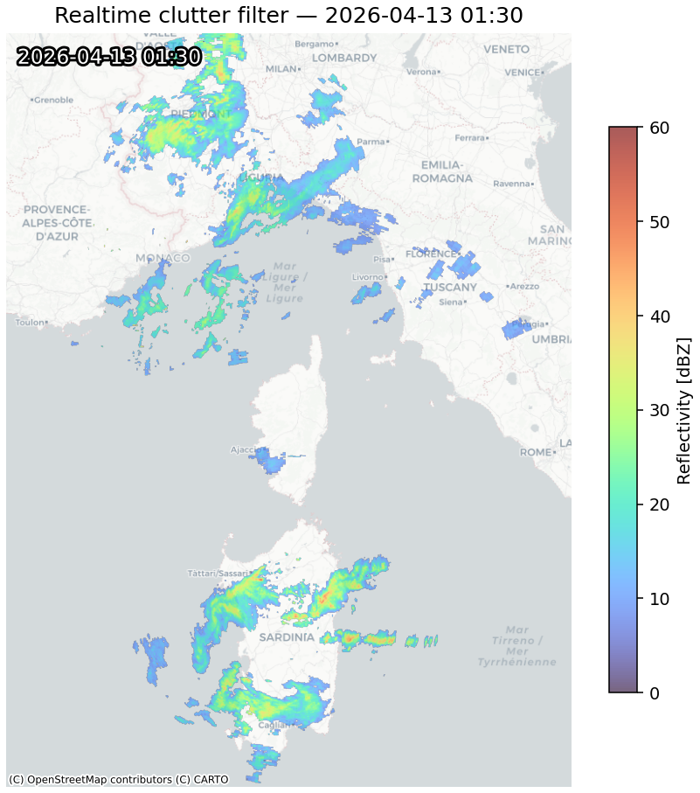
REAL-TIME FILTERING
The filter applies a causal adaptive-background approach, retaining only echoes that exceed both a minimum intensity threshold and a residual threshold relative to the background estimated from previous frames.

Slide 7
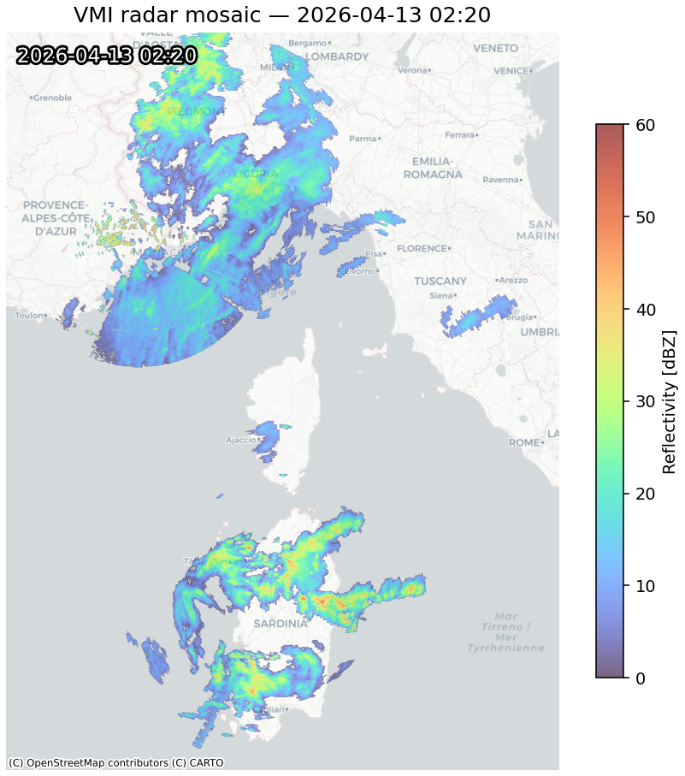
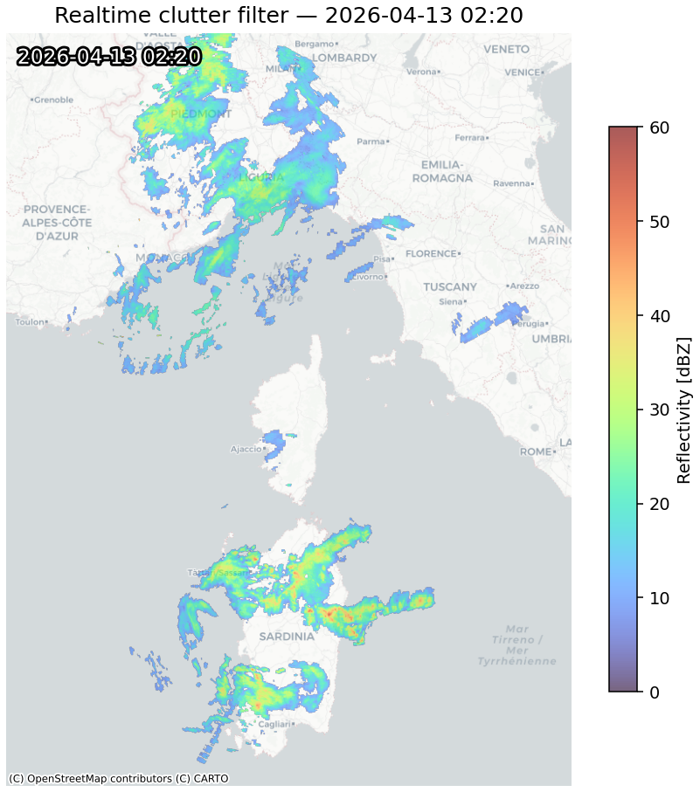
REAL-TIME FILTERING
Geotiff ingest
Frame filtering comparing with background and min-echo
Adaptive background
Morphological and single noise pixels cleaning
Geotiff output

Slide 8

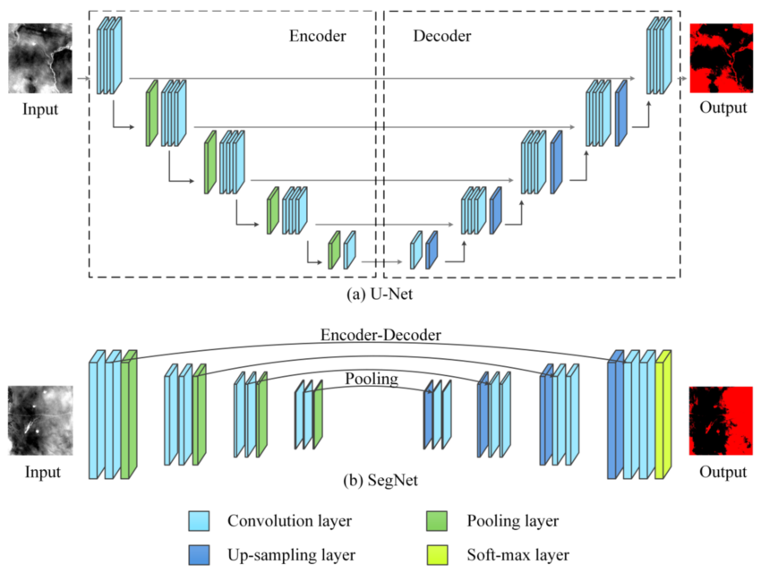

COMPARED TECHNIQUES
DGMR
RainNet

Slide 9
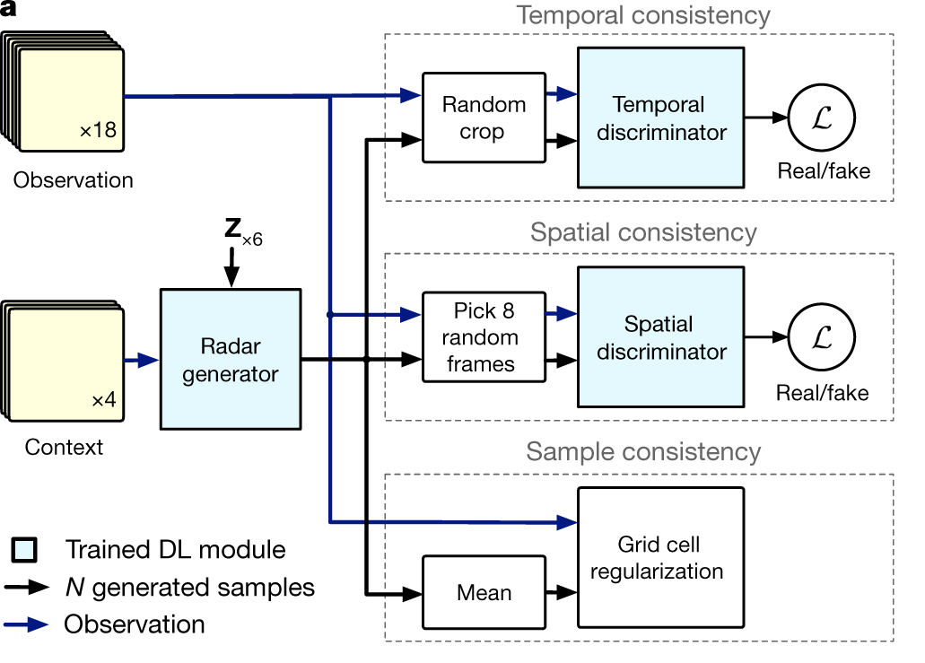
DGMR
Input: last 4 radar frames (I1..I4) in the G generator.
Generator encodes through a stack of convolutional residual blocks that progressively extract multi-scale spatial features.
Z: latent stocastic sampled variable to generate probabilistic prediction (ensemble).
G generates a sequence Ŷ(1:T).
Discriminators:
- Spatial: precipitation morphology, convective structures,
spatial textures on single frames.
Temporal: evaluates the entire predicted sequence, for temporal consistency, dynamic evolution
pixel-wise regularization: the average of the generated samples must approach the true observation (reduces offsets).
https://github.com/pySTEPS/pysteps-dgmr-nowcasts
Ravuri, S., Lenc, K., Willson, M. et al. Skilful precipitation nowcasting using deep generative models of radar. Nature 597, 672–677 (2021)

Slide 10
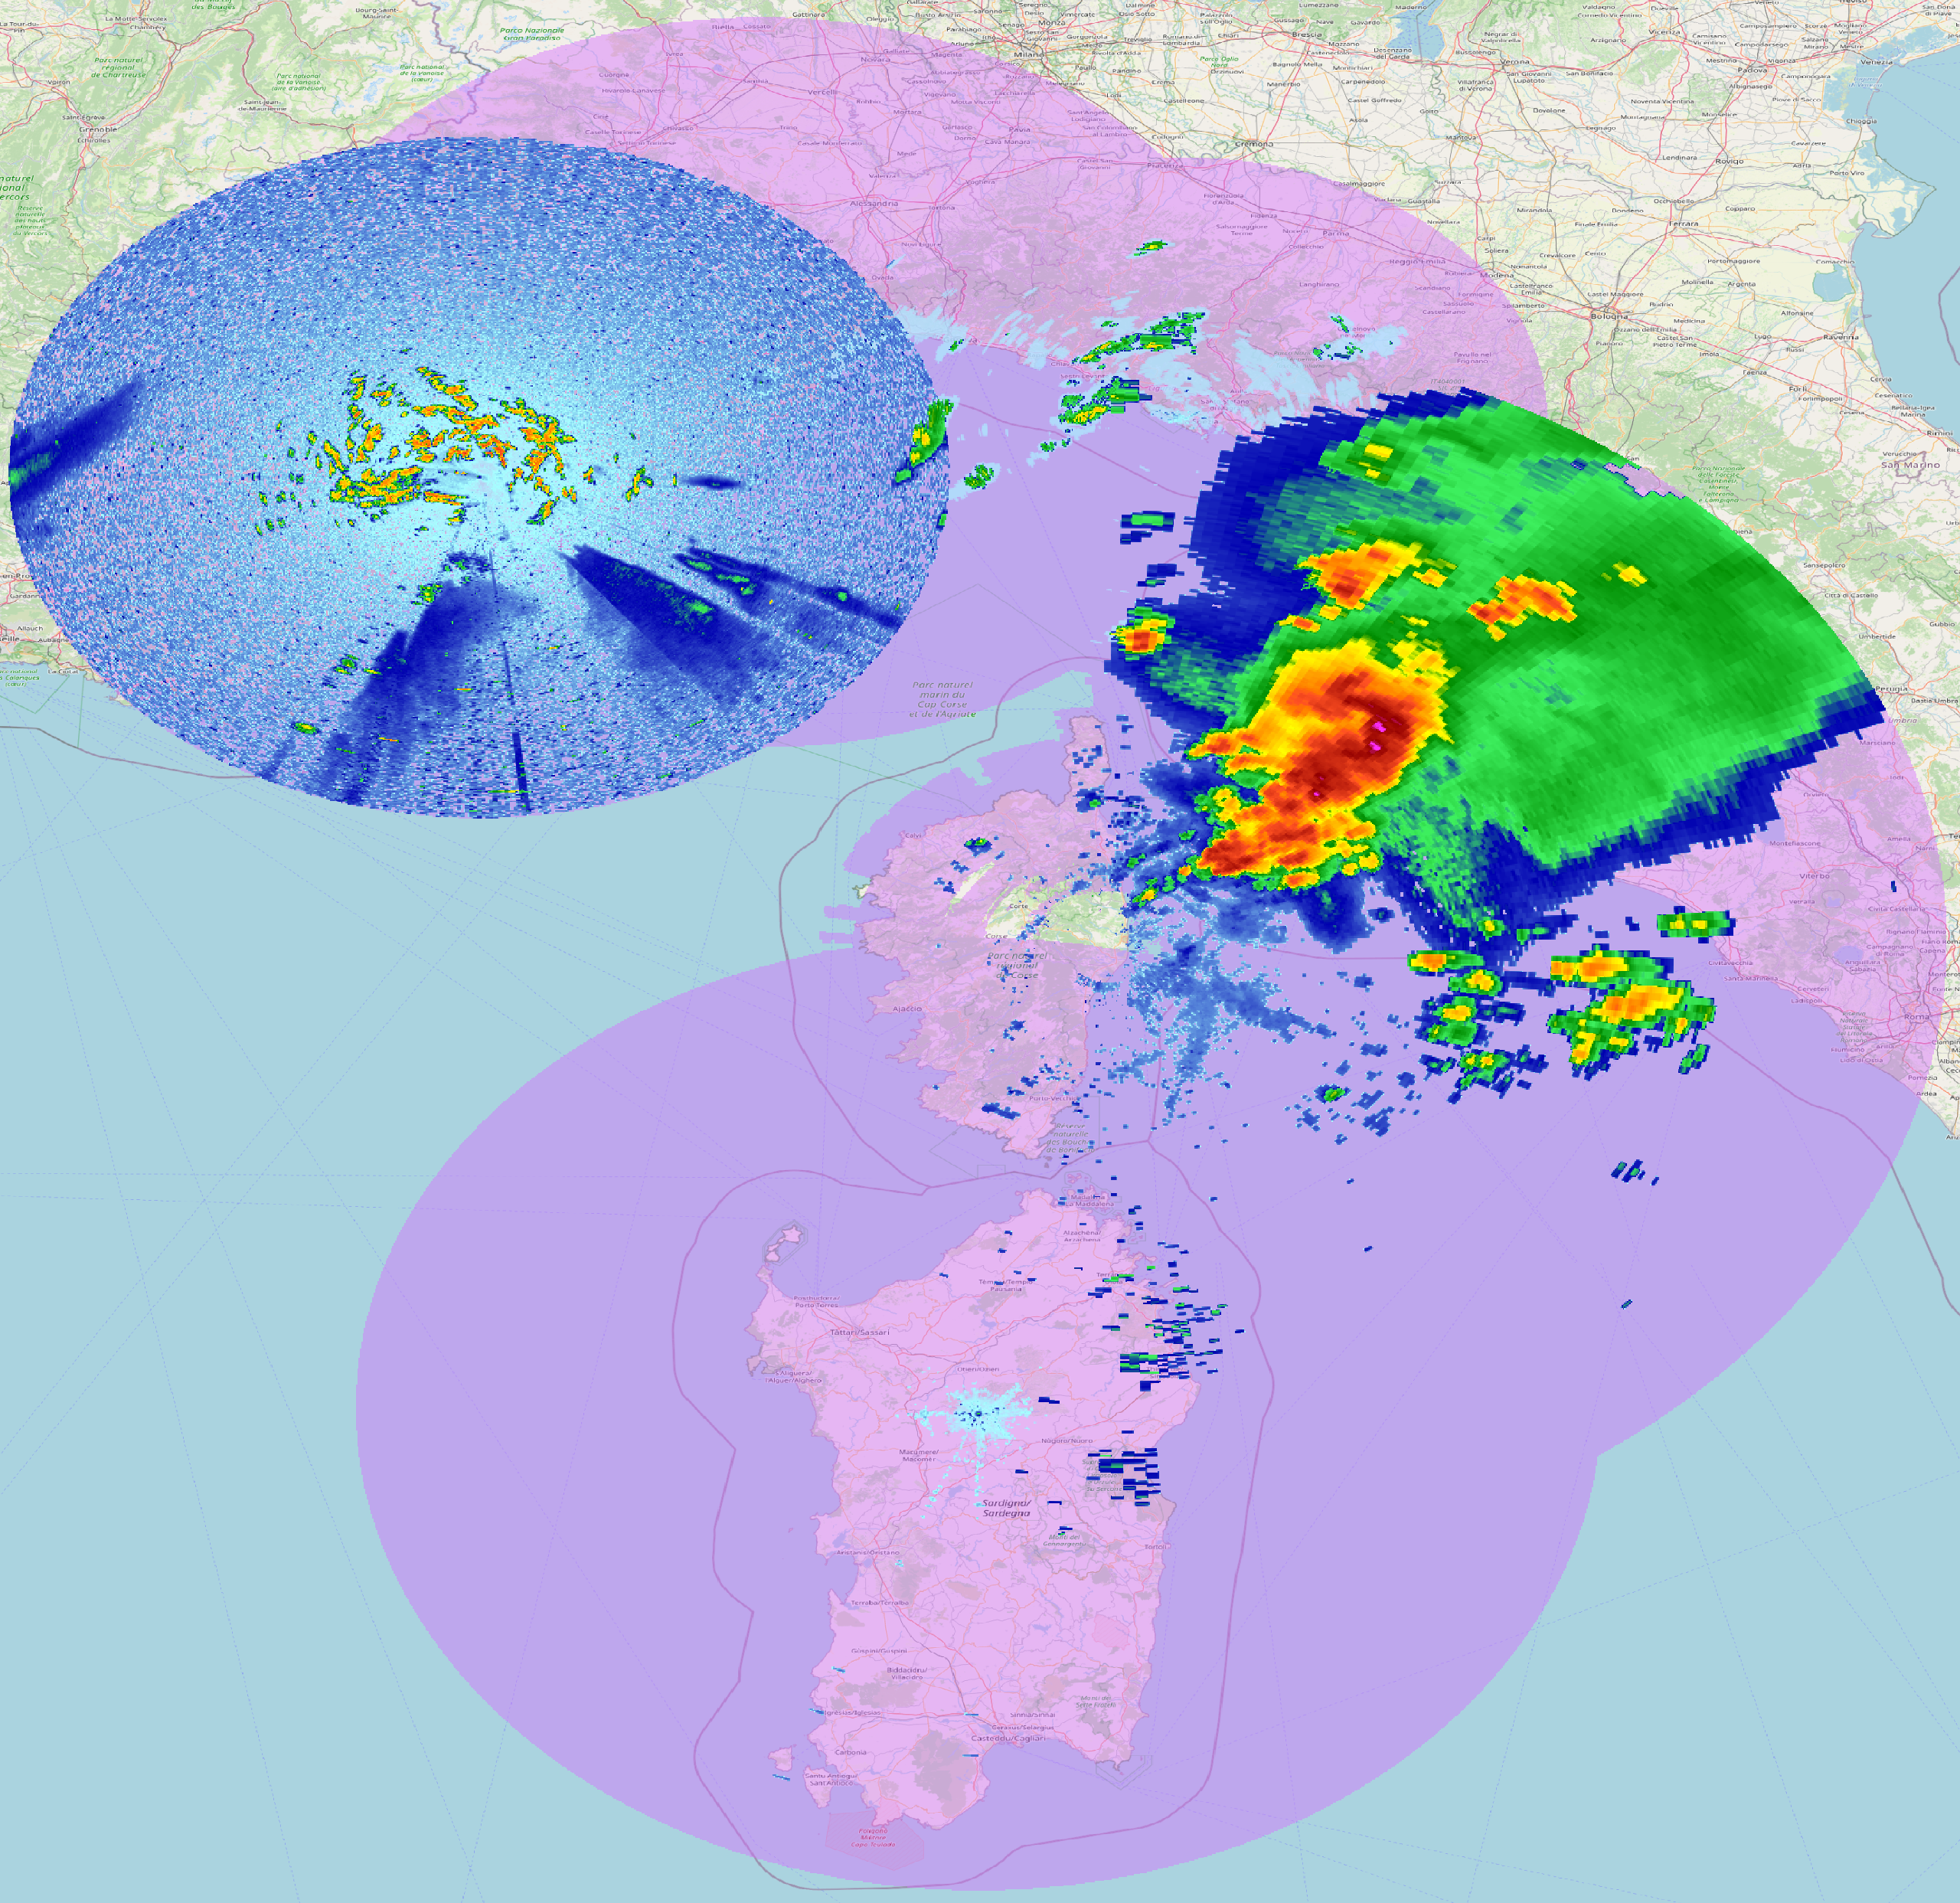
DGMR
TILING
Image subdivision into partially overlapping (64-pixel) 256x256 patches
Normalization of each patch to the [0, 1] range
Inference performed on each patch using 4 consecutive images
Image reconstruction (overlap-add method) ensuring spatial coherence

Slide 11
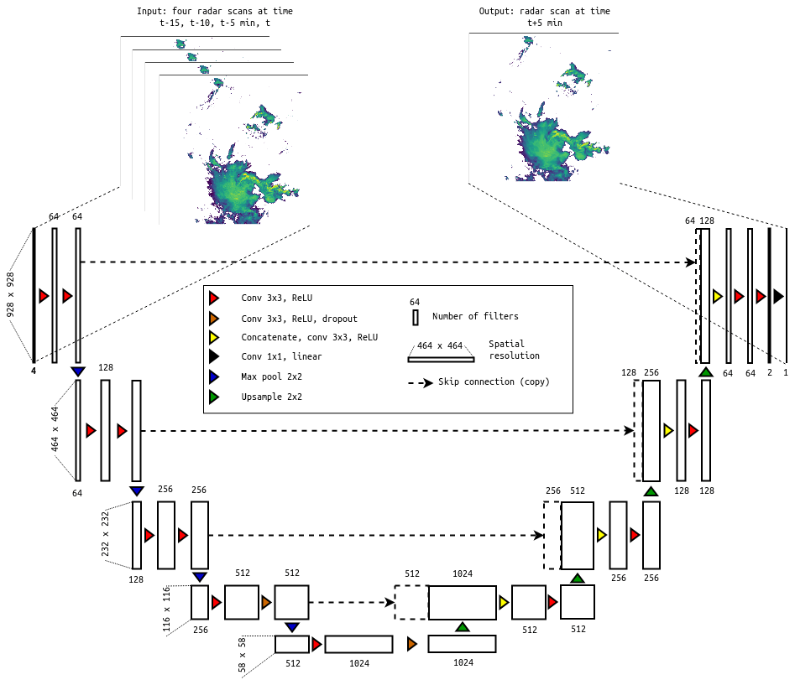
RAINNET
CNN encoder–decoder inspired by U-Net/SegNet for +5-minute nowcasting; it uses four scans (at t−15, t−10, t−5, and t) as input and precipitation at t+5 minutes as the target. Values ​​are transformed using log(x + 0.01).
The model was trained on the DWD RADOLAN RY product (rainfall accumulation: 1 km / 5 min) rather than reflectivity; therefore, if starting from dBZ, a conversion sequence (Z–R → mm/h → mm/5min) is required prior to the log-transformation.
It is implemented in Keras (Functional API): https://github.com/hydrogo/rainnet
Pre-trained weights and the model are available on Zenodo [rainnet_weights.h5].

Slide 12
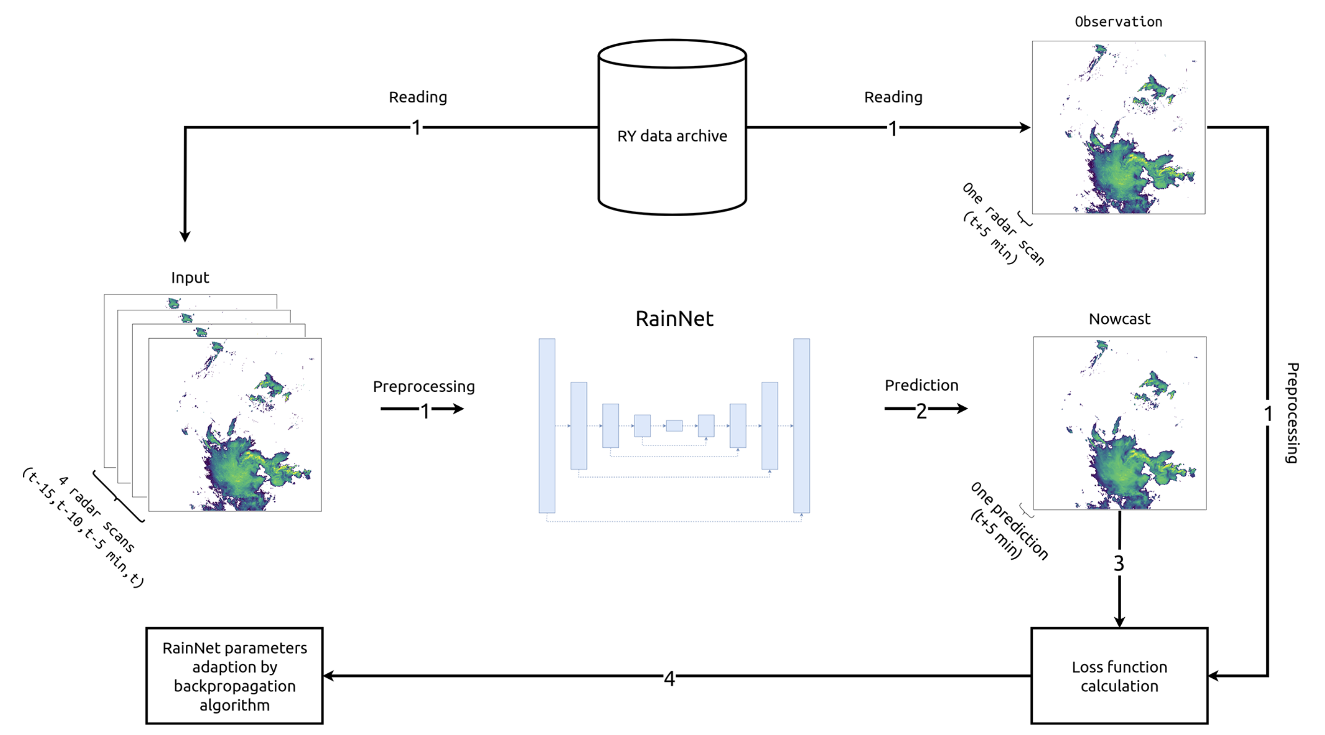
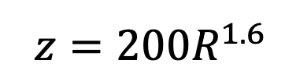
RAINNET
Marshall-Palmer z-R Relationship

Slide 13
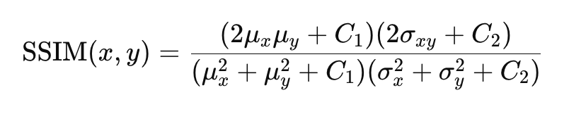
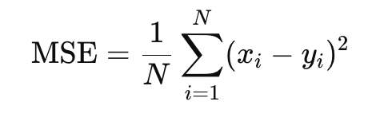
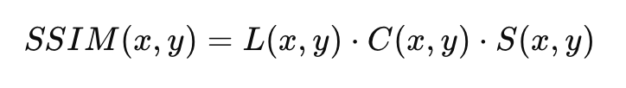
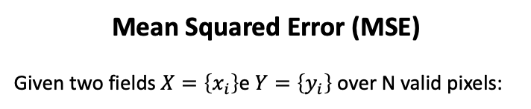
EVALUATION METRICS
Structural Similarity Index (SSIM)
Given two images x and y, the SSIM is computed through the standard formula (Wang et al., 2004)
where:
𝜇_{𝑥} ,𝜇_{𝑦} = average of 𝑥 and 𝑦
𝜎_{𝑥}², 𝜎_{𝑦}² = variance of 𝑥 and 𝑦
σ_{xy} = cvariance
𝐶1, 𝐶2 C1,C2 = stabilization constants
SSIM is typically in [0,1]
Mean Squared Error (MSE)
Given two fields $X=\left\{x_{i}\right\}$e $Y=\left\{y_{i}\right\}$over N valid pixels:
Luminance (L): Compares the average brightness of the two images.
Contrast (C): Compares the variance (distribution) of pixel intensities.
Structure (S): Compares the correlation between local pixel patterns
• Average squared pixel-wise error
• Strongly penalizes large intensity errors
• Lower is better; units are squared field units
• Similarity of spatial patterns, texture and contrast
• Sensitive to morphology of precipitation systems
• Range: typically 0–1; higher is better

Slide 14
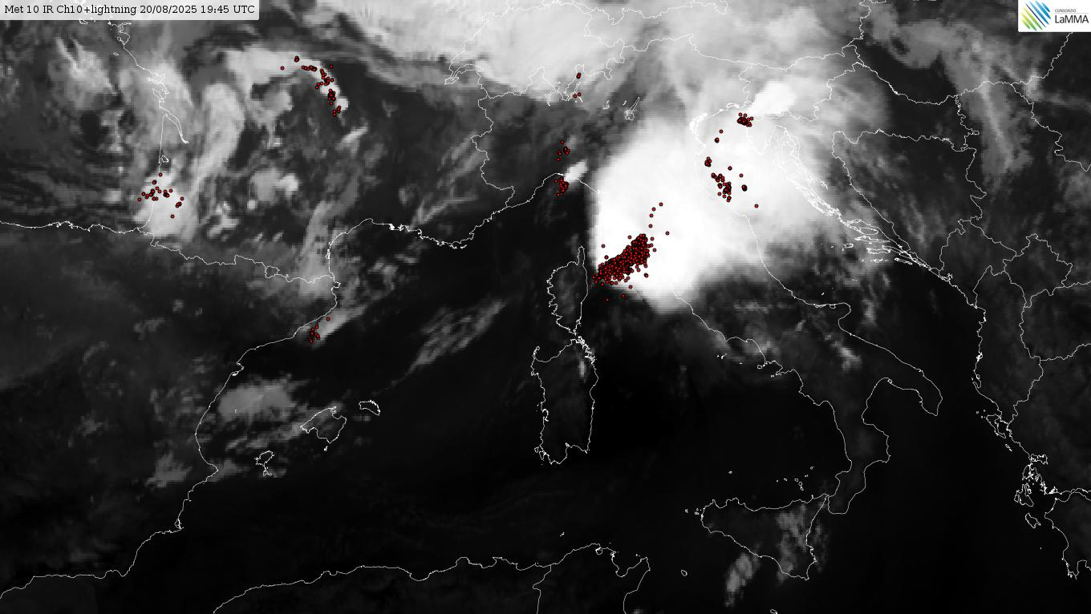
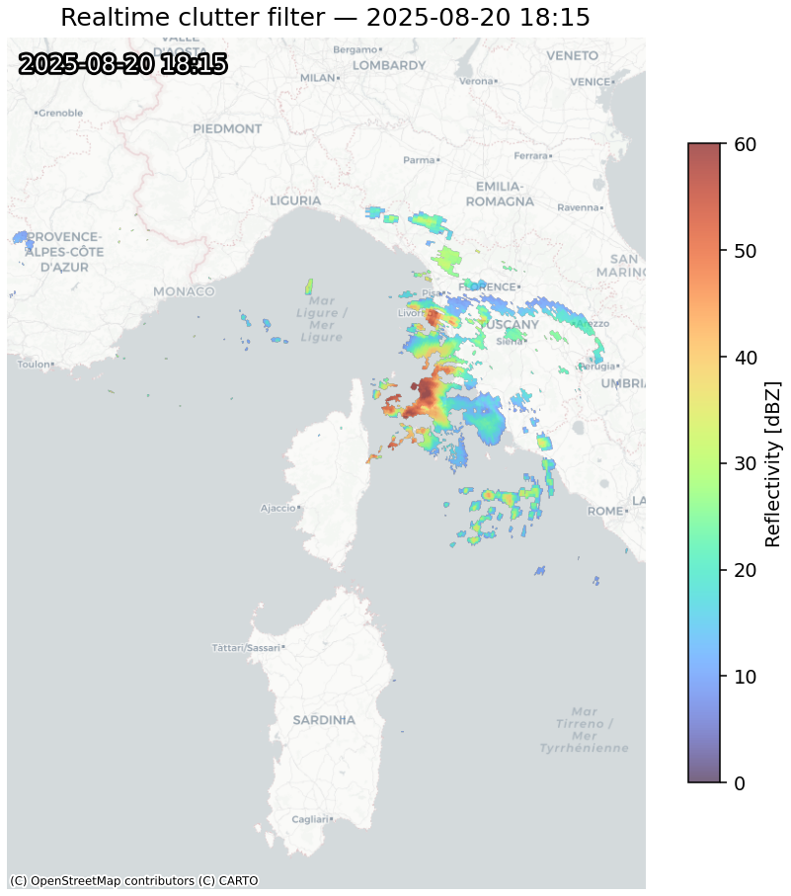
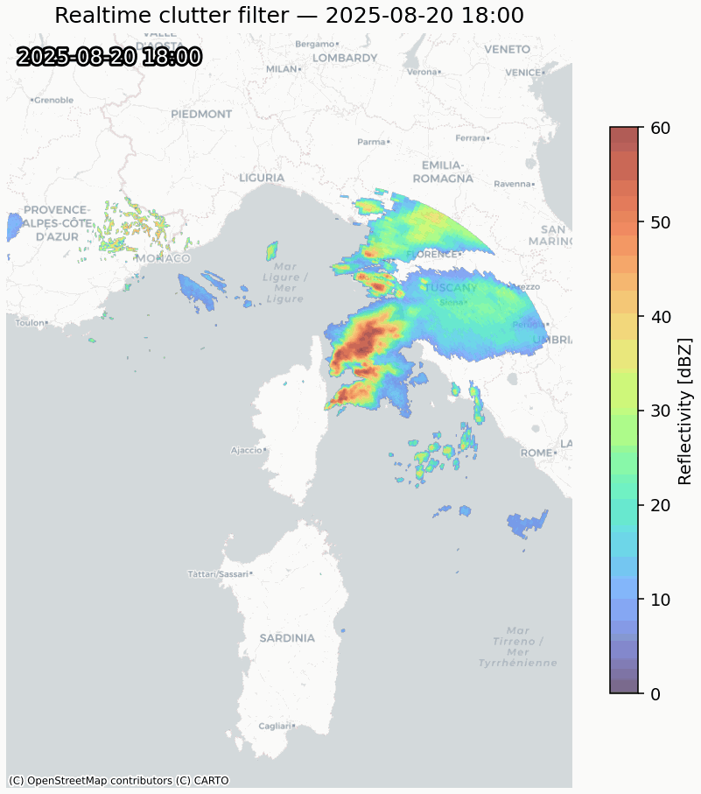
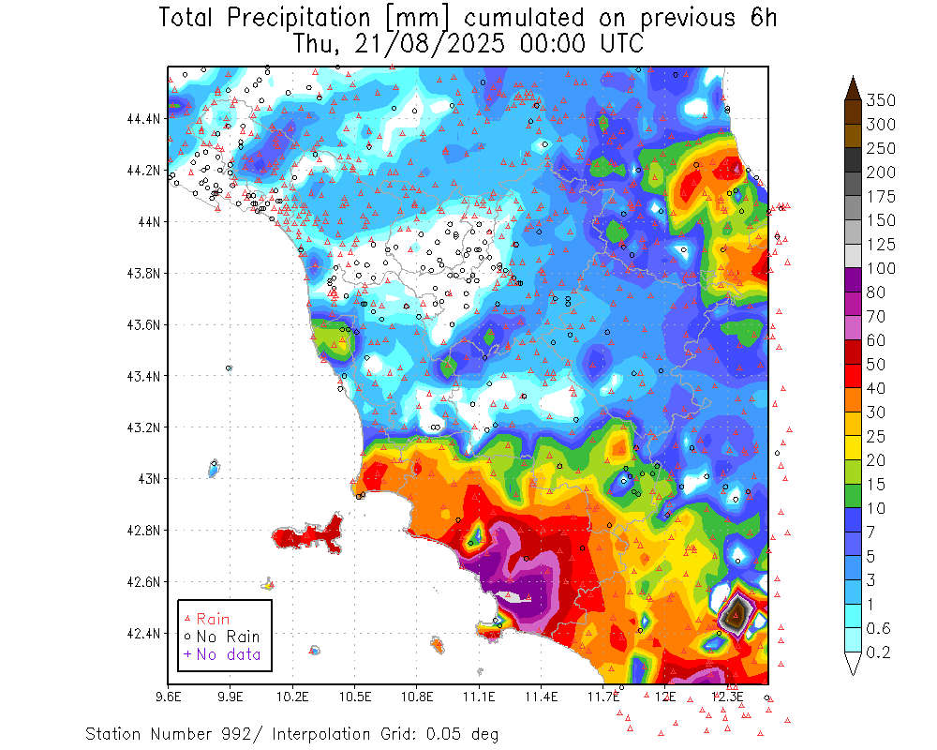
CASE STUDY 20/8/2025

Slide 15
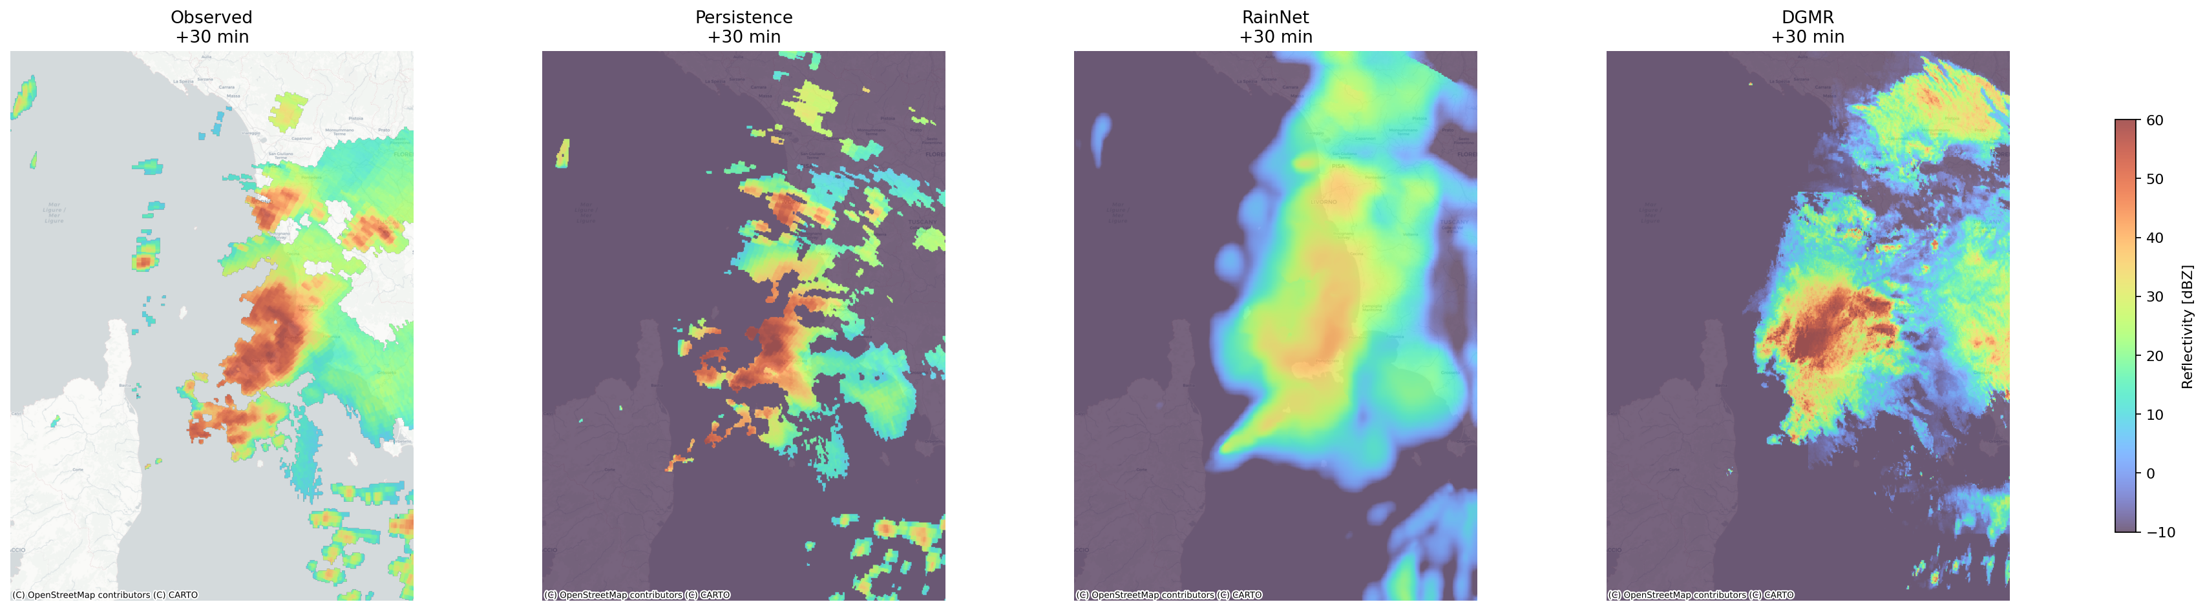
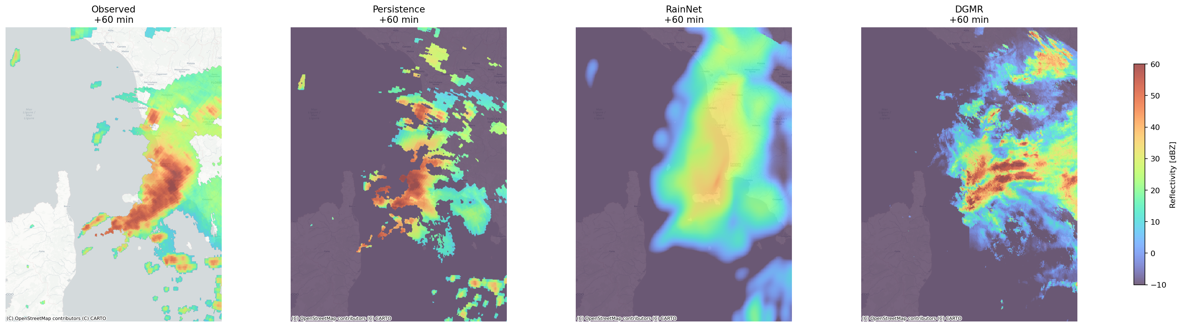
CASE STUDY 20/8/2025
T₀+30 min
T₀+60 min

Slide 16
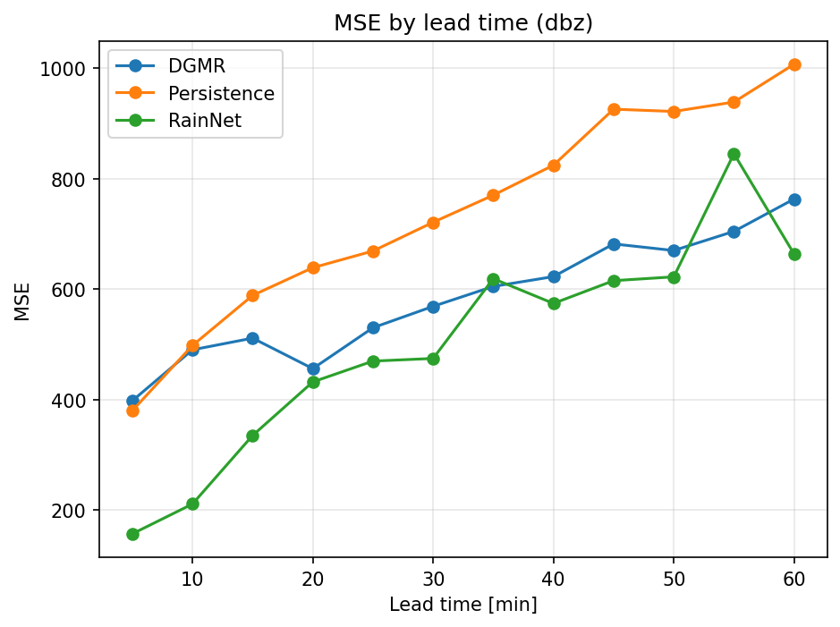
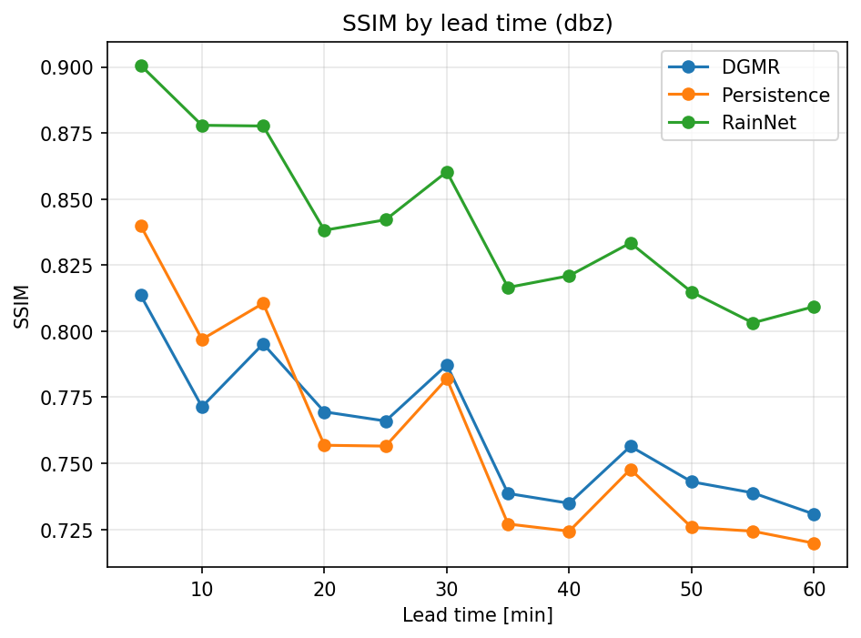
CASE STUDY 20/8/2025

Slide 17
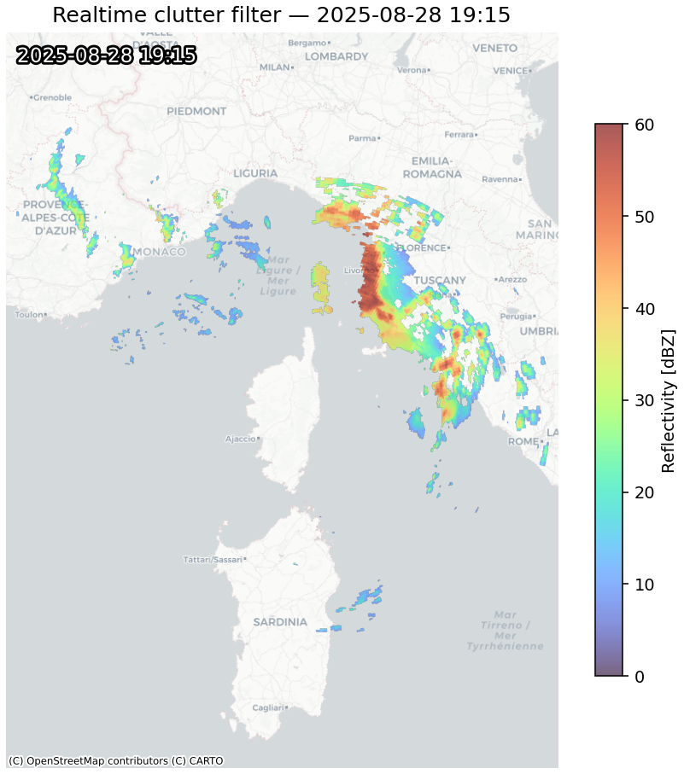
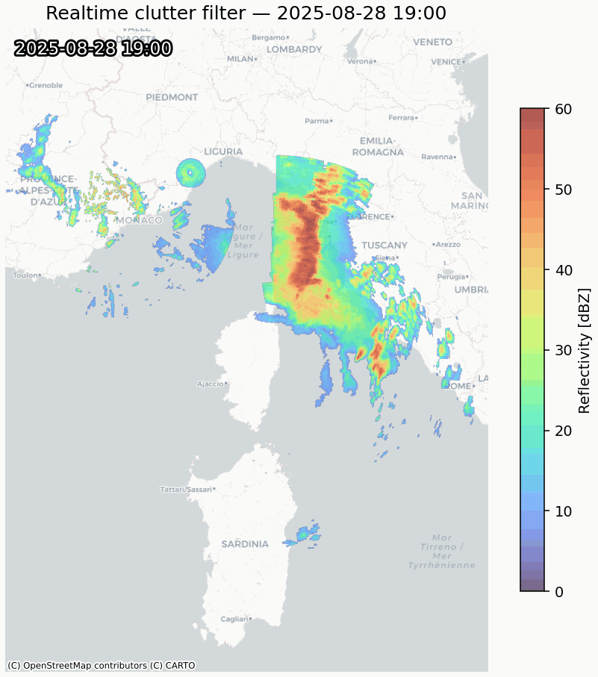
CASE STUDY 28/8/2025

Slide 18
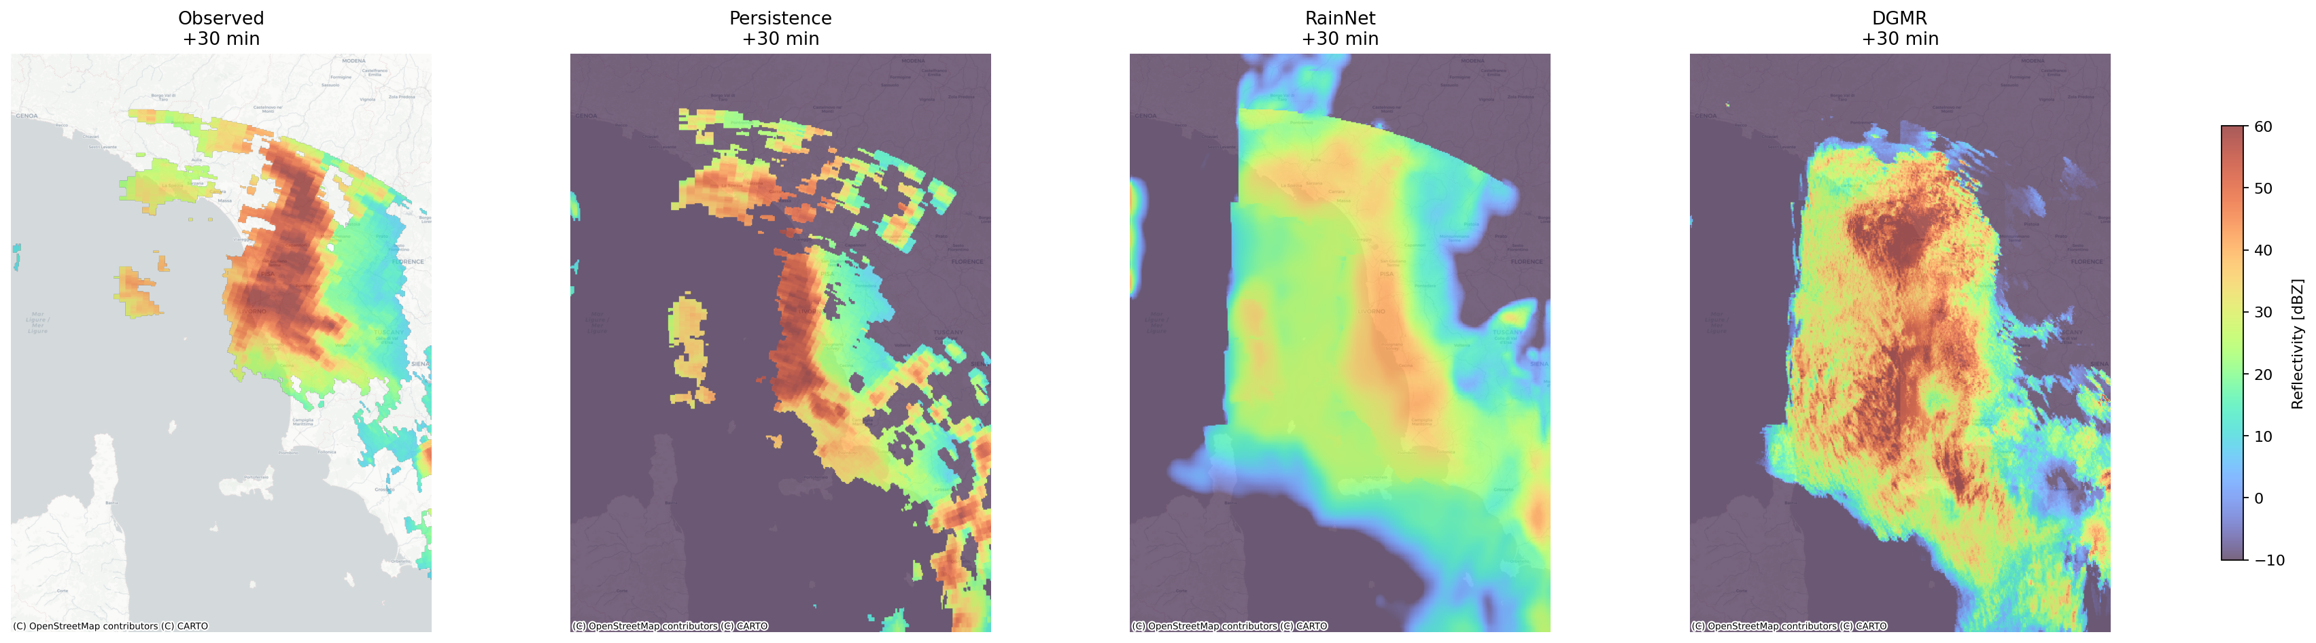
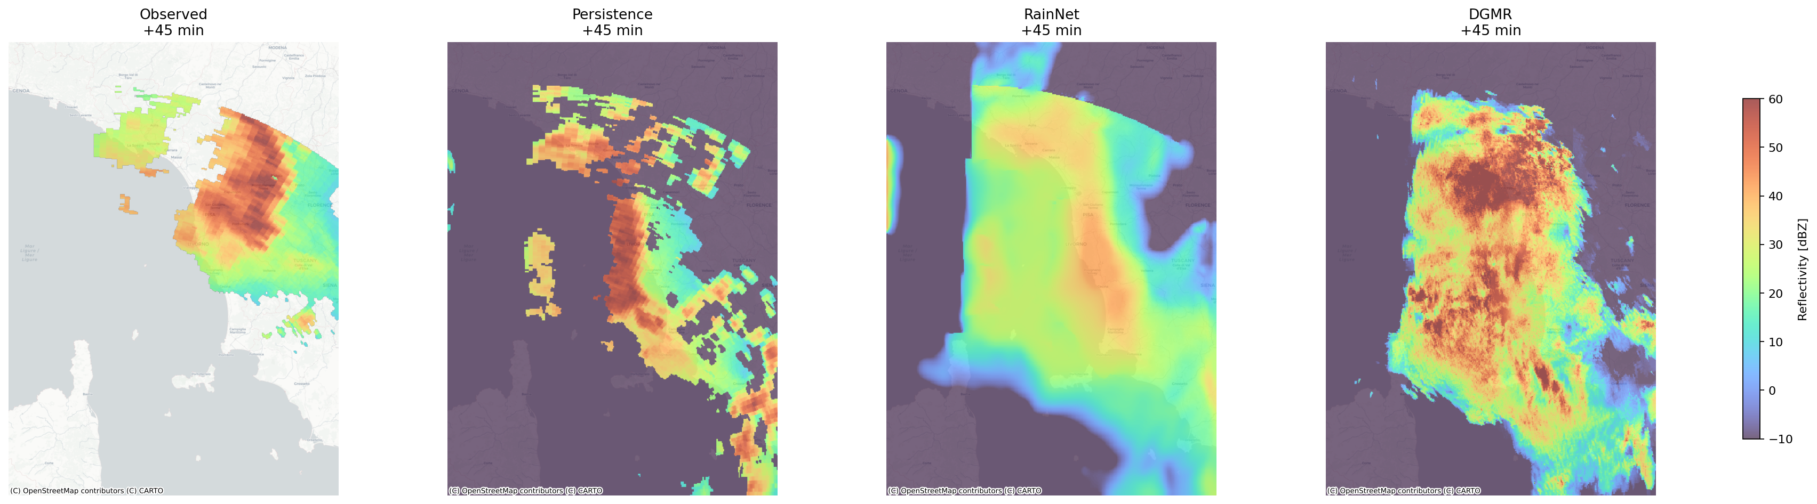

CASE STUDY 28/8/2025

Slide 19
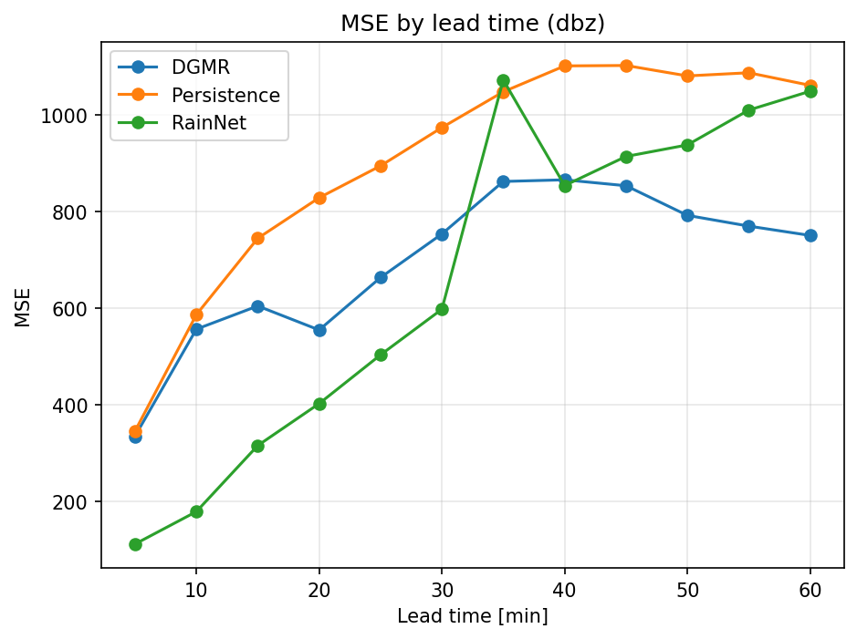
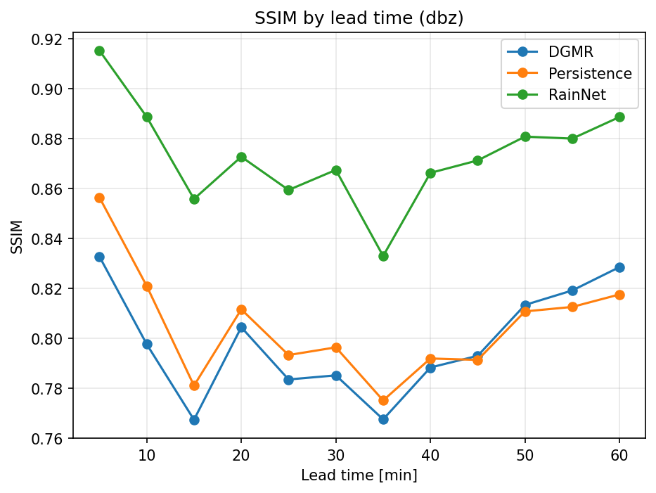
CASE STUDY 28/8/2025

Slide 20
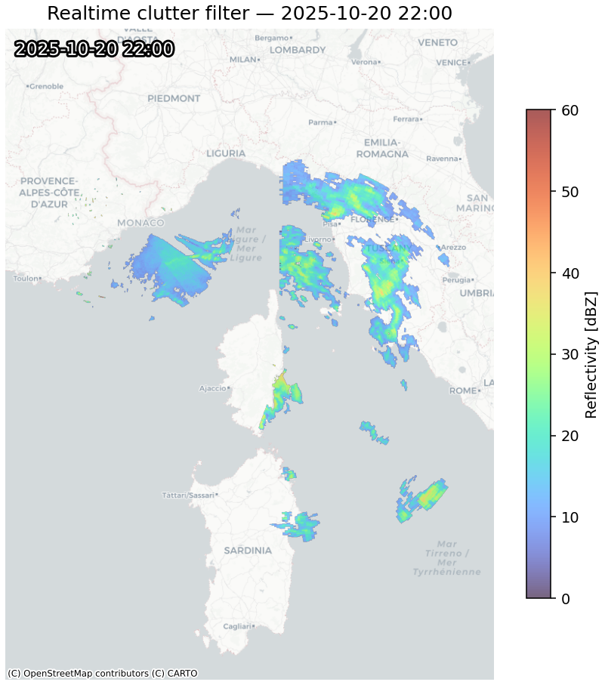
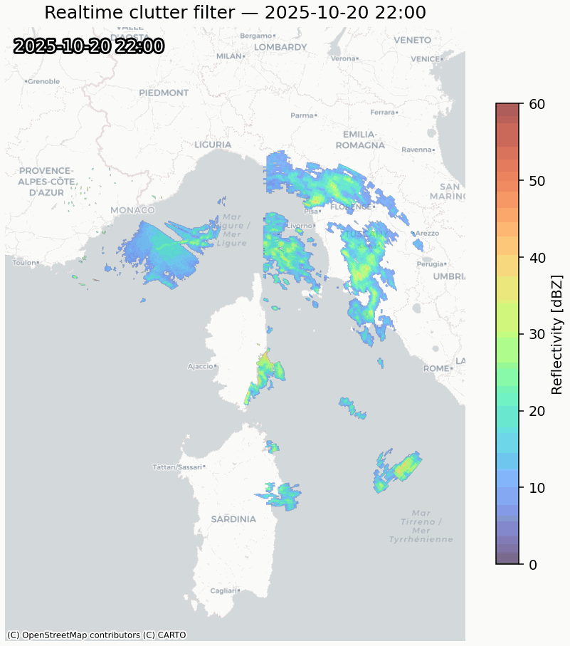
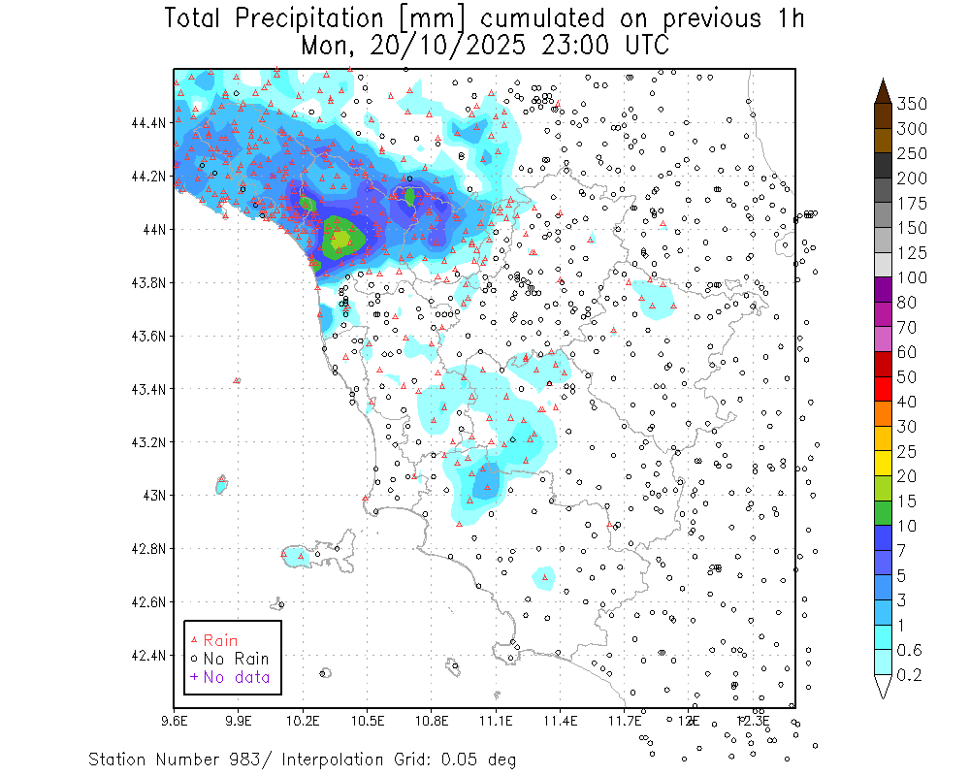
CASE STUDY 20/10/2025

Slide 21
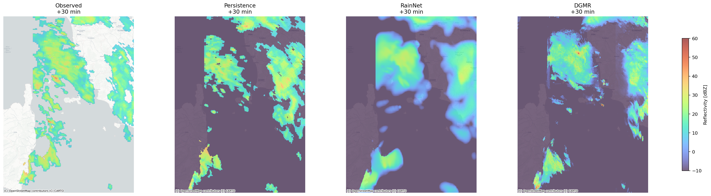
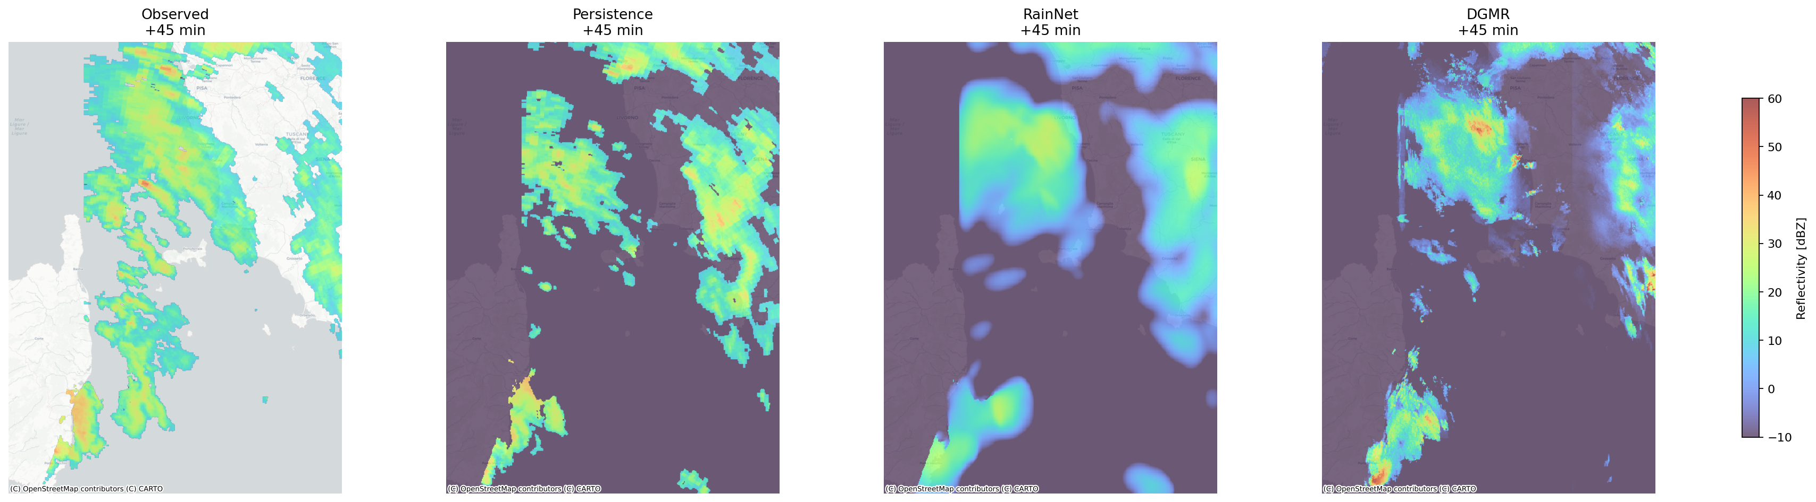
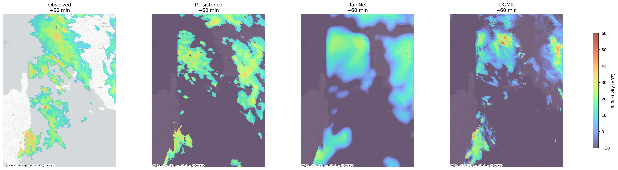
CASE STUDY 20/10/2025
T₀+30 min
T₀+45 min
T₀+60 min

Slide 22
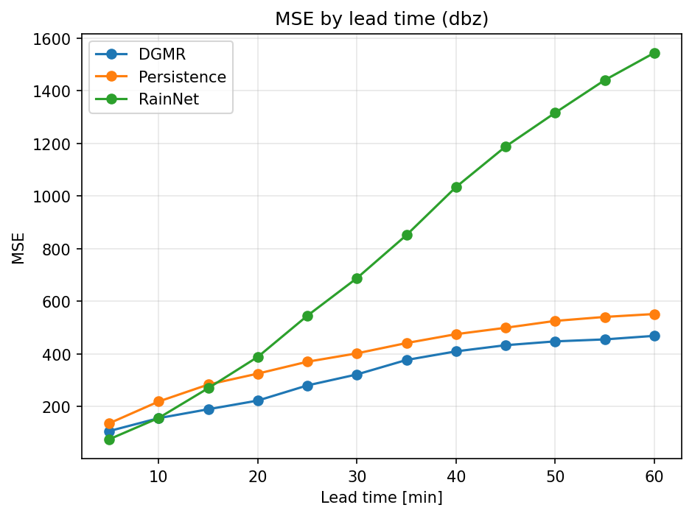
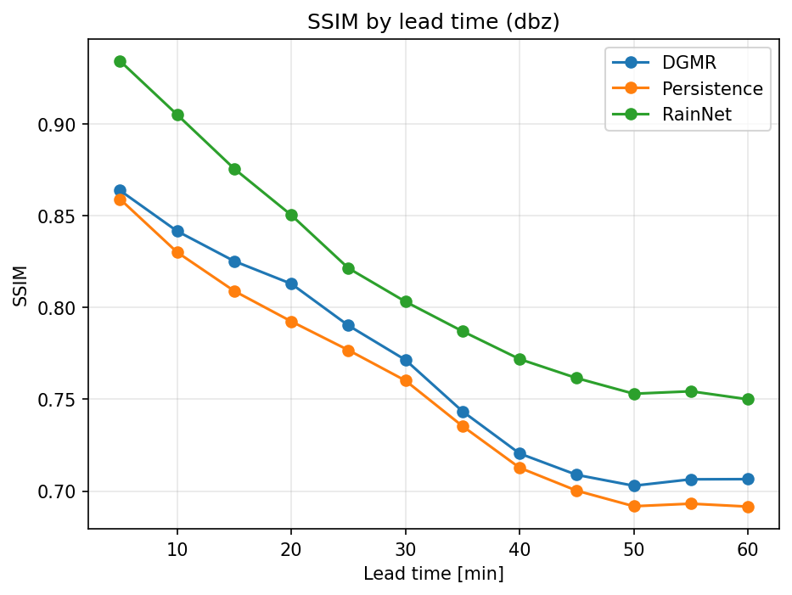
CASE STUDY 20/10/2025

Slide 23
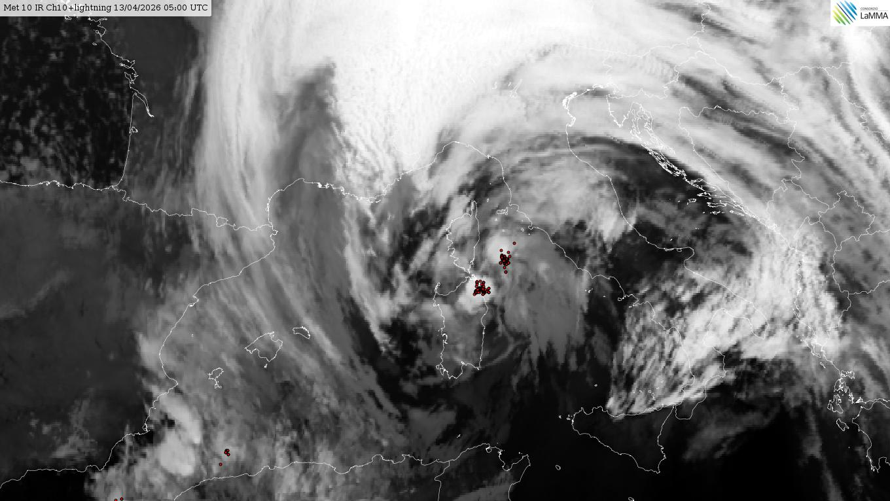
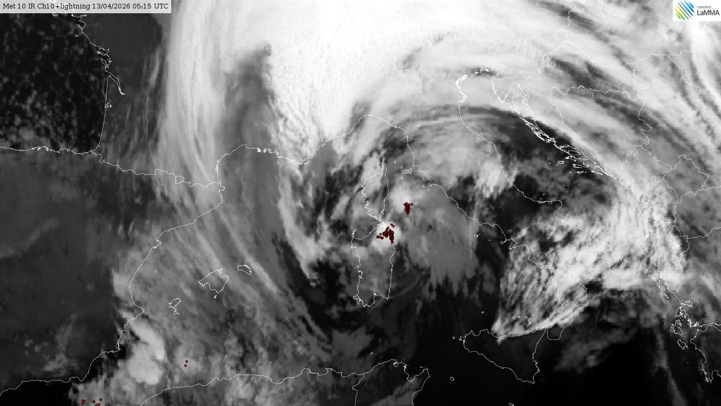
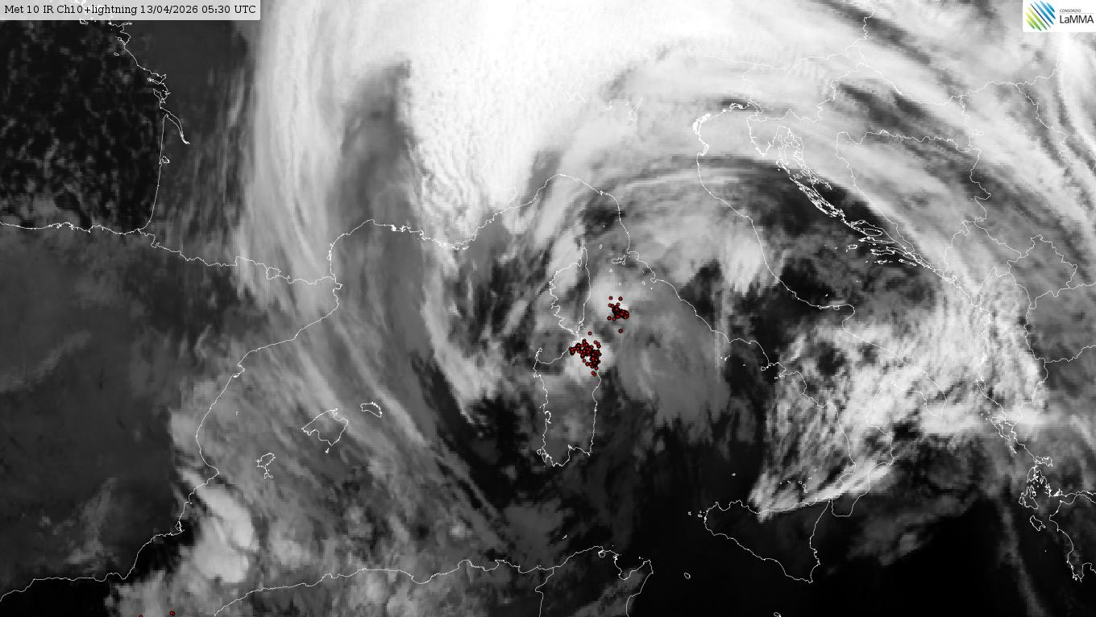
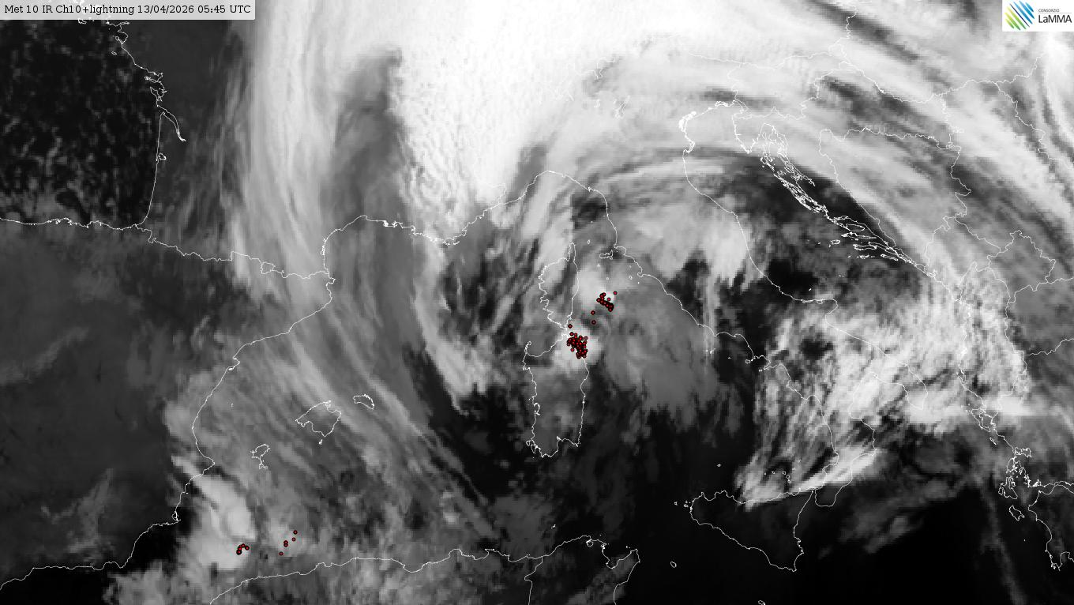
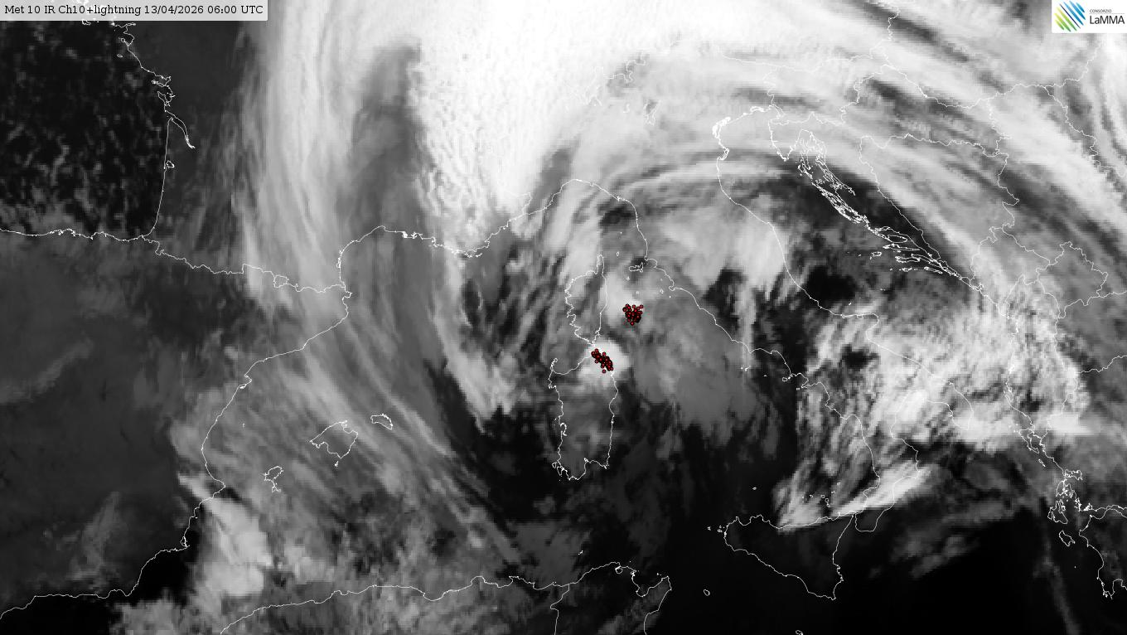
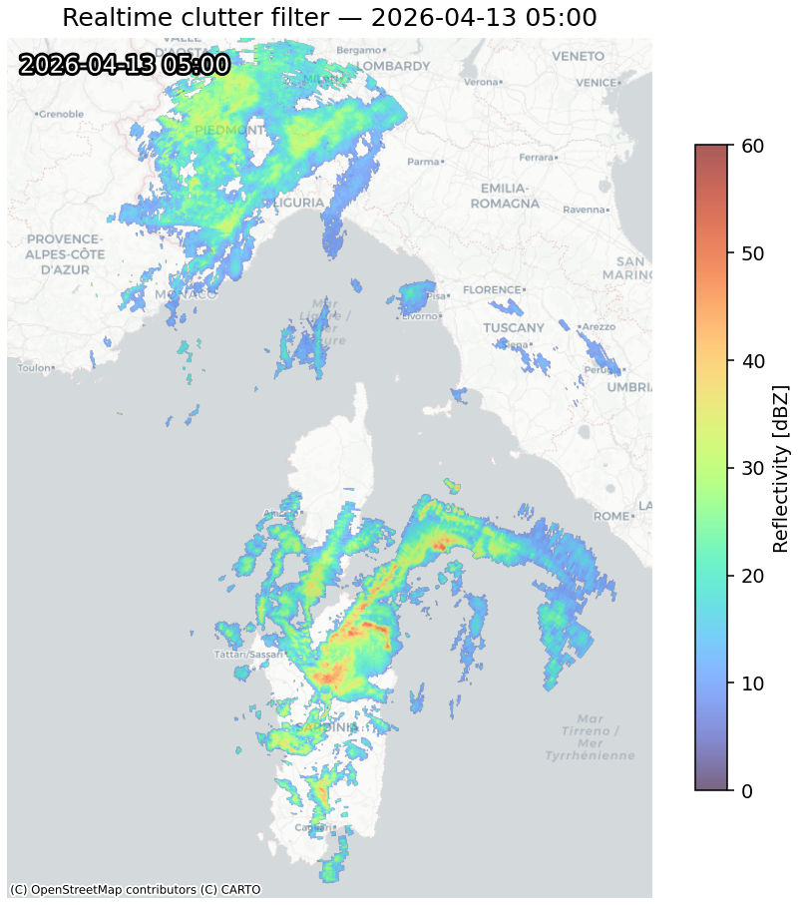
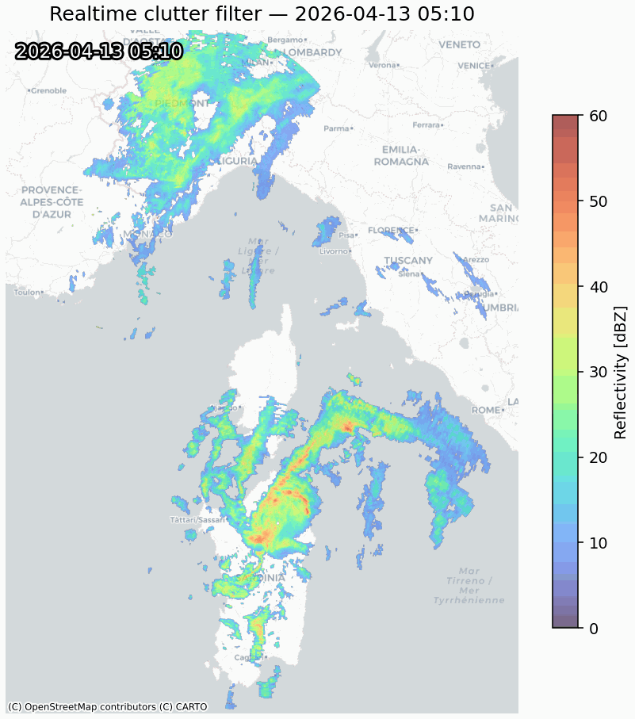
CASE STUDY 13/4/2026

Slide 24
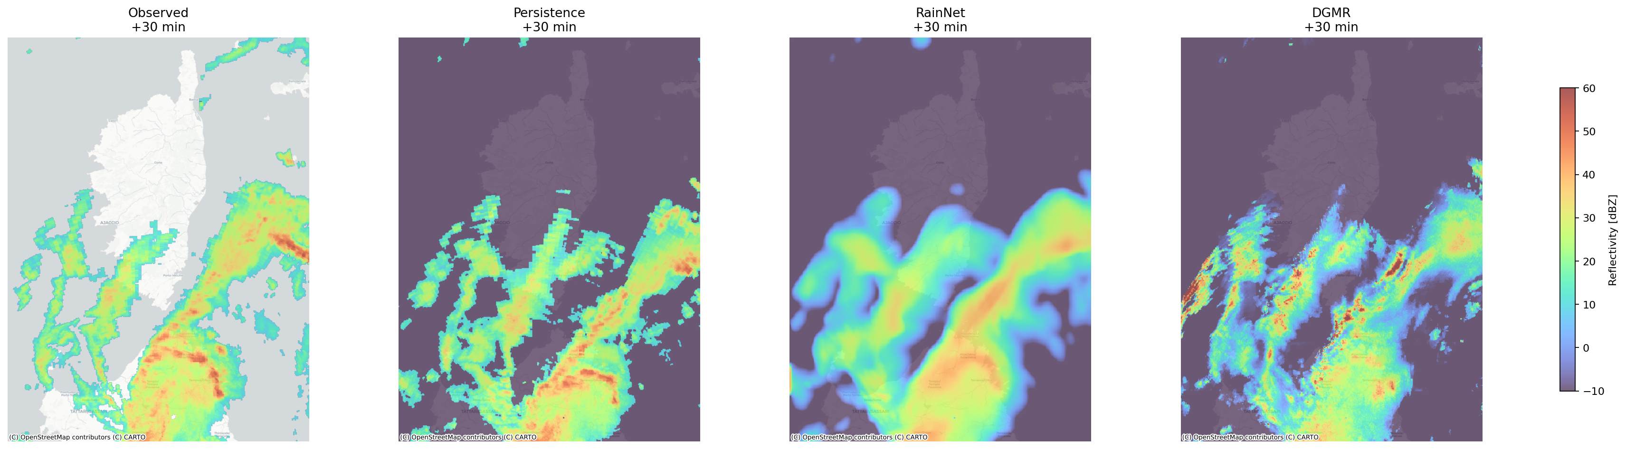
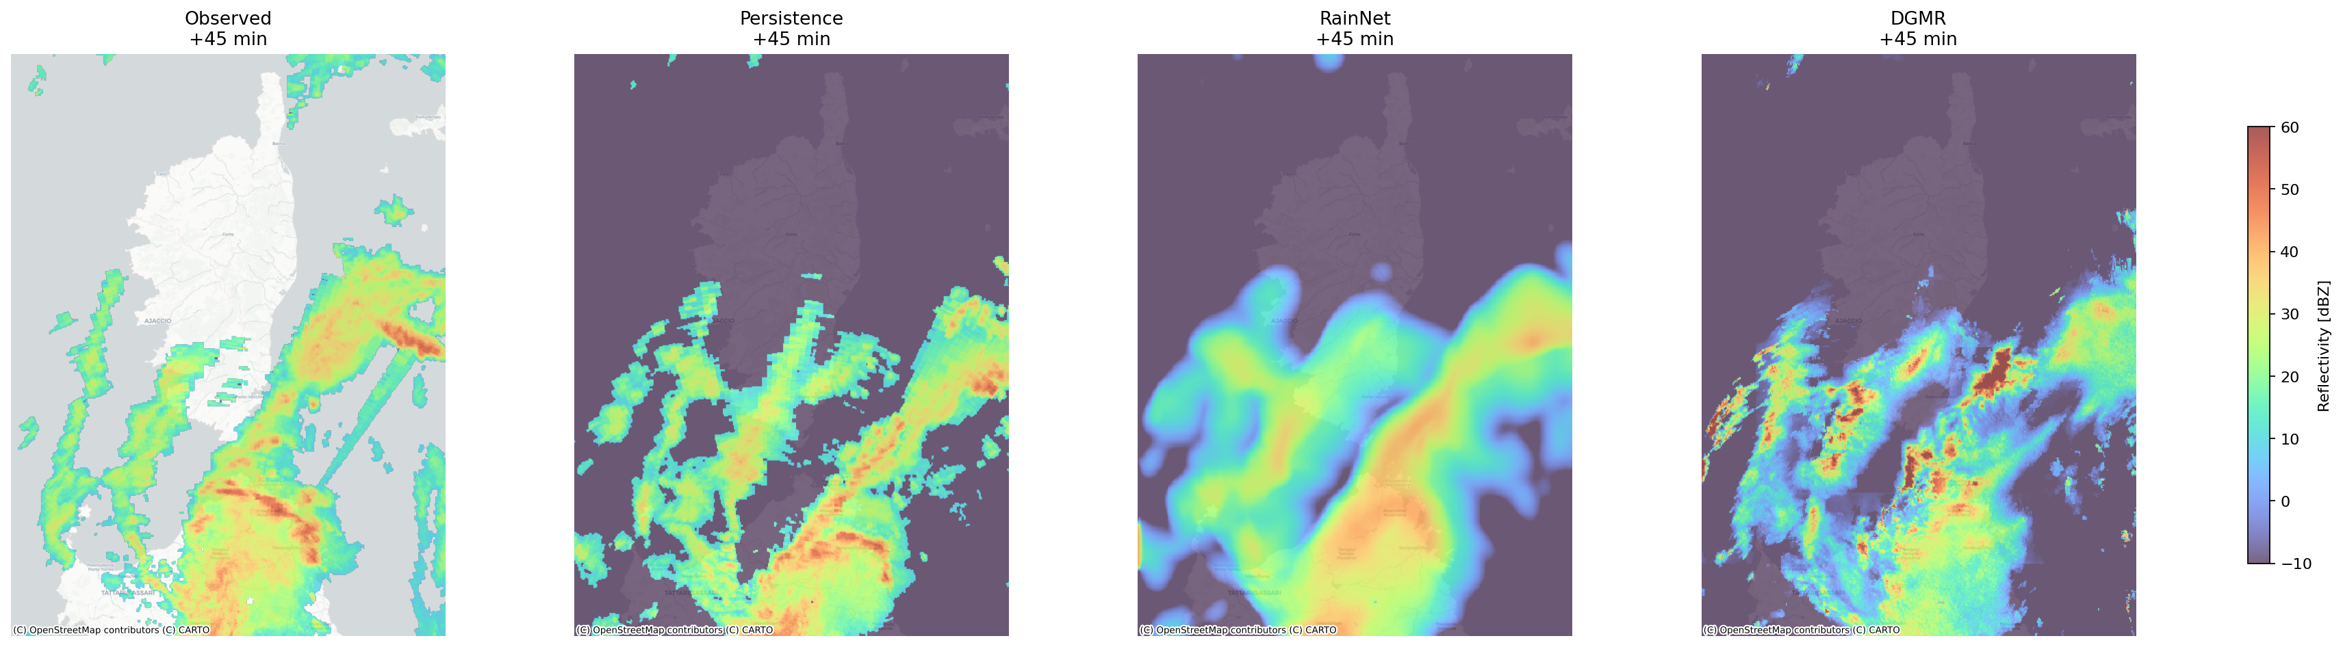
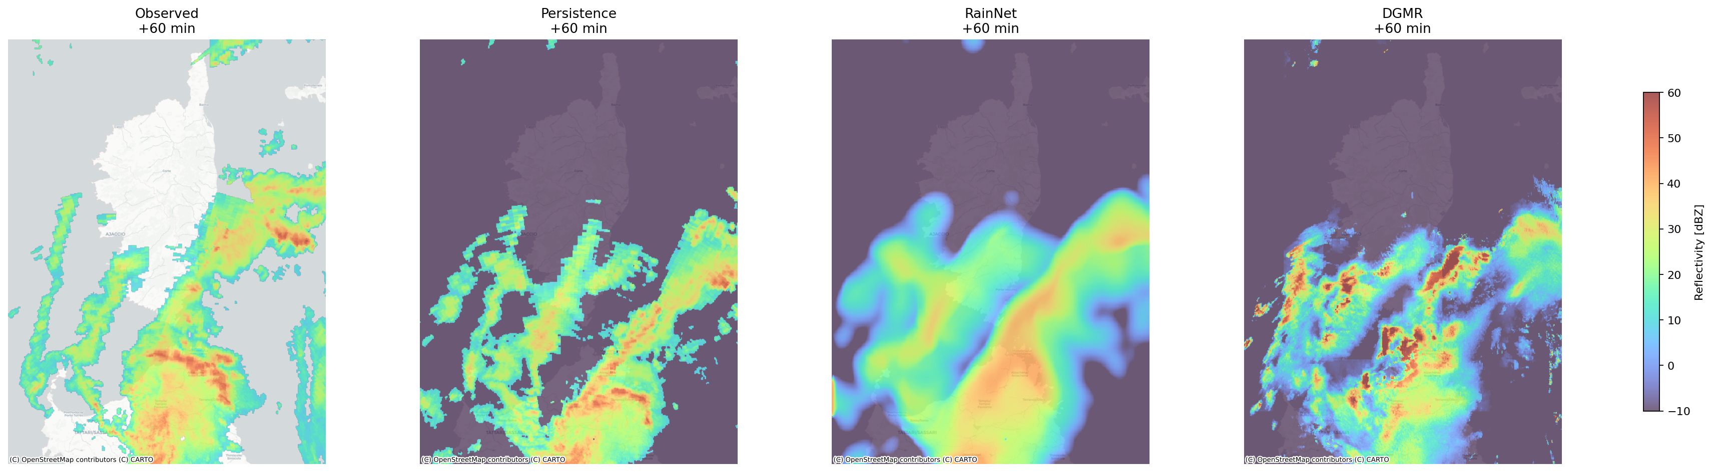
CASE STUDY 13/4/2026
T₀+30 min
T₀+45 min
T₀+60 min

Slide 25
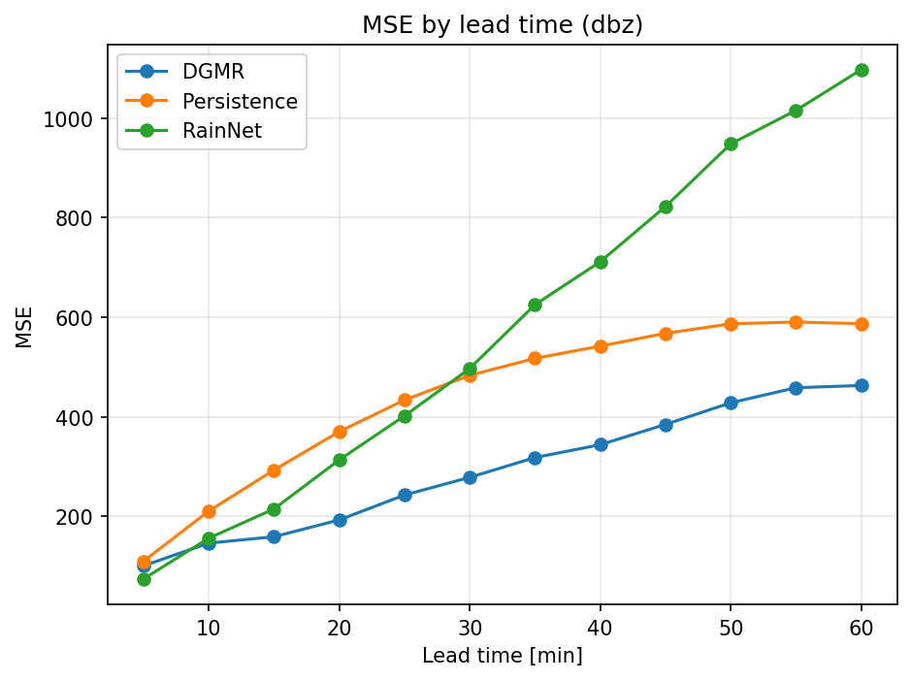
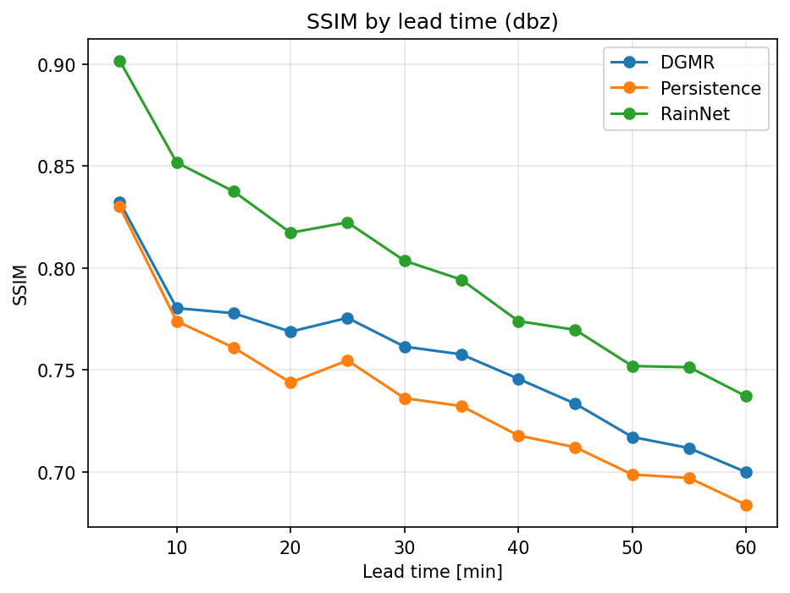
CASE STUDY 13/4/2026

Slide 26

INTRODUCTION OF ANCILLARY DATA

Slide 27
CONCLUSIONS AND FUTURE WORKS
Implementation of nowcasting algorithms (DGMR and RainNet)
Preliminary validation using selected case studies demonstrates potential that complements optical flow algorithms for convective phenomena.
Main limitation relates to processing time (5–10 minutes using Colab environment).
Future integration with other sensors (satellites, lightning detection, ground-based measurements, GNSS-meteo) for a better dynamic interpretation of the phenomena.

