Slide 1


Extreme Precipitation Scaling with Temperature: A Storm-Type Perspective
Rajani Kumar Pradhan¹, and Francesco Marra¹, Colin Price²
Department of Geosciences, University of Padova, Itay
Department of Geophysics, Tel Aviv University, Israel
IPWG-12
12th Workshop of International Precipitation Working Group
July 7-10, 2026, Kraków Poland

Slide 2
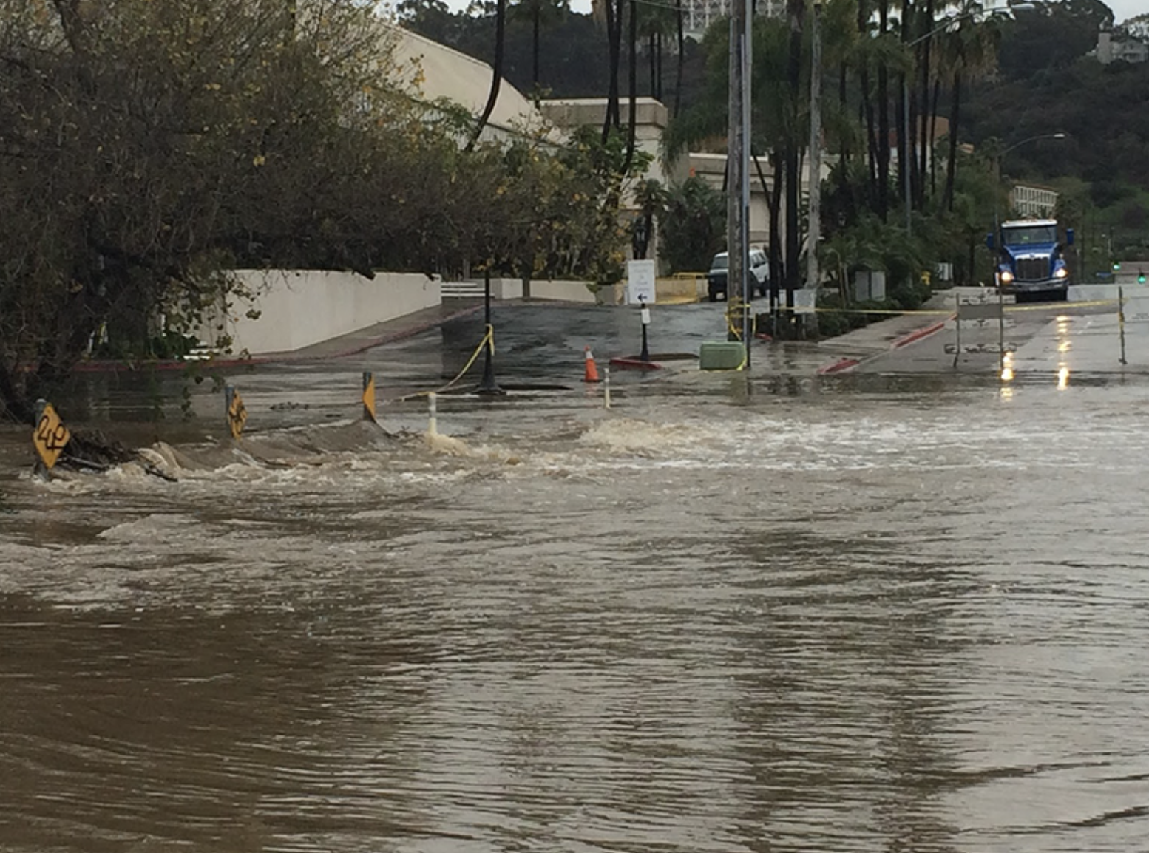

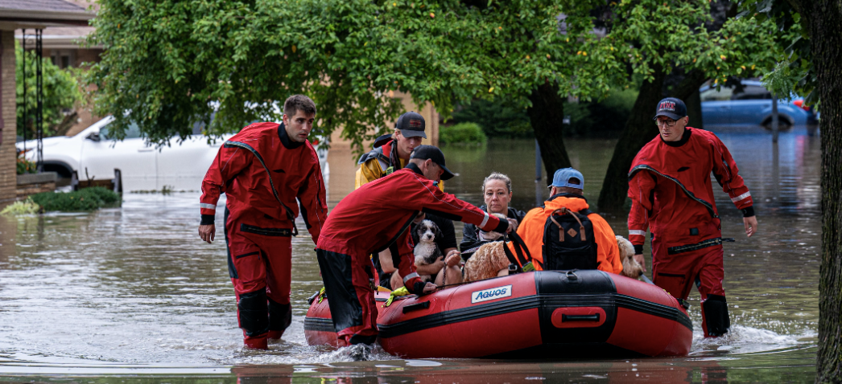
Motivation
⚡
📈
Global intensification underway
🏙
Flash flood trigger
Planning & hazard mitigation
Short-duration rainfall bursts initiate flash floods in both rural and urban catchments, leaving almost no warning time for communities to respond.
(Fadhel et al., 2018; Archer & Fowler, 2018)
Extreme rainfall has already intensified at the global scale under anthropogenic warming and is projected to continue rising with further temperature increase.
(Li et al., 2020; Westra et al., 2014; Fowler et al., 2021)
Understanding the physical mechanisms of extreme rainfall generation is essential for flood risk planning, infrastructure design, and saving lives.
(Wasko et al., 2016; Moustakis et al., 2021)
Notes:
Slide 1: Introduce the hazard problem. Key message: short-duration extremes are already dangerous and warming makes them worse. Sources: Fadhel 2018, Fowler 2021, Archer 2018, Wasko 2016, Li 2020.

Slide 3
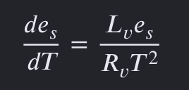

Clausius–Clapeyron scaling and its deviations
Observed scaling rates at a glance
es = Saturation vapor pressure
T = Temperature
Lv = Latent heat of vaporization
Rv = Water vapor gas constant
Sub-CC / negative CC
< 6%/°C
Drobinski et al., 2016
(Thermodynamic CC)
~6–7%/°C
Trenberth et al., 2003
Super-CC (2×CC)
~14%/°C
Ali et al., 2021
Super-CC (3×CC)
~21%/°C
CC rate ≈ 6–7% / °C increase in moisture per degree warming
Guerriero et al., 2018
Notes:
Slide 2: The CC framework and why sub-daily extremes often scale faster. Key references: Trenberth 2003, Ali 2021, Lenderink 2011, Guerriero 2018, Drobinski 2016.

Slide 4
What does storm type reveal about scaling?
This study asks…
The unresolved question: storm type
Molnar et al. (2015) (Switzerland) : mixing convective and stratiform storm types inflates apparent scaling rates.
Da Silva & Haerter (2025) (Germany): super-CC signal is primarily driven by a statistical shift toward convective precipitation at higher temperatures — not by convective invigoration alone.
A storm-type-resolved, globally applicable scaling framework is still lacking.
RQ1
How physically meaningful and robust is a storm classification based on ambient thermodynamic environments (Tb, CAPE, CIN)?
RQ2
How does extreme precipitation–temperature scaling differ across storm types (severe convective, moderate convective, stratiform)?
RQ3
How do these scaling behaviours and thermodynamic sensitivities diverge between land and ocean regions?
Notes:
Slide 3: Close the gap narrative and state the three research questions. Key refs: Ali 2021 (global benchmark), Molnar 2015 (storm type mixing problem), Da Silva & Haerter 2025 (super-CC = type shift).

Slide 5
Data and methods
Dataset | Variables | Spatial Resolution | Temporal Resolution | Record length
IMERG -F | Precipitation | 0.1˚ × 0.1˚ | 30 min | 2000 - 2024
MERGIR | Brightness Temp (Tb) | 0.04˚ × 0.04˚ | 30 min | 2000 - 2024
ERA5 | Dew Point Temp (Td), CAPE, & CIN | 0.25˚ × 0.25˚ | hourly | 2000 - 2024
WWLLN | Lightning Stroke Density | Complemented | event-based | 2012 - 2024

Slide 6
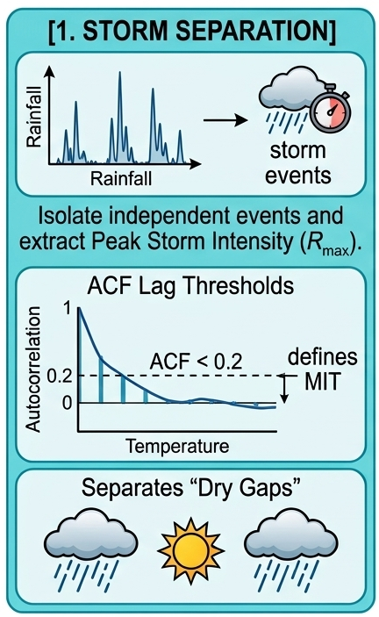
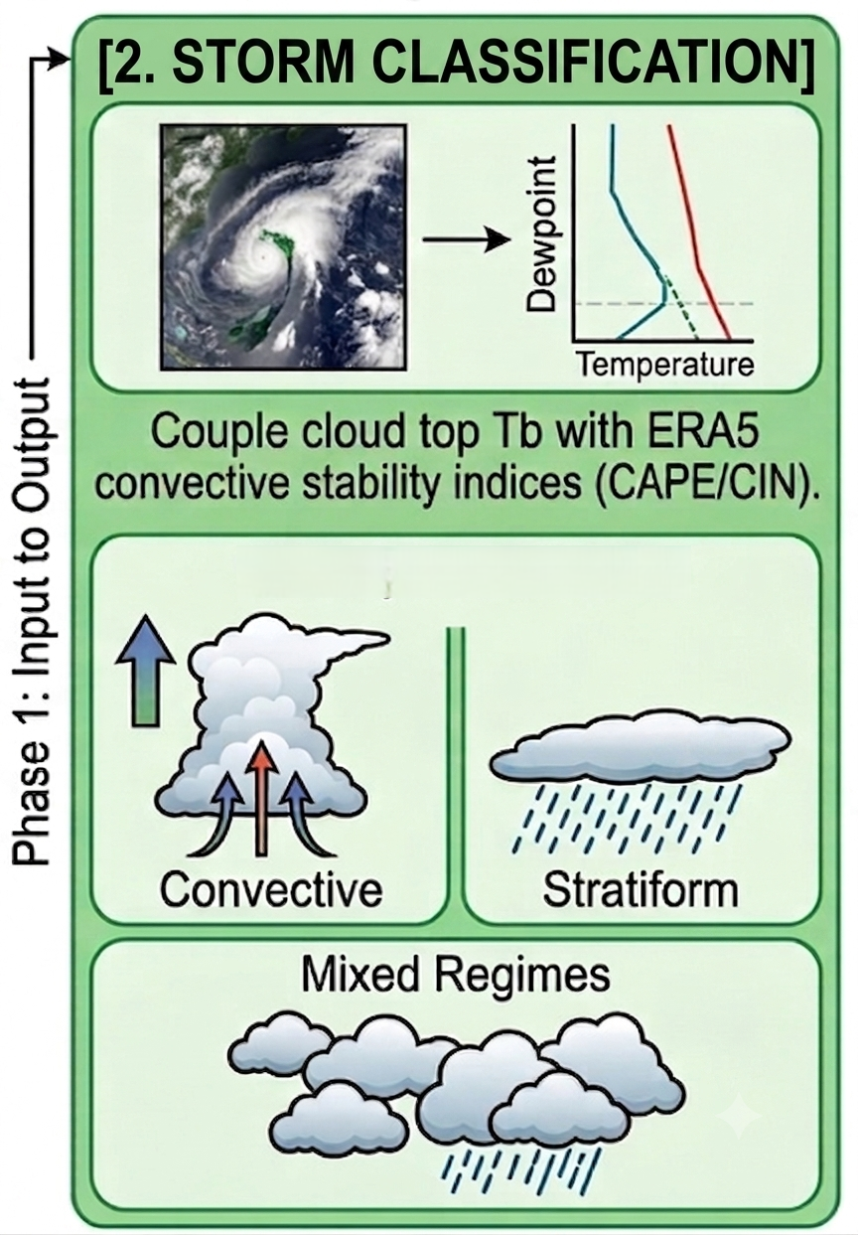
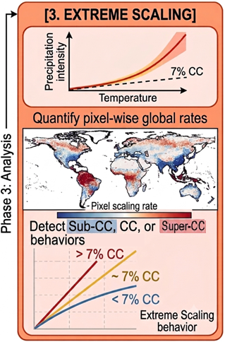
Data and methods

Slide 7
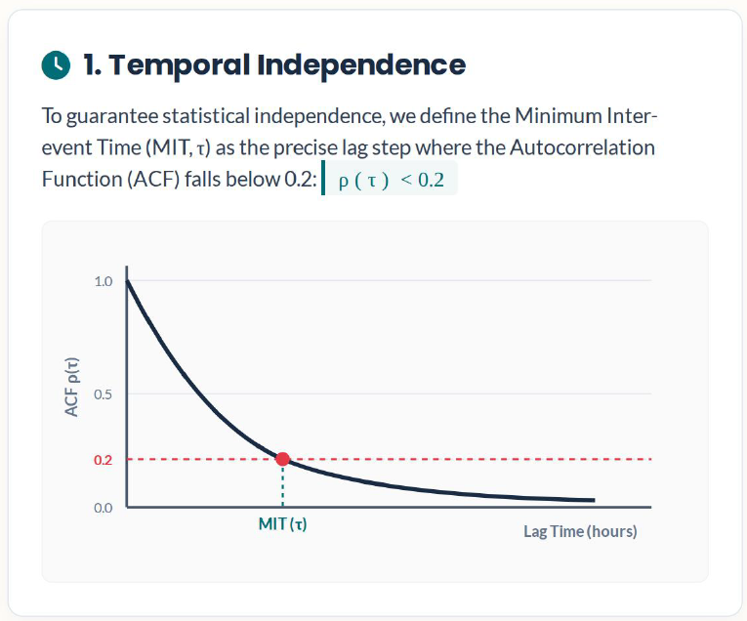
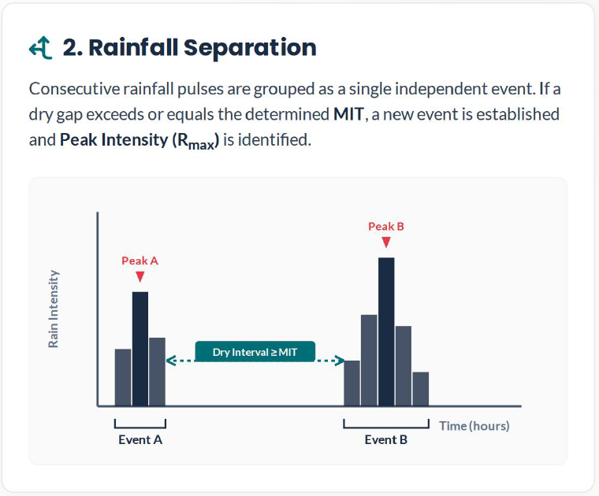
Data and methods

Slide 8

Storm classification
$$S_{total}=S_{T_{b}}+S_{range}+S_{CAPE}−S_{CIN}$$
01 Formulating Convective Score (S)
02 Parameter Criteria & Weighting
03 Simplified 3-Class Output Model
Predictor Array | Physical Threshold | Assigned Weight
Brightness Temp (T_{b}) | < 210K | < 225K | < 240K | < 255K | +4 | +3 | +2 | +1
Spatial T_{b} Range | > 25 K | > 15 K (Thermal Gradient) | +2 | +1
Pre-Storm CAPE | > 2000 | > 1000 | > 300 J/kg | +3 | +2 | +1
Pre-Storm CIN | > 200 J/kg (Inhibition Penalty) | -1.0
Convective
S ≥ 5
Mixed
S = 3-5
Stratiform
S < 3

Slide 9
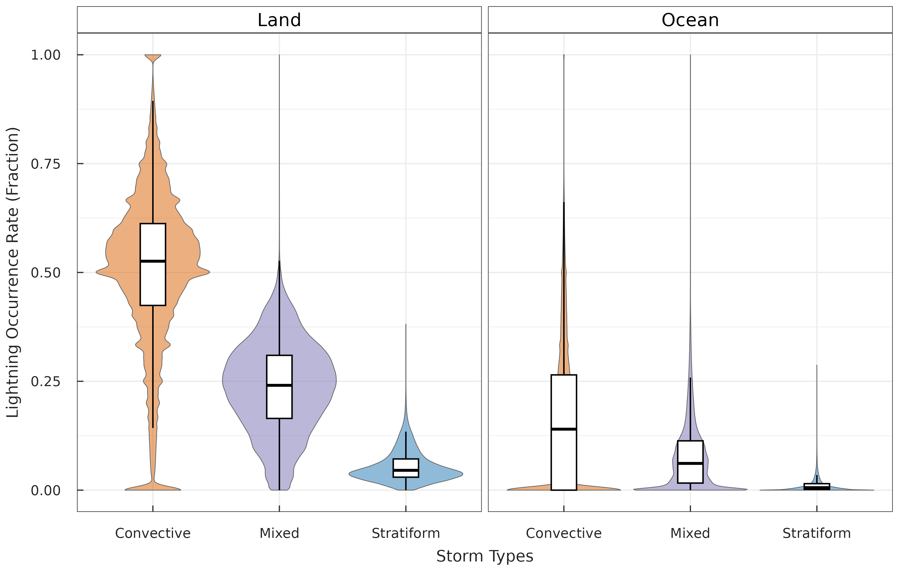
Storm classification

Slide 10
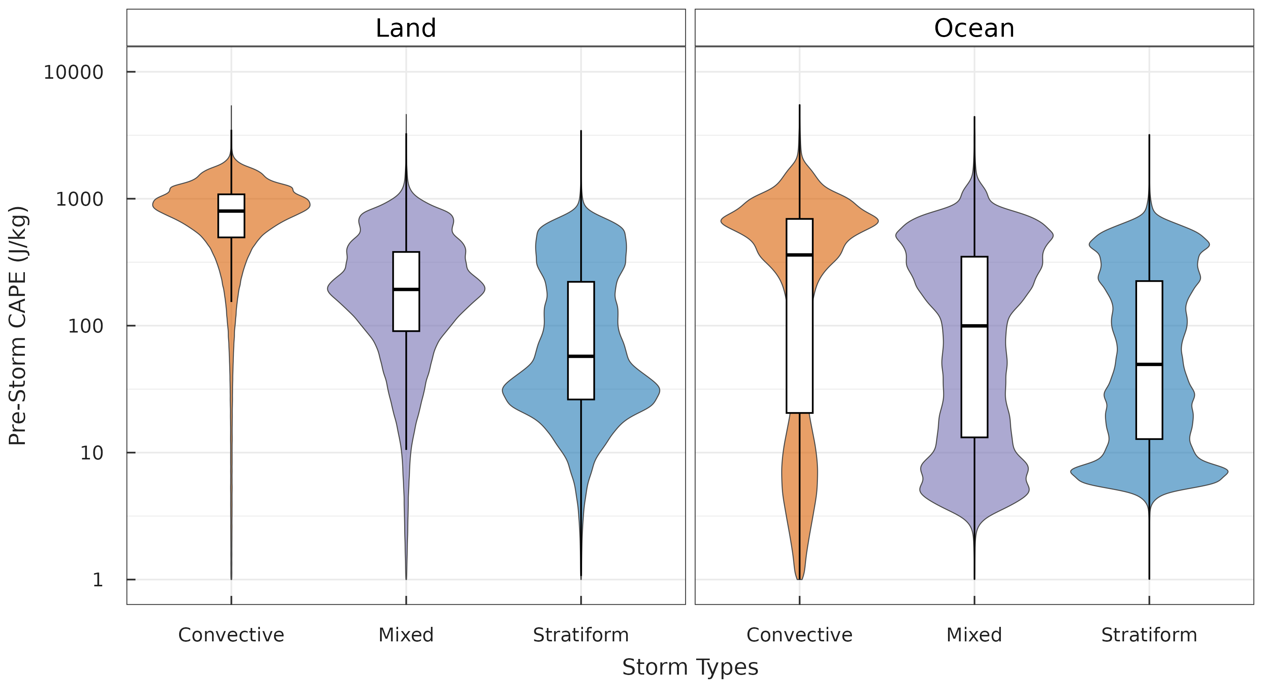
Storm classification

Slide 11
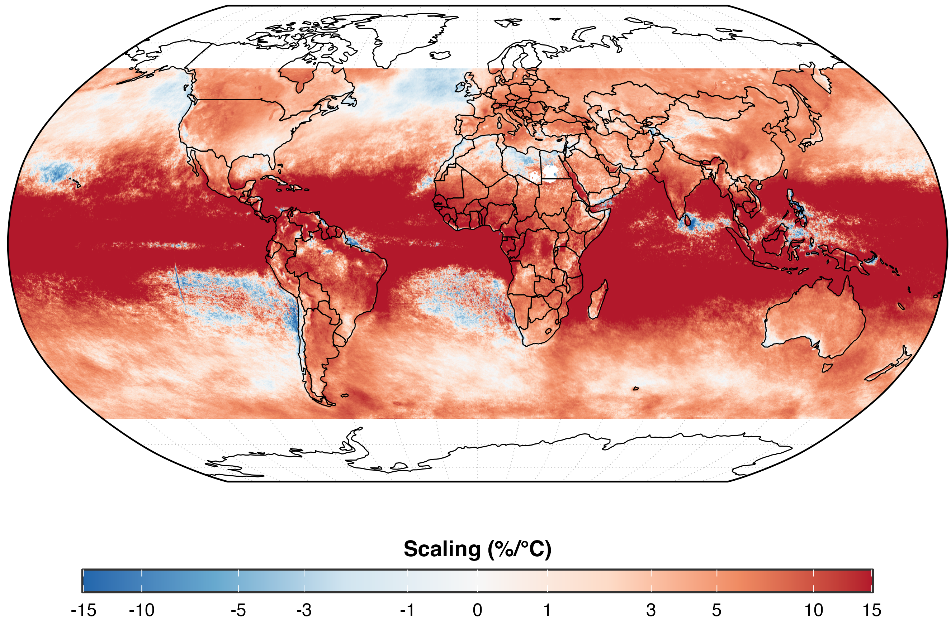
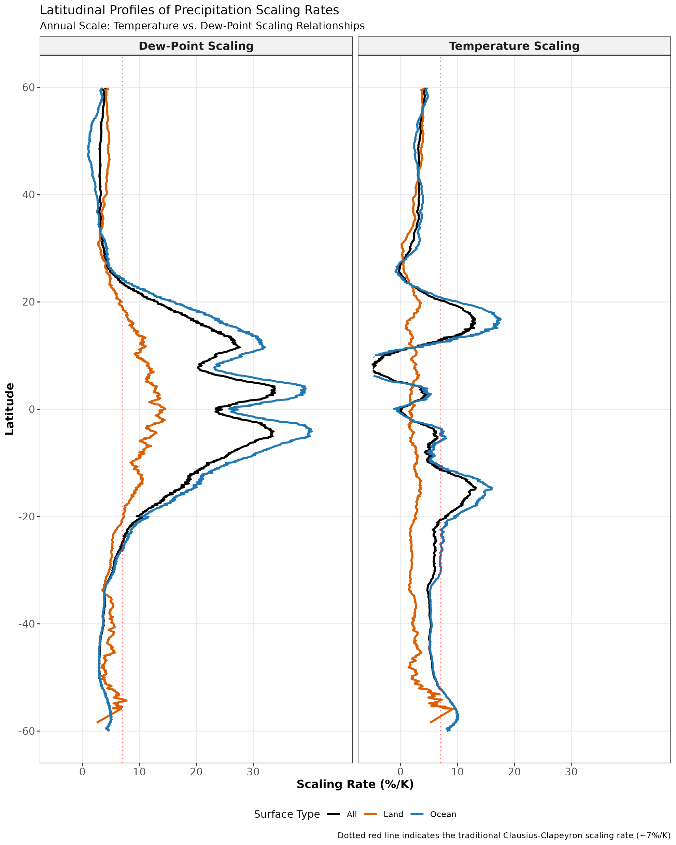
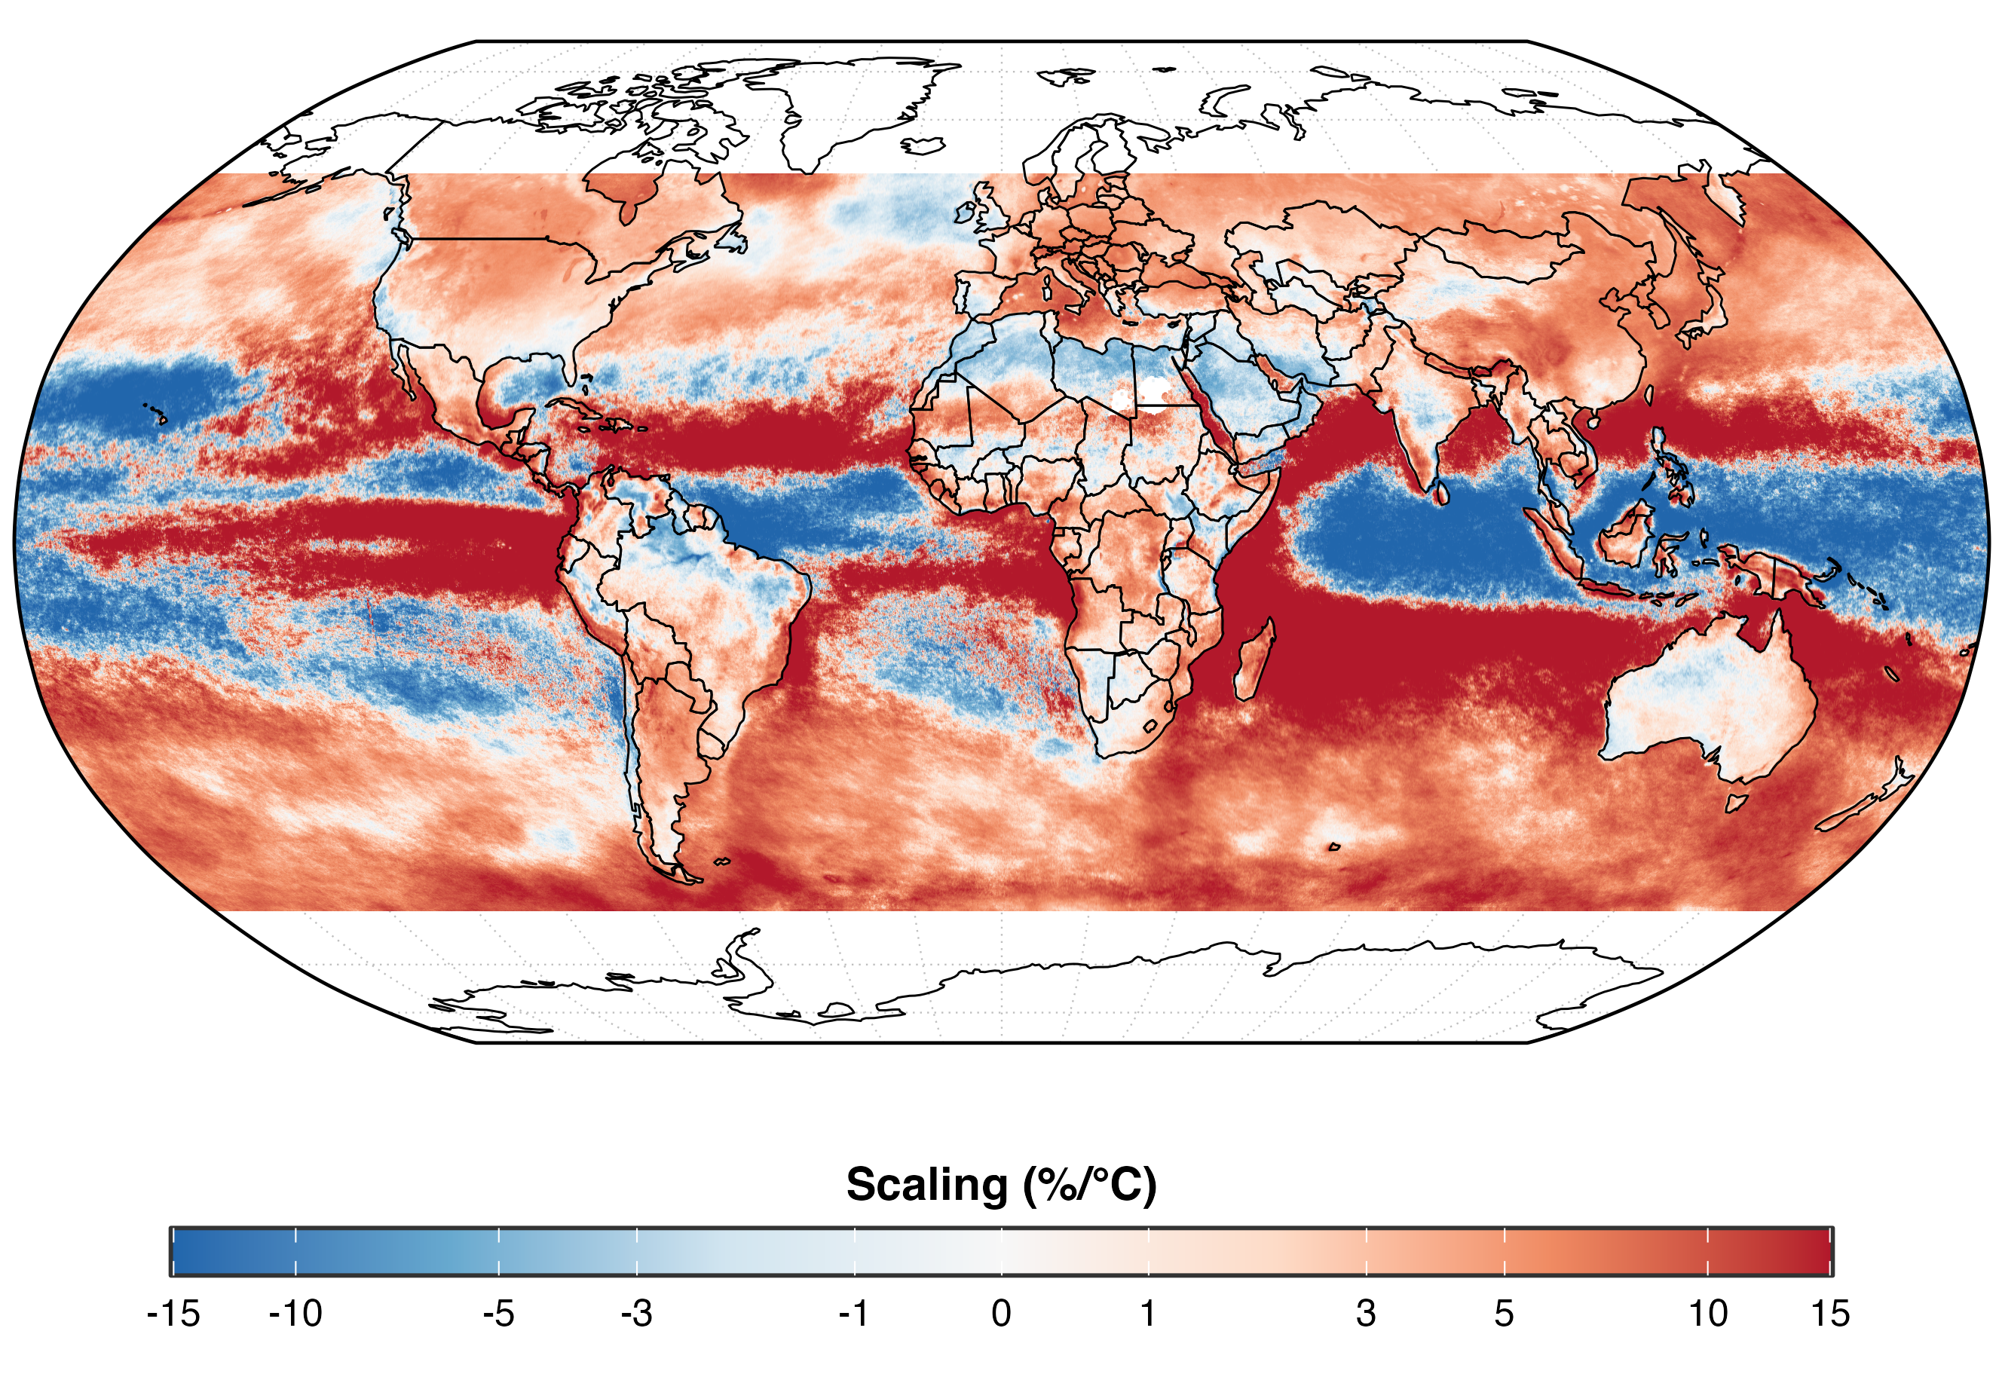
Overall scaling of precipitation (p95)

Slide 12
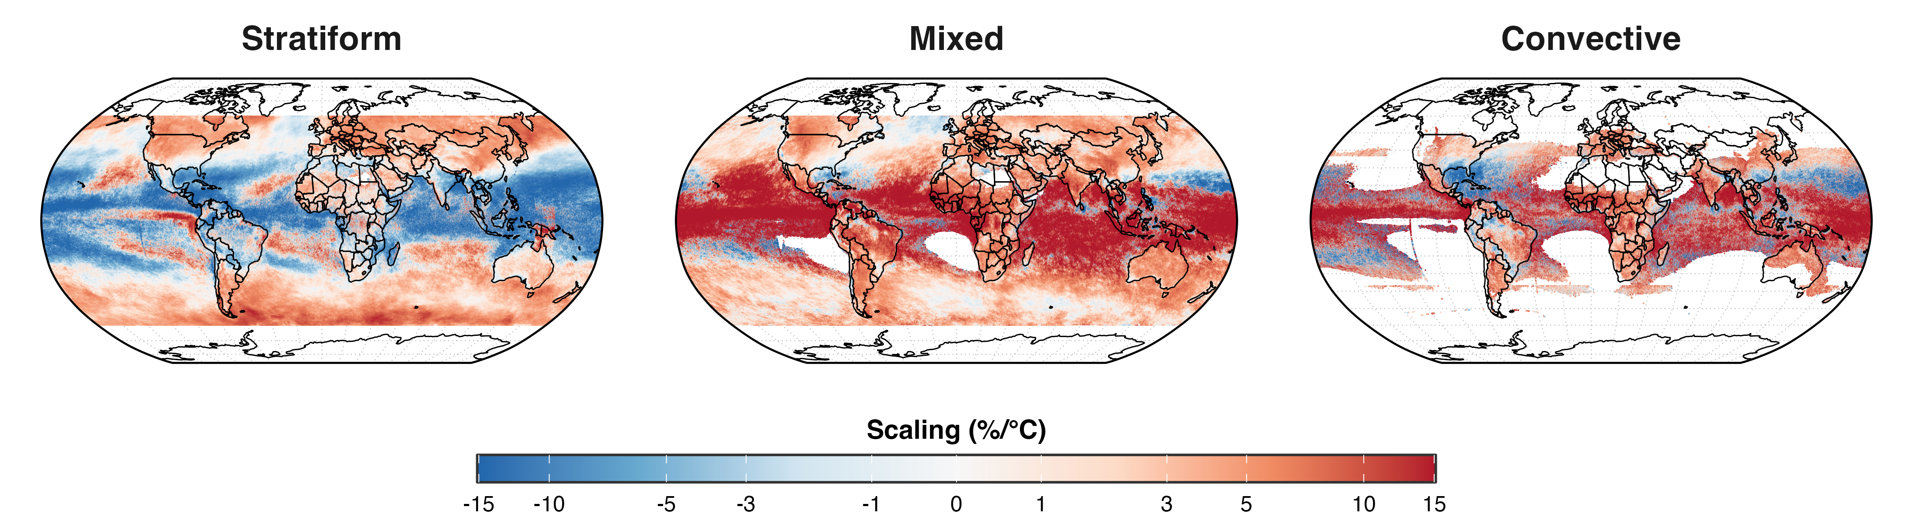
Scaling: storm types

Slide 13
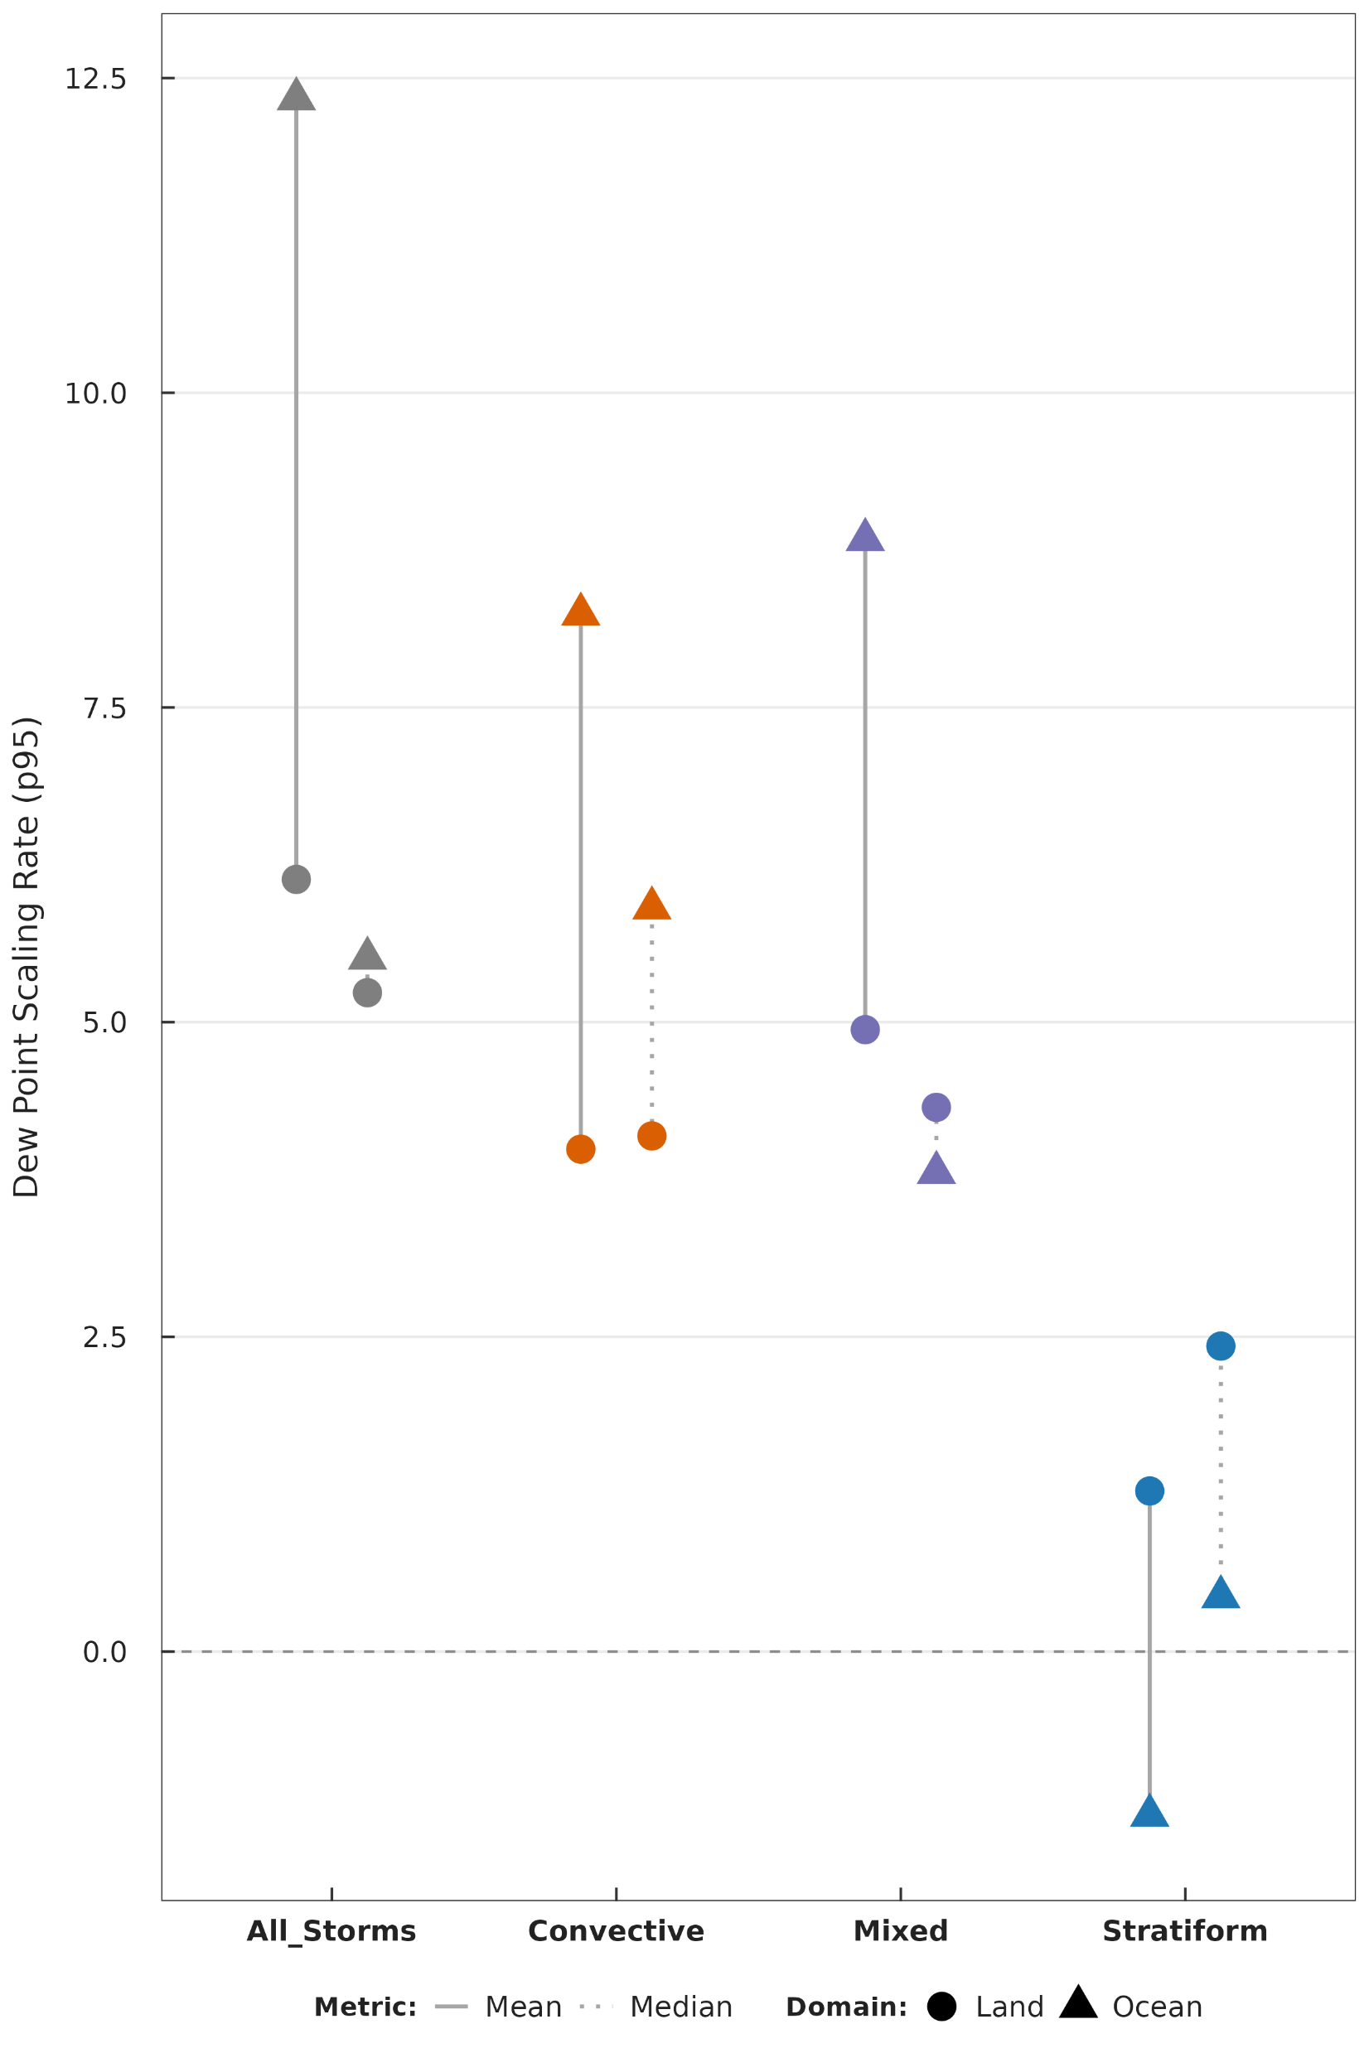
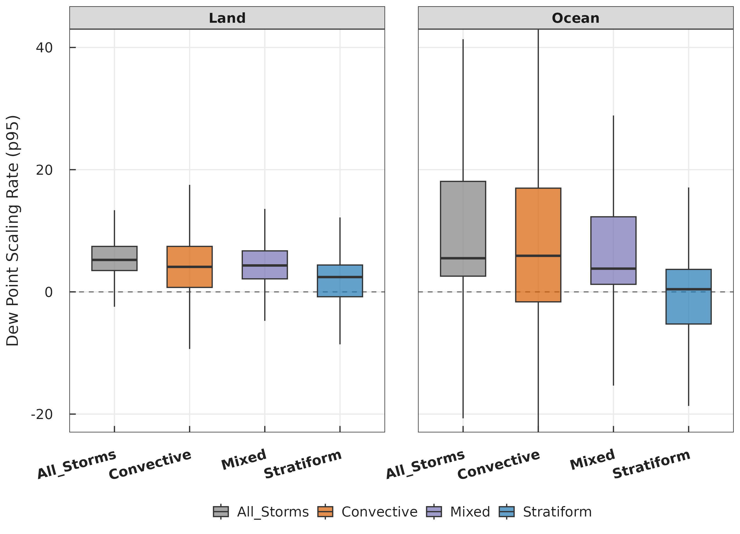
Scaling: storm types

Slide 14
Summary
The Trap of Pooling Data
  Blending all data (All Storms) hides the true physical mechanisms.
  Classification reveals distinct, hidden thermodynamic scaling profiles.
Stratiform: Sub-CC & Negative Scaling
  Associated predominantly with negative or sub-CC scaling (< 7%/˚ C).
  The only type where Land scaling exceeds Ocean scaling (near-zero over land, negative over marine environments).
Convective & Mixed: CC & Super-CC Scaling
  Exhibit the highest positive scaling rates globally.
  Frequently exceed thermodynamic expectations, driving super-CC scaling (> 7%/˚ C) especially in the tropics.
Land vs. Ocean Amplification
  Peak scaling values are concentrated over the Ocean for Convective, Mixed, and All Storm types.

Slide 15
Thank you!
rkpradhan462@gmail.com

