Slide 1

Leveraging Passive Microwave Observations for Precipitation Nowcasting
Simon Pfreundschuh (simon.pfreundschuh@colostate.edu)

Slide 2
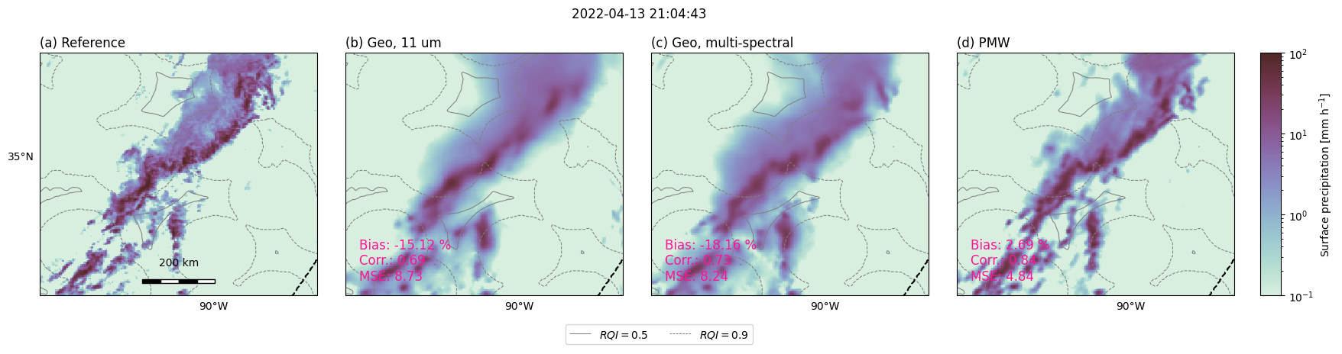
Motivation
The accuracy satellite precipitation retrieval are information limited
Increasing information content key to reducing retrieval errors, increasing effective resolution, and capturing extremes.

Slide 3
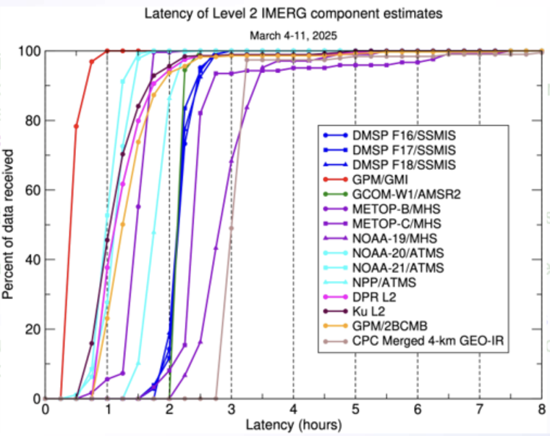
The Challenge
PMW observations have high information content but sparse coverage
Latency of PMW observations is higher than that of geostationary
Leveraging PMW observations for real-time applications requires spectral and temporal fusion
Courtesy of E. Nelkin and G. Huffman

Slide 4
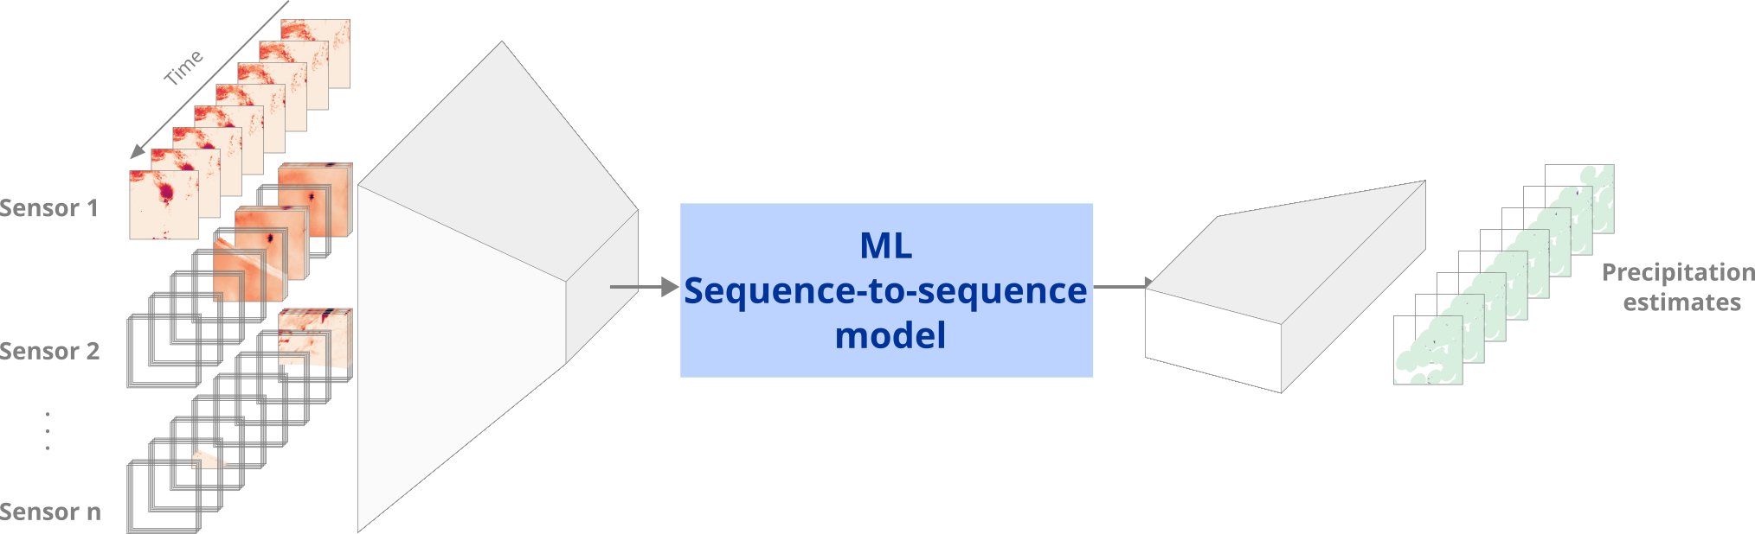
Previous Work: CHIMP
Flexible retrieval framework for multi-sensor, multi-timestep retrievals
  Used by SMHI, Tomorrow.io
Use sequence-to-sequence modeling approach
Drawbacks:
  Works best with temporally dense training data (ground-based radar)

Slide 5
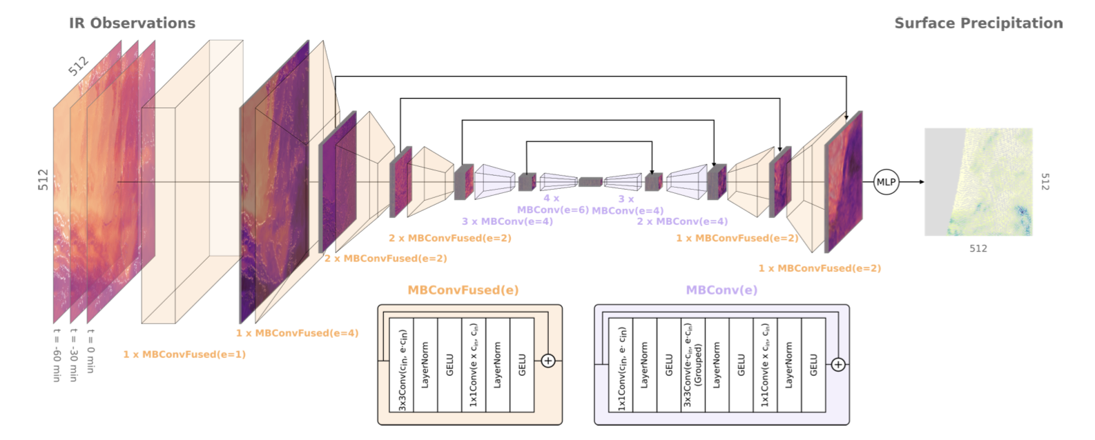
Previous Work: GPROF-IR

Slide 6
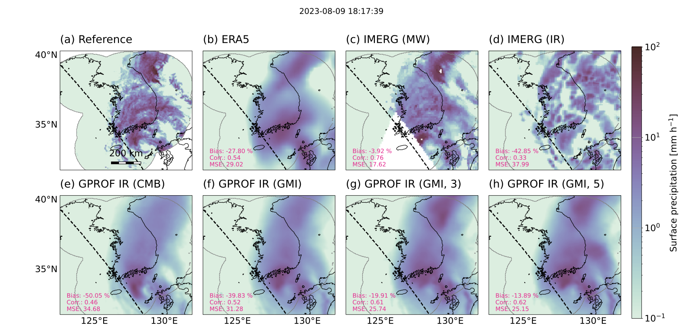
Previous Work: GPROF-IR

Slide 7

Argos
Not an acronym
Global precipitation nowcasting retrieval fusing geostationary Vis/IR and LEO PMW
Aim: Leverage (potentially delayed PMW observations) for real-time precipitation monitoring and short-term forecasting

Slide 8
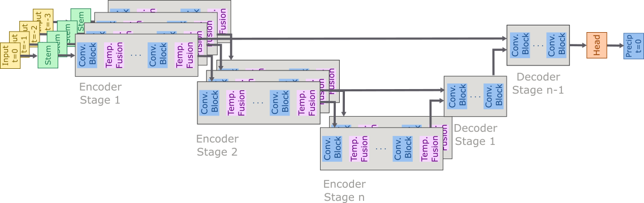
Argos: Implementation
Architecture: EfficientNet-V2 U-Net with temporal fusion modules in encoder
Motivation: Enable initialization from single timestep model

Slide 9
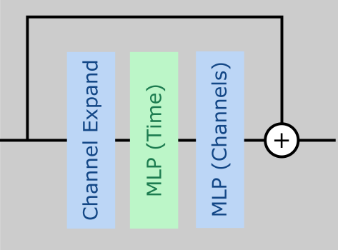
Temporal Fusion Module
MLP across time steps followed by MLP across channels
Residual connection that preserves the most recent time steps
Aim: Conserve information from latest time step

Slide 10
Training and Evaluation Setup
Geo Sensors: ABI, AHI, SEVIRI
PMW Sensors: ATMS, SSMIS, MHS, TROPICS TMS
Training Data: January – June 2024
Evaluation: October 2024

Slide 11
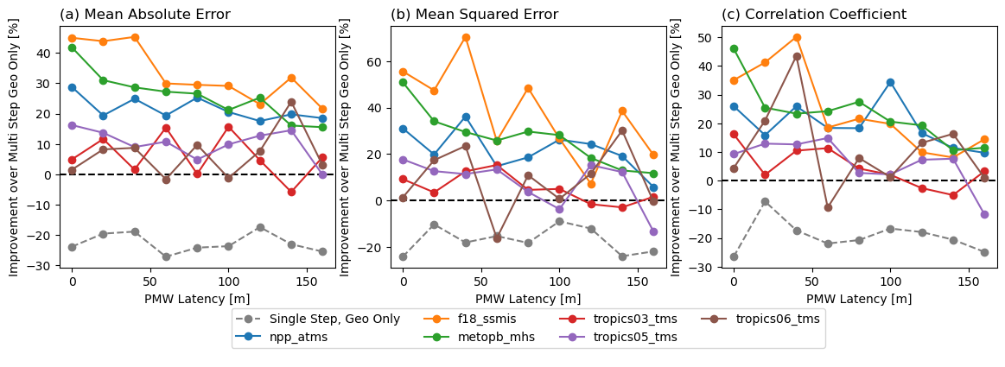
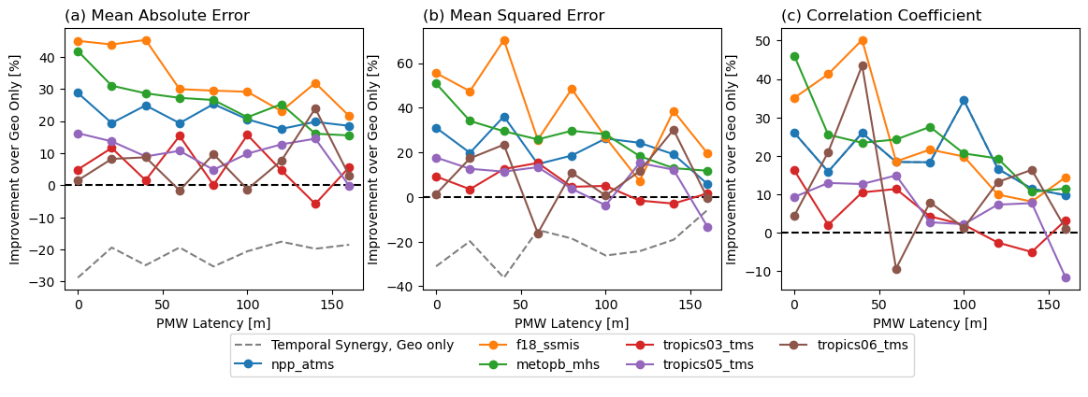
Results

Slide 12
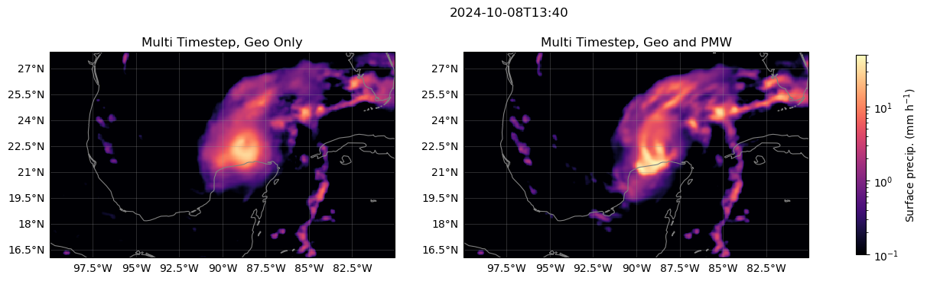
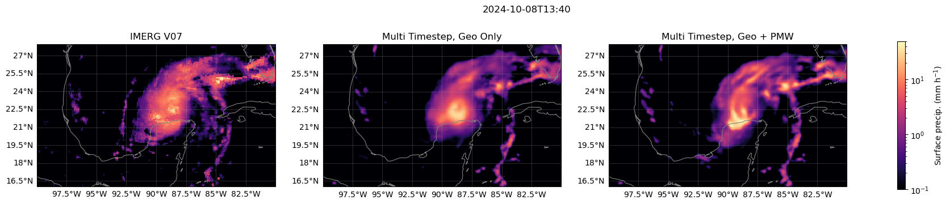
Hurricane Milton

Slide 13
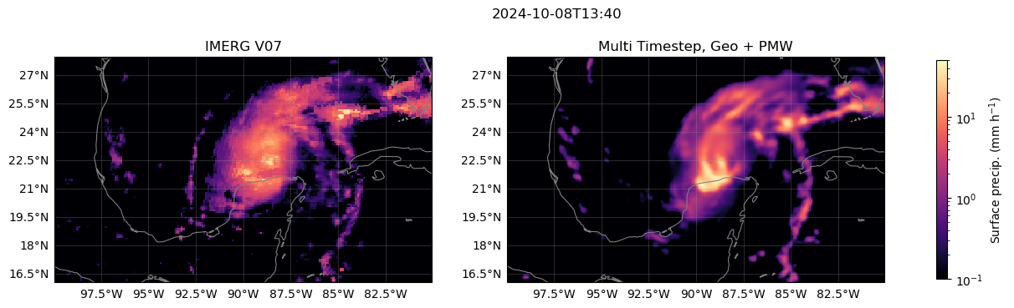
Hurricane Milton

Slide 14
Conclusions and Future Work
Spectral and temporal fusion yields notable improvements in accuracy over Geo-only baseline
Impact seems to persist across full three-hour input window
NRT Precipitation Retrieval to be publicly available later 2026.

