Slide 1
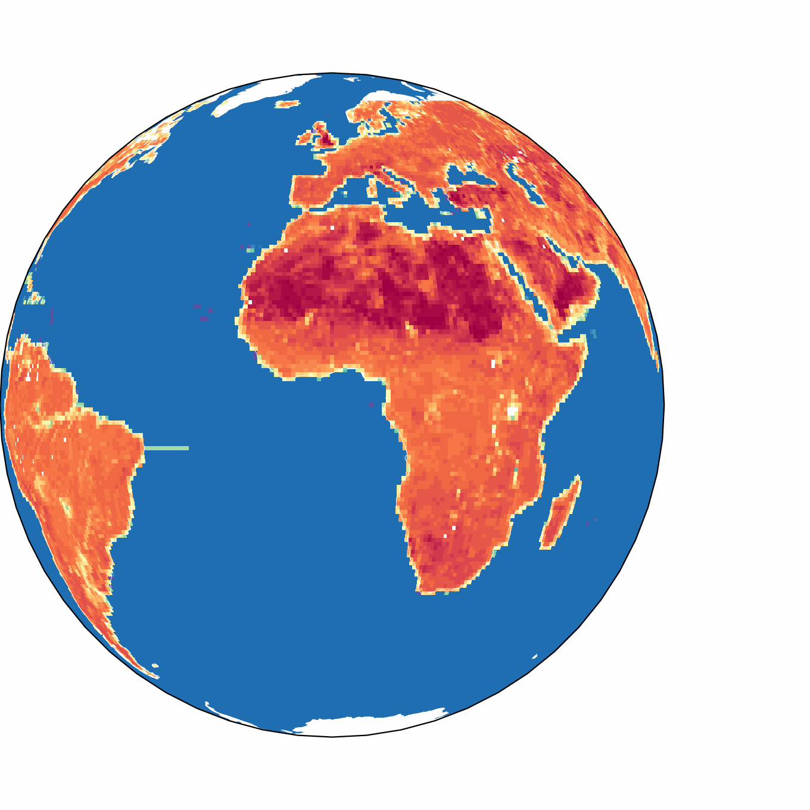
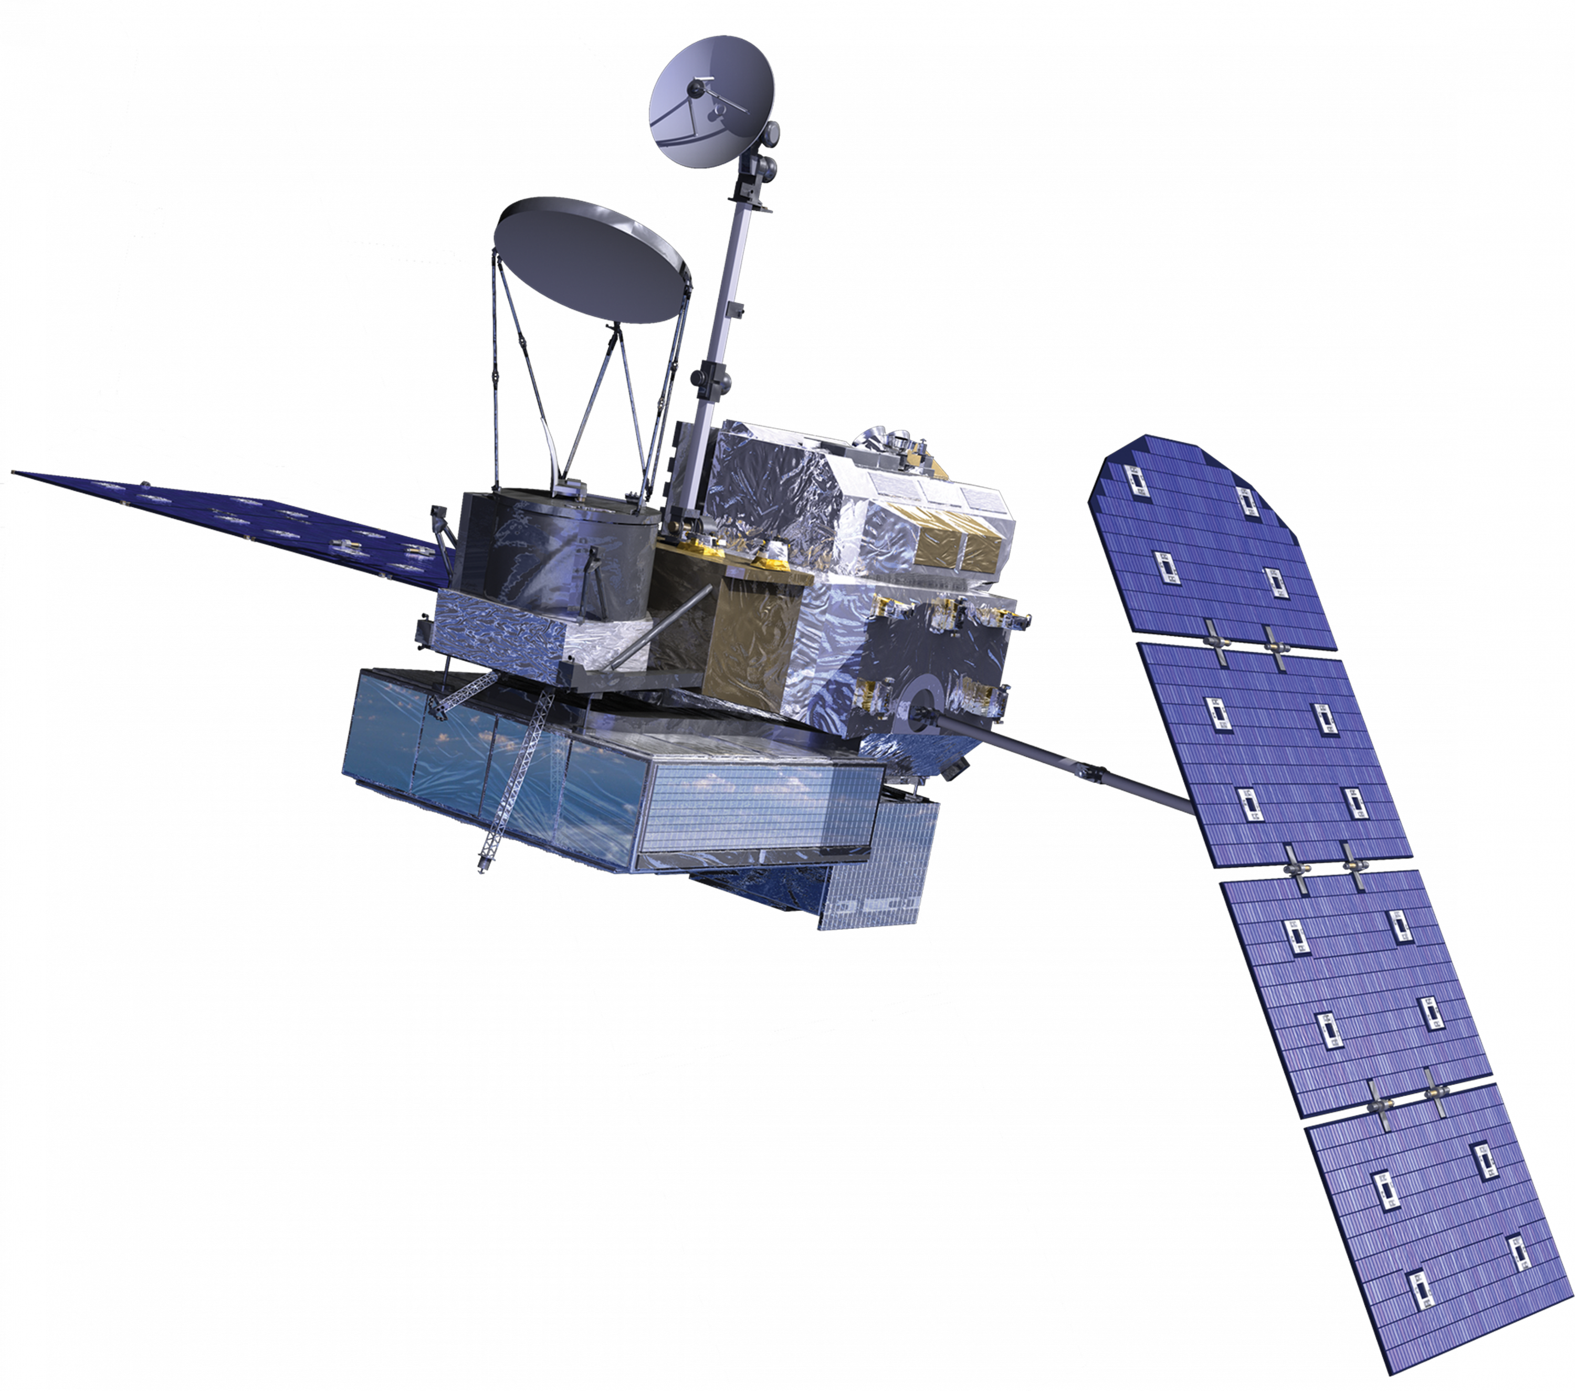





Transformer-Based Modeling of Global Microwave Land Surface Emissivity Using GPM
IPWG-12
12TH WORKSHOP OF INTERNATIONAL PRECIPITATION WORKING GROUP
Session 7 – AI (08/07/2026)
Fraser King^{1,2,3} & Sarah Ringerud²
¹University of Maryland
²NASA Goddard Space Flight Center
³University of Wisconsin-Madison

Slide 2

Motivation
High-quality surface emissivity estimates are critical for accurately assessing atmospheric conditions
Instead of running error prone physical models across multiple microwave frequencies, we developed an empirical mapping between them
Following Ringerud et al., 2015, we built a global ML-based approach that ingests 10.65 Hpol surface emissivity and a few other surface variables to predict the 12 remaining higher frequency GMI channel emessivities
T_{B}
= Brightness
Temperature
T_{CB}
T_{a}
T_{S}
Surface temperature and emissivity

Slide 3
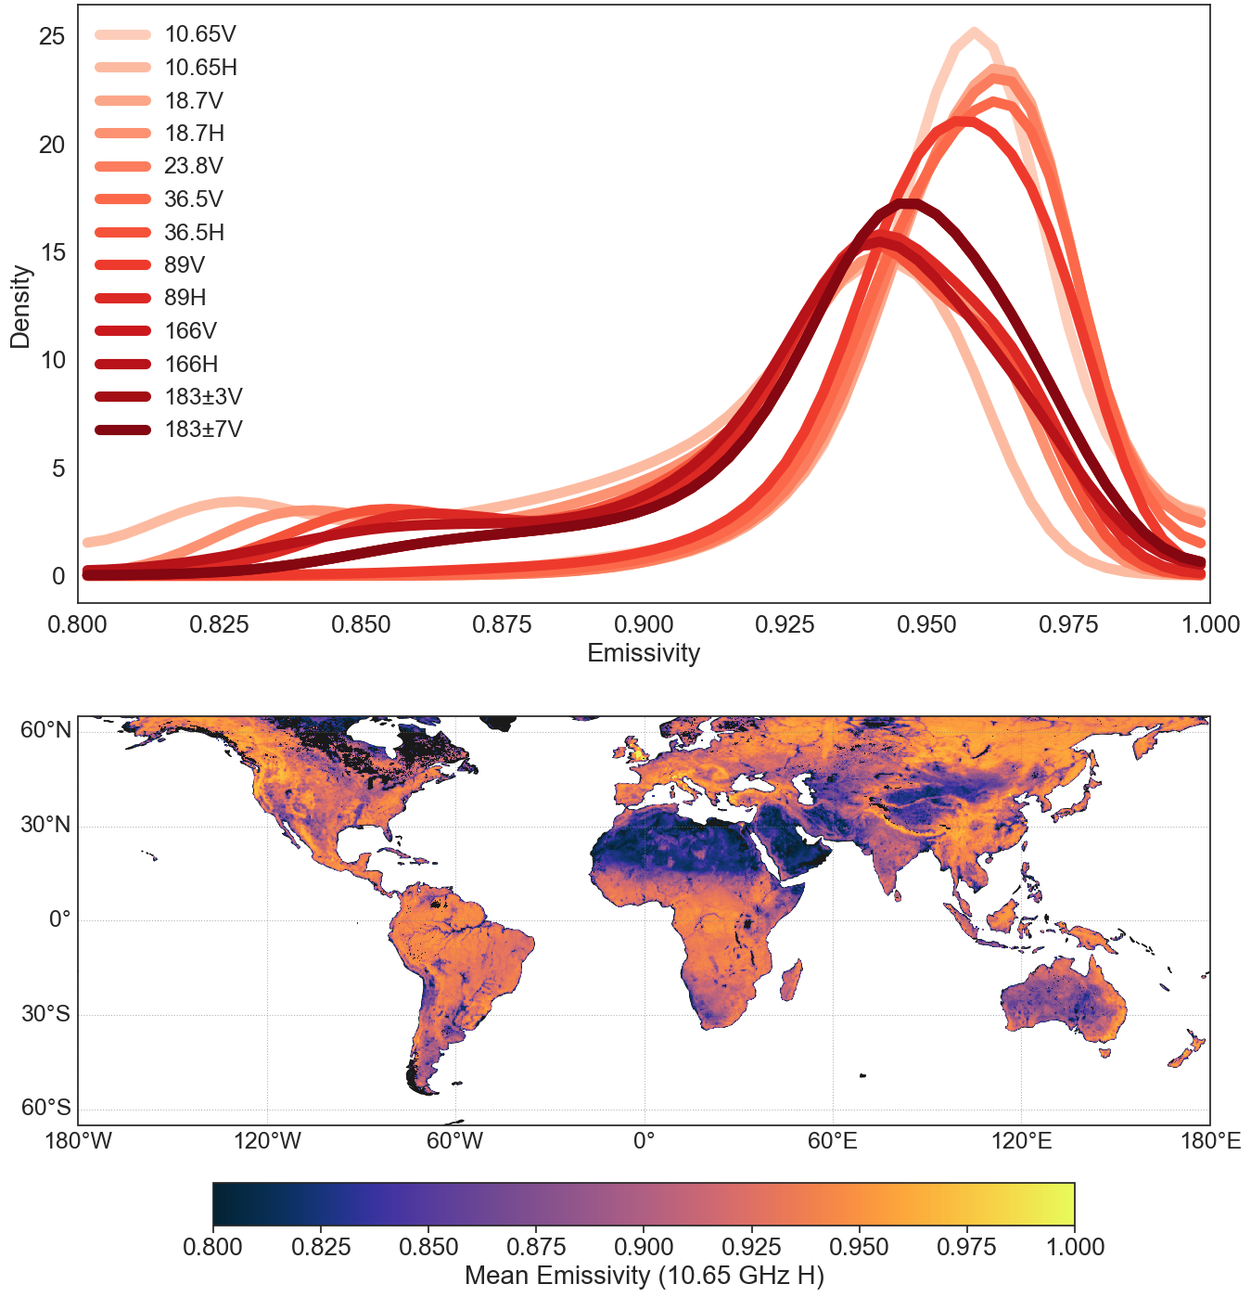
Data Overview
Global Emissivity KDEs
All data has been collected and spatiotemporally aligned over only land pixels, snow free, and clear sky from 2015-2019
We have 26,936 granules over 5 years
  9,441,632 total pixels
Input Variable | Units | Source
Skin temperature | K | GPM_2BCMB
Elevation | m.a.s.l. | SPL4SMLM
Clay fraction | Fraction | SPL4SMLM
Sand fraction | Fraction | SPL4SMLM
Leaf area index | m² m⁻² | SPL4SMGP
Surface soil moisture | m³ m⁻³ | SPL4SMGP
Surface emissivity @ 10 GHz (H) | -- | GPM_2BCMB (OE-based retr.)

Slide 4
Model Suite
We explore a series of models of increasing complexity to evaluate skill across multiple architectures
Multiple Linear Regression
Feature Tokenizer Transformer
Channel
Covariances
Random Forest
Multilayer Perceptron
ID: COV
ID: MLR
ID: RF
ID: MLP
ID: FTT
Linear
Linear
Nonlinear
Nonlinear
Nonlinear
Tokenizes features; self‑attention models for cross‑feature interactions
Leverages cross-channel covariance to infer surface emissivity
Linear combination of features predicts each channel
Ensemble of decision trees capturing nonlinearities & interactions
Feedforward neural network learning nonlinear mappings

Slide 5
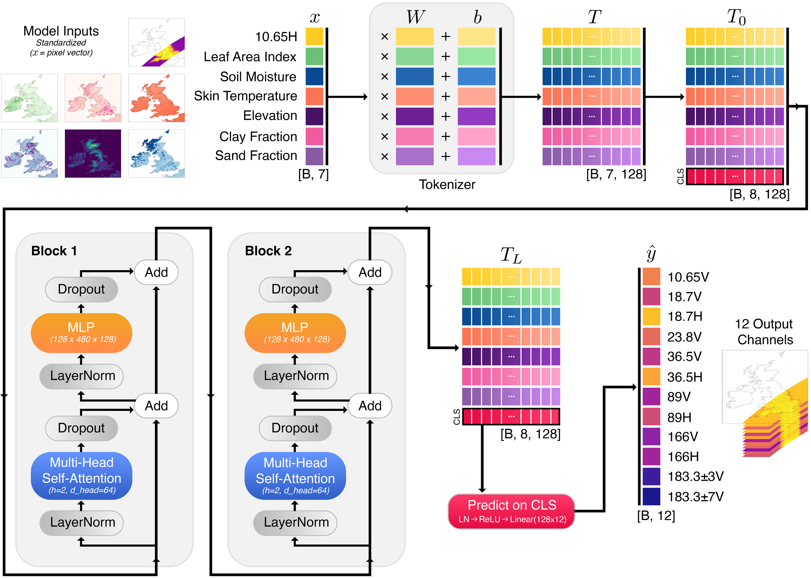
FTT Architecture
Tokenizing turns each input into a flexible learned representation, making variables comparable and easy to combine
Attention lets tokens share context, capturing interactions between predictors (e.g canopy–soil coupling) without manual feature engineering
These are per-pixel models for easy operational integration

Slide 6
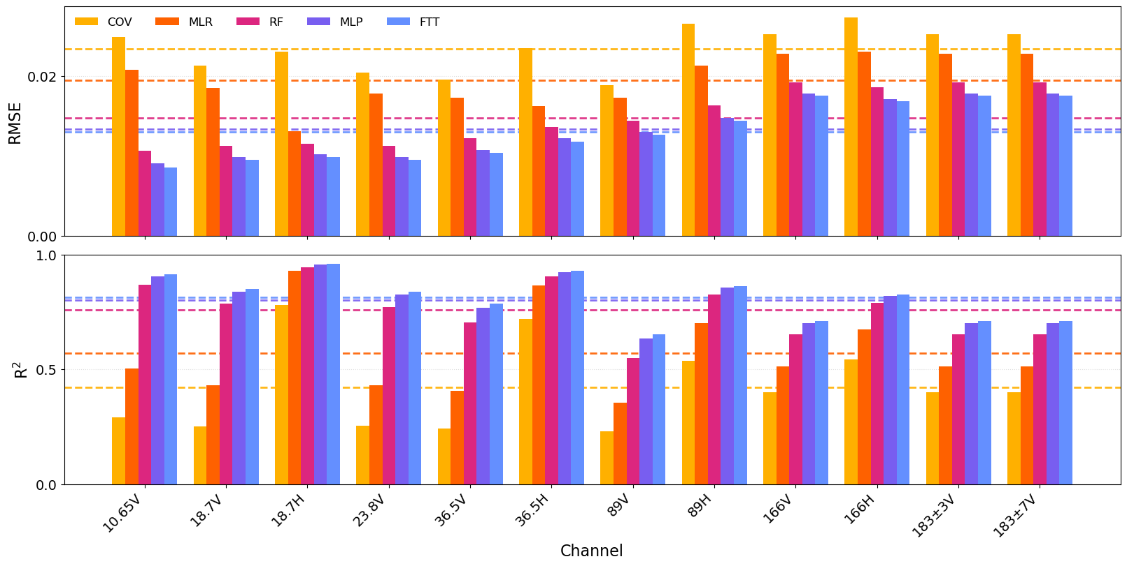
Emissivity Model Intercomparison

Slide 7
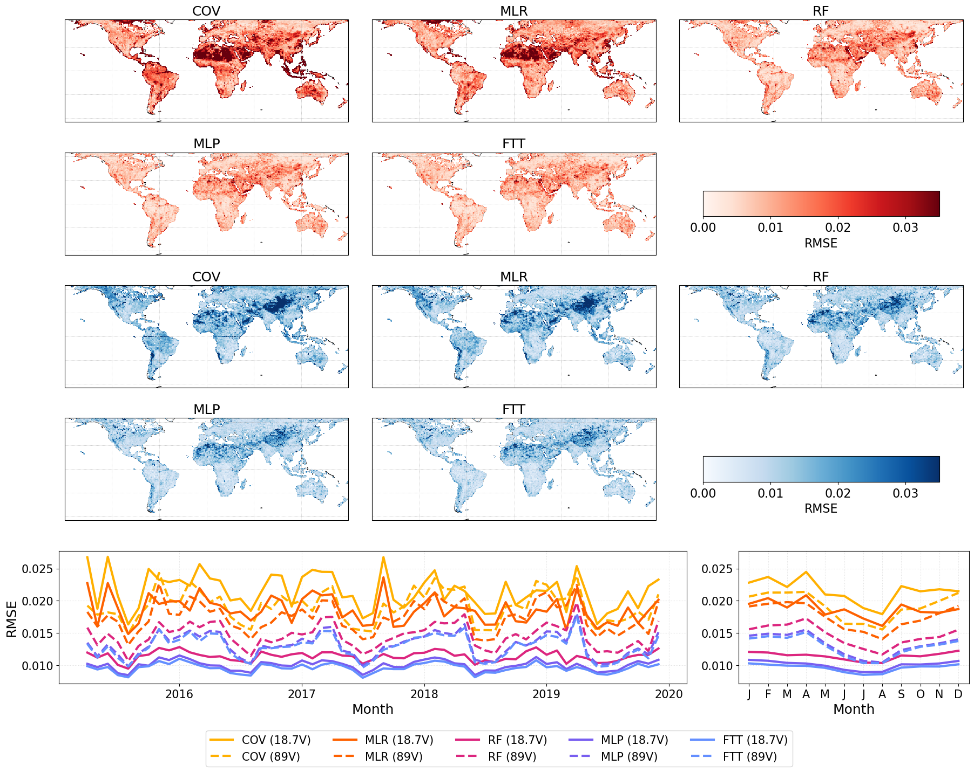
Overall
Spatiotemporal
Emissivity Skill
Let’s consider two channels for brevity (18.7V: red, and 89V: blue)
The linear methods appear unable to capture complex geographical /seasonal differences
We note a stepwise reduction in error as we move to nonlinear methods (NN-based performing best)

Slide 8
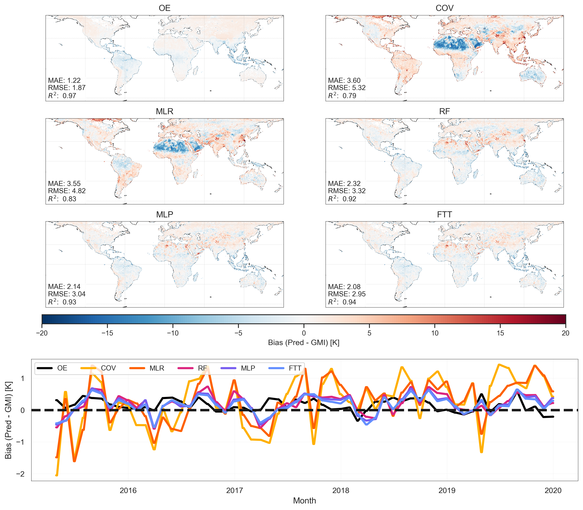
Overall
GMI Tbs – 18.7V
Q: How do GMI-observed TOA Tbs compare to forward modelled estimates based on our model-predicted surface emissivity values?
The best agreement we expect to achieve with our models is our OE-based Tbs (upper left panel) as that is our target
Similar to the emissivity results, we note improved spatial distributions and reduced seasonable variability as we move to the more complex models

Slide 9
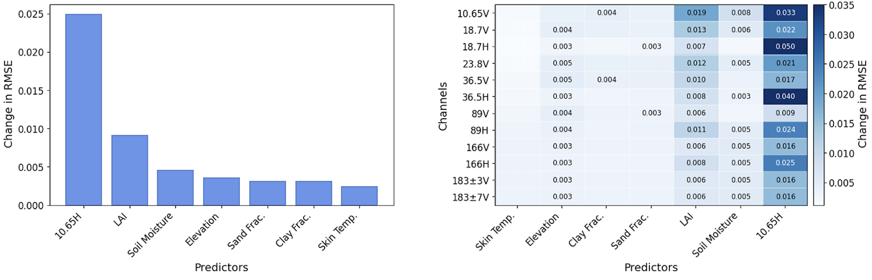
Global Importance
The 10.65 H emissivity is the anchor input (i.e., the reference channel the model conditions on to predict the other surface emissivity values)
Emissivity is most important on H-pol channels and at lower frequencies since the atmosphere is more transparent and surface emission dominates
LAI and SM typically display higher importance on low frequency V-pol channels because vegetation and soil emission are more visible

Slide 10
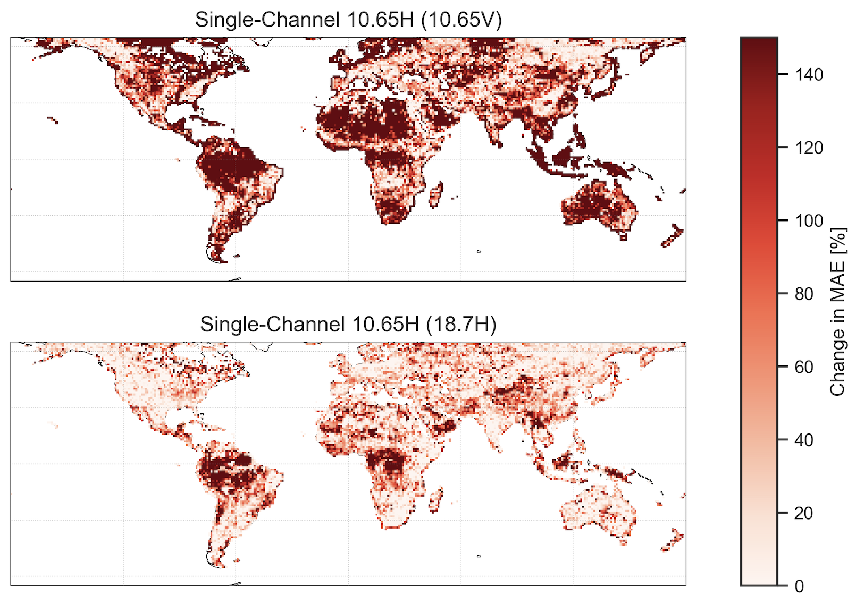
Input Ablation Tests – Only 10.65H

Slide 11
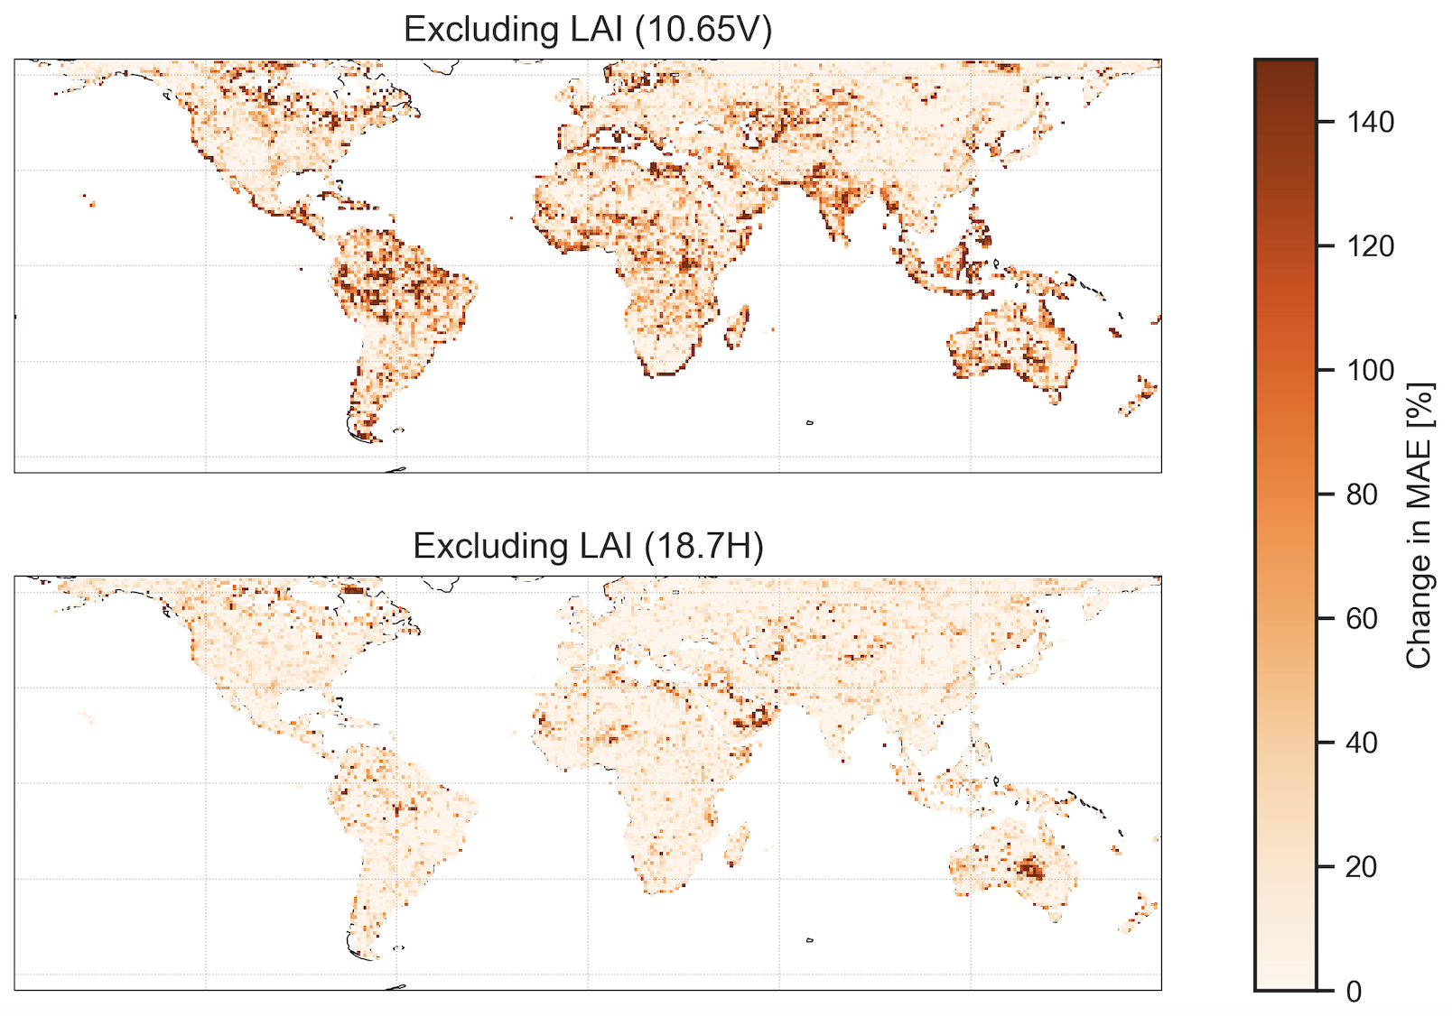
Input Ablation Tests – Excluding LAI

Slide 12
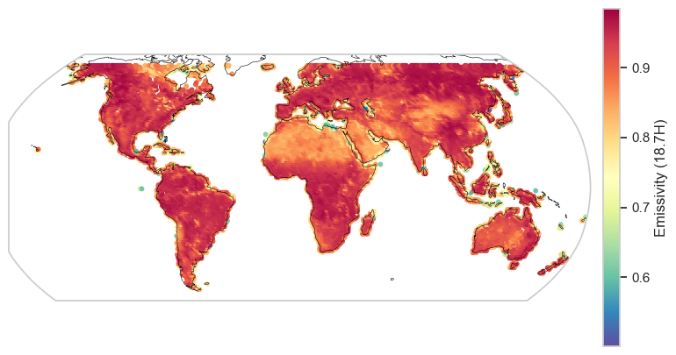

Generalizability
We perform robustness checks by swapping out the 10.65 H input channel used during training for a new 10.65 H channel derived in the Tool to Estimate Land Surface Emissivities at Microwave frequencies 2 (TELSEM2) used in the Radiative Transfer for TOVS (RTTOV) model
The product has a long history and has been used in a variety of data assimilation/NWP studies over the past decade and is a common option for independent model validation
RTTOV/TELSEM2

Slide 13
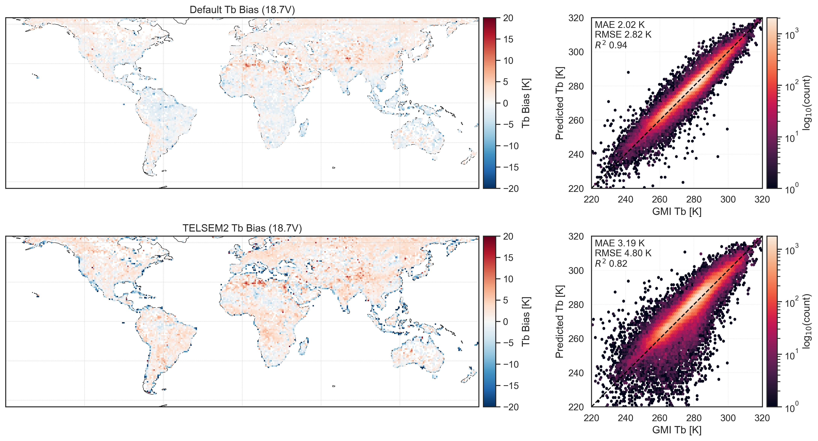
TELSEM2 Tbs – 18.7V

Slide 14
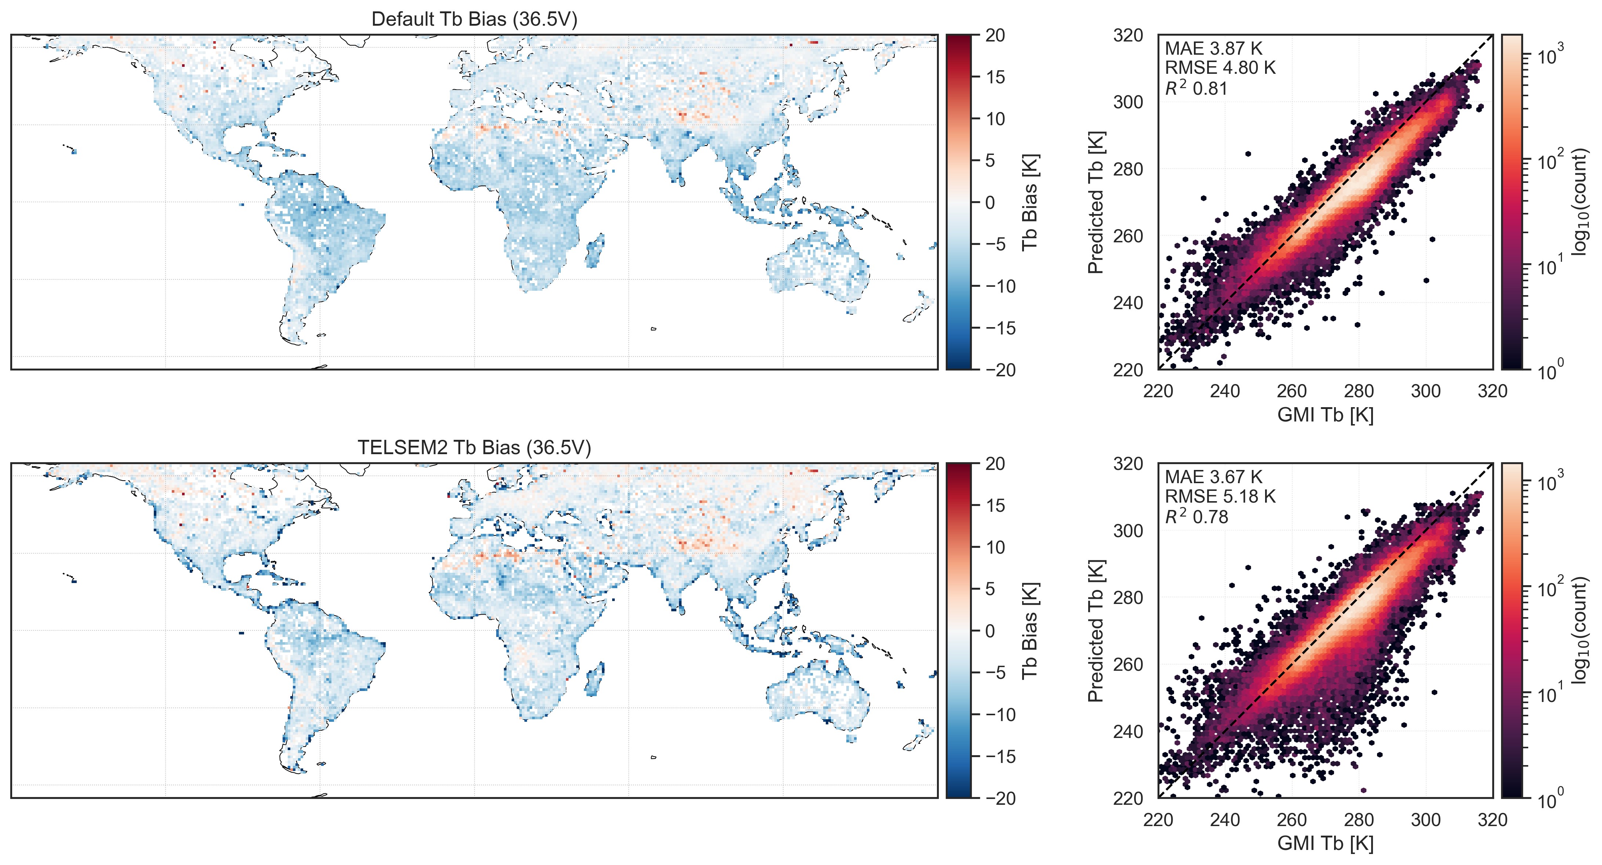
TELSEM2 Tbs – 36.5V

Slide 15
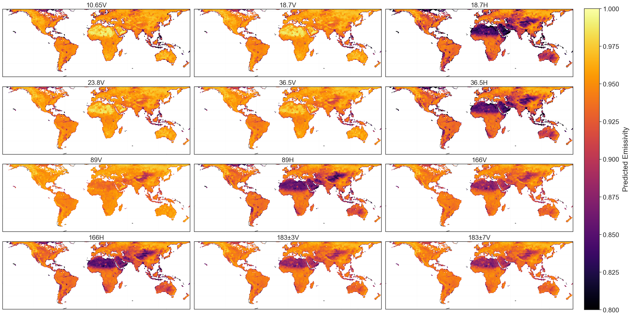
All-Channel FTT Emissivity Maps

Slide 16




Additional Resources

Slide 17

Summary
Accurate global surface emissivity predictions are critical for data assimilation, numerical weather prediction, and quantitative precipitation estimation
Using a transformer-based approach, the model achieves average R² values of ~0.8 across the other channels; when run through a clearsky radiative transfer model, we achieve R² > 0.88 for all channels below 89 GHz compared to the GMI
Using TELSEM2 as the emissivity source also displays good overall skill, with R² > 0.55 for surface emissivities and Tb comparisons showing R² > 0.75 for all channels below 89 GHz compared to the GMI
Finally, XAI techniques suggest the model is likely picking up physically important features such as vegetation structure (LAI), elevation and roughness, and baseline 10.65 GHz emissivity as an anchor, consistent with physical surface properties
Next steps: Hyperspectral applications, operational integration, structure-based approaches

Slide 18


Thank You!
Questions?

