Slide 1

The First Step Toward the Development of a Machine Learning–Based Correction for HSAF Precipitation Products over Poland
Tobiasz Górecki, Andrzej Strychalski
Many thanks to Bożena Łapeta and Żaneta Nguyen Huu
Institute of Meteorology and Water Management – National Research Institute
08.07.2026, Kraków Poland
Temat/Tytuł
Autor (imię i nazwisko/Centrum/Wydział/Zespół/Inne)
DD/MM/RRRR, miejsce

Slide 2
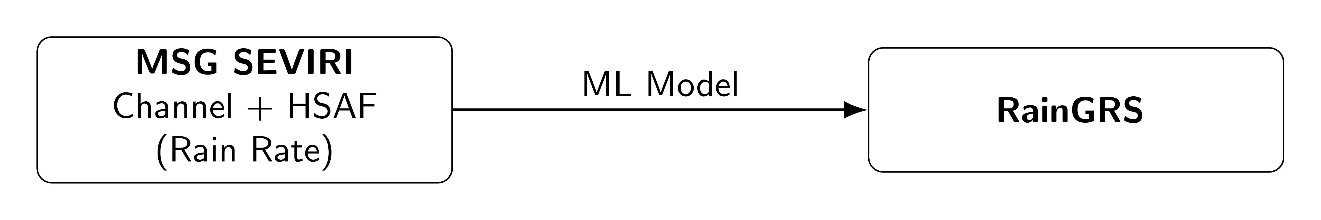
Motivation
TEMAT SLAJDU
Estimation of precipitation is important from both meteorological and hydrological perspectives, especially for understanding and forecasting hazardous events such as floods.
There are three reasons why we decided to apply the H60 correction:
To improve precipitation estimation over a larger domain surrounding Poland.
Satellite observations may provide additional information about precipitation compared to ground-based observations.
We plan to use the corrected H SAF product as input for precipitation nowcasting.

Slide 3
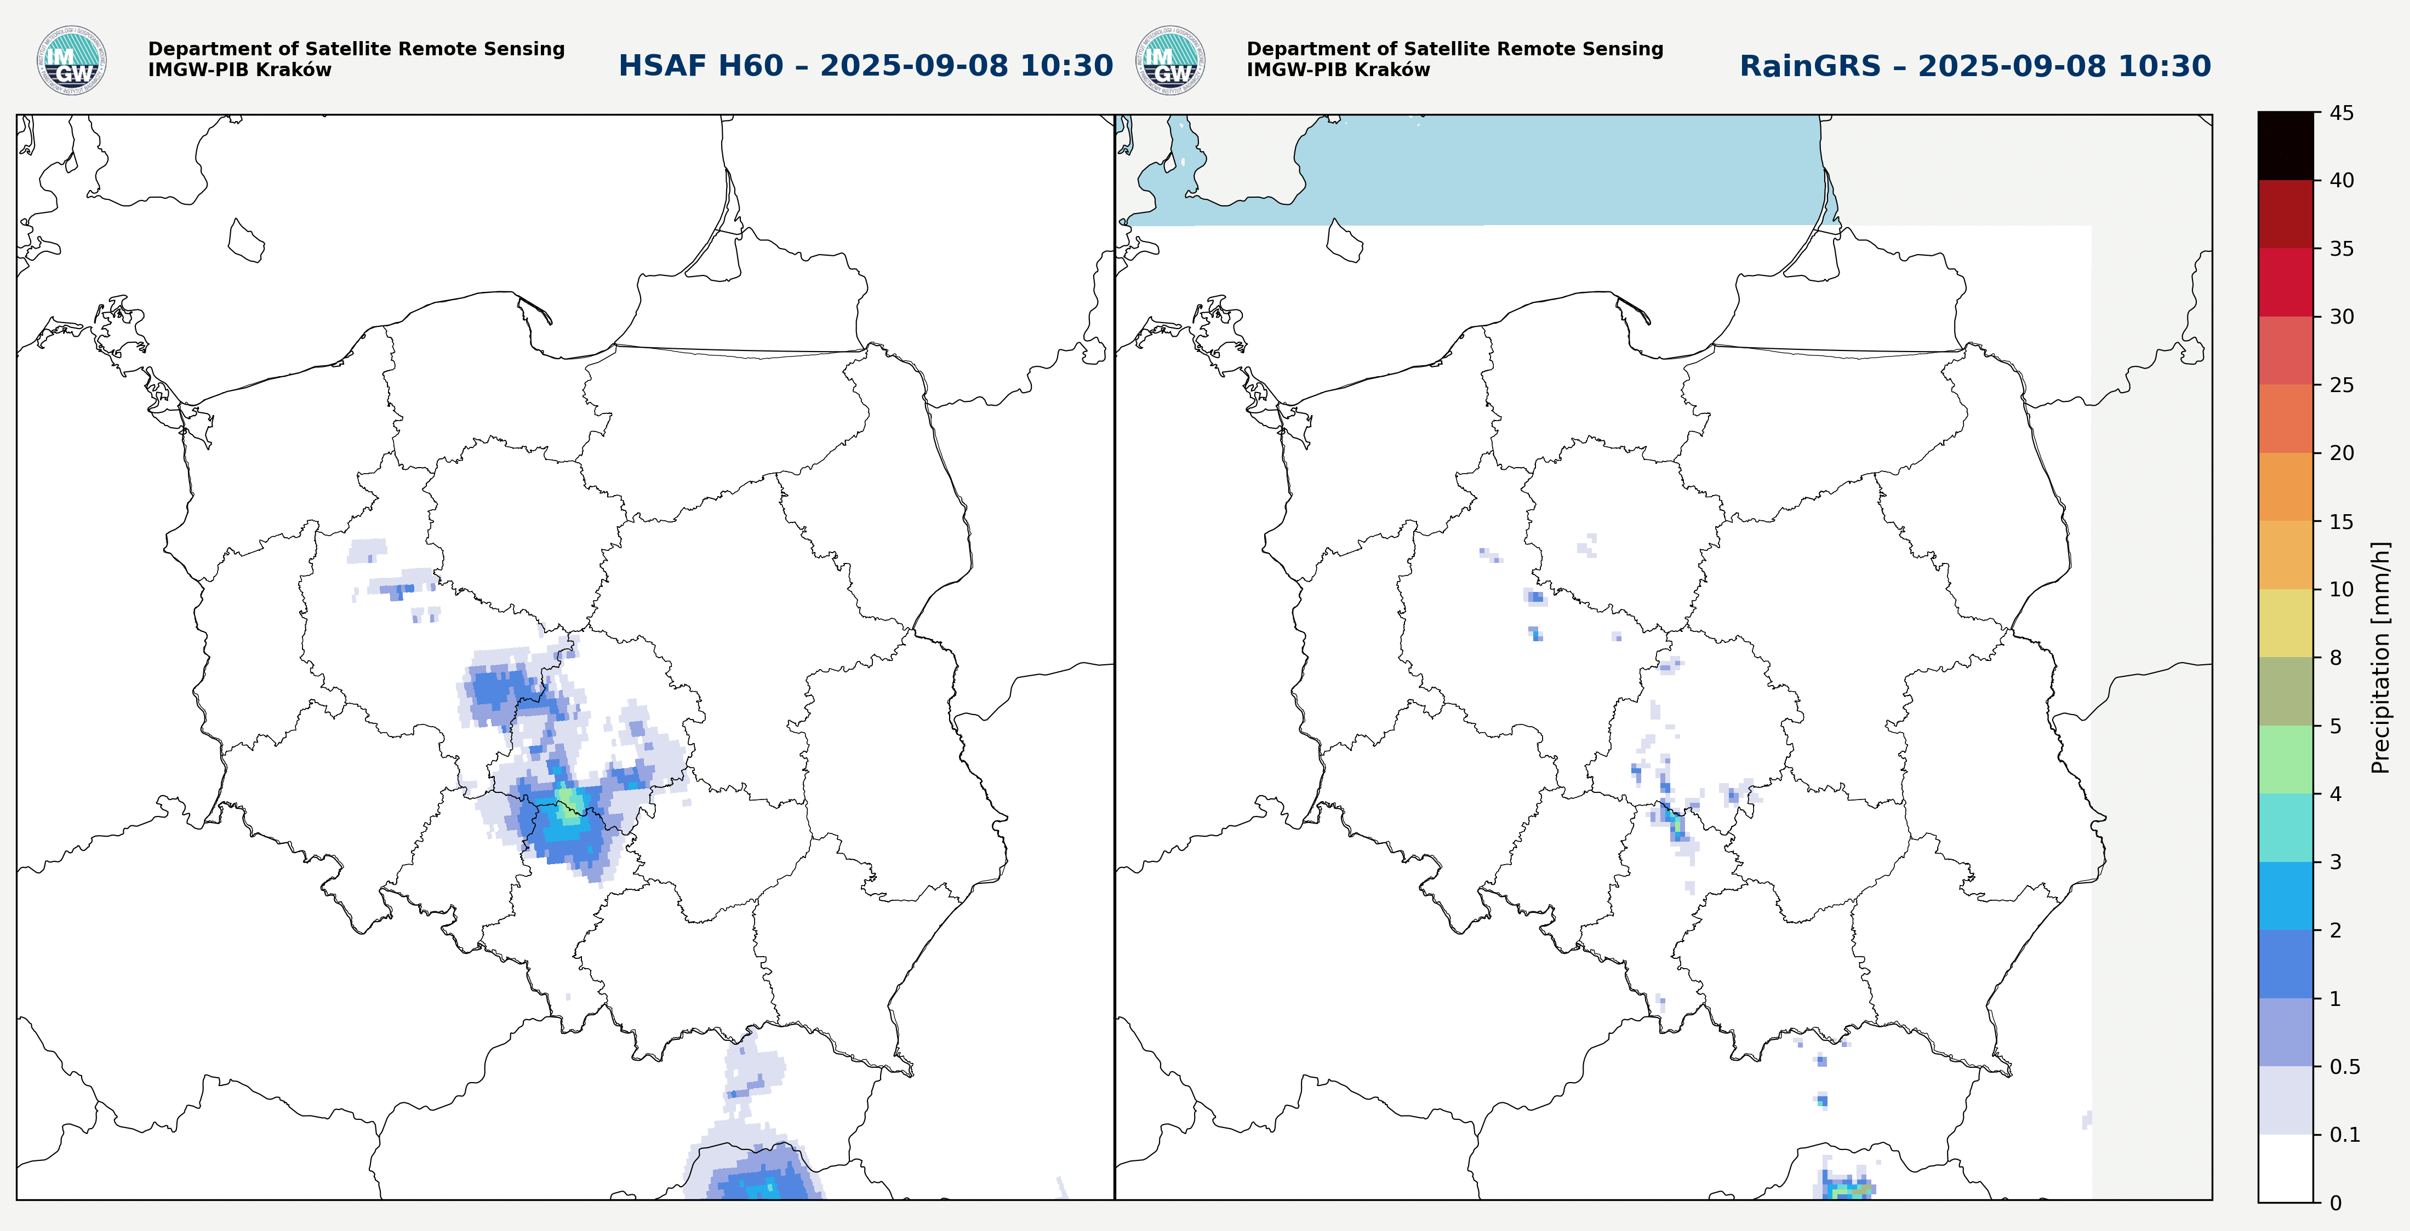
Motivation
TEMAT SLAJDU
In Poland, we use the RainGRS product, which combines information from weather radar, raingauges, and satellite data (to a very limited extent, NWCSAF Precipitating Clouds).
In our analysis, we focus on the midlatitude region (Central Europe) and use ground-based data to correct the H60 (Rain rate) precipitation product.
The H60 product tends to both overestimate and underestimate precipitation in terms of rainfall intensity (RR) and spatial extent.

Slide 4
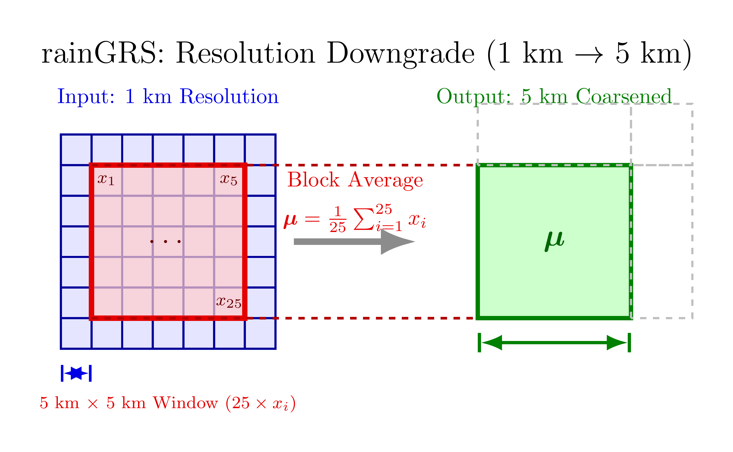
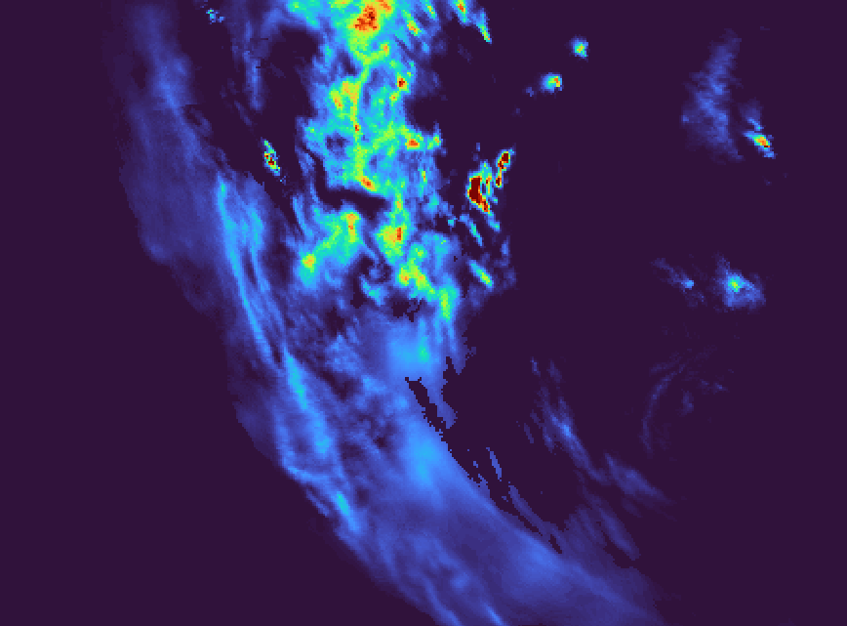
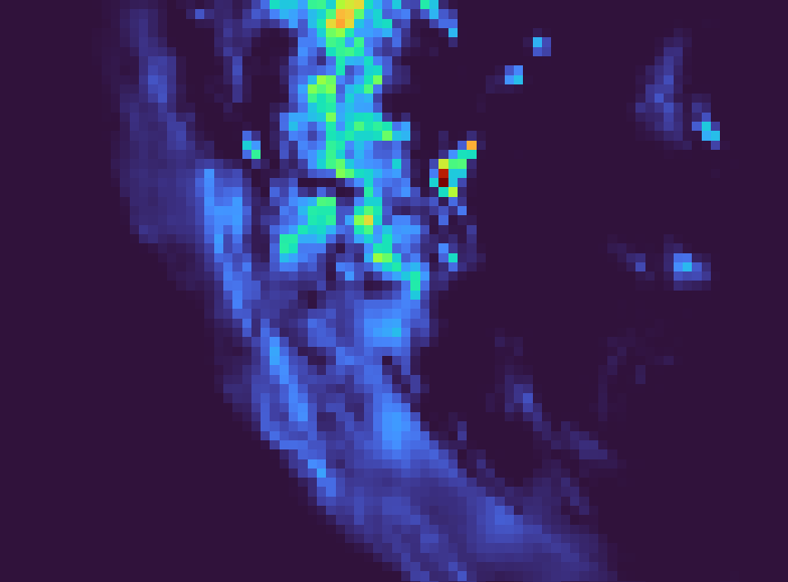
Data Preparation
TEMAT SLAJDU
Because MSG channels have a different resolution than RainGRS, we downgrade RainGRS by averaging pixels to match the MSG resolution.

Slide 5
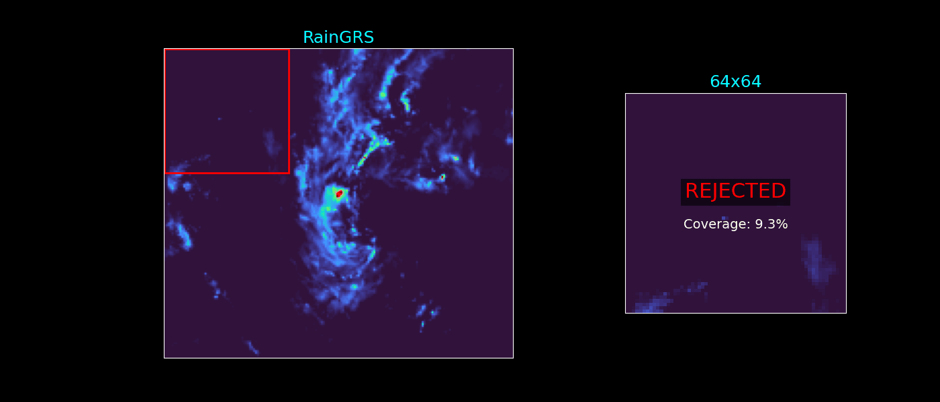
Data Preparation
TEMAT SLAJDU
We generate multiple 64×64 images from all MSG channels, RainGRS, and H60 by dividing the original domain into overlapping tiles (50% overlap). Tiles are accepted only if at least 10% of the pixels contain precipitation; otherwise, they are rejected.

Slide 6
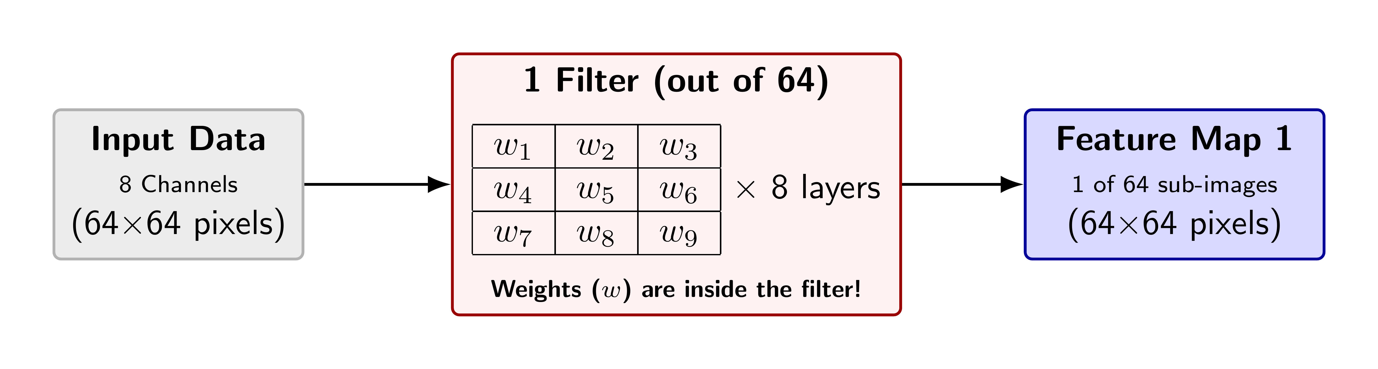
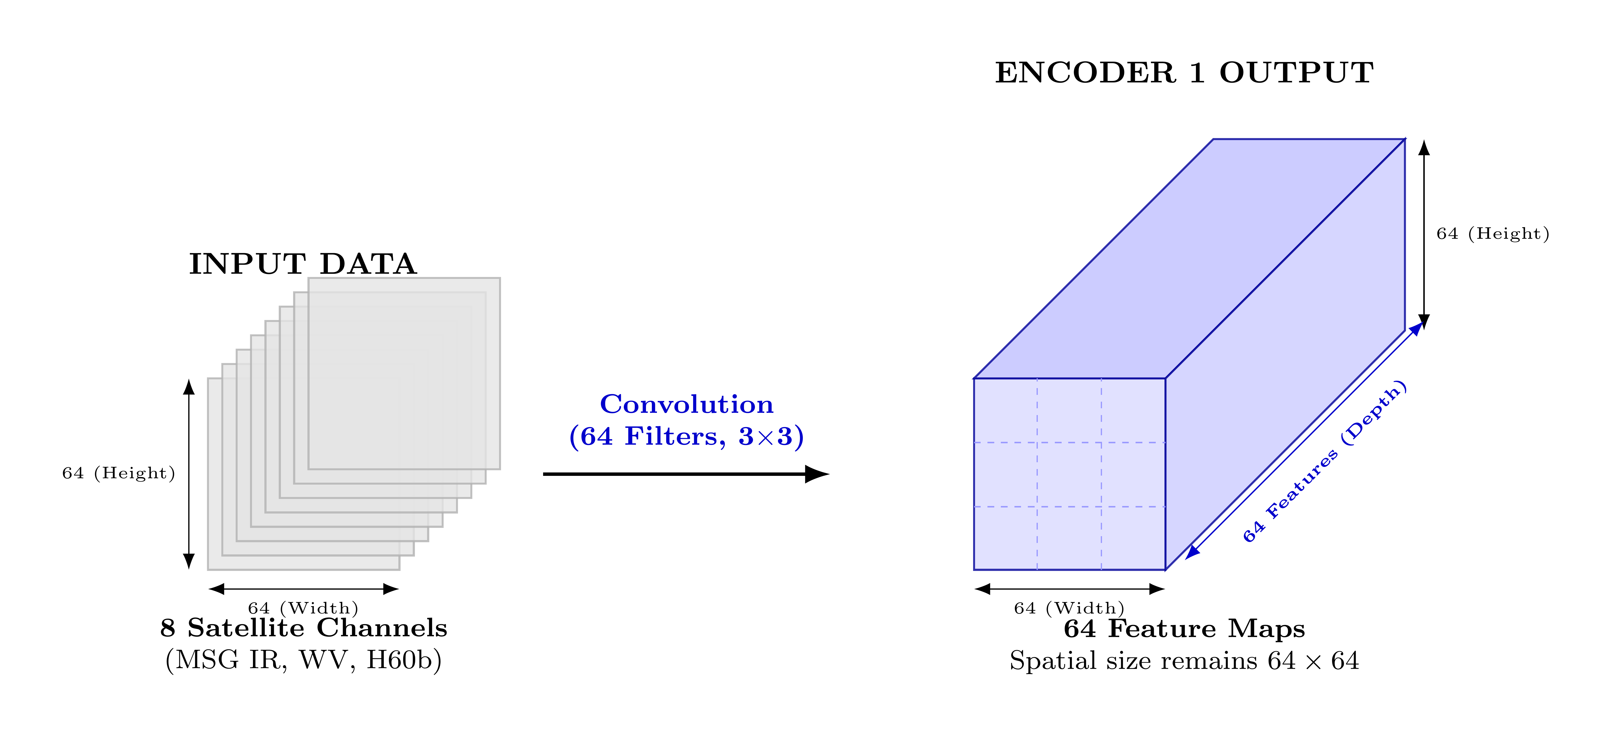
UNET model
TEMAT SLAJDU
U-Net is a deep convolutional neural network widely used for image analysis.
It consists of two parts: an encoder that reduces the image size and learns features, and a decoder that reconstructs the image to full size and produces pixel-level predictions.
It also uses skip connections between the encoder and decoder to transfer feature maps and preserve fine spatial details.

Slide 7
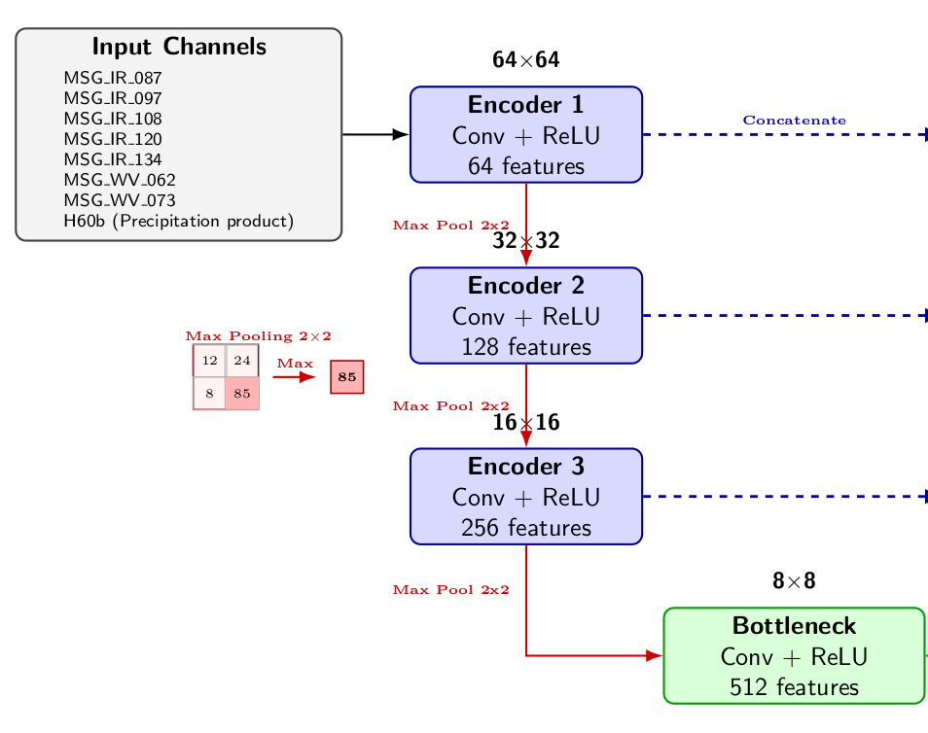
UNET model
TEMAT SLAJDU
Encoder
1. Input Data: The network takes a 64×64 image containing 7 MSG channels (infrared, water vapor, and precipitation data) + H60.
2. First Features: 64 different filters scan the input to look for basic shapes and edges, creating 64 sub-images (64×64).
3. Downsampling (Encoder): Max Pooling shrinks the image size step-by-step (64→32→16→8) to see the bigger picture, while the filters double (64→128→256) to find more complex weather patterns.
4. Bottleneck: At the very bottom, the image is at its smallest (8×8), but has the most filters (512). This is where the model analyzes global structures.

Slide 8
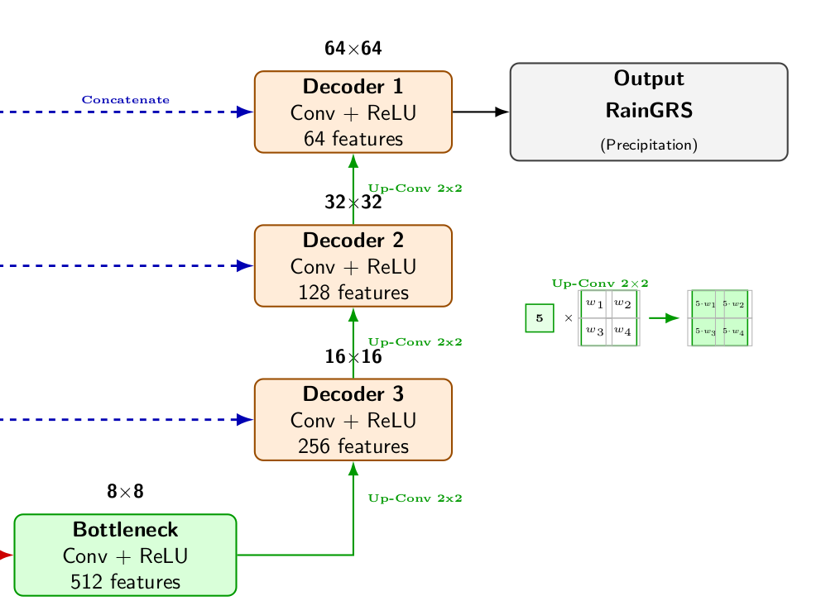
UNET model
TEMAT SLAJDU
Decoder
5. Upsampling (Decoder): The network reverses the process and enlarges the image size back up (8→16→32→64) to rebuild the original resolution.
6. Skip Connections: The model copies the sharp, detailed sub-images from the Encoder and pastes them directly into the Decoder.
7. Final Output: A final layer blends the data into 1 single image (64×64), where every pixel represents the calculated rain rate (RainGRS).

Slide 9
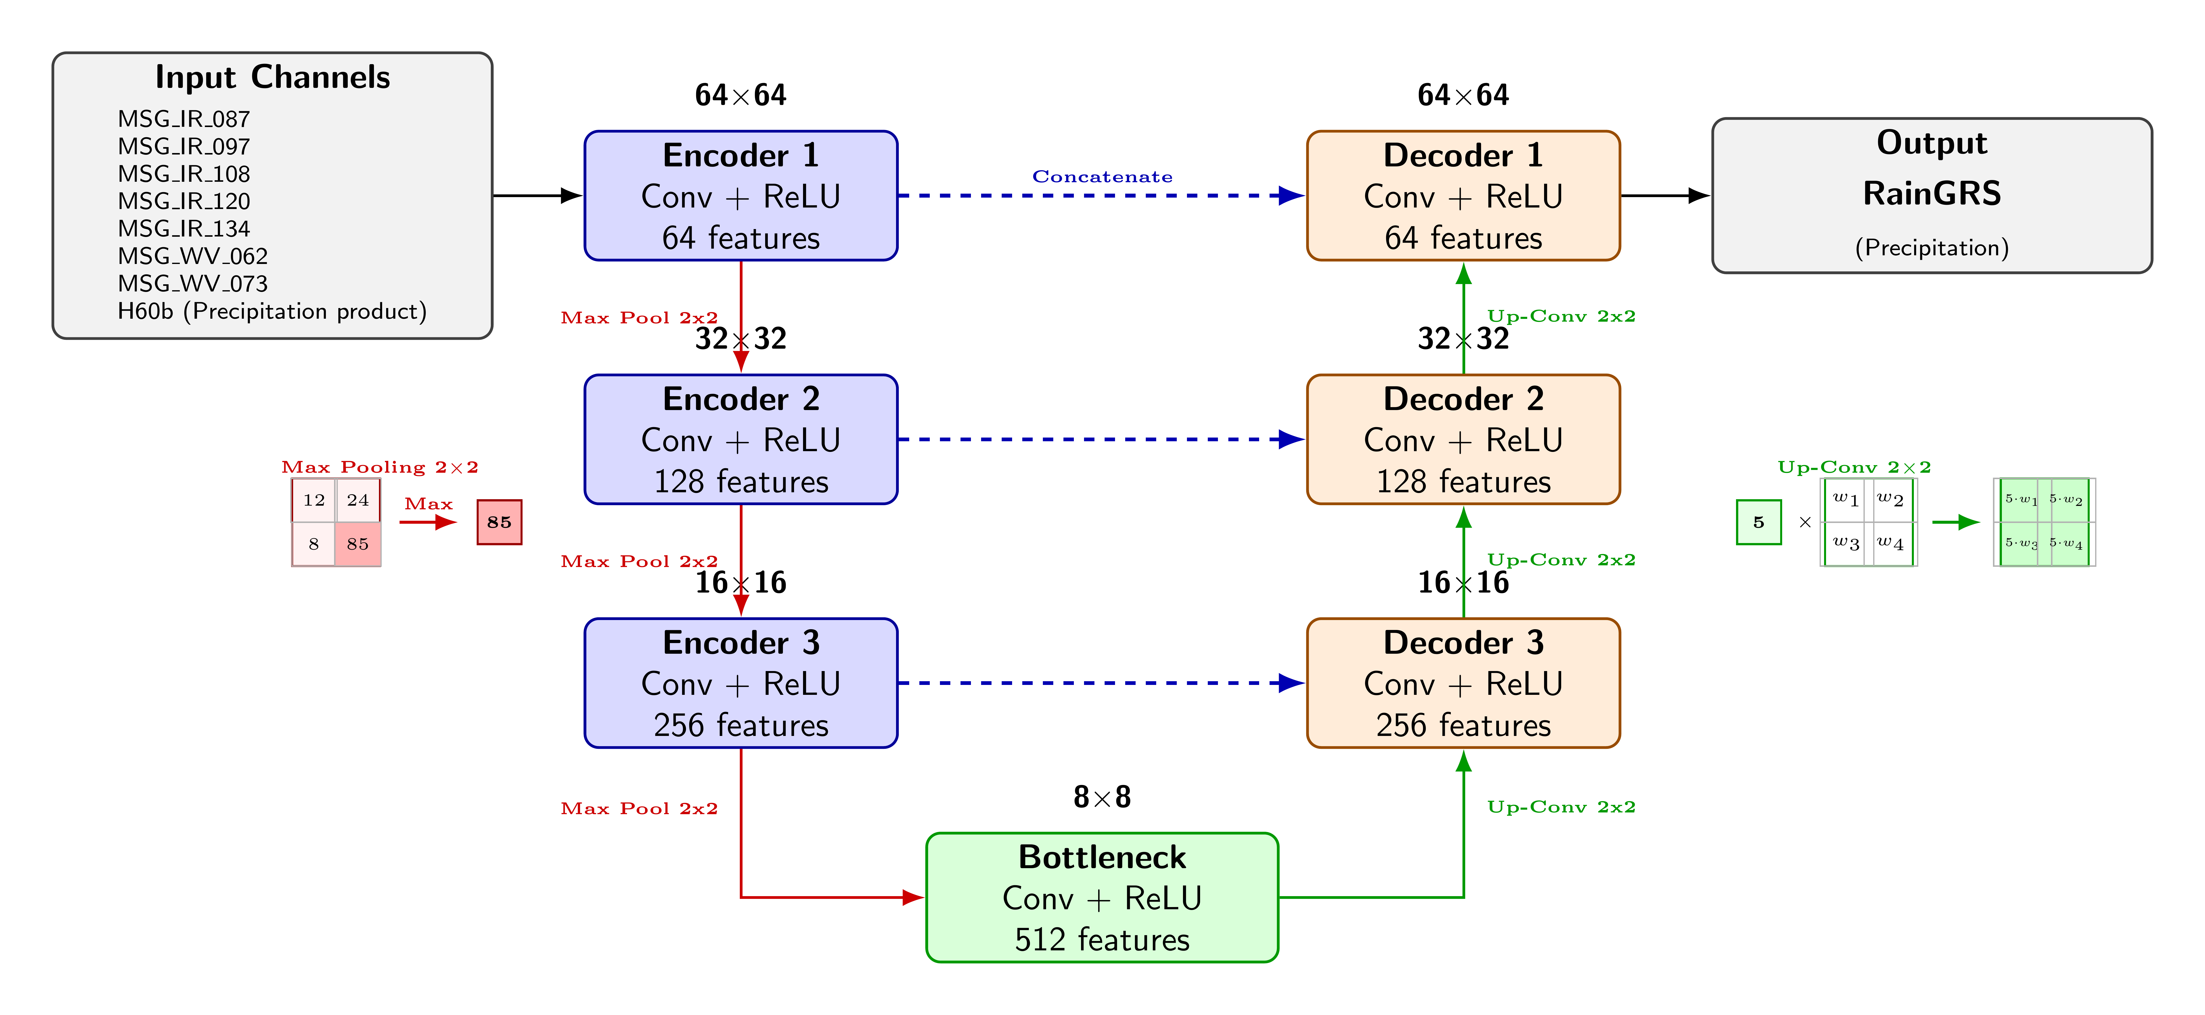
UNET model
TEMAT SLAJDU

Slide 10
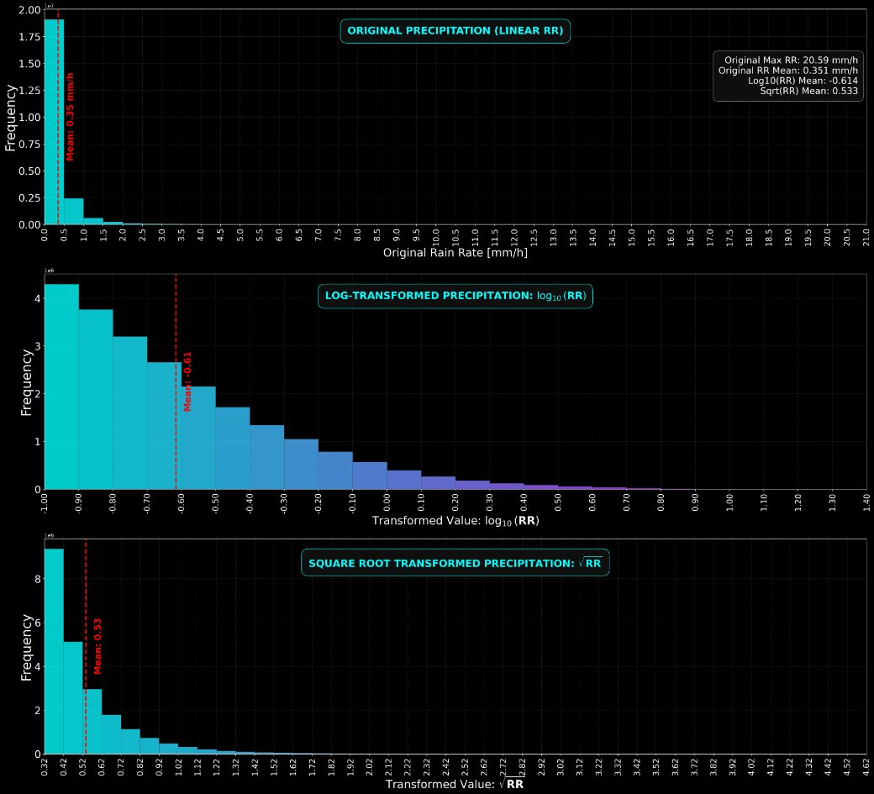
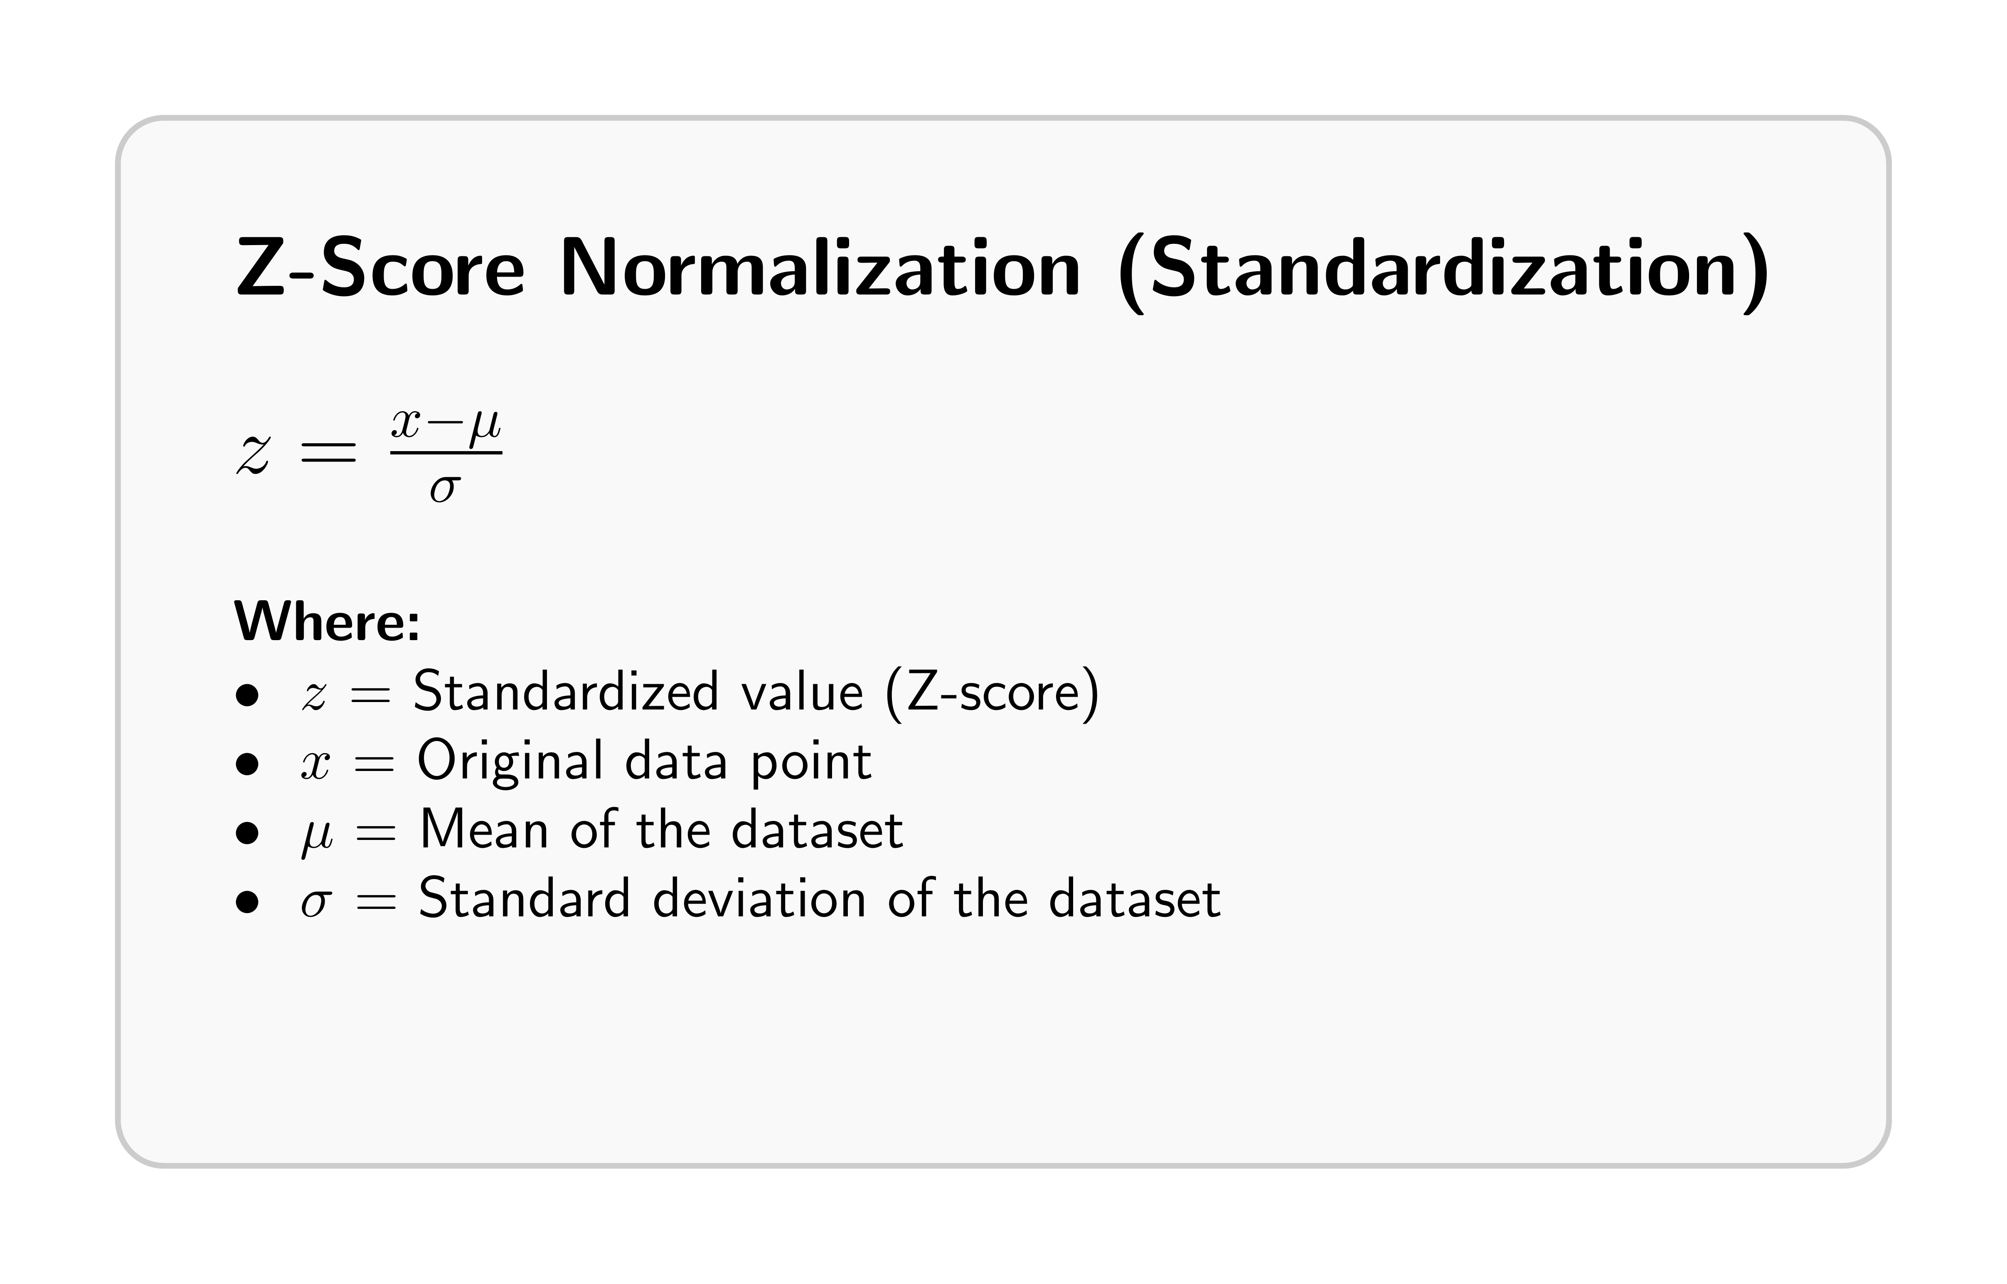
UNET model – normalization
TEMAT SLAJDU
One of the most important parts of data preparation for U-Net is normalization.
The distribution of precipitation is highly skewed, with a long tail toward higher rain rates, so we apply a logarithmic transformation.

Slide 11
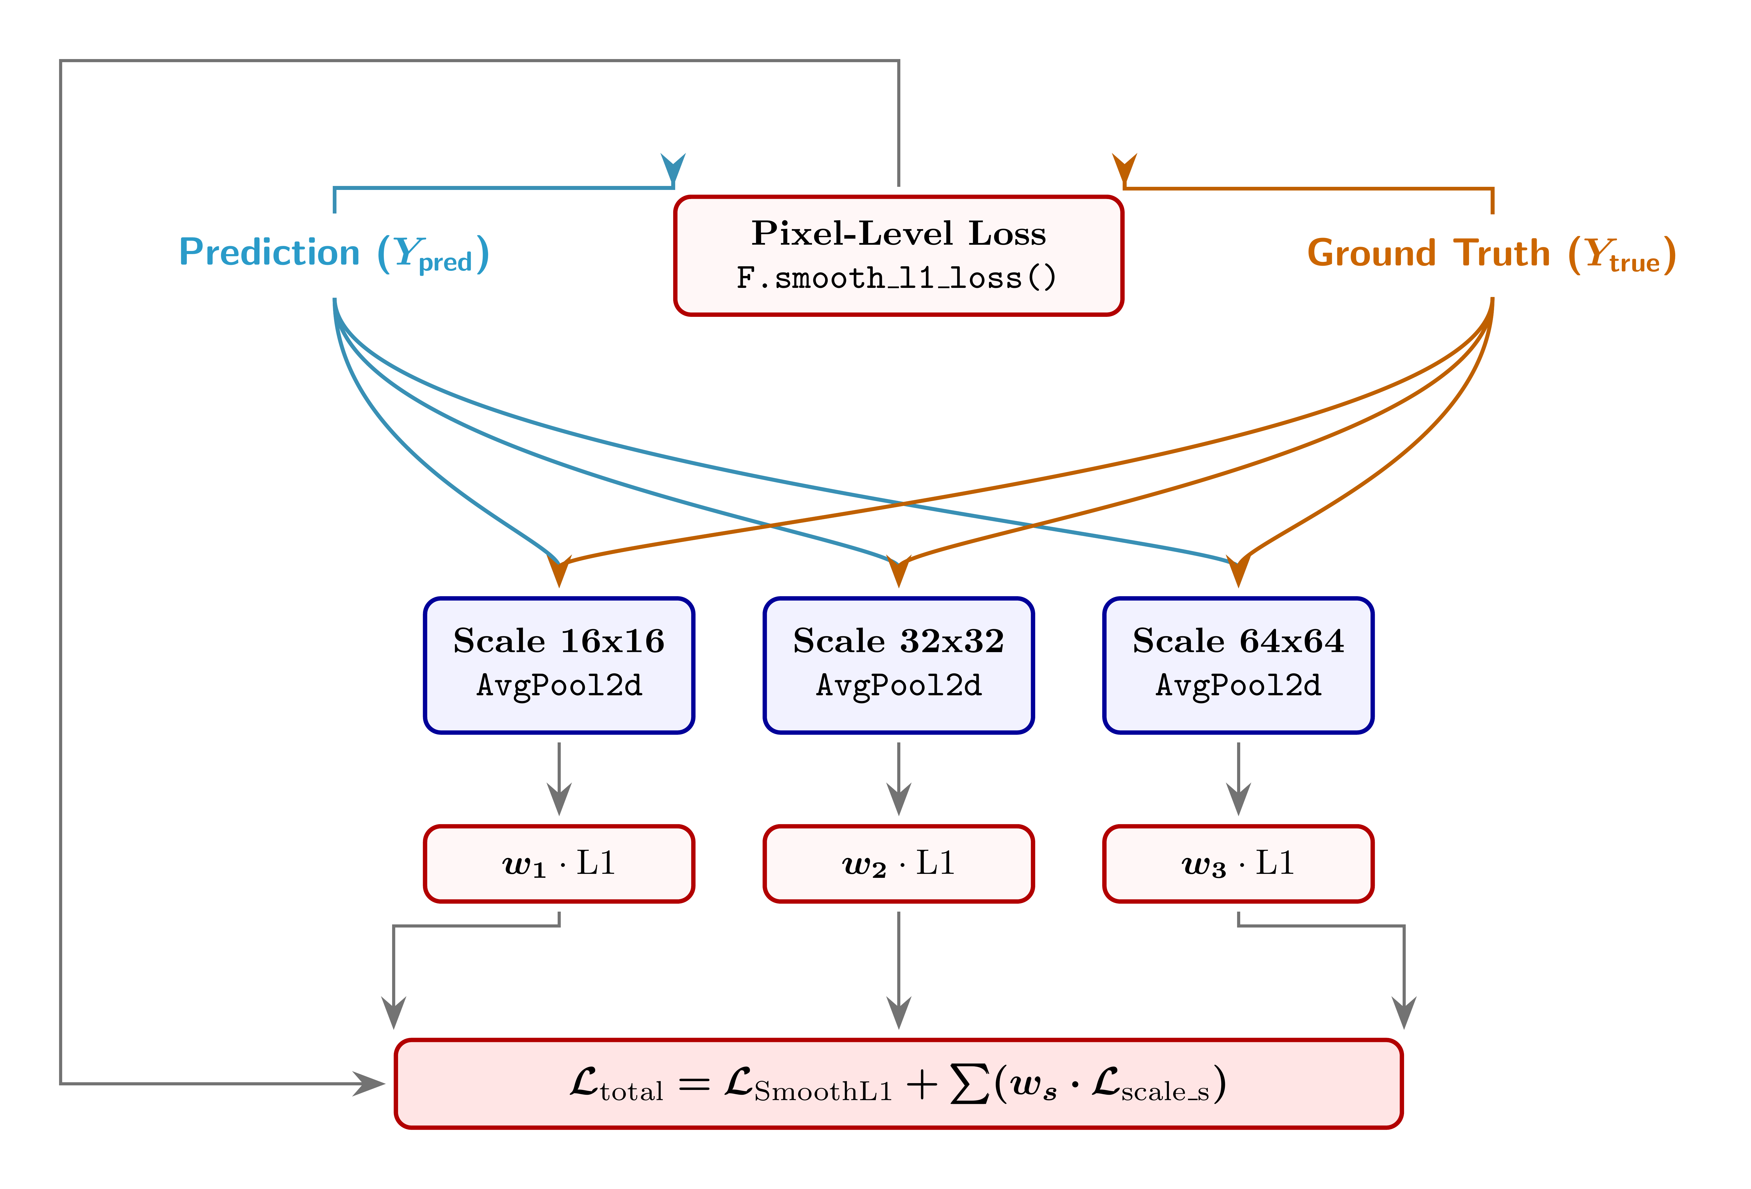
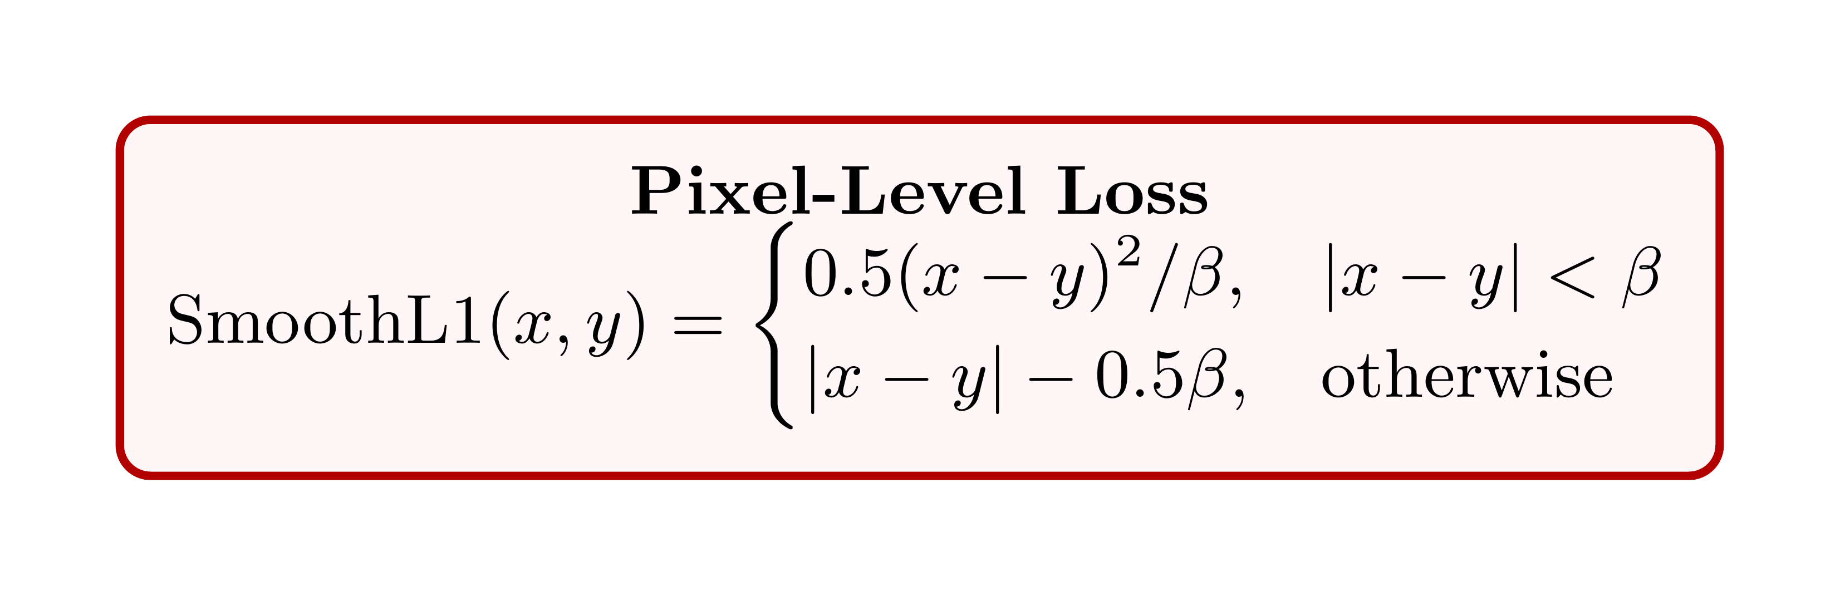
UNET model – loss function
TEMAT SLAJDU
We extend the standard pixel-to-pixel loss function with an additional term enforcing consistency of average pixel intensities across different scales.

Slide 12
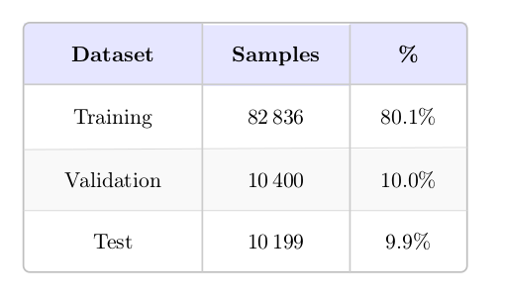
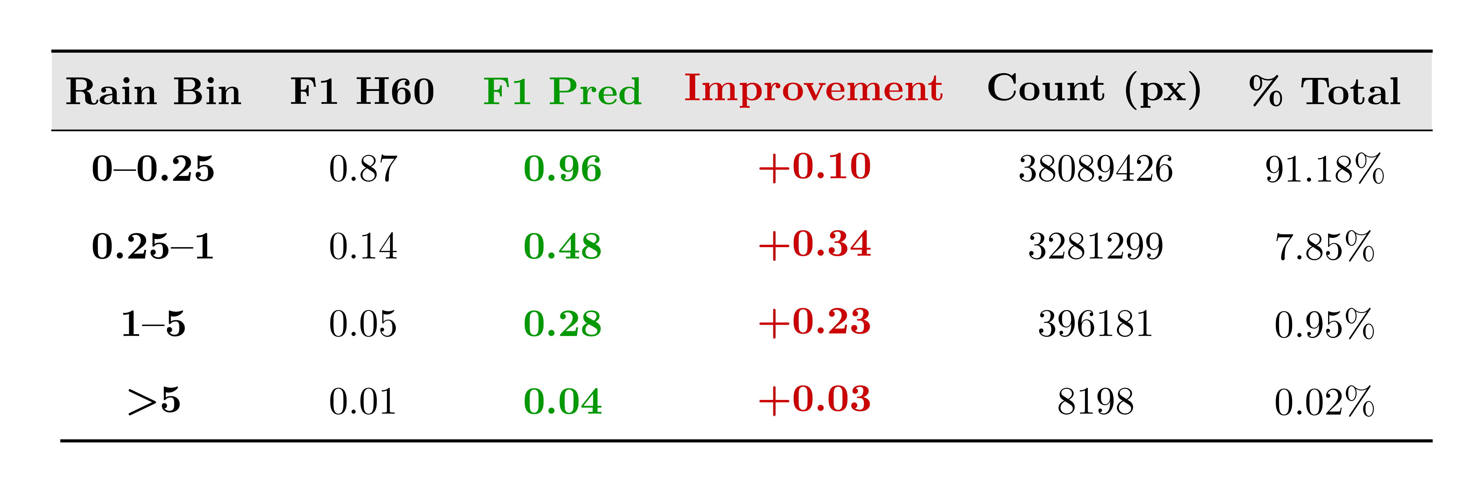
Results
TEMAT SLAJDU
We collected data from 2022 to 2025 and used them in our U-Net model.
We used the F1 score to evaluate the model (F1 score ∈ [0, 1], where 1 indicates a perfect score).
The F1 score is a demanding metric because it evaluates both precision and recall, requiring a balanced model performance!

Slide 13
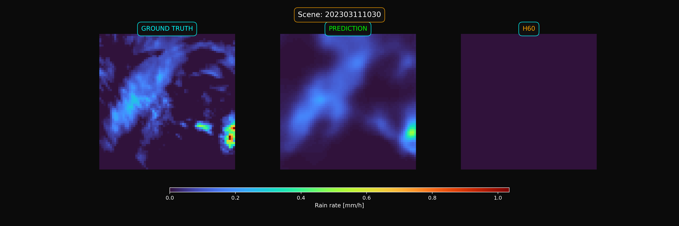
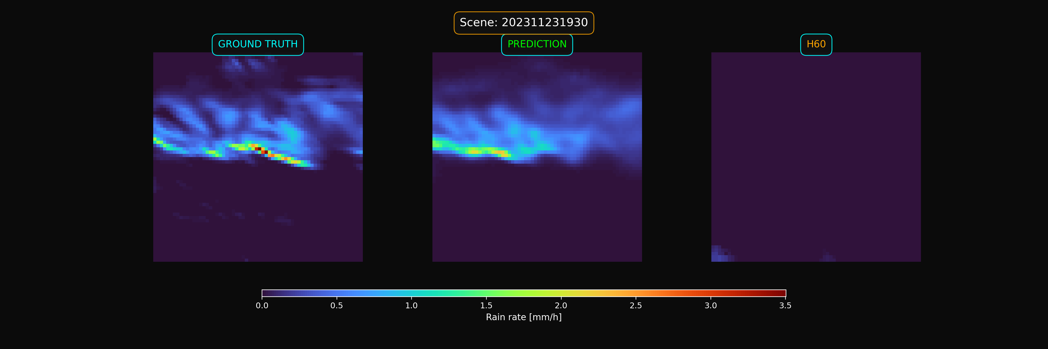
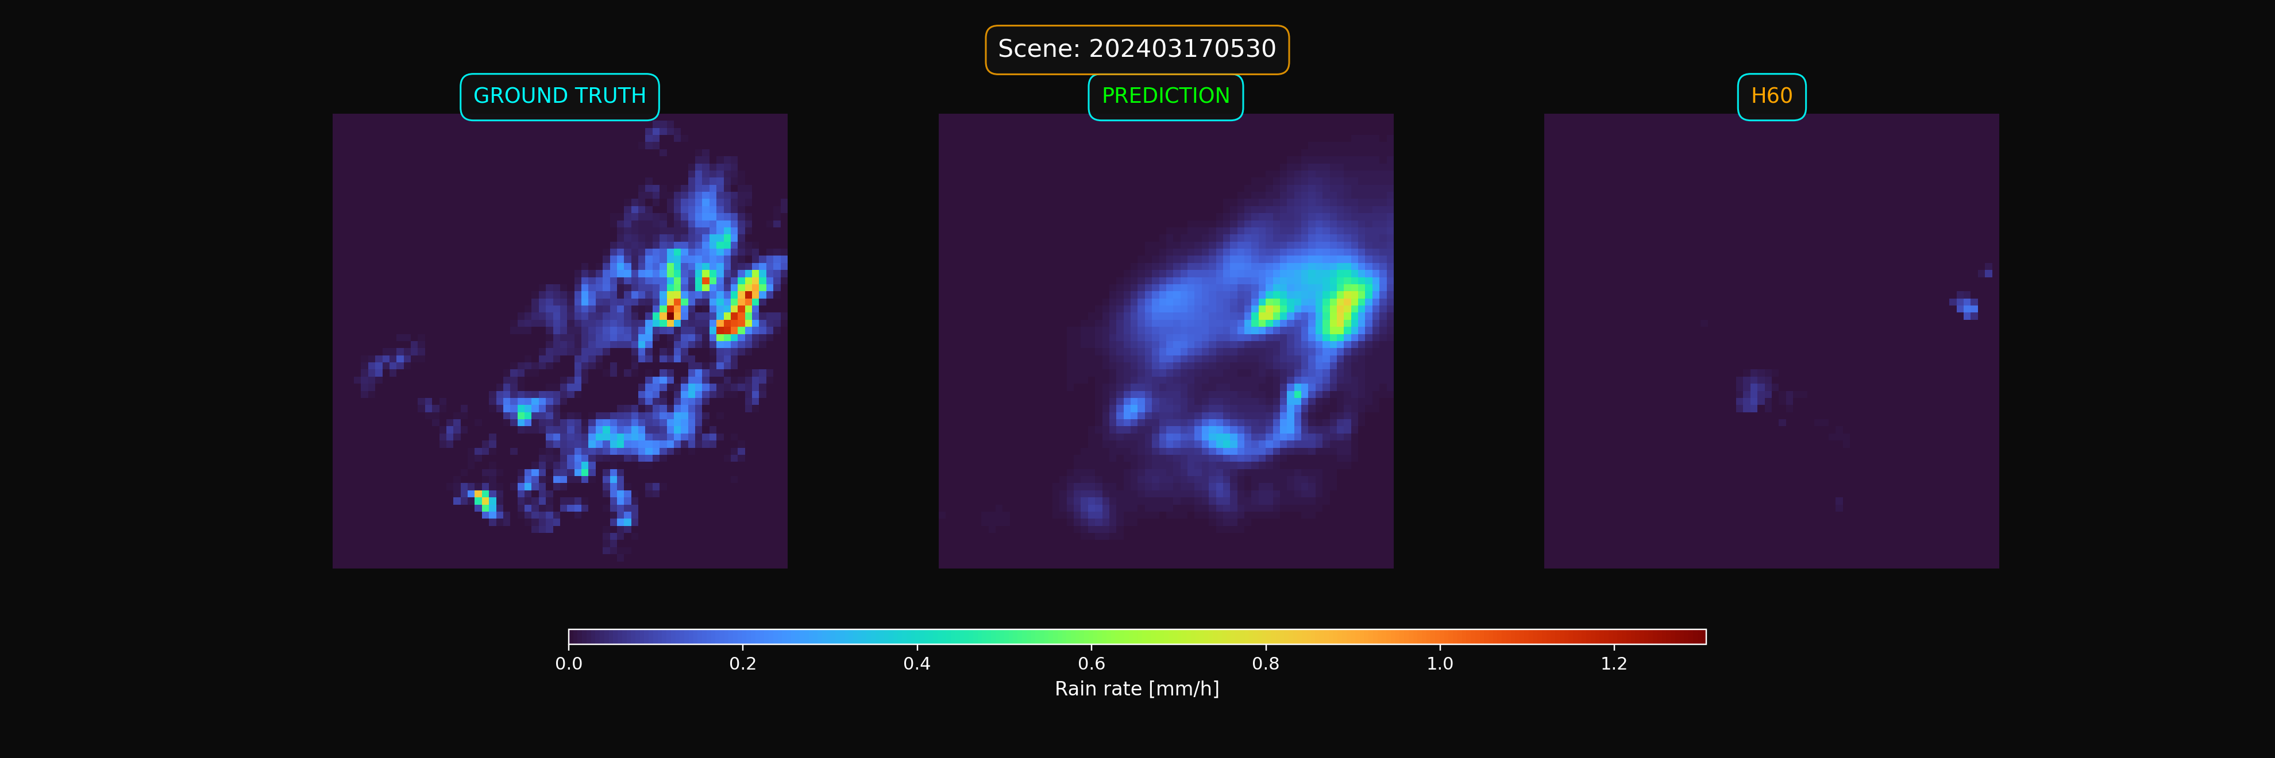
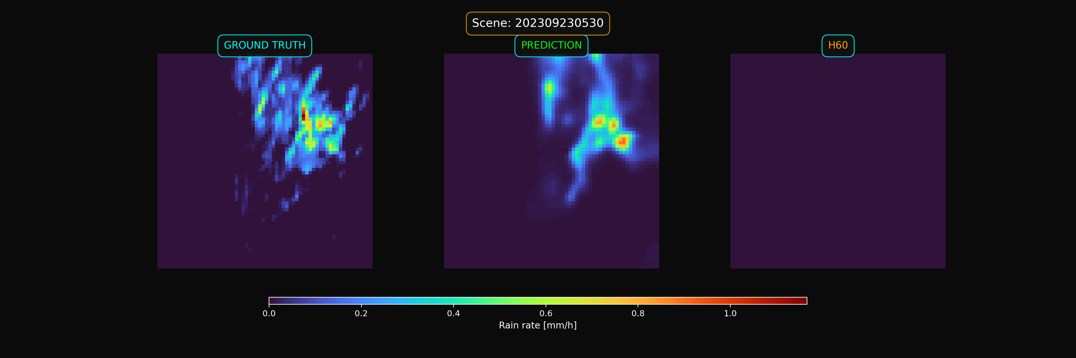
Results
TEMAT SLAJDU
Example results comparing H60, ground truth (GT), and model predictions for a case where no H60 precipitation is detected.

Slide 14
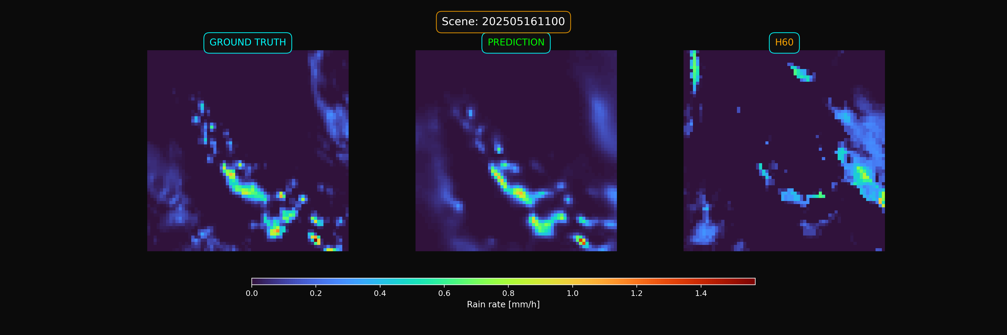
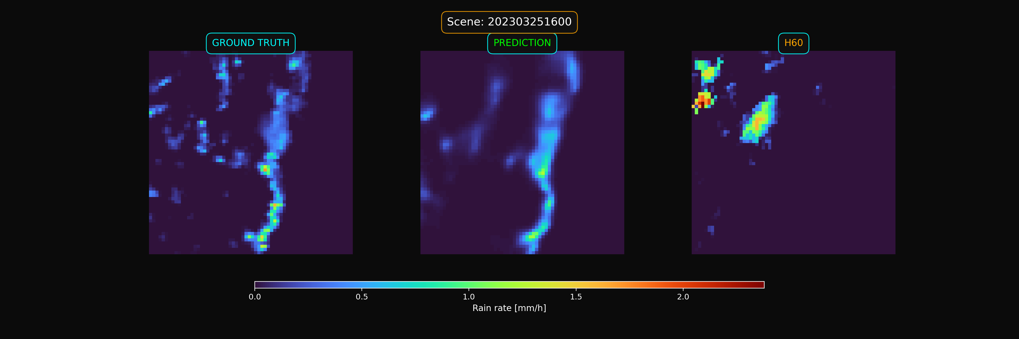
Results
TEMAT SLAJDU
Example results showing good agreement between the model-predicted precipitation distribution and the ground truth (GT).

Slide 15
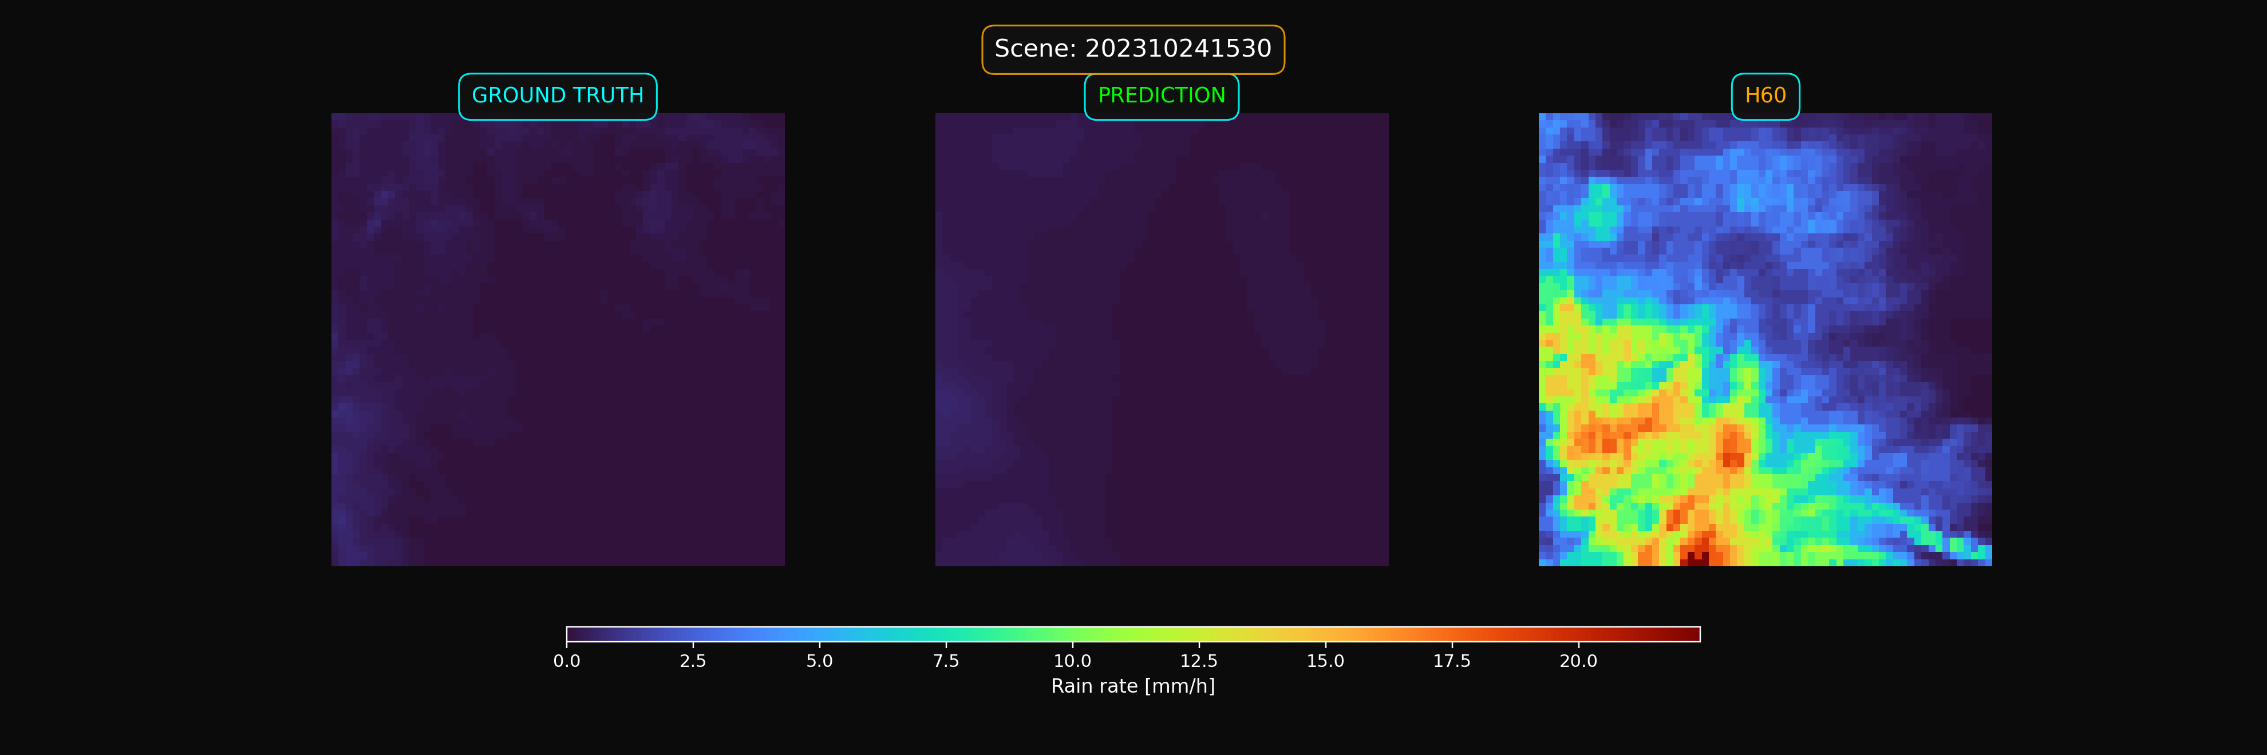
Results
TEMAT SLAJDU
Example results showing a case where both the GT and model predictions detect no precipitation, while H60 shows a large area of strong precipitation.

Slide 16
Thank you
Tobiasz Górecki
08.07.2026​
Instytut Meteorologii i Gospodarki Wodnej – Państwowy Instytut Badawczy
Institute of Meteorology and Water Management – National Research Institute
01-673 Warszawa, ul. Podleśna 61 | tel.: +48 22 569 41 00 | fax: +48 22 834 18 01 | e-mail: imgw@imgw.pl | www.imgw.pl
Regon: 000080507 | NIP: 525-000-88-09

