Slide 1



Fully Connected Neural Networks for Radiative Transfer Emulation and Microwave Radiometer Quality Control
IPWG 12
Spencer Jones

Slide 2
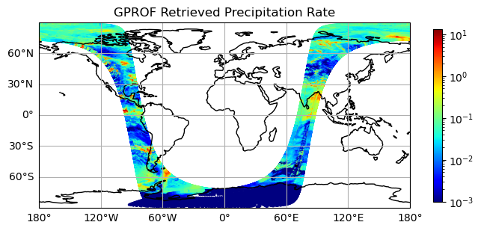
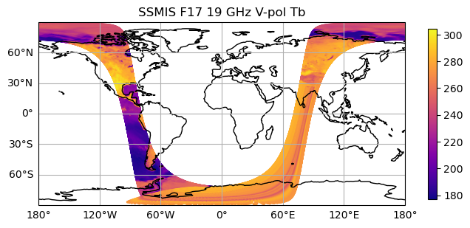
Part I: Machine Learning Quality Control (MLQC)
Motivations:
Need fast and effective QC for screening anomalous passive microwave observations prior to application
Need more sensitivity than traditional QC methods can offer
Need relatively small amounts of training data for quick implementation for new sensors
Notes:
Be nice if we could do this before being ingested into Level 2 products
Due to increased sensitivity of ML
Be nice if this could quickly be implemented for new sensors

Slide 3
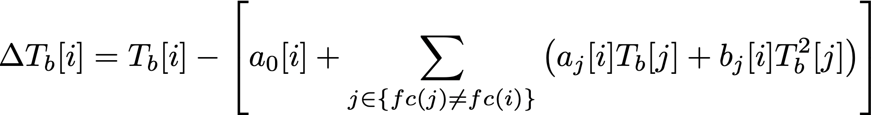
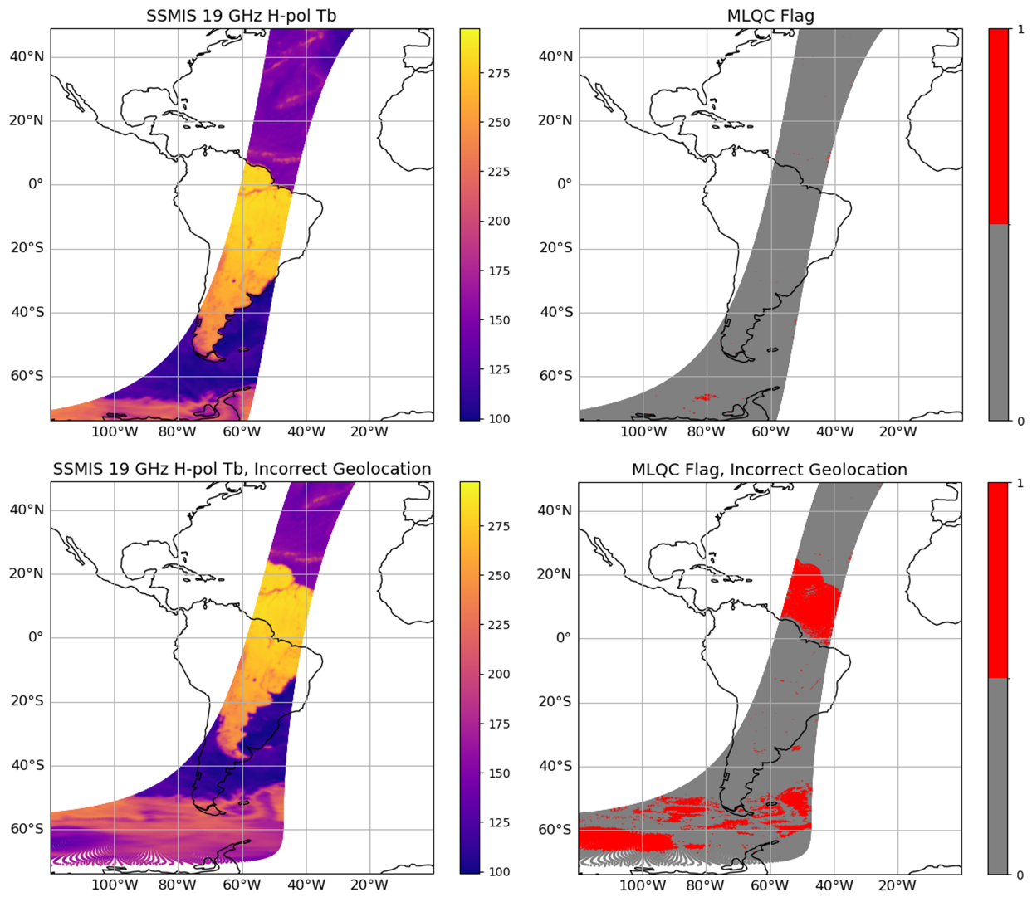
Concept builds on existing QC methods
Spectral difference:
Use correlations between channels
Climatology checks:
Use excessive violations of Tb climatology
Notes:
SD Takes advantage of correlations between channels
Bottom example is timestamp error
-keep track of Lat/lon based statistics of Tbs
Subtle RFI and anomalies can leak past these methods

Slide 4
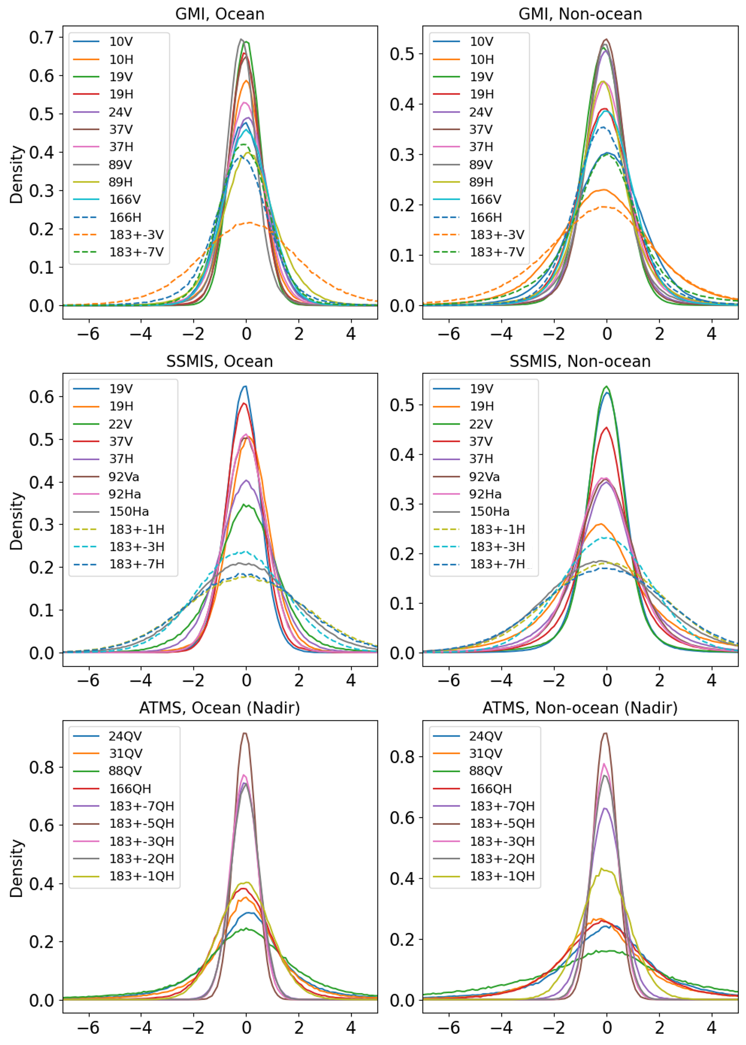
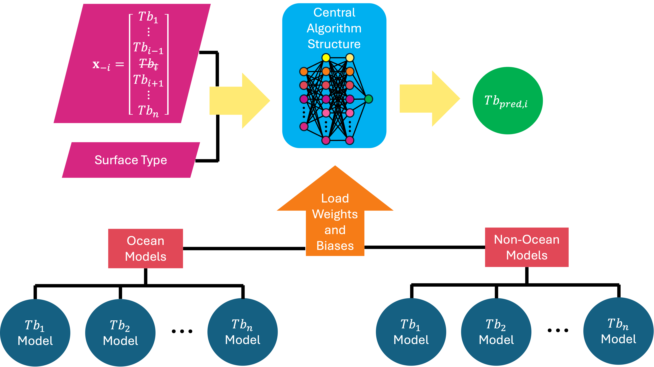

Fully Connected Neural Network Model Tree
Prediction Error ($σ)$
Notes:
Use n-1 channels to predict missing channel
Standardized predicted Tb can be used to flag errors
Generally Gaussian and unbiased

Slide 5
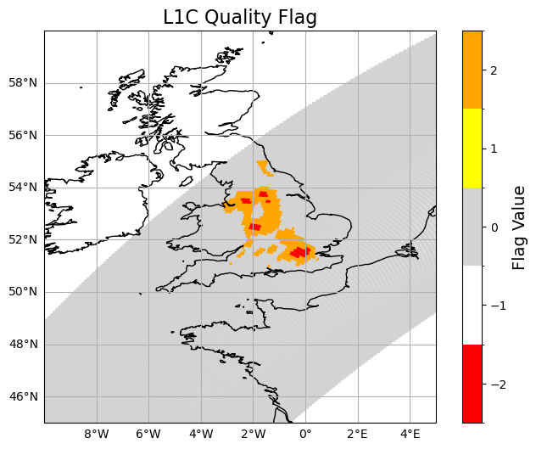
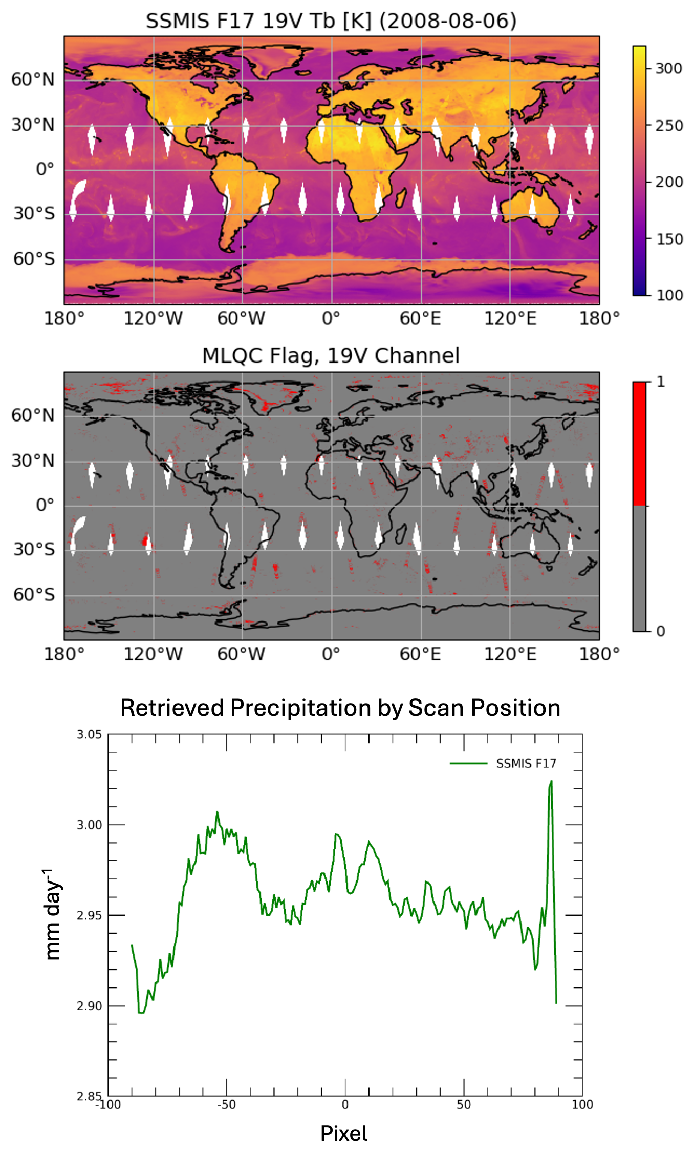
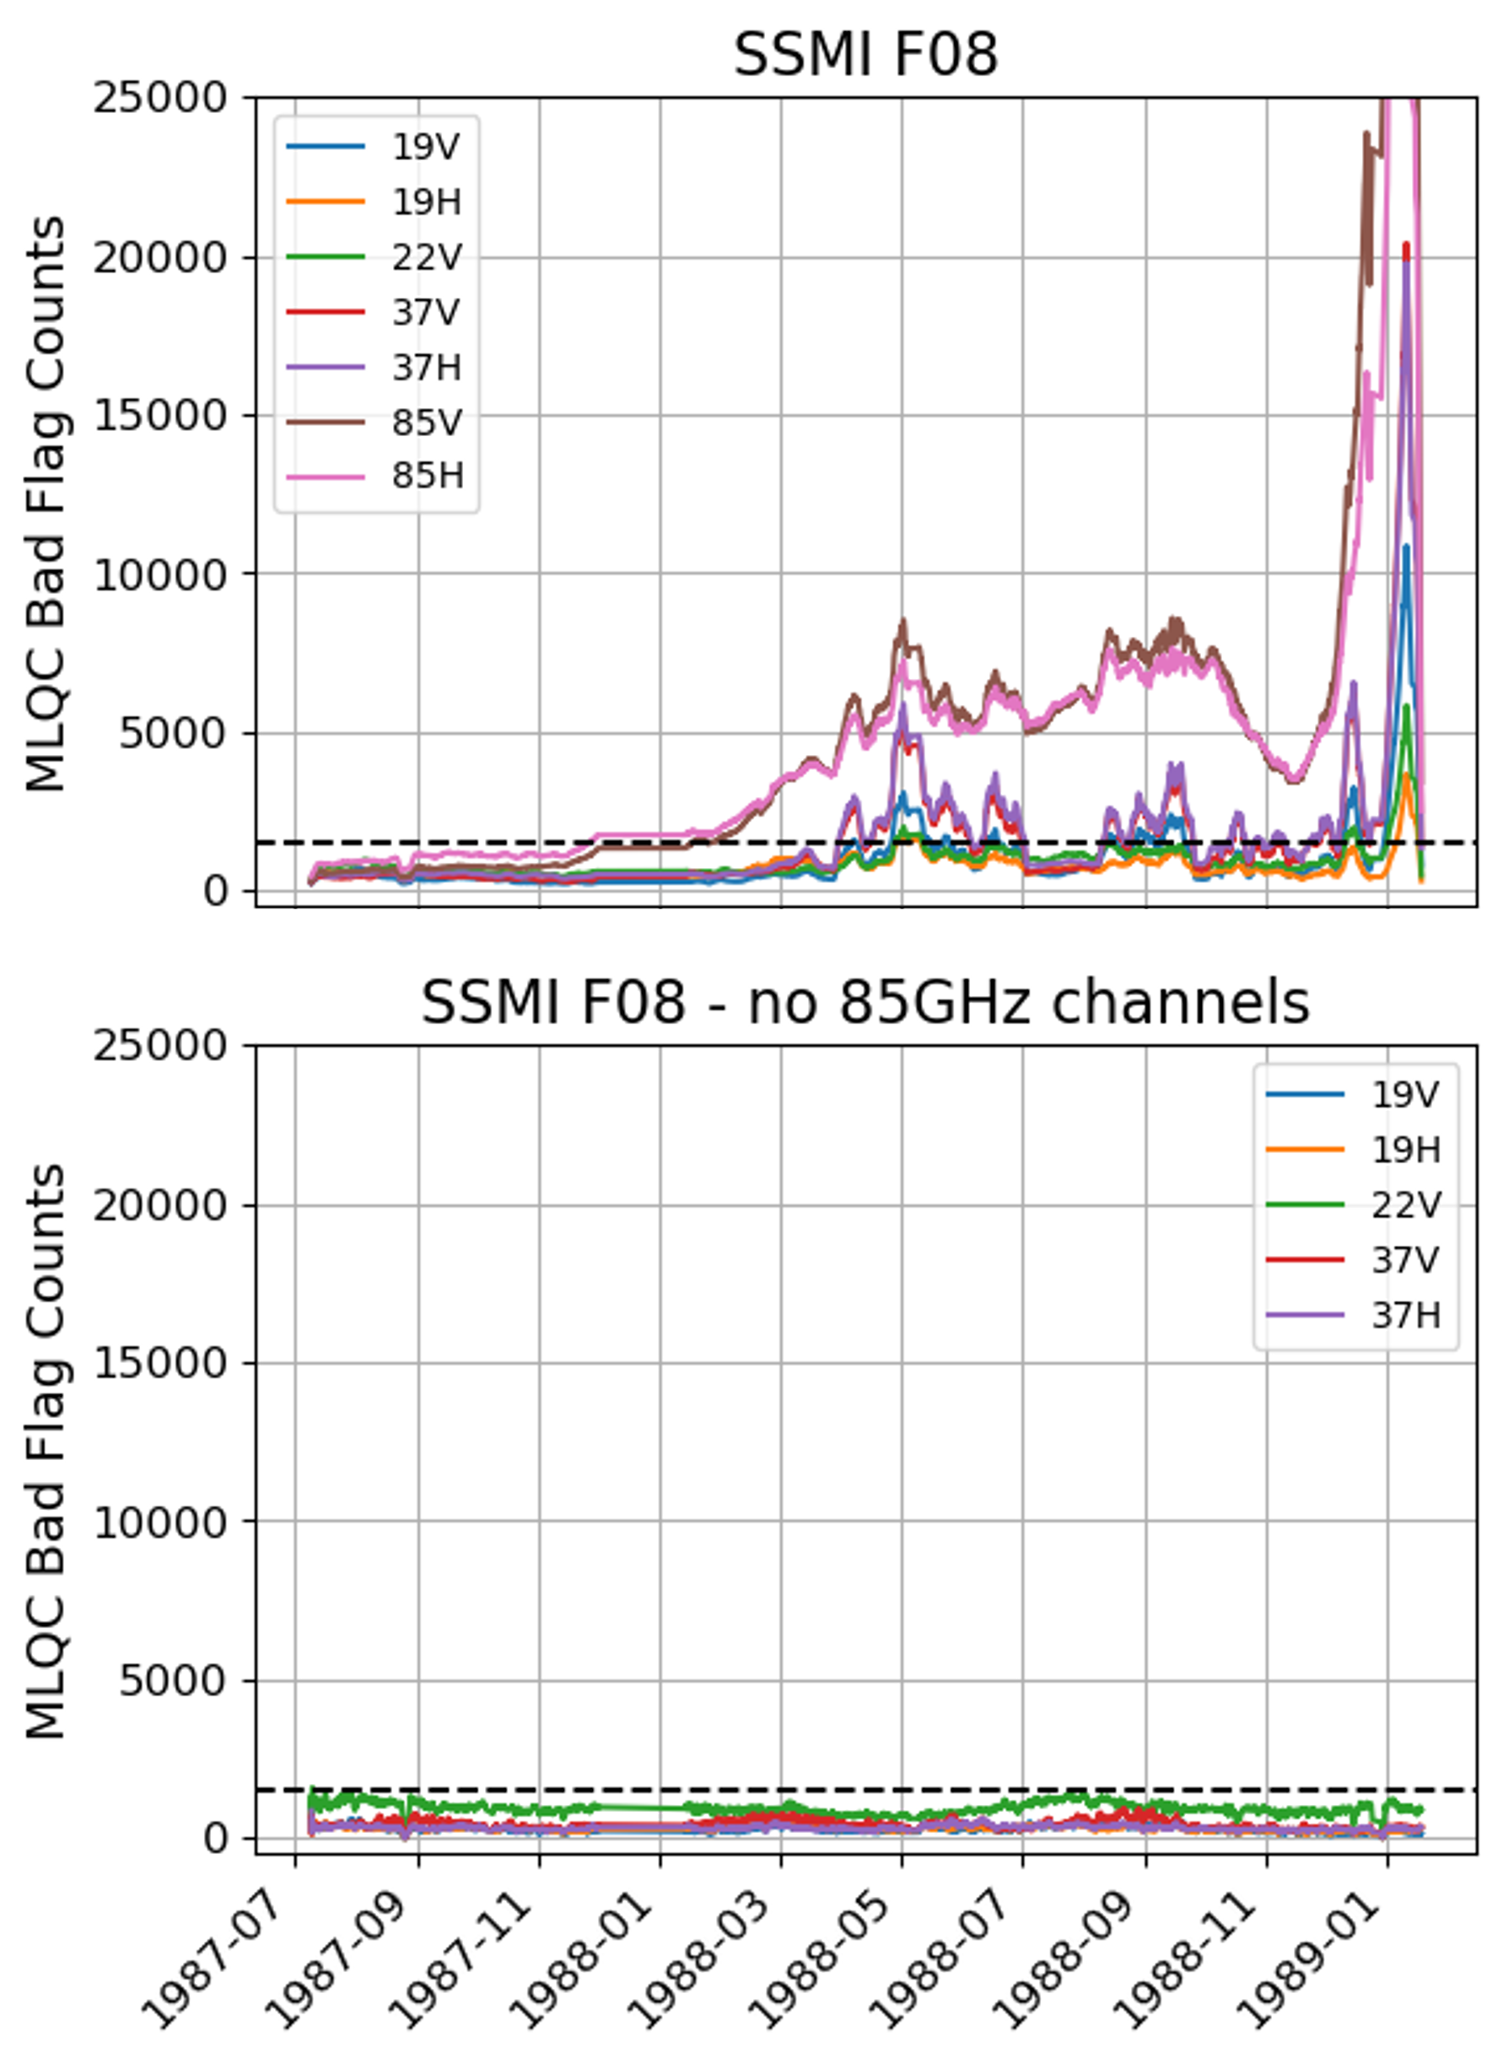
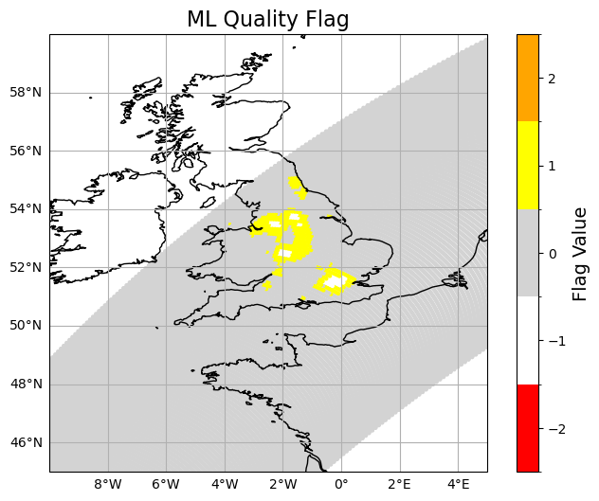
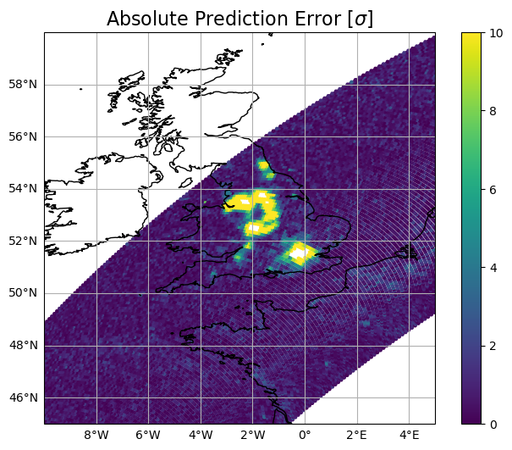
Notes:
Left: ground RFI in 10 GHz channel in GMI
Middle: channel failure in 85 GHz channel on F08
Right: another example effecting precipitation retrievals

Slide 6
Conclusions – Part I
MLQC Algorithm exploits poor prediction performance of NNs when predictors are out of sample
Prediction error thresholds can be used to flag bad data
Small amounts of training data (a few days of orbits are generally enough)
Error thresholds must be set for individual application
  Tradeoff between random noise and misses

Slide 7
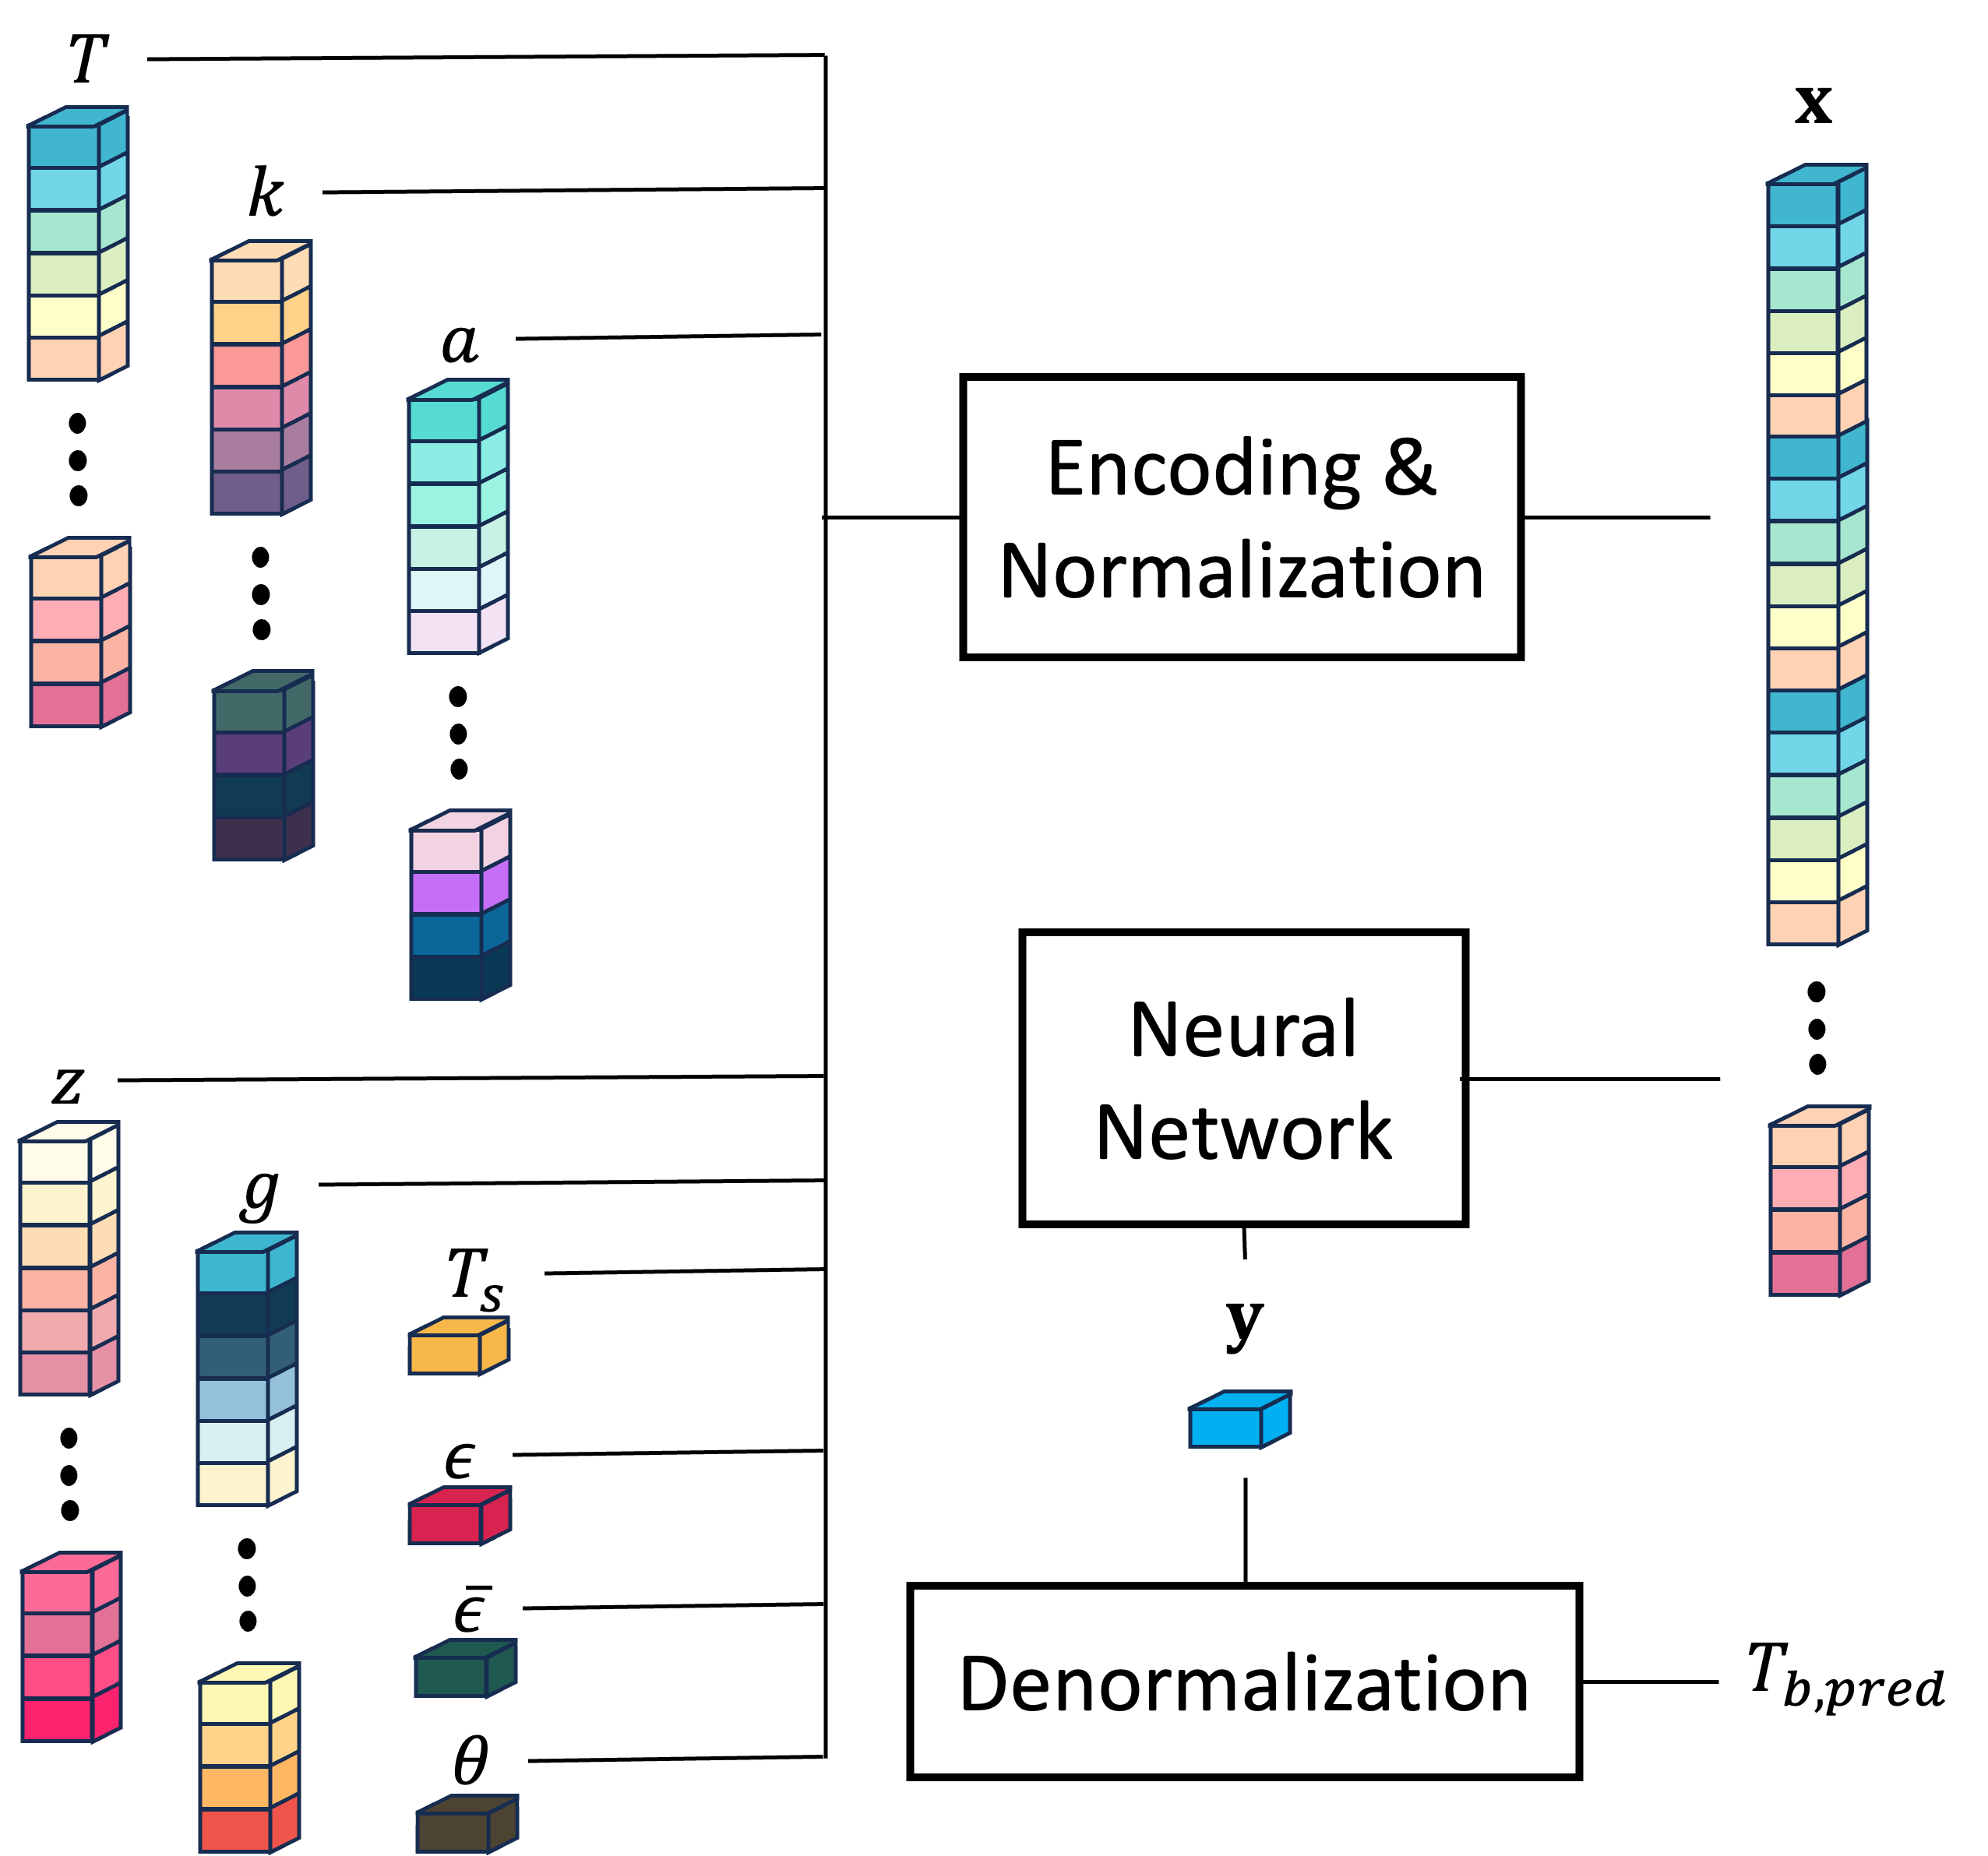
Part II: Core Radiative Transfer Emulation
Goals:
  Very fast radiative transfer for observational and DA applications
  Model error < sensor noise compared to reference scheme
  General radiative transfer emulation for simulated observations by future and proposed sensors
Solution:
  Train directly on optical properties

Slide 8
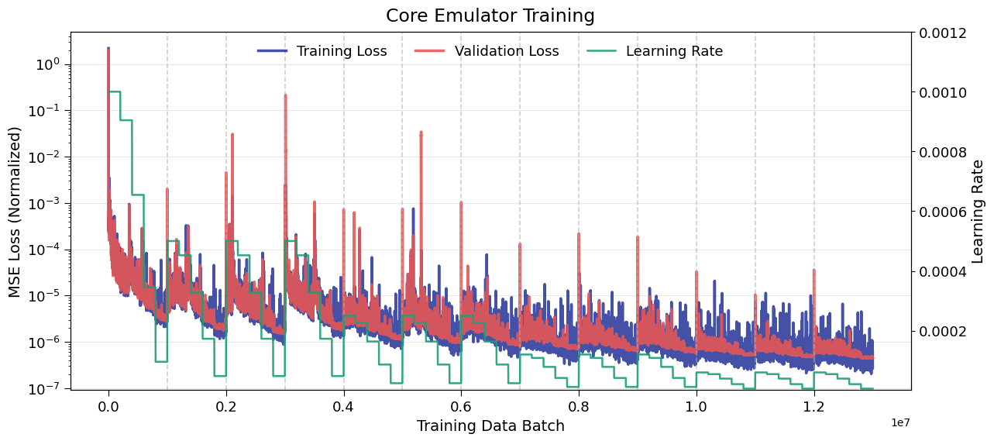
Training setup:
Training data built from microwave optical properties of ~100 million ERA5 atmospheric profiles
  Randomly assign frequencies, incidence angles, and particle size distribution parameters
  Create forward-model simulations to act as “truth”
  Training – 1st, 15th of each month of 2024
  Testing/validation taken from 2025
  Train against 3 core reference schemes
Multi-stage training with cosine annealing learning rate
Eddington 1D Emulator Training

Slide 9
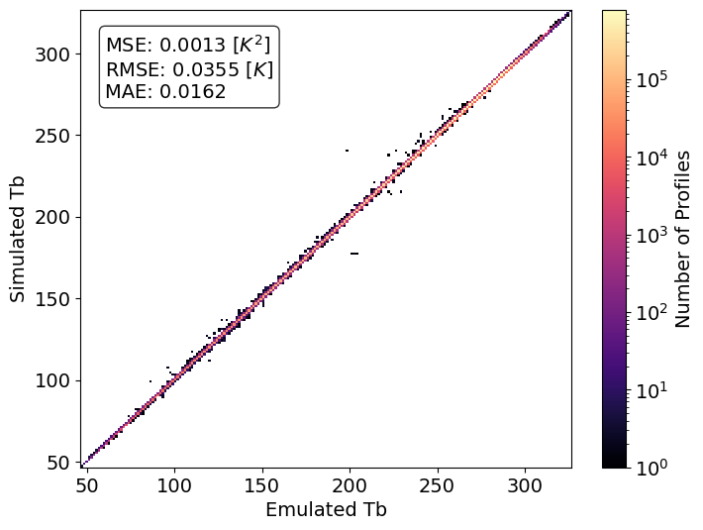
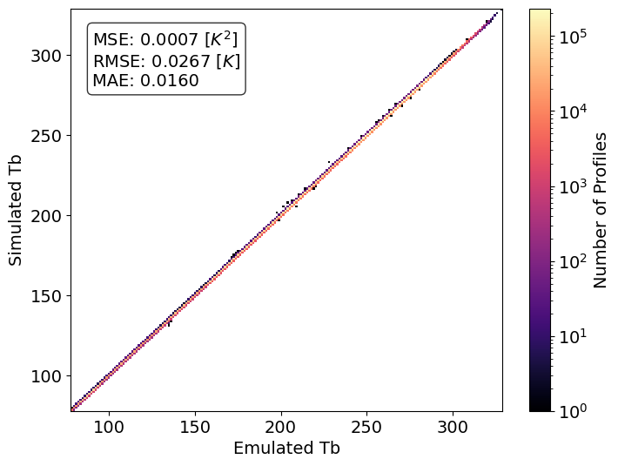
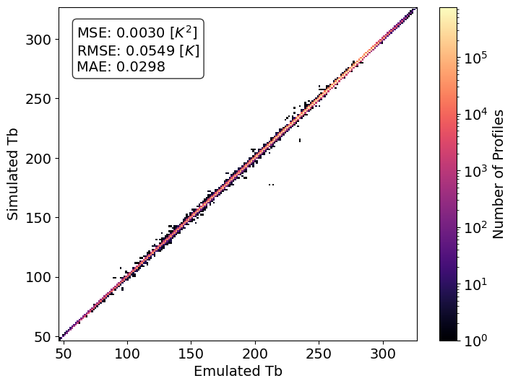
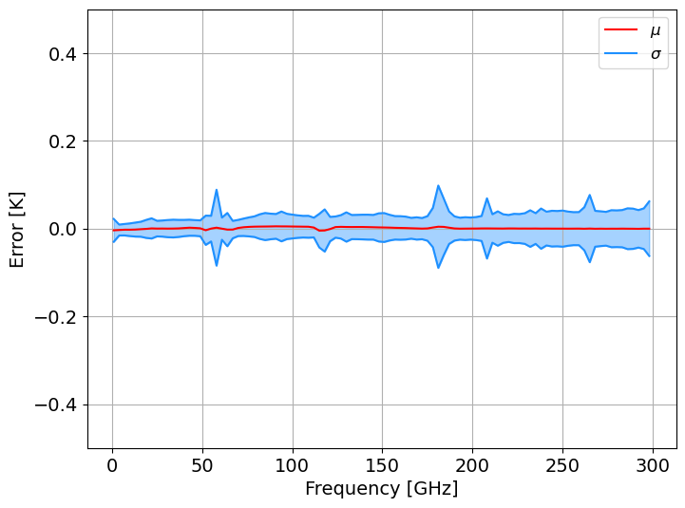
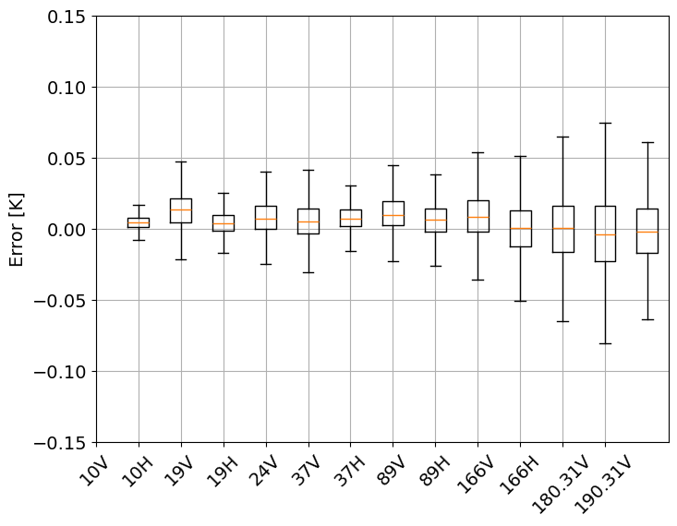
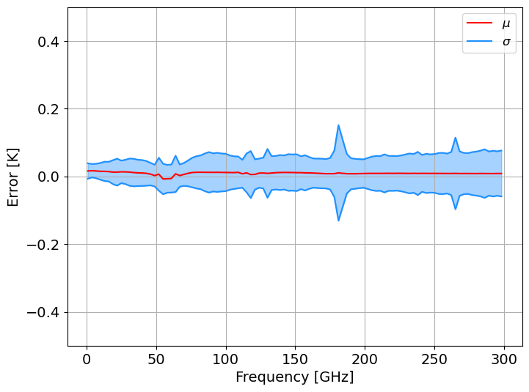
Training results
Eddington 2-Stream 1D
CRTM 1D (GMI)
Eddington Slant Path

Slide 10
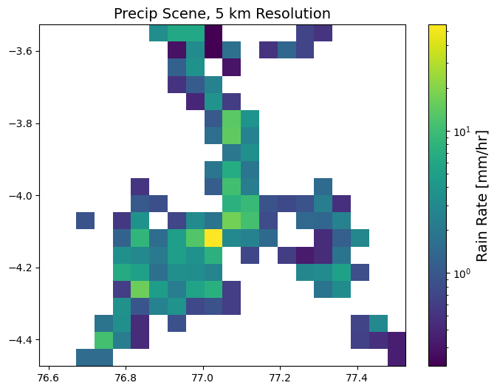
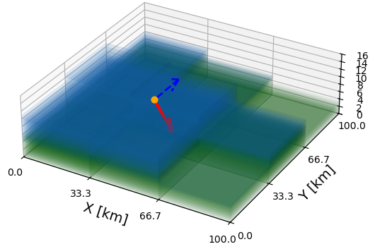
Preliminary training against “exact” 3D RT
Strategy:
  Use full 3D backward Monte Carlo simulations of GPM radar field
  Regrid to various lower resolutions
  Shuffle cloud field
  Calculate optical properties for single frequency (89 GHz) and eia (53°) and use same model architecture
  Assess convergence of preliminary training → get an idea of how much training data and computational resources would be necessary to do this

Slide 11
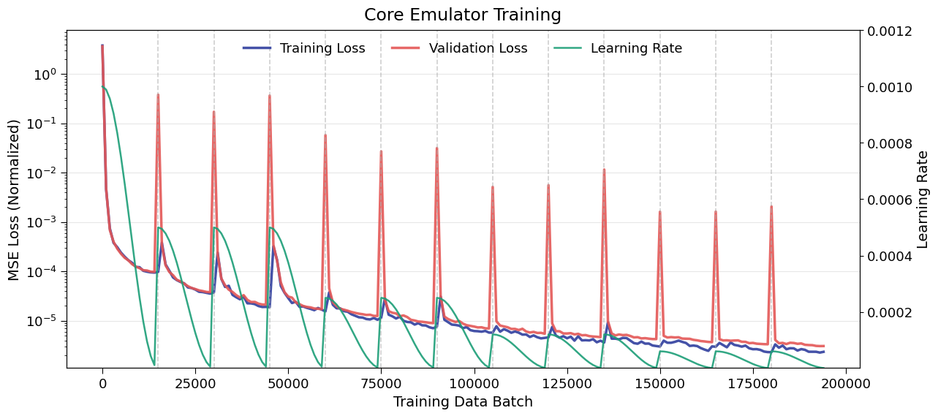
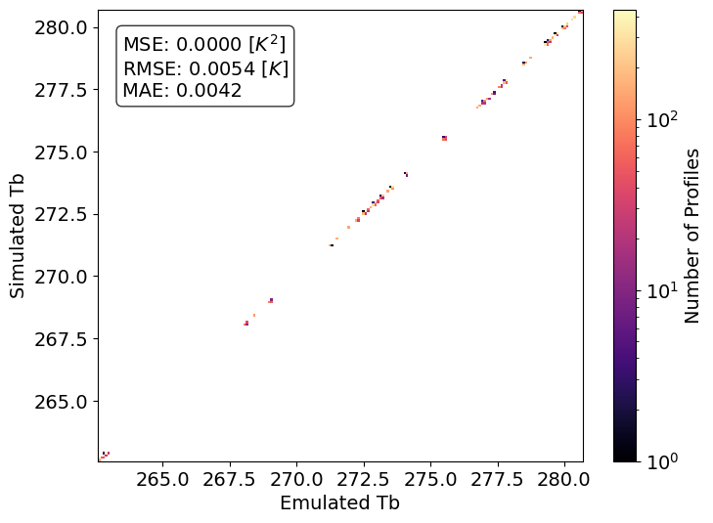
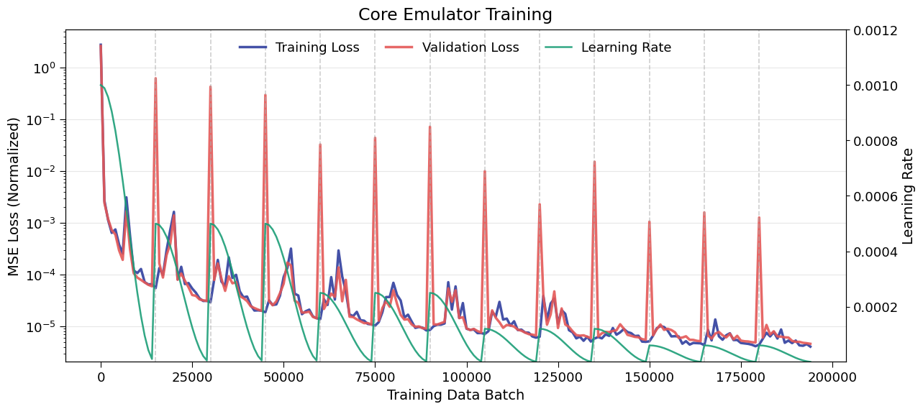
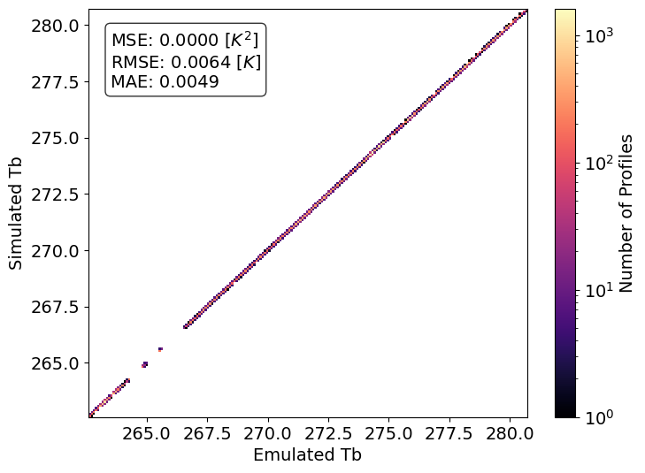
Preliminary training against “exact” 3D RT
3x3 Scene (33 km resolution)
4x4 Scene (25 km resolution)

Slide 12
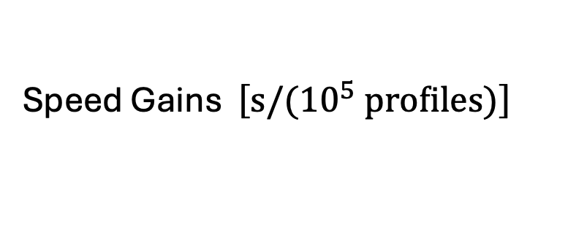
Conclusions – Part II
Training directly on optical properties allows emulation of Core RT
  No need for retraining if microphysics/emissivity scheme is changed
  Wrapper emulators or lookup tables can handle conversion from geophysical variables to optical properties
Model error less than sensor noise and quantifiable for retrieval and DA applications
Preliminary training shows promise for full 3D exact RT emulation
Speed Gains $\left.\left[s/({10}^{5} profiles\right.)\right]$
 | 1D Eddington | CRTM | p3D Eddington | Monte Carlo
CPU Explicit (Fortran) | 3.15 | 14.53 | 6.20 | 49,621.4
CPU Emulator | 3.54 | 3.17 | 4.43 | 5.86
GPU | 0.0019 | 0.0014 | 0.0016 | 0.0014

Slide 13

Thank you
MLQC Paper Preprint:
spencer.jones@colostate.edu

