Slide 1
The Global Precipitation Climatology Centre (GPCC) has published new gridded precipitation analyses that provide long-term averages, monthly totals, and daily totals
Elke Rustemeier, Markus Ziese, Zora Schirmeister, Peter Finger, Raphaele Schulze, Astrid Heller,
Jan-Nicolas Breidenbach, Siegfried Fränkling, Michael Jahn, Magdalena Zepperitz
Global Precipitation Climatology Centre, Deutscher Wetterdienst, Offenbach am Main
E-Mail: gpcc@dwd.de ; Web: gpcc.dwd.de

Slide 2
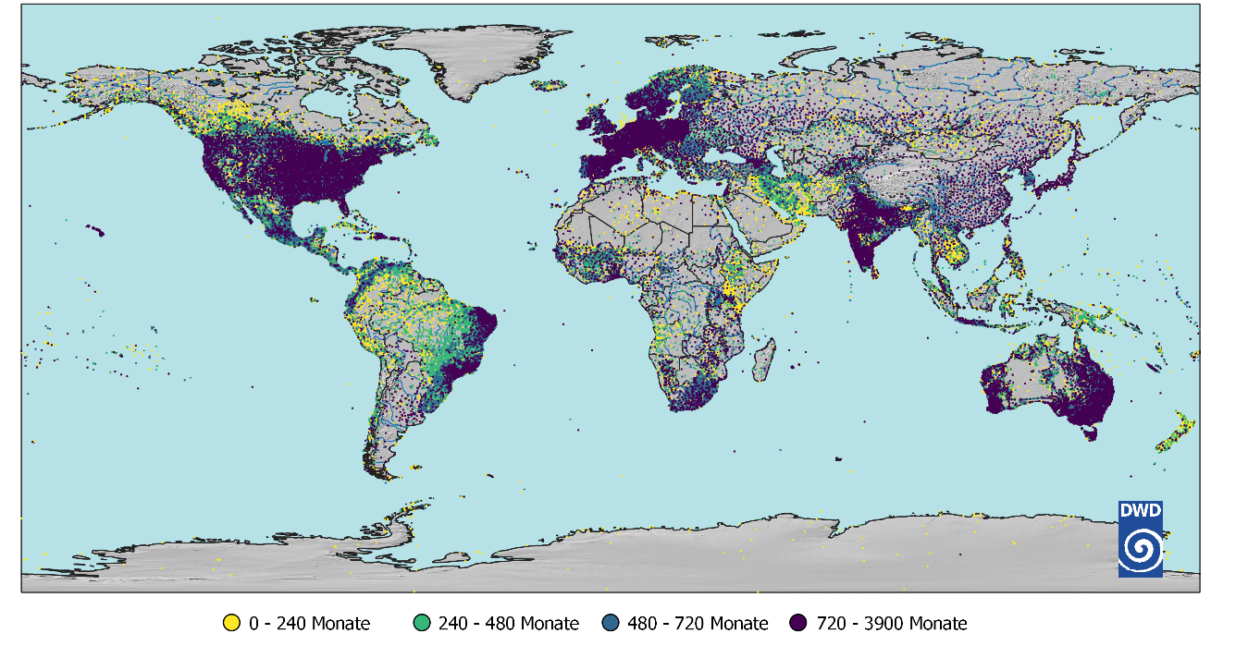
GPCC data base
More than
129,000 stations
(245,000 stations, when counting duplicates from different sources)
Daily and monthly values
0 – 20 years
21 – 40 years
41 – 60 years
61 – 325 years

Slide 3
Global Precipitation Climatology Centre - Background
GPCC was established at the beginning of 1989 at Deutscher Wetterdienst (DWD) on invitation by WMO; now in operation for 35 years
GPCC’s main task is the analysis of precipitation on the basis of in-situ data for the land-surface
Provide reliable reference information for the assessment of precipitation events and the quantification of the global water cycle
Therefore, the GPCC:
  Collects in situ precipitation data
  Does a Quality Control
  Store them in a data bank
  Produce public available gridded analyses

Slide 4
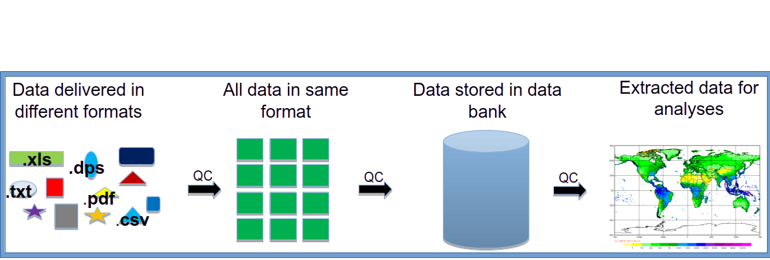
GPCC data flow

Slide 5
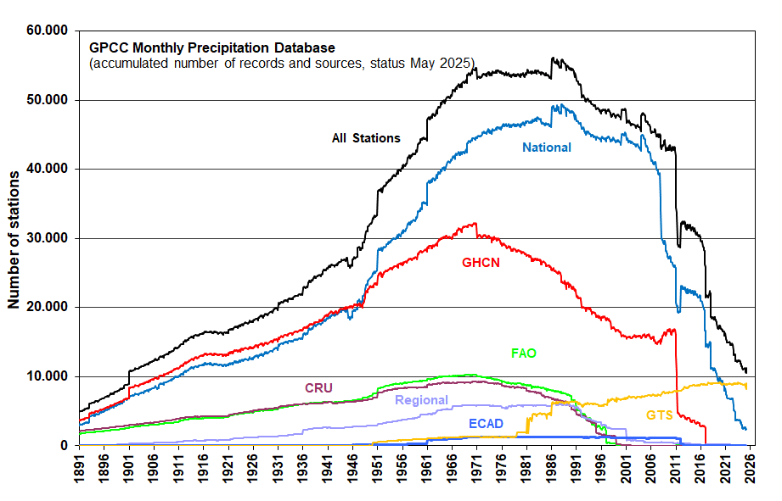
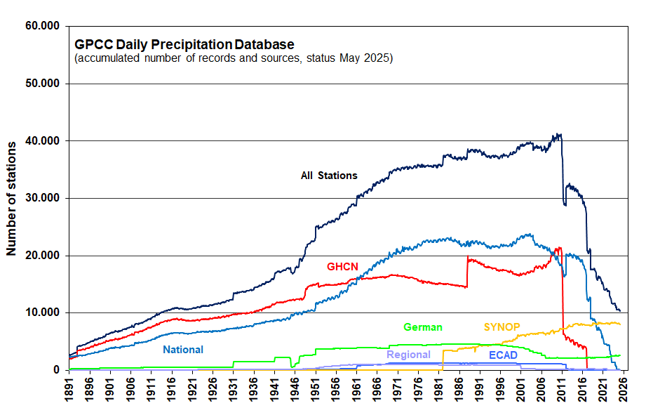
GPCC data base
Monthly totals, collected since 1989
Daily totals, collected since 2012
Number of stations in data bank: more than 129,000

Slide 6
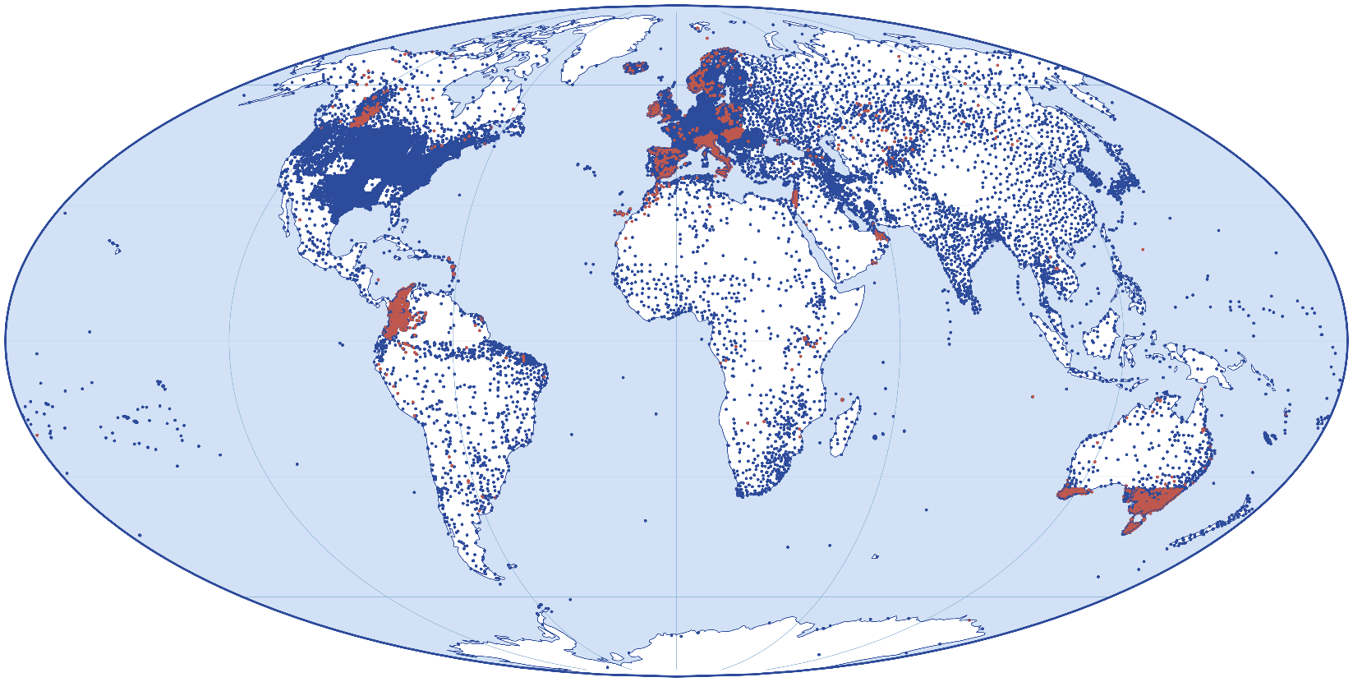


Improvements since Version 2022
Added stations
Added data records
The graphic depicts in red the new stations and in blue the stations to which data records have been added or have been corrected in GPCC‘s database since the release of the last version Full Data Monthly Version 2022.
→ We added 5430 stations.
→ We added data to ~46’000 stations.

Slide 7
New products
GPCC Precipitation Analysis Climatology Version 2025
GPCC Precipitation Analysis Monthly Version 2025
  Replacement of Monitoring and Full Data Monthly
To be released soon
GPCC Precipitation Analysis Daily Version 2025
  Replacement of Full Data Daily

Slide 8
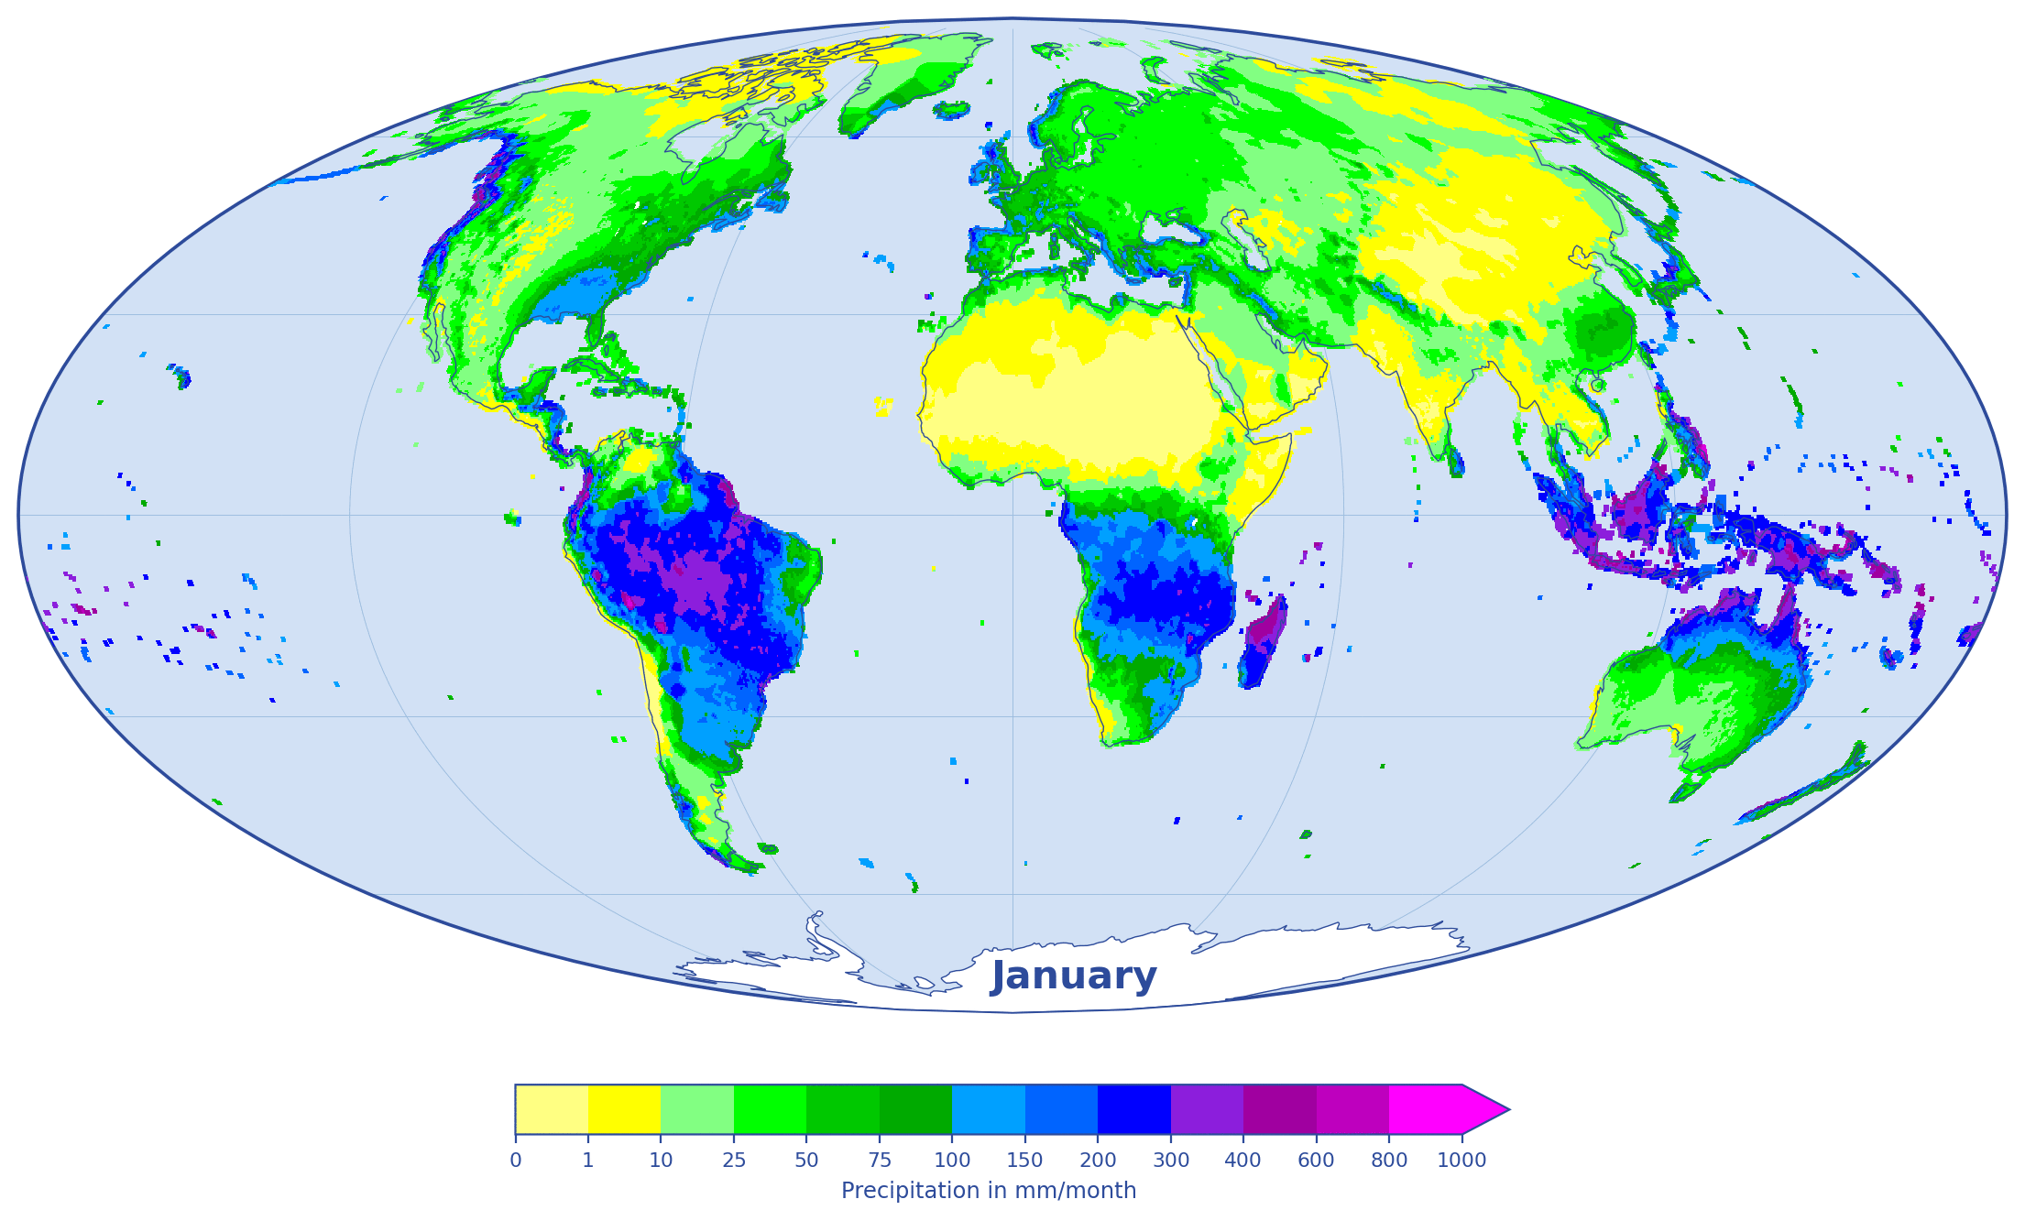
GPCC Precipitation Analysis Climatology Version 2025
Gridded Monthly precipitation climatology for the Earth’s land surface
Based on normals:
    collected by WMO (CLINOs)
    or delivered by the countries to GPCC
    or calculated from time-series of monthly data (with at least 10 complete years of data)
Spatial resolutions of 0.25°, 0.5°, 1° and 2.5°
All other GPCC products utilize this product as background fields to grid the monthly data at the corresponding resolution with the anomaly interpolation method
Open access
The Animation shows GPCC Climatology Version 2025
(Reference Period 1951 - 2000)
Available 30-yr periods: 1931-1960, 1941-1970, 1951-1980, 1961-1990, 1971-2000, 1981-2010, 1991-2020
And 1951-2000

Slide 9
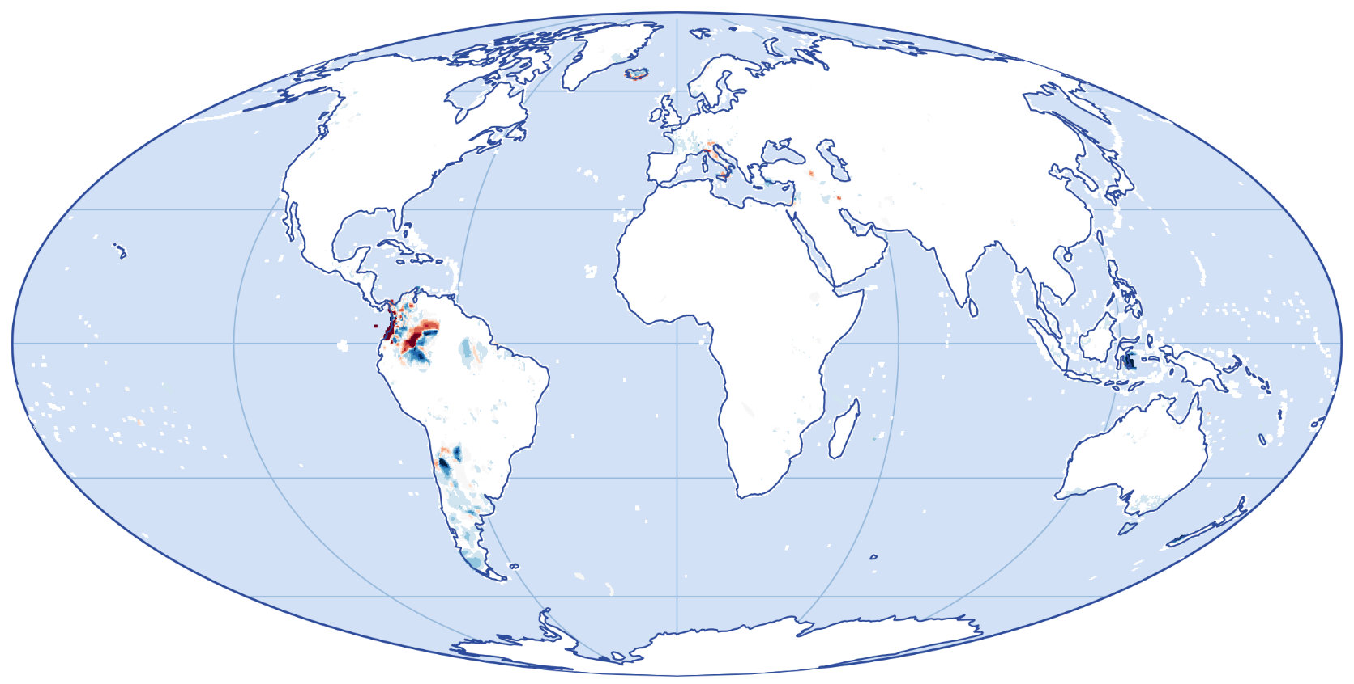
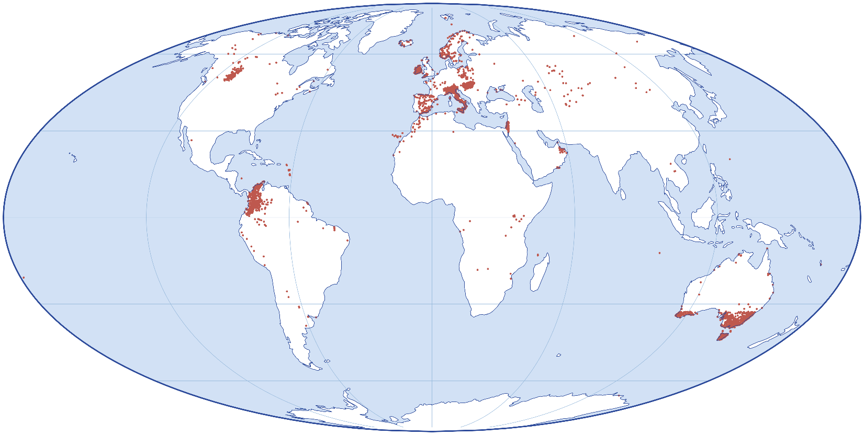
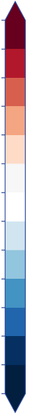
Improvements of GPCC Climatology V. 2025
-150 mm
-125 mm
-50 mm
-25 mm
Differences between Version 2025 and Version 2022
-10 mm
-1 mm
1 mm
10 mm
25 mm
50 mm
125 mm
150 mm
5430 new stations since the last Version.
Precipitation difference in mm/month
January (Reference period 1951 – 2000)

Slide 10
GPCC Monthly: What‘s new?
Its name: Full Data Monthly → GPCC Precipitation Analysis Monthly (short: GPCC Monthly)
Near realtime dataset, starting in 1891
regular monthly updates, with a latency of 2 months
  Historic and near real-time monthly analyses in one product from now on
Full Data Monthly + Monitoring Product kllöllöklkläömä öm =
GPCC Precipitation Analysis Monthly Version 2025
More data sources used to calculate the Monthly appended updates (ex-Monitoring Product)
    WIS/GTS (SYNOP-reports, CLIMATS)
    NEW: available national data from APIs
  Improvement of Analysis Quality, due to more stations included
2 new variables:
  dist_int (mean distance of stations, that were used by interpolating the grid cell)
  gauge_int (number of gauges, that were used by interpolating the grid cell)
Climatological infilling, can be used to improve the quality in regions with scarce station coverage by using the variable precip_infill.

Slide 11
GPCC Daily: GPCC Precipitation Analysis Daily Version 2025
In preparation
Full Data Daily
Gridded Daily precipitation totals for the Earth’s land surface
1982 to 2025
Reprocessing of the whole time period
Based on:
  data provided by the national hydrological and/or meteorological services (NHMS) > 190 countries
  global and regional data collections
  SYNOP reports
Spatial resolutions of 1°x1°
Anomaly interpolation with modified SPHEREMAP
Open access
2025
Information on the release:
gpcc@dwd.de
1982

Slide 12
Variable overview of the new products:
Variable | Description | Unit
precip | Precipitation | mm / month
gauge | Number of gauges | number of gauges per grid cell
err | Interpolation error (YAMAMOTO) | mm / month
sys_err | GPCC undercatchment gauge error correction factor | Multiplier
gauge_int | Number of gauges used by interpolation | Number gauges used for interpolation
dist_int | Mean distance of gauges used by interpolation | Mean distance in kilometer
liquid | Proportion of liquid precipitation | % / month
solid | Proportion of solid precipitation | % / month
precip_infill | Precipitation with climatological station values infilling | mm / month

Slide 13
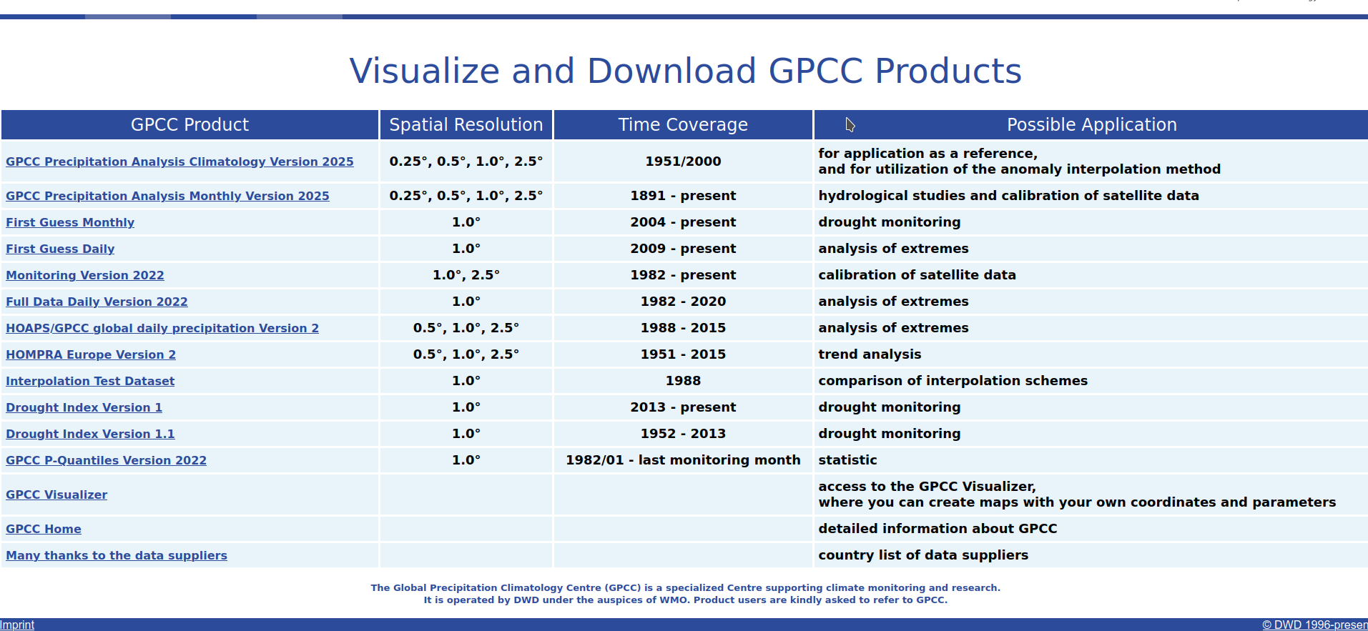
https://gpcc.dwd.de
https://opendata.dwd.de/climate_environment/GPCC/html/download_gate.html

Slide 14
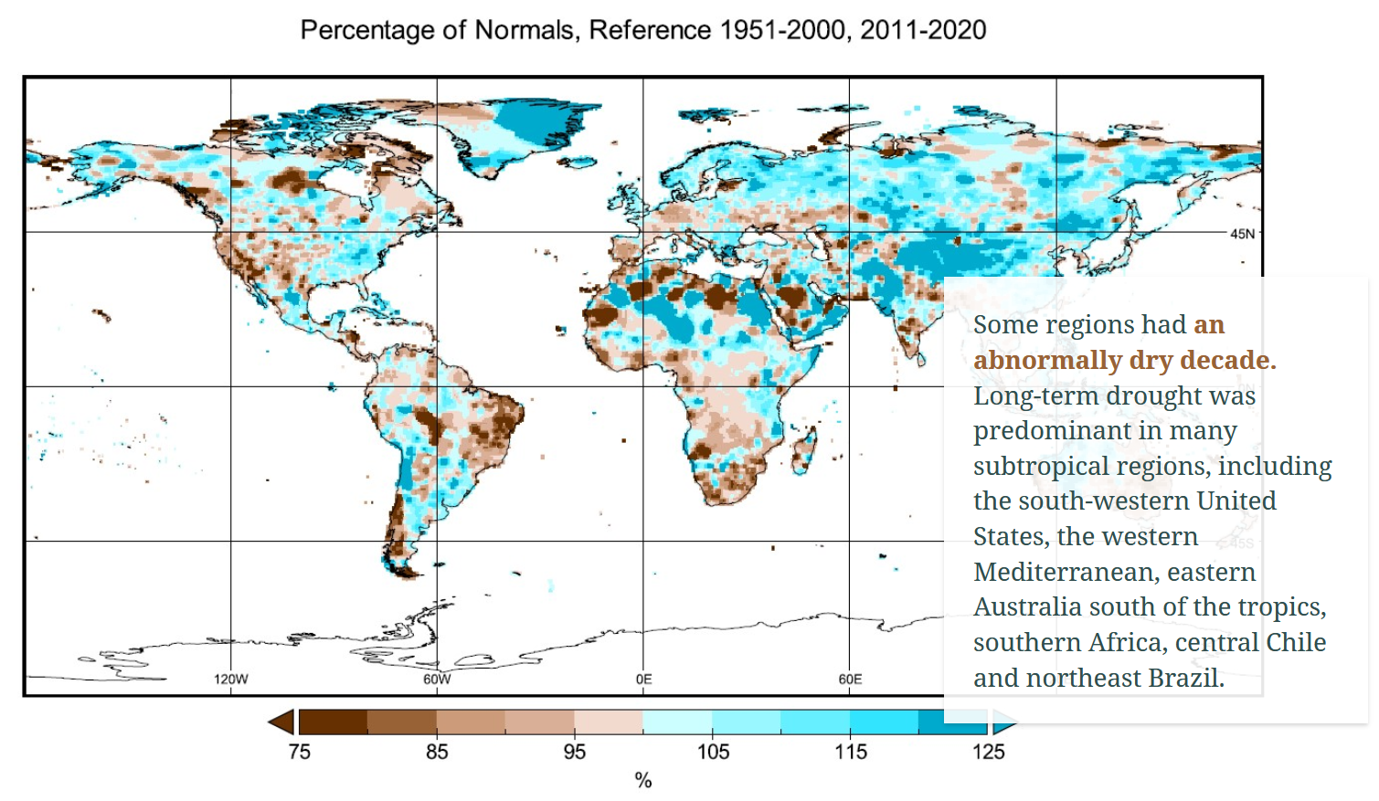
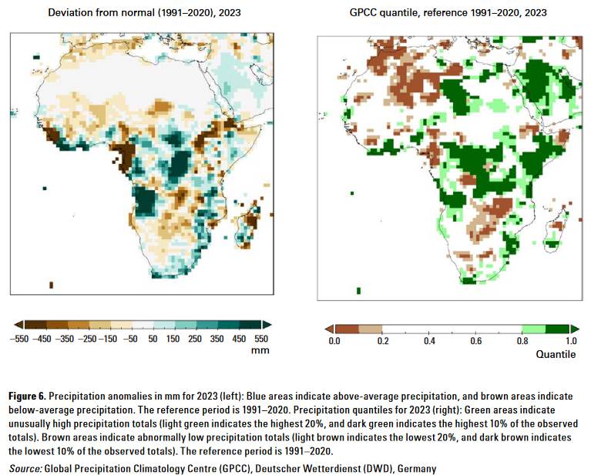
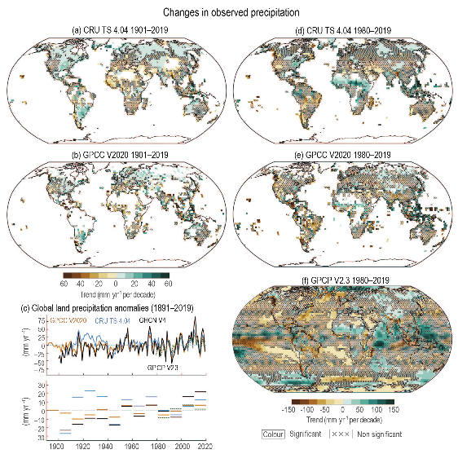
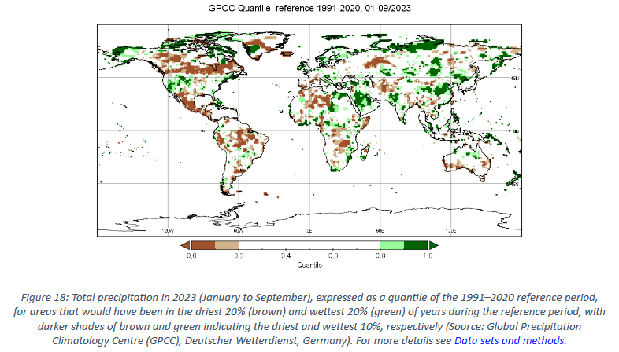
Usage of GPCC products in Publications (examples)
WMO Decadal State of the Climate 2011-2020
IPCC AR6 WG1
GPCC contributes also to DWD reports
WMO State of the Climate in Africa 2023
WMO Provisional State of the Global Climate 2023

Slide 15
Thank you
The GPCC would like to express its sincere thanks to all data providers. Without their support, these analyses would not be possible.
https://www.dwd.de/EN/ourservices/gpcc/editorial/latest_datadeliveries.html

Slide 16
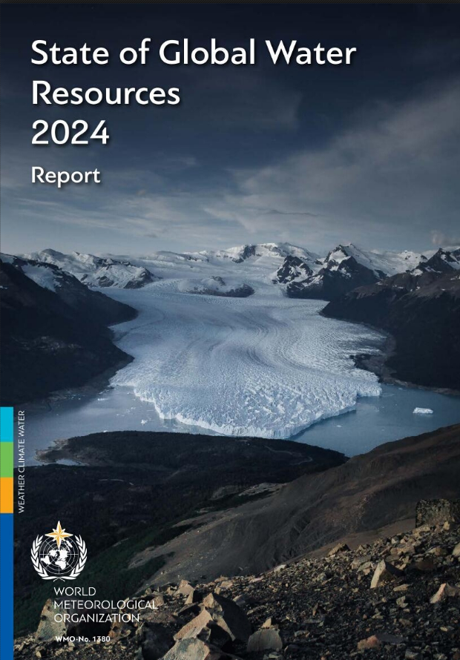
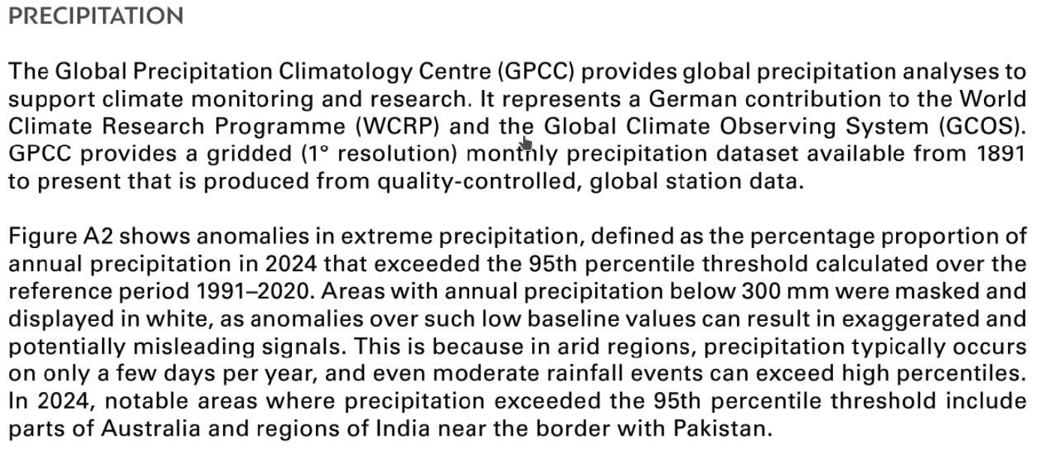
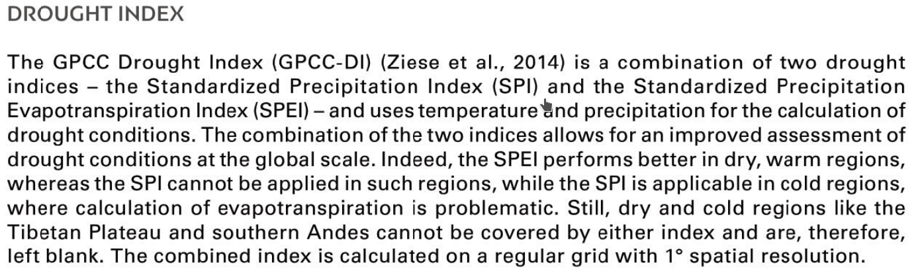
Usage of GPCC products in Publications (examples)

Slide 17
Meteo Data Collection Centre for Copernicus Emergency Management Service requested by the European Commission
eg. European Flood Awareness System (EFAS)
„WASA – Vebundprojekt Co-Hydim-SA: Co-Design eines hydrometeorologischen Informationssystems für eine nachhaltige Bewirtschaftung der Wasserresourcen im südlichen Afrika, Teilprojekt 2“ (CoHydim-SA-TP2)
  Development of a meteorological drought monitoring (and forecast -> project partners) for Namibia and Botsuana
„Qualitätskontrolle von stationsbasierten Niederschlagszeitreihen mit KI Verfahren beim Weltzentrum für Niederschlagsklimatologie (WZN)” (QC-Precip)
  Quality control of station-based precipitation time series with AI methods at the GPCC
Ongoing projects

Slide 18


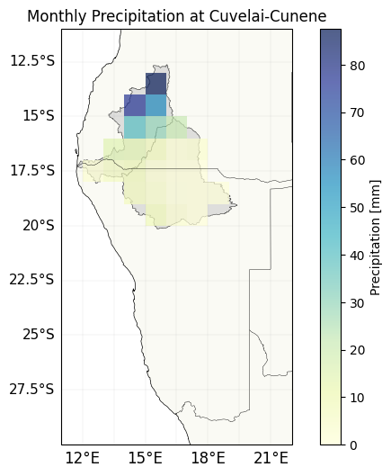
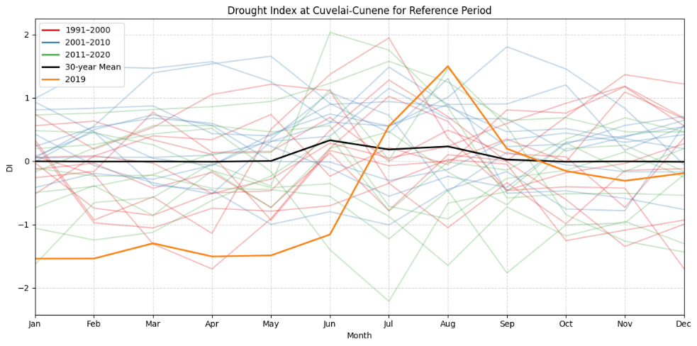
Cuvelai-Cunene
Co-Design eines hydrometeorologischen Informationssystems für eine nachhaltige Bewirtschaftung der Wasserresourcen im südlichen Afrika
Notes:
Grid cells shown for the Cuvelei-Cunene region (precipitation for October 2020)
2nd Figure shows Precipitation for the Cuvelei-Cunene Region for several years.
Red, blue green -> tens years of precipitation
Black -> mean over the entire time span, corresponds to the reference period
Orange -> highlights the year 2019
For 2019 first a bit lower precipitation, but then close to the mean
Remember: May to September -> nearly no precipitation

Slide 19
Quality control
Shifted in time - day, one month, one year, …
Calendar conversion
Factor error e.g. units in inches or continuous factor 10 error
Incorrect labeling of missing precipitation observations („0“)
Strange false value identifier (Example 1333.2 or 1555.4)
Different definitions of a day
Data from different sources is stored separately in the database,
which is very helpful for QC processing

Slide 20
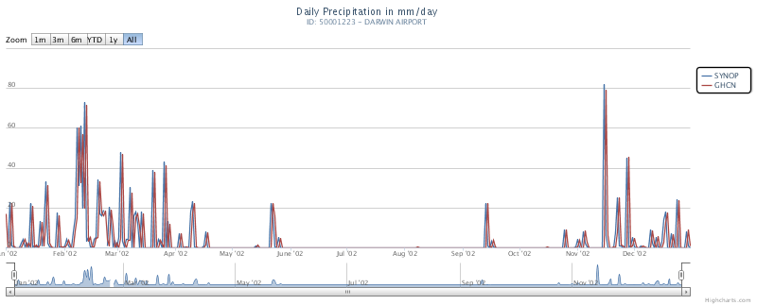
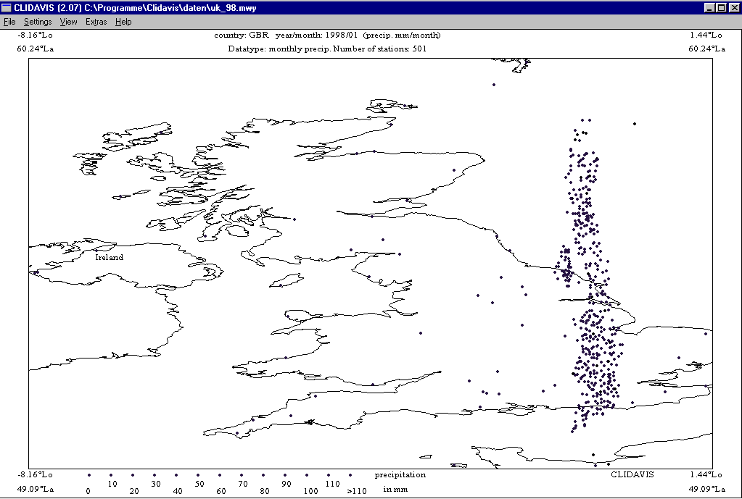
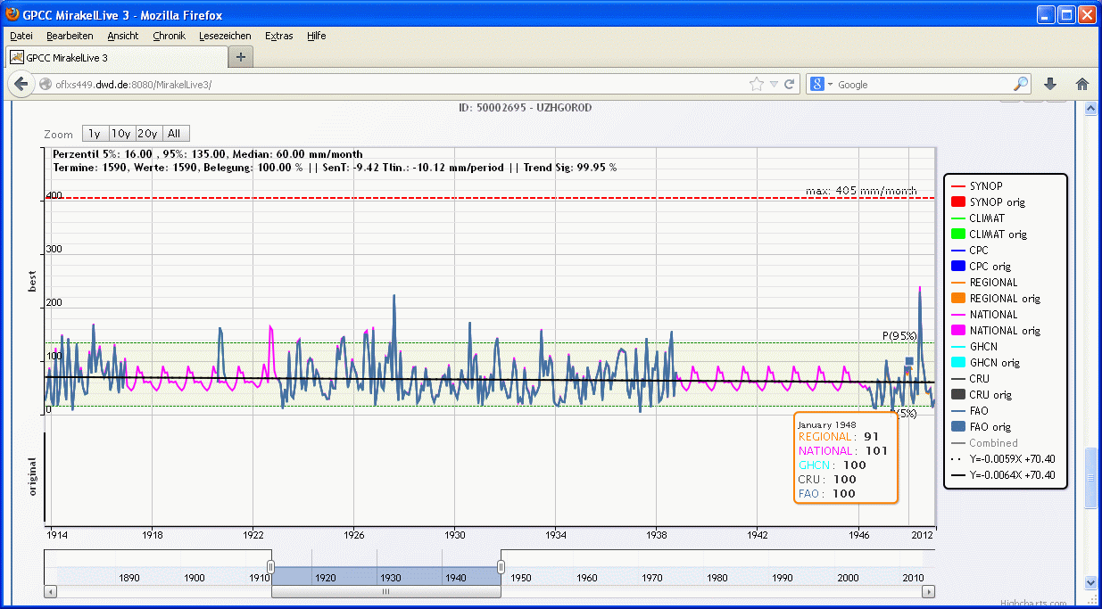
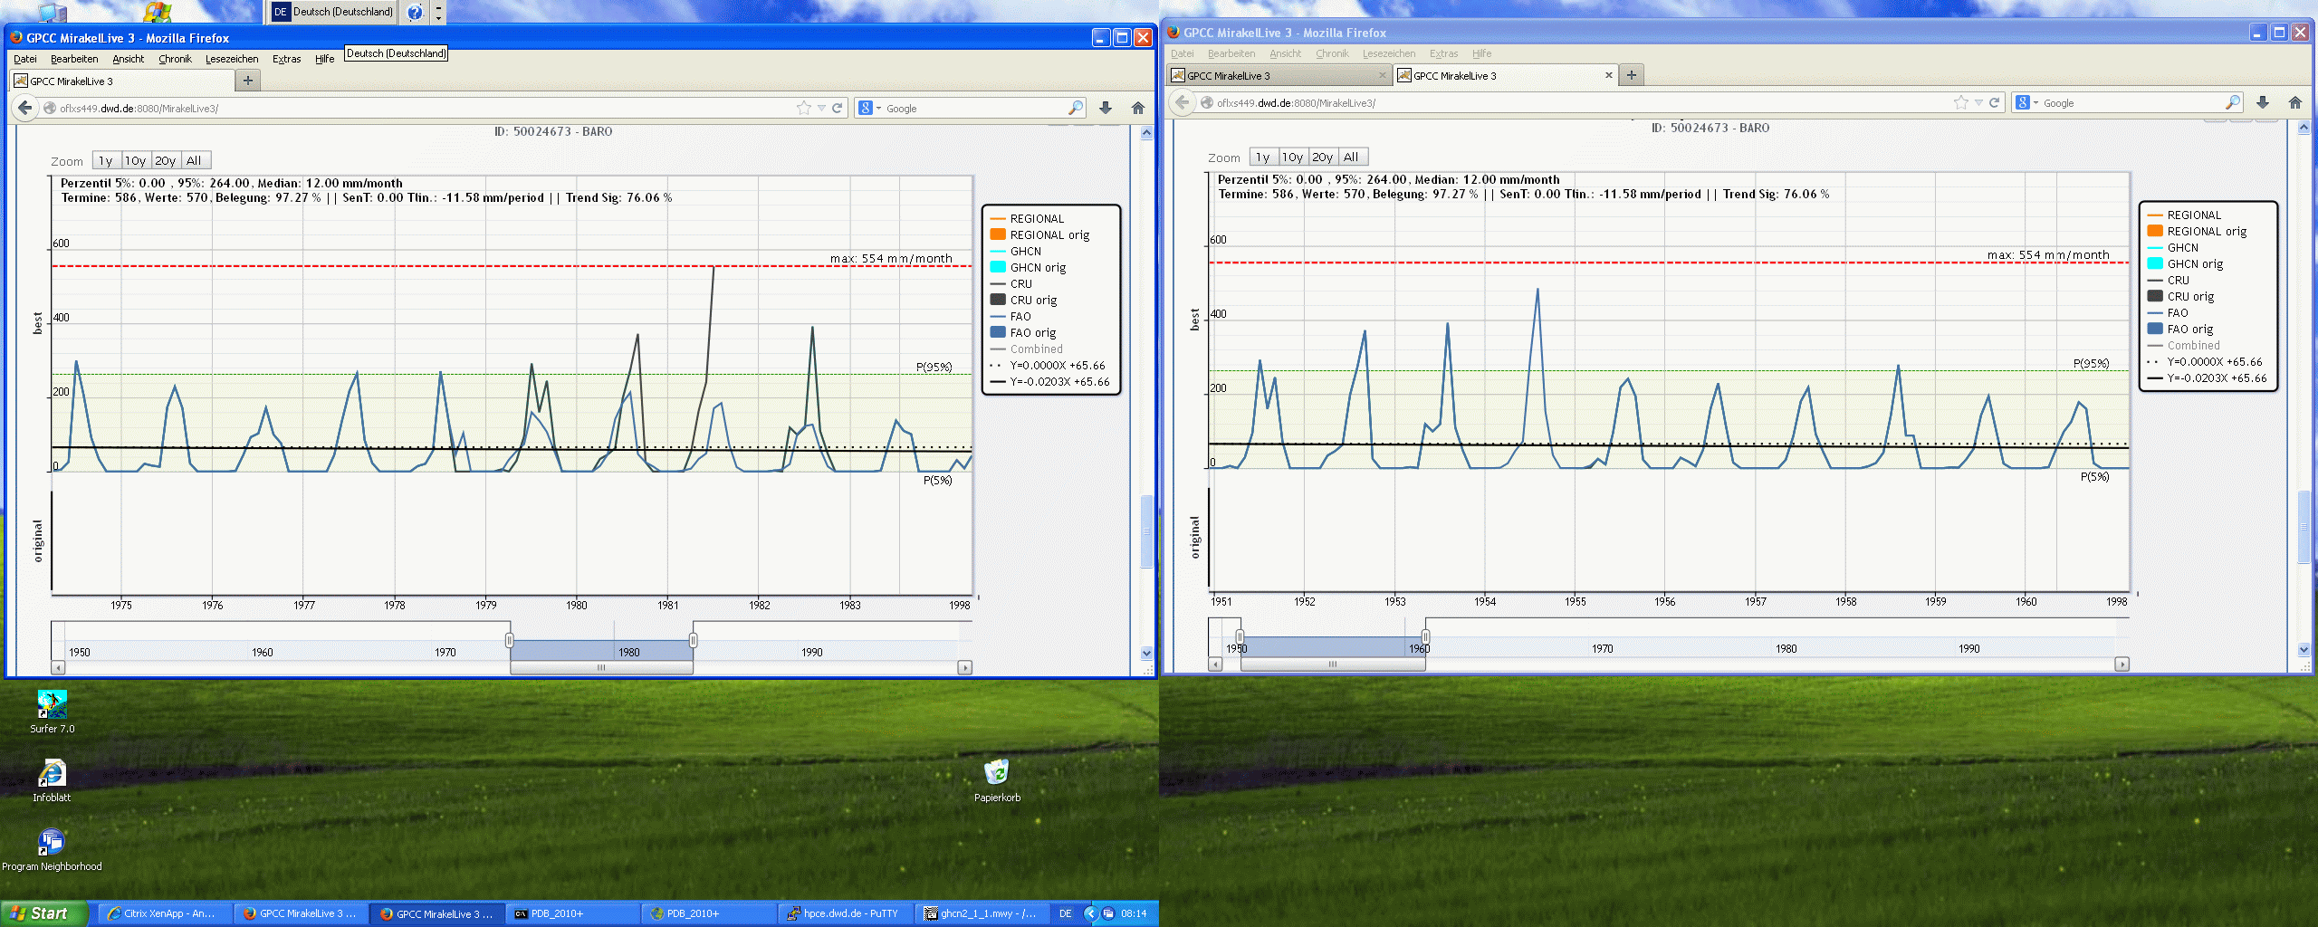
GPCC quality control - examples
Time stamp shifted by one day:
Meta data:
Different transliteration of same station name:
  Huddur
  Huduur
  Hudur
  Hodur
  Oddur
  Xuddur
  Xudur
Gaps filles with long-term means:
Reuse of data:
1979
1980
1982
1951
1952
1953

Slide 21
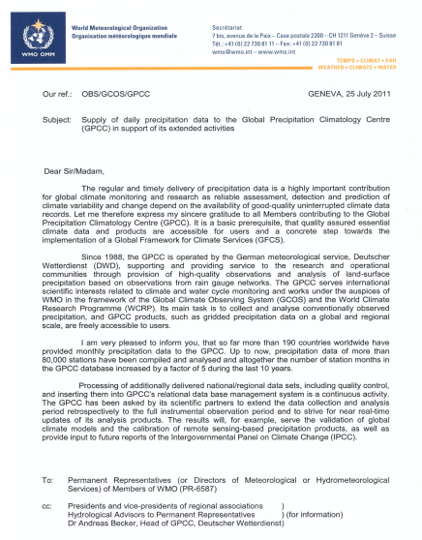
GPCC needs data
Support letter from WMO (update in progress)
Station and meta data not shared with others
Gridded products distributed with an open access policy
Station data cannot derived from grids

Slide 22
