Slide 1
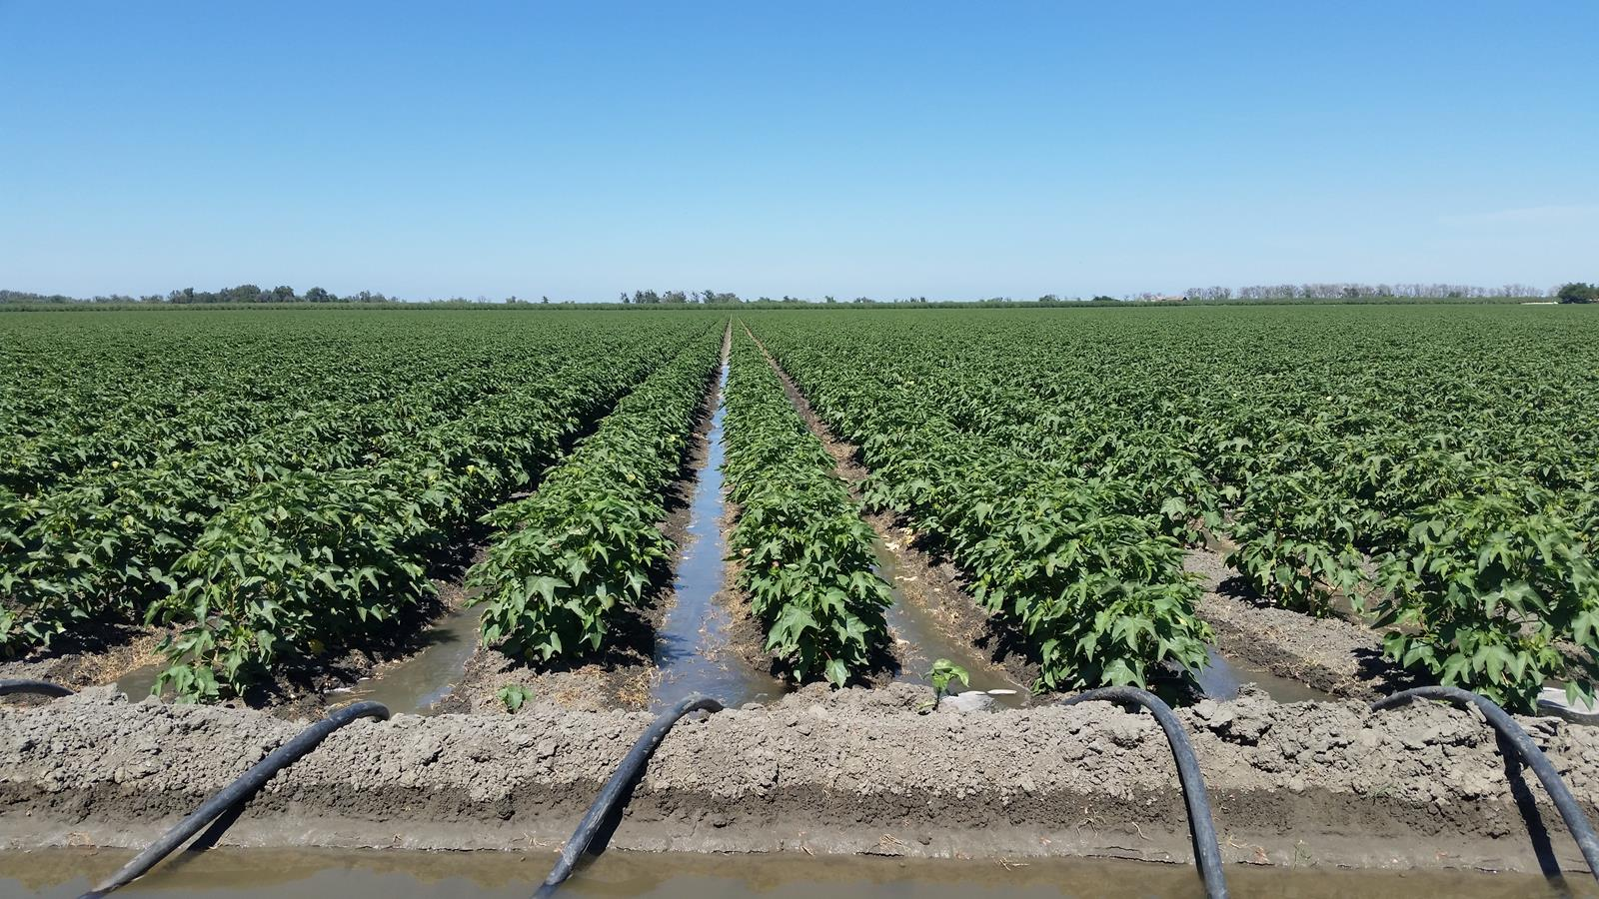
High-resolution precipitation data validation for climate-resilient water management
by
Anne Kappler and Thomas Einfalt
hydro & meteo GmbH, Lübeck, Germany

Slide 2
Who are we ?
Consulting firm in hydrometeorology
Since 1999
Based in Lübeck, Germany
  Analysis and verification of hydrological and meteorological measurements
  Automatic data quality control and correction: weather radar and stations
  Forecast and warning systems
  Climate change adaptation / climate projection downscaling
  Software development SCOUT / ScoutView
  Event analysis / damages
  Education and training
More details on https://www.hydrometeo.de

Slide 3
The REINFORM project
REINFORM
REmote Sensing INtegration For Optimized Resource Management
Scaling farm water balance toolbox for mapping the water productivity and sustainability of the Australian irrigated agricultural sector.
The goal of WaterSENSE consortium:
Develop an operational, modular, water-monitoring system built on Copernicus EO data to provide water managers with a toolbox of reliable and actionable information on water availability and water use, anywhere in the world, in support of sustainable water management and transparency across the entire water value chain.

Slide 4
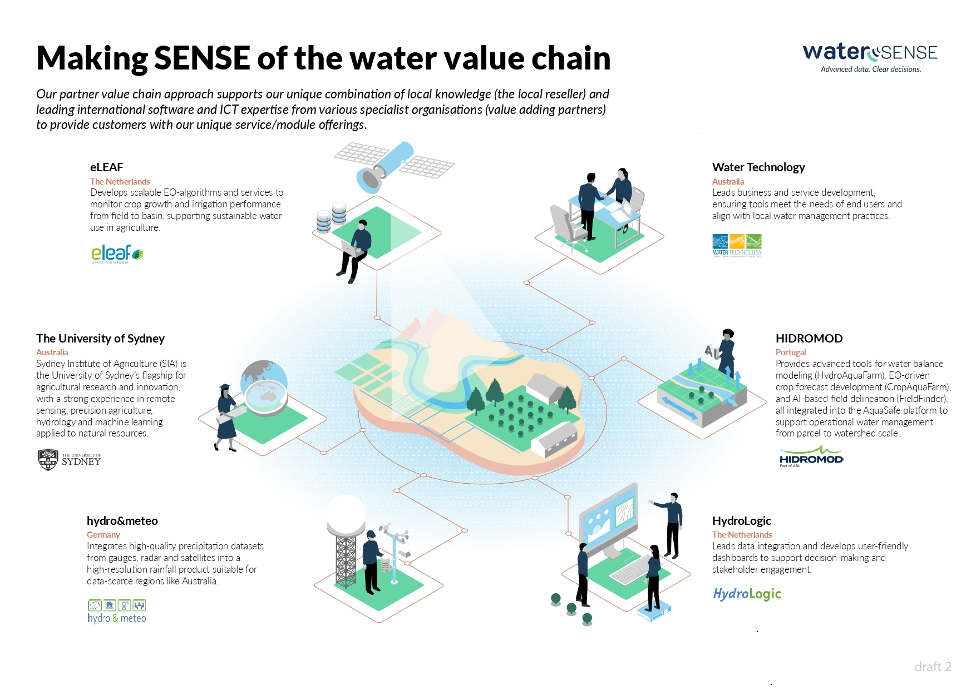







Multi-disciplinary Research-driven Consortium

Slide 5
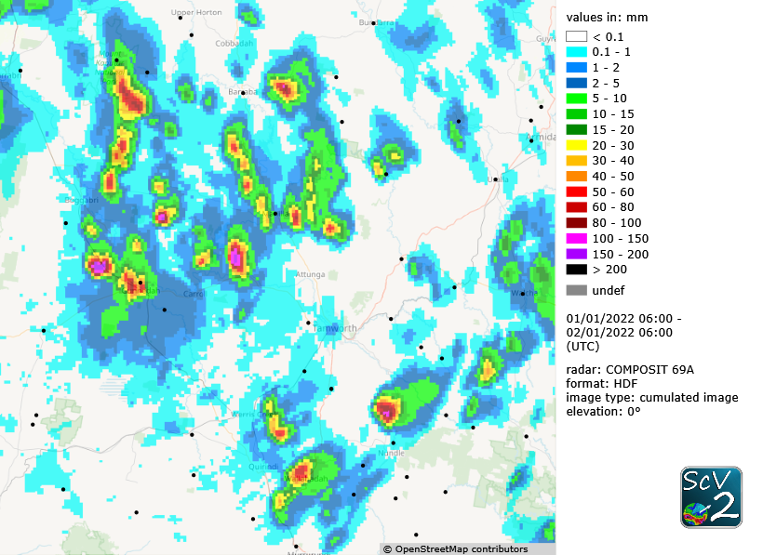
Australian Context
Heavy and localized rain
The significant rain around Tamworth region missed all the gauges on 01 January 2021

Slide 6
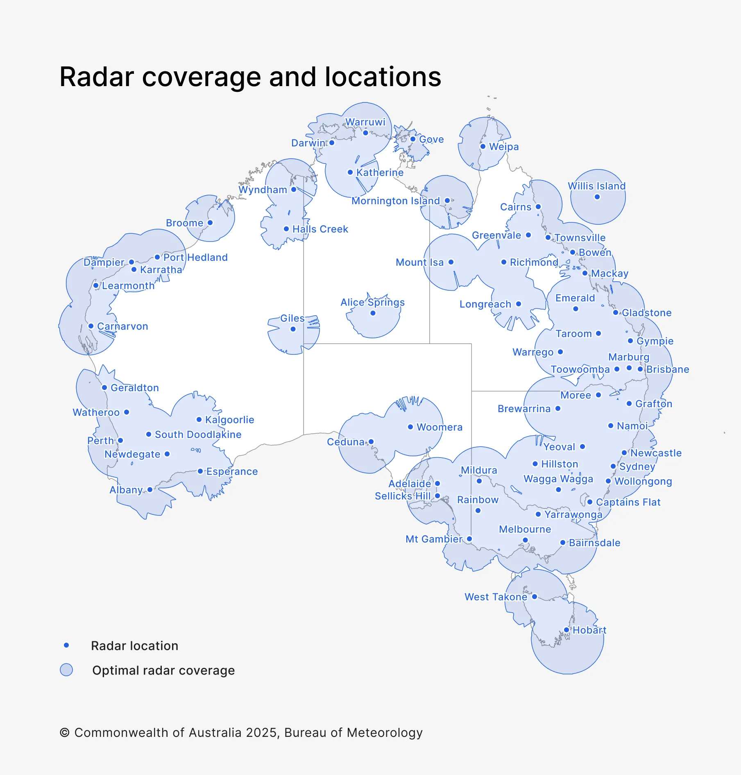
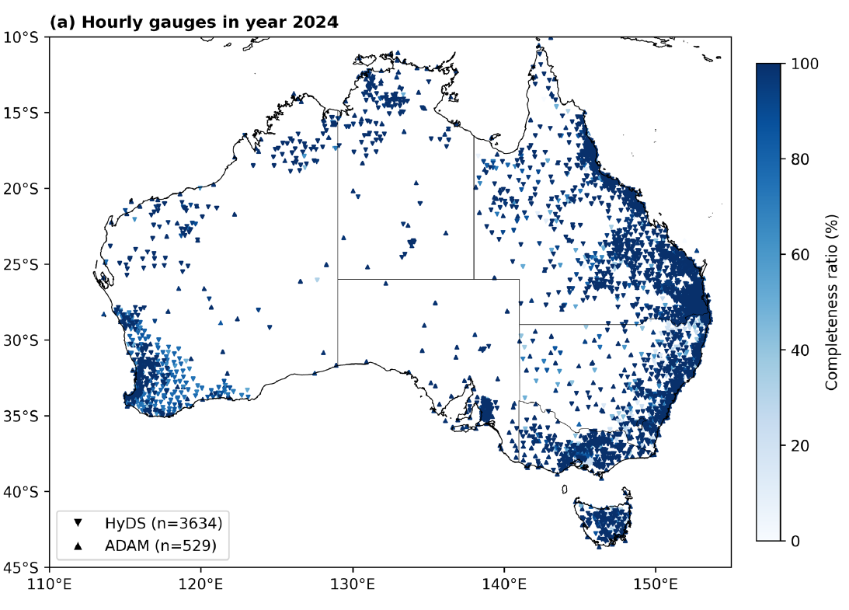
Australian Context
Precipitation measurements and agriculture

Slide 7
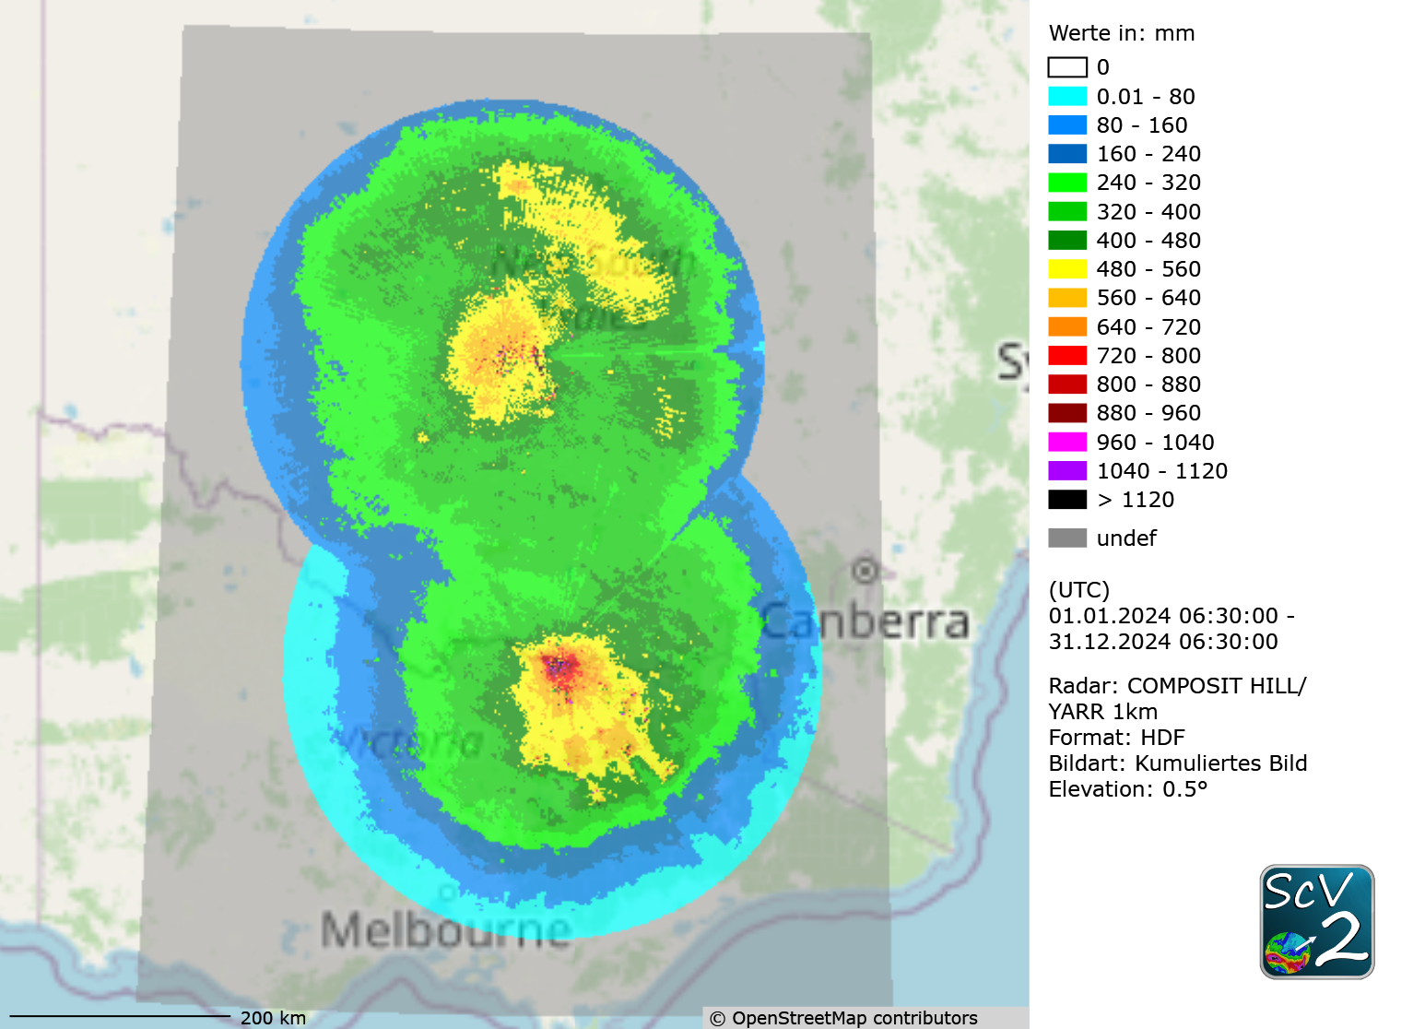
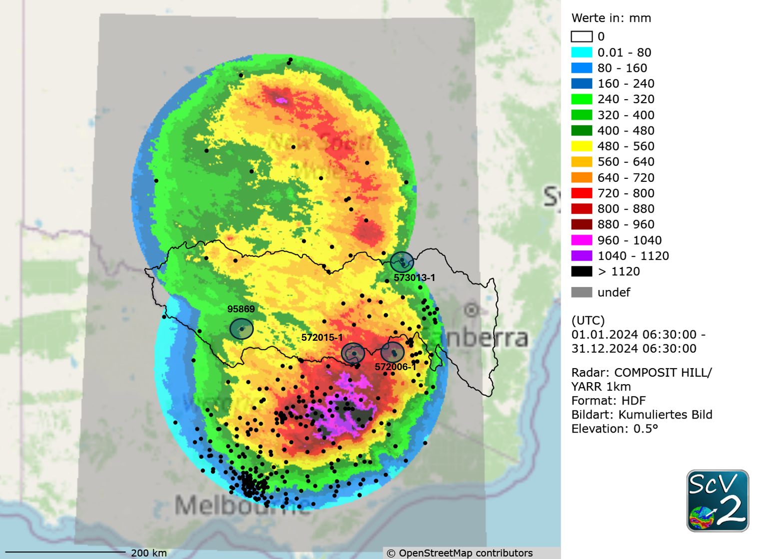
Validation base: radar composit
Original radar composit - 2024
Adjusted radar with BOM and NSW raingauge stations -2024

Slide 8
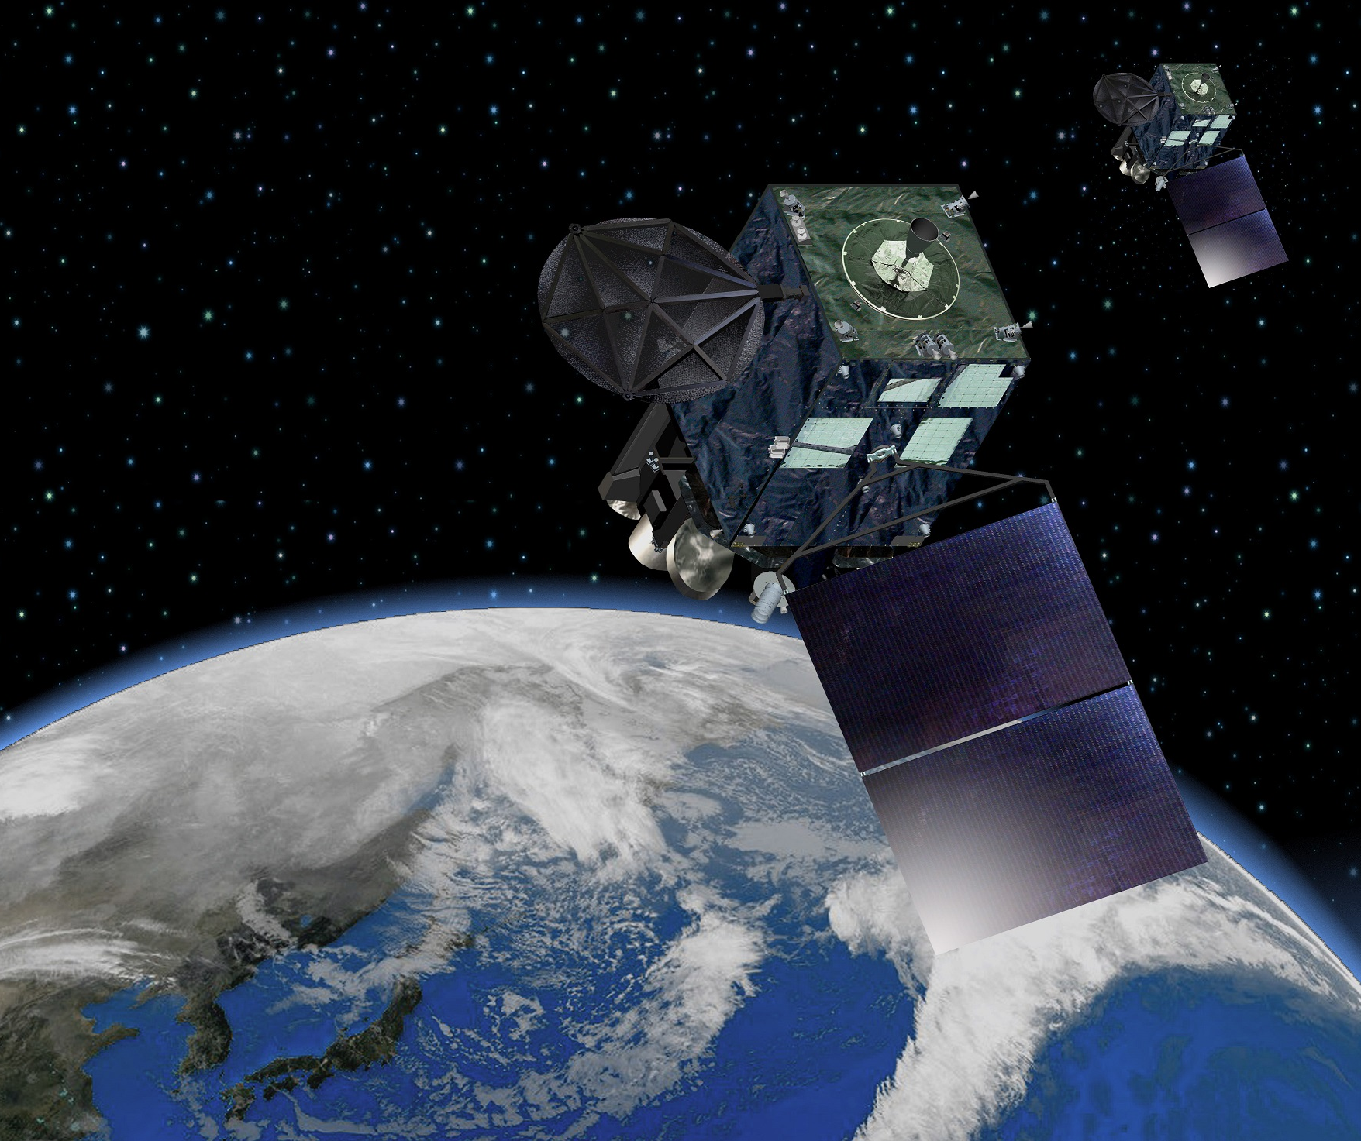
Available Satellite products
Geostationary satellite
  provides frequent observations (every 10 min)
  relies on visible and infrared bands, mainly capture cloud tops and struggle to detect precipitation cores
Low earth orbit satellite
  E.g. GPM mission
  carries microwave imagers + radar
  better characterization of precipitation data/ structure
  longer revisit time
Since we need precipitation measurements with a high resolution, geostationary is the best choice
For Australia, Himawari-9 is the best geostationary satellite
By Japan Meteorological Agency, CC BY 4.0

Slide 9
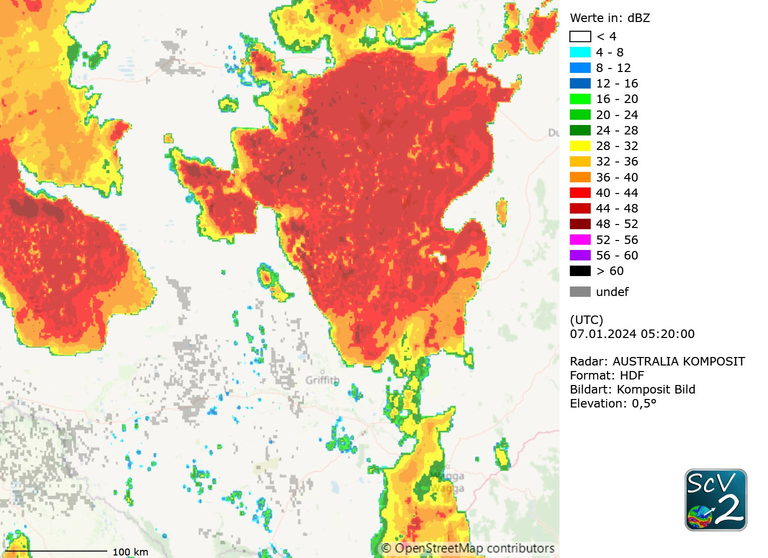
CRRPh product and composition
Convective Rainfall Rate from Cloud Physical Properties (CRRPh)
Nowcasting tool (NWC SAF) by EUMETSAT that provides information on convective, and stratiform areas associated to convection, instantaneous rain rates and hourly accumulations
based on Principal Component Analysis
Input data:
  GEO-cloud microphysics (CMIC Cloud Optical Thickness, CMIC Effective Radius,
  CMIC Phase)
  Satellite imagery (Himawari 8/9, SEVIRI channels)
    IR8.7, IR9.7, IR10.8,IR12.0,IR13.4 (Brightness temperature)
    VIS0.6 (Normalized reflectance and corrected with Sun distance)
    WV6.2,WV7.3 (Brightness temperature)
https://www.nwcsaf.org/crr-ph_description#4.%20List%20of%20inputs%20for%20CRR-Ph

Slide 10
CRRPh product and composition
Resolution:
  Spatial: 2km
  Temporal: 10min
One single algorithm is used for the whole day
CWP (Cloud Water Phase) and VIS0.6 are not available during night
  Solution: artificial method which creates pseudo-channels derived from
  infrared and water vapour channels
Further limitations:
  Max. precipitation is 50mm/h, and it is measured in 0.2 mm/h steps
https://www.nwcsaf.org/crr-ph_description#4.%20List%20of%20inputs%20for%20CRR-Ph

Slide 11
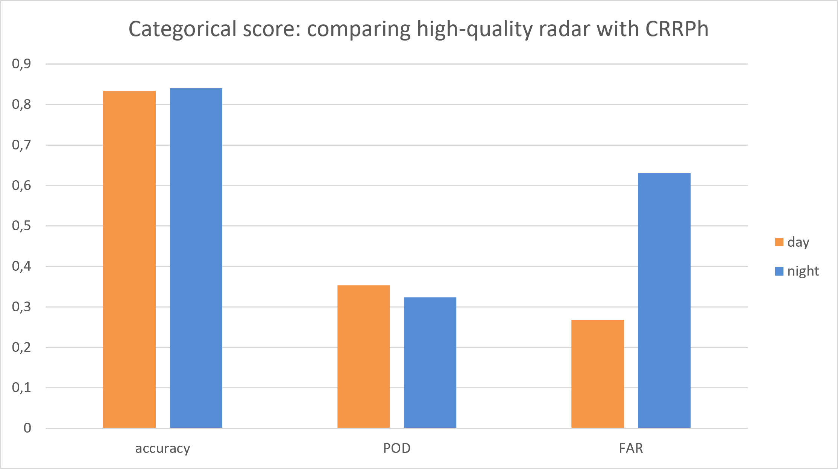
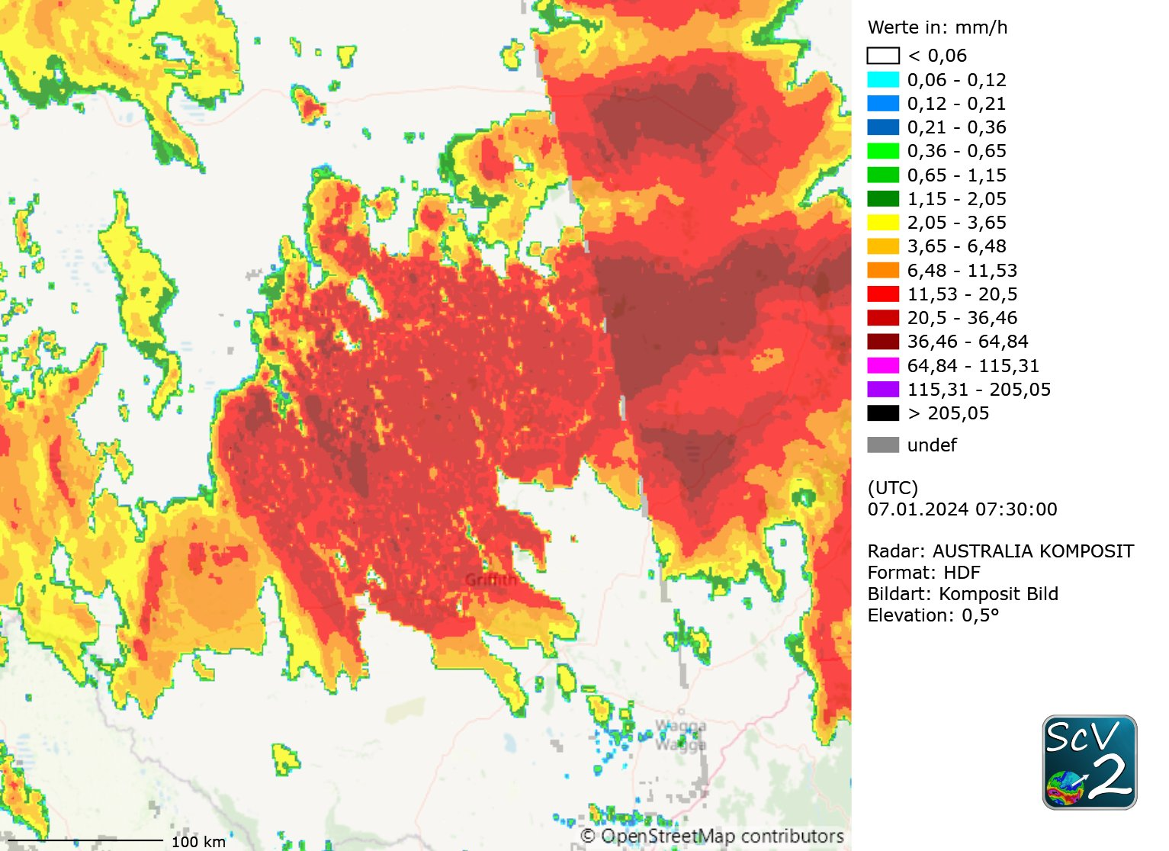
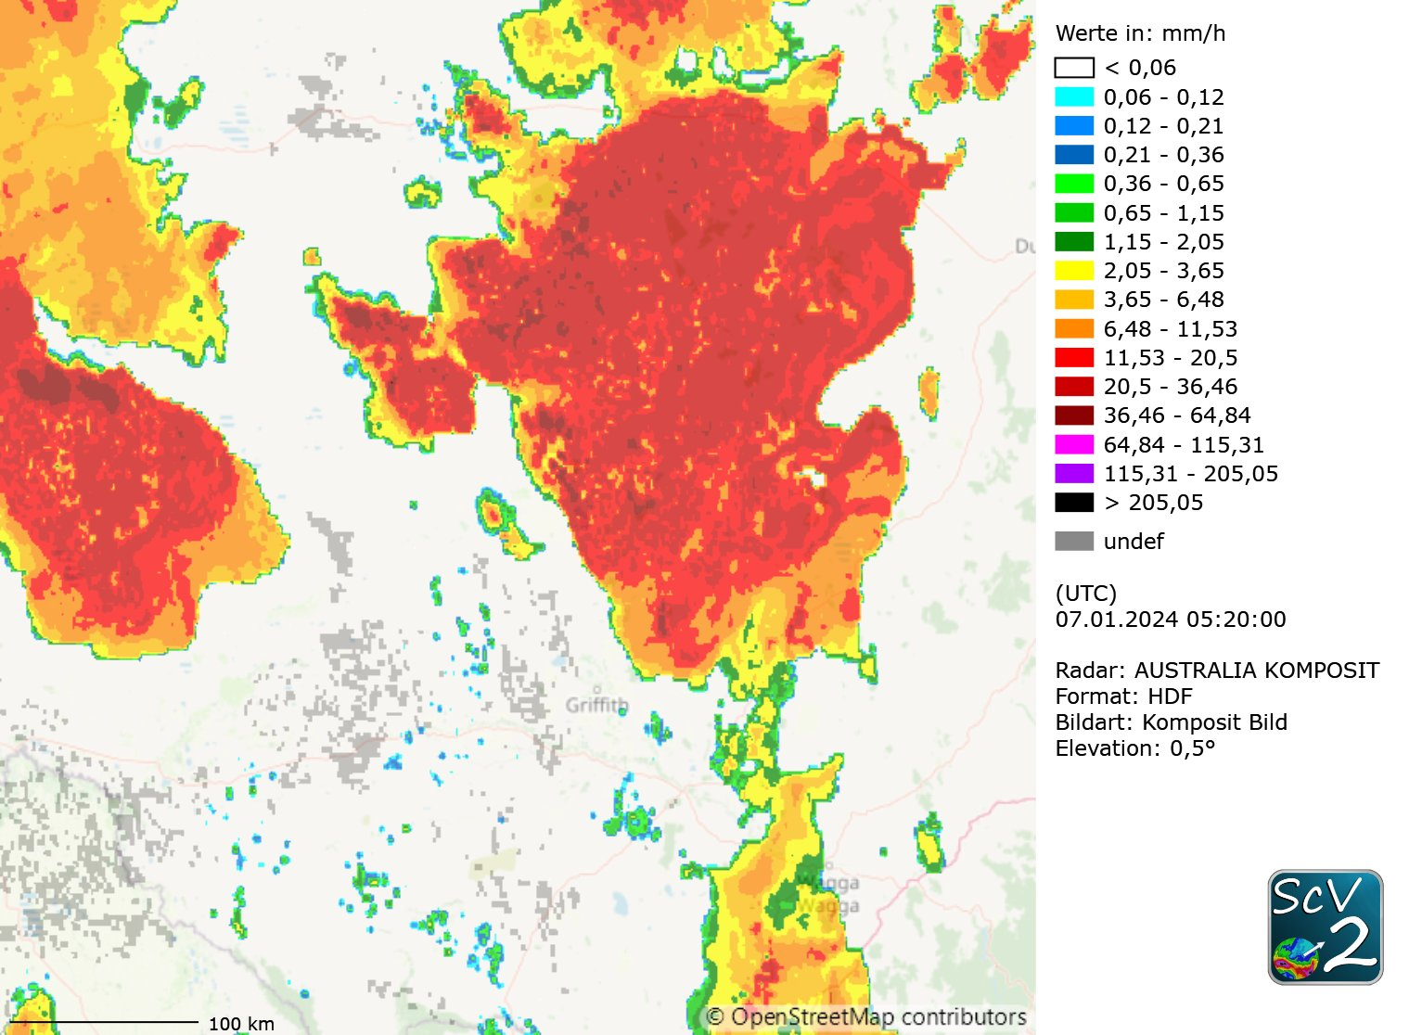
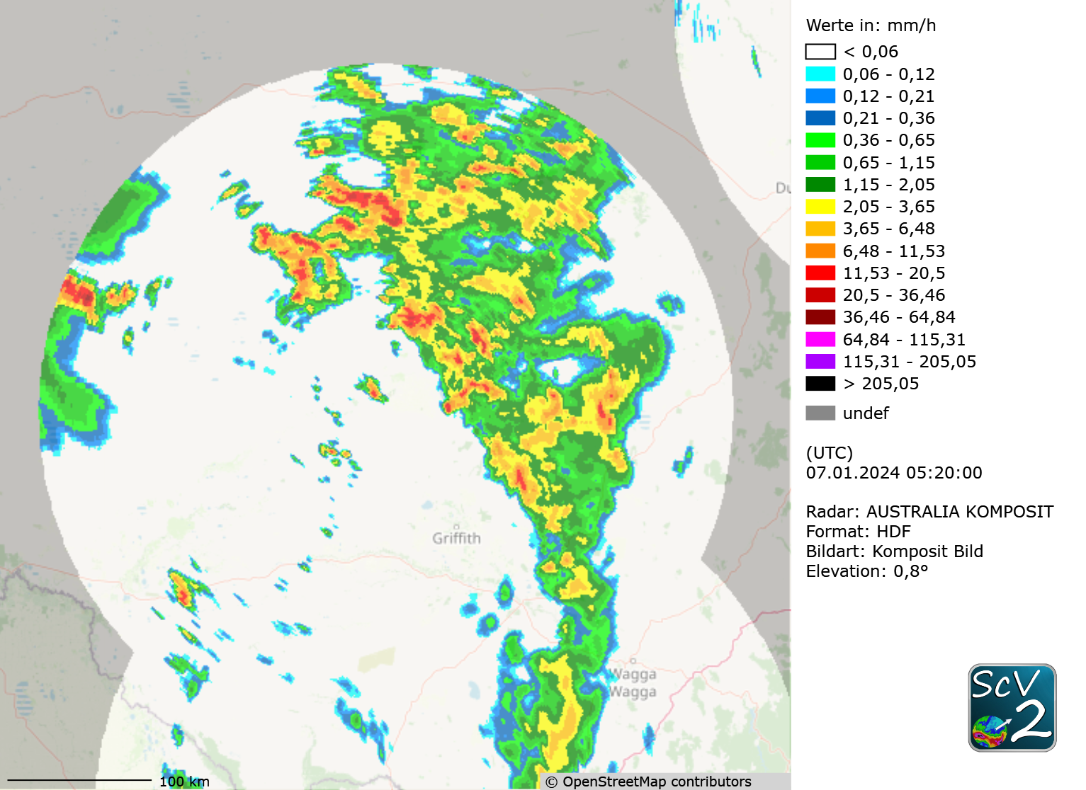
Success and disappointment
Transition from day to night or vice versa whenever the solar zenith angle is greater than 70°
Visible effects:
  moves from finer to very coarse resolution
  Changes structural appearance (+overestimation) of the precipitation
It is possible to configure the product to only use the night algorithm
Similar structural features but clear overestimation of the precipitation values within bigger areas of the satellite product and underestimation/ missing precipitation in smaller areas (highlighted circle)
Complex to use

Slide 12
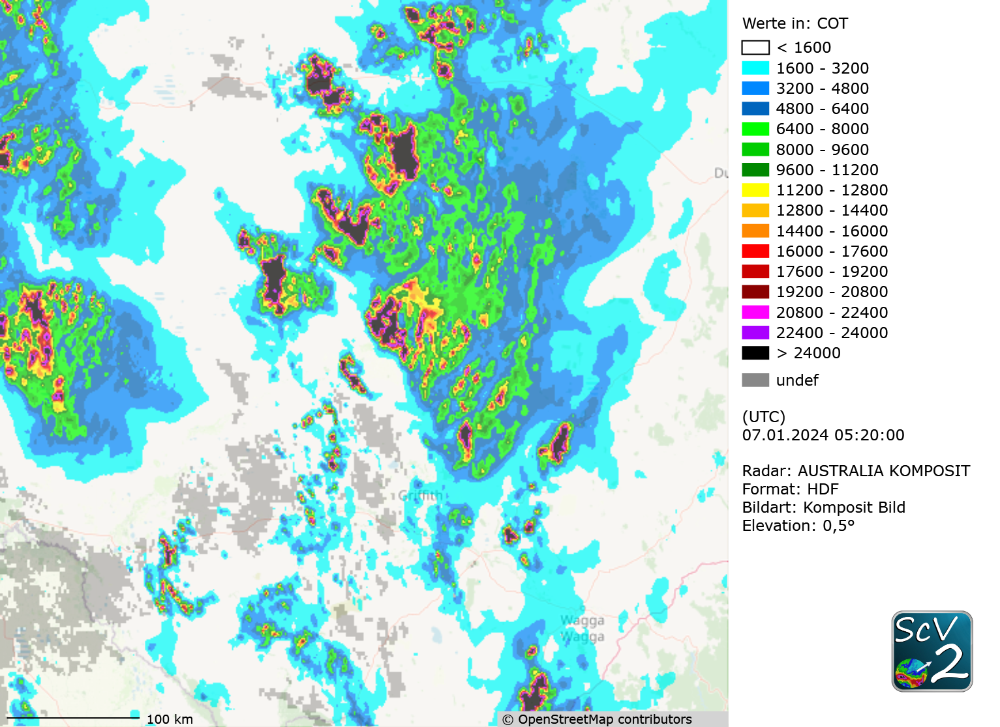
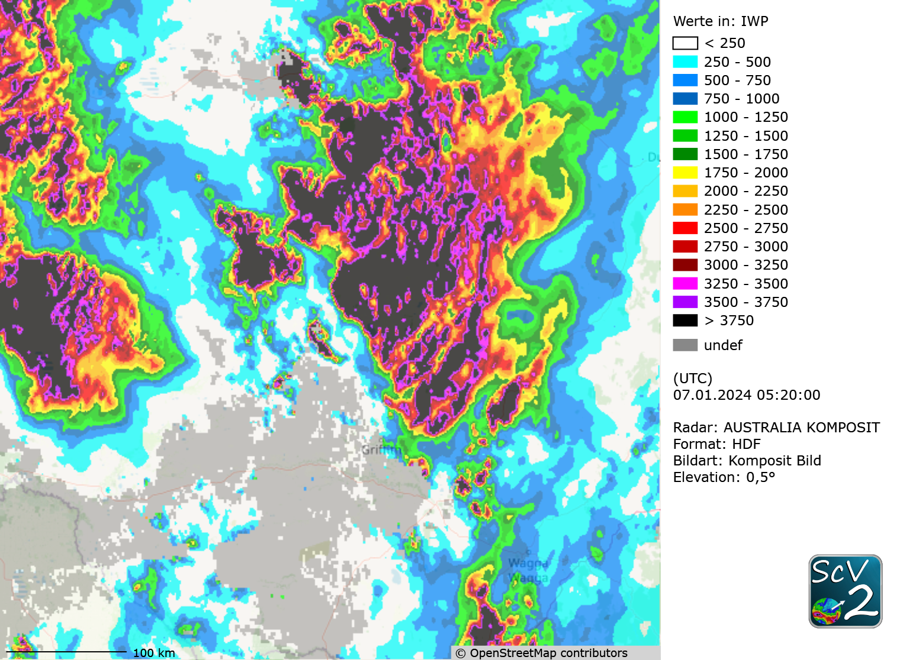
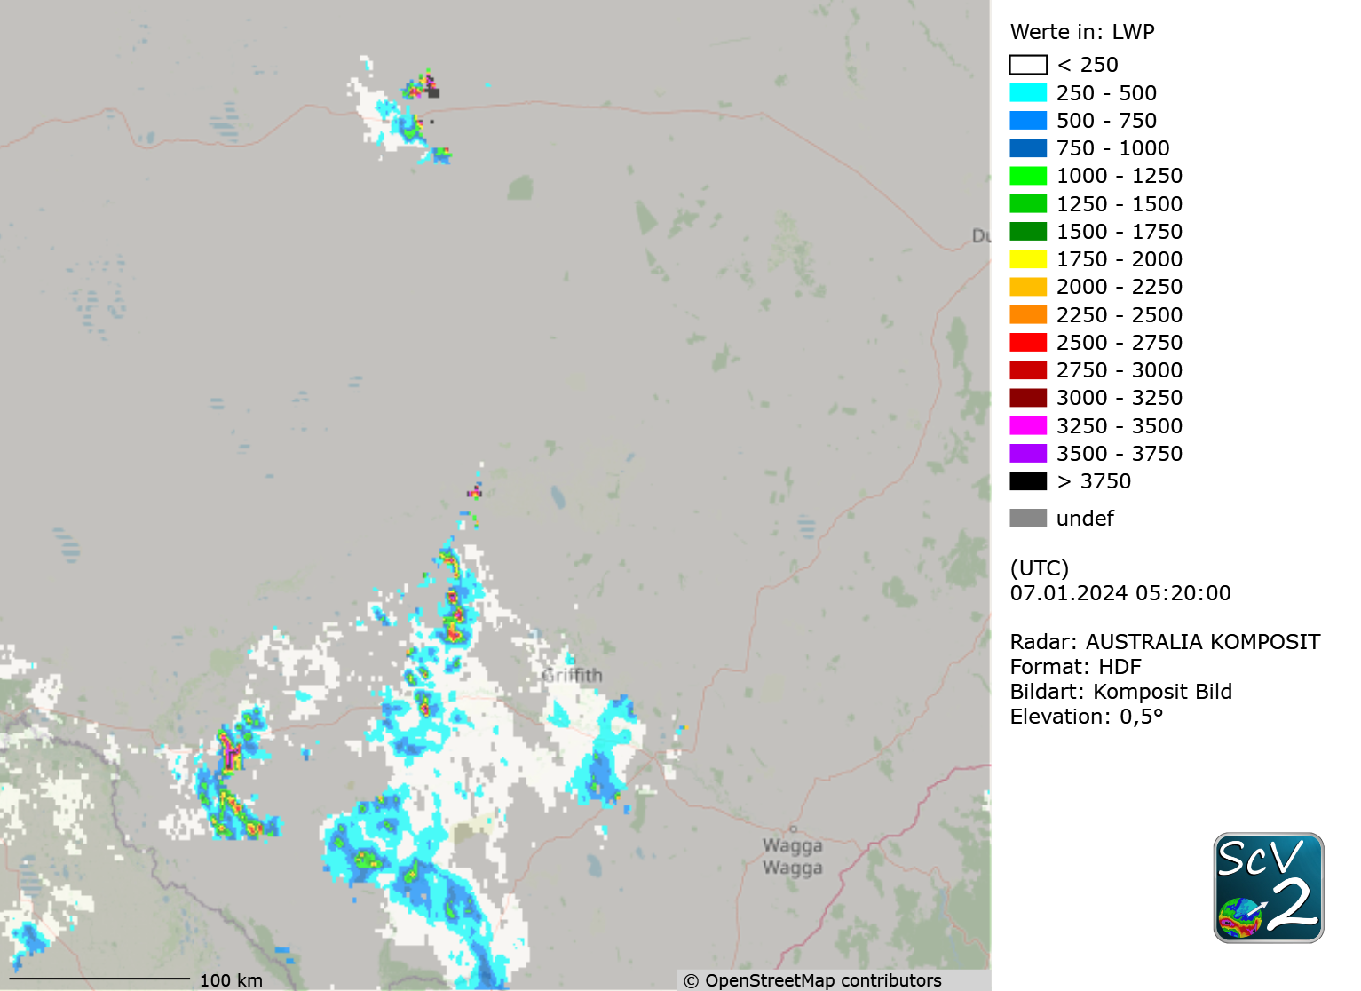
Individual input data
Long name: NWC GEO CMIC Cloud Optical Thickness
units: 1
Valid range: 0, 32000
Long name: NWC GEO CMIC cloud Ice Water Path
units: kg/m²
Valid range: 0, 4000
Long name: NWC GEO CMIC Cloud Liquid Water Path
units: kg/m²
Valid range: 0, 4000
Trying to understand the satellite product by looking at the individual input data

Slide 13
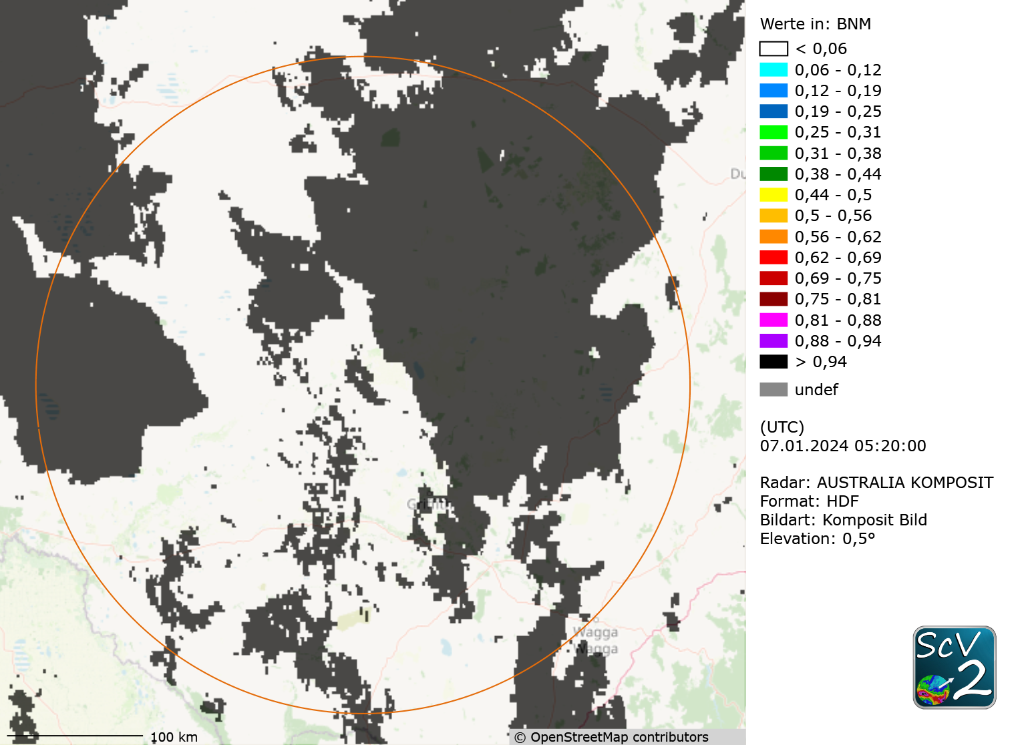
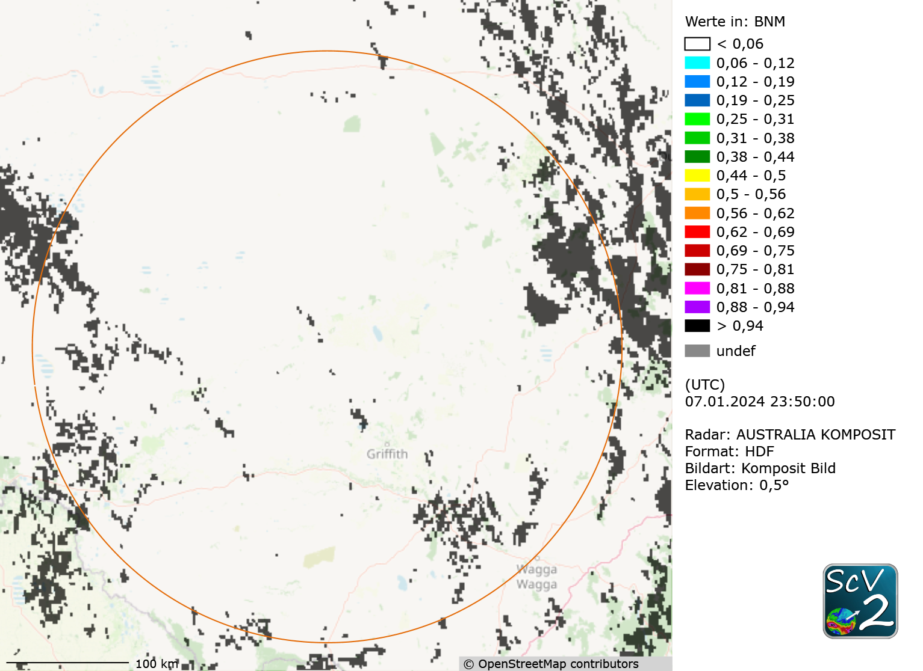
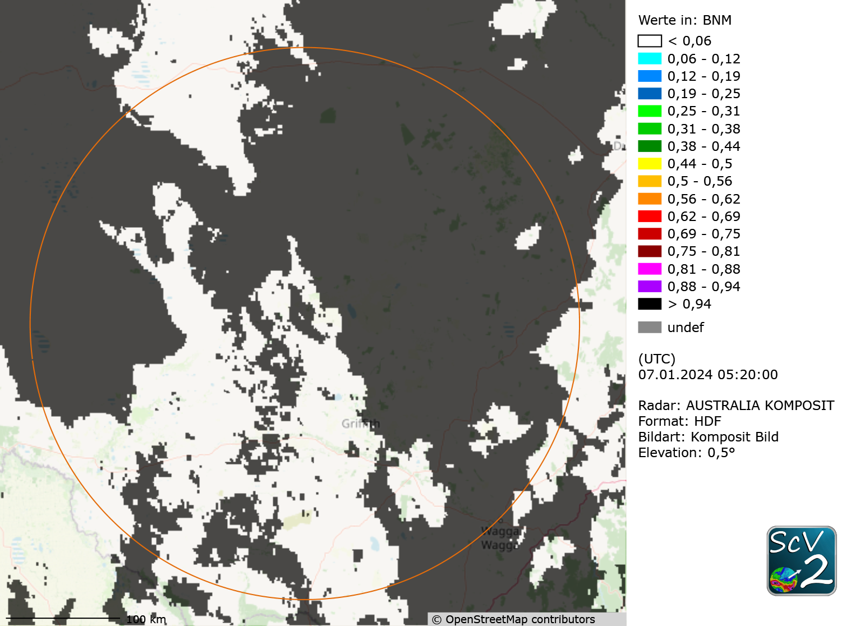
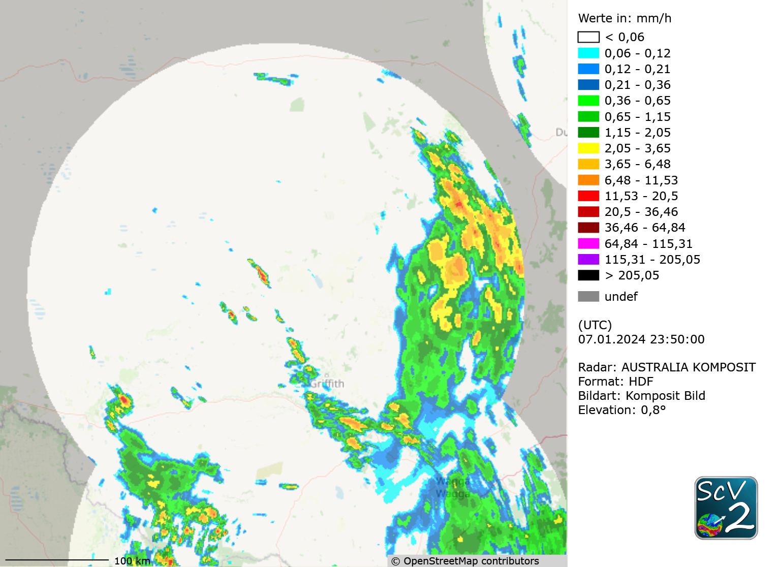
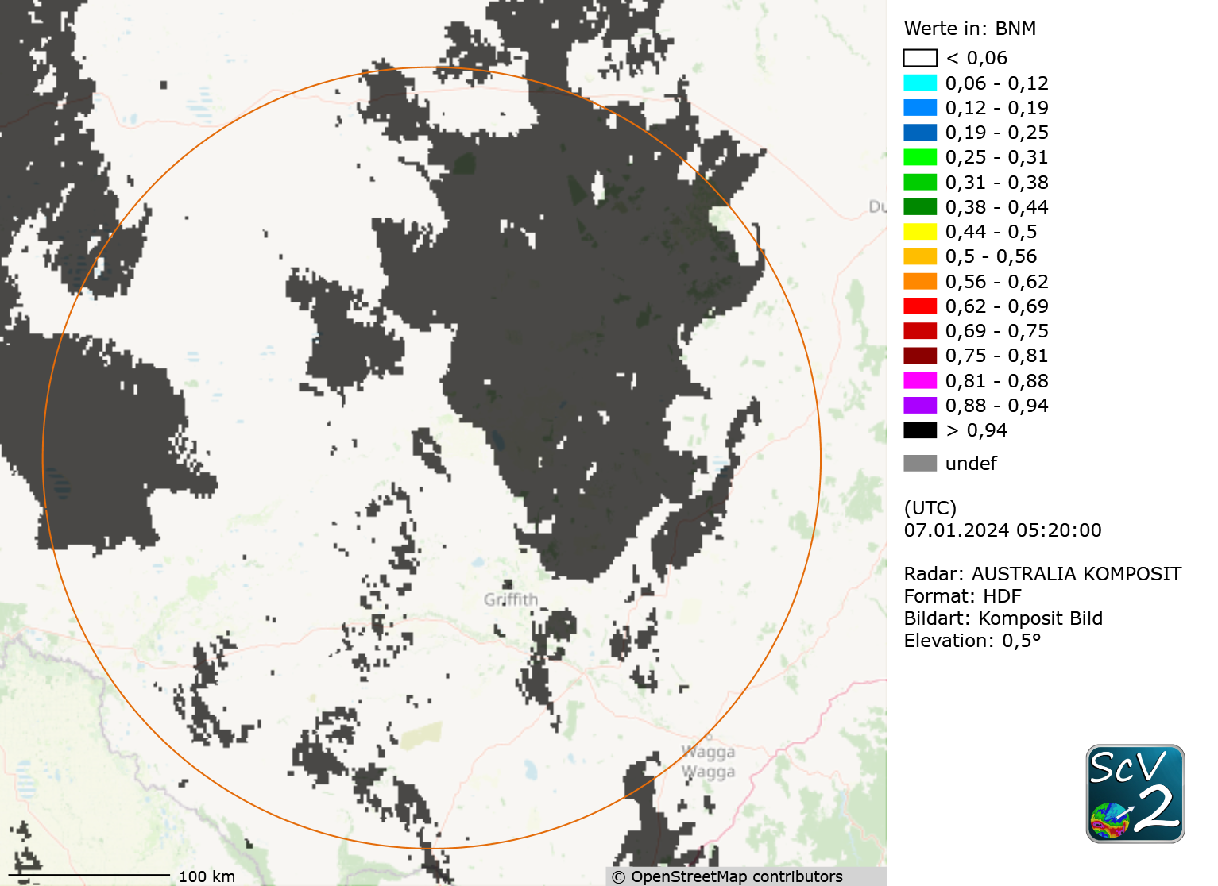
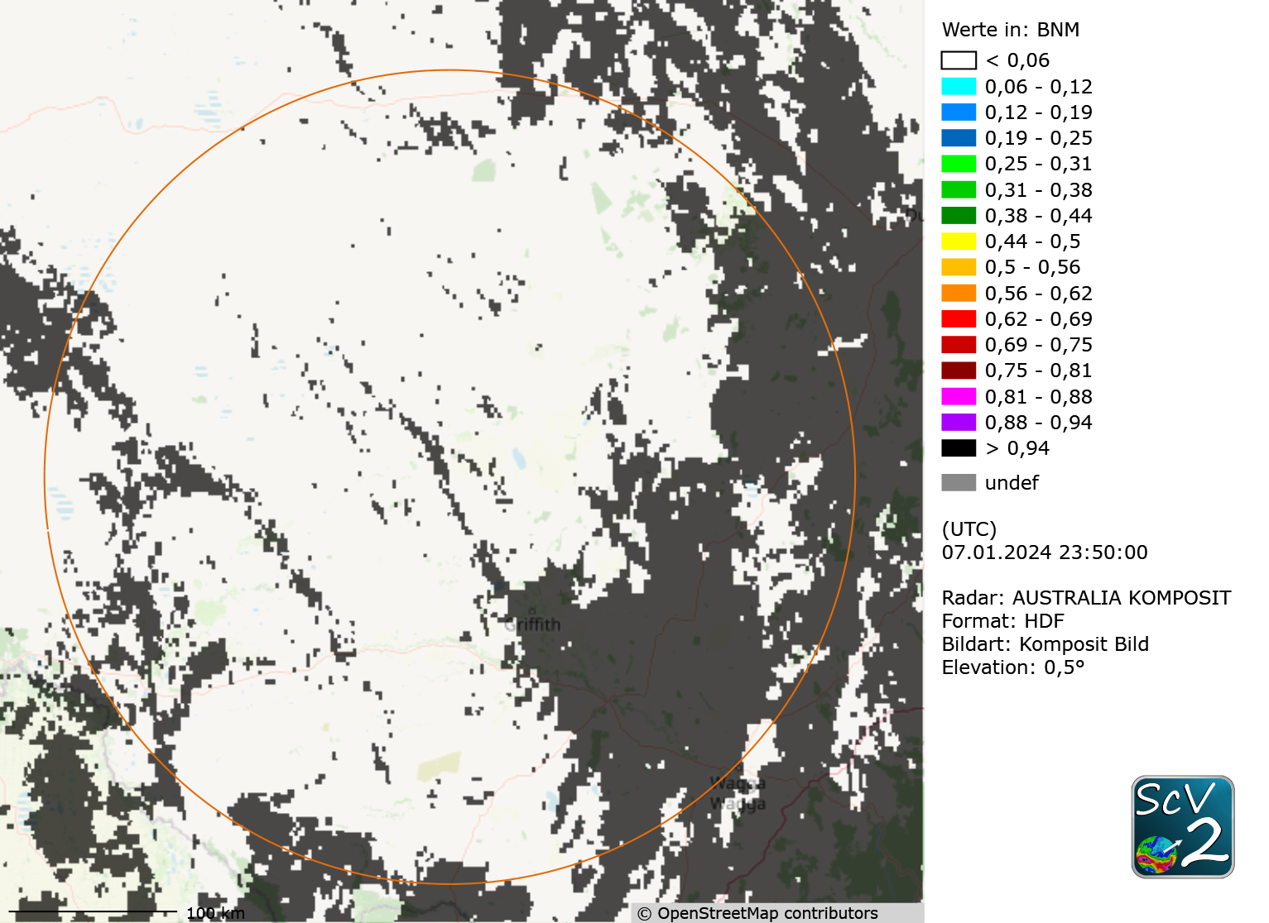
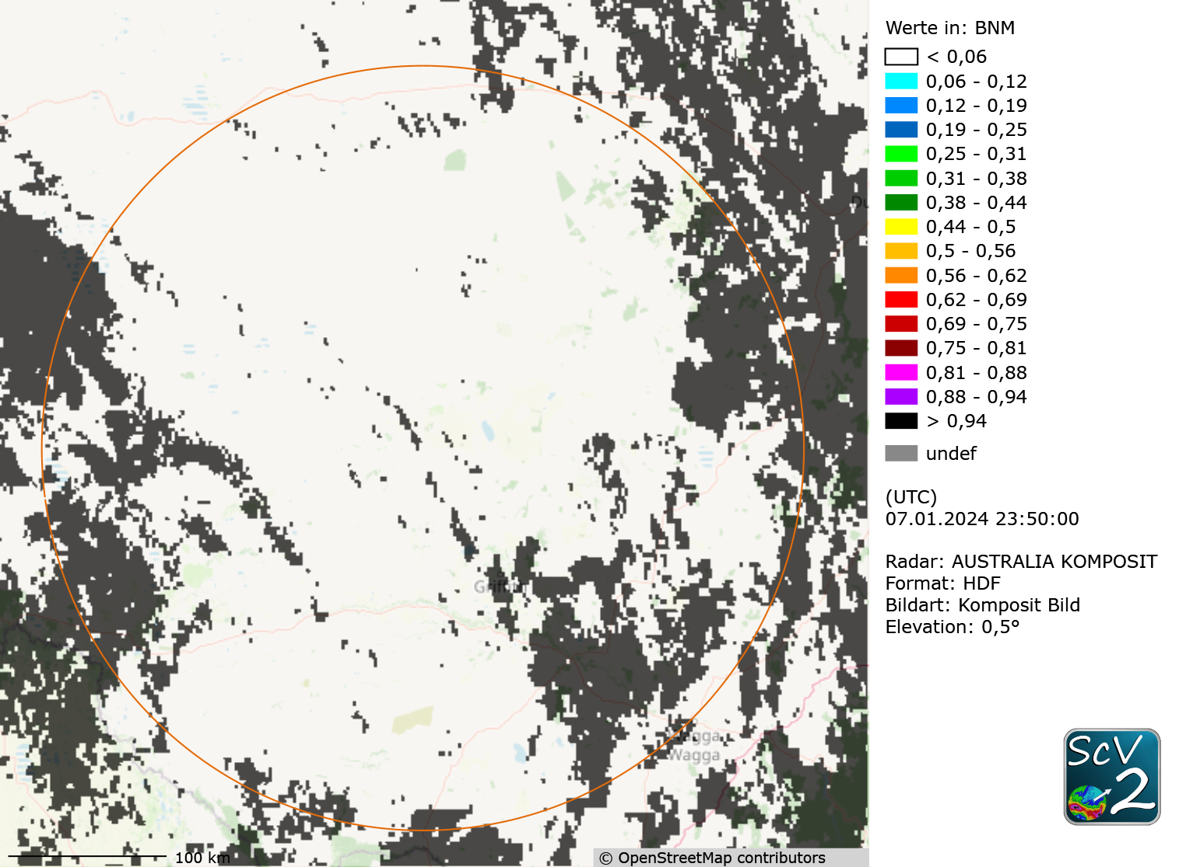
Binary masks
Notes:
1. Maske: COT > 3500 und (LWC>200 oder IWC >200)
2. Maske: COT > 2000 und (LWC>50 oder IWC >50)
3. Maske: COT > 1000 und (LWC>250 oder IWC >250)

Slide 14
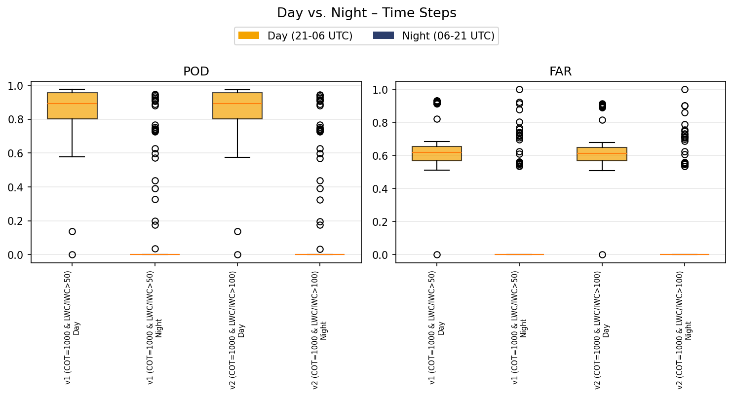
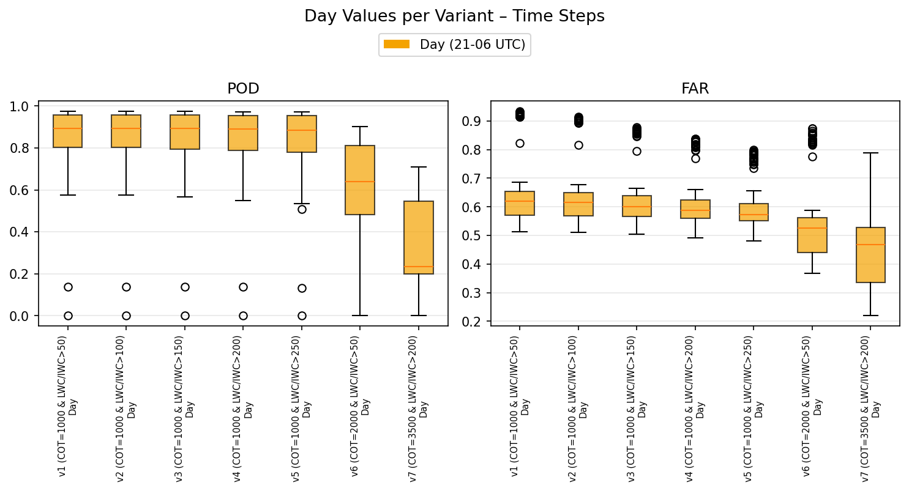
Binary masks

Slide 15
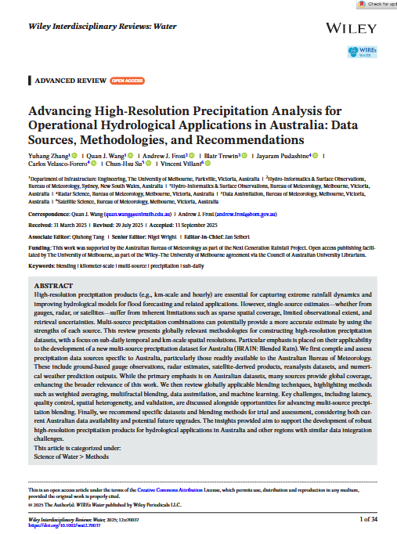
Multi-source precipitation dataset
Single-source estimates suffer from inherent limitations such as sparse spatial coverage, limited observational extent, retrieval uncertainties
The goal is to develop a multi-source precipitation product
Possible components:
  Radar
  Satellite
  Rain gauges
  NWP
  Temperature
  …
Zhang, Y. et al. published a paper, analysing and recommending specific
datasets and blending methods for trial and assessment
  multi-source precipitation dataset for Australia (BRAIN: Blended Rain)

Slide 16
Outlook for Europe
Meteosat Third Generation
  For areas without radar coverage
  For radar data correction
  For an improvement of radar / rain gauge adjustment
  First steps by the end of 2026

Slide 17
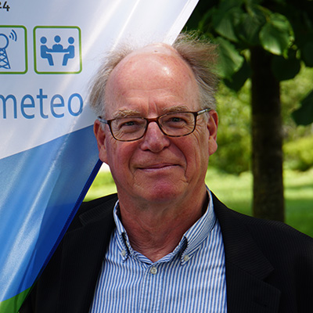

Thank you for listening!
Dr. Thomas Einfalt
Senior Consultant & Founder
einfalt@hydrometeo.de
Tel.: +49-451 – 702 73 33
Anne-Kathrin Kappler
Hydrologist
a.kappler@hydrometeo.de
Tel.: +49-451 – 702 73 35

