Slide 1






An Extreme Precipitation Event Database for the Contiguous U.S.
Daniel Watters¹, Pierre Kirstetter¹⁻⁴, Andy Wood^{5,6}, Andy Newman⁵, & Guoqiang Tang⁷
¹Advanced Radar Research Center, University of Oklahoma (OU)
²School of Meteorology, OU
³School of Civil Engineering and Environmental Sciences, OU
⁴NOAA National Severe Storms Laboratory
⁵NCAR
⁶Colorado School of Mines
⁷Wuhan University
IPWG-12 Workshop | Krakow, Poland | July 2026

Slide 2
Overview
Aim: Produce a sub-hourly extreme precipitation event database for CONUS to mutually support the newly-developed Geospatial Probabilistic Estimation Package (GPEP) daily multi-decadal probabilistic surface precipitation product (and vice versa).
Novelties:
  First database to quantify record of CONUS extreme precipitation events
  Bridge in-depth and consistent process characterization from sub-hourly to daily timescales
Benefits:
  Study extreme precipitation processes in high spatiotemporal resolution
  Evaluate and develop models and new precipitation datasets
  Validate spaceborne precipitation retrievals from a process perspective
  Support emergency management
IPWG-12 Workshop
Daniel Watters – daniel.watters@ou.edu
2

Slide 3
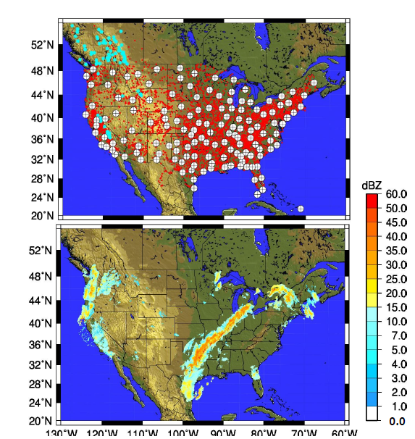
MRMS: The Multi-Radar Multi-Sensor System
MRMS = Mosaic of
Ground Radars + Gauges + Model
Domain: 20-55°N, 130-60°W
Resolution: 0.01°, 2-min update cycle
Data sources:
  ~180 polarimetric radars every 2-min
  ~9000 gauges every hour
  RAP model hourly 3D analyses
Top: MRMS inputs including radars (crosshairs) and gauges (red circles)
Bottom: Reflectivities from MRMS mosaic for a frontal system at 0800 UTC on April 11, 2011
IPWG-12 Workshop
Daniel Watters – daniel.watters@ou.edu
3

Slide 4
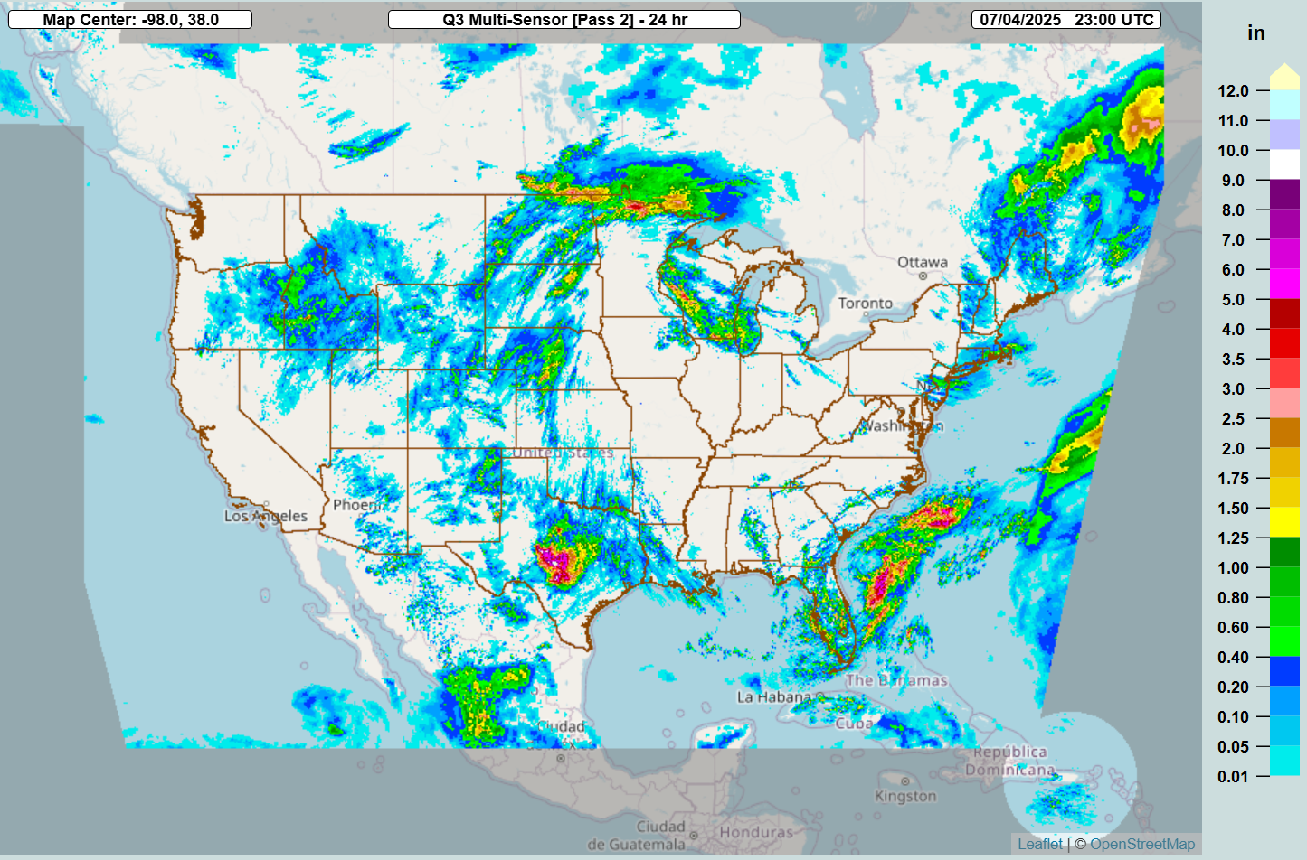
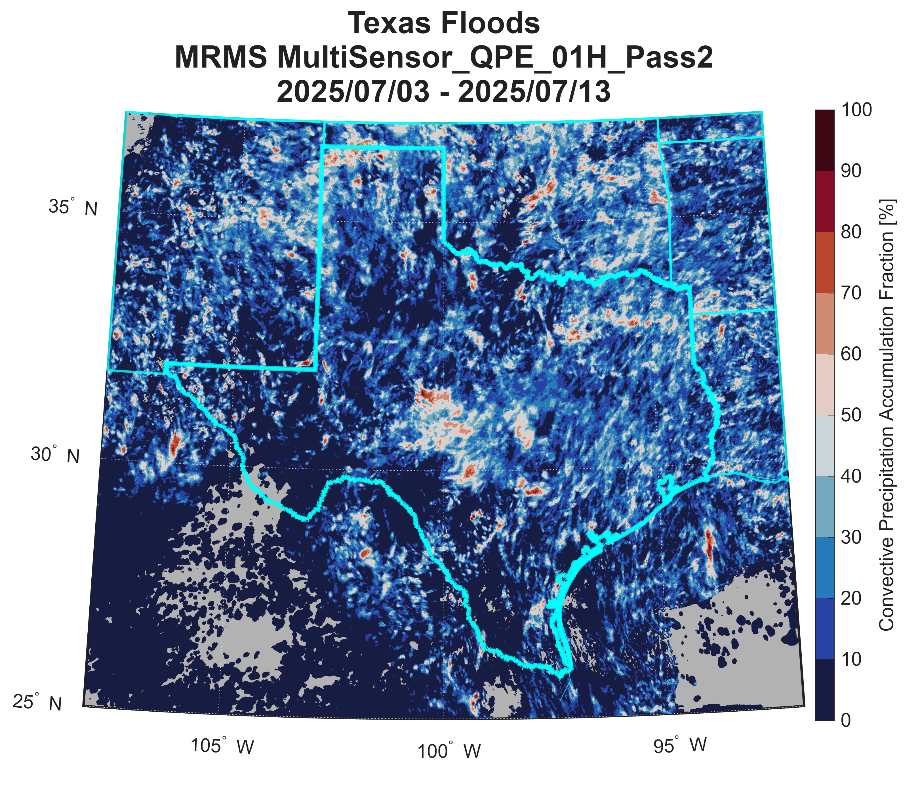
Method
Daily Scale
Automatically Detect Extreme Event
Sub-Daily Scale (2-min, Hourly)
Detailed Diagnosis
Texas Floods
July 2025
Daily accumulation for July 4, 2025
Convective fraction from 2-min files for July 3-13, 2025
IPWG-12 Workshop
Daniel Watters – daniel.watters@ou.edu
4

Slide 5
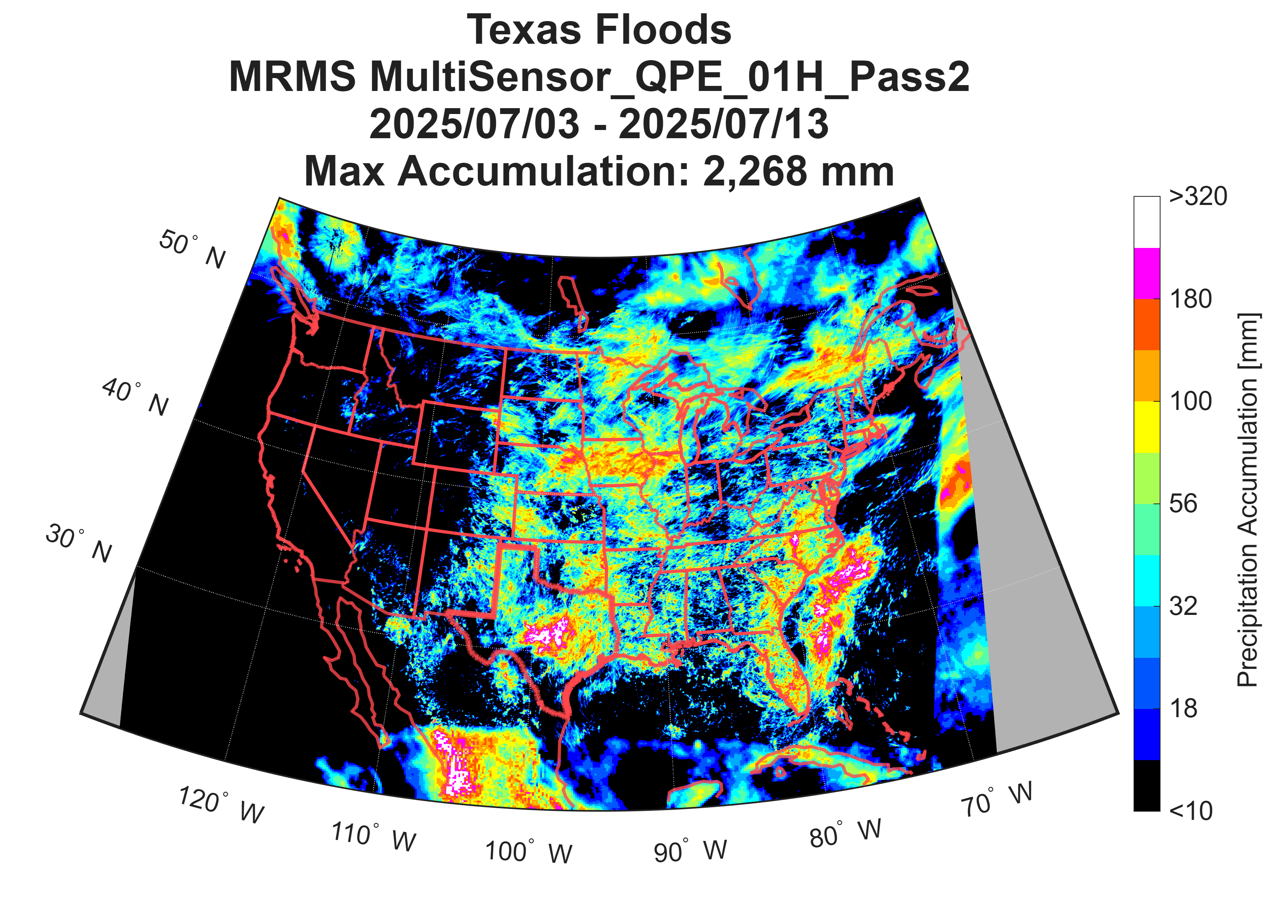
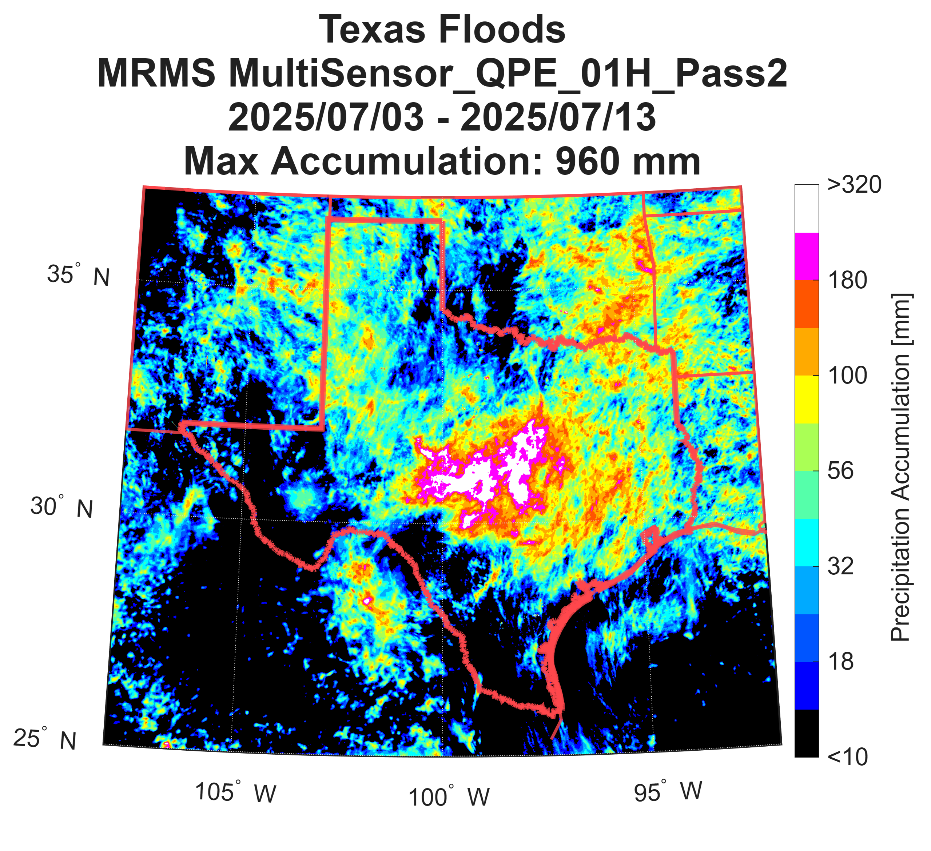
Event Period Extraction
Texas Floods 2025
Event Characteristics: Accumulation
CONUS
Texas
Accumulation = Sum of hourly MRMS precipitation rates across event period
MRMS resolution = 0.01° x 0.01°
IPWG-12 Workshop
Daniel Watters – daniel.watters@ou.edu
5

Slide 6
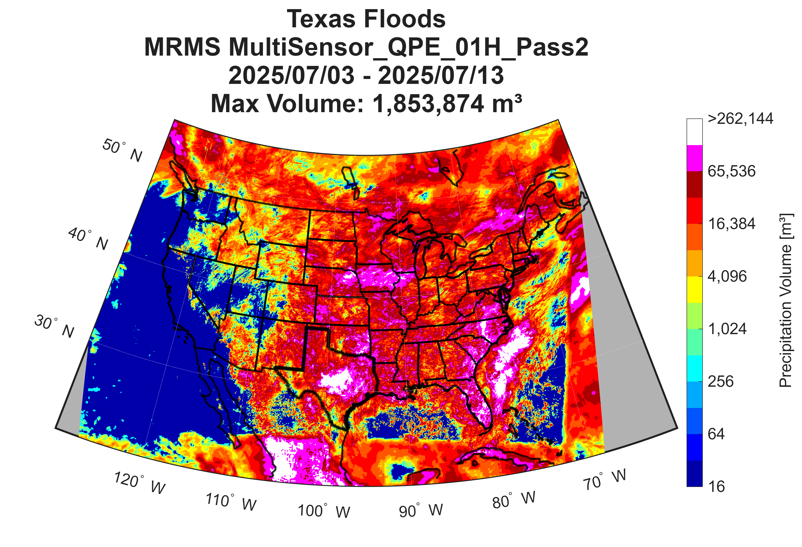
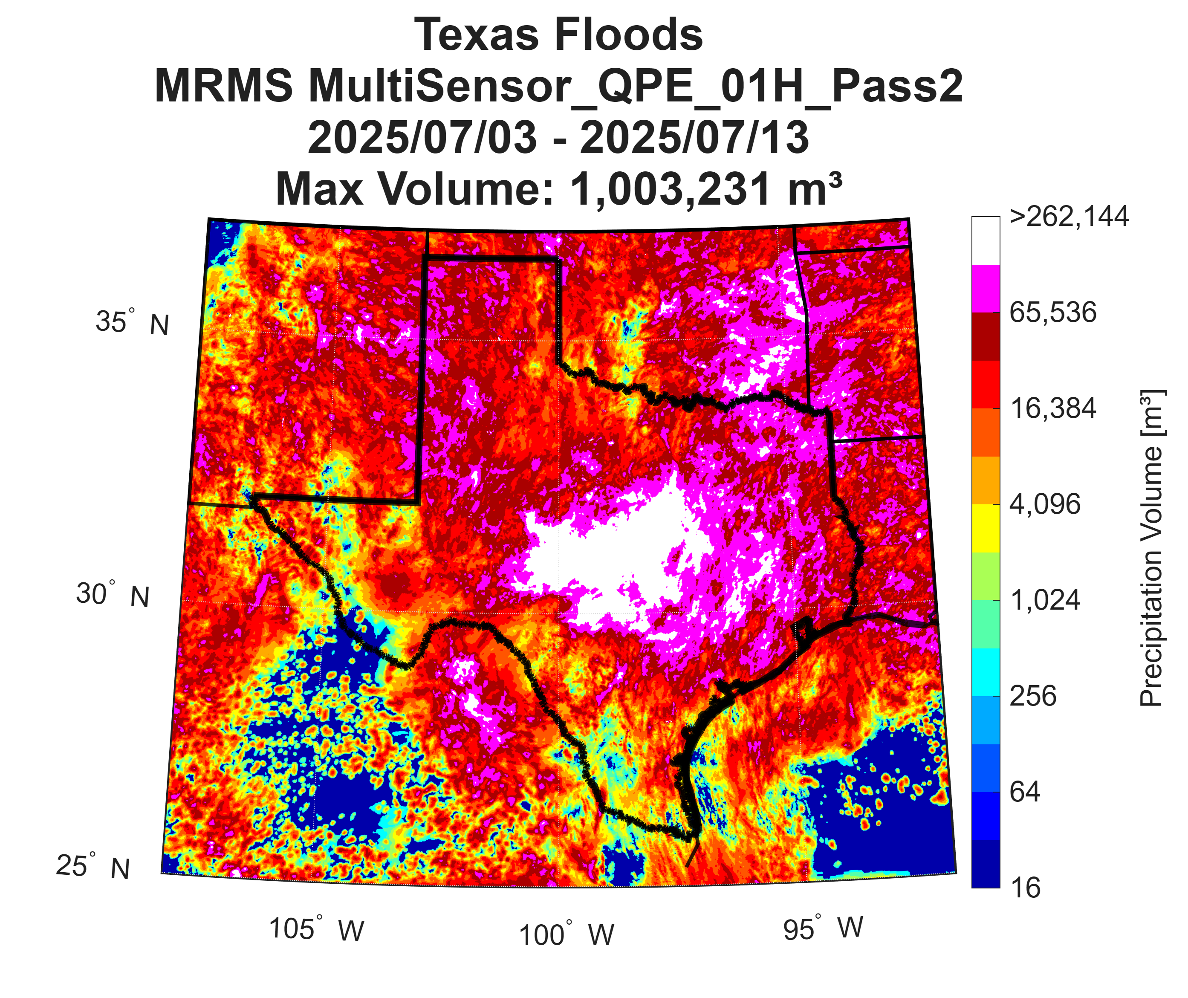
Event Period Extraction
Texas Floods 2025
Event Characteristics: Volume
CONUS
Texas
Volume [m³] = Accumulation [m] x Pixel Area [~ 10⁶m²]
MRMS resolution = 0.01° x 0.01°
IPWG-12 Workshop
Daniel Watters – daniel.watters@ou.edu
6

Slide 7
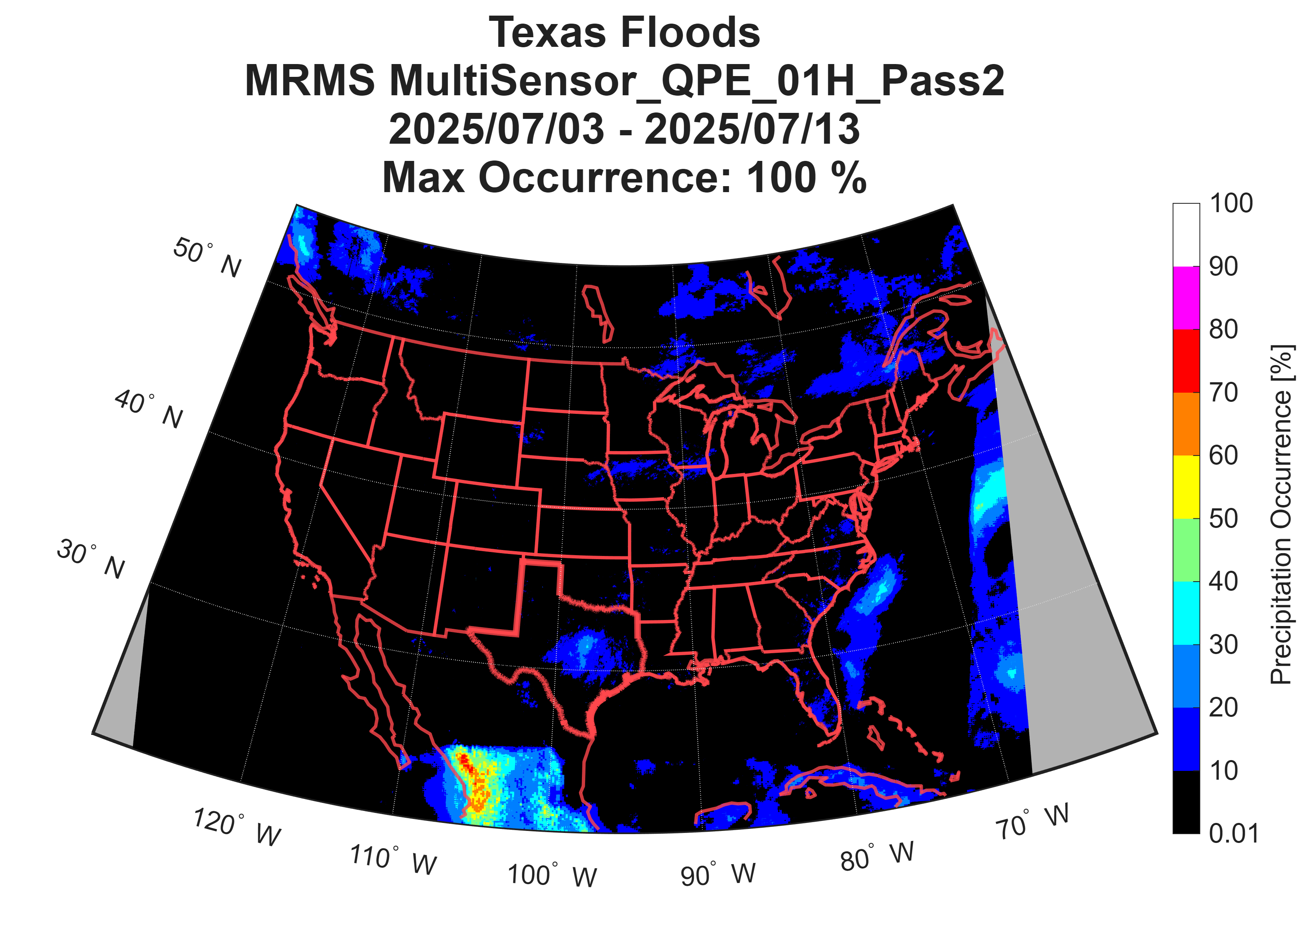
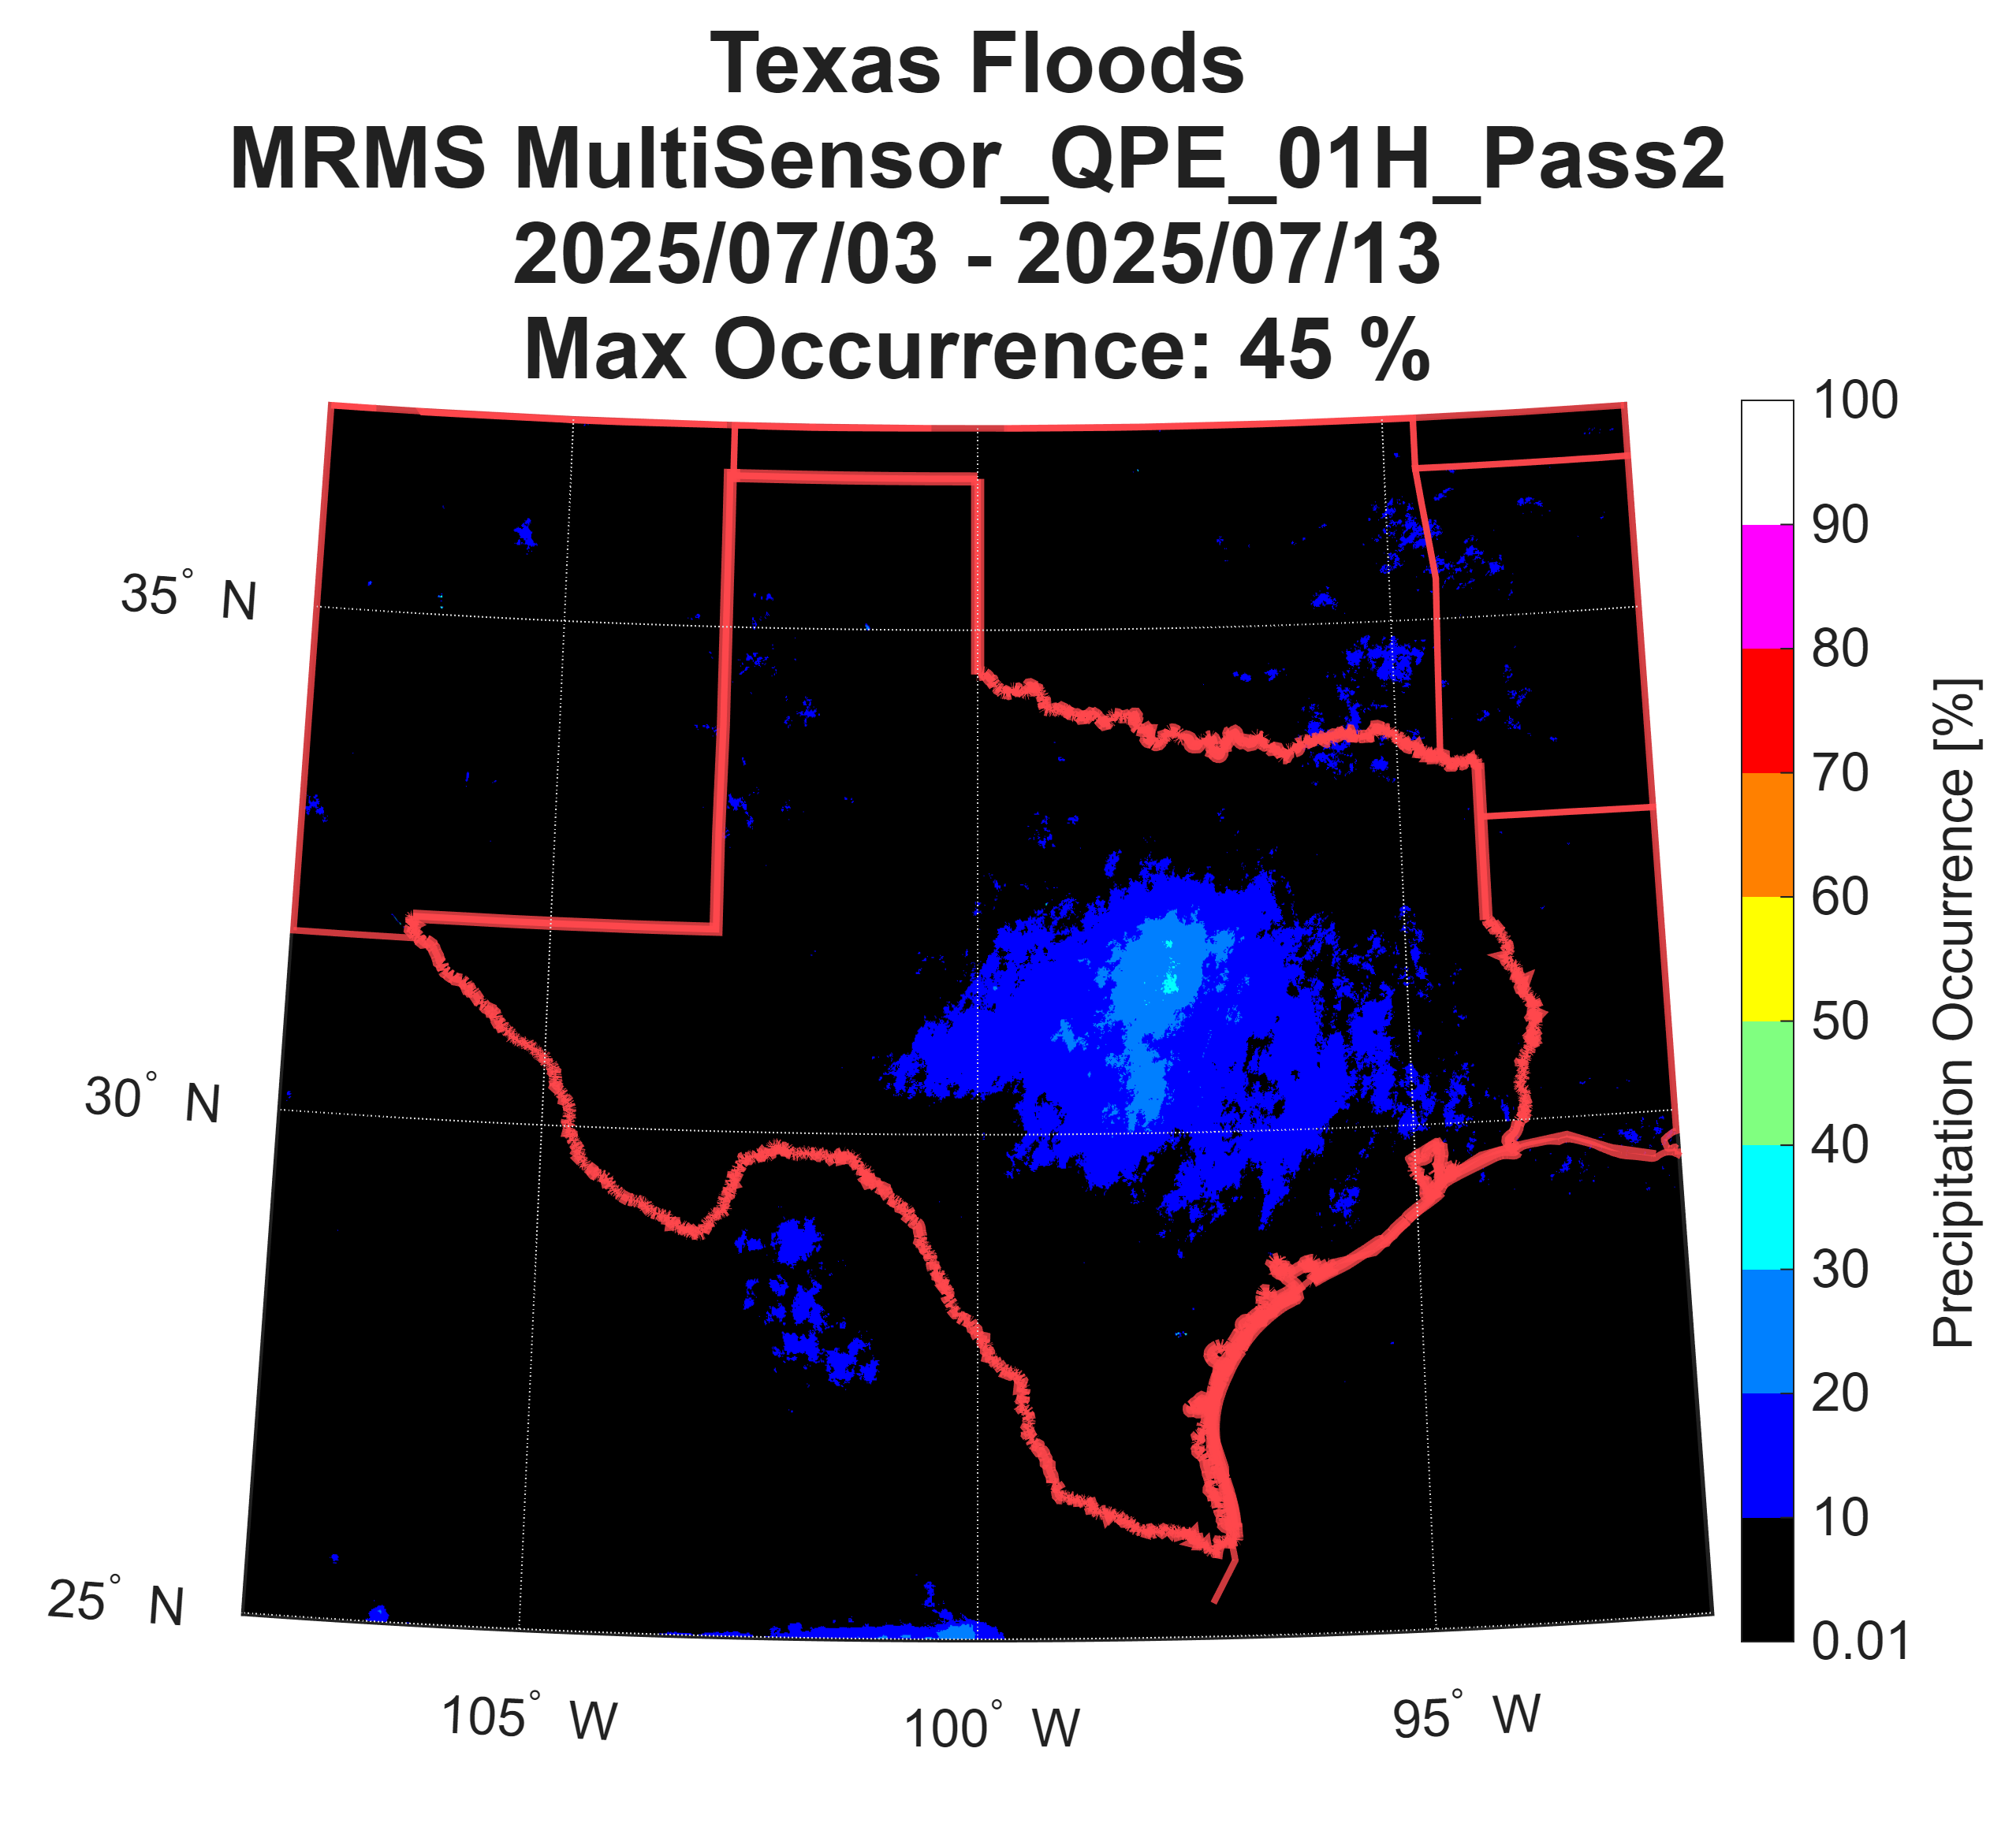
Event Period Extraction
Texas Floods 2025
Event Characteristics: Occurrence
CONUS
Texas
Occurrence = Percentage of hourly MRMS estimates that have precipitation across event period
MRMS resolution = 0.01° x 0.01°
IPWG-12 Workshop
Daniel Watters – daniel.watters@ou.edu
7

Slide 8
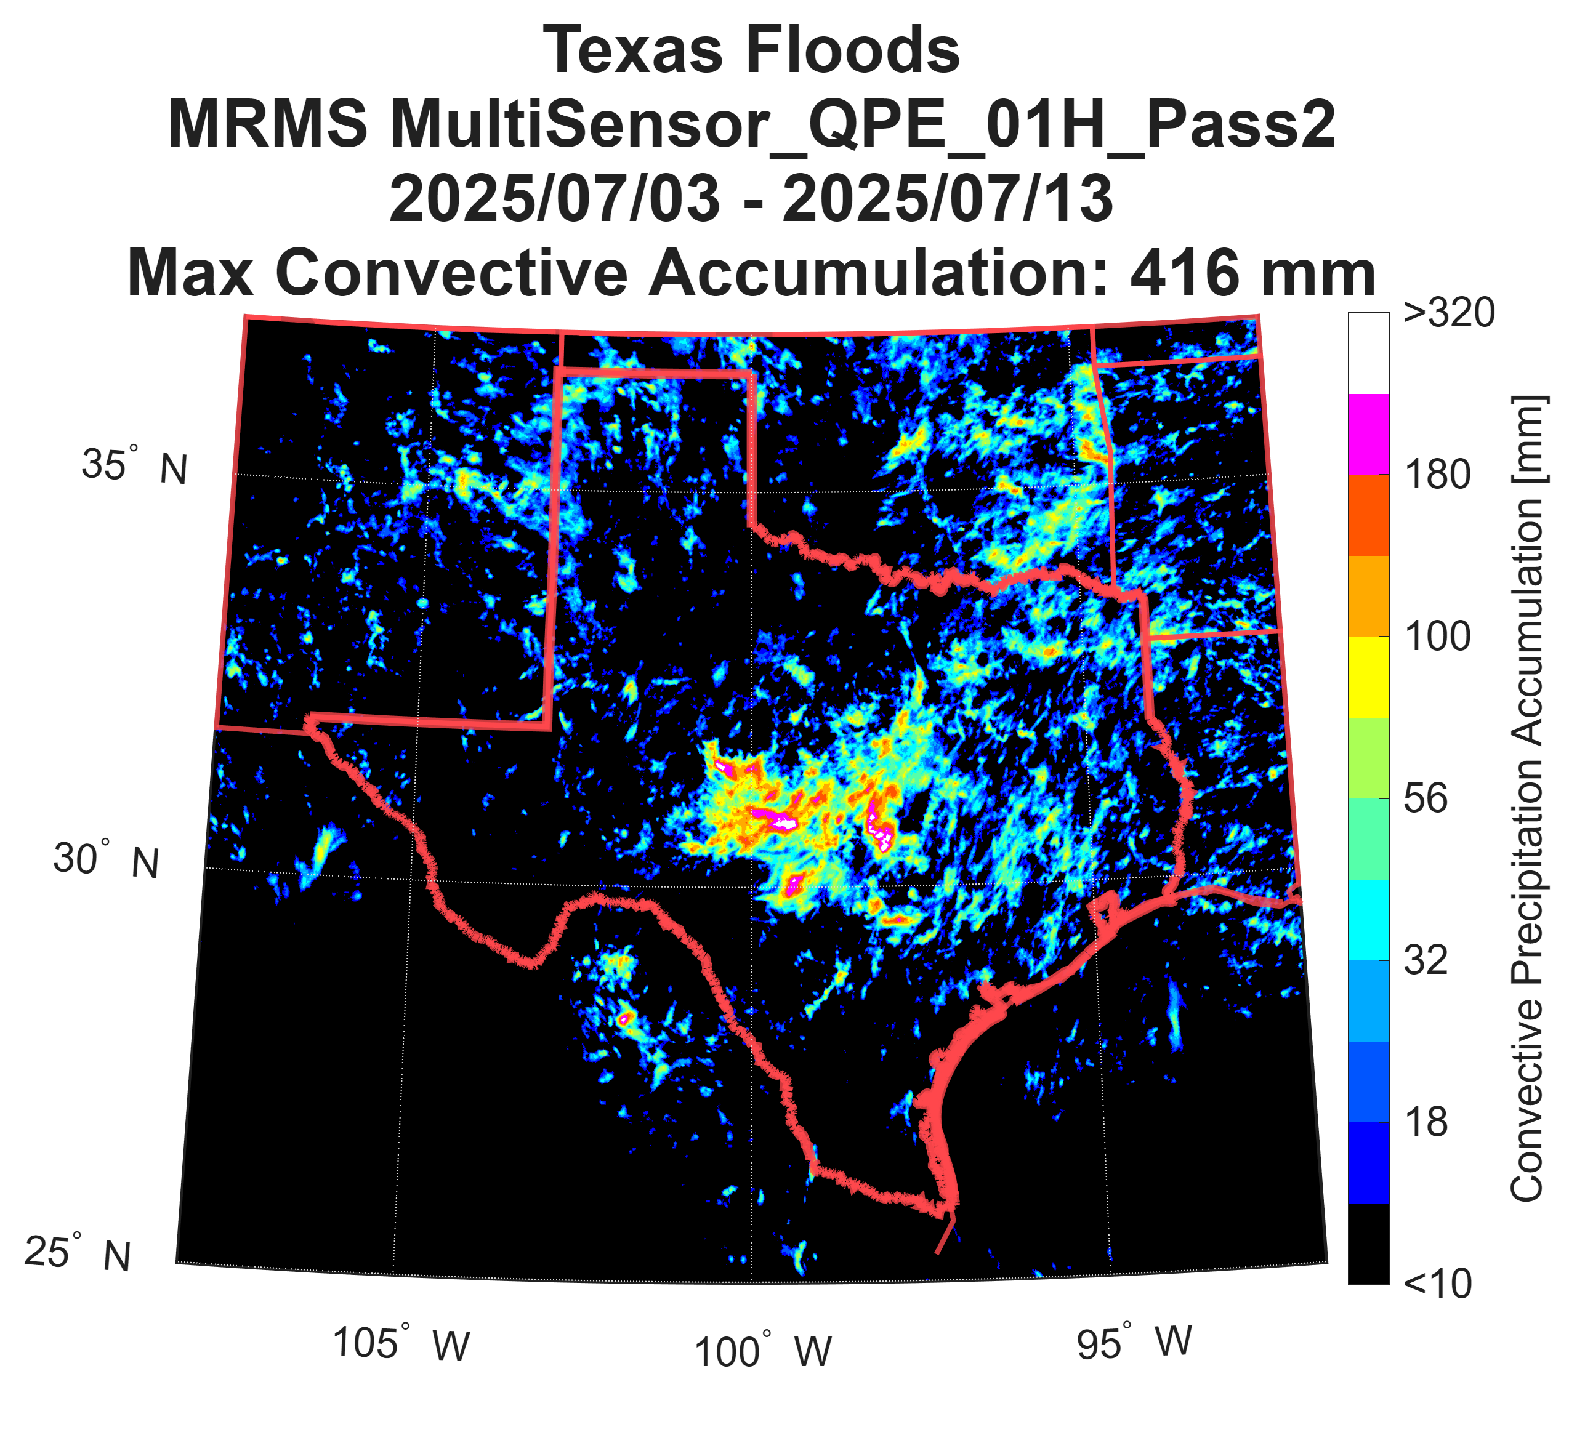
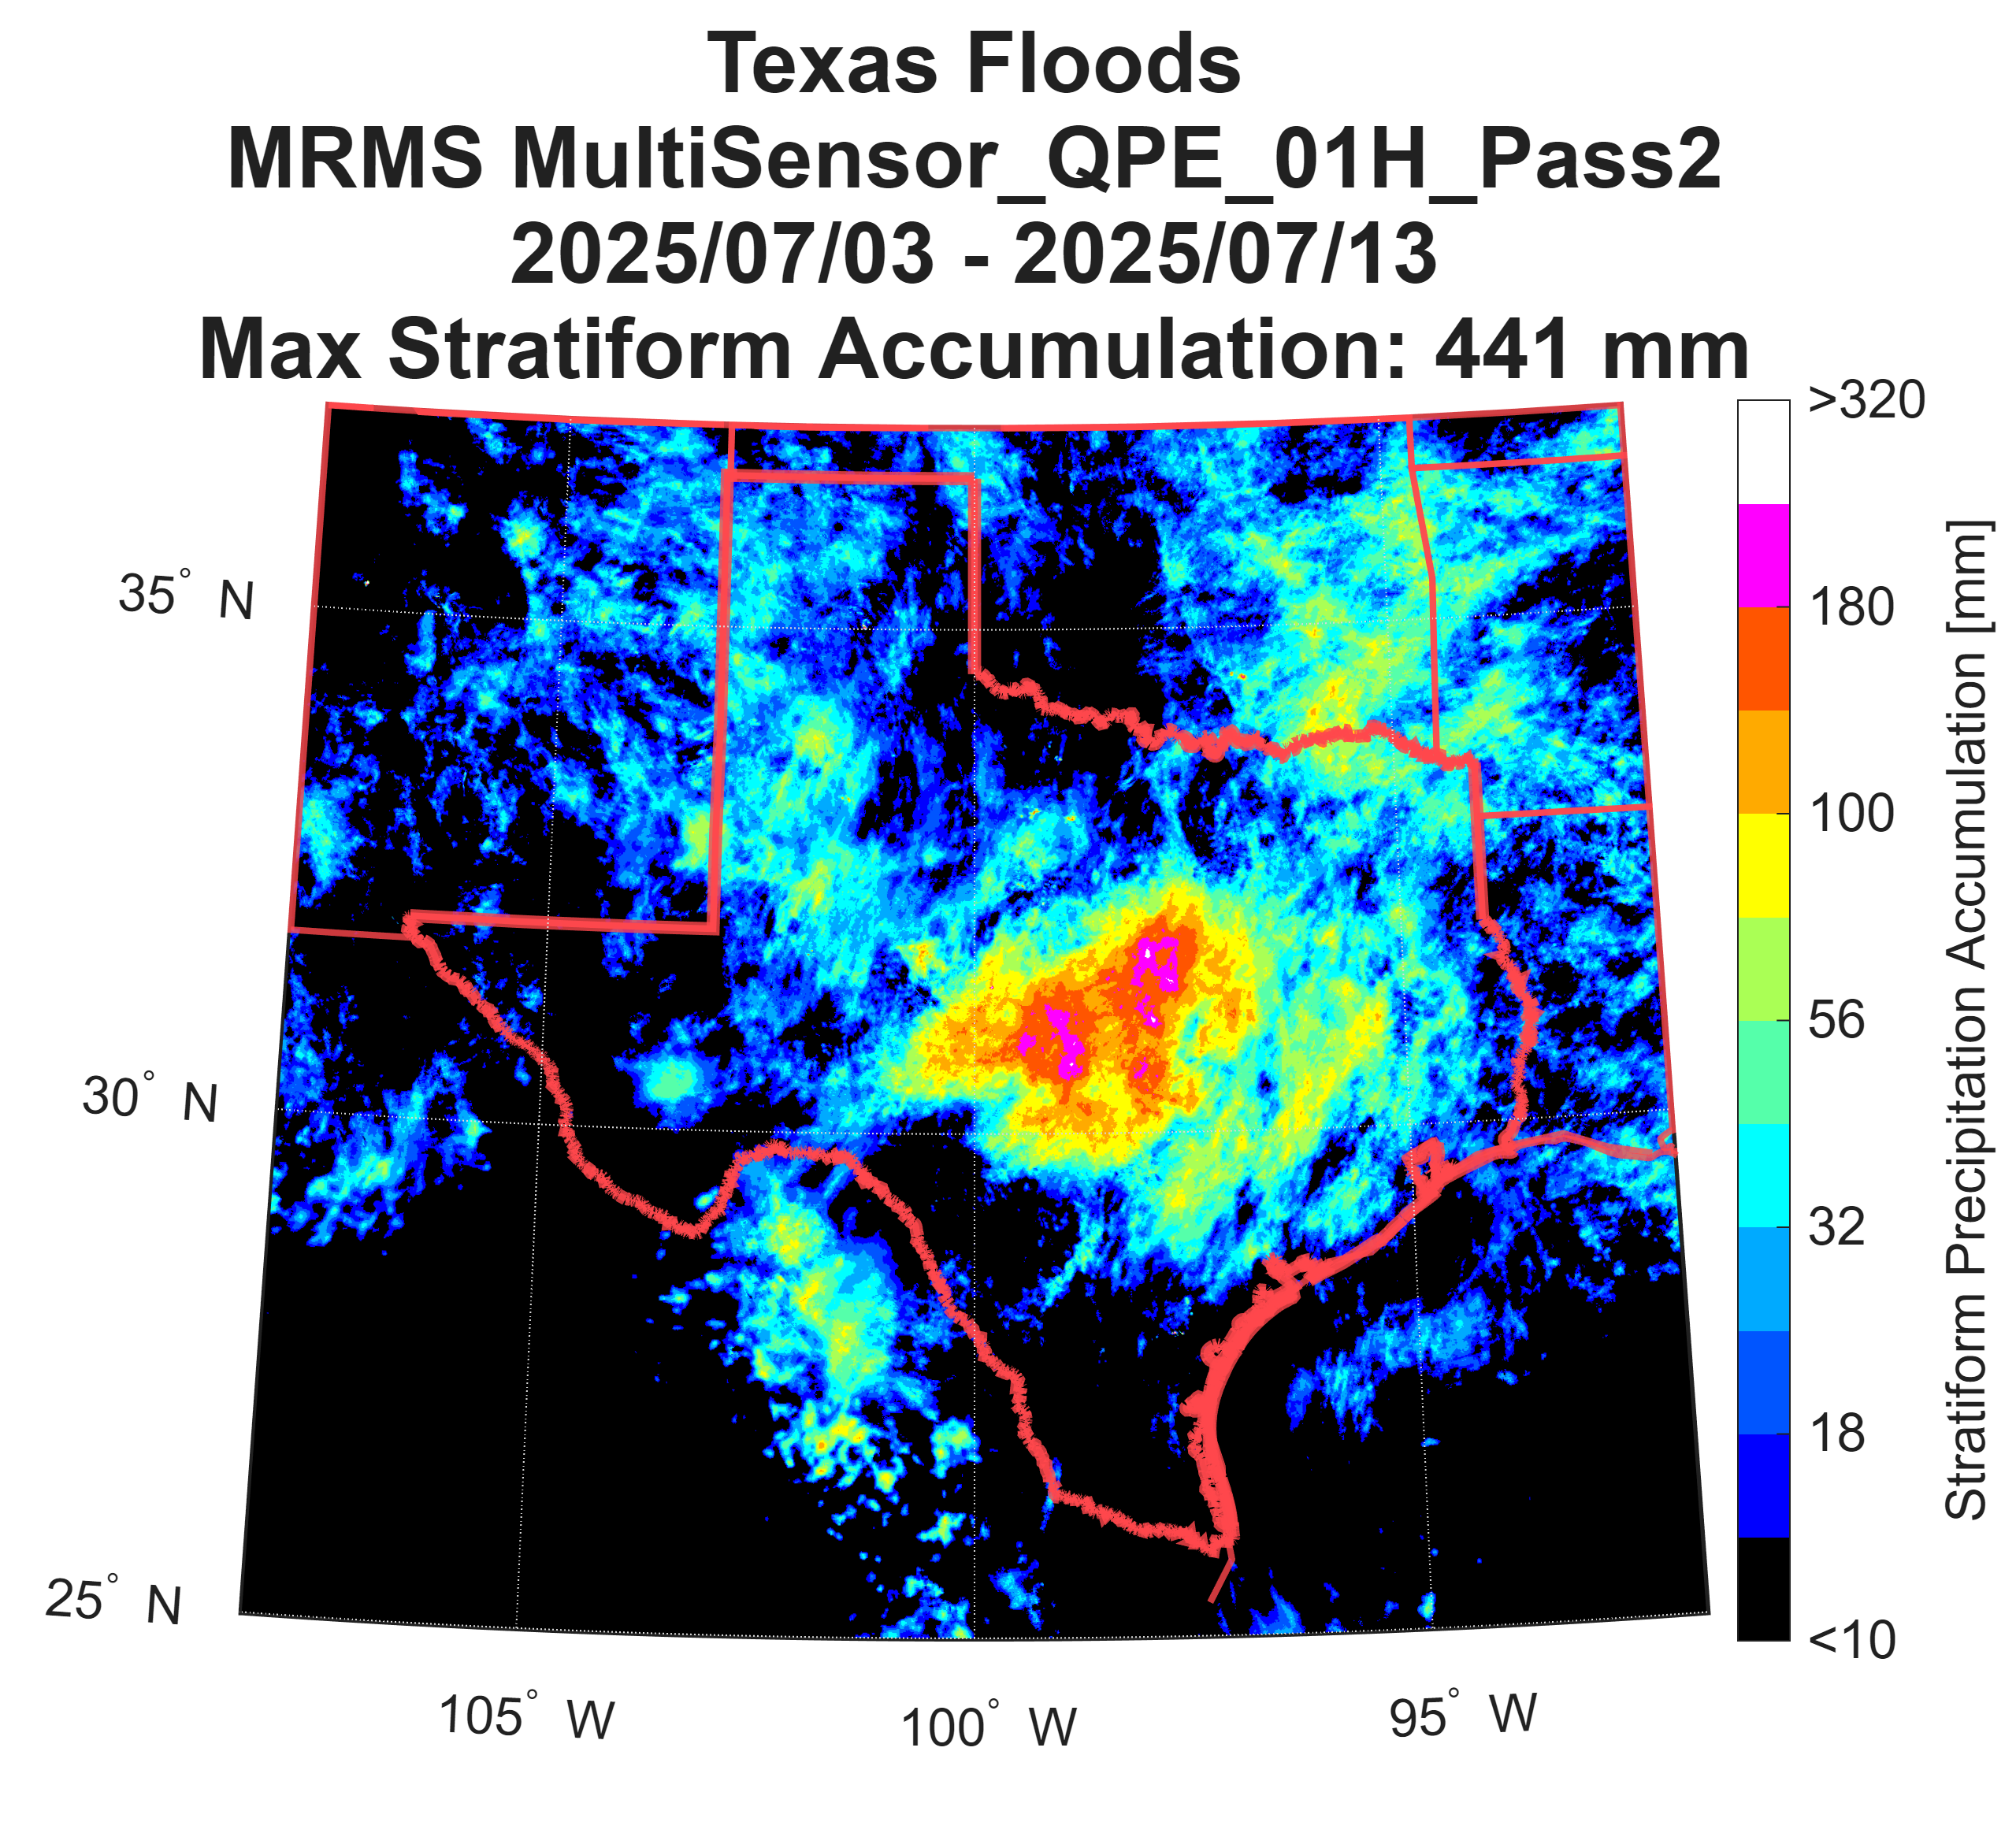
Sub-Daily Extraction
Texas Floods 2025
Precipitation Typology
Convective Accumulation
Stratiform Accumulation
Typology Accumulation = Sum of hourly MRMS precipitation rates across event period x Fraction of 2-min. MRMS typologies
IPWG-12 Workshop
Daniel Watters – daniel.watters@ou.edu
8

Slide 9
Sub-Daily Extraction
Texas Floods 2025
Precipitation Typology Contribution
Accumulation
Convective Fraction
Convective
Stratiform
Accumulation = Sum of hourly MRMS precipitation rates across event period
Percentage of 2-min. MRMS convective flags
IPWG-12 Workshop
Daniel Watters – daniel.watters@ou.edu
9

Slide 10
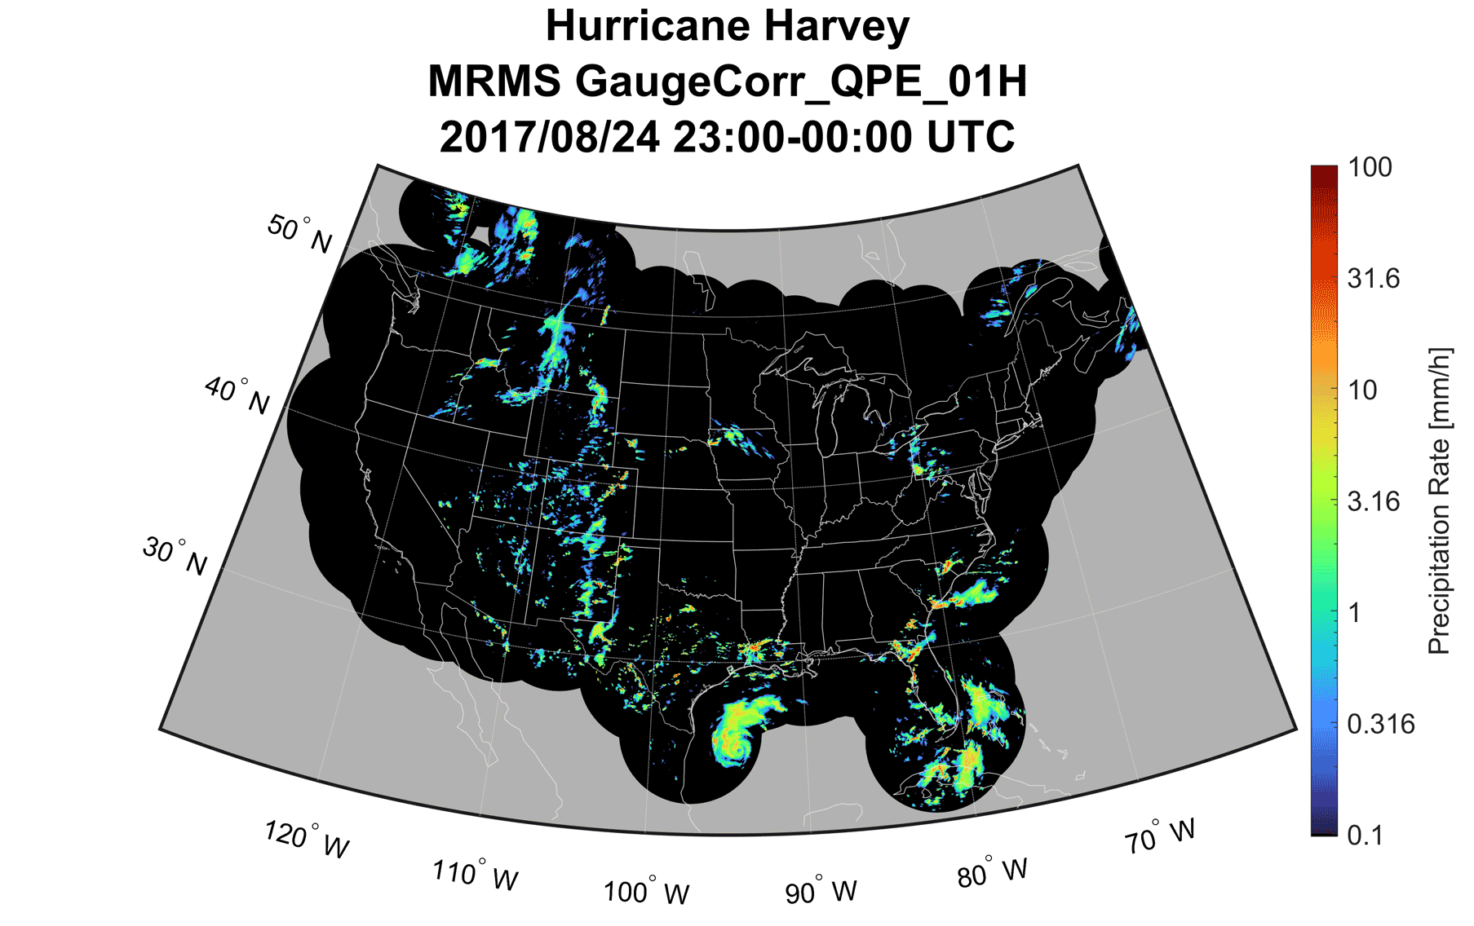
Future Work
Sub-Daily Extractions
Max 2-min/hourly/daily intensity
(and corresponding timing)
Percentiles of precipitation characteristics
System evolution
  Temporal evolution
  Distance travelled
  Size
  Period
Automate Detection of Daily Events
Percentile based approach with GPEP and other products
Evolution of Hurricane Harvey in Aug/Sep 2017
IPWG-12 Workshop
Daniel Watters – daniel.watters@ou.edu
10

