Slide 1




12th Workshop of International Precipitation Working Group
July 7-10, 2026, Kraków Poland
Examining the Potential of Satellite Precipitation Product for Monitoring Extreme Urban Precipitation Events across Contiguous United States
Diya Das¹ and Sandip Pal¹
¹Texas Tech University
The work was done under S³-MAAP project, sponsored by the NASA AWARD # 80NSSC 22K1786 .Thanks to TTU National Wind Institute, West Texas Mesonet (WTM)
Mr. Wesley Burgett and Mr. Matt Asel.
We also express our gratitude to Texas Tech University for awarding us the Distinguished Graduate Student Assistantship (2025-2026), which significantly bolsters our research efforts.
7TH July 2026

Slide 2
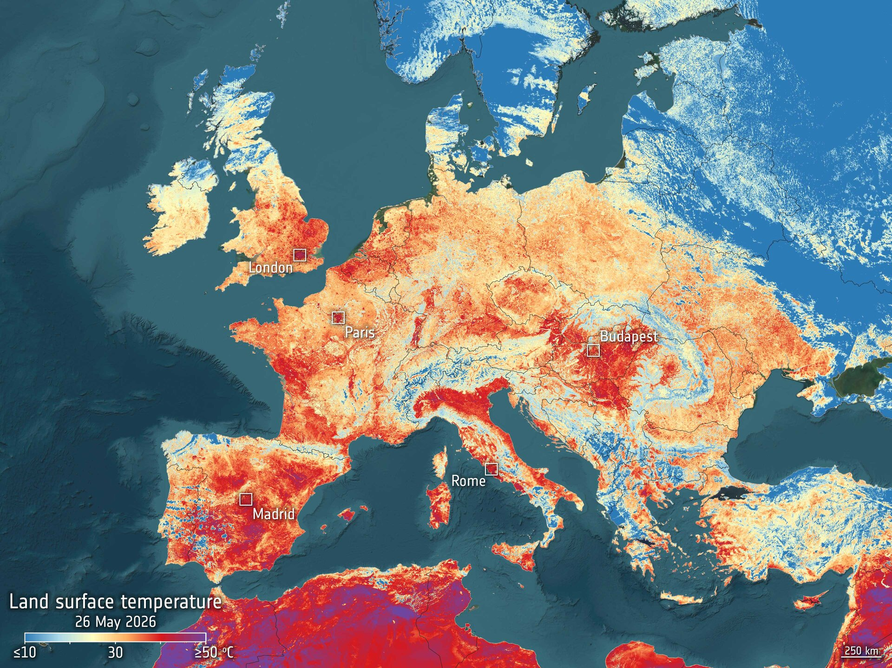
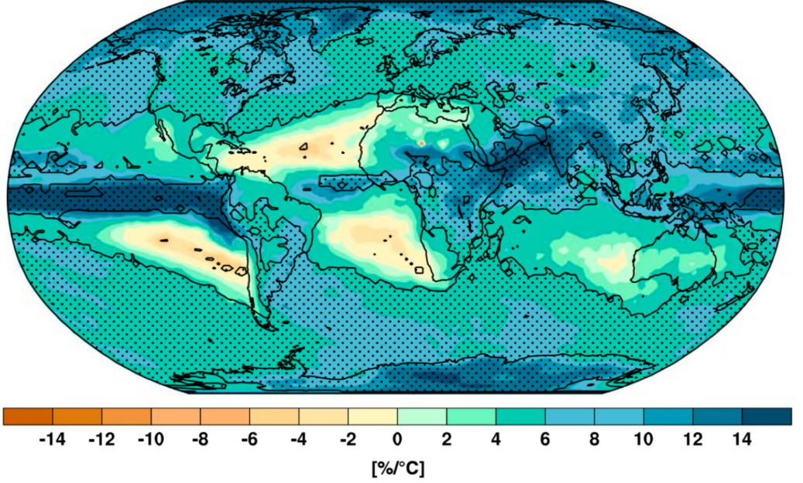
GLOBAL CLIMATE CHANGE
Source : https://www.carbonbrief.org/explainer-what-climate-models-tell-us-about-future-rainfall/
Fischer, E. M., Sedláček, J., Hawkins, E., & Knutti, R. (2014). Models agree on forced response pattern of precipitation and temperature extremes. Geophysical Research Letters, 41(23), 8554-8562.
https://www.esa.int/ESA_Multimedia/Images/2026/05/Hot_surfaces_during_Europe_s_heatwave_seen_by_Sentinel-3
Percent change in heavy precipitation per degree warming, defined as the heaviest daily precipitation event of the year for each location. Figure adapted from Fischer et al 2014.
Hot surfaces during Europe's heatwave 'seen' by Sentinel-3. Land Surface Temperatures (LST) across Europe on May 26, 2026
“For November, global temperatures were 1.54°C above pre-industrial levels, and the three-year average for 2023–2025 is on track to exceed 1.5°C for the first time”: Samantha Burgess, Strategic Lead for Climate at ECMWF, Dec. 2025, Copernicus

Slide 3
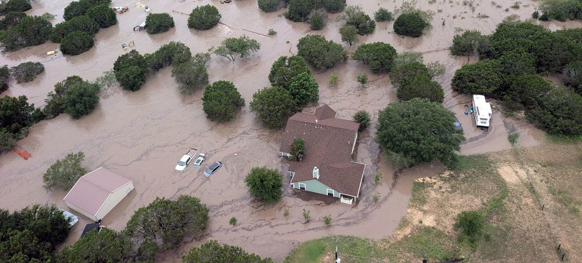
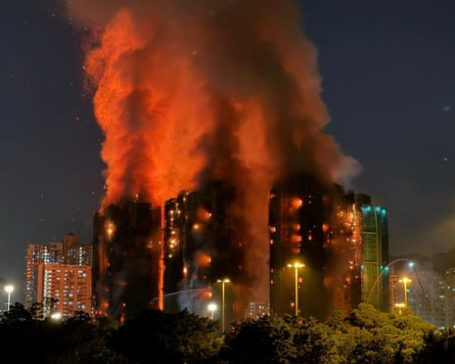
PRECIPITATION EXTREMES
SEVERE RAPID FLOODS
DRY CONDITIONS · FIRE-PRONE WEATHER
The July 4, 2025, Texas floods killed at least 136 people, including more than two dozen children and counselors at Camp Mystic, one of the first areas overwhelmed as the Guadalupe River rose explosively. The river crested at a record 37.52 feet near Hunt, unleashing catastrophic damage and marking one of the deadliest flood disasters in Texas history.
A devastating fire at the Wang Fuk Court apartment complex in Hong Kong's Tai Po district on November 26, 2025, resulted in at least 160 deaths, making it the deadliest fire in the city since 1948. The blaze, which burned for over 40 hours, injured dozens more and left thousands homeless.
Source: https://news.un.org/en/story/2025/07/1165337
Source: https://thestreetjournal.org/death-toll-from-hong-kong-fire-rises-to-146/

Slide 4
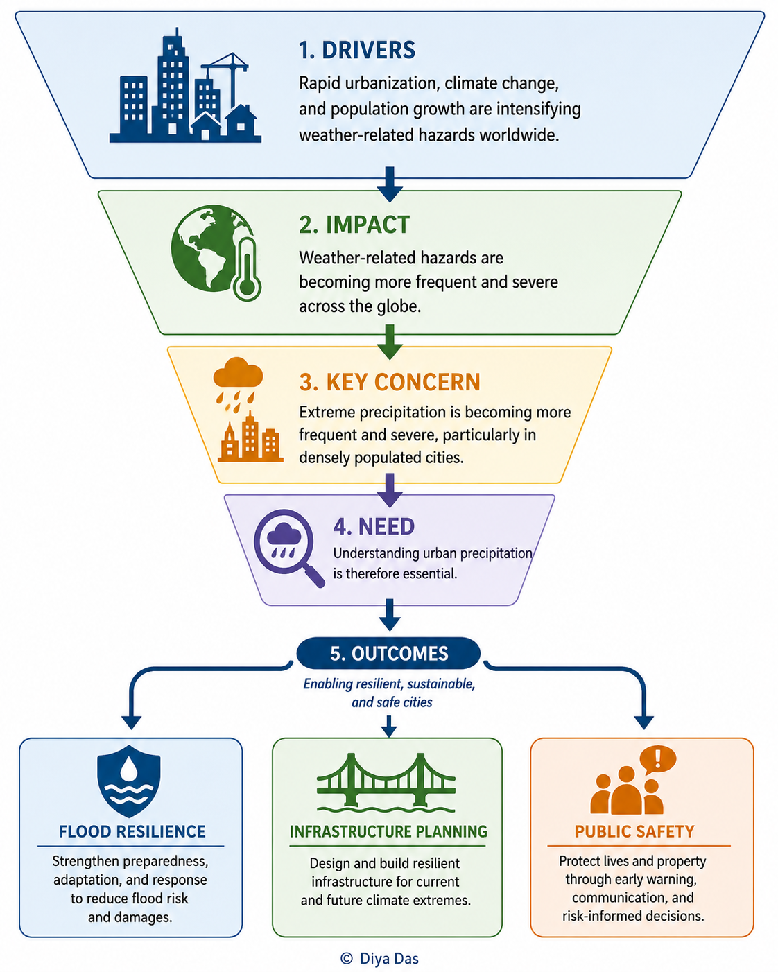
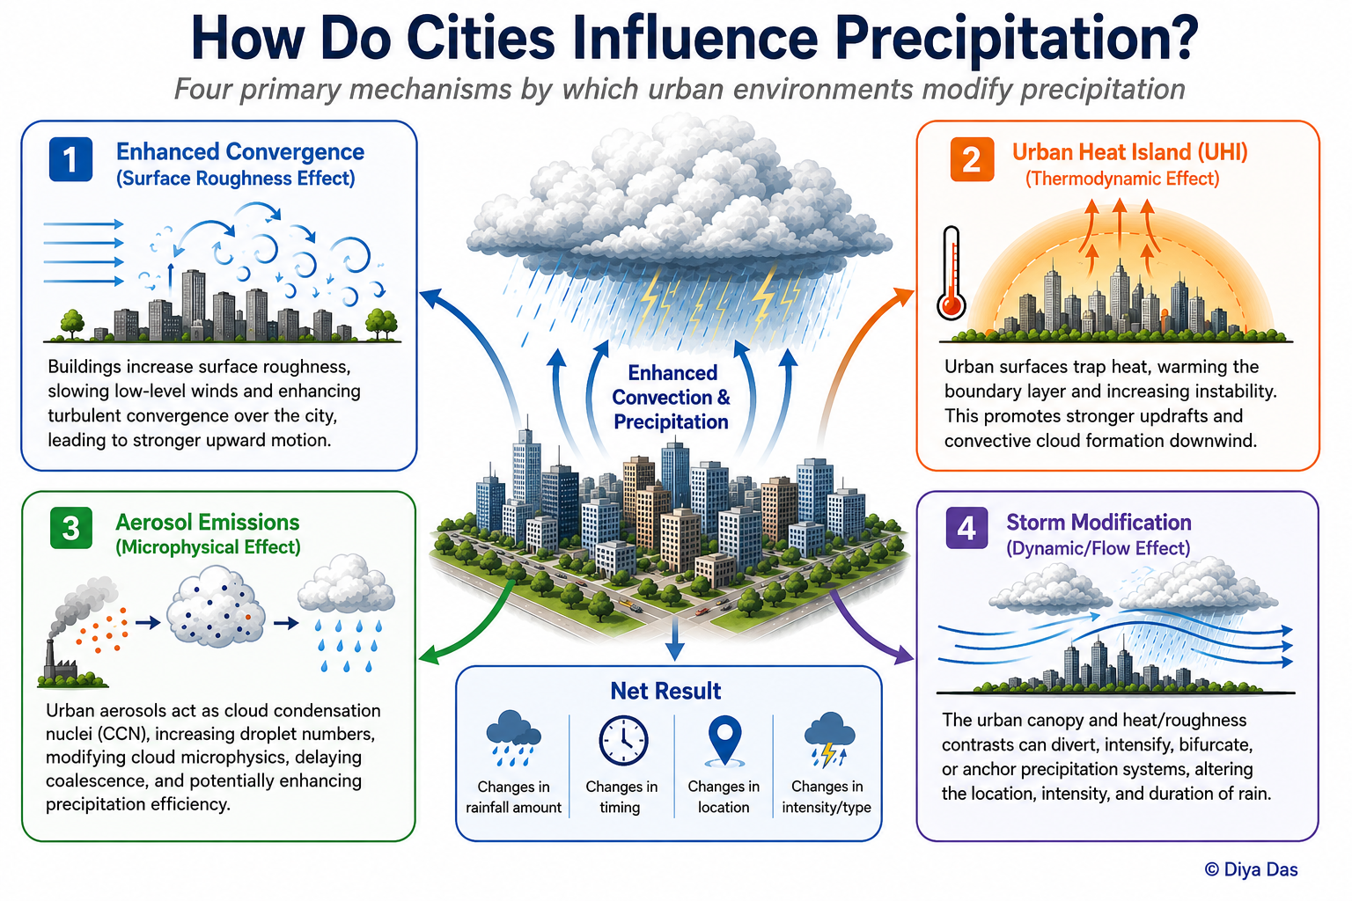
URBAN PRECIPITATION: IMPACT AND PHYSICAL MECHANISMS

Slide 5
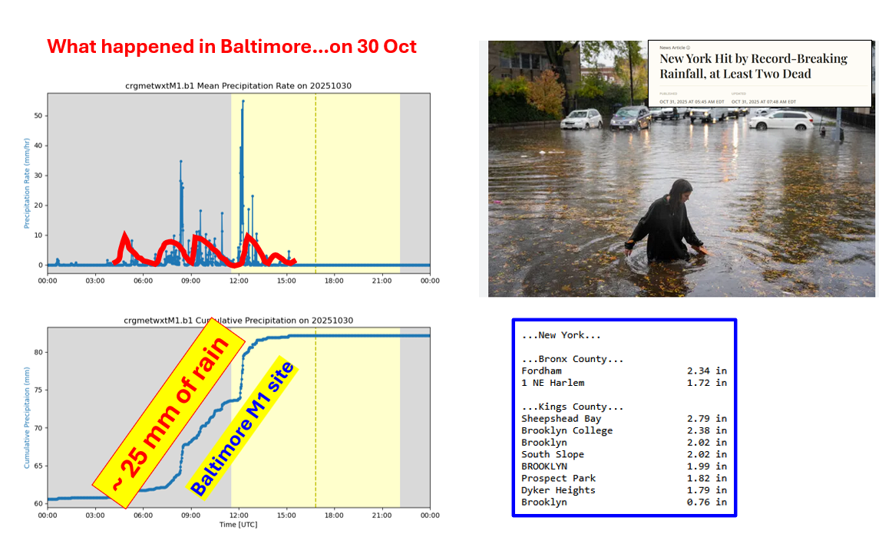
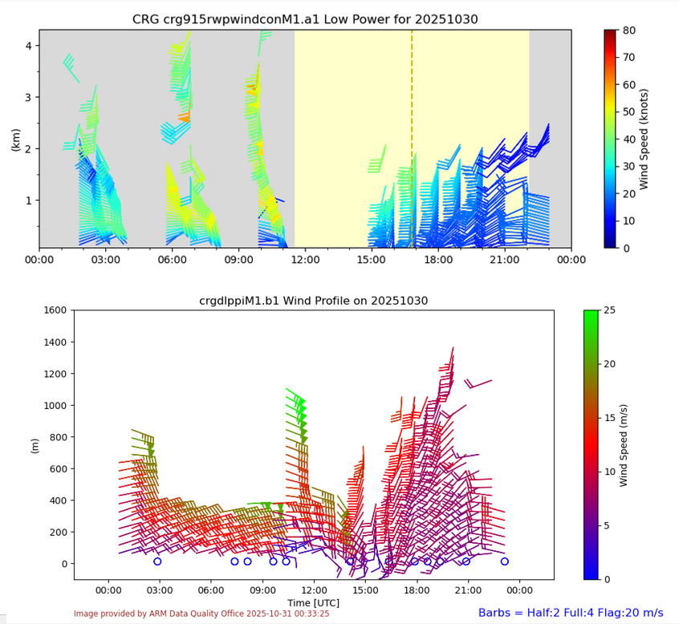
CASE STUDY : A LOW-LEVEL JET TRIGGERED URBAN HEAVY RAINFALL OVER BALTIMORE (30 OCTOBER 2025)
Collaboration opportunities w SUNY Team
LLJ type flows over all three sites triggering CI

Slide 6
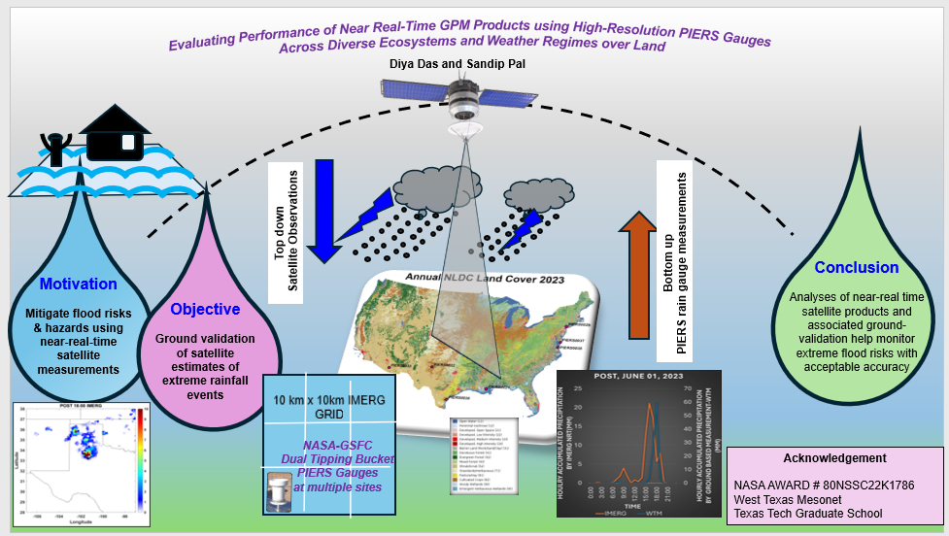
CONCEPTUAL FRAMEWORK FOR GPM-IMERG EVALUATION
As part of the NASA-funded S3-MAAP project, this research contributes to a broader framework that combines satellite validation, uncertainty quantification, process-based understanding, and education and workforce development to enhance the reliability and application of satellite observations.

Slide 7
MONTHLY EVALUATION OF NEAR REAL-TIME GPM PRECIPITATION PRODUCTS
PIERS MONTHLY ACCUMULATED PRECIPITATION
MONTHLY ACCUMULATED PRECIPITATION, mm
NRT GPM products successfully capture the seasonal cycle of monthly precipitation but exhibit region-dependent biases relative to PIERS observations.
Satellite performance varies across sites, highlighting the influence of local climate, terrain, and precipitation characteristics.
Regional validation and bias correction are essential for improving the reliability of NRT GPM products for real-time precipitation monitoring.
IMERG MONTHLY ACCUMULATED PRECIPITATION, AT PIERS LOCATIONS
MONTHLY ACCUMULATED PRECIPITATION, mm
DIFFERENCE IN PRECIPITATION , IMERG -PIERS
IMERG-PIERS, mm

Slide 8
MOTIVATION AND EXPLORATORY ANALYSIS
Hourly comparison of WTM, IMERG, and GSMaP precipitation, highlighting intensity, bias, inter-product differences, and rain detection performance during May and October.

Slide 9
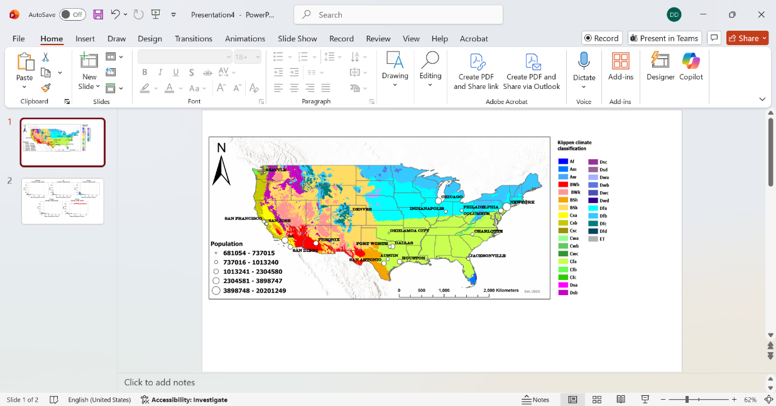
US CITIES ACROSS DIVERSE CLIMATE AND WEATHER REGIMES
Spatial distribution of selected U.S. cities overlaid on the Köppen–Geiger climate classification map . Circle symbols indicate city locations, with marker size proportional to population. Major climate zones are shown, highlighting the diverse climatic regimes.

Slide 10
ACCUMULATED PRECIPITATION ACROSS DIVERSE WEATHER REGIMES
DJF
MAM
JJA
SON
IMERG-FINAL, Monthly, Dec 2023- Nov 2024

Slide 11
UPPER-TAIL CHARACTERISTICS OF DAILY PRECIPITATION EXTREMES
Tail probability density functions (PDFs) of daily mean precipitation for five selected U.S. cities (New York, Los Angeles, Denver, Chicago, and Houston, from 01-01-2020 to 01-01-2025). Distributions are constructed using values exceeding the city-specific 90th percentile (P90), highlighting the upper tail of precipitation intensity. The red dashed line denotes the 95th percentile threshold (P95). N represents the number of daily exceedances.

Slide 12
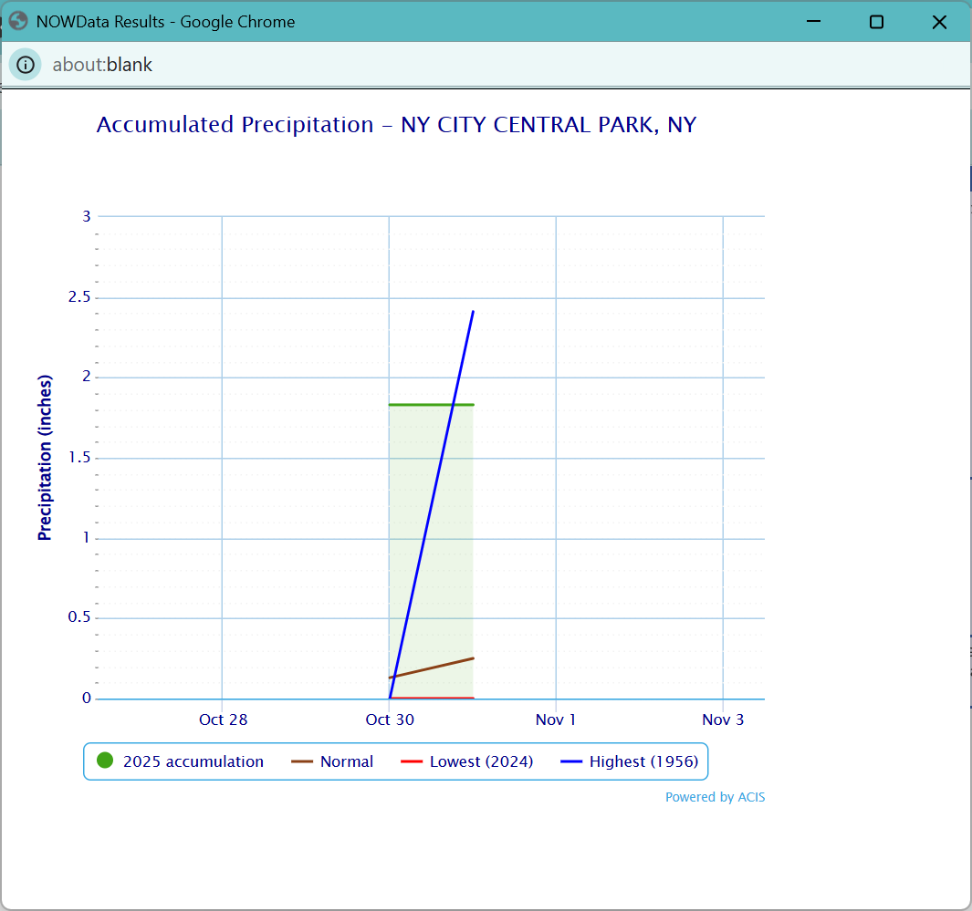
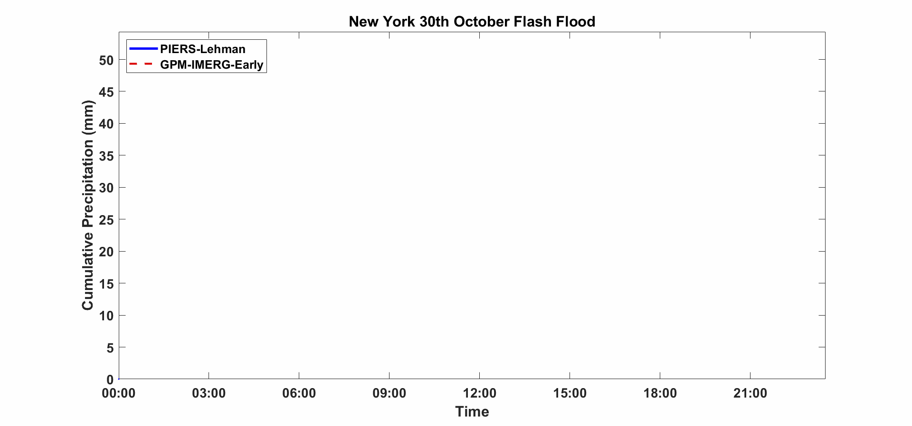
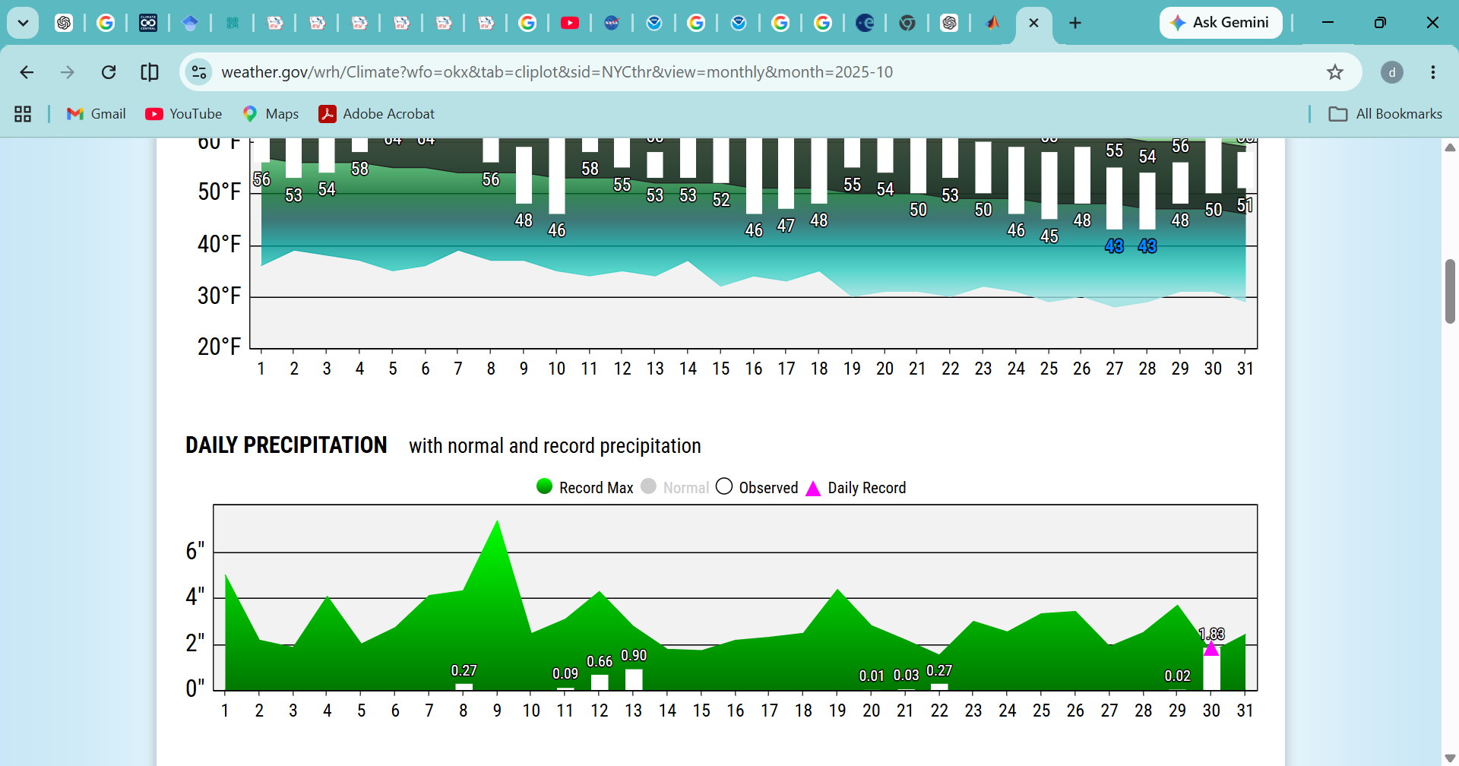
RESULTS: IMERG VS GPM_PIERS, NEW YORK CASE
https://www.weather.gov/wrh/Climate
Source : https://www.weather.gov/wrh/Climate?wfo=okx
A severe storm brought deadly flash flooding to New York City on Thursday, October 30, 2025, resulting in the deaths of two men who were trapped in flooded basements in Brooklyn and Manhattan.
The storm produced record-breaking rainfall, with Central Park recording its highest total for that specific day in over a century.
Notes:
https://www.weather.gov/wrh/Climate

Slide 13
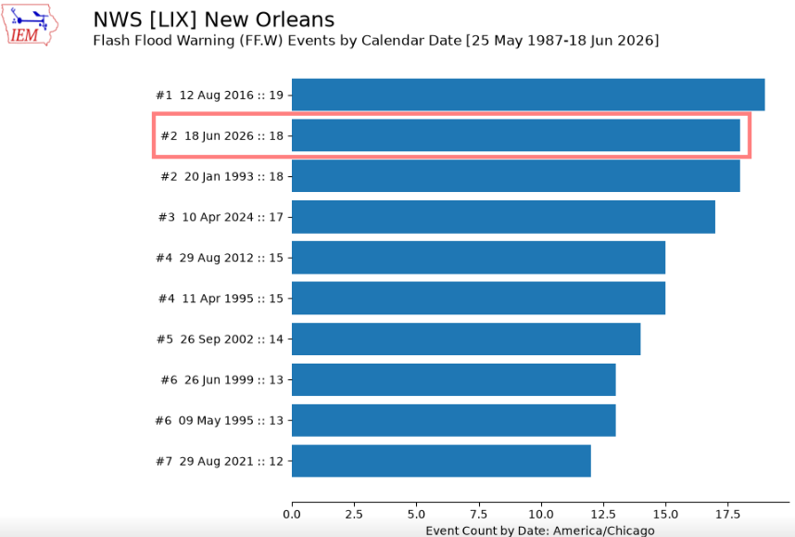
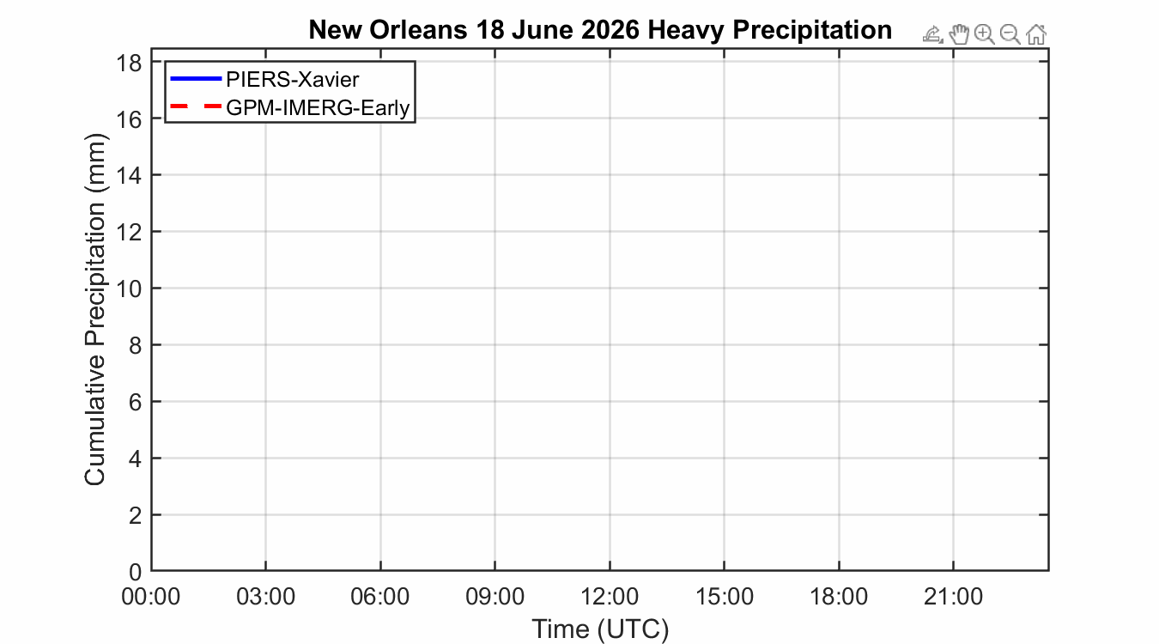
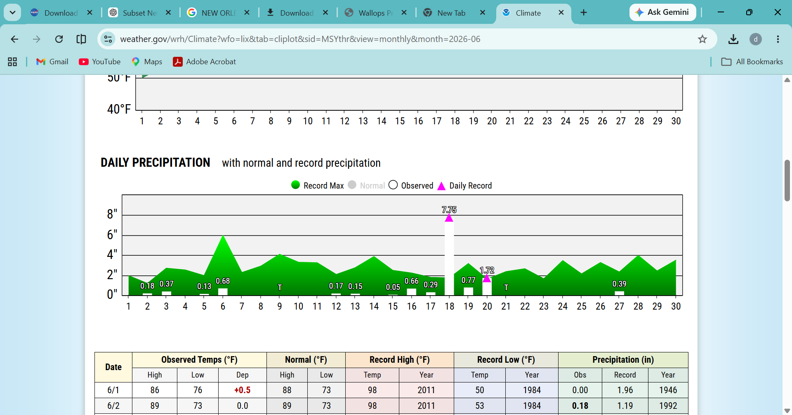
RESULTS: IMERG VS GPM_PIERS, NEW ORLEANS CASE
https://mesonet.agron.iastate.edu/onsite/features/cat.php?day=2024-10-10
https://www.weather.gov/wrh/Climate
On 18 June 2026, the remnants of Tropical Storm Arthur brought intense rainfall to the New Orleans metropolitan area, triggering severe flash flooding, isolated tornadoes, and widespread power outages. Heavy rainfall began around 1:30 a.m. UTC, persisting for nearly five hours, with radar-estimated rainfall rates exceeding 3 inches per hour.

Slide 14
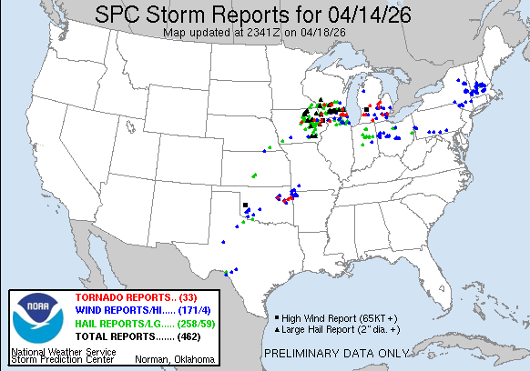
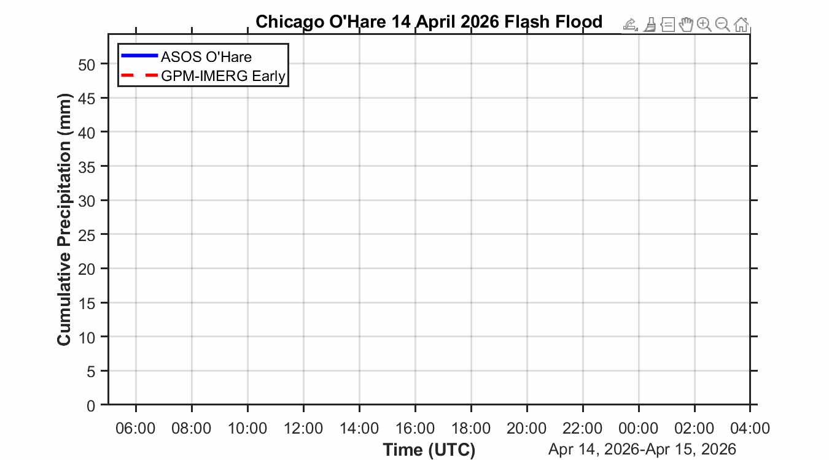
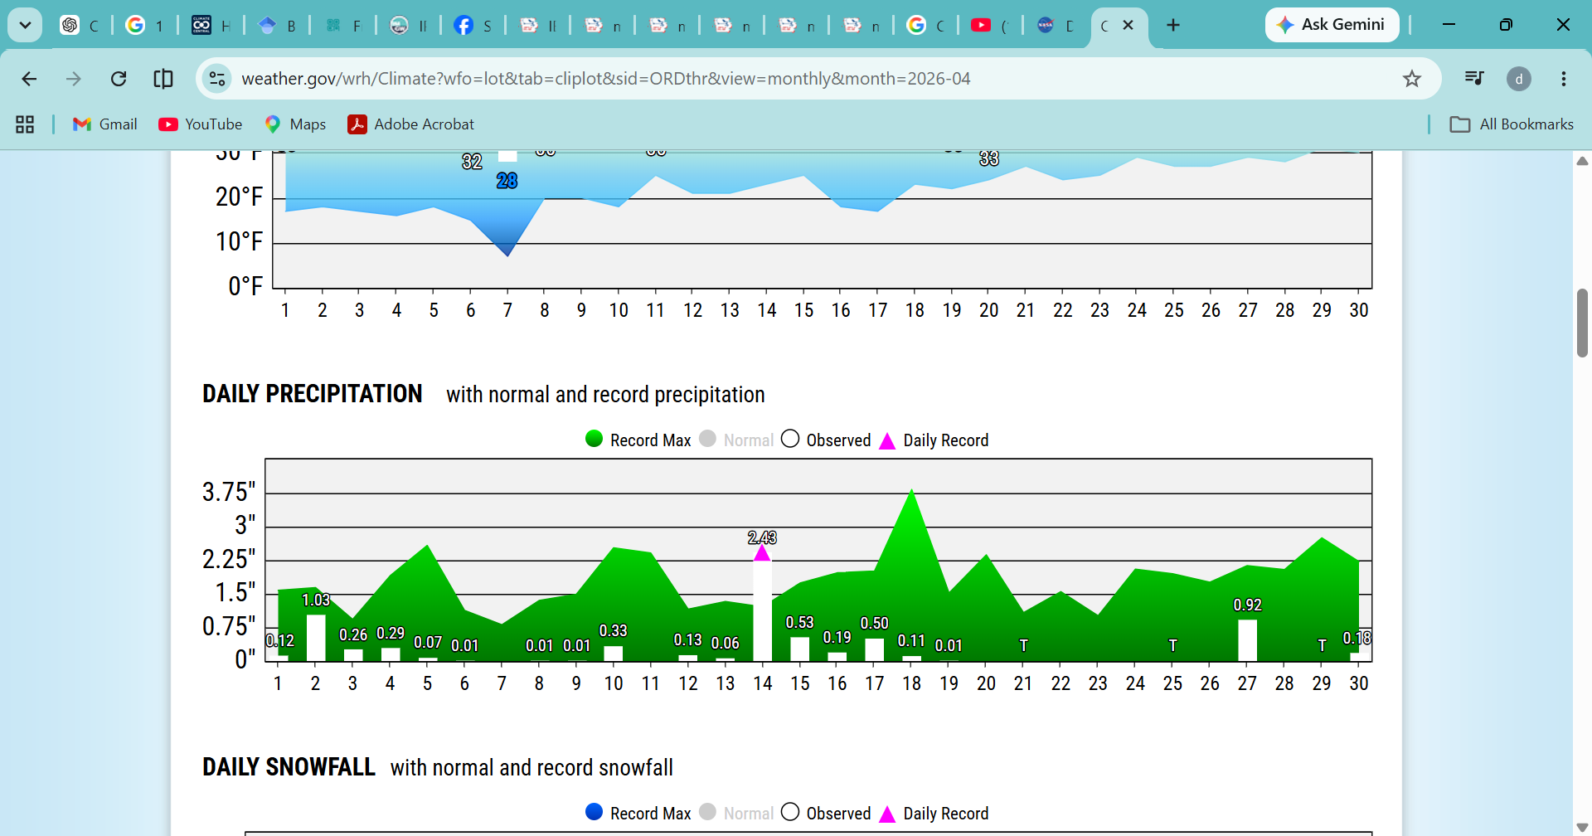
RESULTS: IMERG VS ASOS, CHICAGO CASE
SOURCE:NWS
On April 14, 2026, a powerful line of severe thunderstorms dumped a record-breaking 2.43 inches of rain at Chicago's O'Hare International Airport. This deluge shattered a 77-year-old daily record for that date, causing widespread urban flash flooding, transit disruptions, and basement inundations.
https://www.weather.gov/wrh/Climate

Slide 15
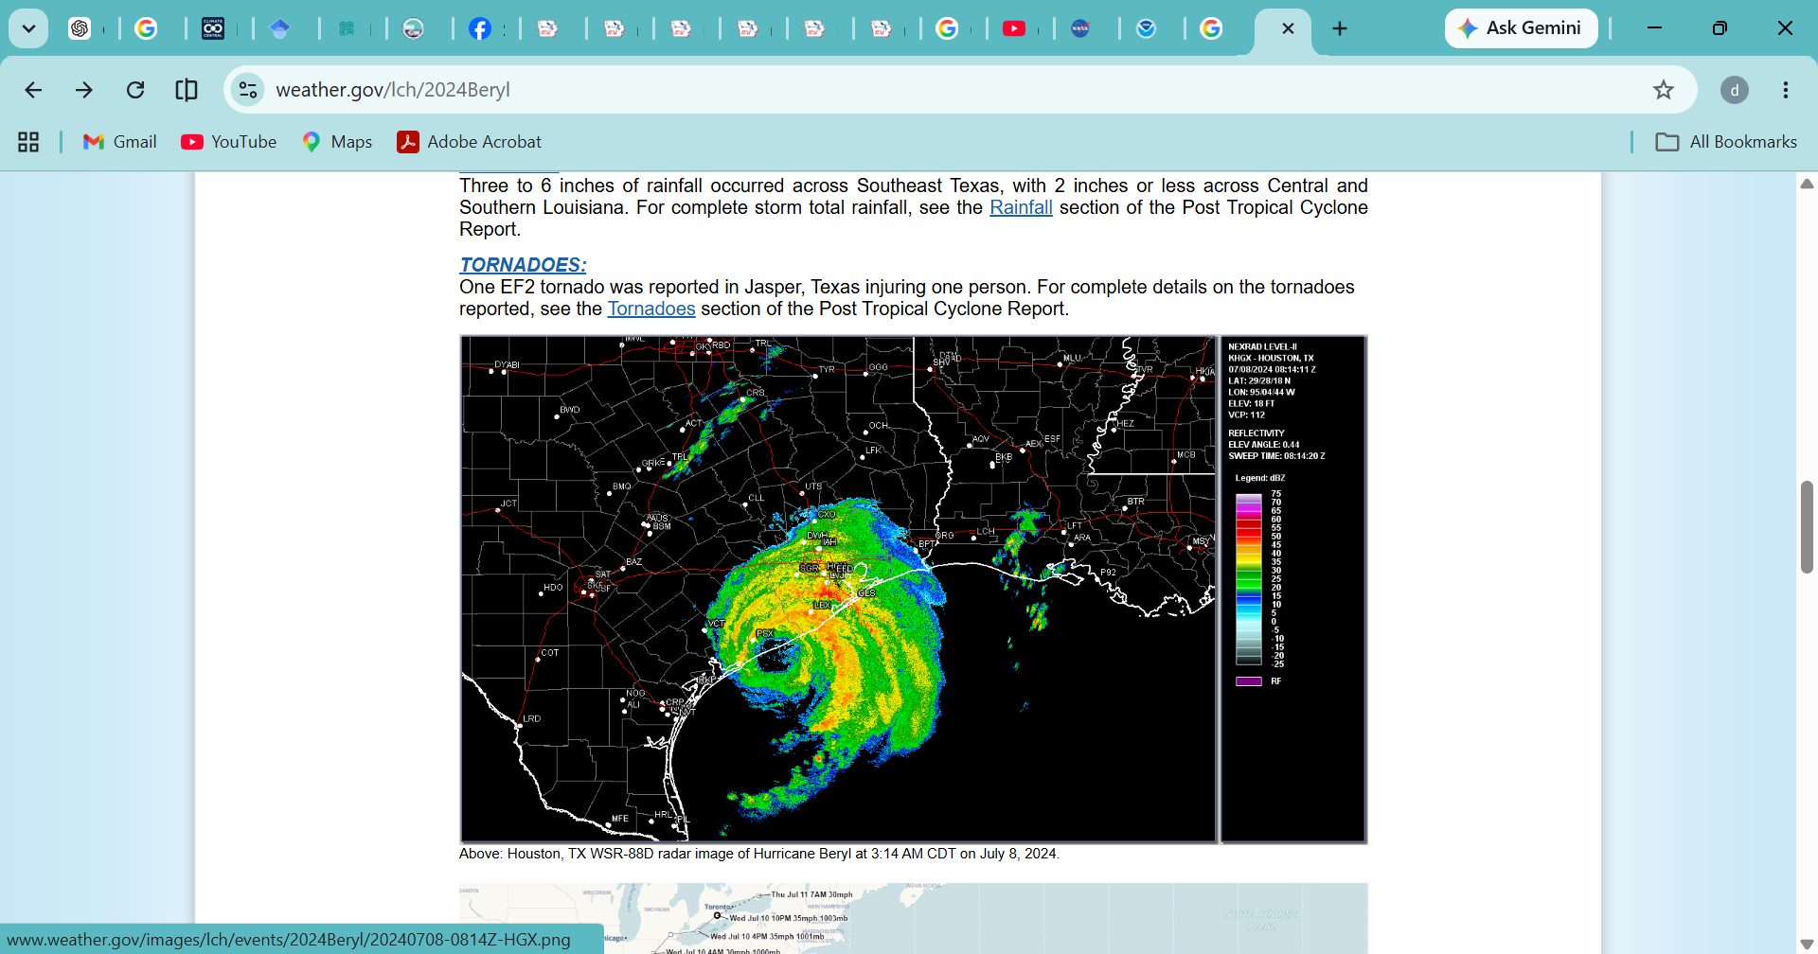
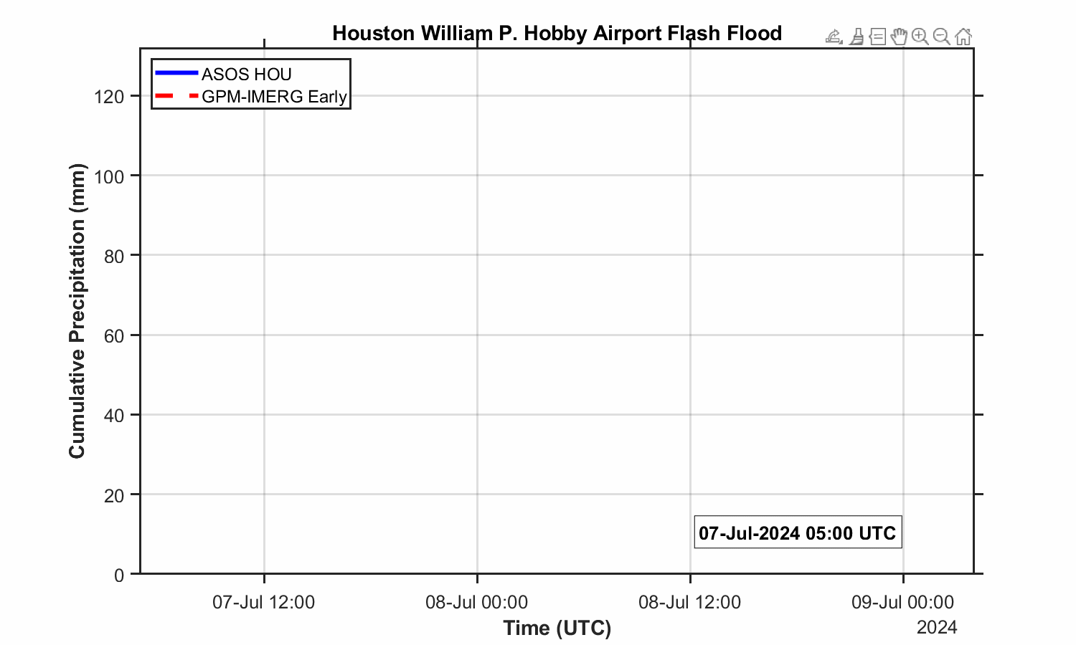
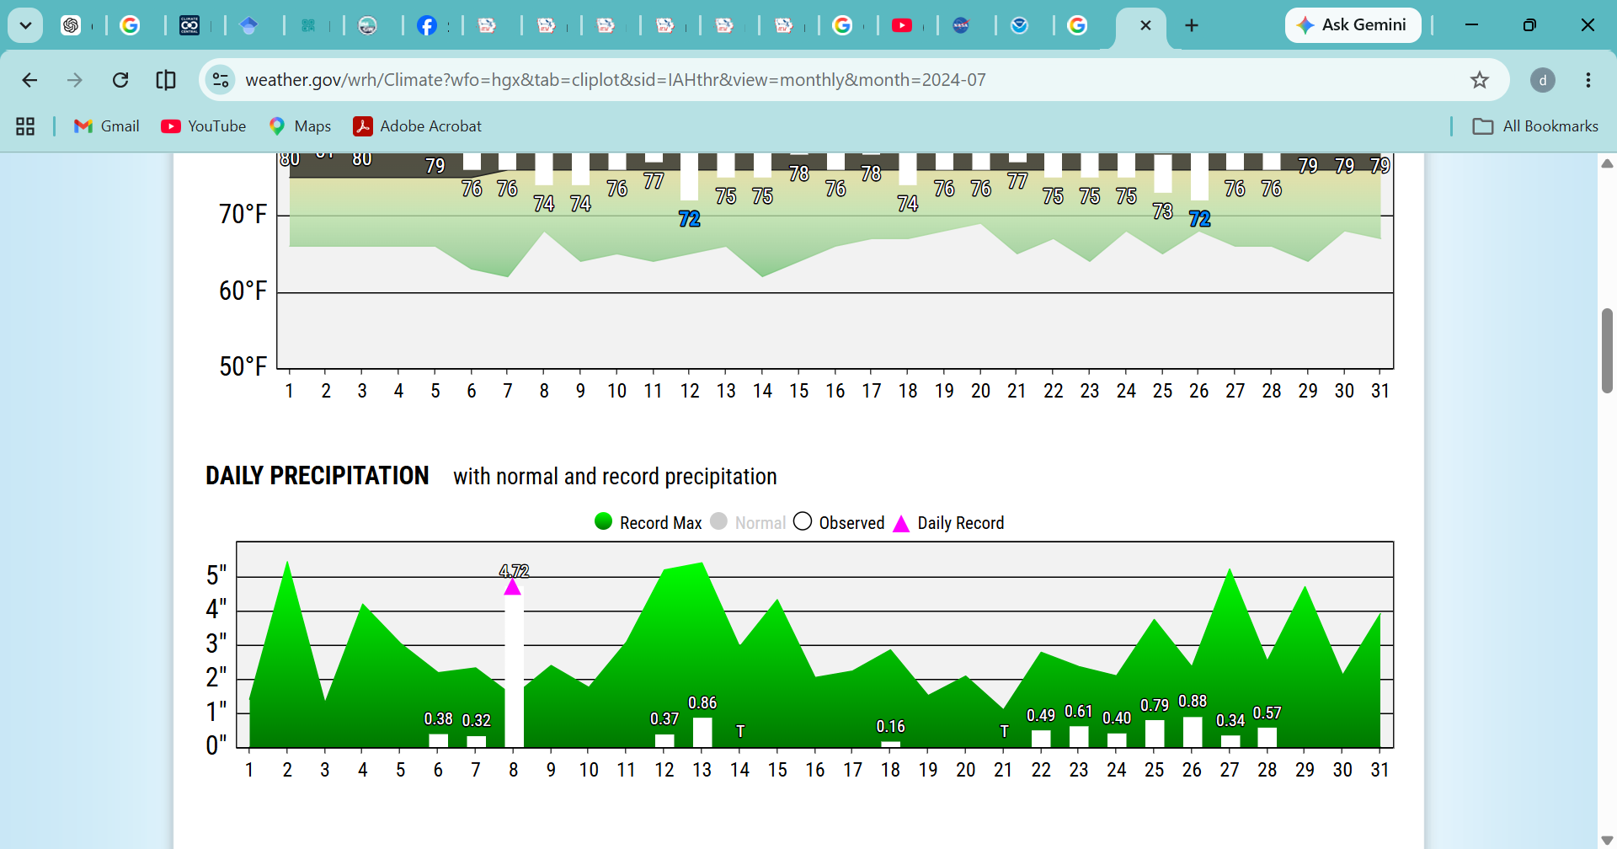
RESULTS: IMERG VS ASOS, HOUSTON CASE
SOURCE:NWS
https://www.weather.gov/wrh/Climate
On July 8, 2024, the catastrophic flooding and damage in Houston were caused by Hurricane Beryl, which made landfall near Matagorda, Texas, as a Category 1 storm before tracking directly across the Houston metropolitan area. The storm delivered torrential rainfall, extreme wind gusts, and severe flash flooding that crippled the region

Slide 16
Outlook and Future Methodology
Chicago O'Hare (14 April 2026)
IMERG captured the rainfall onset but significantly underestimated the total accumulation.
Houston William P. Hobby Airport (7–9 July 2024)
IMERG closely captured the temporal evolution of Hurricane Beryl but underestimated the peak accumulation by ~20 mm (~17%), particularly during the most intense rainfall period.
New Orleans (18 June 2026)
IMERG detected the early rainfall but underestimated the main rainfall peak and the final event accumulation (~11 mm vs. ~16 mm observed).
New York City (30 October 2025)
IMERG reproduced the overall event evolution but underestimated the rapid evening rainfall and final accumulation.
Overall
IMERG consistently captures rainfall timing but tends to underestimate peak rainfall intensity and cumulative totals during extreme urban precipitation events.
Identify extreme urban precipitation events across major U.S. cities using satellite and rain gauge observations.
Classify each event according to the dominant weather regime (e.g., low-level jet, frontal system, tropical cyclone, mesoscale convective system, sea breeze).
Evaluate satellite precipitation products using rainfall intensity, timing, spatial distribution, bias, RMSE, correlation, POD, FAR, and CSI.
Investigate the influence of urban characteristics (urban extent, land cover, impervious surface, and Urban Heat Island intensity) on satellite performance.
Diagnose the physical mechanisms responsible for satellite retrieval uncertainties under different weather regimes.
Develop a weather-regime-based framework to improve satellite precipitation monitoring over urban environments

Slide 17
References
Bornstein, R., & Lin, Q. (2000). Urban heat islands and summertime convective thunderstorms in Atlanta: Three case studies. Atmospheric Environment, 34(3), 507–516.
Changnon, S. A. (1968). The La Porte weather anomaly—Fact or fiction? Bulletin of the American Meteorological Society, 49(1), 4–11.
Changnon, S. A. (1981). METROMEX: A Review and Summary. American Meteorological Society.
Changnon, S. A., Huff, F. A., & Vogel, J. L. (1977). METROMEX: An Investigation of Inadvertent Weather Modification. Illinois State Water Survey.
Howard, L. (1818–1820). The Climate of London (Vols. 1–3). London: W. Phillips.
Landsberg, H. E. (1981). The urban climate (Vol. 28). Academic press.
Niyogi, D., Pyle, P., Lei, M., Arya, S. P., Kishtawal, C., Shepherd, M., Chen, F., & Wolfe, B. (2011).
Urban modification of thunderstorms: An observational storm climatology and model case study for the Indianapolis urban region. Journal of Applied Meteorology and Climatology, 50(5), 1129–1144.
Oke, T. R. (1987). Boundary Layer Climates (2nd ed.). Routledge.
Shepherd, J. M. (2005). A review of current investigations of urban-induced rainfall and recommendations for the future. Earth Interactions, 9(12), 1–27.
Shepherd, J. M., Pierce, H., & Negri, A. J. (2002). Rainfall modification by major urban areas: Observations from spaceborne rain radar. Journal of Applied Meteorology, 41(7), 689–701.
Mitra, C., & Shepherd, J. M. (2015). Urban precipitation: A global perspective. In The Routledge Handbook of urbanization and global environmental change (pp. 152-168). Routledge.
Berne, A., & Uijlenhoet, R. (2017). Pathways to rainfall estimation by remote sensing. Nature, 7, 1–10.

Slide 18
THANK YOU

