Slide 1

Validation of GSMaP Using a 1-Minute Precipitation Rate Product (1MPR) Combining Ground-based Radar and Rain Gauge Data over Japan
IPWG 12 (Krakow, Poland), July 7th, 2026
4.3, Session 4 (Product Assessments)
Shinta SETO (Nagasaki University, Japan)
Nobuyuki UTSUMI (Institute of Science Tokyo, Japan)

Slide 2
Background and Purpose
The development of GSMaP assumes precipitation rate estimates from microwave radiometers (MWRs) as hourly precipitation rates.
For the validation of GSMaP, observed hourly precipitation rates are usually used.
The time scale of precipitation rate estimates from MWRs and their time lag relative to ground surface measurements are not clearly known.
The precipitation rate estimates of GSMaP derived from MWRs are validated with 1-minute precipitation rate product (1MPR) over Japan.

Slide 3
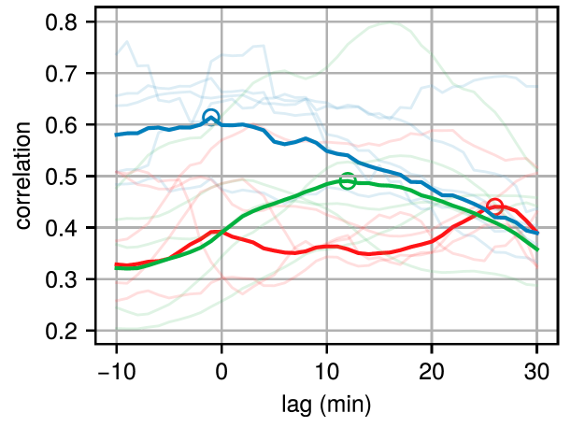
Reviews on time scale and time lag of rain rate estimates by microwave radiometers
Tan et al. (2018) analyzed the time lag between GPROF estimates and rain gauge data
  High spatial density of rain gauges
  Time lag between 0 and 30 minutes
Red: Pacomoke (Pacific Coast, USA)
Blue: WegenerNet (Alps)
Green: Walnut (west of USA)
Tan et al.(2018;JHM)

Slide 4
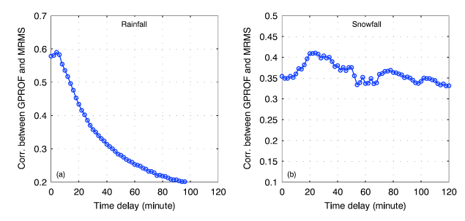
Reviews on time scale and time lag of rain rate estimates by microwave radiometers
You et al. (2019) analyzed the time lag between GPROF and ground-based radar data (MRMS)
  Rainfall : Time lag = 4 minutes
  Snowfall : Time lag = 20 minutes
You et al.(2019;GRL)

Slide 5
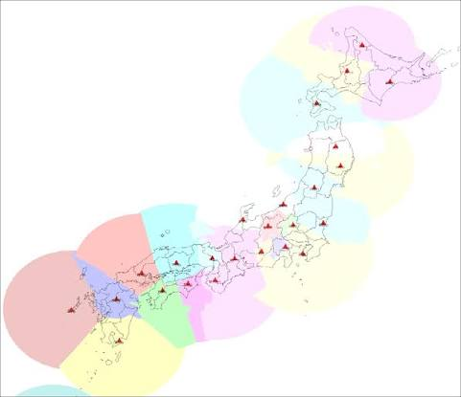
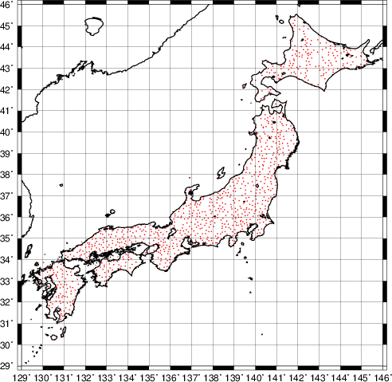
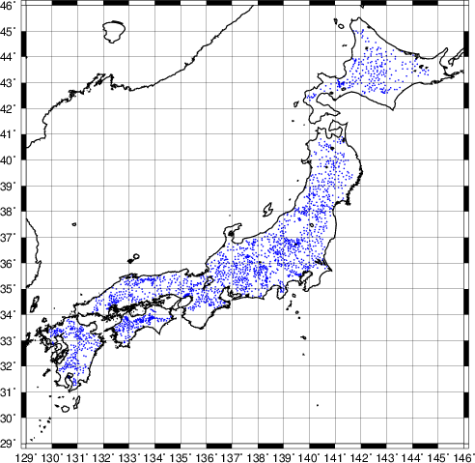
1-minute precipitation rate product (1MPR)
Over Japan
Spatial resolution=250m, Temporal resolution = 1min
XRAIN (C-band and X-band composite data)
Rain gauges (~1300 by JMA and ~2200 by MLIT)
XRAIN
Radars
JMA
Gauges
MLIT
Gauges

Slide 6
1-minute precipitation rate product (1MPR)
With Rain gauges
Without
Rain Gauges
Rain gauge
XRAIN
XRAIN
Smoothing
Interpolation
Coefficients
Coefficients
Interpolation
1MPR
1MPR

Slide 7
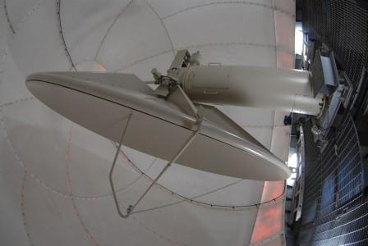
1-minute precipitation rate product (1MPR)
In the development of 1MPR, the time lag correction with the ground surface has not been implemented for XRAIN.
Correction method with the following assumptions
  Any location is observed by the nearest radar
  The radar elevation angle is always at 1.8 degrees
  Considering XRAIN observation altitude, 1 min. time lag is given for 250 m of altitude. Consequently, the timestamp of 1MPR is delayed.
radar
Time difference between radar observation and ground measuremetns
1 min 250m
altitude
1.8º
Surface

Slide 8
Validation of GSMaP
<Data>
GSMaP Version 8 standard product
  Rain rate estimates
  Sateinfo (satellite information)
  ➔ Only estimates by MWRs are analyzed
  Timeinfo (time stamp)
1MPR
  Averaged for 0.2 degrees.
  Averaged for 1 min, 10 min, 30 min, 60 min.
  With time lag : -30 min to +60 min
0.2 deg.
1MPR
Footprint of MWR
GSMaP
0.1 deg.
60 min average with +30 min lag
-60 min
-45 min
-30 min
-15 min
+ 15 min
+ 30 min
+ 45 min
+ 60 min
Observation
By MWR

Slide 9
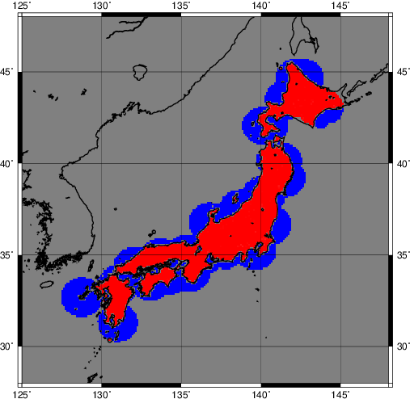
Validation of GSMaP
<Target Period>
Mar, Jun, Sep, Dec of 2022
<Target Area>
XRAIN area excluding Okinawa
Quantitative measurement area
  *60 km from X-band radar or 120 km from C-band radar
<Classification>
Ocean/Land is judged by GLCNMO
  Ocean : 100 % of water surface
  Land : 10 % or lower of water
Over Ocean (quantitative)
Over Land (quantitative)

Slide 10
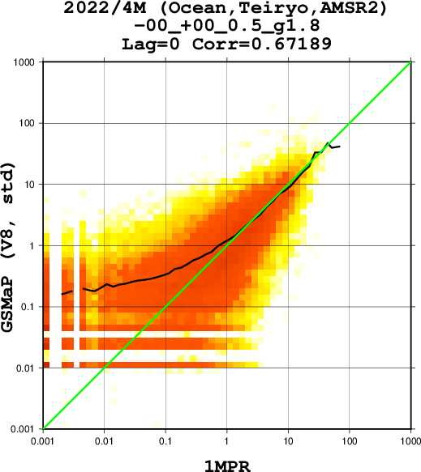
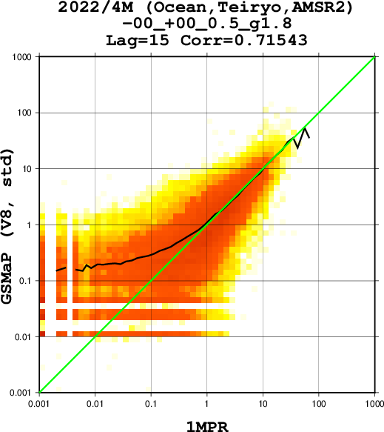
Validation of GSMaP
Over Ocean, AMSR2
1-min average, lag=0 min
1-min average, lag=15 min
CC = 0.672
CC = 0.715

Slide 11

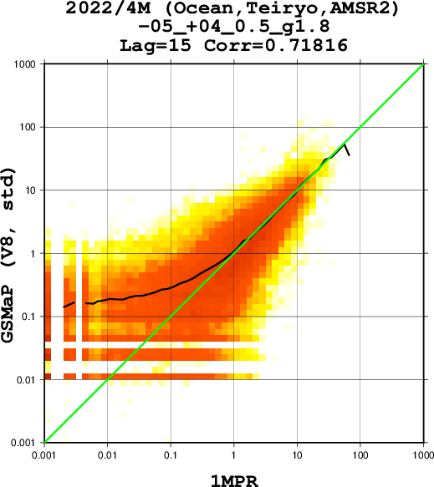
Validation of GSMaP
Over Ocean, AMSR2
10-min average, lag=0 min
10-min average, lag=15 min
CC = 0.674
CC = 0.718

Slide 12


Validation of GSMaP
Over Ocean, AMSR2
30-min average, lag=0 min
30-min average, lag=15 min
CC = 0.689
CC = 0.720

Slide 13
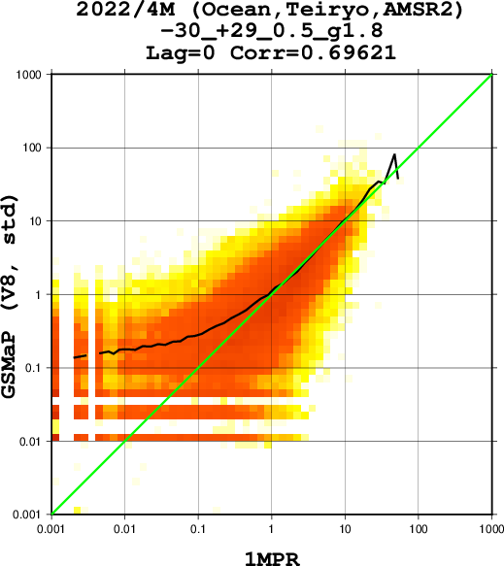

Validation of GSMaP
Over Ocean, AMSR2
60-min average, lag=0 min
60-min average, lag=15 min
CC = 0.696
CC = 0.710

Slide 14
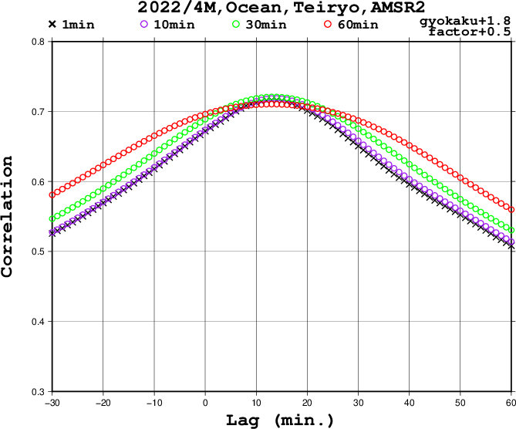
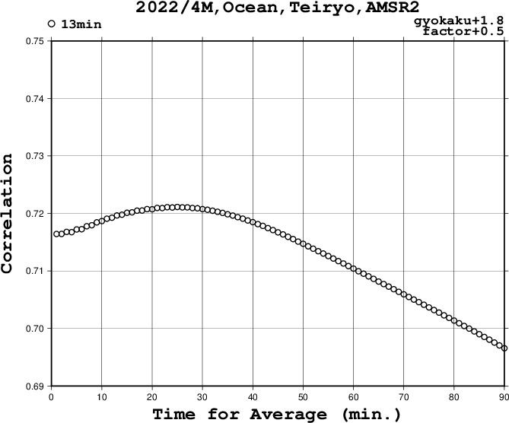
Time scale and time lag of GSMaP
Ocean, AMSR2
CC with different time scale and time lag
-30 min.
0 min.
30 min.
60 min.
Time Lag = + 13 min.
Maximum CC = 0.721
(Average time = 25 min.)
Maximum CC (time lag)
1-min ave. 0.716 (+13 min.)
10-min ave. 0.718 (+14 min.)
30-min ave. 0.721 (+13 min.)
60-min ave. 0.710 (+13 min.)

Slide 15
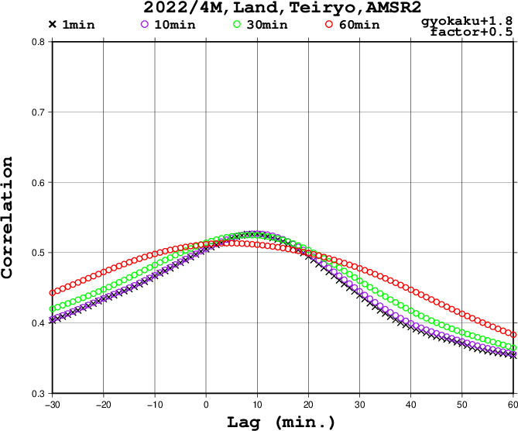
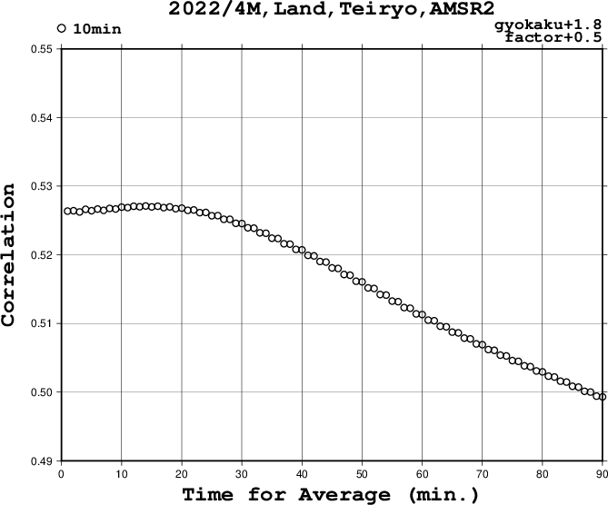
Time scale and time lag of GSMaP
Land, AMSR2
CC with different time scale and time lag
-30 min.
0 min.
30 min.
60 min.
Maximum CC (time lag)
1-min ave. 0.526 (+10 min.)
10-min ave. 0.526 (+10 min.)
30-min ave. 0.525 (+08 min.)
60-min ave. 0.513 (+04 min.)
Time Lag = + 10 min.
Maximum CC = 0.527
(Average time = 14 min.)

Slide 16
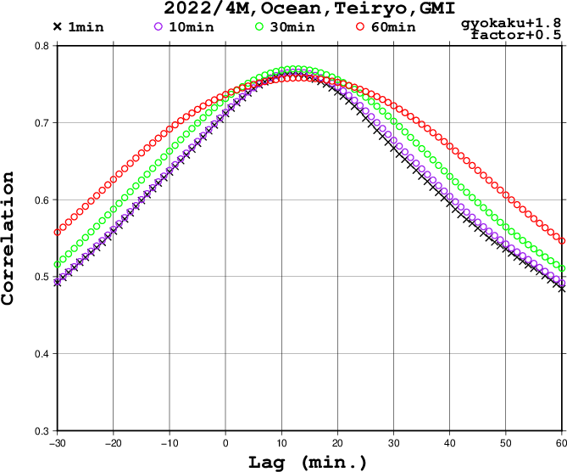
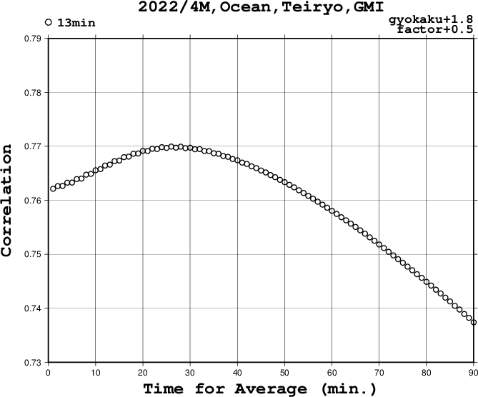
Time scale and time lag of GSMaP
Ocean, GMI
CC with different time scale and time lag
-30 min.
0 min.
30 min.
60 min.
Time Lag = + 13 min.
Maximum CC = 0.770
(Average time = 26 min.)
Maximum CC (time lag)
1-min ave. 0.763 (+12 min.)
10-min ave. 0.766 (+13 min.)
30-min ave. 0.770 (+13 min.)
60-min ave. 0.758 (+13 min.)

Slide 17
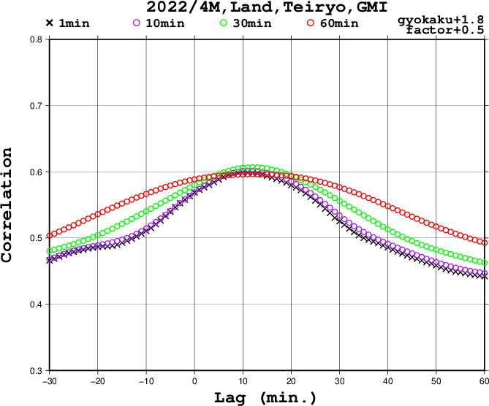
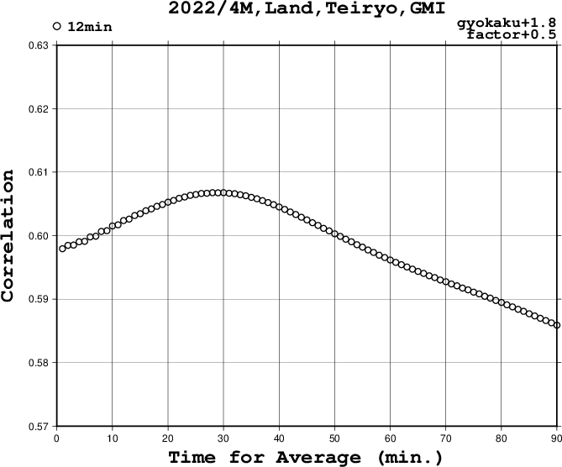
Time scale and time lag of GSMaP
Land, GMI
CC with different time scale and time lag
-30 min.
0 min.
30 min.
60 min.
Time Lag = + 12 min.
Maximum CC = 0.607
(Average time = 30 min.)
Maximum CC (time lag)
1-min ave. 0.599 (+11 min.)
10-min ave. 0.602 (+11 min.)
30-min ave. 0.607 (+12 min.)
60-min ave. 0.596 (+12 min.)

Slide 18
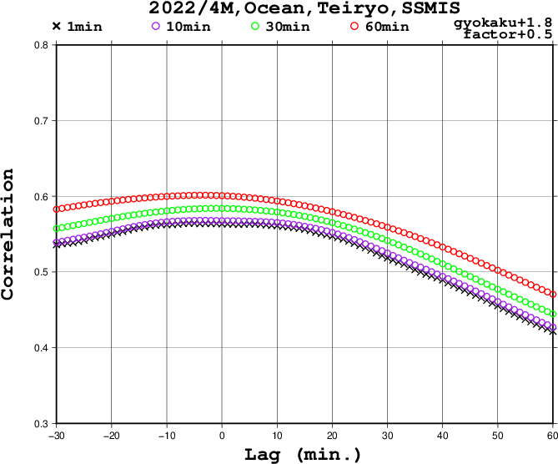
Time scale and time lag of GSMaP
Ocean, SSMIS
CC with different time scale and time lag
-30 min.
0 min.
30 min.
60 min.
Average time of longer than 60 min. gives better CC
Maximum CC (time lag)
1-min ave. 0.564 (-06 min.)
10-min ave. 0.568 (-03 min.)
30-min ave. 0.584 (-01 min.)
60-min ave. 0.601 (-04 min.)

Slide 19
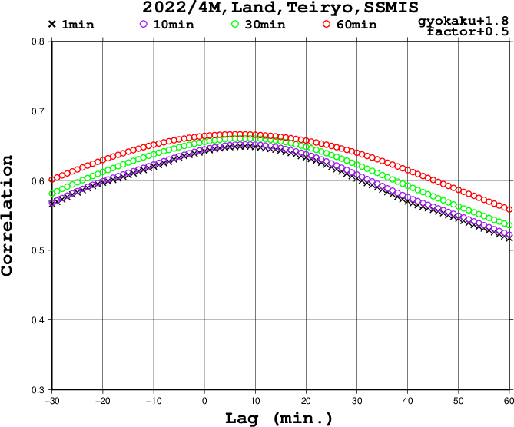
Time scale and time lag of GSMaP
Land, SSMIS
CC with different time scale and time lag
-30 min.
0 min.
30 min.
60 min.
Average time of longer than 60 min. gives better CC
Maximum CC (time lag)
1-min ave. 0.649 (+08 min.)
10-min ave. 0.652 (+08 min.)
30-min ave. 0.661 (+08 min.)
60-min ave. 0.666 (+07 min.)

Slide 20
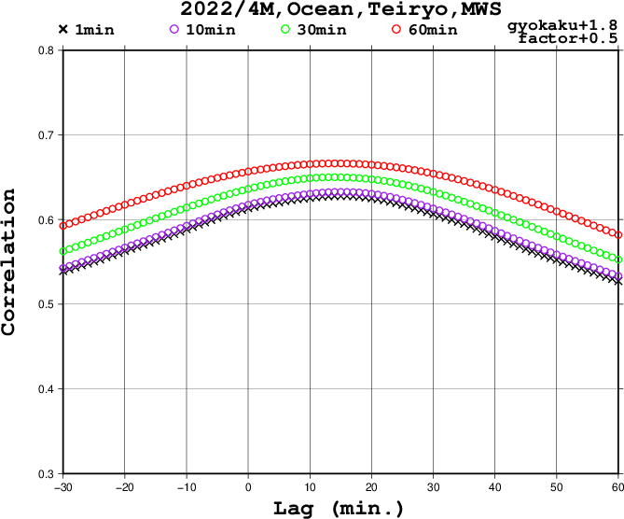
Time scale and time lag of GSMaP
Ocean, Sounders
CC with different time scale and time lag
-30 min.
0 min.
30 min.
60 min.
Average time of longer than 60 min. gives better CC
Maximum CC (time lag)
1-min ave. 0.628 (+14 min.)
10-min ave. 0.633 (+15 min.)
30-min ave. 0.650 (+14 min.)
60-min ave. 0.666 (+14 min.)

Slide 21
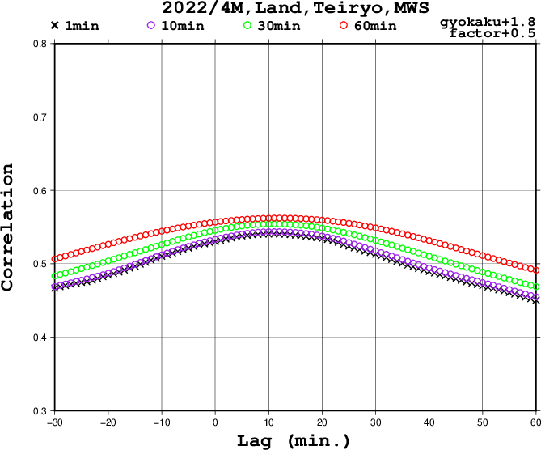
Time scale and time lag of GSMaP
Land, Sounders
CC with different time scale and time lag
-30 min.
0 min.
30 min.
60 min.
Average time of longer than 60 min. gives better CC
Maximum CC (time lag)
1-min ave. 0.541 (+11 min.)
10-min ave. 0.544 (+11 min.)
30-min ave. 0.554 (+11 min.)
60-min ave. 0.562 (+12 min.)

Slide 22
Time scale and time lag of GSMaP
Lag. (min) | Ocean | Land
AMSR2 | +13 min. | +10 min.
GMI | +13 min. | +12 min.
SSMIS | -04 min. | +07 min.
Sounders | +14 min. | +12 min.
Scale (min) | Ocean | Land
AMSR2 | 25 min. | 14 min.
GMI | 26 min. | 30 min.
SSMIS | > 60 min. | > 60 min.
Sounders | > 60 min. | > 60 min.

Slide 23
Time scale and time lag of GSMaP
Time lag to ground measurements
  Time lag between 10 min. to 15 min. is derived except for SSMIS
  No clear difference between Ocean and Land
Time scale (average time for maximum CC)
  30 min. or shorter for AMSR2 and GMI
  Over 60 min. for SSMIS and Sounders
Difference of spatial resolutions among sensors and frequencies may affect the results.
  Spatial matchup with 1MPR should be considered more.

Slide 24
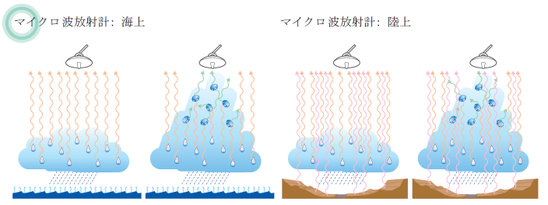
Expected results on time scale and time lag of rain rate estimates by microwave radiometers
Ocean
mainly emission algorithm
Sensitive to liquid precipitation
Time scale <-> 0 ºC height
Time lag <-> relatively small
Land
scattering algorithm
Sensitive to solid precipitation
Time scale <-> Storm height - 0 ºC height
Time lag <-> relative large
Rain from the space 2

Slide 25
Time scale and time lag of GSMaP
Time lag to ground measurements
  Time lag between 10 min. to 15 min. is derived except for SSMIS
  No clear difference between Ocean and Land
Time scale (average time for maximum CC)
  30 min. or shorter for AMSR2 and GMI
  Over 60 min. for SSMIS and Sounders
Difference of spatial resolutions among sensors and frequencies may affect the results.
  Spatial matchup with 1MPR should be considered more.

Slide 26
Spatial resolutions of microwave radiometers
 | Sensor | Satellite | Spatial resolution
Microwave Imagers | AMSR2 | GCOM-W | 14km×22km (18.7GHz) 3km×5km (89.0GHz)
 | GMI | GPM core | 11km×18km (18.7GHz) 4km×7km (89.0GHz)
 | SSMIS | DMSP (F16,F18) | 43km×69km (19.3GHz) 13km×15km (85.5GHz)
Microwave Sounders | AMSU | NOAA-19 Metop-B Metop-C | 48km (23.8～89GHz) 16km (89～183GHz)
 | ATMS | NPP | 75km (23～32GHz) 32km (50～90GHz) 16km (165～183GHz)

Slide 27
Recommendation for GSMaP
For hourly rain rate estimates for X:00 to (X+1):00 observations between X:00 to (X+1):00 are used.
  Time lag is set to be -30 min to + 30 min.
  Positive time lag over 30 min may give better result than negative time lag under 30 min

Slide 28
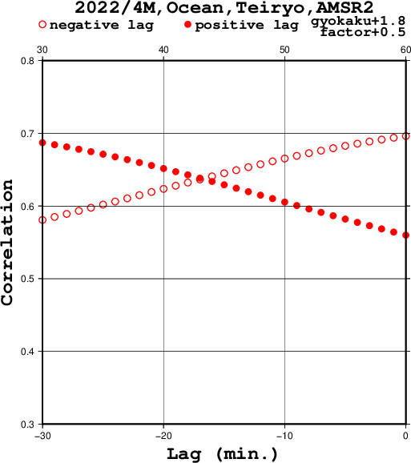
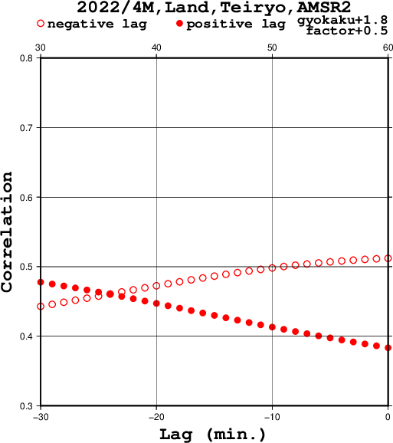
Recommendation for GSMaP
Ocean, AMSR2
Land, AMSR2
+30 to +43 min
+30 to +36 min
-30 to -17 min
-30 to -24 min

Slide 29
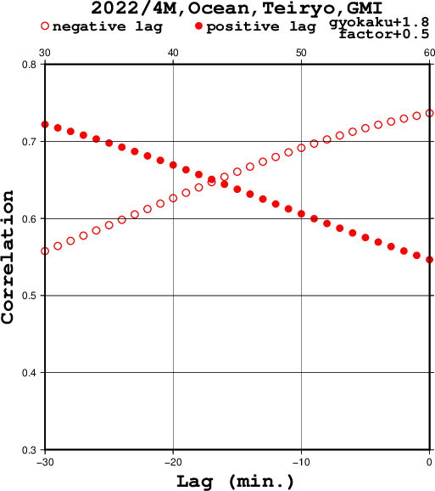
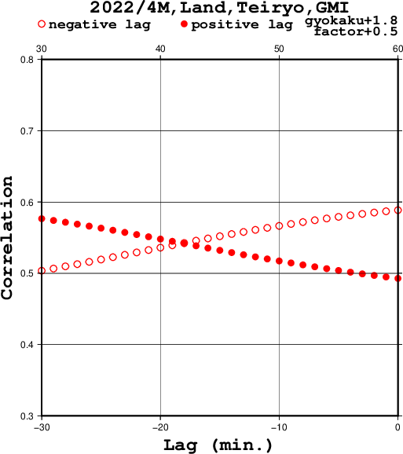
Recommendation for GSMaP
Ocean, GMI
Land, GMI
+30 to +43 min
+30 to +42 min
-30 to -17 min
-30 to -18 min

Slide 30
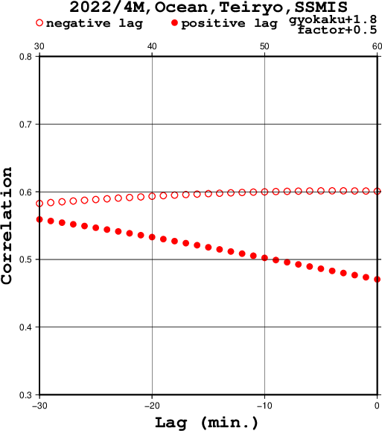
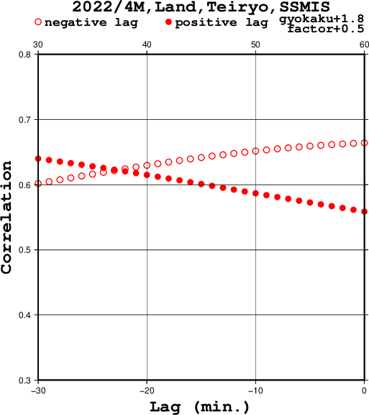
Recommendation for GSMaP
Ocean, SSMIS
Land, SSMIS
+30 to +37 min
-30 to -23 min

Slide 31
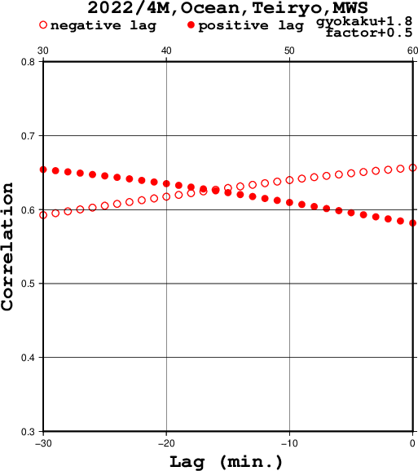
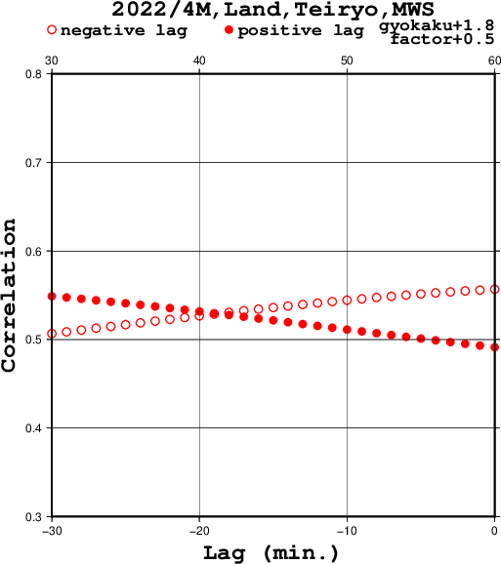
Recommendation for GSMaP
Ocean, MWS
Land, MWS
+30 to +44 min
+30 to +41 min
-30 to -16 min
-30 to -19 min

Slide 32
Recommendation for GSMaP
For hourly rain rate estimates from X:00 to (X+1):00 observations between X:00 to (X+1):00 are used.
  Time lag is set to be -30 min to + 30 min.
  Positive time lag over 30 min may give better result than negative time lag under 30 min
For hourly rain rate estimates from X:00 to (X+1):00, observations in the following time can be used.
 | Ocean | Land
AMSR2 | (X-1):47 to X:47 | (X-1):54 to X:54
GMI | (X-1):47 to X:47 | (X-1):48 to X:48
SSMIS | X:00 to (X+1):00 | (X-1):53 to X:53
MWS | (X-1):46 to X:46 | (X-1):49 to X:49

Slide 34
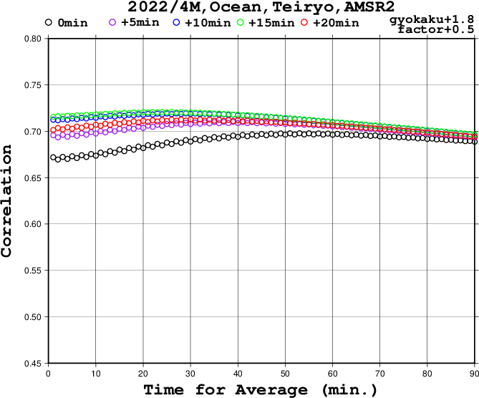
Ocean, AMSR2

Slide 35
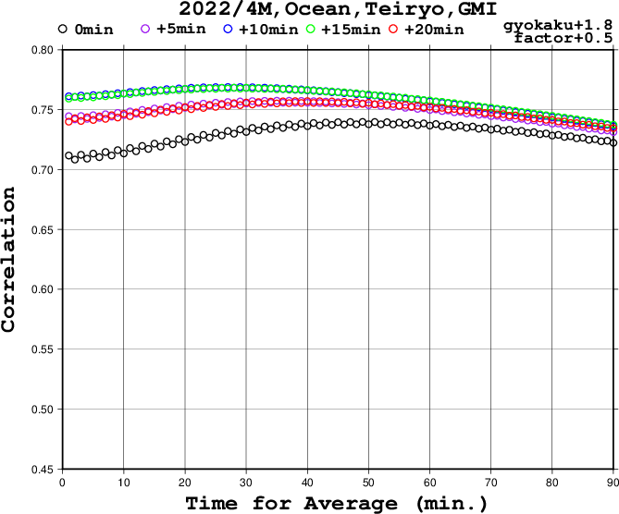
Ocean, GMI

Slide 36
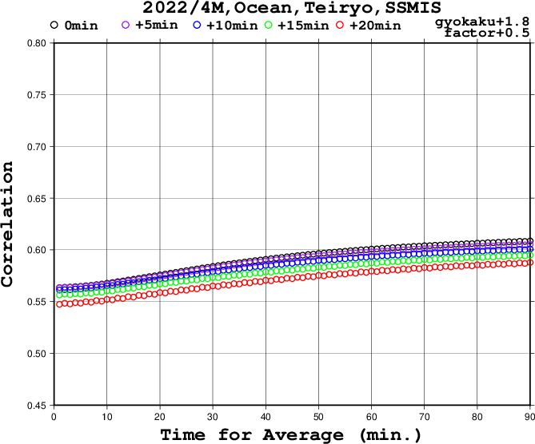
Ocean, SSMIS

Slide 37
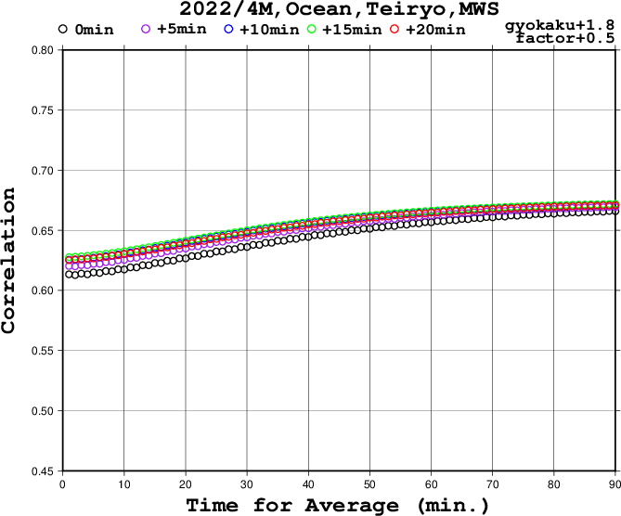
Ocean, MWS

Slide 38
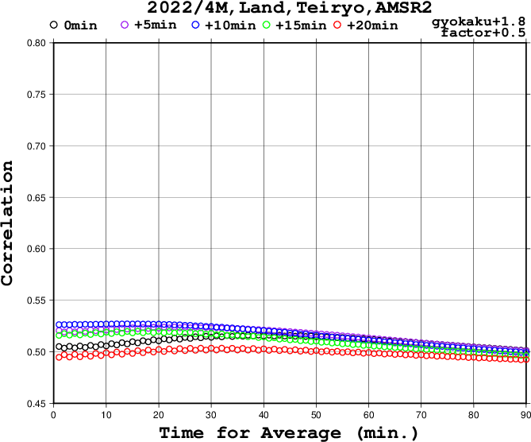
Land, AMSR2

Slide 39
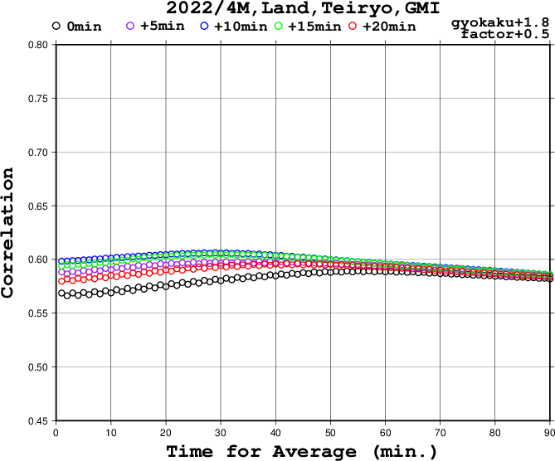
Ocean, GMI

Slide 40
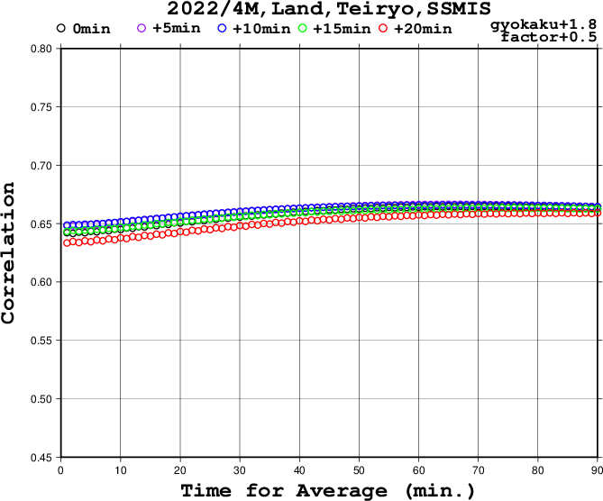
Ocean, SSMIS

Slide 41
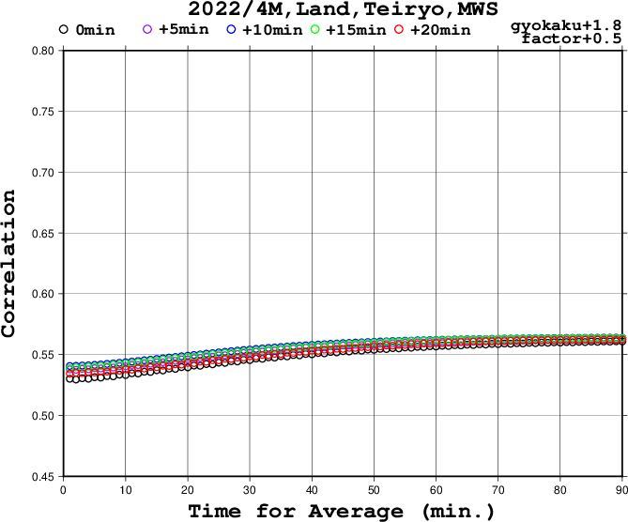
Ocean, MWS

Slide 42
1MPRの作成手順
降水強度
XRAINの降水強度
1分
時刻
転倒
１回目
転倒
２回目
転倒
３回目
転倒
４回目

Slide 43
1MPRの作成手順
降水強度
XRAINの降水強度
降水量
0.2mm
降水量
0.6mm
降水量
0.4mm
時刻
転倒
１回目
転倒
２回目
転倒
３回目
転倒
４回目

Slide 44
1MPRの作成手順
降水強度
0.2 → 0.5
0.6 → 0.5
0.4 → 0.5
補正
+0.3
×0.83
+0.1
補正後の降水強度
XRAINの降水強度
降水量
0.5mm
降水量
0.5mm
降水量
0.5mm
時刻
転倒
１回目
転倒
２回目
転倒
３回目
転倒
４回目

Slide 45
1MPRの作成手順
(補正後の降水強度)=S×(XRAINの降水強度)+C
降水強度
S=1.0
C= 0.3/T₁
S=0.833
C=0
S=1.0
C=0.1/T₂
S≦1とする
S＜1の場合、C=0
補正後の降水強度
XRAINの降水強度
降水量
0.5mm
降水量
0.5mm
降水量
0.5mm
時刻
転倒
１回目
転倒
２回目
転倒
３回目
転倒
４回目

Slide 46
1MPRの作成手順
(補正後の降水強度)=S×(XRAINの降水強度)+C
雨量計1
雨量計3
補正係数 S₁ ,C₁
距離 d₁
距離 d₃
補正係数 S₃ ,C₃
格子の補正係数の決定
距離 d₂
雨量計2
補正係数 S₂ ,C₂
S₀=1 C₀=0 D=111.111km
Wは「補正しない」の重み
Nは使用する雨量計の数

