Slide 1
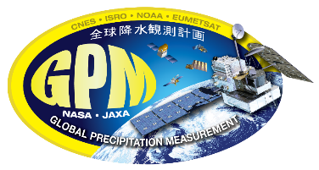


Evaluation of Potential TRMM/GPM Orbit Boost Effects within Core Observatory Precipitation Products and Resulting Calibration Challenges for IMERG V08
Robert Joyce^{1,2}, George J. Huffman¹, David T. Bolvin^{1,2}, Eric Nelkin^{1,2}, Jackson Tan^{1,3}
1 NASA Goddard Space Flight Center, Greenbelt, MD, USA
2 Science and Technology Corporation Inc., Hampton, VA, USA
3 University of Maryland Baltimore County, Baltimore, MD, USA
International Precipitation Working Group [IPWG]-12
July 7-10, 2026
Jagiellonian University Didactic and Library Centre
Kraków, Poland
Notes:
1
1
1

Slide 2
Resulting Effects on V07 CORRA-T/G Precipitation from Core Satellite Changes
Change Effects Verification
TRMM Core Observatory ~ 6% volume loss over ocean - 4 years spatiotemporally coincident boost from 350 km to ~ 5% volume loss over land pre & post TRMM boost F13+F14 SSMI
402 km August 2001
TRMM satellite ~ 3% volume gain over ocean - 4 years spatiotemporally coincident
PR A=>B switch ~ 4% volume gain over land pre & post TRMM PR A=>B switch TMI
May 2009
GPM Core Observatory ~ 12% volume loss over ocean - 2 years spatiotemporally coincident boost from 402 km to ~ 7% volume loss over land pre & post GPM boost F16, F17, F18
435 km November 2023 SSMIS and GCOM-W1 AMSR-2
IPWG-12 July 7-10, 2026
Jagiellonian University Didactic and Library Centre
Kraków, Poland

Slide 3
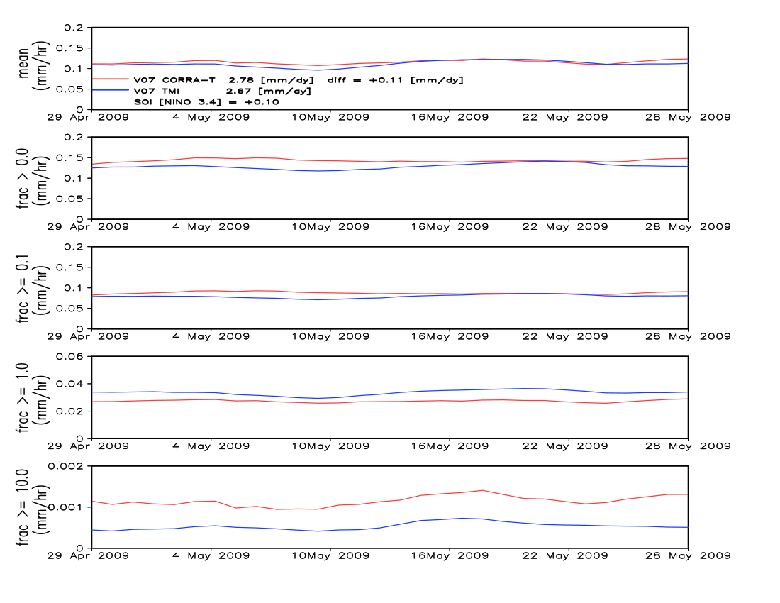
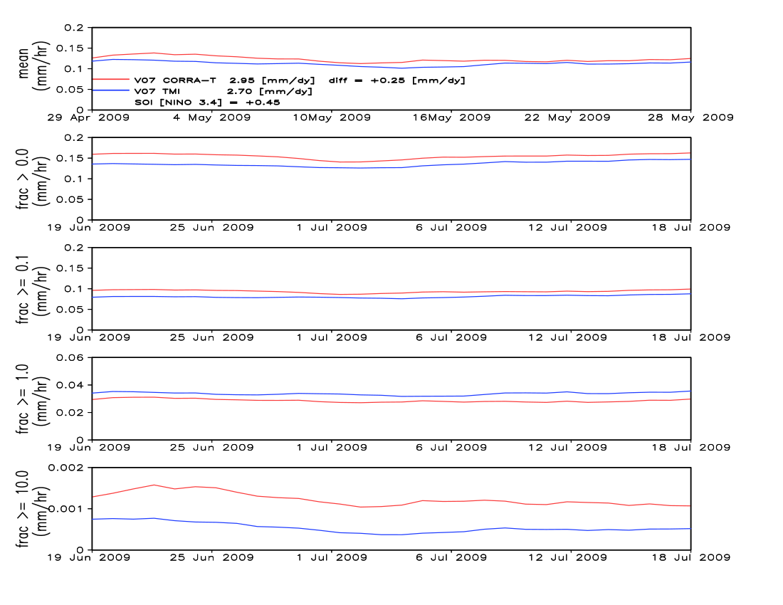
Pacific Ocean [105E-70W]
Pre TRMM PR A=>B Switch Post PR A=>B Switch
Relative to V07 GPROF TMI perhaps we see an
increase in the V07
CORRA-T mean and
precipitation detection
fraction from the
PR A=>B switch
However; detection of
heavier rates seems not
to change
IPWG-12 July 7-10, 2026
Jagiellonian University Didactic and Library Centre
Kraków, Poland

Slide 4
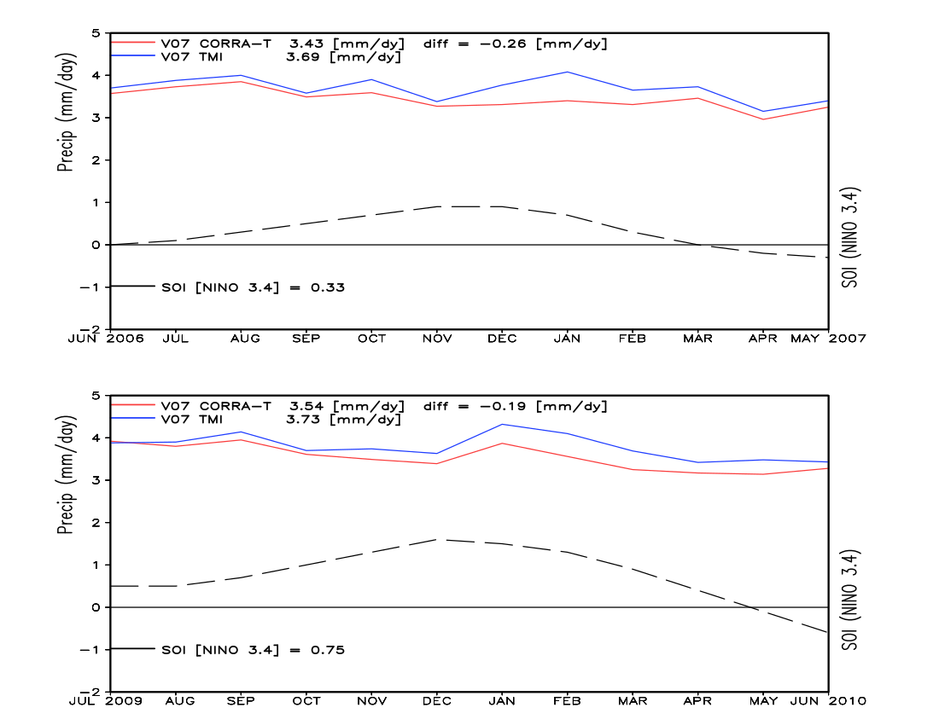
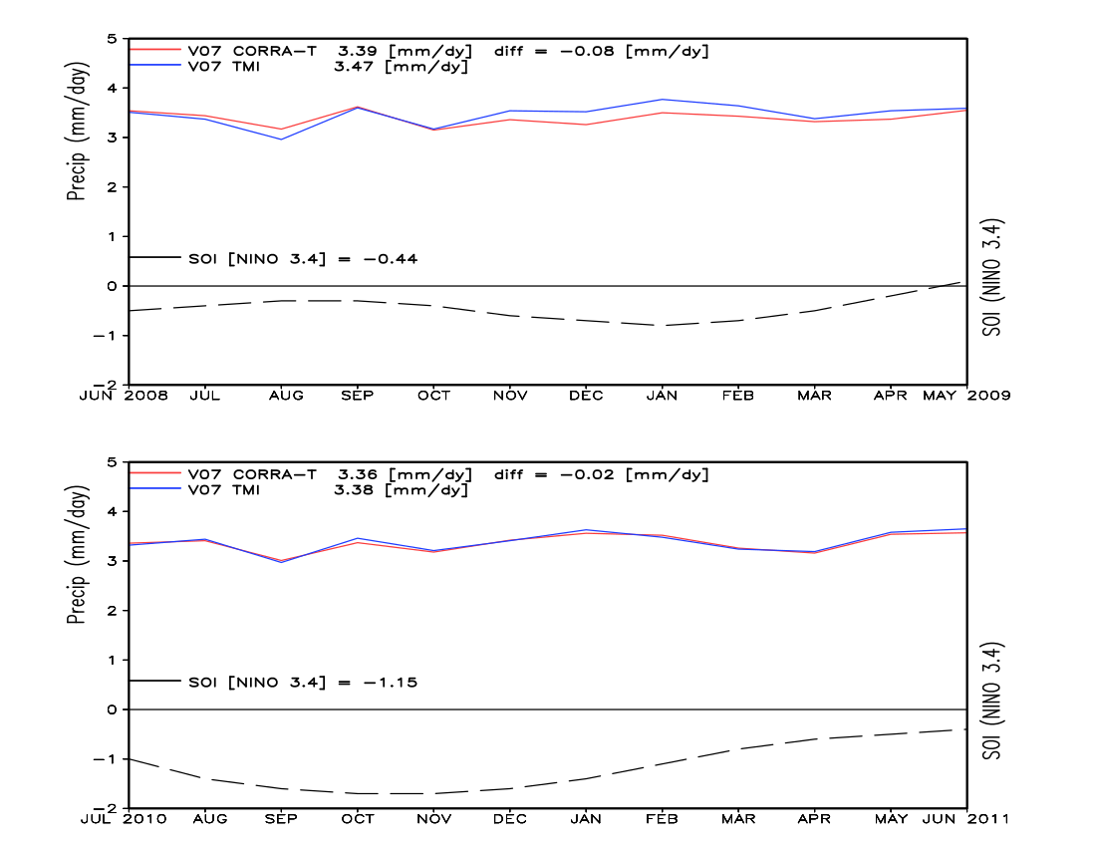
Over ocean the ENSO cycle affects the CORRA-T/TMI relationship more than the TRMM PR A=>B switch
Pre-Switch
Post-Switch
El Niño Pacific Ocean [105E-70W]
La Niña Pacific Ocean [105E-70W]
IPWG-12 July 7-10, 2026
Jagiellonian University Didactic and Library Centre
Kraków, Poland

Slide 5
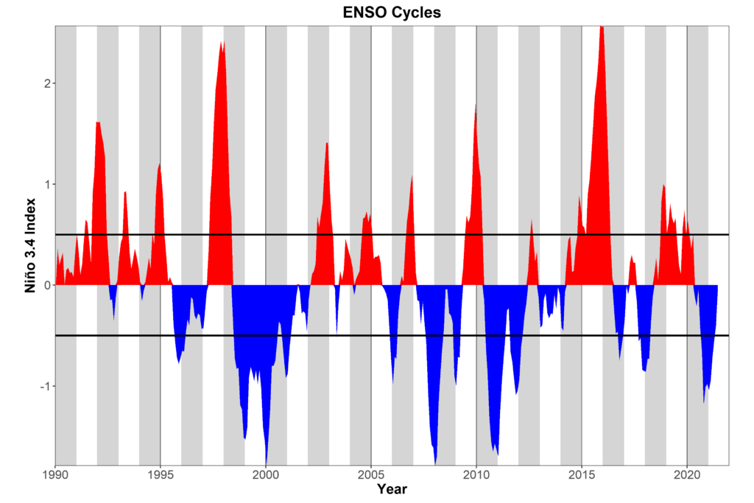
4 years of ENSO cycle years for pre TRMM PR A=>B switch CORRA-T and TMI are matched with 4 similar years of post TRMM PR A=>B switch CORRA-T and TMI
Notes:
5

Slide 6
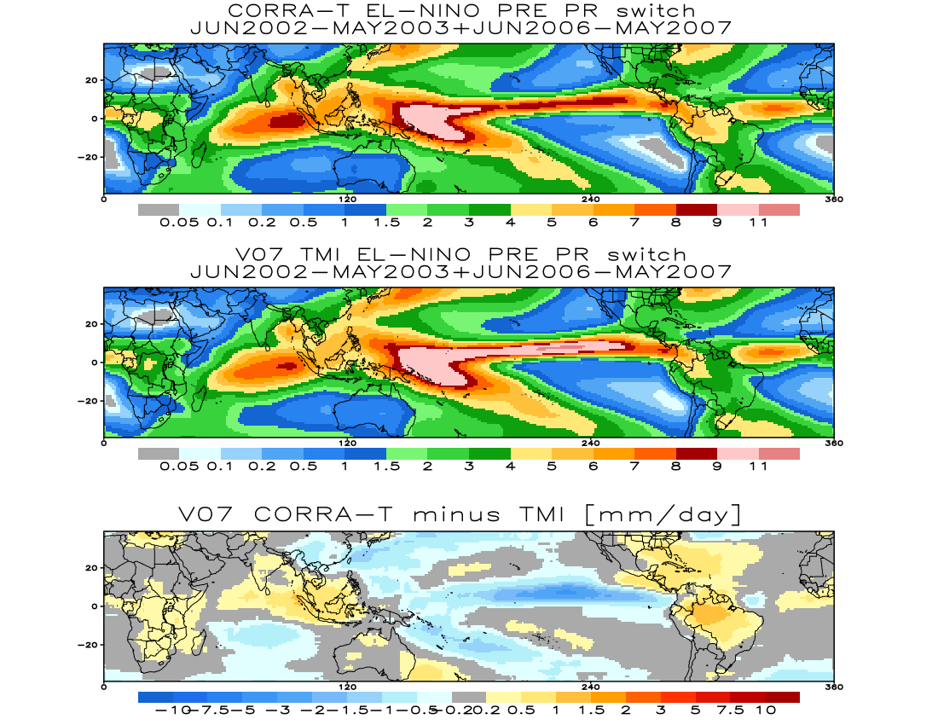
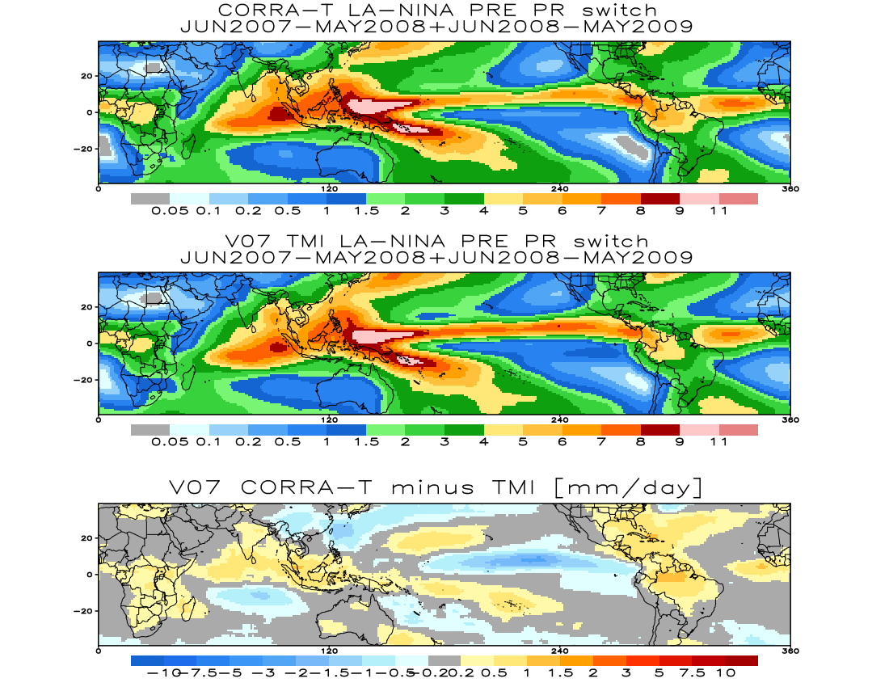
Pre PR A=>B Switch El Niño Pre PR A=>B Switch La Niña
CORRA-T
TMI
CORRA-T
minus TMI
For pre switch years, Pacific ocean TMI is relatively much heavier relative to CORRA-T for El Niño years, not so for La Niña years
IPWG-12 July 7-10, 2026
Jagiellonian University Didactic and Library Centre
Kraków, Poland

Slide 7
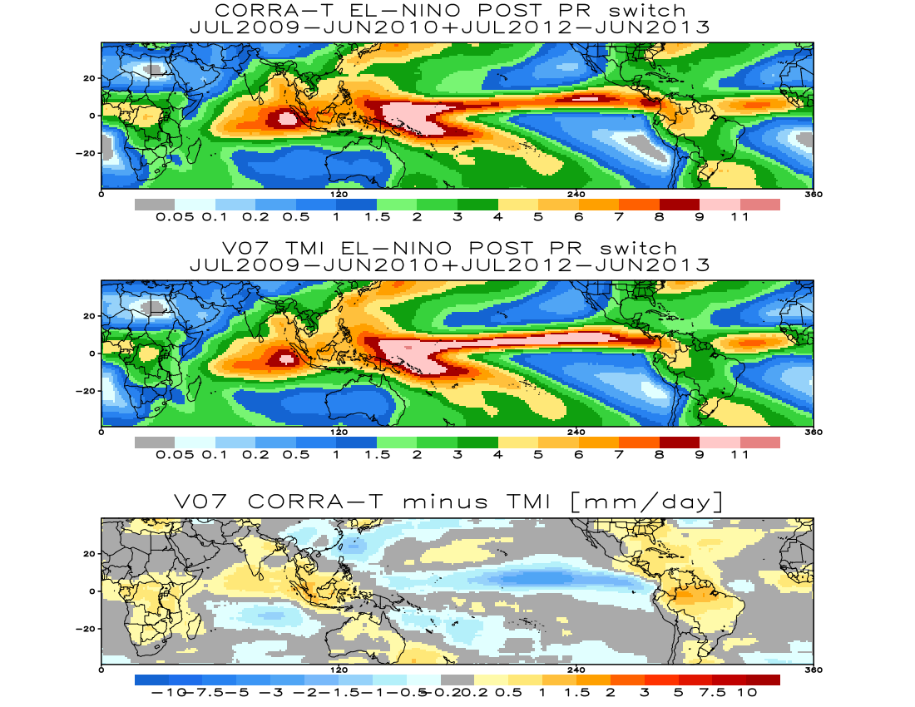
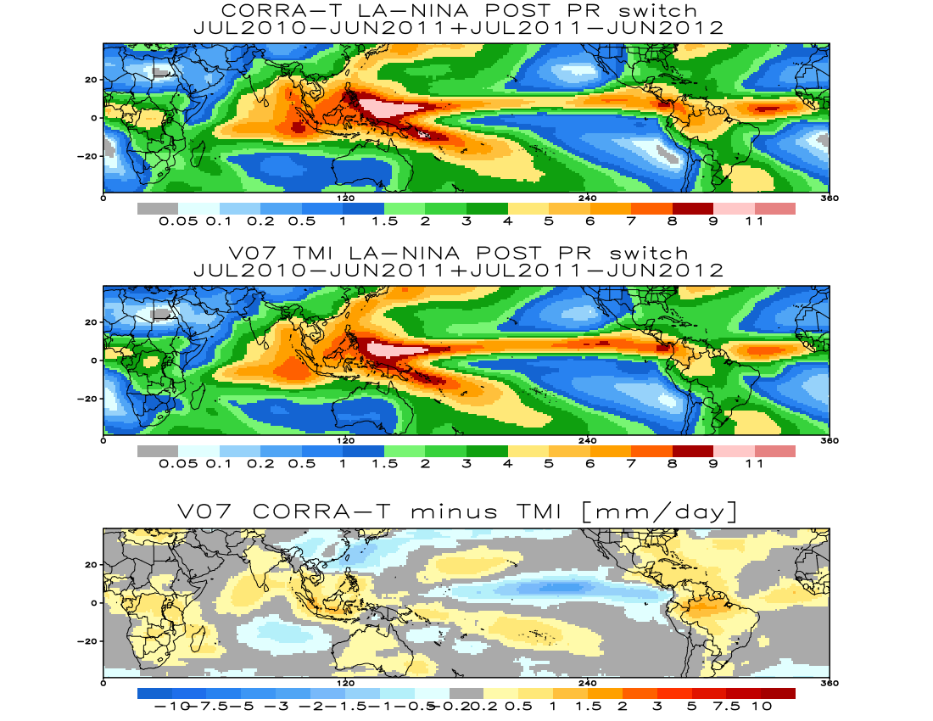
Post PR A=>B Switch El Niño Post PR A=>B Switch La Niña
CORRA-T
TMI
CORRA-T
minus TMI
Same for post switch years, however relative to TMI, CORRA-T
seems to be heavier than the pre switch years
IPWG-12 July 7-10, 2026
Jagiellonian University Didactic and Library Centre
Kraków, Poland

Slide 8
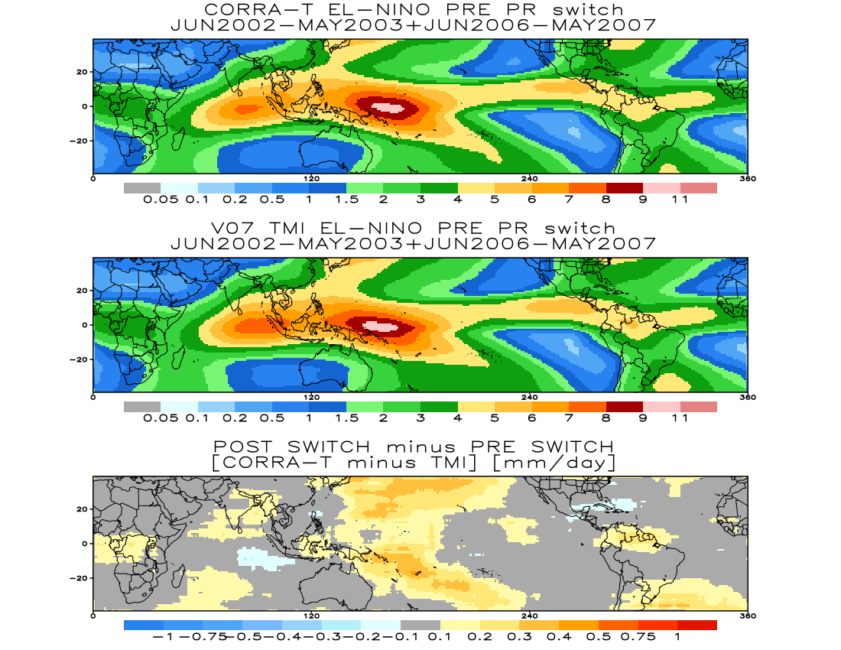
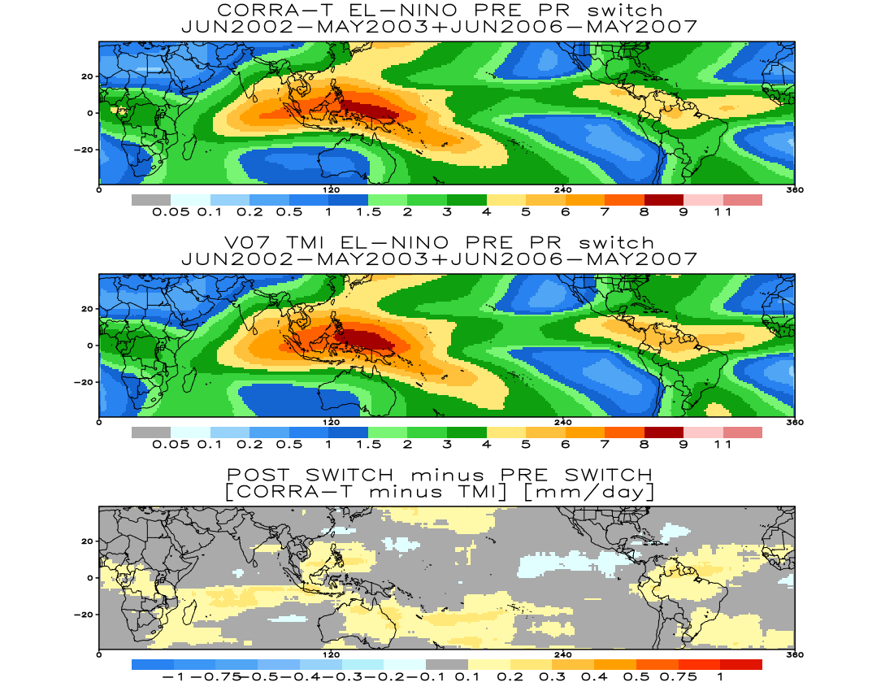
Post minus Pre PR A=>B Switch Post minus Pre PR A=>B Switch
El Niño La Niña
Ocean: [mm/day] Land: [mm/day] Ocean: [mm/day] Land: [mm/day]
CORRA TMI ratio CORRA TMI ratio CORRA TMI ratio CORRA TMI ratio
Pre-switch 3.10 3.26 95.0% 2.17 1.94 112.1% Pre-switch 3.10 3.11 99.7% 2.28 2.05 111.1%
Post-switch 3.20 3.28 97.6% 2.31 2.01 115.2% Post-switch 3.17 3.13 101.3% 2.36 2.06 114.6%
gain/loss [+2.6%] [+3.1%] gain/loss [+1.6%] [+3.5%]
Pre and Post boost A=>B switch differences are comparable by separating El Niño and La Niña
IPWG-12 July 7-10, 2026
Jagiellonian University Didactic and Library Centre
Kraków, Poland

Slide 9
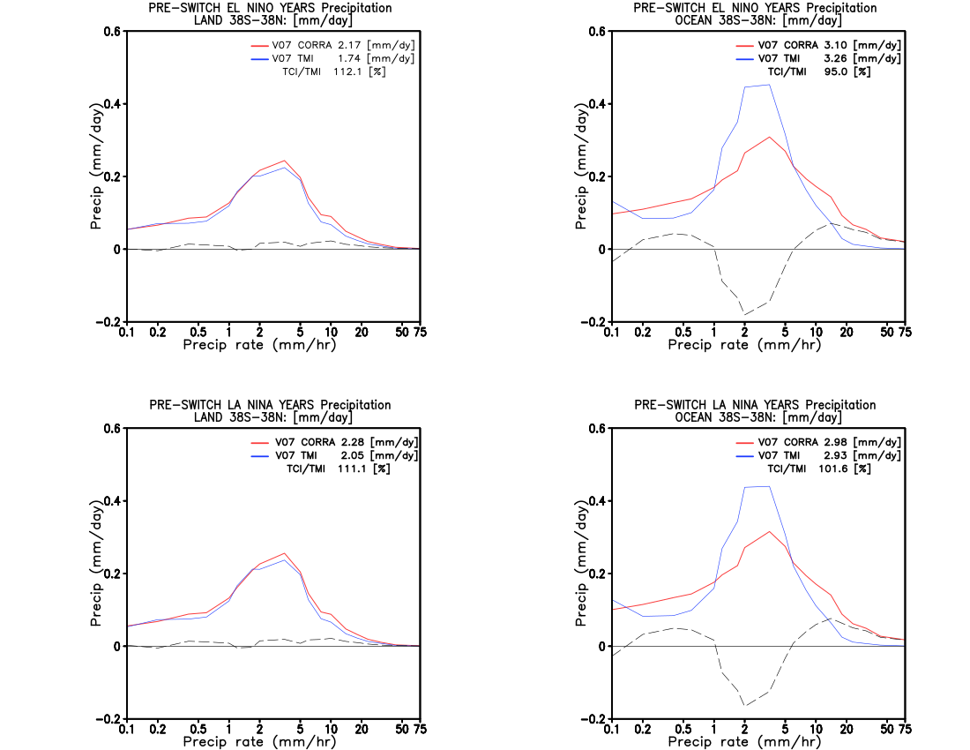
pre-switch CORRA-T &TMI pre-switch CORRA-T &TMI
land 38S-38N [mm/day] ocean 38S-38N [mm/day]
Precipitation rate distribution of CORRA-T close to TMI over land
CORRA-T precipitation for moderate rates much less than TMI over ocean
IPWG-12 July 7-10, 2026
Jagiellonian University Didactic and Library Centre
Kraków, Poland

Slide 10
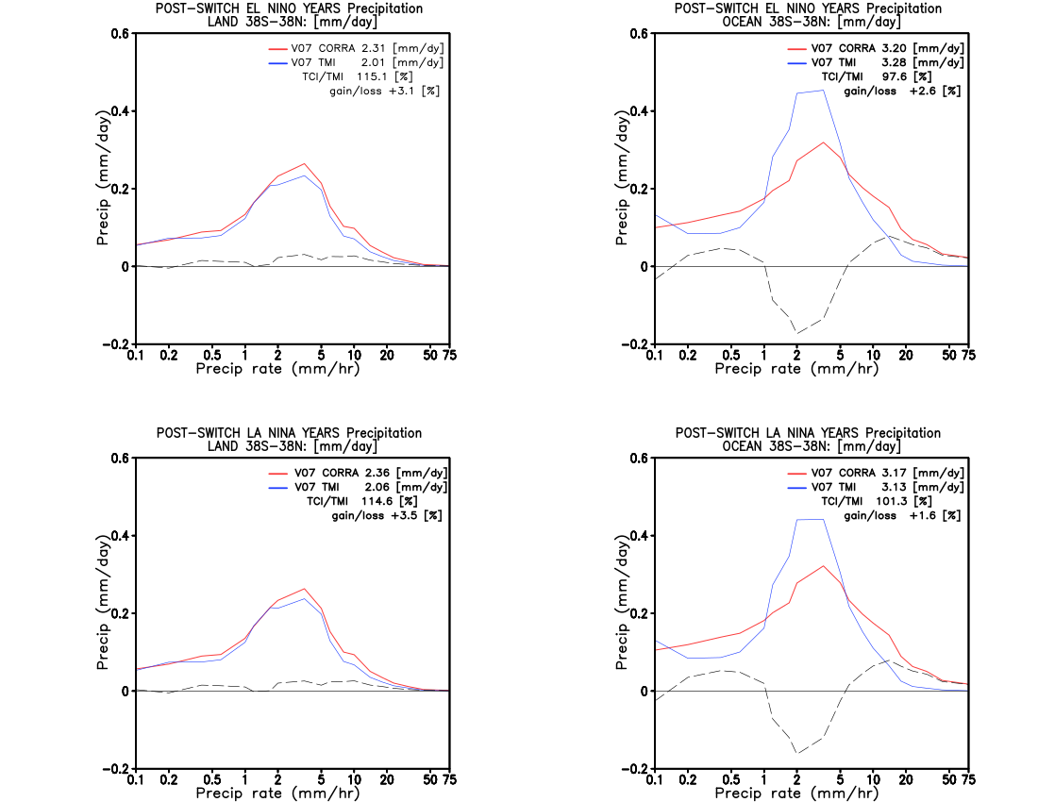
post-switch CORRA-T &TMI post-switch CORRA-T &TMI
land 38S-38N [mm/day] ocean 38S-38N [mm/day]
post-switch CORRA-T gains over land relative to pre-switch mostly in the
<10 mm/hr range
post-switch CORRA-T gains over ocean relative to pre-switch also mostly in the <10 mm/hr range
IPWG-12 July 7-10, 2026
Jagiellonian University Didactic and Library Centre
Kraków, Poland

Slide 11
Summary and Future Work
In IMERG, the GMI/TMI calibrated partner satellites’ PMW precipitation estimates are ultimately calibrated by the CORRA-G/T for the GPM/TRMM eras respectively.
CSU has done a lot of work on V08 GPROF, and the CORRA group as well, completing the final stages of V08. Certainly there will be improvements in V08, but we need to verify.
Core observatory orbit boosts and the TRMM PR A=>B switch have substantial effects on V07 CORRA-T/G precipitation, reduction from orbit boosts, increases from the PR switch..
For the TRMM PR A=>B switch, spatiotemporally matched GPROF TMI is used to quantify the switch effects; however similar pre/post ENSO cycle periods are required for comparison since the V07-CORRA/V07-GPROF relationship changes between cold and warm events.
V08 GPROF TMI & GMI are possible candidates for orbit boost effect quantification on V08 CORRA-T/G since early indications yield little GPM boost effect on V08 GMI.
The cold/warm ENSO CORRA-T/G relationship dependency needs to be reevaluated with the V08 version of both products, however; matching pre/post ENSO periods will be used.
IPWG-12 July 7-10, 2026
Jagiellonian University Didactic and Library Centre
Kraków, Poland
Notes:
11
11
11

