Slide 1





12TH IPWG WORKSHOP · KRAKÓW 2026
ABSTRACT · ORAL PRESENTATION
Case-Study-Based Validation and Performance Analysis of HSAF Precipitation Products over Türkiye
Ahmet Öztopal¹ · Abdurrahman Durmaz¹ · Melek Akın¹* · Ahmet Emre Tekeli²
¹ İstanbul Technical University — Dept. of Climate Science & Meteorological Engineering, İstanbul
² Iğdır University — Dept. of Civil Engineering, Iğdır
* Presenting author: akinm@itu.edu.tr
Notes:
My name is Melek Akın, from Istanbul Technical University, Department of Climate Science and Meteorological Engineering.
This is joint work with my colleagues Ahmet Öztopal and Abdurrahman Durmaz from ITU, and Ahmet Emre Tekeli from Iğdır University.
Today, I will present our work entitled "Case-Study-Based Validation and Performance Analysis of HSAF Precipitation Products over Türkiye."

Slide 2
OUTLINE · 02 / 16
CONTENTS
Presentation outline
Six steps from study area to conclusions
01
Study area & climate
Türkiye — four climate regimes and complex terrain
02
HSAF precipitation products
Operational product families and specifications
03
Reference data
TSMS AWOS network — 1259 automated ground stations
04
Methodology
Match-up workflow, processing steps and validation metrics
05
Case studies & results
Three precipitation events: synoptic setting and performance
06
Discussion & conclusions
Performance, error structure and outlook
IPWG-12 · KRAKÓW 2026
Notes:
This slide shows the outline of my presentation. It has six steps.
First, I will introduce the study area and its climate regimes.
Second, I will give a short overview of the HSAF precipitation products evaluated in this study.
Third, our reference data — we have more than twelve hundred ground stations.
Then the methodology and the case studies with results.
Finally, I will discuss the findings and conclude with future perspectives/work.

Slide 3
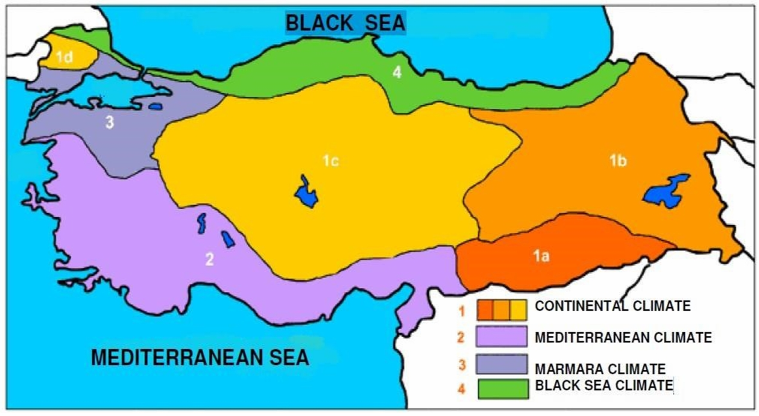
STUDY AREA · 03 / 16
STUDY AREA & CLIMATE REGIMES
Türkiye — a country of climatic contrasts
36°–42° N, 26°–45° E
Türkiye is a mountainous country between warm and subtropical climate zones. Ranges parallel to the coasts — the Taurus and the North Anatolian Mountains — form a barrier that drives a continental interior and sharp regional contrasts in climate, land cover and precipitation.
Mediterranean
South and west coasts: hot, dry summers with intense autumn–winter rainfall and convective storms.
Black Sea
North coast: humid and heavily vegetated, with abundant orographic rainfall year-round.
Marmara
Transitional northwest: moderate temperatures with rainfall spread across the year.
Continental
Interior and east: cold, snowy winters and hot, dry summers. Snow and frozen ground challenge retrieval.
Figure 1: Climate regions of Türkiye (Atalay 1997; Şensoy et al. 2009).
IPWG-12 · KRAKÓW 2026
Notes:
It is important to understand why rainfall estimation over Türkiye is particularly challenging.
So, Türkiye is located between Europe and Asia, and it has very different climate conditions.
As shown in the map, the country has 4 main climate regimes in a relatively small area. These are Mediterranean, Marmara, Black Sea, and Continental climate.
The Mediterranean region has a different rainfall regime. Summers are generally hot and dry. The rainfall events occur during autumn and winter.
The Black Sea region is much wetter. Moist air comes from the sea and rises over the North Anatolian Mountains. This causes orographic precipitation during the year.
The Marmara region has a transitional climate. It is affected by both maritime and continental conditions, so rainfall can occur in different seasons.
Central and Eastern Türkiye have a continental climate. Winters are cold and snowy, summers are hot and dry, and the terrain is mountainous.
The study area is a difficult region for satellite rainfall estimation because it has mountains, different climate regimes, and different rainfall types. This diversity is one of the main reasons why we selected Türkiye as our study area.

Slide 4
PRODUCTS · 05 / 16
PRODUCT FAMILY OVERVIEW
Accumulated precipitation products
H42
H61
H90
P-AC-FCI
P-AC-SEVIRI-PMW
P-AC-SEVIRI_E
Accumulated
Accumulated
Accumulated
Level-3 accumulated precipitation that integrates the 10-minute H40 maps into hourly and daily totals, inheriting FCI's finer ≈2 km sampling.
Level-3 accumulated precipitation built by time-integrating the H60 maps; provides the hourly 1-hour total and, every six hours, the 24-hour total over the Meteosat 0° disc.
Accumulated precipitation for the Indian-Ocean Data Coverage (IODC) region over 45.5° E. It integrates the instantaneous H63 (P-IN-SEVIRI_E) maps — IODC SEVIRI IR blended with LEO PMW.
OPERATIONAL
OPERATIONAL
OPERATIONAL
IPWG-12 · KRAKÓW 2026
Notes:
Here, you can see the three accumulated precipitation products in more detail.
H42 is the new product obtain from H40. It gives hourly rainfall totals and has about 2-kilometer resolution.
H61 is the SEVIRI - based product. It integrates the H60 maps and gives 1-hour totals every hour. The resolution is approximately 3 kilometers at nadir.
H90 covers the Indian Ocean region. It uses the SEVIRI instrument on the Meteosat at 45.5 degrees east. It has the same spatial resolution as H61.
All three products are operational accumulated precipitation products.
They provide hourly rainfall totals, so they are suitable for comparison with the hourly ground station observations.
Although they have a similar purpose, they differ in sensor, algorithm, and coverage.

Slide 5
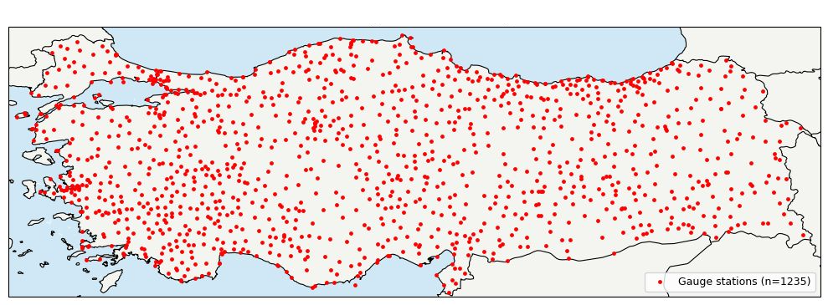
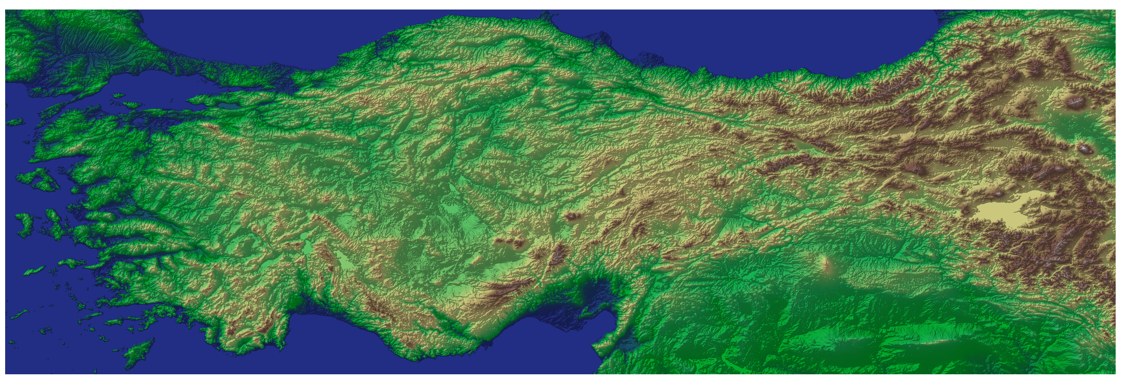
REFERENCE DATA · 06 / 16
GROUND REFERENCE
TSMS automated weather observation stations
IPWG-12 · KRAKÓW 2026
Notes:
For the ground truth, we use the automated weather stations of the Turkish State Meteorological Service.
This network has 1,259 stations — so more than twelve hundred automated stations, covering the whole country.
The stations provide hourly rainfall data, and the satellite products also provide hourly rainfall totals. So, we can compare them directly.
At the bottom you can see the digital elevation map of study area. It shows the complex terrain, especially in the east. This is important because mountains affect rainfall and make satellite precipitation estimation more difficult.

Slide 6
METHODOLOGY · 07 / 16
METHODOLOGY
Case-study validation workflow
Four stages — what goes in, what we do, and what comes out
1
READ THE DATA
H-SAF hourly rain files and more then 1200 TSMS gauge records are loaded; the start–end dates of the event are set.
OUT: event data loaded
2
MATCH IN SPACE
The satellite grid is turned into lat/lon and every station is linked to its nearest pixel (KD-Tree) — once, valid for all hours.
OUT: station ↔ pixel pairs
3
PAIR & CLEAN
Hour by hour, satellite rain + QI at the matched pixel meet the same-hour gauge value; missing, negative and low-QI records are removed.
OUT: clean hourly pairs
4
SCORE & COMPARE
Satellite − gauge differences plus continuous and categorical metrics are computed.
OUT: metrics · Excel · maps
IPWG-12 · KRAKÓW 2026
Notes:
Now the methodology. Our workflow has four stages. I will explain it step by step.
Stage one: read the data.
Stage two: match in space.
Stage three: pair and clean.
Stage four: score and compare.
We applied the same procedure to all three products. Therefore, the comparison between H42, H61 and H90 is consistent and fair.

Slide 7
METHODOLOGY · 08 / 16
METHODOLOGY
What happens at each stage
The full processing chain behind every validation number
1
Read & prepare
2
Locate & match
– Read H-SAF files, station coordinates, hourly gauge data
– Set the start–end dates of the event
– Build timestamps; drop records outside the window
– Mark missing-data codes as NaN
– Convert the satellite grid (MSG projection) to lat/lon
– Cut the Türkiye sub-grid; keep valid pixels
– Build a KD-Tree from the pixel centres
– Find each station’s nearest pixel — fixed for all hours
3
Pair & clean
4
Score & Compare
– Open each hourly file; read rain and QI fields
– Take both values at every station’s matched pixel
– Pair with the same-hour gauge value (station ID)
– Drop missing, negative and low-QI records
–– Difference = satellite total − gauge total
– ME, MAE, RMSE, bias, CC + POD, FAR, CSI, Hit Rate
– Save CSV / Excel tables; plot the maps
IPWG-12 · KRAKÓW 2026
Notes:
This slide shows the same four stages, but with the full details
The first stage focuses on preparing the input data.
We read the HSAF precipitation files, the station coordinates, and the hourly rain gauge observations.
Then we define the event period, generate consistent timestamps, and identify missing observations.
The second stage is the spatial matching.
The satellite grid is converted into latitude and longitude coordinates.
Then, each station is assigned to its nearest satellite pixel. For this purpose, we use a KD-tree nearest-neighbor approach, because it is efficient and repeatable. We do this only once, and then the matching is fixed for all hours.
In the third stage, we perform temporal matching and quality control.
For every hour, we extract the satellite precipitation value and the quality index from the matched pixel.
Then, we pair these values with the gauge observation from the same hour and the same station.
For quality control, we use the quality index of each satellite pixel. If the quality index is below 0.2, we remove that record.
We also remove missing values and invalid records before the analysis.
Finally, in the last stage is comparison.
For each station-pixel pair, we compare the satellite rainfall with the station rainfall. Then, we calculate the difference between them.
We calculate error metrics, such as MAE and RMSE.
We also calculate detection metrics, such as probability of detection and false alarm ratio.

Slide 8
METHODOLOGY · 09 / 16
METHODOLOGY
Methodology flowchart
The validation pipeline at a glance — from raw files to metrics
H-SAF hourly files
+ TSMS gauge data
Hourly: rain + QI at pixel
↔ same-hour gauge
Read inputs
set the event window
QC pass?
QI ≥ 0.2 · valid
No
drop record
Yes
Parse timestamps
missing → NaN
Compare rain per station
over the event
Grid → lat/lon (MSG)
Türkiye subset
Compute metrics
continuous + categorical
KD-Tree match
station → nearest pixel
Excel / CSV tables
+ difference maps
IPWG-12 · KRAKÓW 2026
Notes:
This flowchart shows the full process, from input data to final metrics.
The process starts with two main inputs: the HSAF hourly precipitation files and the rain gauge observations from automatic weather observation stations.
You can see the quality-control decision in the middle: if a record passes the quality-index test, it goes into the statistics. If not, we drop it. our threshold is 0.2
At the end, we obtain the validation metrics and the difference maps.
Now, let us move to the case studies.

Slide 9
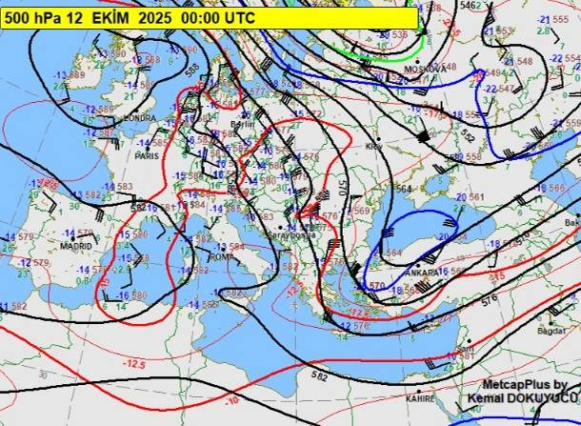
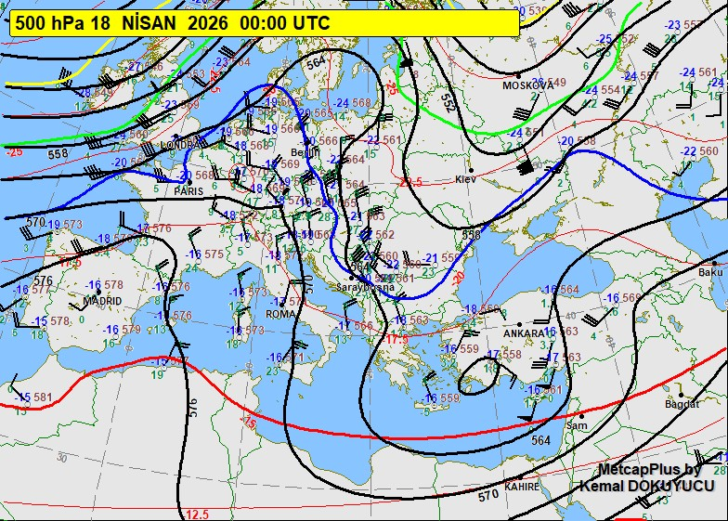
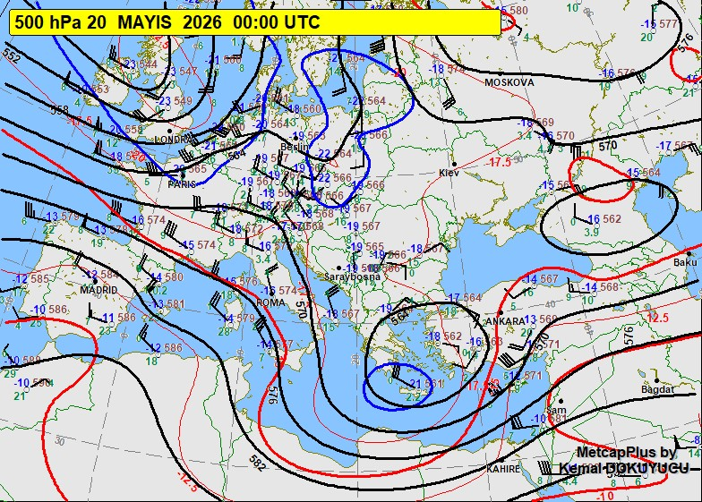
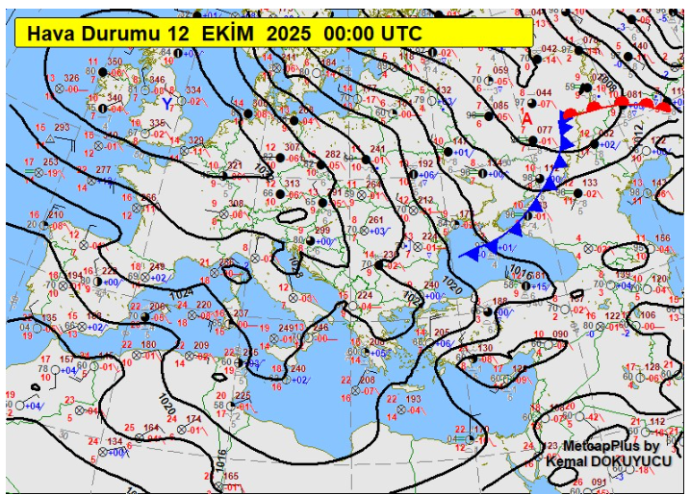
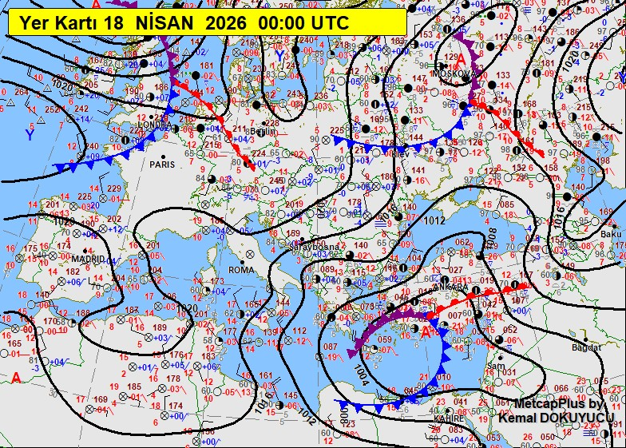
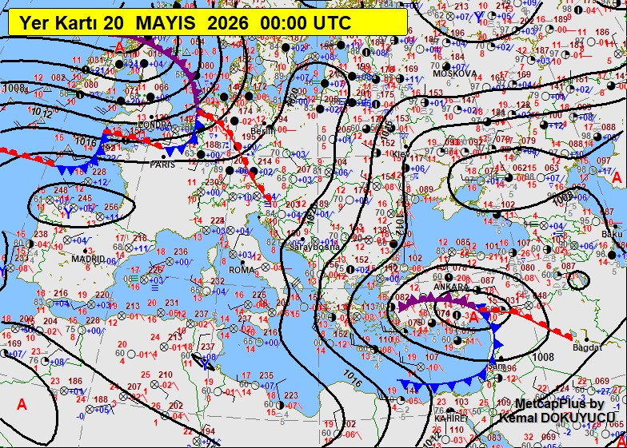
CASE STUDIES · 10 / 16
CASE STUDIES
Selected case-study events
Synoptic setting of the three events — surface and 500 hPa charts from TSMS
12.10.2025
18.04.2026
20.05.2026
500 hPa chart
500 hPa chart
500 hPa chart
Surface chart
Surface chart
Surface chart
IPWG-12 · KRAKÓW 2026
Notes:
Here, I show the synoptic conditions of the three selected precipitation events. Each column is one event, in time order.
The upper panel shows the 500-hectopascal chart, and the lower panel shows the surface chart.
In the first case, on 12 October 2025, we see an upper-level trough over the eastern Mediterranean region. At the surface, we see a cold front in the north and a local cyclone in the south. This system produced significant rainfall, especially over the eastern part of Türkiye.
In the second case, on 18 April 2026, there is a low-pressure centre at upper levels. At the surface, we see a cyclone over the Eastern Mediterranean and a frontal system. This shows that Türkiye was under a strong low-pressure system, and a large part of the country experienced precipitation.
In the third case, on 20 May 2026, the cyclone is closer to Türkiye, and the upper-level low also supports the system. Because this event occurred in late May, local instability and convective rainfall may also have contributed.
So, these three cases represent different atmospheric conditions. This helps us test the HSAF products under different rainfall situations.

Slide 10
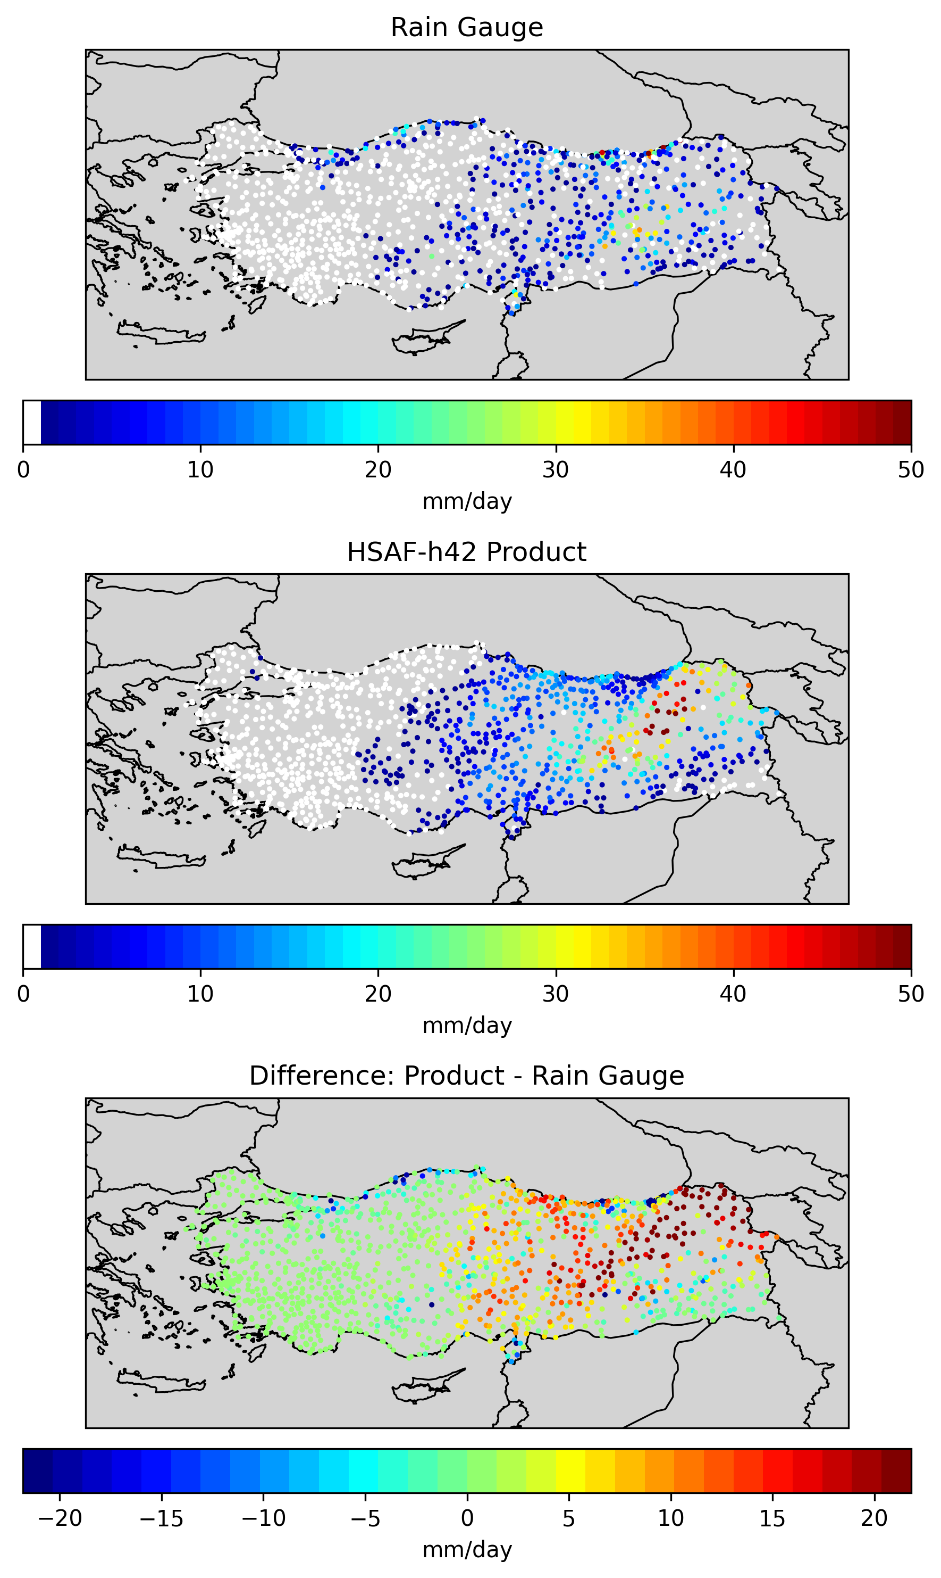
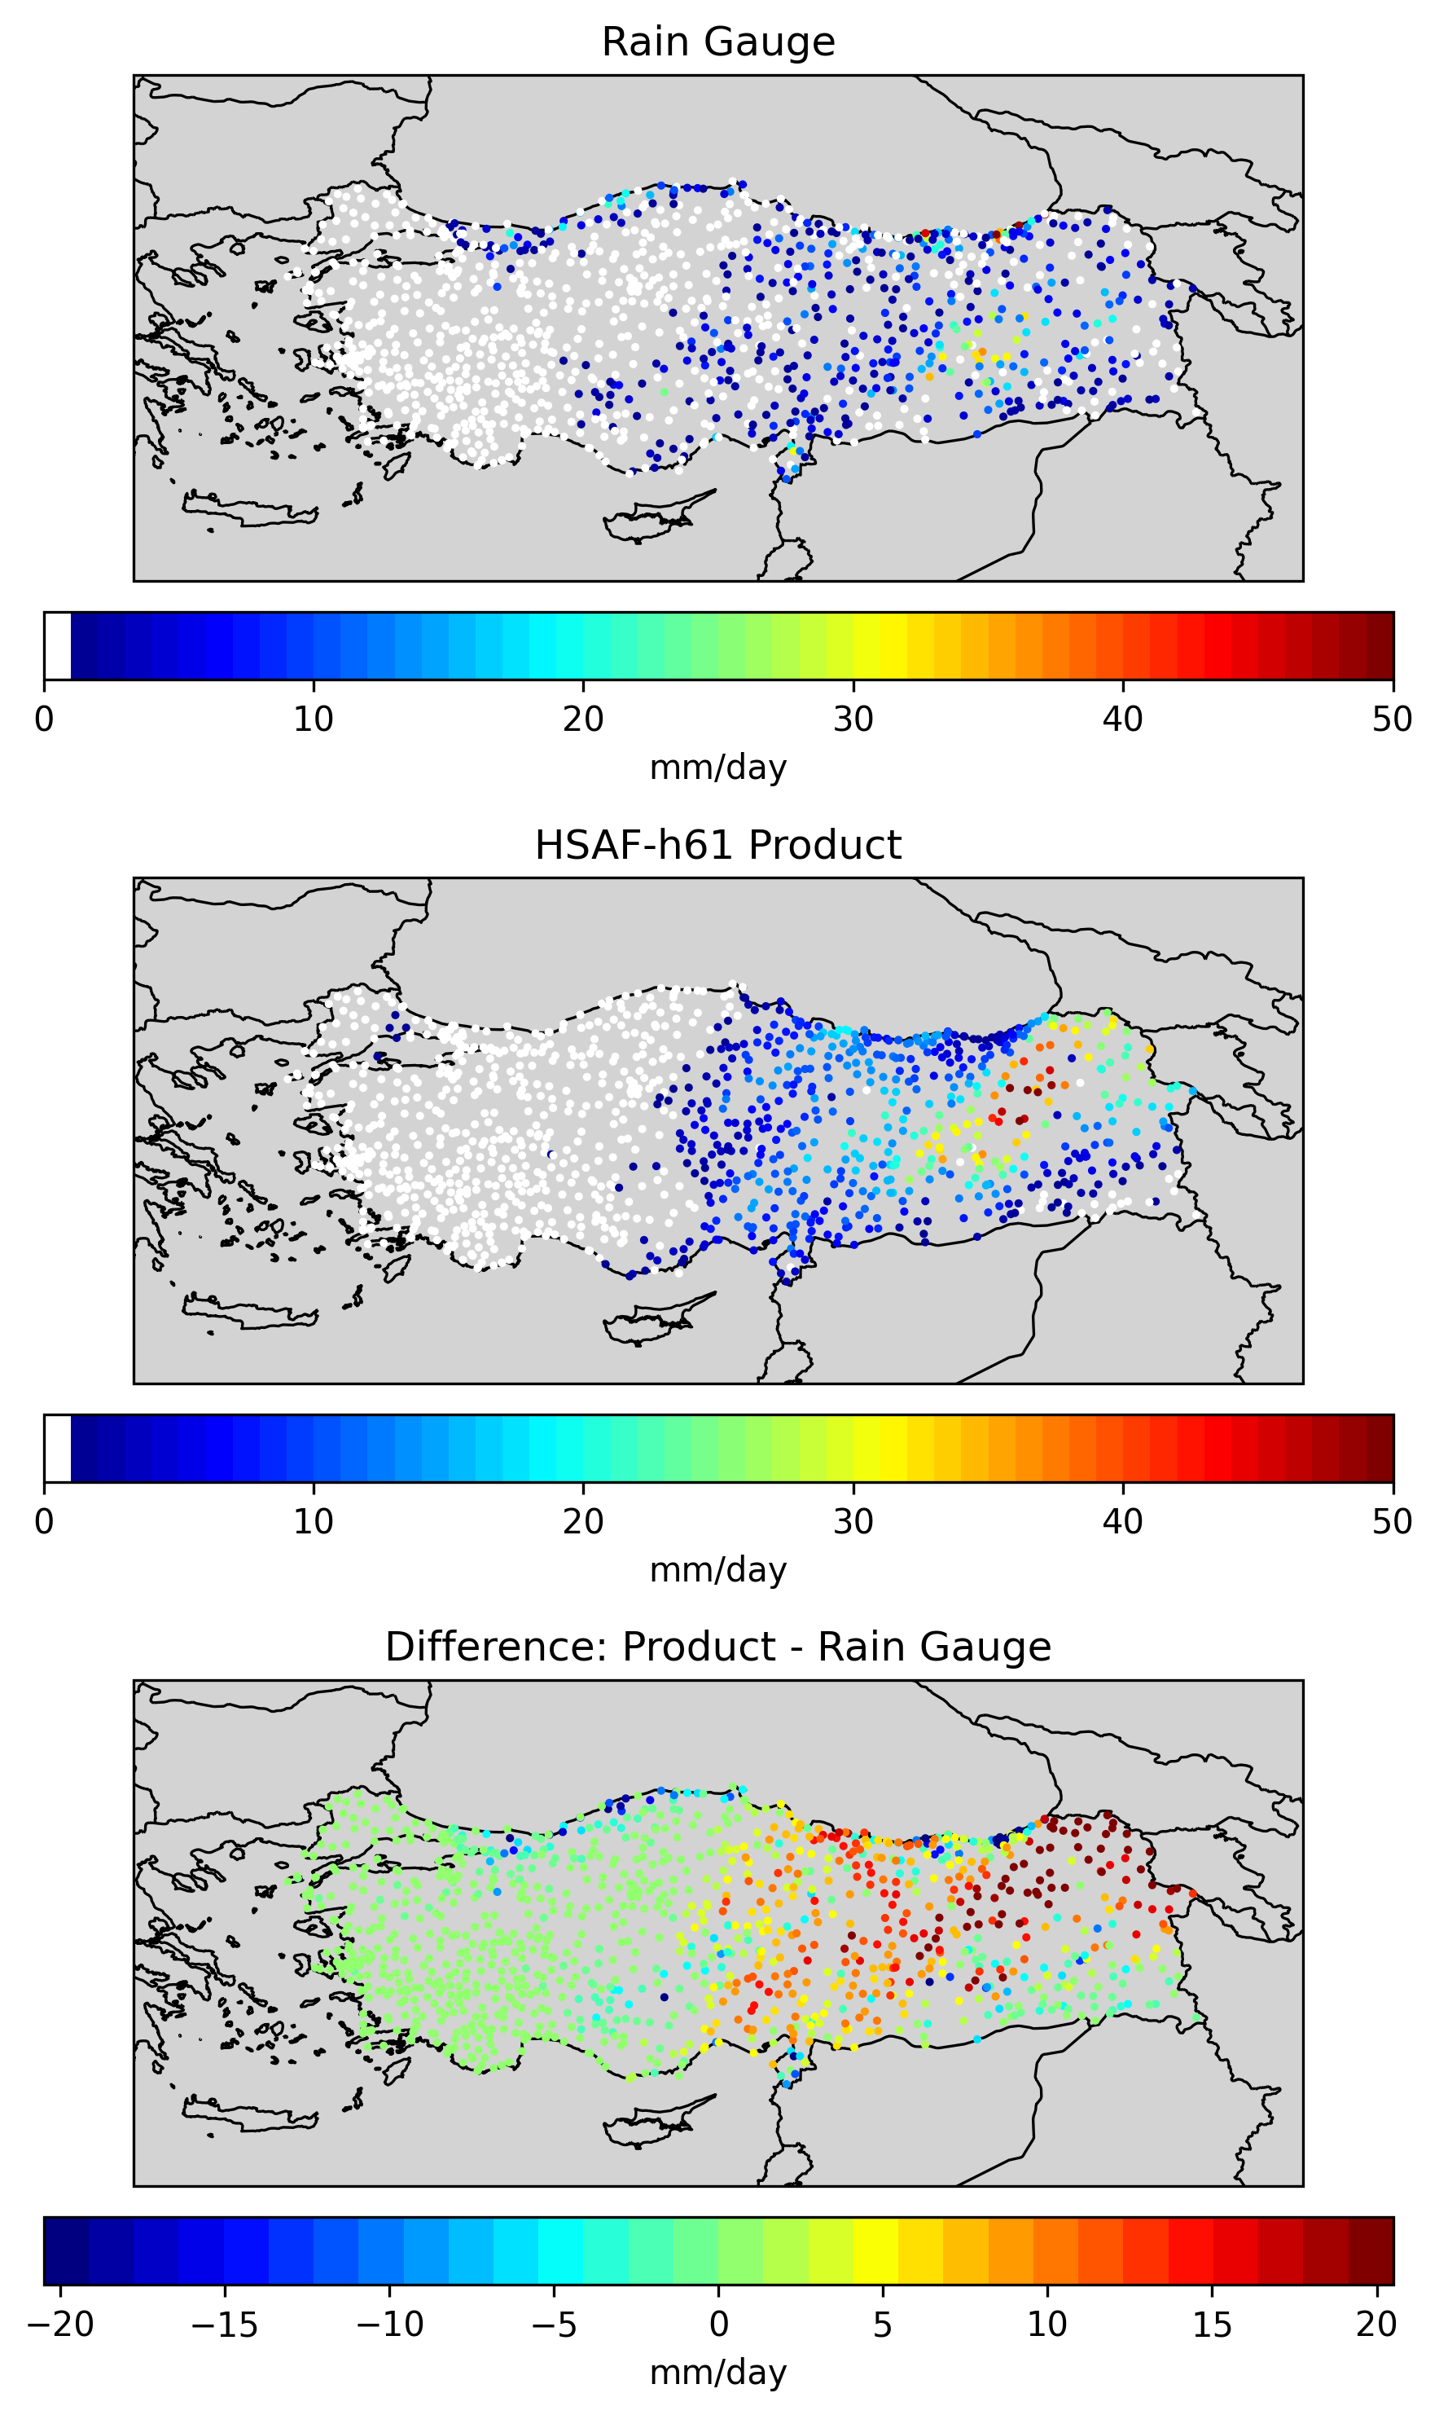
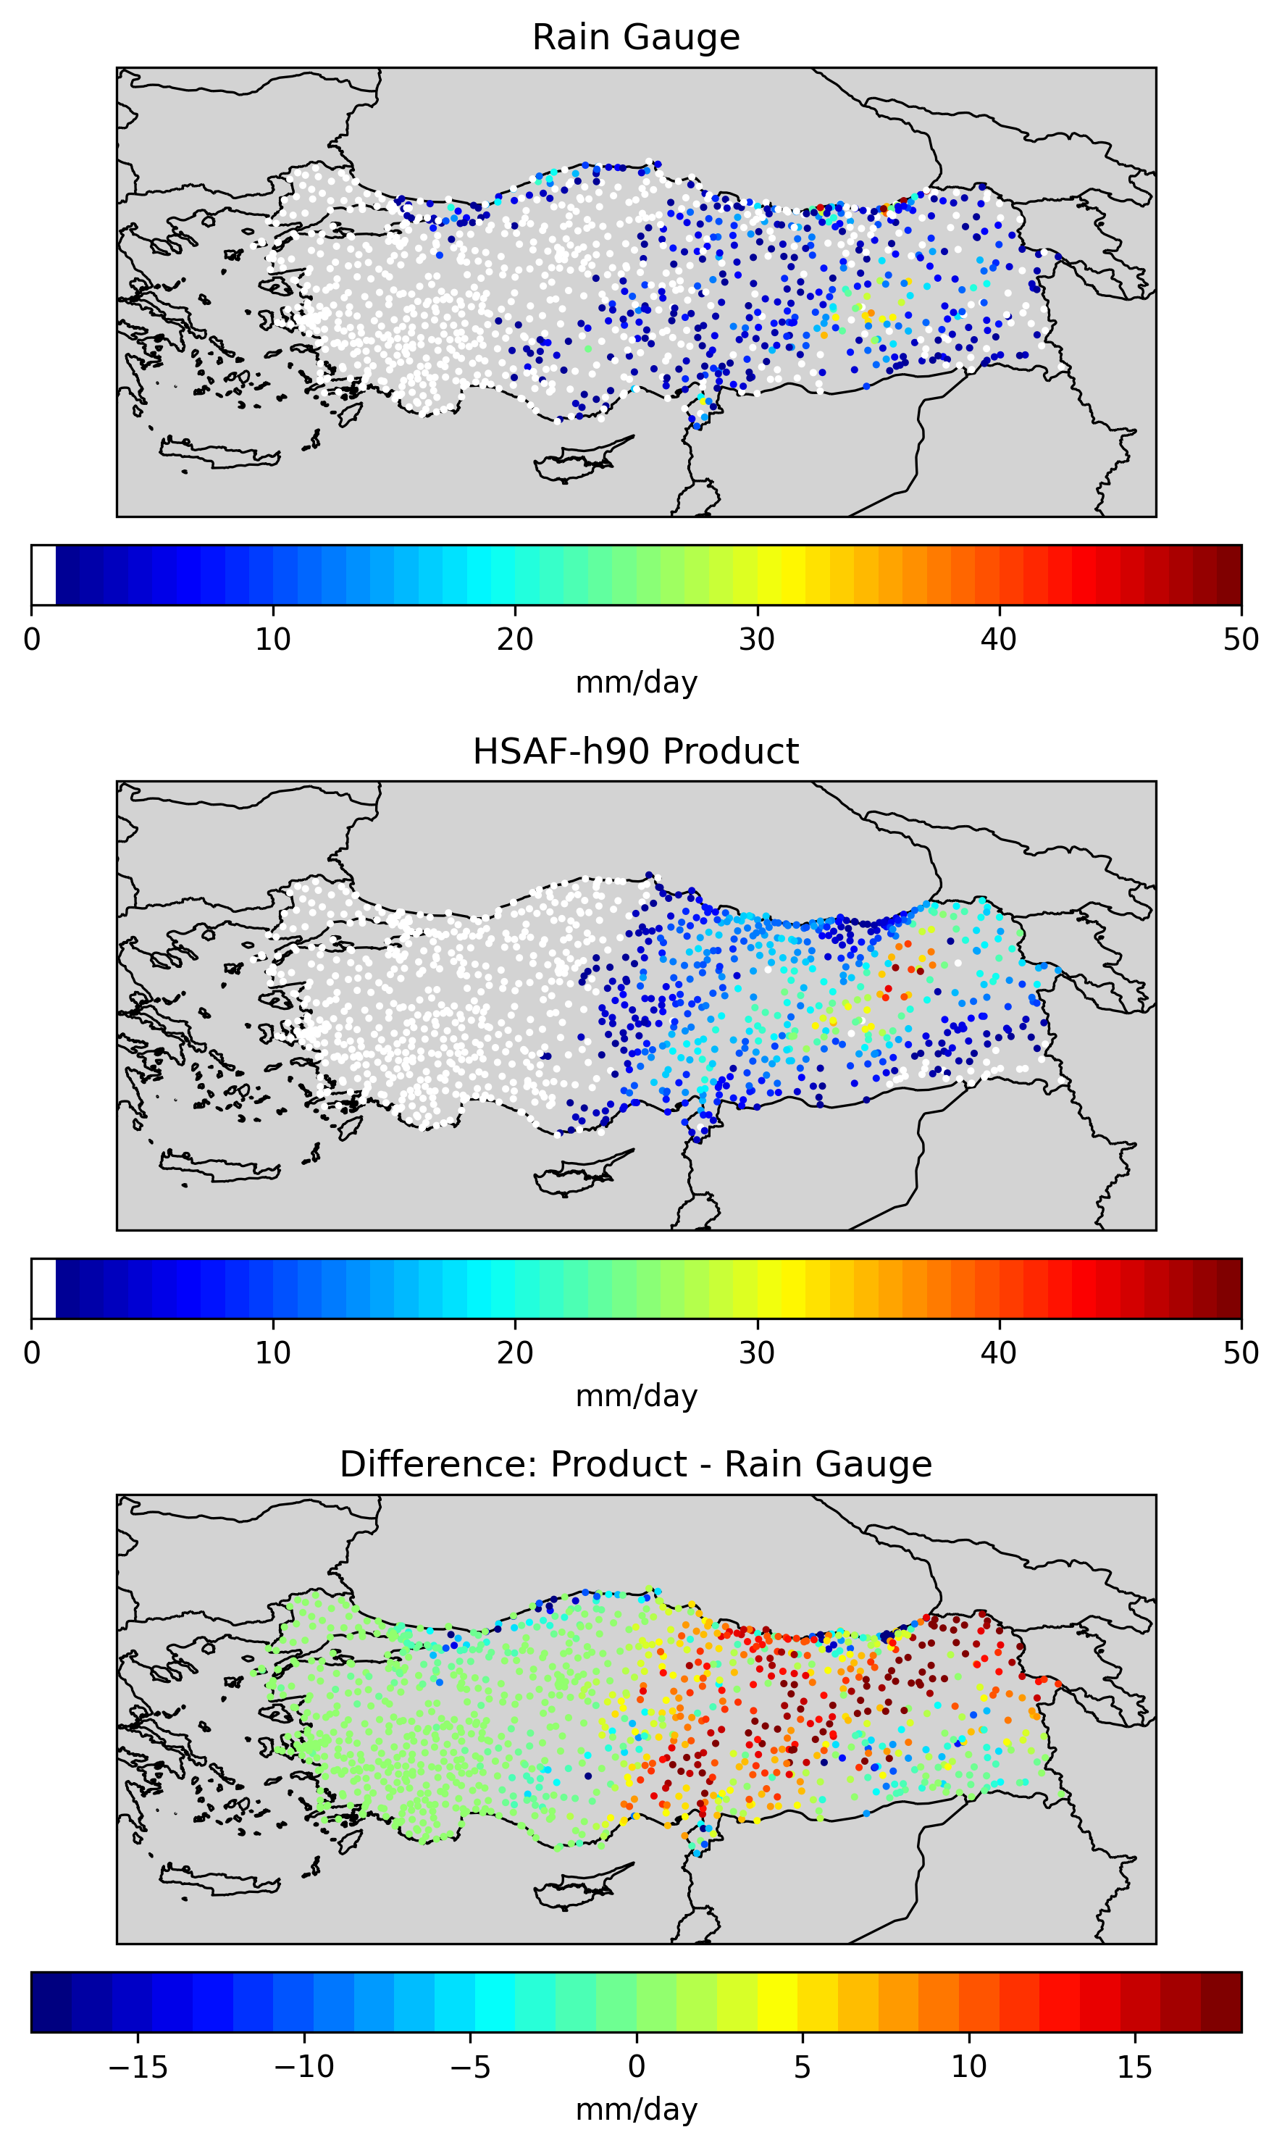
RESULTS · 11 / 16
RESULTS
Case-study performance at 12.10.2025
 | H42 |  | H61 |  | H90
 | r ≥ 1 mm | r ≥ 10 mm | r ≥ 1 mm | r ≥ 10 mm | r ≥ 1 mm | r ≥ 10 mm
Number of Obs. | 449 | 121 | 449 | 121 | 449 | 121
MAE | 8.83 | 11.217 | 8.33 | 10.753 | 8.303 | 10.219
RMSE | 12.759 | 15.323 | 11.951 | 14.623 | 11.347 | 13.881
Corr. Coef. | 0.253 | 0.142 | 0.262 | 0.155 | 0.232 | 0.137
POD | 0.833 | 0.57 | 0.808 | 0.579 | 0.802 | 0.579
FAR | 0.372 | 0.751 | 0.342 | 0.746 | 0.337 | 0.763
IPWG-12 · KRAKÓW 2026
Notes:
Here are the results for the October event.
The table shows two thresholds: stations with at least 1 millimeter, and stations with at least 10 millimeters of observed rain
The first thing you see: all three products behave very similarly. / show comparable performance
Above one millimetre precipitation threshold, the detection is good: the probability of detection is around 0.8 for all products, and the false alarm ratio is moderate, around 0.35.
For the heavier rainfall threshold, above ten millimetres, the detection skill decreases for all products. This is an important point because it shows that detecting light or moderate rainfall is easier than detecting heavier precipitation amounts.
In terms of MAE and RMSE, H61 and H90 perform slightly better than H42.
So, for this event, all three products are close to each other. The main point is that light rainfall is detected better than heavy rainfall.

Slide 11
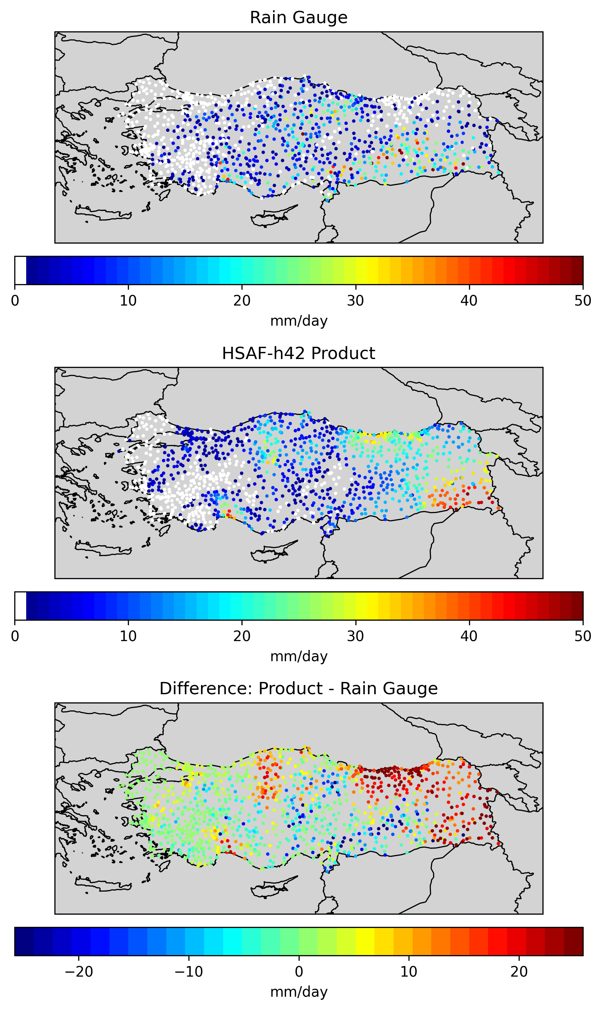


RESULTS · 12 / 16
RESULTS
Case-study performance at 18.04.2026
 | H42 |  | H61 |  | H90
 | r ≥ 1 mm | r ≥ 10 mm | r ≥ 1 mm | r ≥ 10 mm | r ≥ 1 mm | r ≥ 10 mm
Number of Obs. | 680 | 266 | 680 | 266 | 680 | 266
MAE | 9.410 | 12.065 | 9.310 | 12.013 | 8.61 | 11.47
RMSE | 12.883 | 15.024 | 12.760 | 14.966 | 11.802 | 14.555
Corr. Coef. | 0.329 | 0.138 | 0.339 | 0.149 | 0.342 | 0.161
POD | 0.871 | 0.684 | 0.859 | 0.677 | 0.885 | 0.647
FAR | 0.342 | 0.604 | 0.344 | 0.597 | 0.346 | 0.602
IPWG-12 · KRAKÓW 2026
Notes:
The April event is the biggest one: 680 stations with rain, and 266 stations with at least 10 millimeters.
Again, all three products show relatively good detection skill for rainfall above one millimetre. In this case, H90 has the highest probability of detection at the lower threshold, while H42 and H61 also perform very closely.
When we move to the ten-millimetre threshold, the detection probability decreases, as expected. H42 gives the highest POD for heavier rainfall,
One important result here is that H90 gives the lowest MAE and RMSE values for both rainfall thresholds. This means that H90 is slightly closer to the gauge totals for this event. / This indicates that, for this particular event, H90 represents the accumulated rainfall magnitude slightly better than the other two products.
The correlation coefficients are still modest, but they are slightly higher than in the first event.
This is the largest event in our analysis. All products detect the rain well, but H90 gives slightly lower errors.

Slide 12
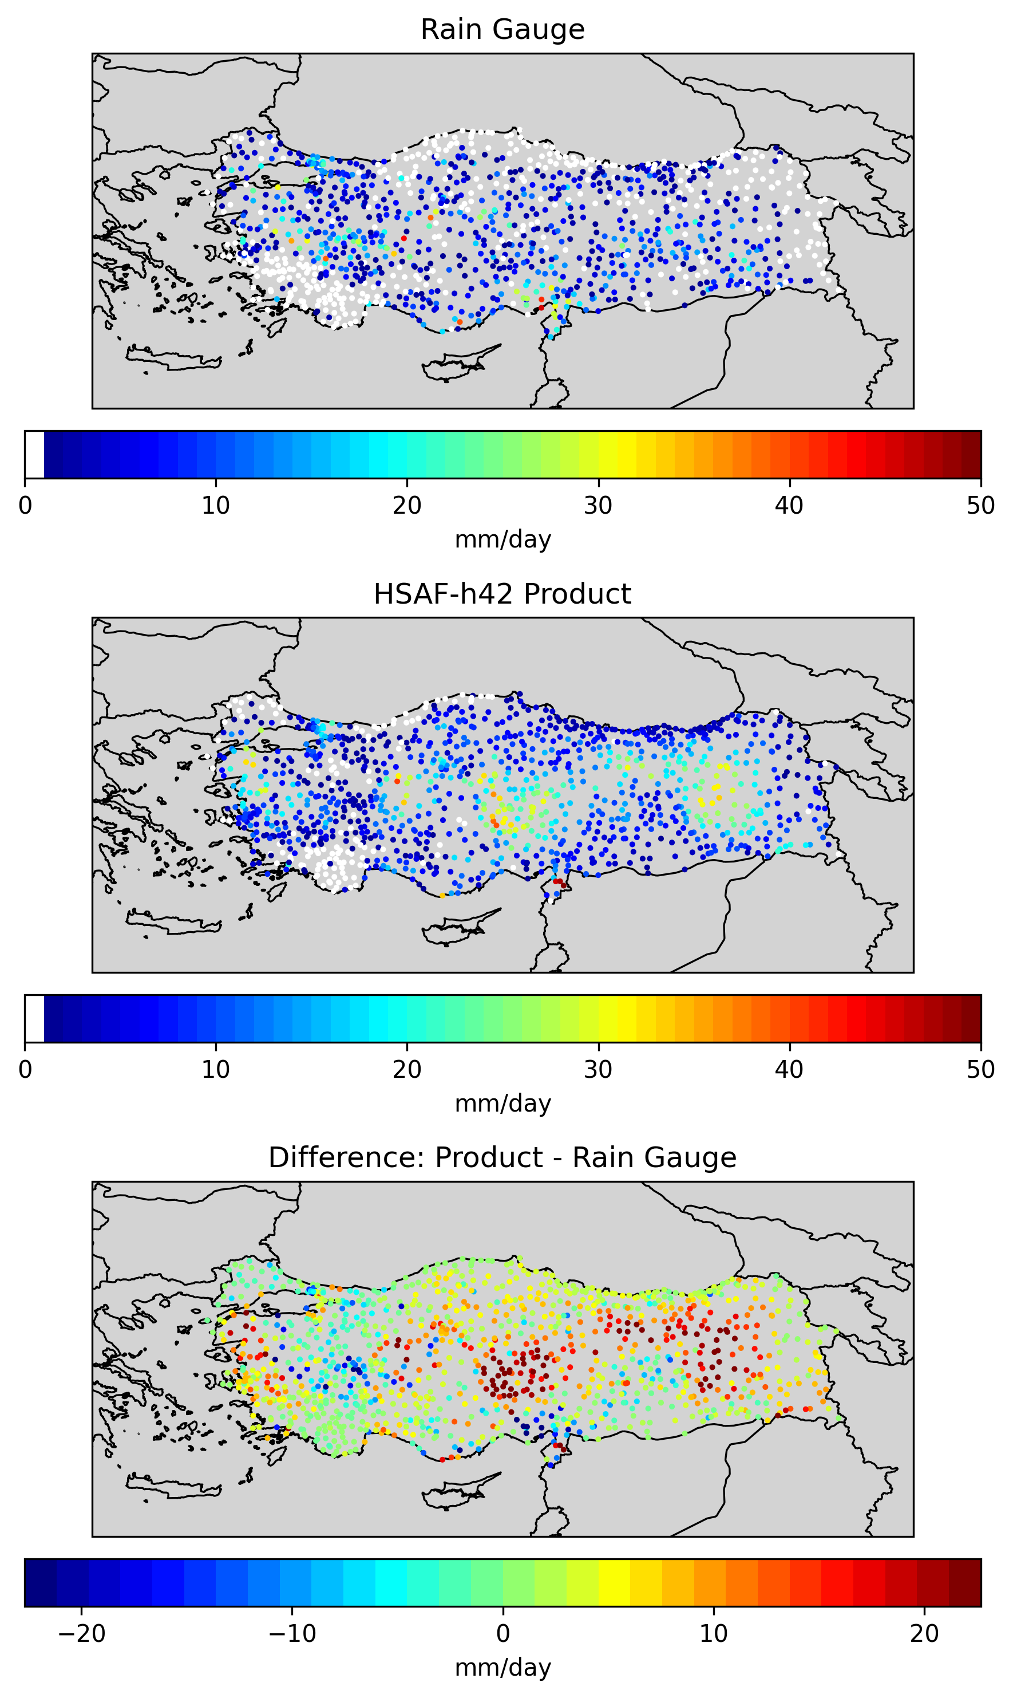

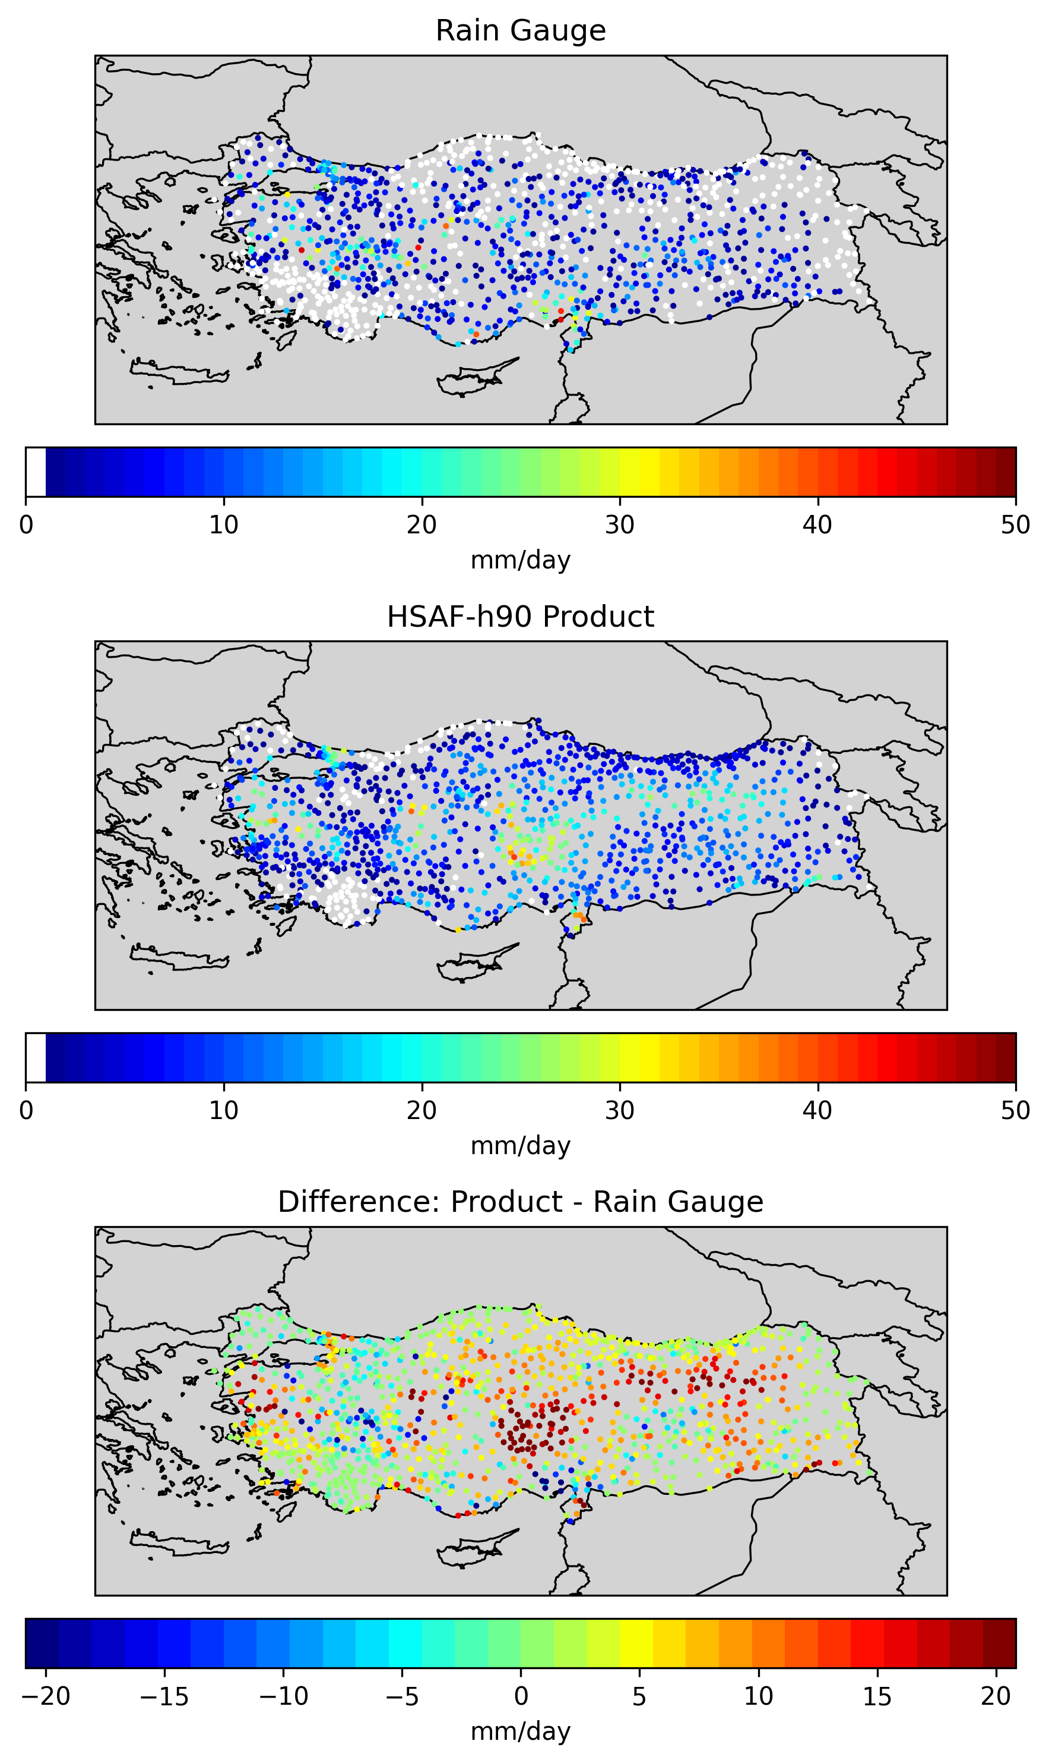
RESULTS · 13 / 16
RESULTS
Case-study performance at 20.05.2026
 | H42 |  | H61 |  | H90
 | r ≥ 1 mm | r ≥ 10 mm | r ≥ 1 mm | r ≥ 10 mm | r ≥ 1 mm | r ≥ 10 mm
Number of Obs. | 749 | 216 | 751 | 220 | 727 | 200
MAE | 7.655 | 9.450 | 7.797 | 9.307 | 7.158 | 8.685
RMSE | 10.544 | 12.009 | 10.699 | 11.876 | 9.774 | 11.07
Corr. Coef. | 0.167 | 0.023 | 0.167 | 0.025 | 0.233 | 0.076
POD | 0.948 | 0.556 | 0.955 | 0.577 | 0.96 | 0.62
FAR | 0.301 | 0.692 | 0.296 | 0.692 | 0.317 | 0.689
IPWG-12 · KRAKÓW 2026
Notes:
The May event is a late-spring event, so convective rainfall may also be important.
For rainfall above one millimetre, all three products show very high probability of detection. This means that the products are successful in identifying the occurrence of rainfall during this event.
Among the three products, H90 gives the highest POD and also the lowest MAE and RMSE values. This suggests that H90 performs particularly well in estimating the accumulated rainfall amount for this case.
H42 and H61 also show very similar and consistent behaviour. Their error values are close to each other, and their detection statistics are also very similar.
When we focus on rainfall above ten millimetres, the same pattern continues. Detection skill decreases compared with the one-millimetre threshold, but H90 still shows the highest POD and the lowest error values.
The correlation coefficients remain relatively low, especially for the heavier rainfall threshold. This again tells us that rainfall detection is better than rainfall intensity estimation.
So, The satellite can detect the rain area, but the rainfall amount is still difficult, especially for convective rain. // the satellite knows where it rains, but not how much. For convective rain, the amounts are the weak point.

Slide 13
CONCLUSIONS · 15 / 16
CONCLUSIONS
KEY FINDINGS
1
Product Performance and Stability: There are no huge gaps between the error metrics of the three products.
Rainfall Area and Intensity Balance: All three products are highly successful at mapping the spatial presence of rainfall in frontal and cyclonic systems
2
3
The Convective Challenge: Localized and rapidly developing convective systems remain the biggest challenge for satellite estimations.
Future Work: In future studies, we plan to extend this validation to longer time series. We also plan to classify and analyze the results based on terrain structure, seasons, and synoptic types.
3
IPWG-12 · KRAKÓW 2026
Notes:
Let me conclude.
Finding one: First, the HSAF products generally capture rainfall occurrence over Türkiye reasonably well, especially for the one-millimetre threshold.
Finding two: Heavy precipitation and local convective rainfall are more difficult to estimate than light or widespread rainfall.
Finding three: the errors grow with rain intensity. And over the mountains, the peaks are under-estimated.
* There is no single best product. The result depends on the event, the rainfall threshold, and the metric. // The main message is not that one product is always better than the others. A more accurate conclusion is that product performance depends on the event type, rainfall threshold and validation metric.
As future work, we plan to extend the validation to more events and longer time periods. We also want to analyse the results according to terrain, season and synoptic type.
They know where it rains, but not exactly how much. In other words, rainfall detection is better than rainfall amount estimation.

Slide 14
IPWG-12 · KRAKÓW 2026
Thank you
Questions & discussion
REFERENCES & DOCUMENTS
• Atalay, İ. (1997) — Climate regions of Türkiye (Fig. 1, study-area map)
• Şensoy, S. et al. (2009) — Climate of Türkiye, Turkish State Meteorological Service
• H SAF Product User Manuals & ATBDs: H40/H42 (FCI), H60/H61 (SEVIRI), H90 (IODC)
• EUMETSAT (2025) — New H SAF MTG precipitation products (H40/H42), Aug 2025
• H SAF portal · hsaf.meteoam.it · TSMS · mgm.gov.tr · IPWG-12 · ipwg12.imgw.pl
Notes:
Thank you for your attention.
I am happy to take your questions.

