Slide 1



Upgrades and Early Results for IMERG V08
George J. Huffman(1), Jackson Tan(1,2), Robert Joyce(1,3),
Eric Nelkin(1,3), David T. Bolvin(1,3)
(1) NASA/GSFC Earth Sciences Division – Atmospheres
(2) Univ. of Maryland Baltimore County
(3) Science and Technology Corp.
george.j.huffman@nasa.gov

Slide 2
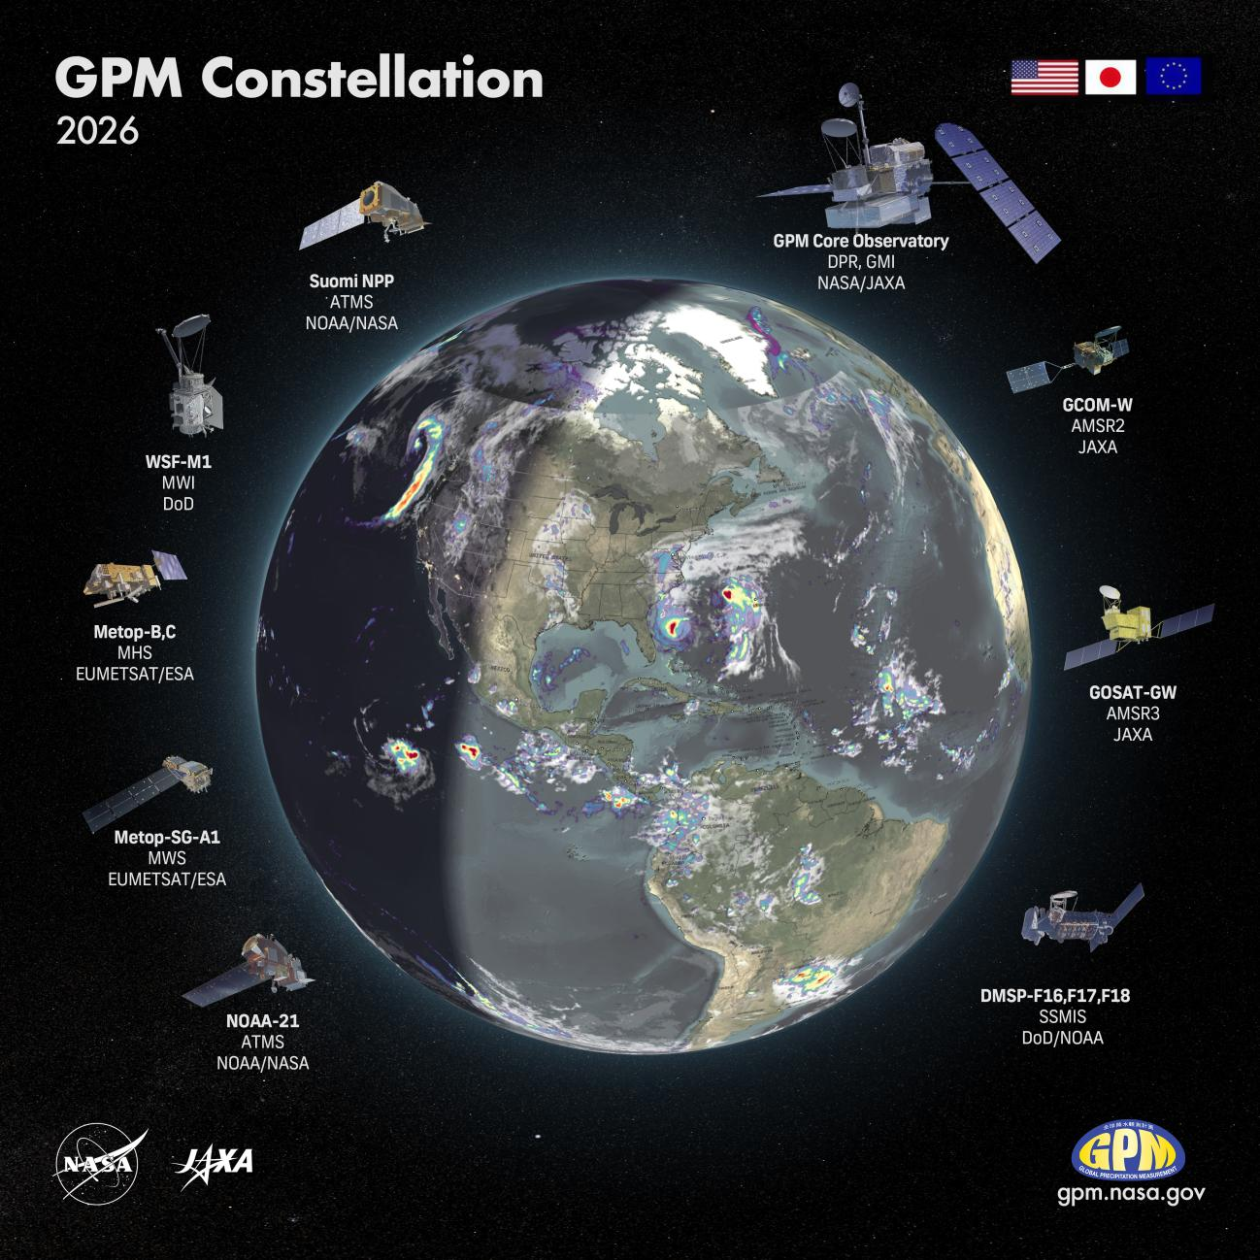
1. Quick Introduction to IMERG
Integrated Multi-satellitE Retrievals for GPM is the U.S. GPM Science Team’s merged satellite precipitation algorithm
• 0.1º, ½ h; global, 1998–present
• three Runs (Final, Late, & Early) cater to different latency requirements
IMERG scheme
• grid the PMW precipitation from the GPM constellation,
• intercalibrate them to the GPM Core Observatory,
• perform forward and backward propagation,
• merge them with IR precipitation in a Kalman filter framework, and
• apply a broad-scale gauge adjustment over land.
GPM products are in the process of upgrading to V08
• DPR V08A and GPROF V08A: in production
• CORRA V08 and IMERG V08: in development
This presentation describes selected changes in IMERG
https://gpm.nasa.gov/sites/default/files/2026-04/GPM_Constellation_2026_v4.jpg

Slide 3
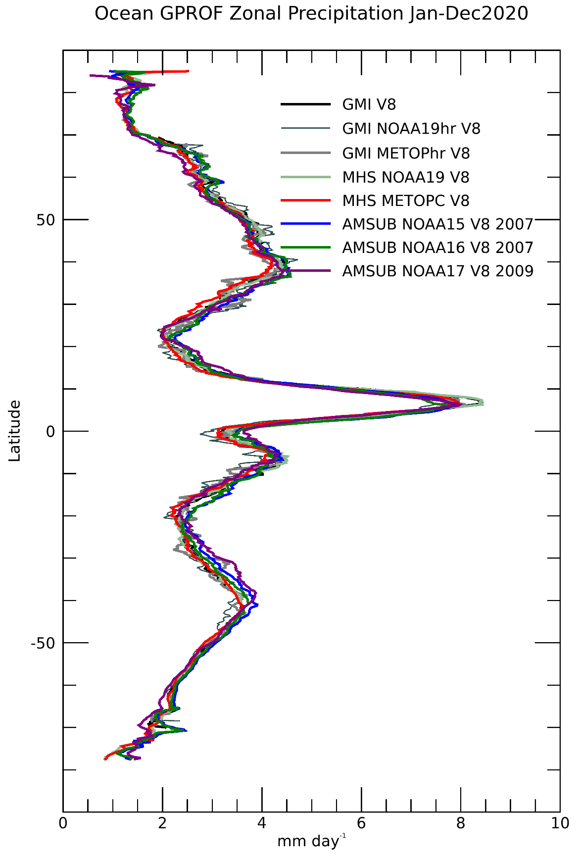
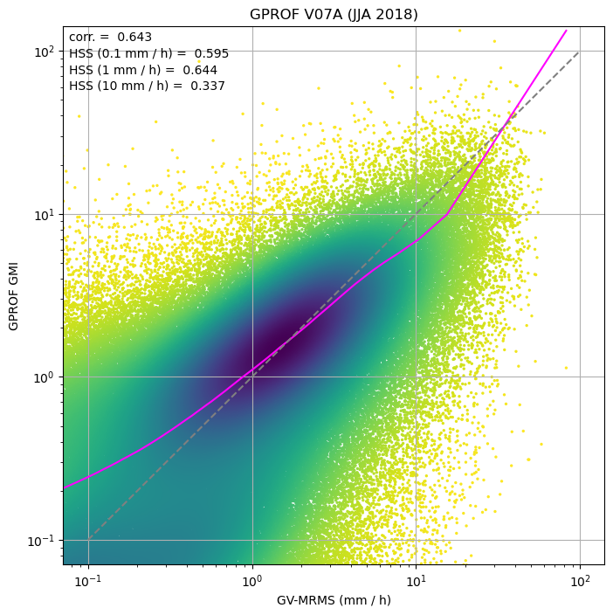
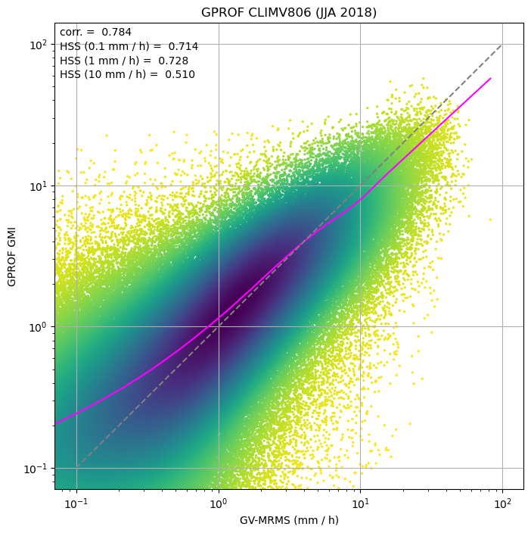
2. ML – GPROF V08 Uses a Neural Net (1/2)
Preliminary comparison GMI, CONUS, one summer, GPROF V07 vs. V08
• shape of scatter is more uniform along the 1:1 line
• zonal profiles for constellation sensors are very similar
GPROF V07B GPROF ClimV806
GPROF-GMI ClimV806 (mm/hr)
GPROF-GMI V07B (mm/hr)
GV-MRMS (mm/hr) June,July,Aug 2018 GV-MRMS (mm/hr)
J. Tan (UMBC; GSFC)
R. Joyce (STC; GSFC)

Slide 4
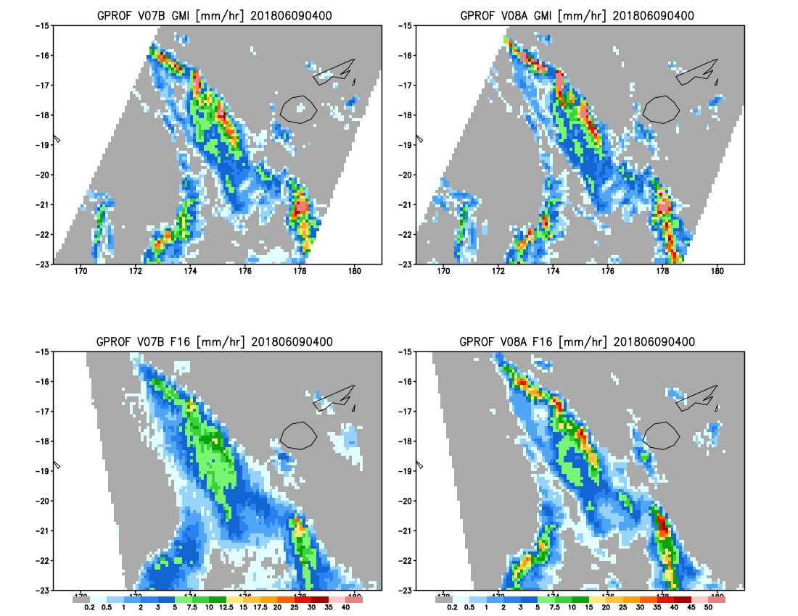
2. ML – GPROF V08 Uses a Neural Net (2/2)
GPROF V07 201806090400 GPROF V08
Preliminary comparison of GPROF V07 vs. V08 in the tropical Pacific for a coincident matchup of GMI and DMSP F-16 SSMIS
• V07 and V08 GMI are much the same
• V08 GMI maxima tend to be higher, but highly correlated with V07 maxima
• the lowest boundary (0.2 mm/hr) varies between the two versions, but there are switches between gray and light blue in both directions
• V07 F-16 SSMIS misses the intensity of the maxima in either GMI
• V08 F-16 SSMIS is much closer to the GMI intensities
• V08 F-16 SSMIS is less smooth than V07, but is smoother than the GMI fields
DMSP F-16 SSMIS GMI
R. Joyce (STC; GSFC)

Slide 5
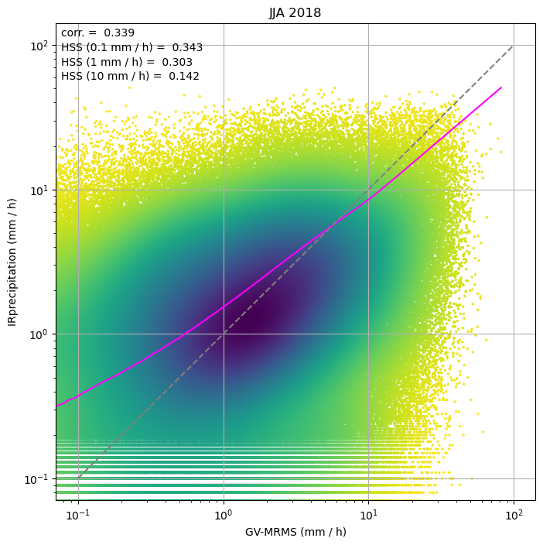
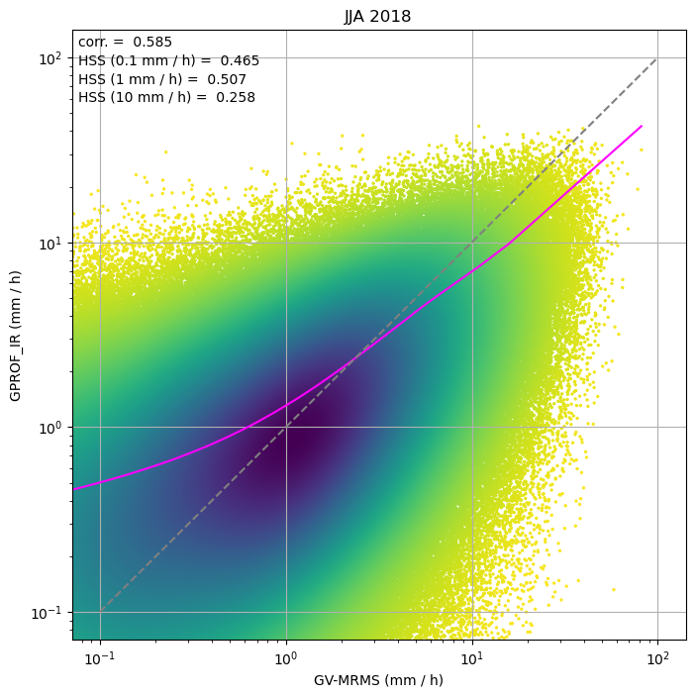
3. GPROF-IR Introduces Improved Consistency and Skill
GPROF-IR leverages the GPROF-NN algorithm developed for the PMW retrievals
• shape of scatter is more uniform along the 1:1 line
• HSS at high threshold shows less skill (the extremes problem)
PDIR GPROF-IR
GPROF-IR (mm/hr)
PDIR (mm/hr)
GV-MRMS (mm/hr) June,July,Aug 2018 GV-MRMS (mm/hr)
J. Tan (UMBC; GSFC)

Slide 6
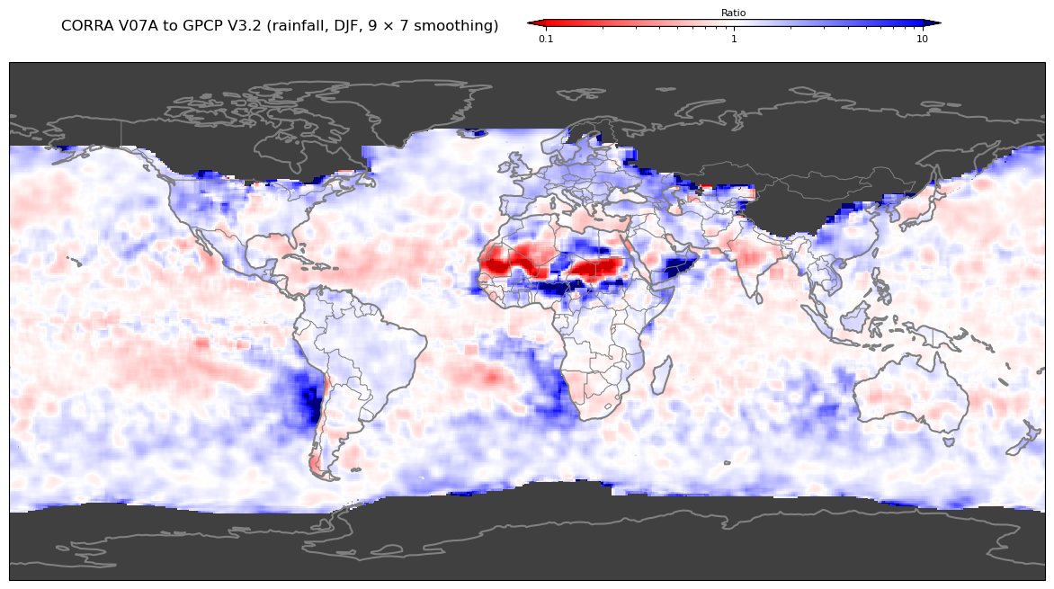
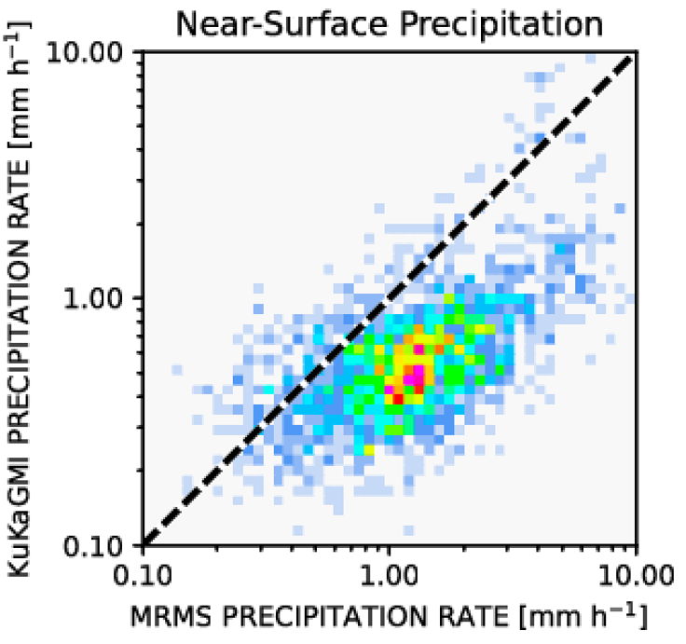
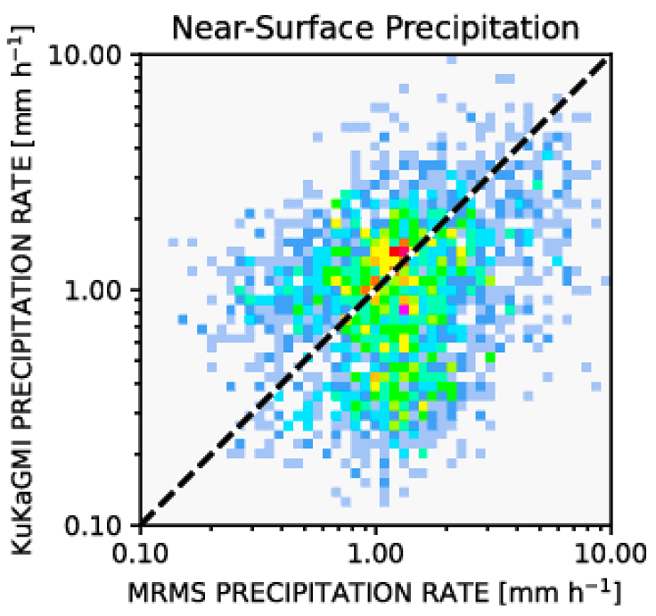
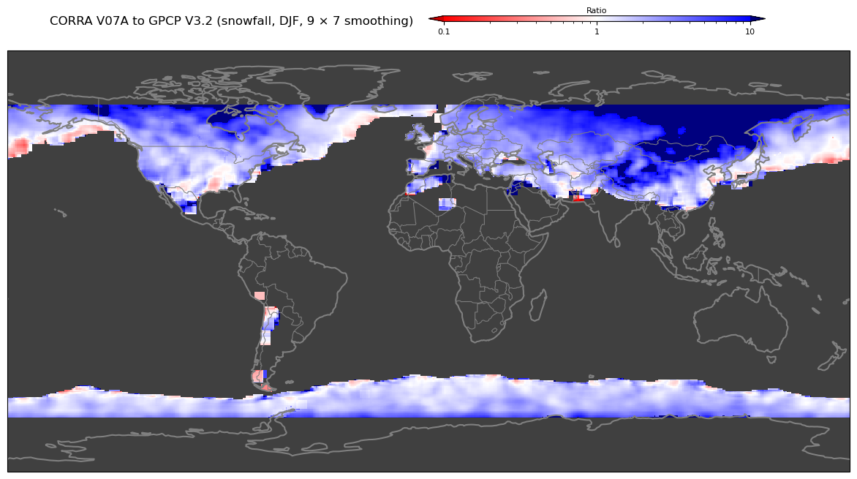
4. The Calibration for Cold-Season Precipitation Will Improve
IMERG V07 underestimates cold-season precipitation because it is calibrated to CORRA, which has a snowfall deficiency
IMERG V08 addresses this issue by
• monitoring the improvement in CORRA V08 snowfall
• separating the climatological calibration to GPCP by phase
CORRA V07 snowfall
CORRA V08dev snowfall
Bill Olson (UMBC; GSFC)
J. Tan (UMBC; GSFC)

Slide 7
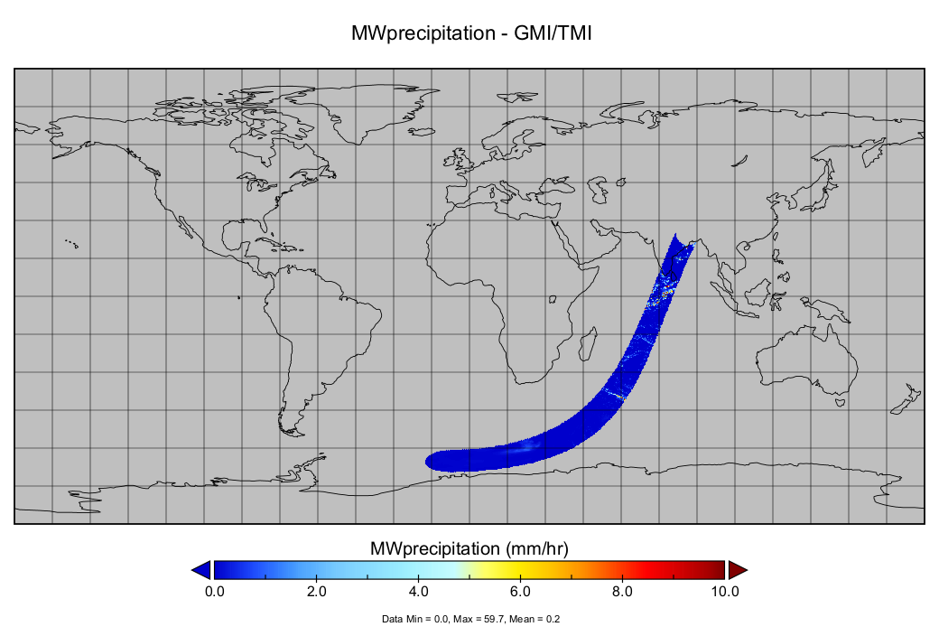
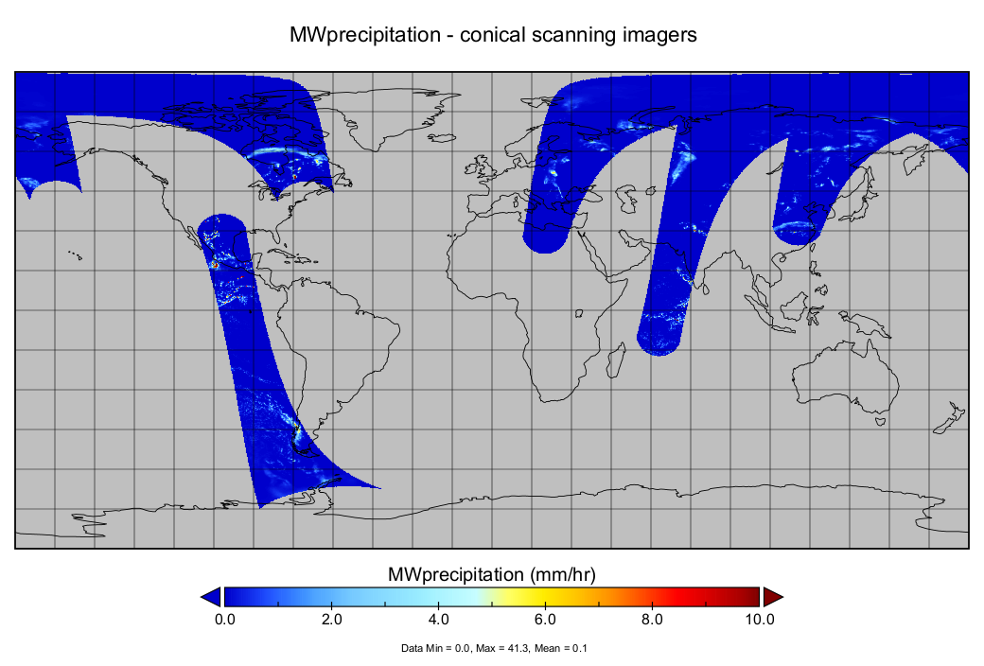
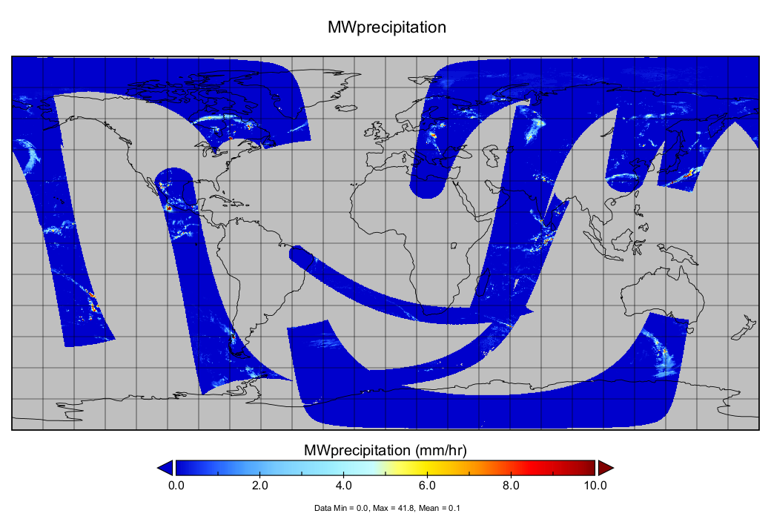
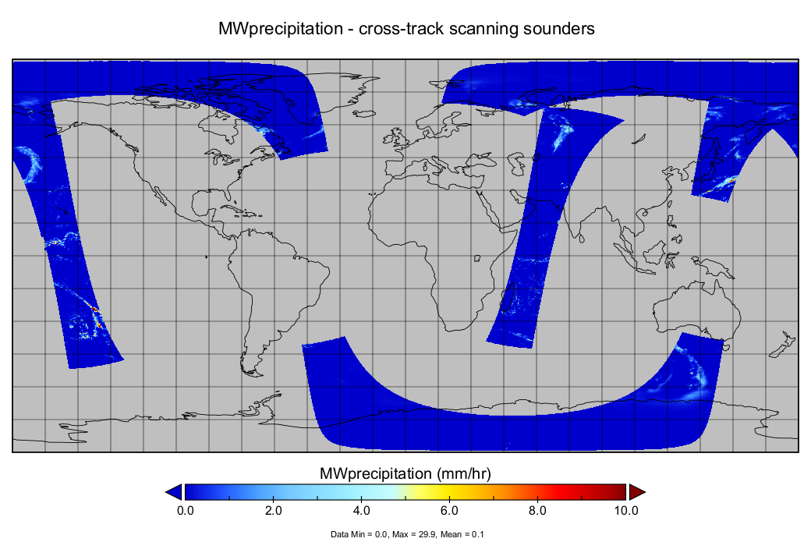
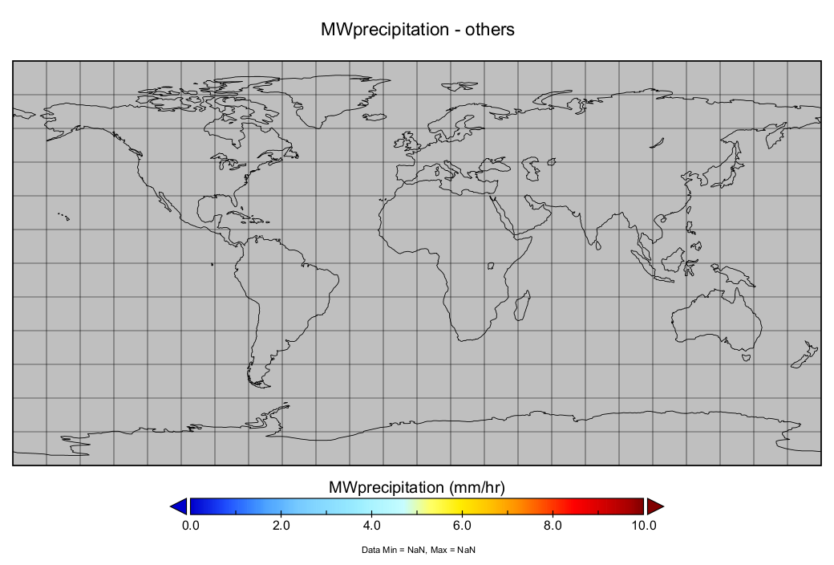
5. In V08 the Single PMW Layer Is Split into Four
This enables better treatment of varying quality for the different classes of sensors
• V07 creates a single PMW layer with a priority order for sensors
• V08 carries sensor classes separately into the Kalman filter
• ”imagers” and “sounders” are mainline agency sensors
• “others” is intended for smallsats
V08: four layers
GMI/TMI
imagers
V07: single layer
sounders
others
J. Tan (UMBC; GSFC)

Slide 8
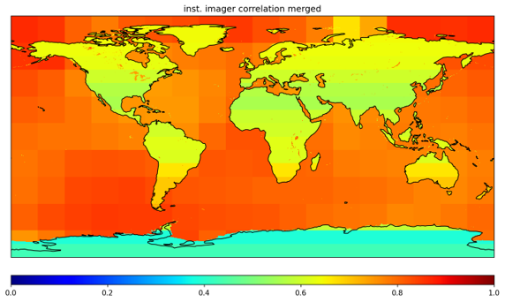
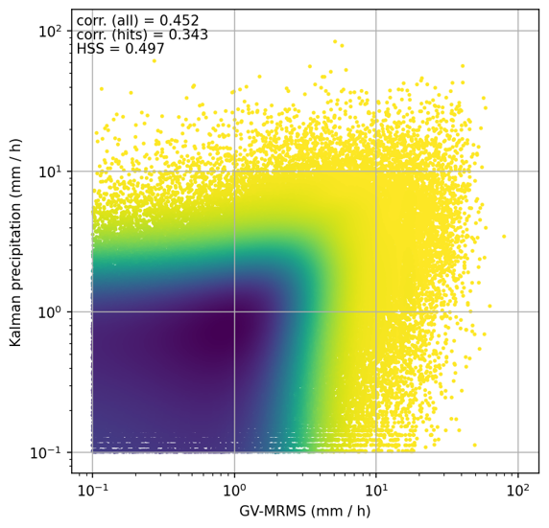
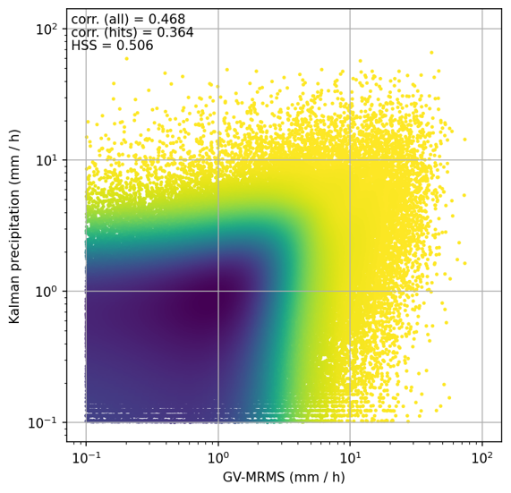
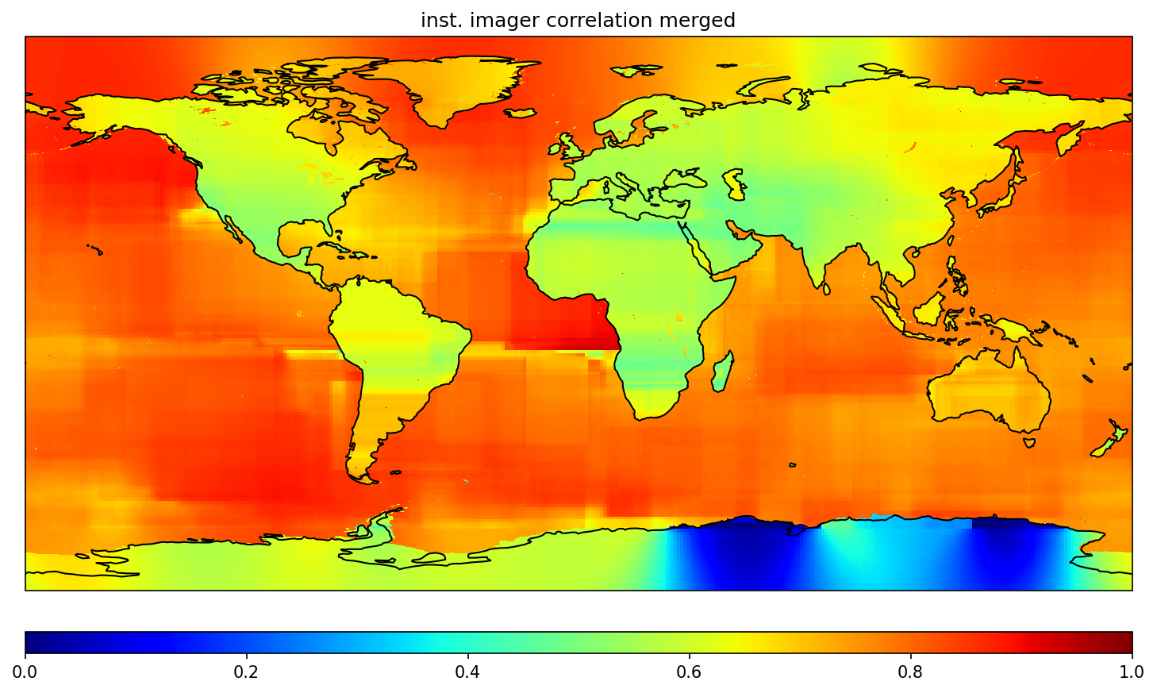
6. Putting Everything Together
Upgrades to the Kalman filter allow for more realistic weighting, better regional representation, and slightly improved skill
V07: reconstructed t = 0 stats for imager
V07 V08dev
V08: computed t = 0 stats for imager
V08dev Kalman output (mm/hr)
V07 Kalman output (mm/hr)
GV-MRMS (mm/hr) June,July,Aug 2018 GV-MRMS (mm/hr)
J. Tan (UMBC; GSFC)
J. Tan (UMBC; GSFC)

Slide 9
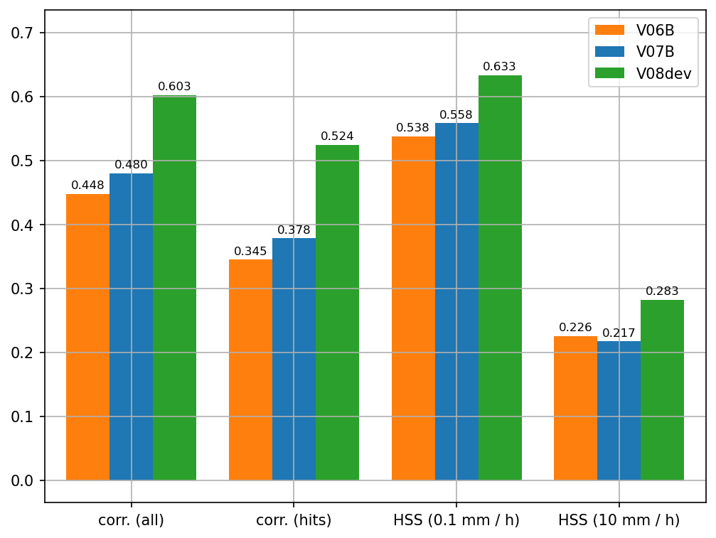
7. Concluding Remarks
IMERG V08 uses improved inputs and addresses issues raised in V07
• early IMERG V08 testing shows a substantial improvement in overall skill
• a great deal of credit goes to improvements by the GPROF team
• demonstrates that problems are best handled at Level 2
• IMERG V08 handles sensor classes more carefully
• positioned to take advantage of future smallsats
IMERG V08 release depends on complete upgrades to input data sets
• small samples of test data are available on request
• the projected release schedule is:
Evaluation against GV-MRMS for July 2014
[late Summer 2026] IMERG V08 Final retrospective processing
IMERG V08 Early and Late retrospective processing
[NET late Fall 2026] IMERG V08 Early and Late initial processing
Today
george.j.huffman@nasa.gov

