Slide 1
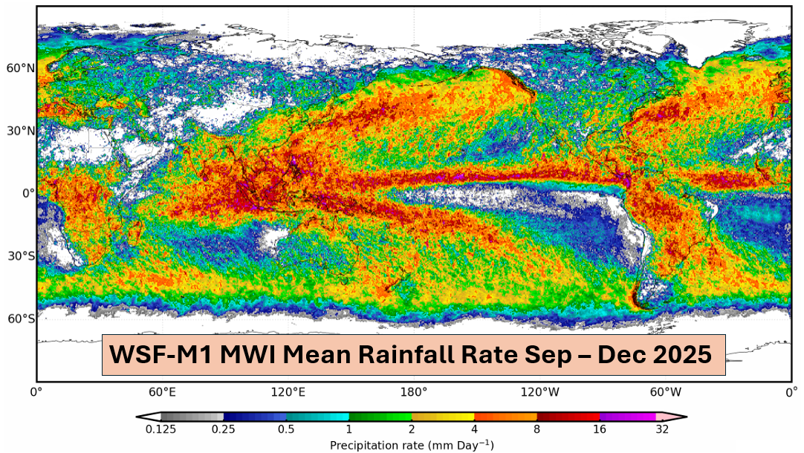

NOAA Satellite Precipitation Products – Operational Capabilities and Future Plans
Huan Meng | NOAA/NESDIS
IPWG-12 • July 7-10, 2026

Slide 2
NOAA Operational Precipitation Products
NOAA provides a comprehensive suite of operational rain and snowfall products derived from NOAA and partner satellite observations
LEO Microwave Level-2
MiRS (Rain Rate)
EMRRT (Rain Rate & Type)
SFR (Snowfall Rate)
GEO IR Level-2
ERR (Rain Rate)
Level-3
CMORPH2 (Rain and Snowfall)
ERR (Rain)
MiRS EMRRT SFR ERR CMORPH2
6 satellites 1 satellite 6 satellites 5 satellites ~15 satellites
(NOAA-21, NOAA-20, S-NPP, (GCOM-W) (NOAA-21, NOAA-20, S-NPP, (GOES-18, GOES-19, Himawari-9, (Multi LEO and GEO
MetOp-C, MetOp-B, GPM) MetOp-C, MetOp-B, GPM) Meteosat-9, Meteosat-10) satellites blend)
MiRS: Microwave Integrated Retrieval System; EMRRT: Enterprise Microwave Rain Rate and Type; SFR: NESDIS Snowfall Rate; CMORPH2: Climate Prediction Center MORPHing Technique V2; ERR: Enterprise Rain Rate

Slide 3
Transitioning to Operations
New operational missions will expand coverage and strengthen resilience
2026
2027+
WSF-M1 (MWI)
EMRRT
MetOp-SG A1 (MWS)
MiRS
SFR
MTG-12
(FCI)
ERR
GOSAT-GW
(AMSR3)
EMRRT
SFR
MetOp-SG B1
(MWI)
EMRRT
SFR
AWS
(MWR)
MiRS
SFR
(local production)

Slide 4
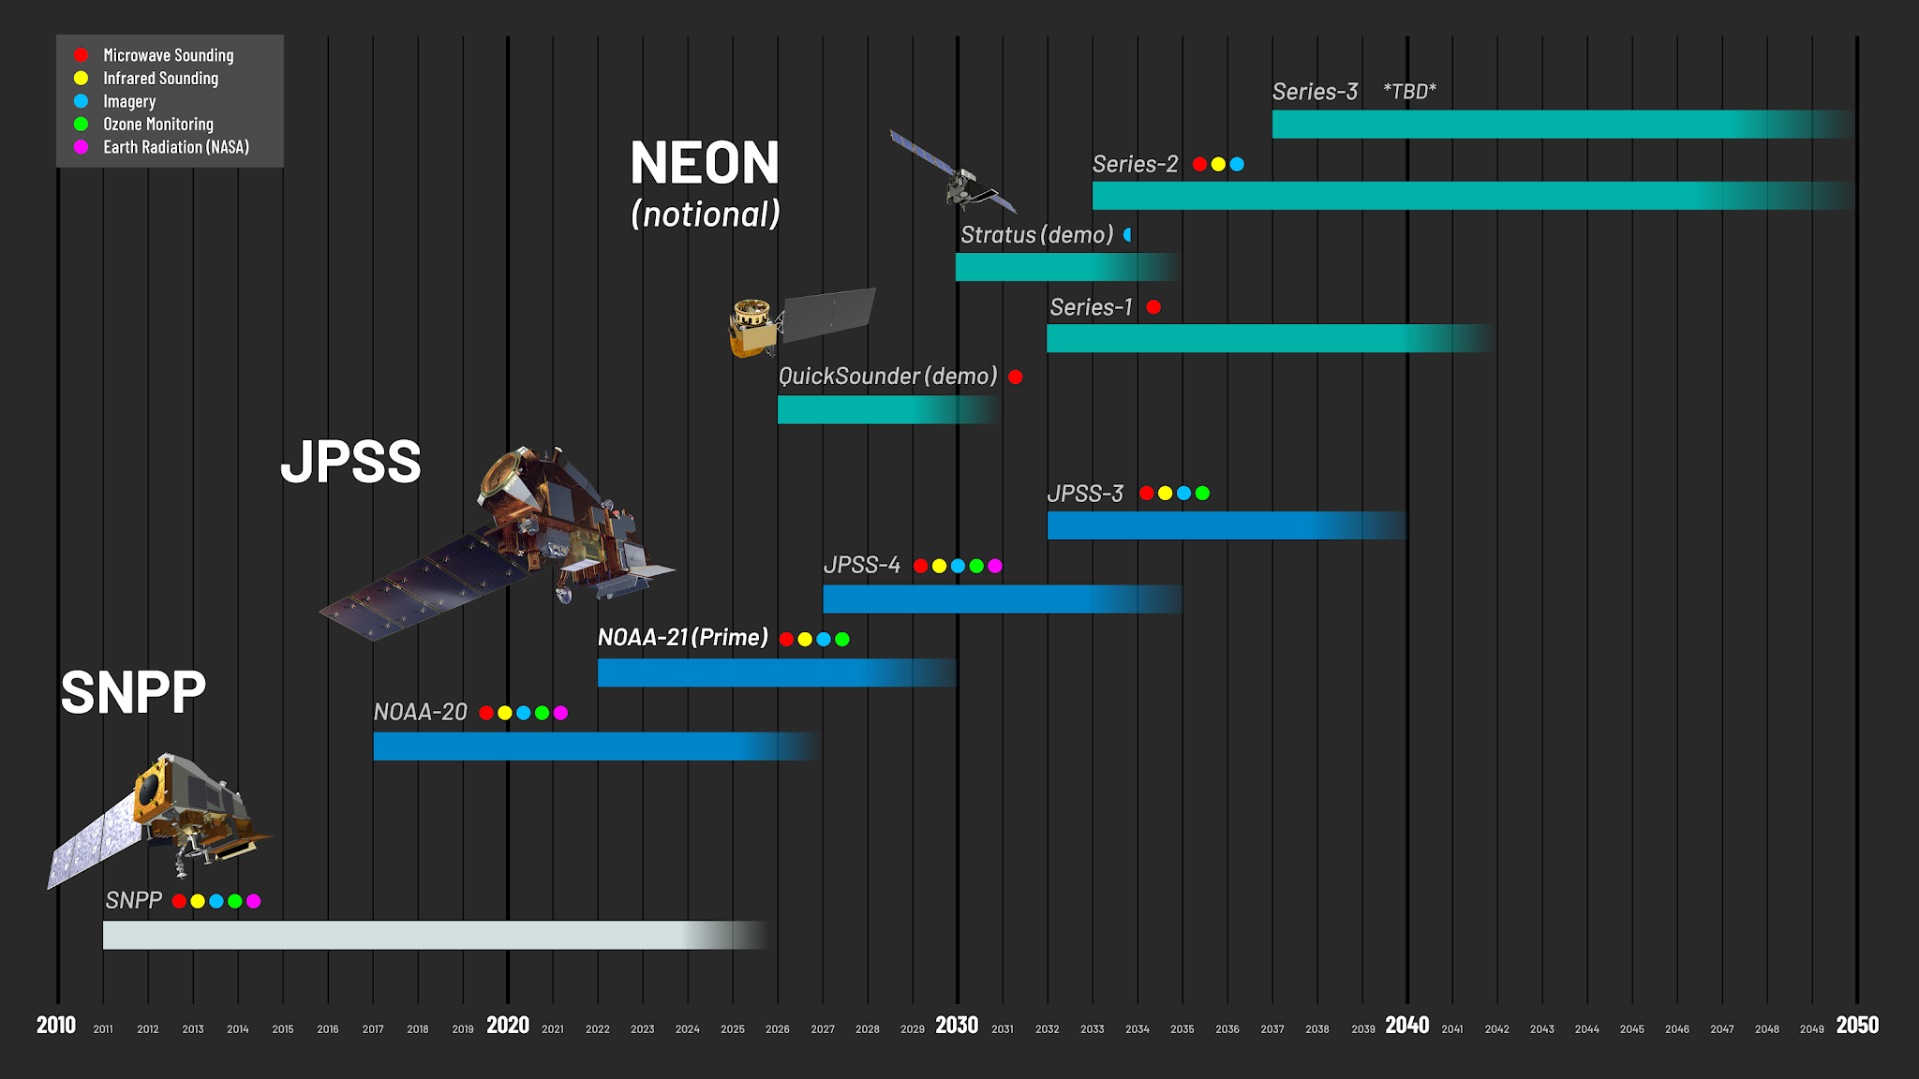
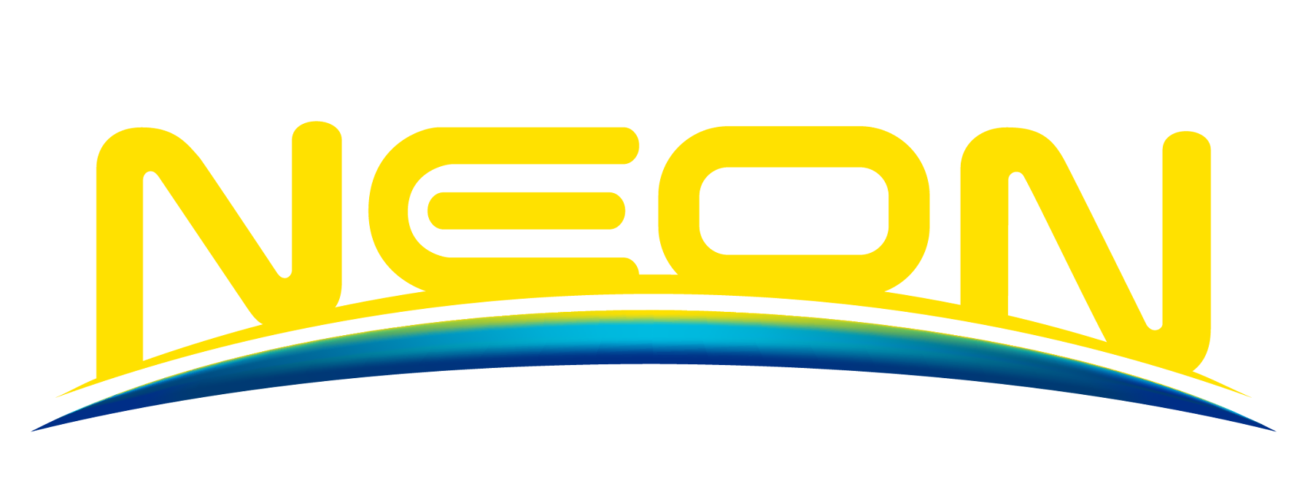
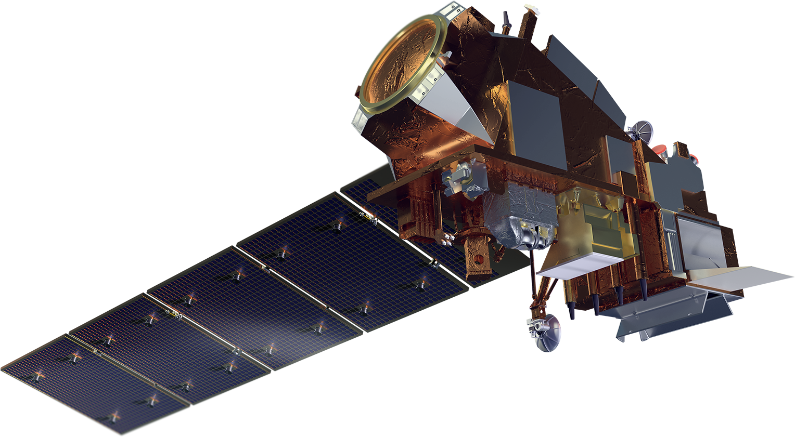
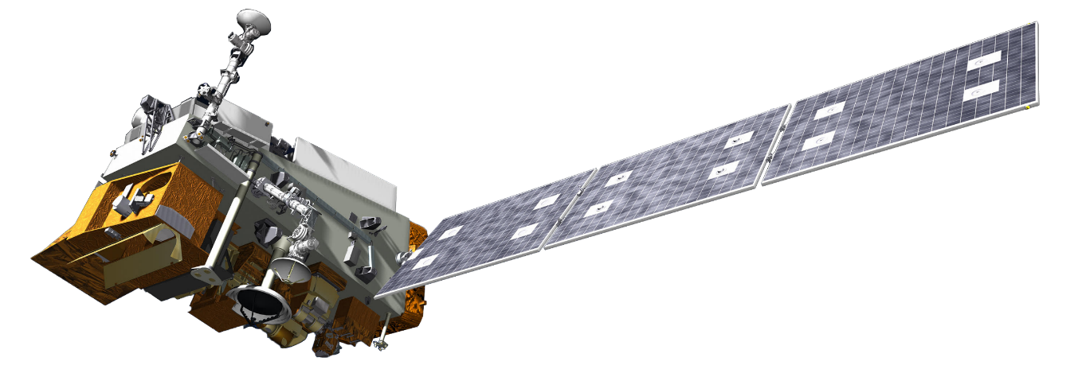
NOAA LEO Satellite Programs
NEON Program
JPSS continuity with expanded capabilities
Small- to medium-sized satellites
Single instrument
QuickSounder (mid-2027)
Series-1 SMBA (mid-2030s)
Continuous coverage is critical for system resilience
JPSS Program
NOAA-21 (Primary)
NOAA-20 (Secondary)
JPSS-4 (September 2027)
JPSS-3 (2032)
S-NPP
Deorbit expected in 2026

Slide 5
Key Developments
Machine learning increasingly integrated into operations
Commercial data and services are being integrated into NOAA operations
Supporting nowcasting with direct broadcast-based precipitation products
Planning underway for Series-1 SMBA
  Hyperspectral microwave sounder
  Additional 118 GHz & 229 GHz channels
  RFP released April 2026
McMurdo ground station expansion with new antennas to enable low-latency data delivery for ESA AWS
Learn More at IPWG-12
MiRS (7.3)
SFR (11.2)
CMORPH2 (7.7, 10.4)
NPreciSe (9.7)

Slide 6
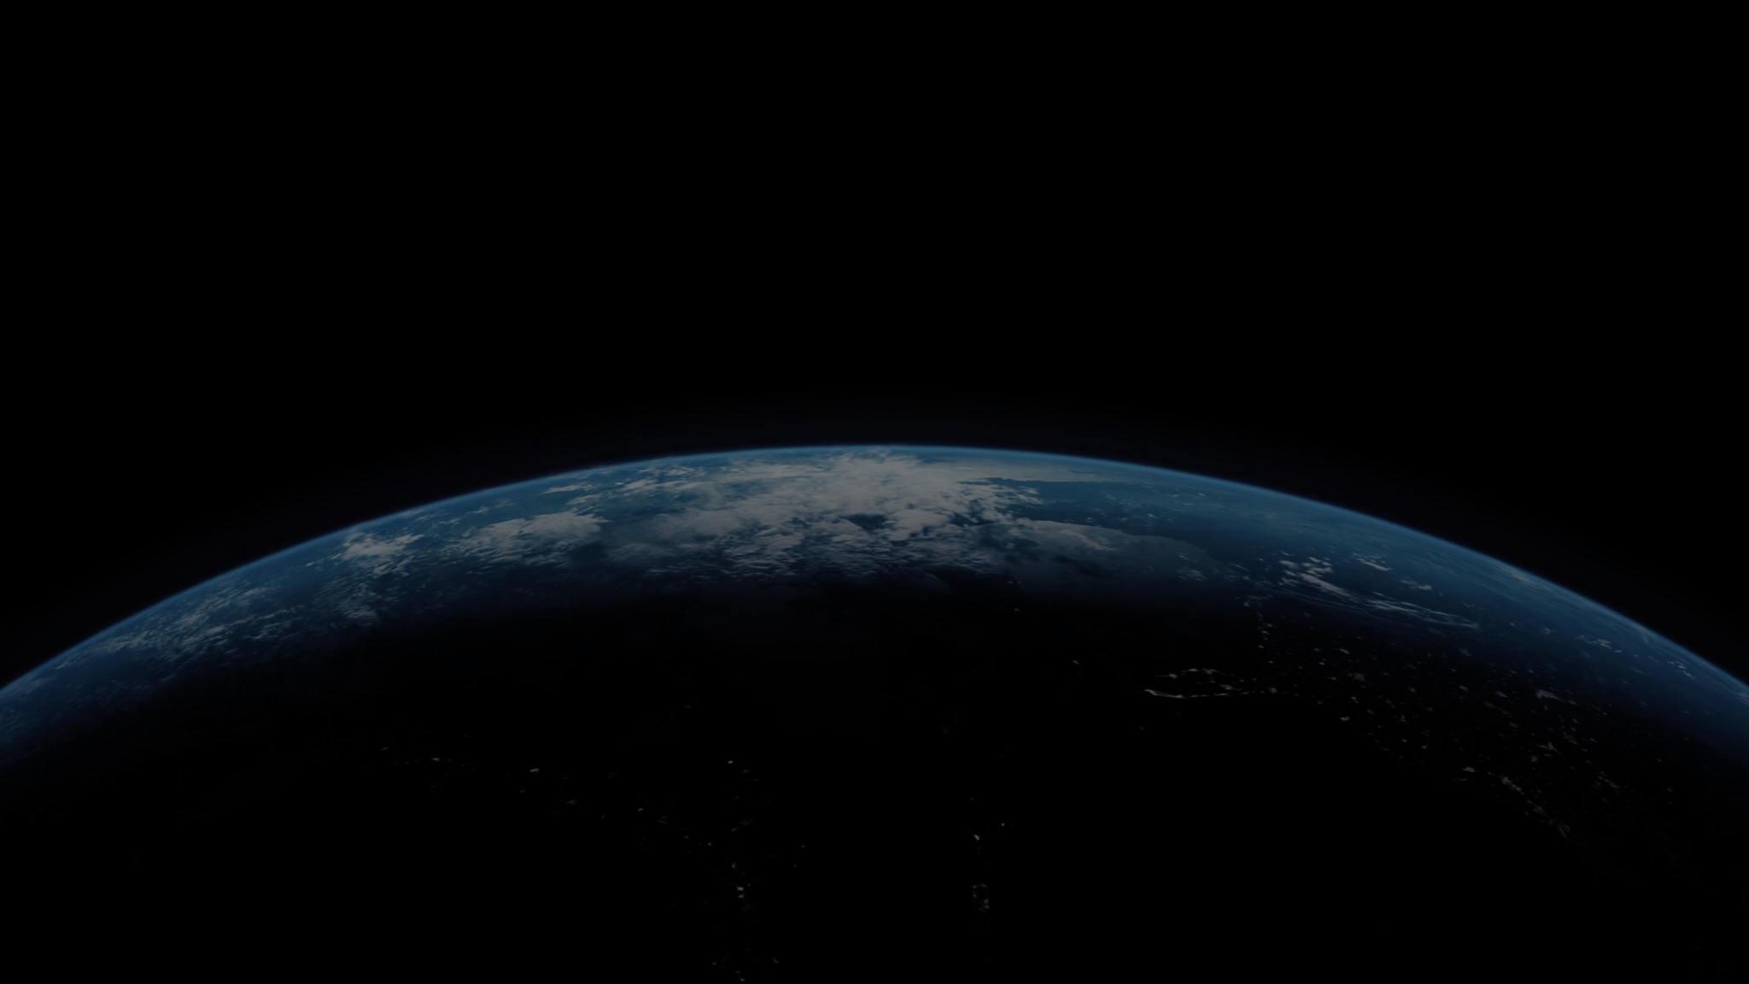




THANK YOU!
Disclaimer: The scientific results and conclusions, as well as any views or opinions expressed herein, are those of the author(s) and do not necessarily reflect those of NOAA or the US Department of Commerce.
@JPSS.PROGRAM
@ JPSSPROGRAM
@NOAASATELLITES

