Slide 1
Assimilating and forecasting precipitation at global scales
Alan Geer (ECMWF), Peter Lean (ECMWF), Kamil Mroz (ECMWF), Mary Borderies (Météo France), Simon Alix (Météo France), Philippe Chambon (Météo France), Kozo Okamoto (JMA/MRI), Yasutaka Ikuta (JMA/MRI),
Ben Johnson (JCSDA), Andrew Collard (NOAA)
International Precipitation Working Group
Kraków July 7th 2026
alan.geer@ecmwf.int

Slide 2
Complementarity of models and observations for precipitation
Ebert, Janowiak and Kidd (2007, https://doi.org/10.1175/BAMS-88-1-47):
  IPWG study
  Validation against rain gauge analyses, comparing:
    Precipitation retrieval algorithms like TMPA-RT, PERSIANN, CMORPH
    Short range forecasts from NWP models like ECMWF, GFS
“…satellite-derived estimates of precipitation occurrence, amount, and intensity are most accurate during the warm season and at lower latitudes, where the rainfall is primarily convective in nature.”
“In contrast, the NWP models perform better than the satellite estimates during the cool season when non-convective precipitation is dominant.”
Conditions for superior model forecasts and analyses of precipitation:
precipitation is predictable
physics embedded in the model brings information that is not found in precipitation observations

Slide 3
Assimilating and forecasting precipitation
Precipitation-related observations (radiances, reflectivities)
Other observations
Data assimilation
Physics-based forecast model
Physics-based forecast model
An analysis is (broadly) a short-range model forecast that best fits all the latest observations
Forecasts at longer time ranges
Precipitation analysis
Precipitation forecast
Assimilating precipitation is not as simple as putting precipitation where the observations see it: it is about bringing the forecast model closer to reality

Slide 4
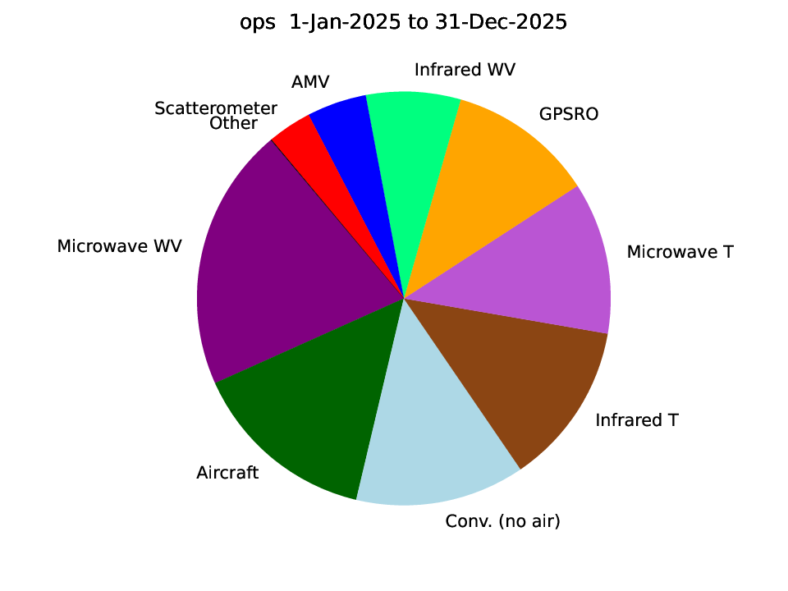
All-sky assimilation of passive microwave at ECMWF
Relative Forecast Sensitivity to Observation Impact (FSOI) on ECMWF 24 h forecast for calendar year 2025
Temperature sounding channels of:
AMSU-A, AWS-MWR, ATMS*
Humidity and imaging channels of:
MHS, MWHS-2, SSMIS, GMI, AMSR2, AWS-MWR, ATMS*
* ATMS is still only assimilated in clear-sky, not all-sky

Slide 5
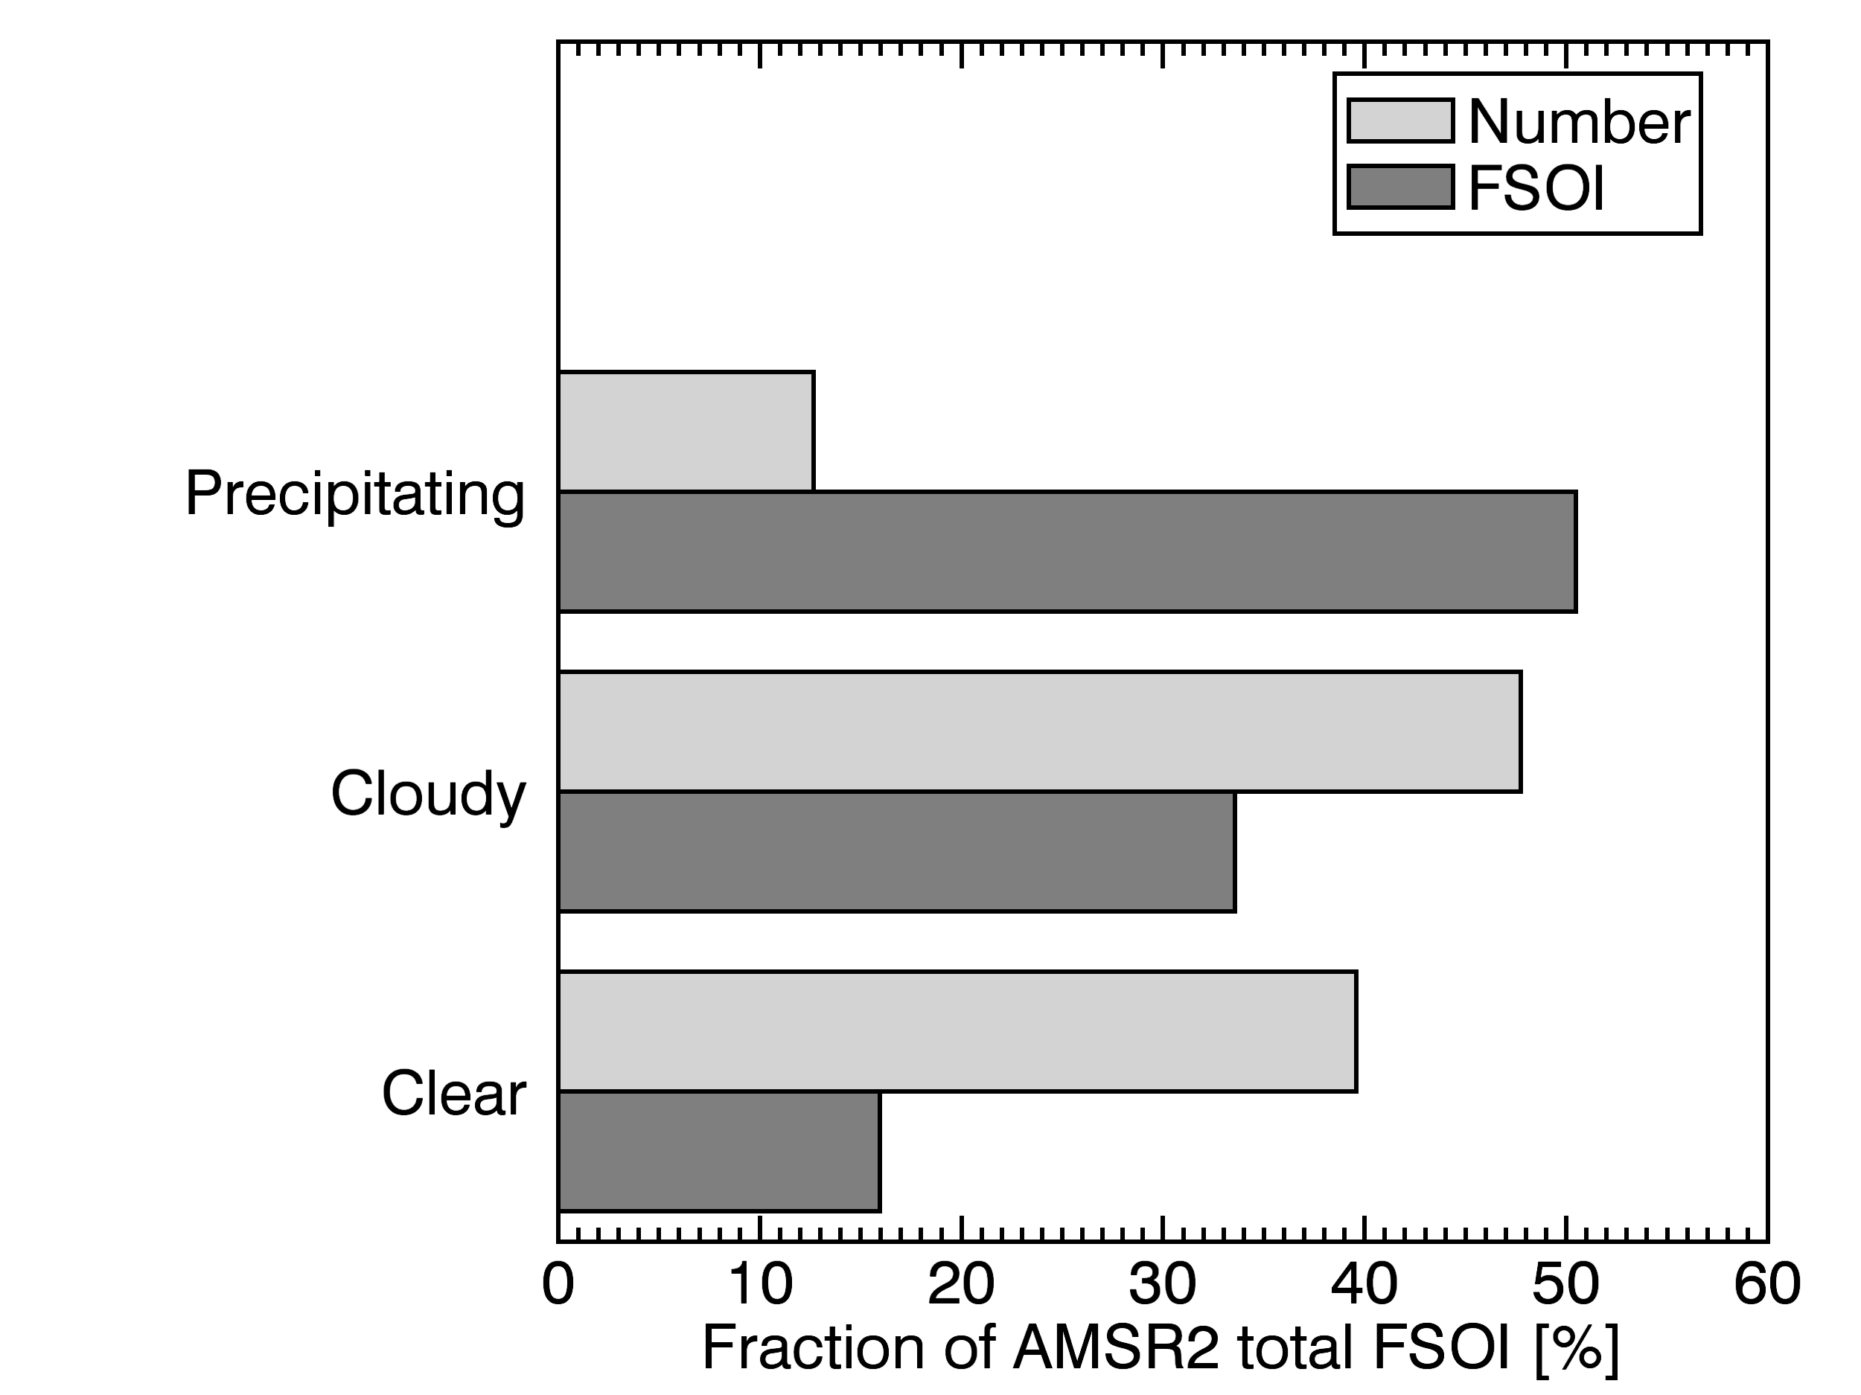
Does the impact of all-sky microwave on weather forecasting come from humidity, cloud or precipitation?
Microwave imagers give their largest forecast impact from a small fraction of precipitating scenes.
Number
Note that microwave humidity sounders extract a lot of information from clear-sky humidity (not shown)
Impact on forecast
AMSR2, July-August 2016
More background: Geer et al. (2017, https://doi.org/10.1002/qj.3172)

Slide 6
Developments in all-sky passive microwave assimilation
Use existing capabilities better
  Reduced thinning and superobbing for humidity sounders -> use more data
  Improved surface emissivity -> use more data over land surfaces, sea ice
  Better data assimilation (e.g. observation errors, QC)
A renewal and expansion of the observing system:
  Renewal of core capabilities, e.g.
    JAXA AMSR3 (now)
    EUMETSAT METOP-SG MWI (early 2027)
    US DoD WSFM-MWI (awaiting global distribution through NOAA)
  Expanded spectral range:
    SMAP at L-band (1.4 GHz) and using 6 and 10 GHz from current satellites
    Sub-millimeter: 325 GHz on AWS (now); up to 664 GHz on ICI (early 2027).
  Smallsat revolution, e.g. ESA AWS and commercial providers
Radio Frequency Interference (RFI)
  An increasing problem, needing increasingly sophisticated screening and mitigation
JMA example here
My talk, Friday
Elisa Chardon--Legrand, Friday
My talk, Friday
Météo France example here
My talk, Friday

Slide 7
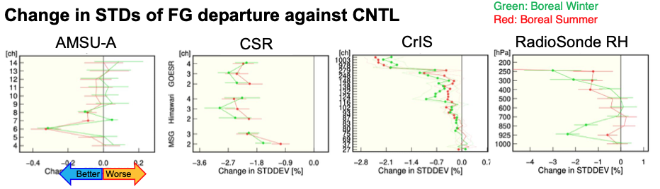
Developments in all-sky passive microwave (JMA example)
Impact of assimilating humidity sounding observations more densely, using superobs, and improving land surface utilisation with dynamic emissivity retrieval:
Hiroyuki Shimizu et al. (2025) poster at ITSC:
https://itwg.ssec.wisc.edu/wordpress/wp-content/uploads/2025/06/poster.9p.06.Shimizu_itsc25.pdf

Slide 8
Development of active microwave assimilation: cloud and rain radar
Ground radar
  Data assimilation in many weather centres, mainly in regional models
Making better use of existing space radars, such as DPR:
  DPR has been assimilated in the JMA mesoscale system using 1D-MLE since 2016 (Ikuta et al., 2021, https://doi.org/10.1002/qj.3950)
Many centres are adding EarthCARE support
  ECMWF operationally assimilate CPR reflectivity since 12th June 2026
Future cloud and precipitation radar missions
  WIVERN; W-band conically scanning Doppler radar with 800 km swath
Météo France example here
Météo France example here
JMA example here
Kozo Okamoto, Friday
My talk, Friday
Météo France example here

Slide 9



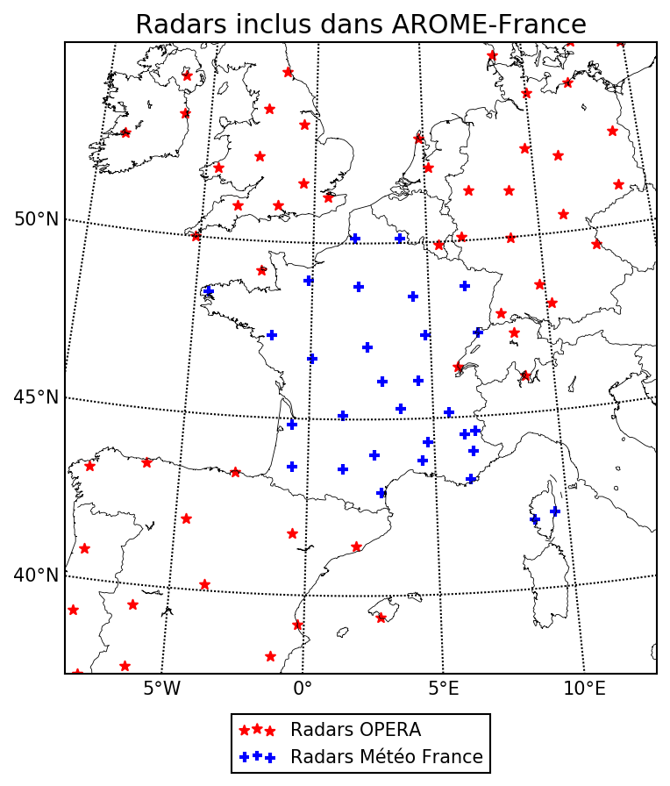
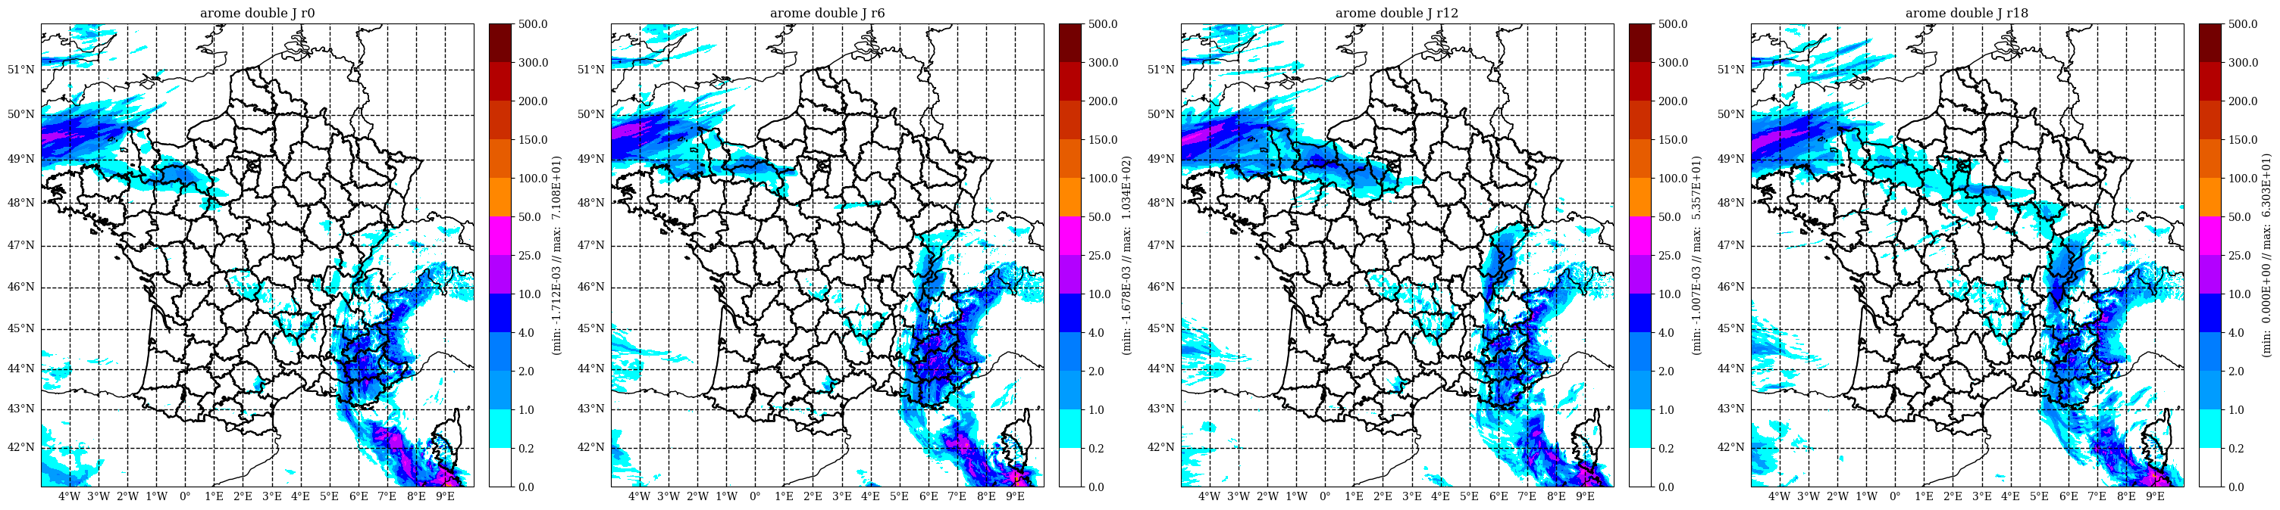
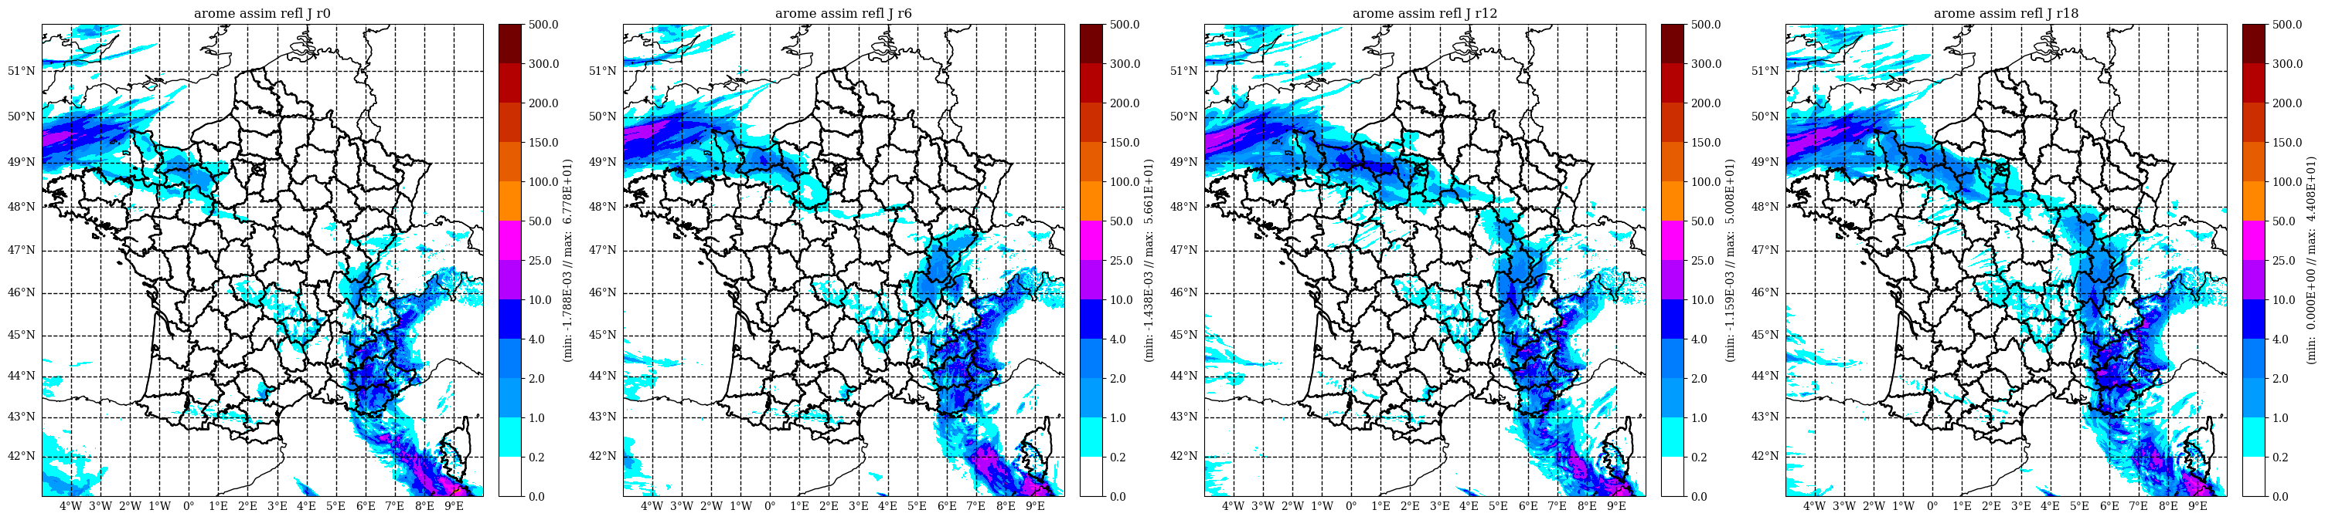
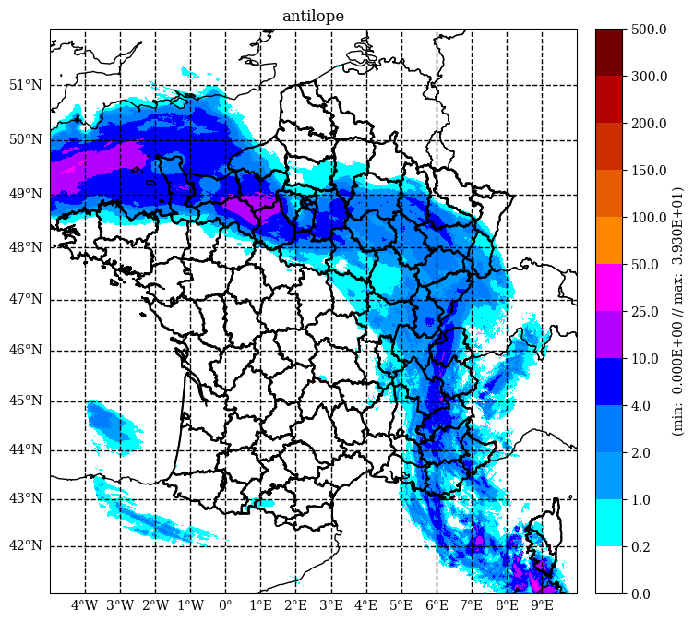
Assimilation of ground-based radar reflectivity observations in AROME regional model
Direct assimilation of ground-based radar reflectivities in AROME, with hydrometeors in the control vector (4DEnVar): becomes operational autumn 2026
Assimilation of reflectivities from the OPERA Network
Significant positive impact on most variables over long periods, as well on case studies
Oper assimilation route “1D-Bay + 3DVar”
Direct Assimilation
Observations
Credit: Maud Martet, Pauline Combarnous

Slide 10
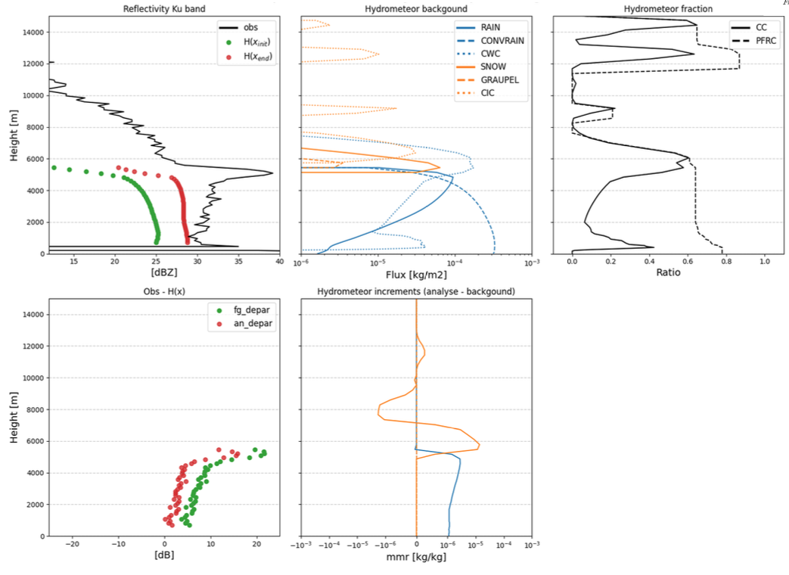
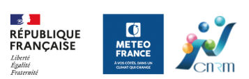
DPR assimilation at Météo France (Simon Alix et al.)
Experimental assimilation into the ARPEGE global model:
  Using the all-sky passive microwave framework within the IFS/Arpege code
  Using RTTOV as the observation operator for reflectivities

Slide 11
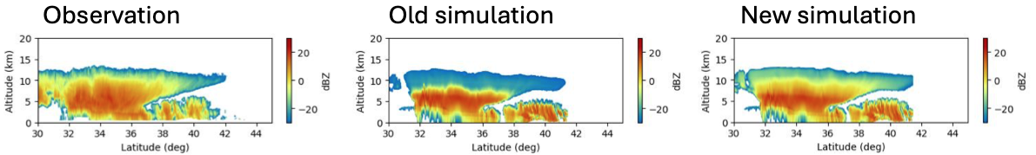
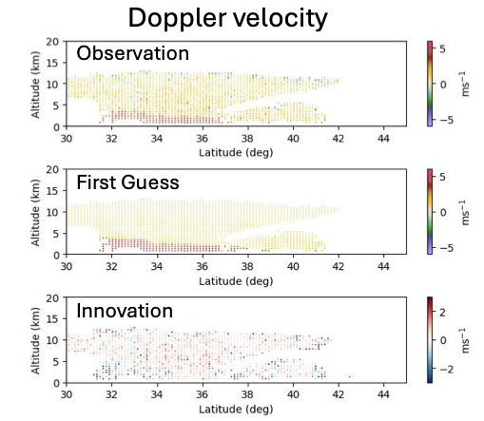
EarthCARE CPR assimilation at JMA (Yasutaka Ikuta)
Microphysical improvements were required to simulate CPR well:
Doppler velocities exhibit fine scale structure:
Experimental assimilation of reflectivity and Doppler into the regional model:
  working, albeit limited impact on precipitation forecasts
Presentation on Friday from Kozo Okamoto, or see:
  https://www.eorc.jaxa.jp/EARTHCARE/event/ws2025/program-data/H316_ikuta.pdf
CPR reflectivity
CPR Doppler velocity

Slide 12
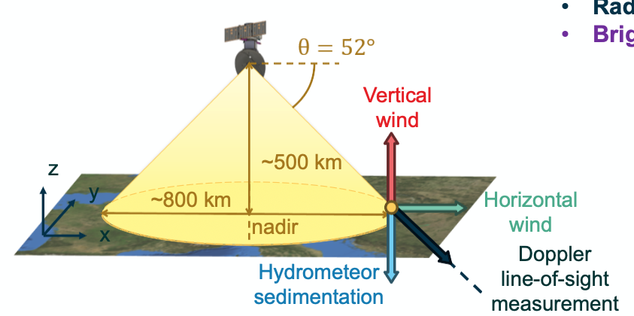
WIVERN – inspiration for the fusion of active-passive sensors?
Wind Velocity Radar Nephoscope
  Selected by ESA as the 11th Earth Explorer mission
  Conically scanning W-band Doppler radar
    Large antenna (3m):
      High horizontal resolution – approx. 1 km around the scan
    Doppler returns from hydrometeors:
      3D wind and precipitation
    Passive 94 GHz TB from the “noise” measurements
      v and h polarisations
  RTTOV simulator is built to provide both TB and reflectivity in one simulation – “WIVERN mode”
    Need to add Doppler support too
    Ensures micro/macrophysical consistency in forward modelling
  Alessandro Battaglia presentation, Thursday
Source: WIVERN presentation at ESA User Consultation meeting
https://www.esa.int/ESA_Multimedia/Videos/2025/07/EE11_User_Consultation_Meeting_2025_WIVERN_Science_Part_1_Technology/(lang)/en

Slide 13
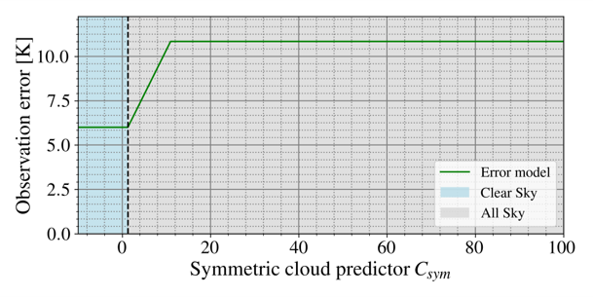
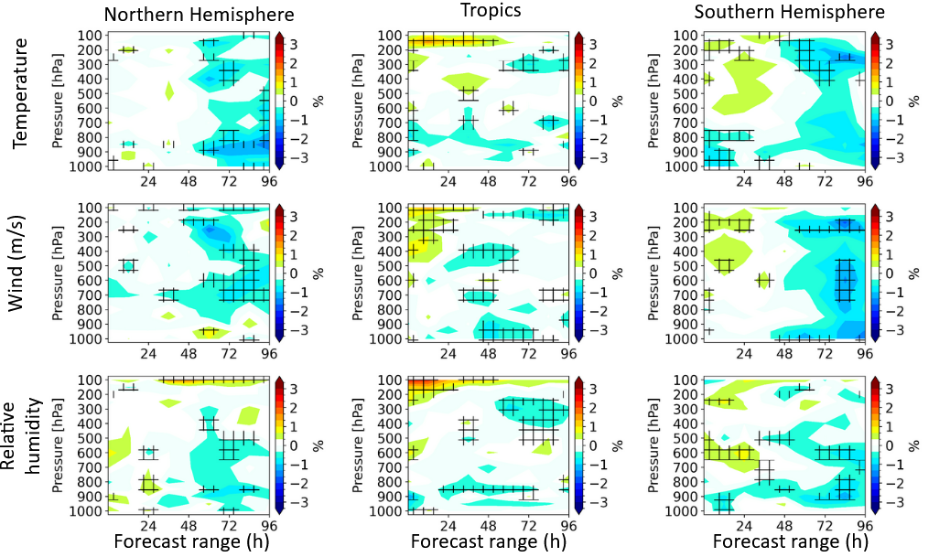
OSSE simulated impact of WIVERN in ARPEGE: focus on the 94GHz v-pol brightness temperature
OSSE estimation of the change in RMSE, due to the assimilation of the 94 GHz brightness temperature
Error model:
- Difficulty to assimilate a single channel in all-sky conditions
- Only over a 2-week period: the impact will likely be neutral if over a longer period
Blue = reduced error
Credit: N. Sasso, M. Borderies, P. Chambon

Slide 14

Operations
Developing
Future
Cloud and precipitation data assimilation: ~2021
Passive Microwave
Radar / Lidar
Passive sub-mm
Infrared
Solar
T-sounding
low-
high-freq.
Cloud
Precip
Lidar
Cloud particles, lighter precip.
Cloud ice water
RO phase
(+ attenuation)
Ice particle size, shape, orientation
Non-spherical rain and ice properties
Vertically resolved
Larger frozen particles, particle size and shape
Cloud fraction, cloud top height, multiple layers
Cloud particle size and number
Size of water cloud particles
Cloud liquid water
Mast to Mast
(+ maybe to mobile)
Melting particles
Lightning
Cloud cover
Sub-FOV heterogeneity & structure
Rain, including particle size
Ground radar
Rain gauges

Slide 15
Operations
Developing
Future
Cloud and precipitation data assimilation: 2026
Passive Microwave
Radar / Lidar
Passive sub-mm
Infrared
Solar
T-sounding
low-
high-freq.
Cloud
Precip
Lidar
Cloud particles, lighter precip.
Cloud ice water
RO phase
(+ attenuation)
Ice particle size, shape, orientation
Non-spherical rain and ice properties
Vertically resolved
Larger frozen particles, particle size and shape
Cloud fraction, cloud top height, multiple layers
Cloud particle size and number
Size of water cloud particles
Cloud liquid water
Mast to Mast
(+ maybe to mobile)
Melting particles
Lightning
Cloud cover
Sub-FOV heterogeneity & structure
Rain, including particle size
Ground radar
Rain gauges

Slide 16
Radiative transfer modelling in cloud and precipitation
All-sky passive microwave, infrared and visible support
  Improved scattering databases and microphysical assumptions
  Cloud and precipitation overlap and sub-grid/FOV heterogeneity
  Polarisation from oriented ice particles, including full Stokes vector in new CRTM
Support for active sensors
  E.g. both RTTOV and CRTM now include radar reflectivity simulations
  Support for Doppler velocities will be added, needing velocity distributions
Data assimilation focus group presentation, Friday

Slide 17
Data assimilation developments
4D-Var / EnVar / Ensemble data assimilation systems do not need hydrometeor control variables to work:
  ECMWF example: modify the strength of a low pressure system in order to reduce frontal rainfall 12 hours later, better fitting the observations (TL/AD needed)
  Meteo France are using 4D-EnVar (no TL/AD needed) in AROME (regional) and aiming to move from 4D-var to 4D-EnVar in ARPEGE (global).
But cloud and precipitation control variables remain of great interest:
  They allow a much closer fit to precipitation observations
  E.g. NOAA now include liquid water, ice, rain, snow and graupel in the DA control vector, although without feedback into the model for now
AI, machine learning and links to data assimilation:
  Retrievals and data assimilation share common Bayesian inverse framework
  Machine learning and data assimilation share common Bayesian framework
Meteo France example here
ECMWF example here

Slide 18
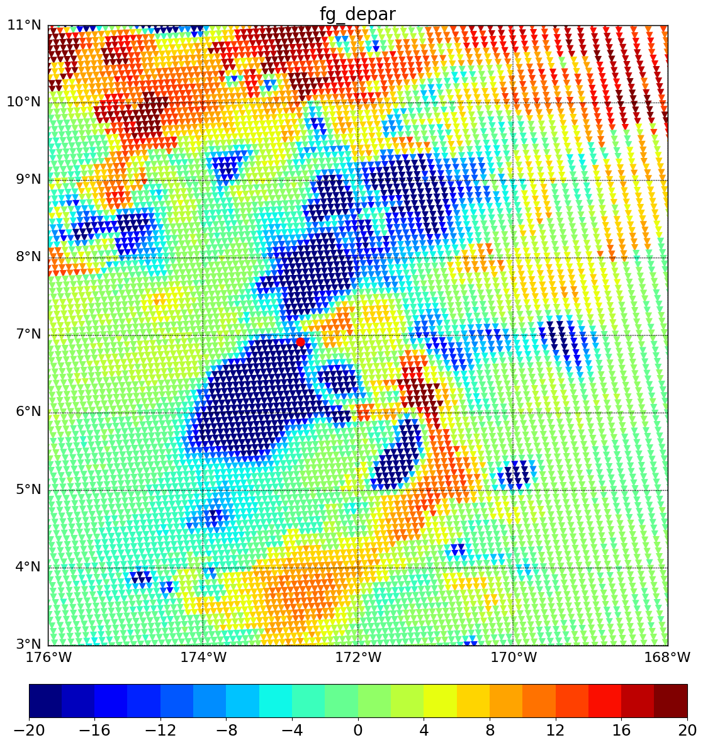
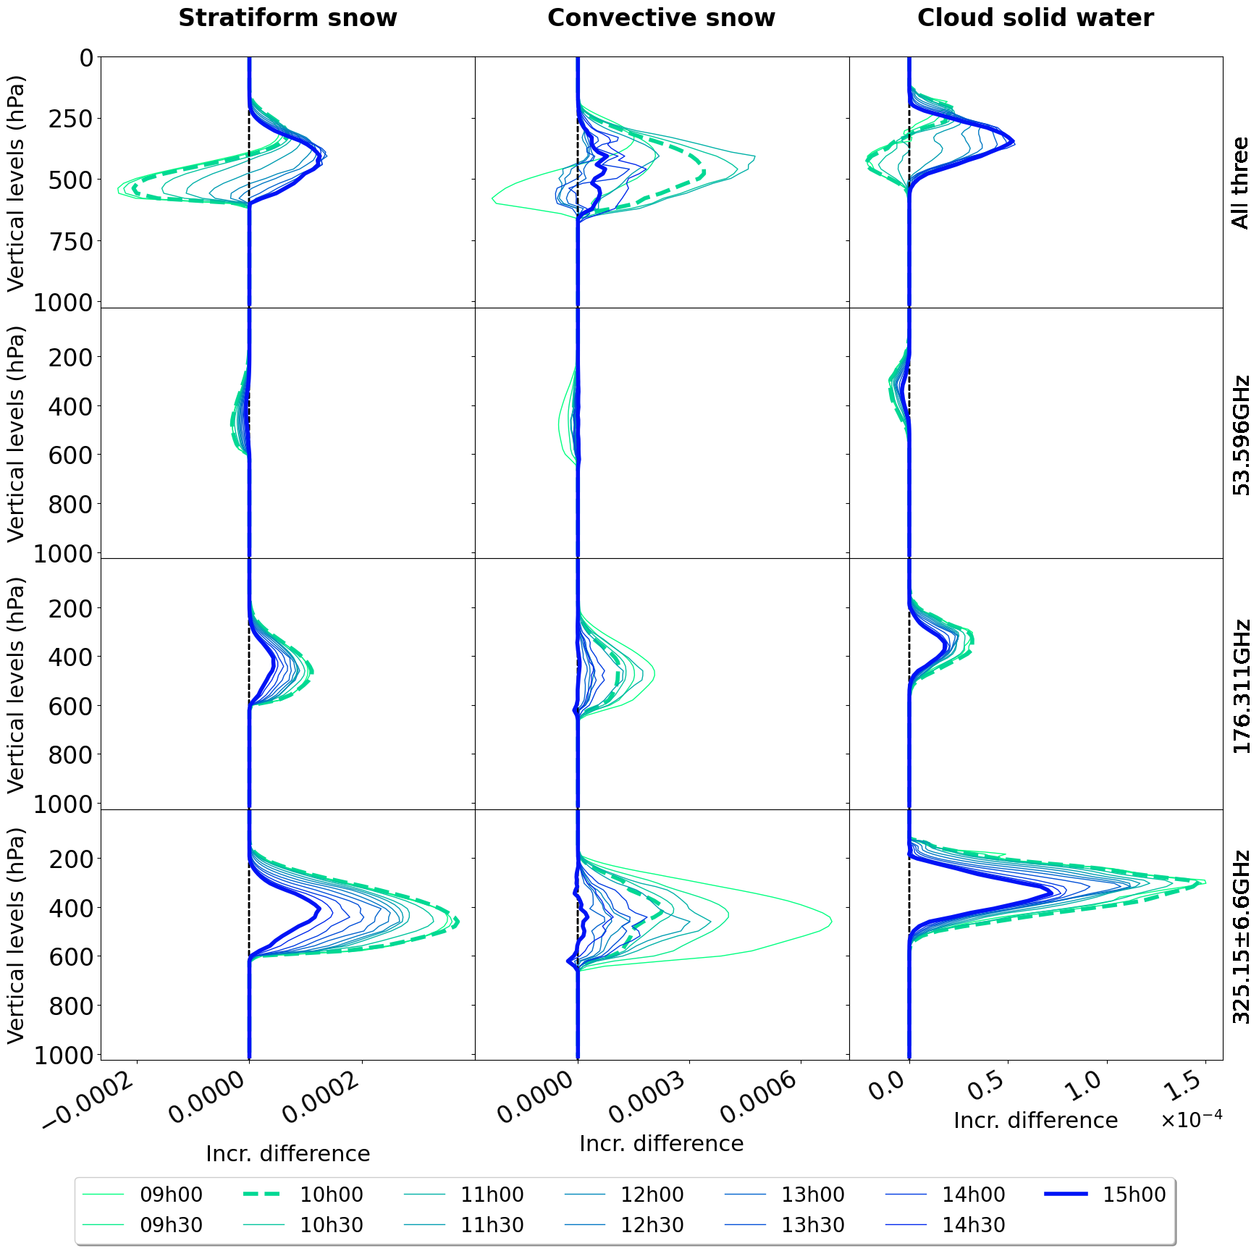
Assimilation of a single AWS observation within the 4DEnVar DA system of ARPEGE with hydrometeors in the control vector
Impact of the assimilation of the 325GHz ± 6.6GHz on the increment of stratiform snow (increment difference)
Observed TB – Simulated TB
(53.596 GHz )
Final increment (15:00)
Observation time (10:00)
Increment difference (kg/kg)

Slide 19

Assimilation of microwave radiances within the 4DEnVar DA system of ARPEGE with hydrometeors in the control vector
For this case, analysis is dominated by the assimilation of the submillimetric channel
Similar results found on other variables (eg. Winds, liquid hydrometeors, temperature, humidity)
On-going: impact experiment over a long period.
Credit: Z. Sassi,E. Arbogast, H. Dumas, P. Chambon, L. Berre, M.Borderies

Slide 20
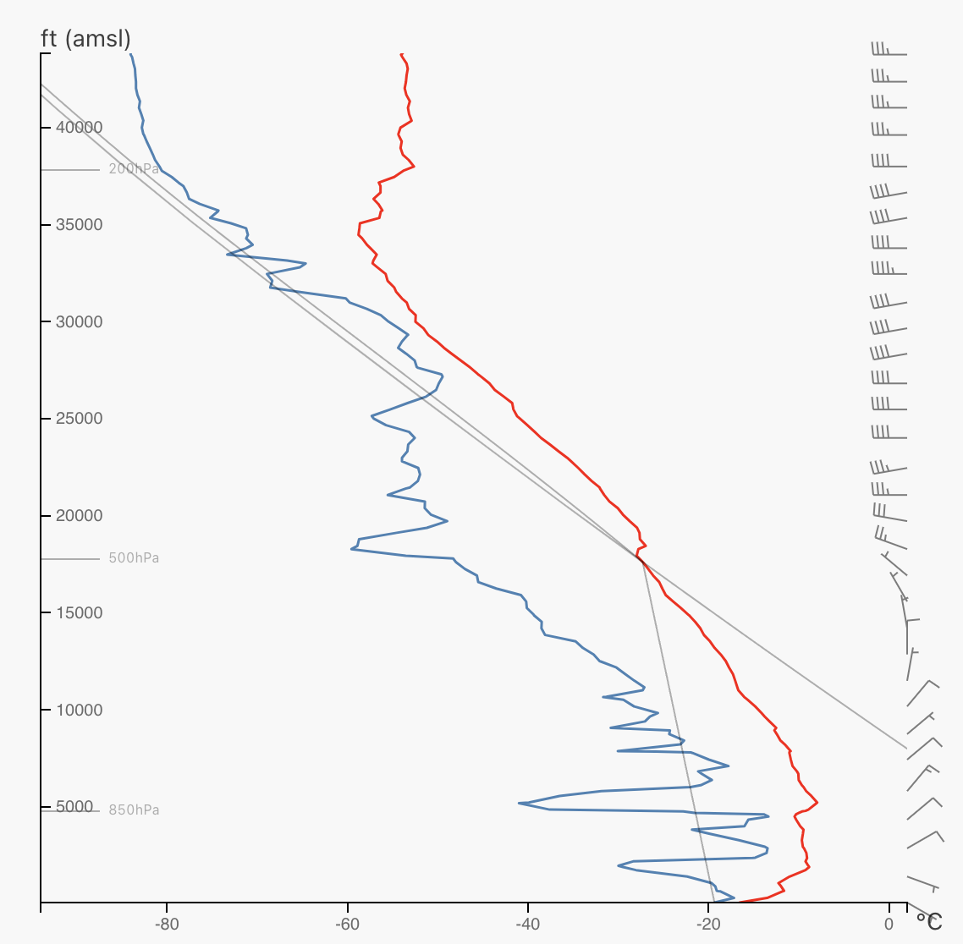
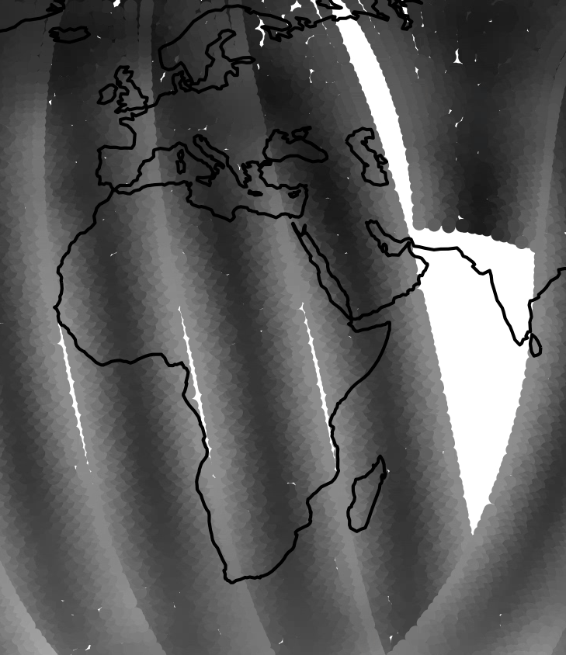
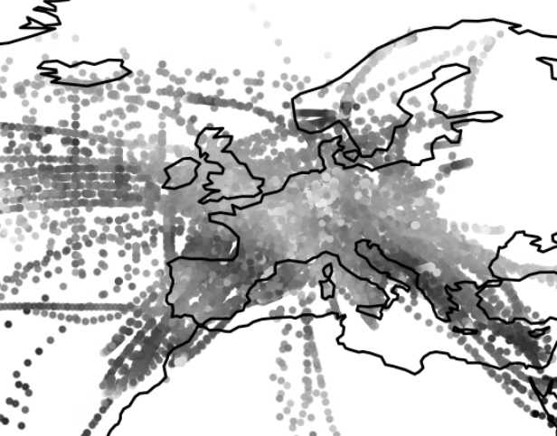
AI-DOP: observation to observation forecasting (Peter Lean et al., ECMWF)
AI-DOP concept at ECMWF:
  End-to-end observations → forecast (no explicit data assimilation step)
  Training objective:
    using observations in an input window,
    predict all future observations in the next window (with no reanalysis data used)
  To accurately predict future observations the network must learn a representation of the state and processes that those observations are sensitive to
  Many reports to read on arXiv:
    Alexe et al. (2024) https://doi.org/10.48550/arXiv.2412.15687
    Lean et al. (2025) https://doi.org/10.48550/arXiv.2508.18018
    Pinnington et al. (2026) https://doi.org/10.48550/arXiv.2606.19093
latent space
Prediction
Encoders map different observation types to a
unified representation in the latent space
Abstract representation which captures temperature + processes which evolve temperature
Decoders map from latent representation back to predicted observations
obs space
e.g. sensitive to temperature

Slide 21
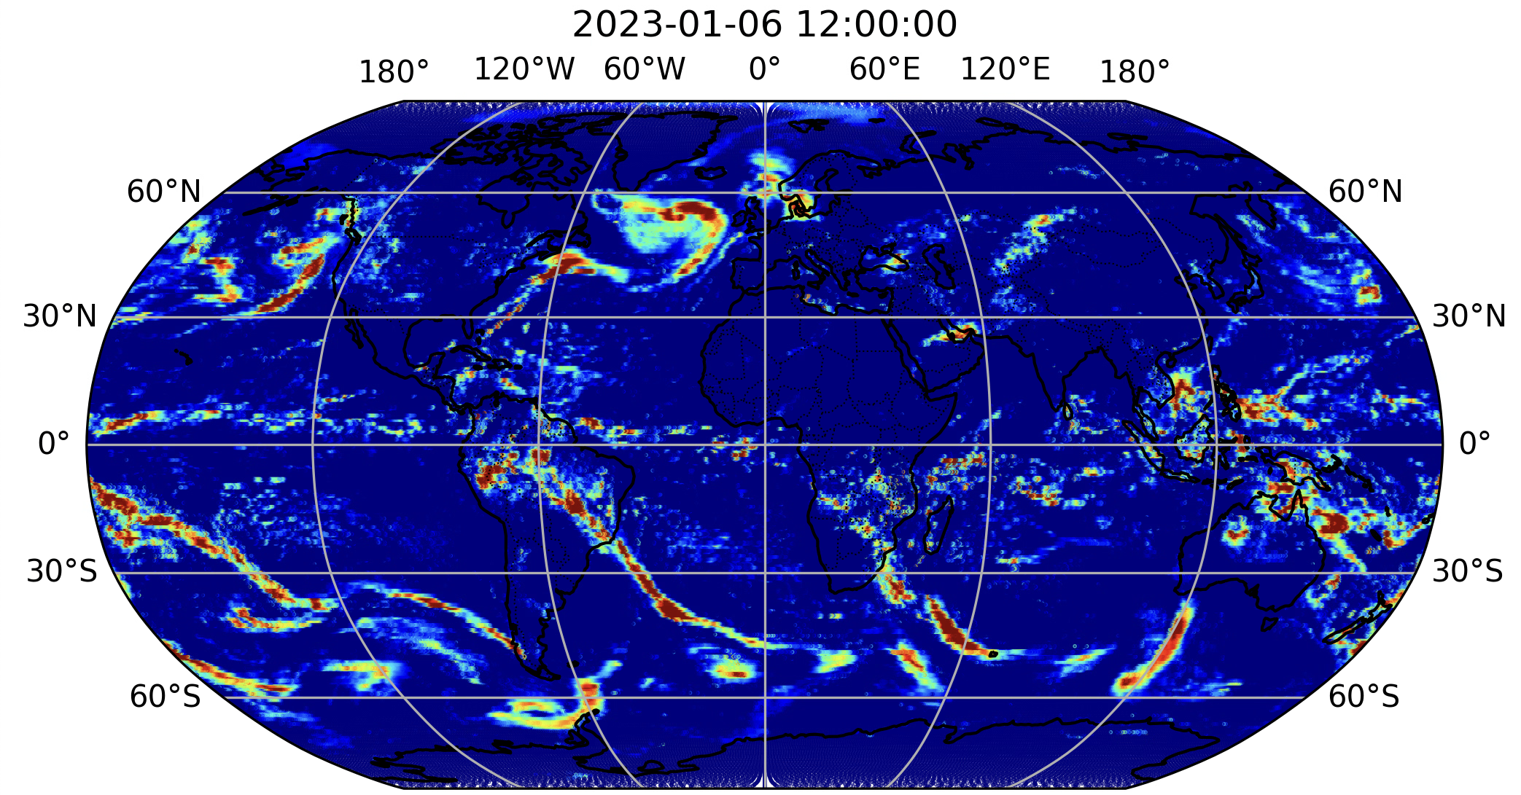
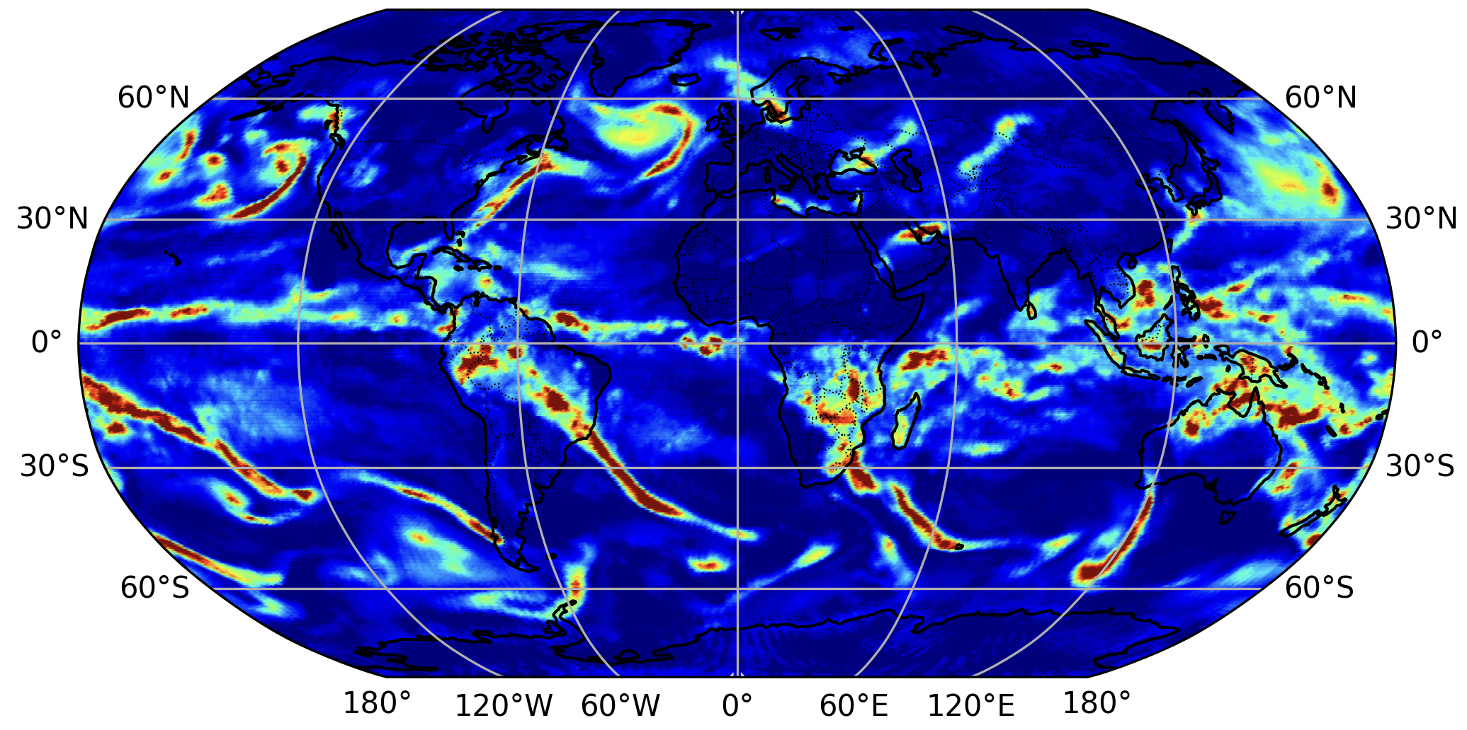
AI-DOP experimental precipitation forecasts (Peter Lean, ECMWF)
Exploratory proof of concept
IMERG precipitation analysis (reference only)
Inputs at t+0:
GPM DPR sfc. precip rate
GMI
MHS
AMSU-A
ATMS
IASI
Conventional data
Outputs at t+12:
Gridded prediction of 1h precipitation accumulation
Using decoder for GPM DPR
AI-DOP
DOP 12h precipitation accumulation forecast

Slide 22
Conclusion
Impact of AI / data-driven forecasting approaches:
  Direct observation prediction (DOP) is inspiration for a global precipitation analysis
    How much of the retrieval comes from observations and how much from the learned statistical representation of the atmosphere?
  How important is physical modelling going forward? (My answer – very, but that is another talk!)
  Both data assimilation and data-driven methods benefit hugely from observations
Progress in precipitation-related assimilation at global weather centres:
  Better exploitation of passive microwave
  Lower (<19 GHz) and higher (> 190 GHz) frequencies
  All-sky all-surface (e.g. sea ice and land surface emissivity)
  Increased exploitation of GPM DPR
  EarthCARE CPR assimilation in development across many centres
  Hydrometeor control variables; more direct assimilation
Data assimilation for weather forecasting relies on key IPWG interest areas:
  Global precipitation observing system
  Inverse frameworks (DA, retrievals) and machine learning
  Cloud and precipitation microphysics, macrophysics and radiative transfer

