Slide 1
Overview of Passive Microwave Missions at EUMETSAT for Precipitation Monitoring
V. Barlakas¹, C. Accadia¹, V. Mattioli¹, J. Ackermann¹, T. Hewison¹, F. De Angelis¹, S. Di Michele¹, I. Krizek¹, R. Ekelund¹, J. Lu², D. Ori², F. Lemmouchi²
¹EUMETSAT, Eumetsat-Allee 1, 64295 Darmstadt, Germany
²CS Group Germany, Robert-Bosch-Straße 7, 64293 Darmstadt
12th Workshop of International Precipitation Working Group, July 7-10, 2026, Kraków, Poland

Slide 2
EPS-SG MW and sub-mm wave missions
MWS, MWI and ICI
CIMR at EUMETSAT
EUMETSAT activities in support of CIMR mission
EPS Sterna
Precipitation products at a glance

Slide 3
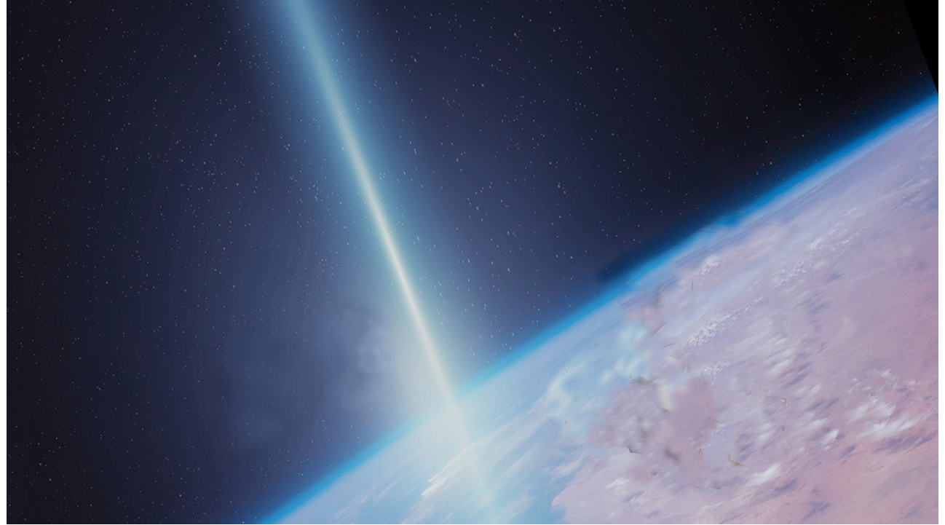
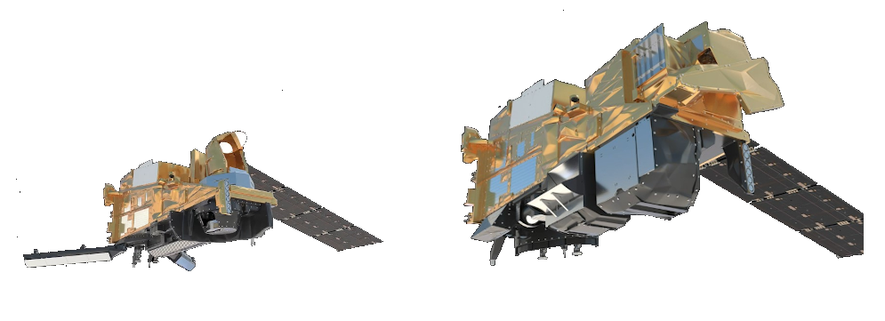
courtesy of ESA
Courtesy of ESA
EPS Second Generation (EPS-SG) Program
Orbit: Sun-synchronous polar at ~835 km
Coverage: 14 orbits/day (orbital period ~100 min)
Carries multiple instruments, including two MW imagers and a sounder
Metop-SG B
Metop-SG A
To be launched in 2026
Launched on 13 August 2025
Conical scanners (53°±2°) with a 1700 km swath
Microwave Imager (MWI)
Ice Cloud Imager (ICI)
MicroWave Sounder (MWS)
Cross-track scanner (±49.85°) with a ~2250 km swath
Notes:
There will be three satellite pairs, where each satellite will have a nominal lifetime of 7.5 years to span a total operational lifetime over 21 years

Slide 4
courtesy of ESA
Courtesy of ESA
EPS Second Generation (EPS-SG) Program
MicroWave Sounder | MicroWave Imager | Ice Cloud Imager
Main applications: Spectral radiance measurements on Temperature Water vapour profiles Cloud liquid and cirrus detection | Main applications: Cloud and precipitation products | Main applications: First operational radiometer for ice cloud monitoring Non-precipitating ice - not covered either in the optical and thermal IR or in the mm-wave range
For Numerical Weather Prediction: Nowcasting and very short-range forecasting Support NWP at regional and global scales | For Numerical Weather Prediction: Nowcasting and very short-range forecasting at regional scales Support NWP at regional and global scales | For climate monitoring: Ice cloud products Validation of ice cloud models Parameterisation of ice clouds in weather and climate models
For climate monitoring: Temperature and humidity sounding records | For climate monitoring: Continuity of key microwave channels as observed by SSM/I, TMI, SSMIS, AMSR-E, GMI
For surface measurements: Observations of sea ice and snow cover, surface temperature, and emissivity | For surface measurements: Observations of sea ice parameters and snow cover, snow water equivalent, sea surface wind
Notes:
There will be three satellite pairs, where each satellite will have a nominal lifetime of 7.5 years to span a total operational lifetime over 21 years

Slide 5
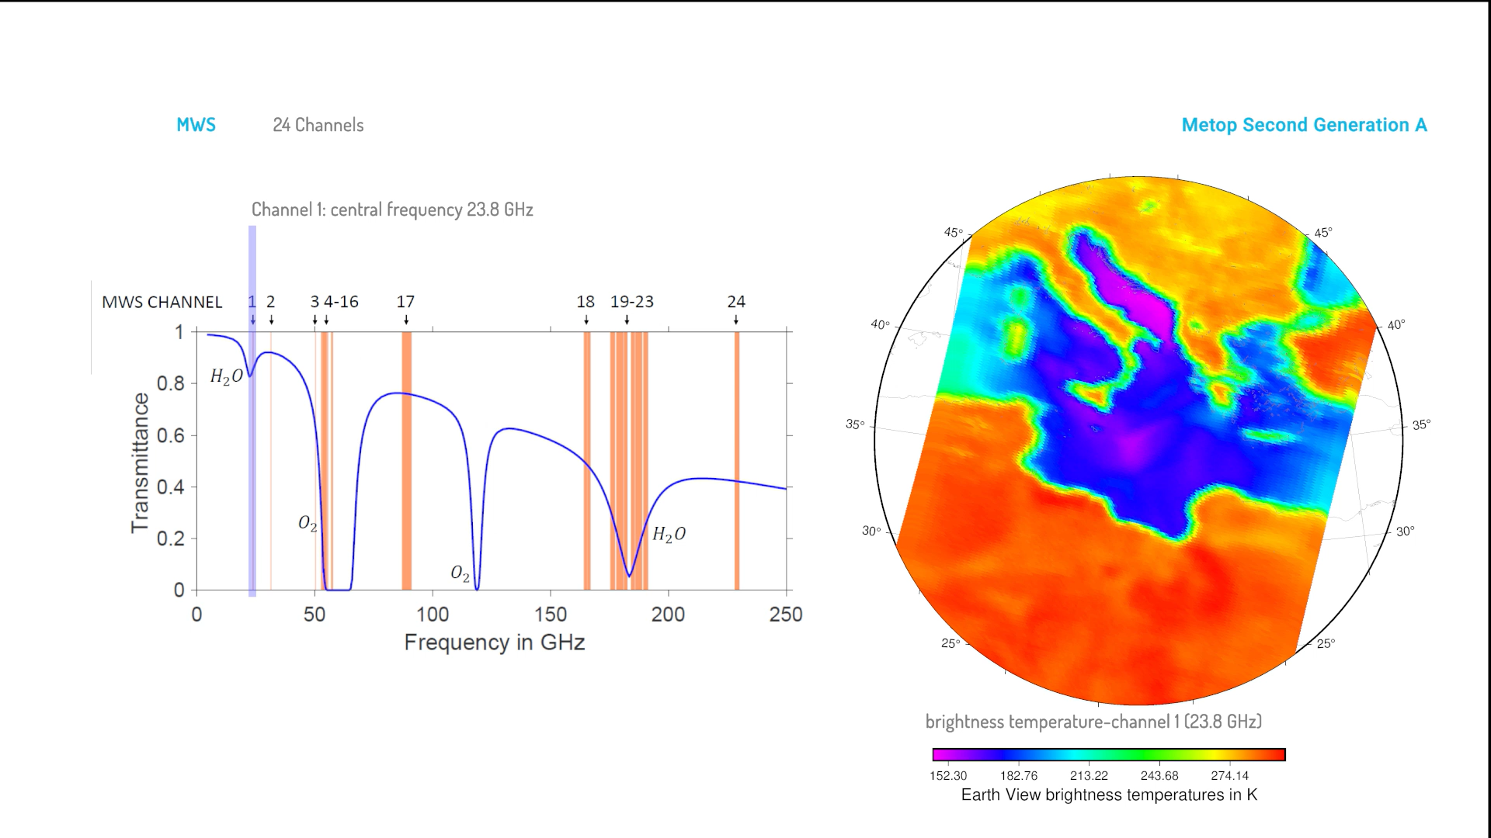
MicroWave Sounder (MWS)
Channel | Frequency (GHz) | Footprint (IFOV) Size at 3dB (km)
MWS-1 | 23.8 | 40
MWS -2 | 31.4 | 40
MWS -3 | 50.3 | 20
MWS -4 | 52.8 | 20
MWS-5 | 53.246 ± 0.08 | 20
MWS -6 | 53.596 ± 0.115 | 20
MWS-7 | 53.948 ± 0.081 | 20
MWS -8 | 54.40 | 20
MWS -9 | 54.94 | 20
MWS -10 | 55.50 | 20
MWS -11 | 57.290344 | 20
MWS-12 | 57.290344 ± 0.217 | 20
MWS-13 | 57.290344 ±0.3222±0.048 | 20
MWS-14 | 57.290344±0.3222±0.022 | 20
MWS-15 | 57.290344±0.3222±0.010 | 20
MWS-16 | 57.290344±0.3222±0.0045 | 20
MWS-17 | 89.0 | 17
MWS-18 | 165.5 ± 0.725 | 17
MWS-19 | 183.311 ± 7.0 | 17
MWS-20 | 183.311 ± 4.5 | 17
MWS-21 | 183.311 ± 3.0 | 17
MWS-22 | 183.311 ± 1.8 | 17
MWS-23 | 183.311 ± 1.0 | 17
MWS-24 | 229 ± GHz | 17
24 channels (23.8 – 229 GHz)
Spatial resolution: ~40 km at low freqs., ~17 km at high freqs.
Temperature & humidity sounding, surface, cloud ice, precipitation
Hurricane Melissa
Ch. 1 – 2: Total Column Water Vapor (TCWV)
Ch. 1 – 3: Sea-ice, land surface temperature
Ch. 1 – 3 & 17 – 18: Ice Water Path (IWP), precipitation
Ch. 24: Cirrus cloud detection

Slide 6
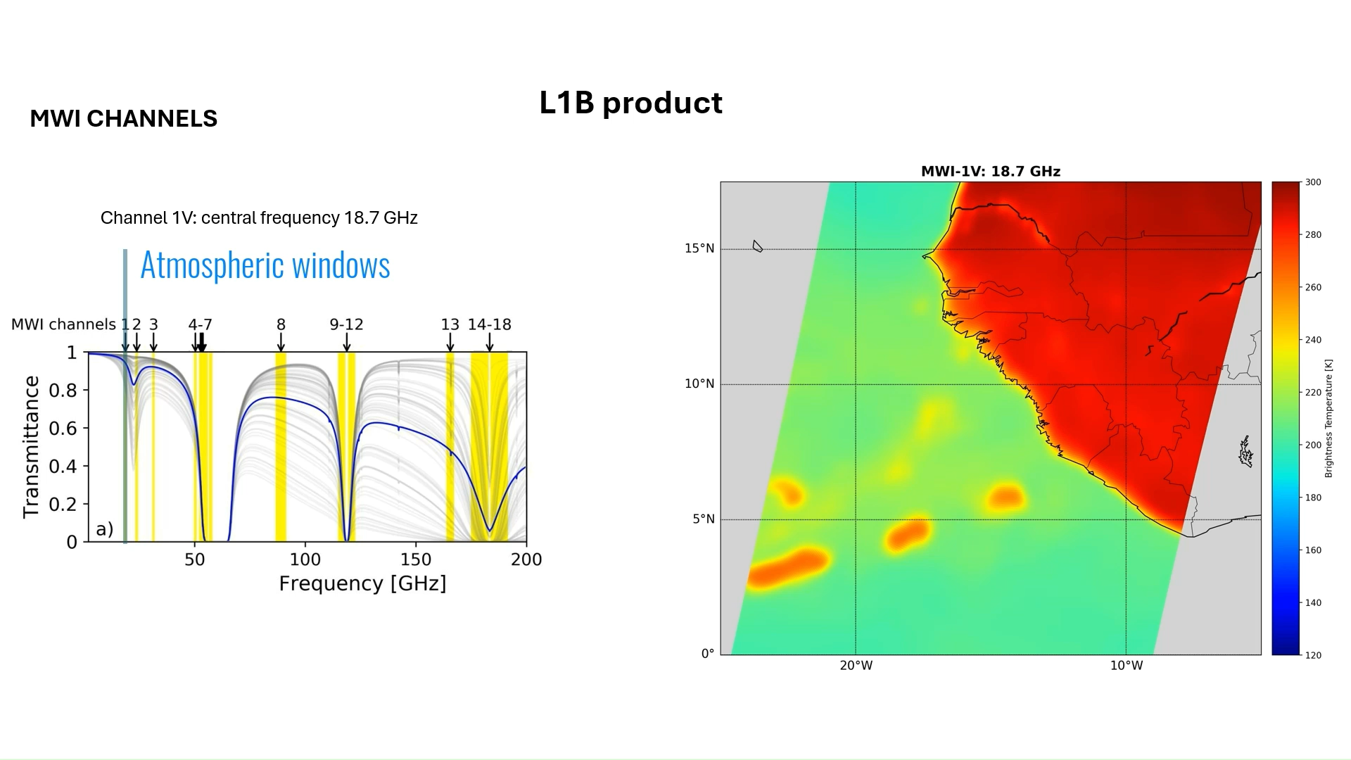
MicroWave Imager (MWI) & Ice Cloud Imager (ICI)
MWI
18 channels (V/H until 89 GHz; V above 89 GHz)
Spatial resolution: 50 km at low freqs., 10 km at high freqs.
Precipitation mission:
MWI Imaging channels
in the “windows” (18.7, 31.4, 89.0, 165.5 GHz) and low WV absorption (23.8 GHz)
MWI Temperature sounding in the O₂ 50/60 complex - 118 GHz line
18 – 31.4 GHz: wind, ice/snow cover, TCWV (+183 GHz)
50/60 & 118 GHz: light precipitation/snowfall
89 & 165 GHz: Snowfall, precipitation
183 GHz: Snowfall, cloud slicing, WV
Humidity sounding in the 183 GHz line (some of bands in common with ICI)
Channel | Frequency (GHz) | Pol.
MWI-1 | 18.7 | V, H
MWI-2 | 23.8 | V, H
MWI-3 | 31.4 | V, H
MWI-4 | 50.3 | V, H
MWI-5 | 52.7 | V, H
MWI-6 | 53.24 | V, H
MWI-7 | 53.75 | V, H
MWI-8 | 89.0 | V, H
MWI-9 | 118.7503±3.2 | V
MWI-10 | 118.7503±2.1 | V
MWI-11 | 118.7503±1.4 | V
MWI-12 | 118.7503±1.2 | V
MWI-13 | 165.5±0.75 | V
MWI-14 | 183.31±7.0 | V
MWI-15 | 183.31±6.1 | V
MWI-16 | 183.31±4.9 | V
MWI-17 | 183.31±3.4 | V
MWI-18 | 183.31±2.0 | V

Slide 7
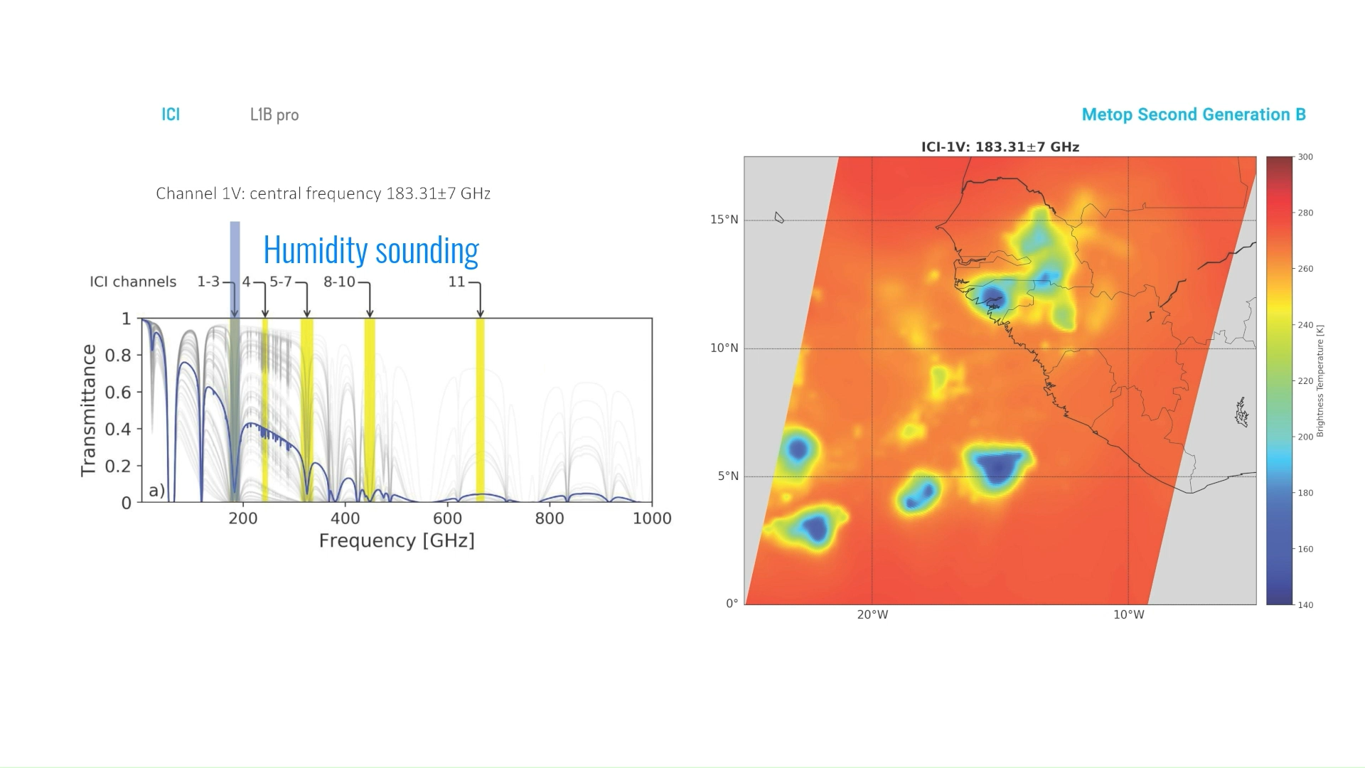
MicroWave Imager (MWI) & Ice Cloud Imager (ICI)
ICI
11 channels (V; 243 & 664 GHz in V/H)
Spatial resolution: 16 km
Cloud ice mission:
MWI Imaging channels
in the “windows” (18.7, 31.4, 89.0, 165.5 GHz) and low WV absorption (23.8 GHz)
MWI Temperature sounding in the O₂ 50/60 complex - 118 GHz line
183 GHz: Snowfall, cloud slicing, cloud ice, WV
Strong WV bands: ice water content/path, ice sizes
V/H quasi window channels: ice shape and orientation
Humidity sounding in the 183 GHz line (some of bands in common with ICI)
Channel | Frequency (GHz) | Pol.
MWI-1 | 18.7 | V, H
MWI-2 | 23.8 | V, H
MWI-3 | 31.4 | V, H
MWI-4 | 50.3 | V, H
MWI-5 | 52.7 | V, H
MWI-6 | 53.24 | V, H
MWI-7 | 53.75 | V, H
MWI-8 | 89.0 | V, H
MWI-9 | 118.7503±3.2 | V
MWI-10 | 118.7503±2.1 | V
MWI-11 | 118.7503±1.4 | V
MWI-12 | 118.7503±1.2 | V
MWI-13 | 165.5±0.75 | V
MWI-14 | 183.31±7.0 | V
MWI-15 | 183.31±6.1 | V
MWI-16 | 183.31±4.9 | V
MWI-17 | 183.31±3.4 | V
MWI-18 | 183.31±2.0 | V
Channel | Frequency (GHz) | Pol.
ICI-1 | 183.31±7.0 | V
ICI-2 | 183.31±3.4 | V
ICI-3 | 183.31±2.0 | V
ICI-4 | 243.2±2.5 | V, H
ICI-5 | 325.15±9.5 | V
ICI-6 | 325.15±3.5 | V
ICI-7 | 325.15±1.5 | V
ICI-8 | 448±7.2 | V
ICI-9 | 448±3.0 | V
ICI-10 | 448±1.4 | V
ICI-11 | 664±4.2 | V, H
..and: ICI channels in “quasi-windows” (243, 664 GHz) and WV bands (325, 448 GHz)
ICI CHANNELS
L1B product

Slide 8

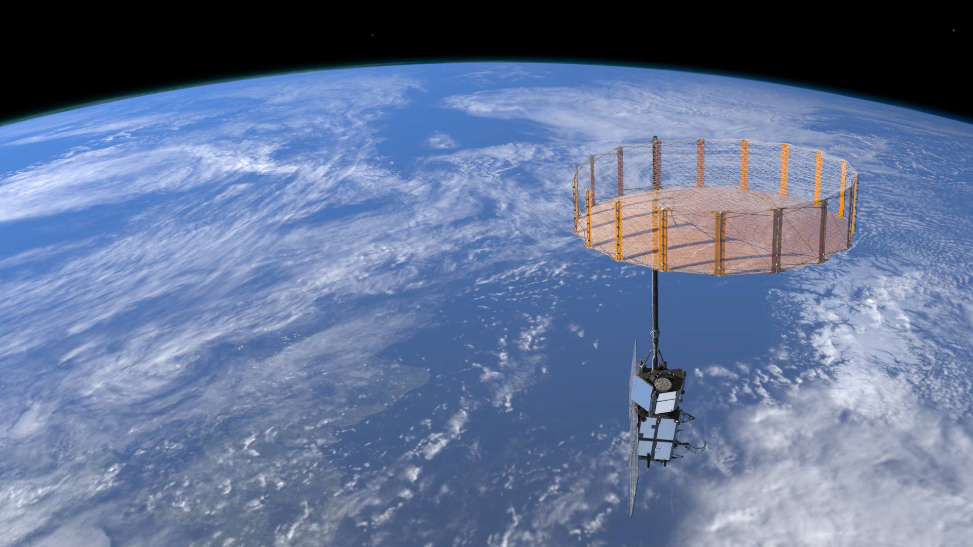


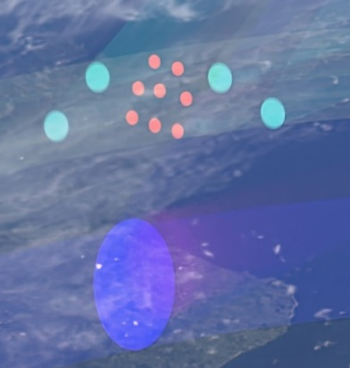
CIMR: The Copernicus Imaging Microwave Radiometer
8.6 m antenna!
Objective: High spatial resolution PMW observations with global coverage and sub-daily revisits at poles to address EU polar Arctic policy
Orbit: Sun-synchronous polar at ~830 km
Coverage: 95% globally
Freq. band | L | C | C | X | K | Ka
Variables | Salinity | Sea surface winds & temp. | Sea surface winds & temp. |  | Water vapour, cloud & rain
Frequency [GHz] | 1.4135 | 6.925 | 6.925 | 10.65 | 18.7 | 36.5
Footprint [km] | <60 | ≤15 | ≤15 | ≤15 | ≤5.5 | <5
Polarisation | Full Stokes
Swath | >1900 km
Observation Zenith Angle [deg] | 52.0 ±1.0 | 55.0 ±2.0
EUMETSAT L2 Ocean and Atmosphere products
L2 Variable ID | Description | Spatial resolution
SST-O | Sea Surface Temperature | ≤15 km
SSS-O | Sea Surface Salinity | < 60 km
OWS-O | Ocean Surface Wind Vector | ≤ 40 km (g=15km)
PR-A | Precipitation rate | ≤10 km (g=5 km)
LWP-A | Liquid Water Path | ≤15 km (g=5 km)
TCWV-A | Total Column Water Vapour | ≤15 km (g=5 km)

Slide 9
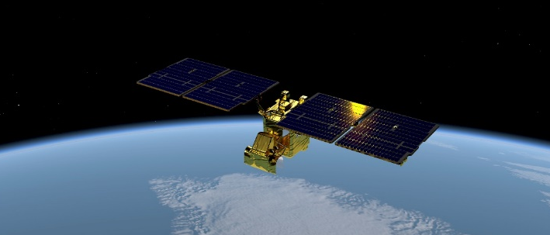
EPS-Sterna constellation
The Artic Weather Satellite (AWS) is a mission launched by the European Space Agency (ESA) on August 2025 as a demonstrator for the future EPS-Sterna constellation
EUMETSAT will support the extension of AWS operations from August 2026
Constellation Architecture
3 Sun-synchronous orbital planes at 595 km altitude.
Nominal constellation: 6 satellites, 2 per orbital plane
Repeat cycle per individual satellite: 9 days.
SmallSat: ~ 135 kg, 11 x 0.7 x 0.8 m
Microwave Radiometer (MWR) Sterna
Across track, with 19 channels (50.3 – 325 GHz)
Swath ~ 2000 km
Channel name | Centre Frequency [GHz] | footprint size [km] | Objective
STERNA-11 | 50.3 | ≤ 40 km (±25%) | Temperature Sounding
STERNA-12 | 52.8
STERNA-13 | 53.246
STERNA-14 | 53.596
STERNA-15 | 54.4
STERNA-16 | 54.94
STERNA-17 | 55.5
STERNA-18 | 57.290344
STERNA-21 | 89 | ≤ 20 km (±25%) | Window and Cloud detection
STERNA-31 | 165.5 | ≤ 10 km (±25%) | Window/humidity sounding
STERNA-32 | 176.311
 |  |  | Humidity sounding
STERNA-33 | 178.811
STERNA-34 | 180.311
STERNA-35 | 181.511
STERNA-36 | 182.311
STERNA-41 | 325.15±1.2 | ≤ 10 km (±25%) | Humidity sounding/cloud detection
STERNA-42 | 325.15±2.4
STERNA-43 | 325.15±4.1
STERNA-44 | 325.15±6.6
Provides also information on:
Precipitation (liquid/solid)
Weak precipitation
Cloud ice, IWP
Courtesy of ESA
Notes:
The four Sterna bands have different geolocations

Slide 10
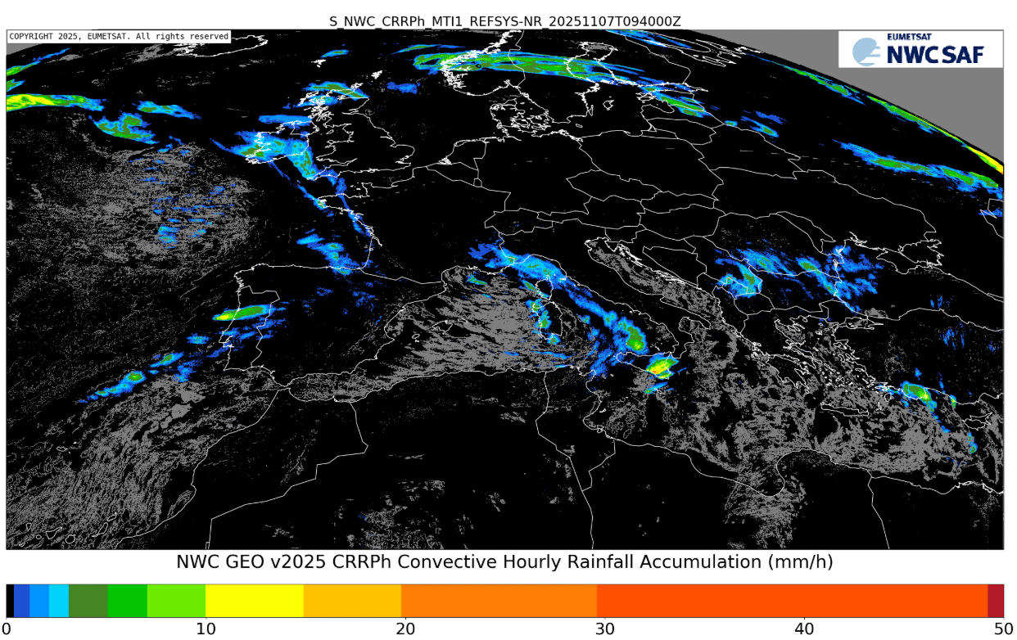



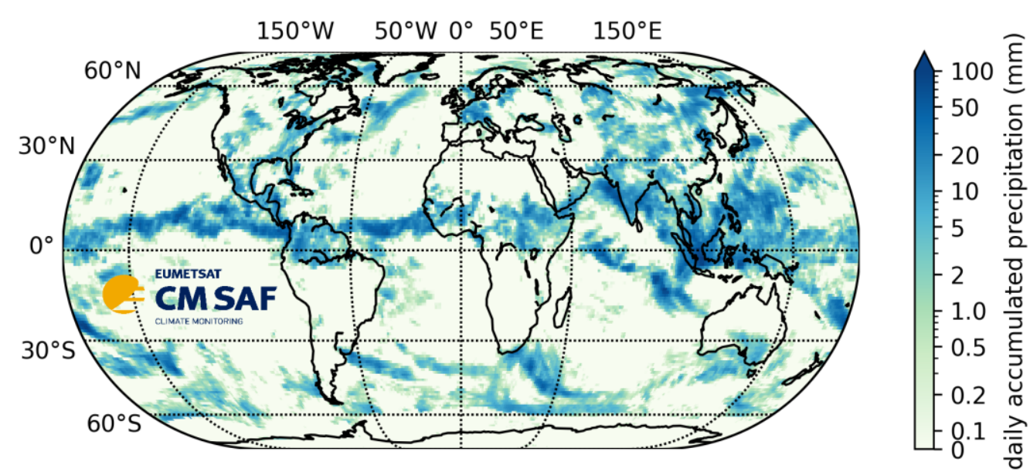
Precipitation products at a glance
NWC SAF, HSAF, and CM SAF provide complementary products
… for low-latency nowcasting applications
https://www.nwcsaf.org/
… for near-real-time hydrological applications
https://hsaf.meteoam.it/
… for long-term Climate Data Records supporting climate monitoring
https://www.cmsaf.eu/

Slide 11
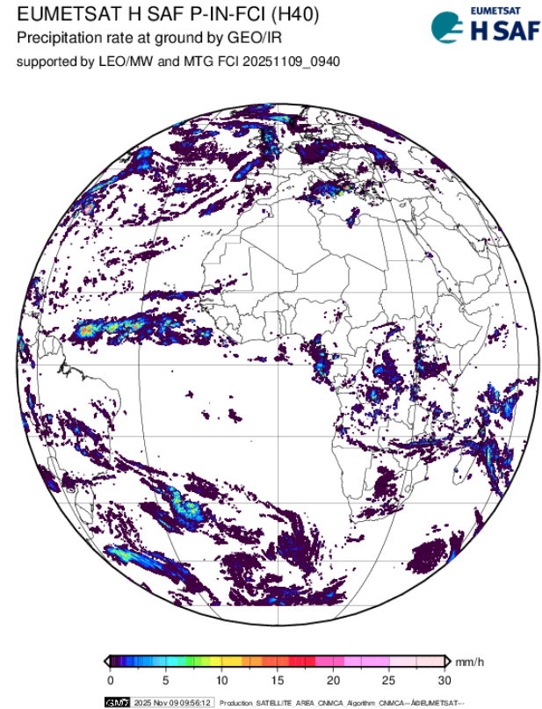
Precipitation products at a glance
Hydrology & Water Management SAF precipitation products
LEO PMW:
Surface precipitation from conical scanner (SSMIS)
Surface precipitation from cross-track scanners (MHS, ATMS)
Gridded precipitation from PMW sensors (SSMIS, AMSR-2, GMI, ATMS, AMSU/MHS)
Blended GEO IR-LEO PMW:
Surface precipitation based on SEVIRI and PMW estimates (+ convective precipitation)
Surface precipitation based on FCI and PMW estimates
Other blended:
Gridded daily precipitation by merging soil moisture rainfall with PMW estimates
Future precipitation products | EUMETSAT & SAFs
PMW: Liquid & frozen precipitation from MWI, MWS, Sterna, CIMR (+ high-latitude products)
  Utilization of active sensors (cloud + precipitation radars) & machine learning
  Snowfall retrieval based on AWS/Sterna
Blended GEO IR – LEO PMW:
  FCI & EPS-SG
  Development of global products & SM2RAIN for accumulated precipitation

Slide 12
Key takeaways
EPS-SG offers new capabilities (channels sensitive to weak liquid/solid precipitation, sub-mm channels)
EPS-Sterna unlocks extended coverage & revisit (channels sensitive to weak liquid/solid precipitation, sub-mm channels)
CIMR unlocks potential synergies at high latitudes (high spatial resolution & crucial information on ice-covered surfaces)
Enhanced precipitation products (new sensors, active observations, ML)
Thank you!
Questions are welcome.

