Slide 1

The Observing System Capability Analysis and Review Tool (OSCAR) and the WMO Gap Analysis of the Space-Based Observations
IPWG-12
Heikki Pohjola and Roger Saunders
7 Jul 2026

Slide 2

Contents
Introduction to WMO OSCAR database
OSCAR/Space user applications
How to keep OSCAR/Space data up to date
WMO Gap Analysis on space-based observations
CGMS Baseline and MW imagers

Slide 3
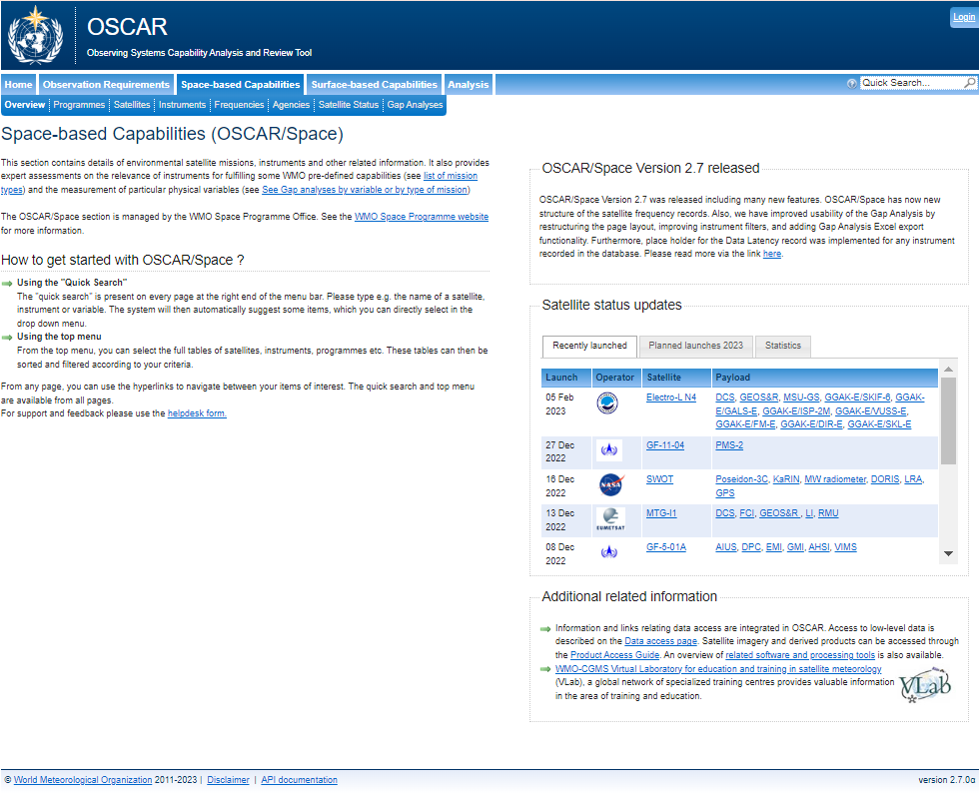

OSCAR database
Variables
Variables
OSCAR is WMO-maintained online resource since 2012, which combines three components
OSCAR/Space:
  Current and planned satellite programmes, satellites and their instruments since TIROS-I (1st April 1960) beyond 2040
  Over 1000 satellites and around 1200 instruments
    800 for Earth Observation and 400 for Space Weather
OSCAR/Surface:
  Surface-based stations/platforms under WIGOS
OSCAR/Requirements:
  Observation requirements for WMO application areas and for all relevant variables
WIGOS = WMO Integrate Global Observing System
OSCAR/
Space
OSCAR/
Requirements
OSCAR/
Surface
http://space.oscar.wmo.int

Slide 4
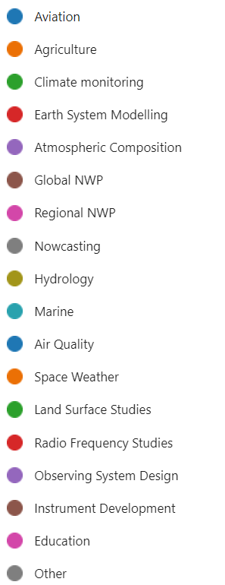
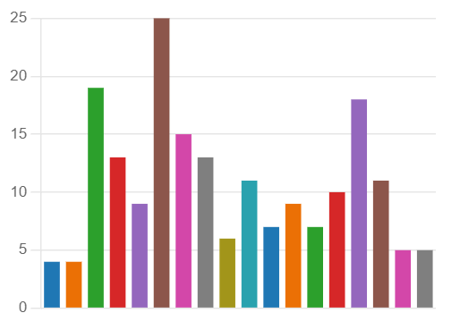
What are the user applications related to OSCAR/Space?
WMO Space Programme uses OSCAR/Space to provide Gap Analysis of WIGOS Space-Based observation system
  WIGOS Vision document
  Observing system design
Publicly open database is used for several applications as an information source for Earth observation satellites
  NWP centers, satellite operators and space agencies
  Most users for NWP, climate monitoring and observing system design
Around 2000 users per week
User applications:

Slide 5
Information sources used to update OSCAR/Space
Updates from space agencies via OSCAR/Space Support Team (O/SST) Members
Presentations in the CGMS meetings
Any public content
Agency | Last name | First name
CMA | Min | Guan
CNES | Lafaye | Murielle
CNSA | Yong | Gan
CSA | Girard | Ralph
ECCC | Kaya Linklater | Shannon Christopher
ESA | Greening | Marie-Claire
EUMETSAT | Bojinski | Stephan
IMD | Mitra | A.K.
ISRO | Thomas | JV
JAXA | Kurino | Toshiyuki
JMA | Yasui | Kazuki
KMA | Kim | Dohyeong
KARI | Lim | Hyo-Suk
NASA | Wicks McCarthy | Jamie Lacey
NOAA | Kutny | Mary Ann
ROSCOSMOS | Karelin | Alexander
ROSHYDROMET | Litovchenko | Konstantin
WMO | Pohjola | Heikki
Gunter’s space page (monitored daily)
CEOS quarterly reports
Spaceflight Now/ Space News & other news sites
Live real time tracking of satellites for orbit information
Jonathan’s space report
NWP SAF monitoring
Bluesky and Twitter/X messages
To update O/SST focal point please contact hpohjola@wmo.int

Slide 6
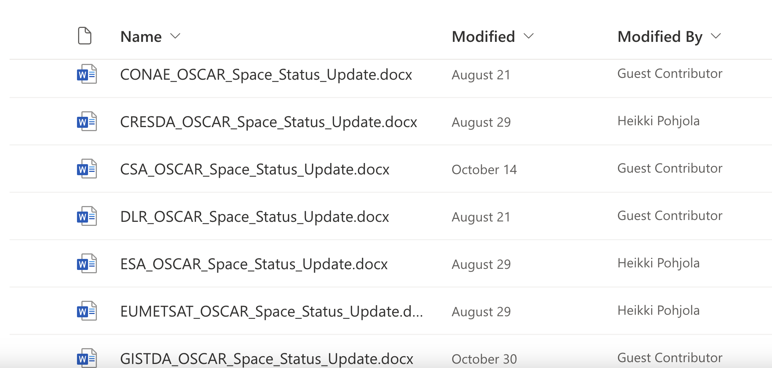
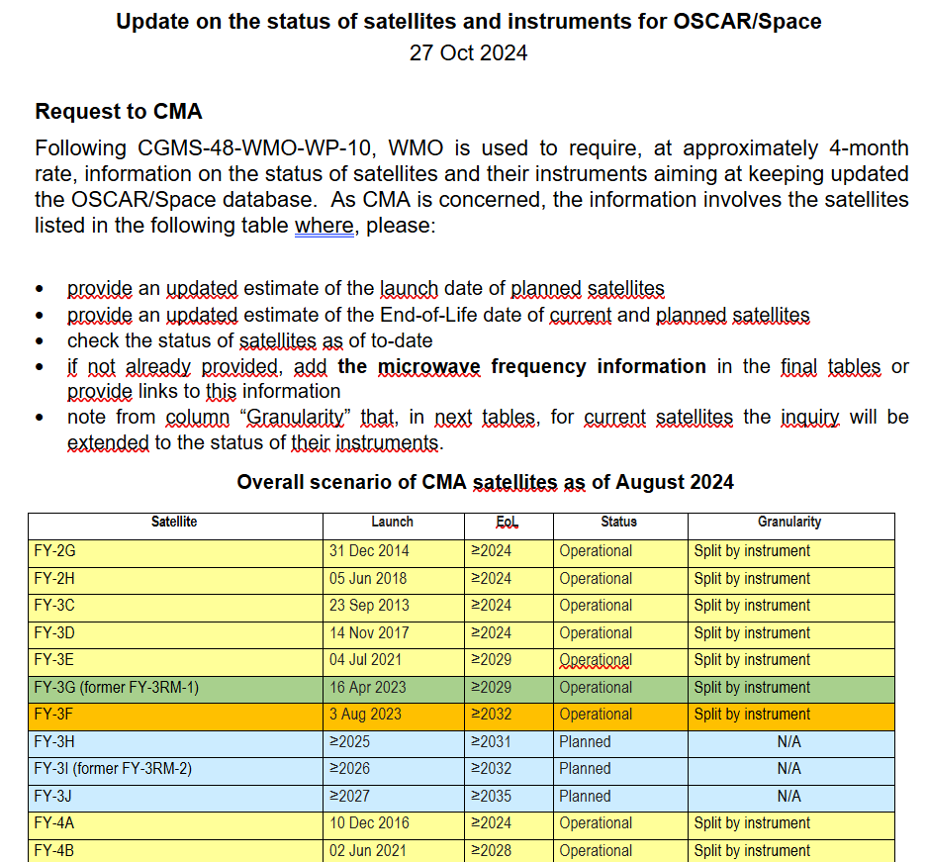
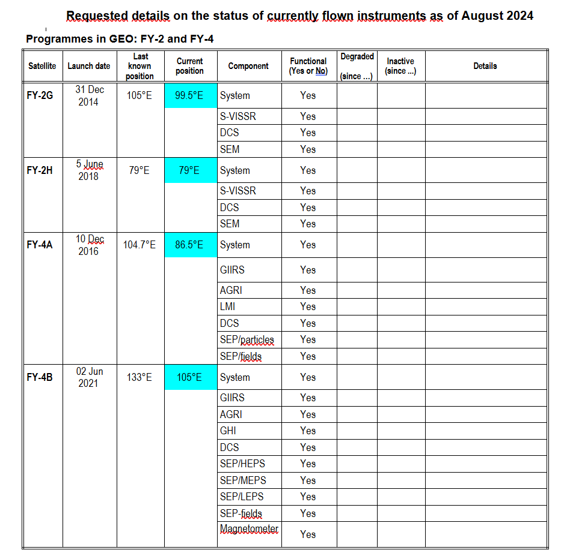
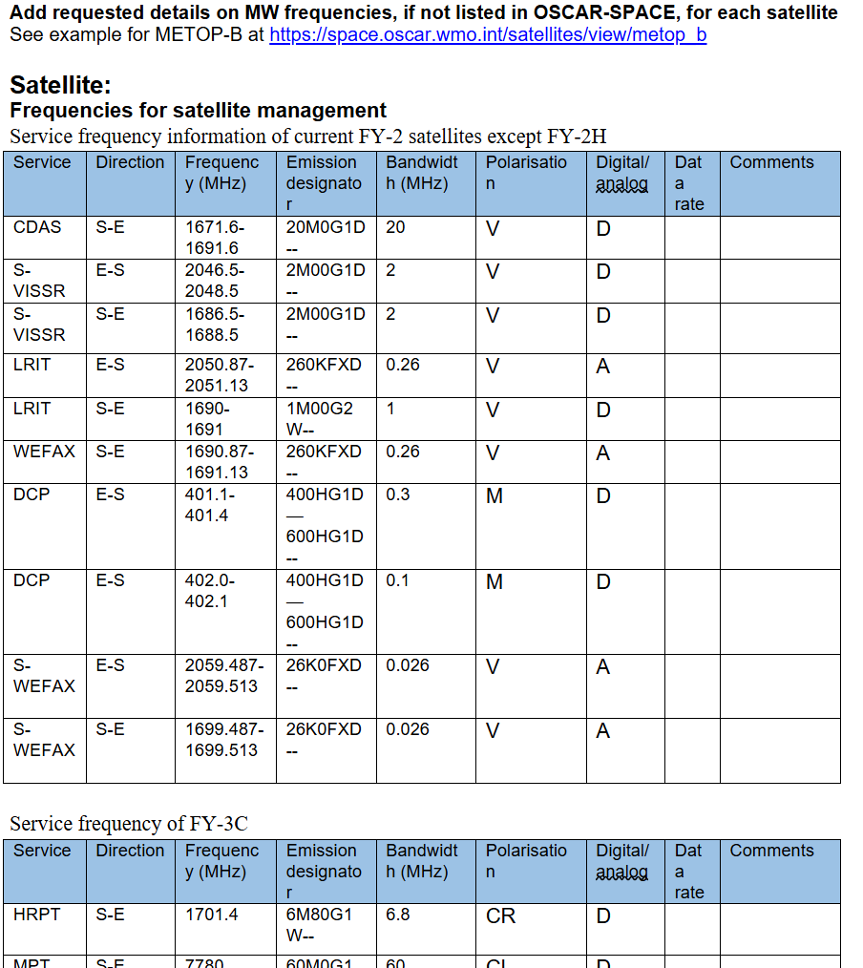
Updating OSCAR/Space database content
  Requests for updates from Space Agencies sent out now on average every 6 months
Example data sheet for CMA

Slide 7
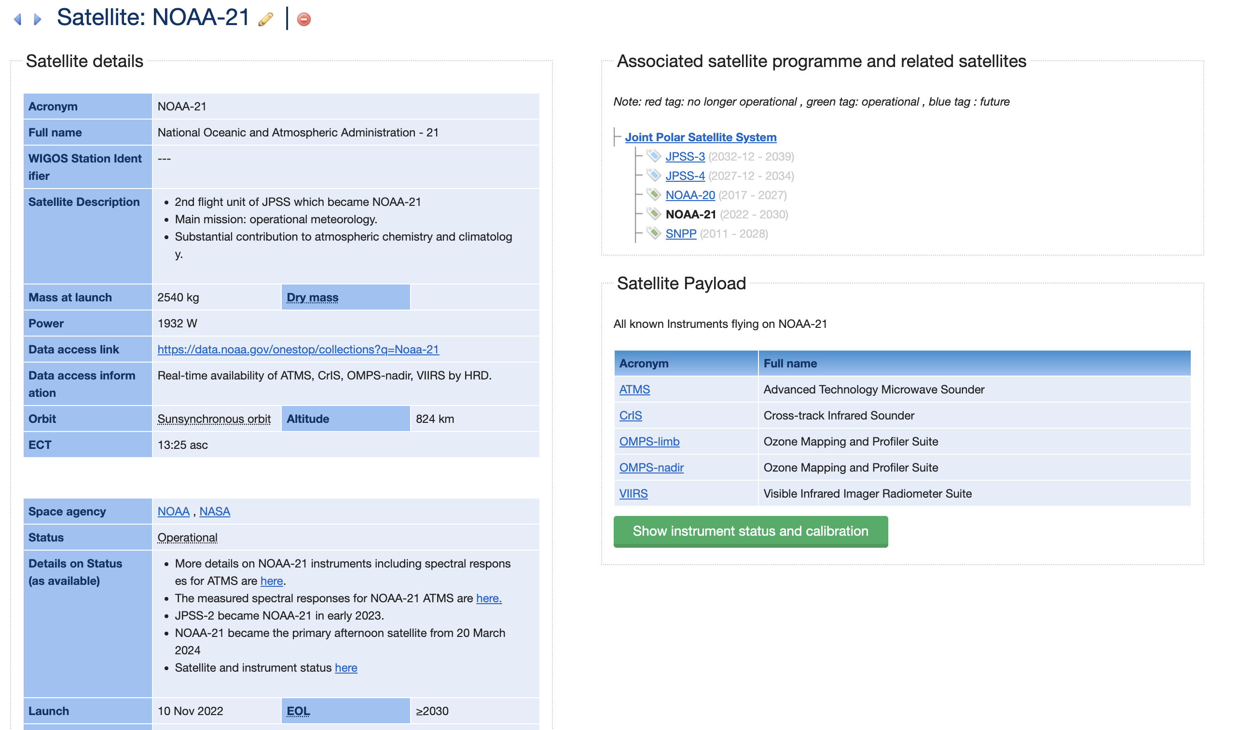
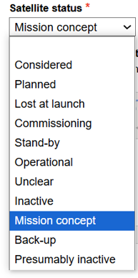
The most critical Satellite and Instrument details concerning Gap Analysis

Slide 8
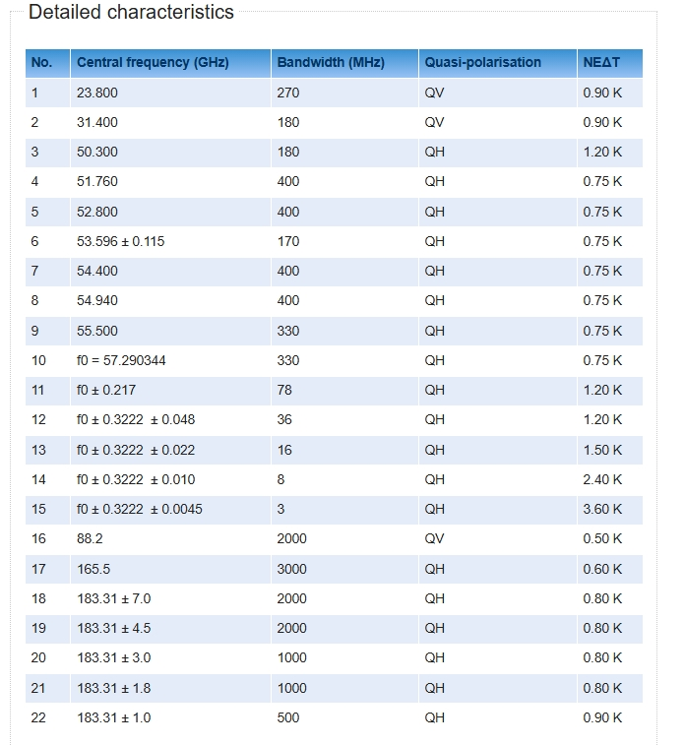
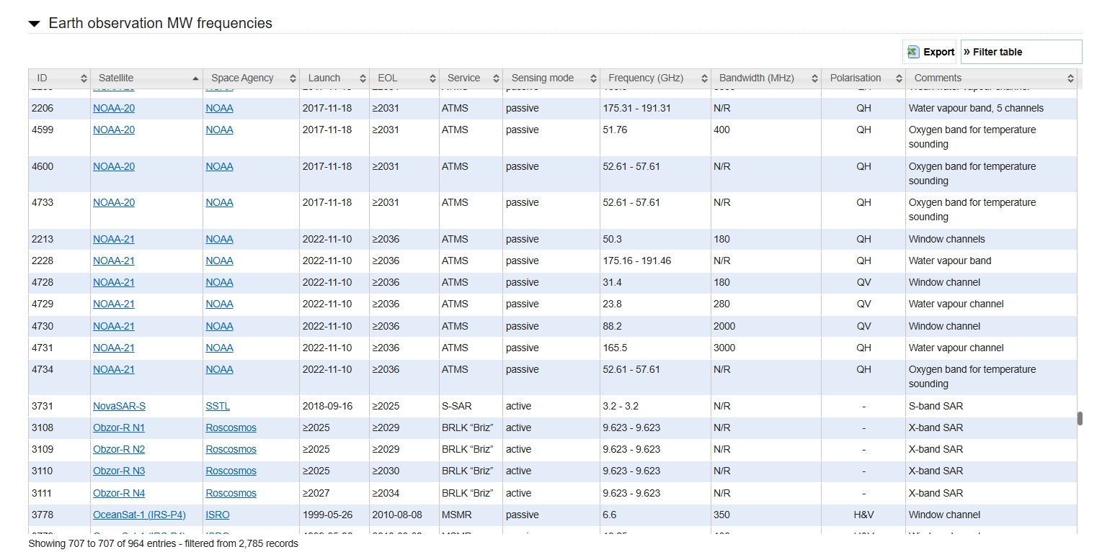
Frequency data in OSCAR/Space
The frequency information on the MW Frequency Page is less detailed than the corresponding channel-specific information available on the individual instrument pages in OSCAR/Space.
ATMS channel specific information Instrument Page
MW Frequency Page
OSCAR/Space – Satellite Frequencies
WMO OSCAR | Details for Instrument ATMS

Slide 9
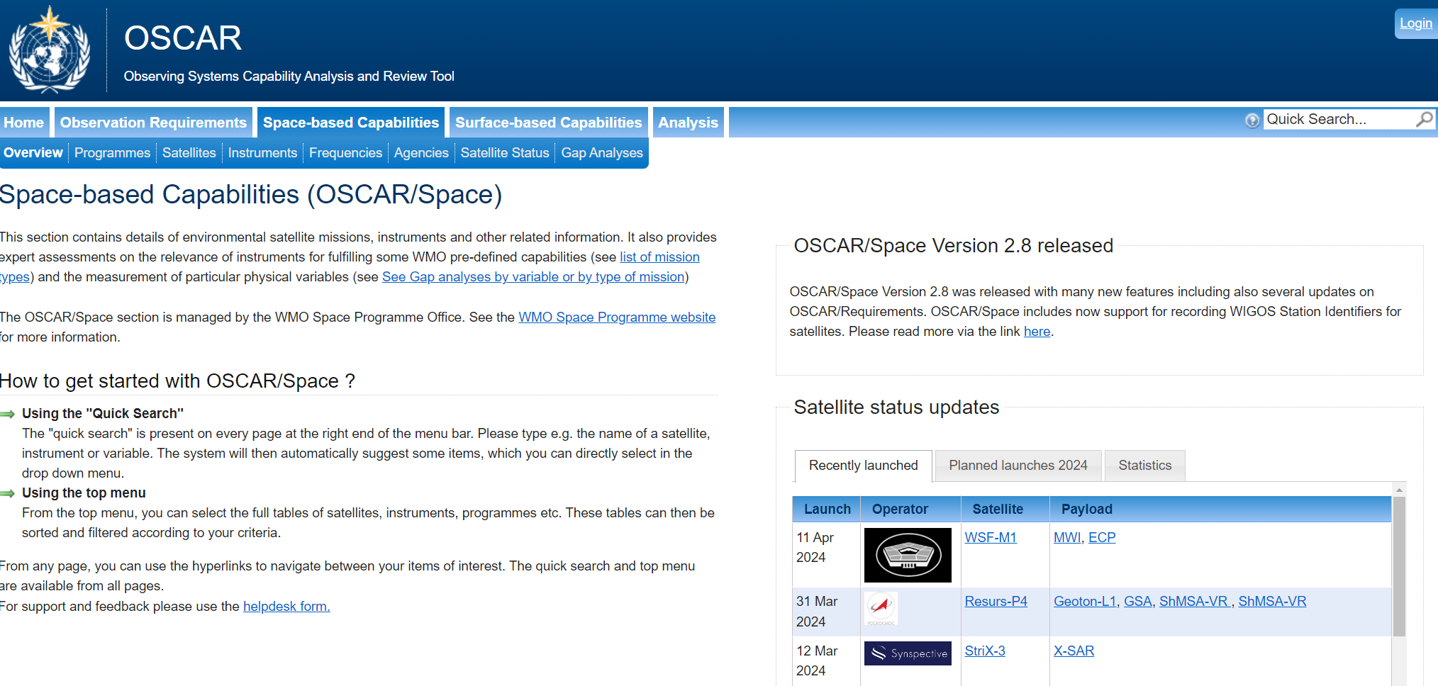
OSCAR/Space gap analysis 2026
Compares the satellite information recorded in OSCAR/Space to the instrument capabilities in the WIGOS Vision 2040
The considered period is the 2026-2036 to support the CGMS WG III Risk Assessment based on space agency plans as in Dec 2025
The WMO Gap Analysis includes a wider range of satellites than the risk assessment e.g. those that are close to approval but not confirmed and some research missions. It does not include commercial missions.
The WMO Gap Analysis categorizes instruments according to the WIGOS satellite instruments.
Both Earth Observation and Space Weather gap analyses have been done
The complete gap analysis extends to 2050 to assist in new vision for 2050 (not presented here)

Slide 10
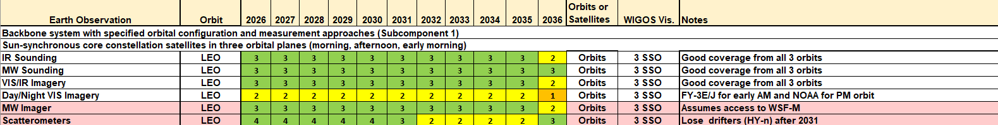
Sun-synchronous core constellation satellites in three orbital planes (morning, afternoon, early morning) and additional scatterometers on drifting orbit (Subcomponent 1)
Gap =
Rows in pink = CGMS baseline instrument

Slide 11
Microwave Imagers on LEO
Within the next few years the number of MW imagers are at risk to reduce with the retirement of the SSMIS instruments on the DMSP satellites
WSF-M1 is now in the early morning orbit (~05:00 LT) and could potentially replace SSMIS avoiding a gap followed by WSF-M2
CIMR will fill the 06:00 LT orbit in 2029
CGMS Baseline
LEO – 2 sun-synchronous orbits, nominally early morning, mid-morning, and afternoon
Slide: 11

Slide 12
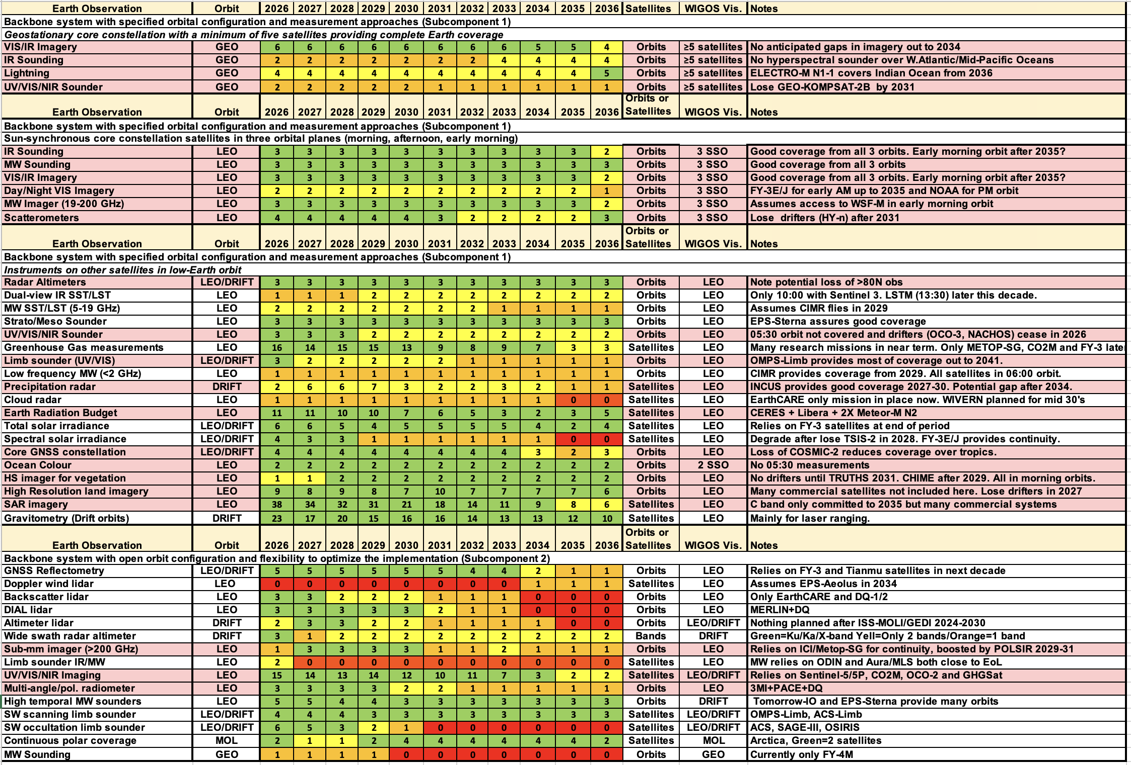
Gap =
Rows in pink = CGMS baseline instrument
Beyond CGMS Baseline WIGOS space-based component has 18 critical gaps.

Slide 13
The most critical Earth observation gaps for the next decade
Gap Application area
UV/VIS/NIR Sounders on GEO
Atmospheric chemistry
Doppler Wind Lidar on LEO/Drift
Weather forecasting, NWP
Only 2 orbits with scatterometers 2032-2035
Sea surface winds (Weather forecasting, NWP, Tropical cyclones)
Backscatter and DIAL lidars
Aereosols, GHG, atmospheric chemistry
Atmospheric chemistry, ozone
Precipitation radar and cloud radar
Weather forecasting, hydrology
No SW occultation limb sounder in next decade
Stratospheric chemistry measurements
Radio occultation sounding in tropics
NWP, Climate
Low frequency MW imagers after SMOS/SMAP
Altimeters and wide swath radars
Limb sounders in IR and MW on LEO/Drift
Soil moisture, salinity
Sea-ice thickness

Slide 14
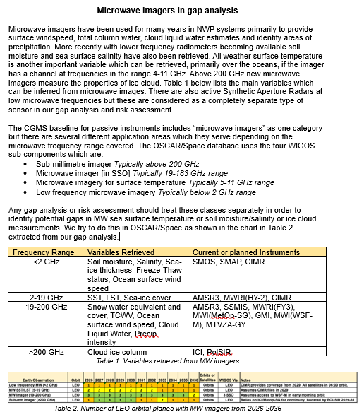
MW frequencies and related application in CGMS Baseline
WMO studied MW frequencies and their applications
  Provided a document covering the applications of MW frequencies, and current (planned) operational instruments
IPWG reviewed the document and confirmed the requirements

Slide 15
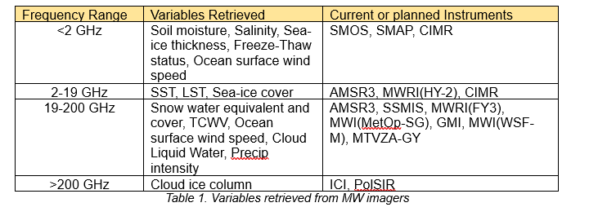
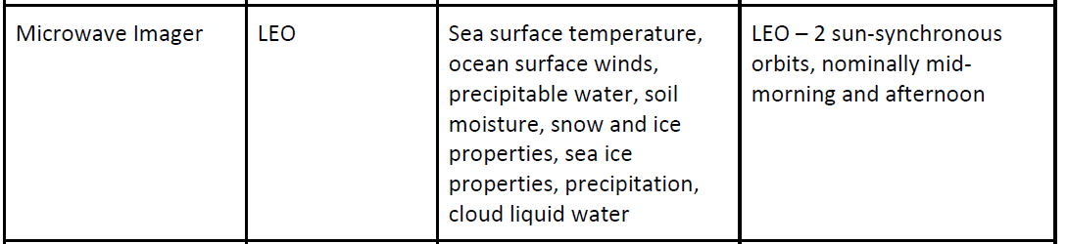
CGMS Baseline and MW imagers
Currently only one instrument category in CGMS Baseline
Proposal to split CGMS Baseline MW imagers following the frequency ranges and their applications
Update CGMS agency commitments (Attributes column)

Slide 16
Updated CGMS Baseline on MW imagers
Sensor type | Orbit | Observations | Attributes
MW Imager, < 2 GHz | LEO | Soil moisture, salinity, sea-ice thickness, freeze-thaw status, ocean surface windspeed | LEO – 1 sun-sychronous early morning orbit
MW Imager, < 2-19 GHz | LEO | SST, LST, Sea-ice cover | LEO – 1 sun-sychronous early morning orbit
MW Imager, 19-200 GHz | LEO | Snow water equivalent and cover, TCWV, Ocean surface wind speed, Cloud Liquid Water, Precipitation intensity | LEO – 2 sun-synchronous orbits, nominally mid-morning and afternoon
MW Imager, > 200 GHz | LEO | Cloud ice column | LEO – 1 sun-synchronous mid-morning orbit

Slide 17
Summary
OSCAR is publicly available WMO-maintained online resource since 2012 including OSCAR/Space, OSCAR/Surface and OSCAR/Requirements
Main user application is WMO annual Gap Analysis for Earth Observation and Space Weather, in addition it is an important information source for several application areas like for NWP, climate monitoring and observing system design
According to WMO Gap Analysis WIGOS space-based component has 18 critical gaps beyond CGMS Baseline
WMO together with IPWG have studied how to present MW sensor types in CGMS Baseline more detailed related to their observing capabilities and applications
Proposal to split CGMS Baseline MW imagers following the frequency ranges < 2 GHz, 2-19 GHz, 19-200 GHz and >200 GHz and their applications

Slide 18
Thank you.
^{wmo.int}

