Slide 1
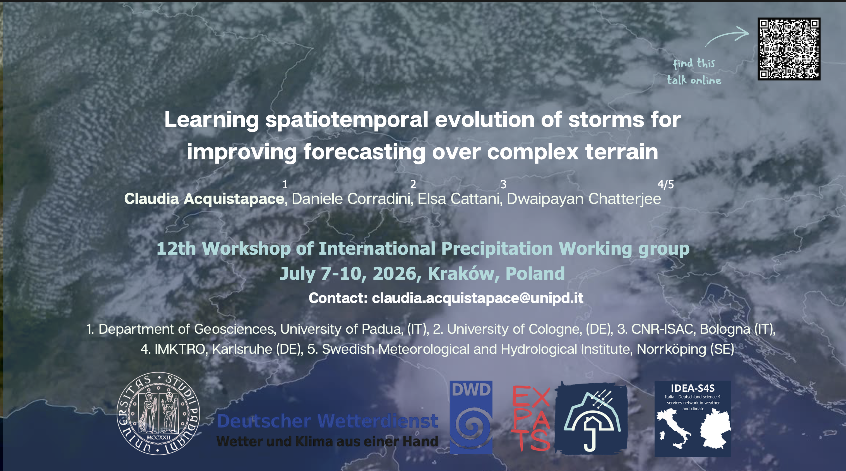

Slide 2
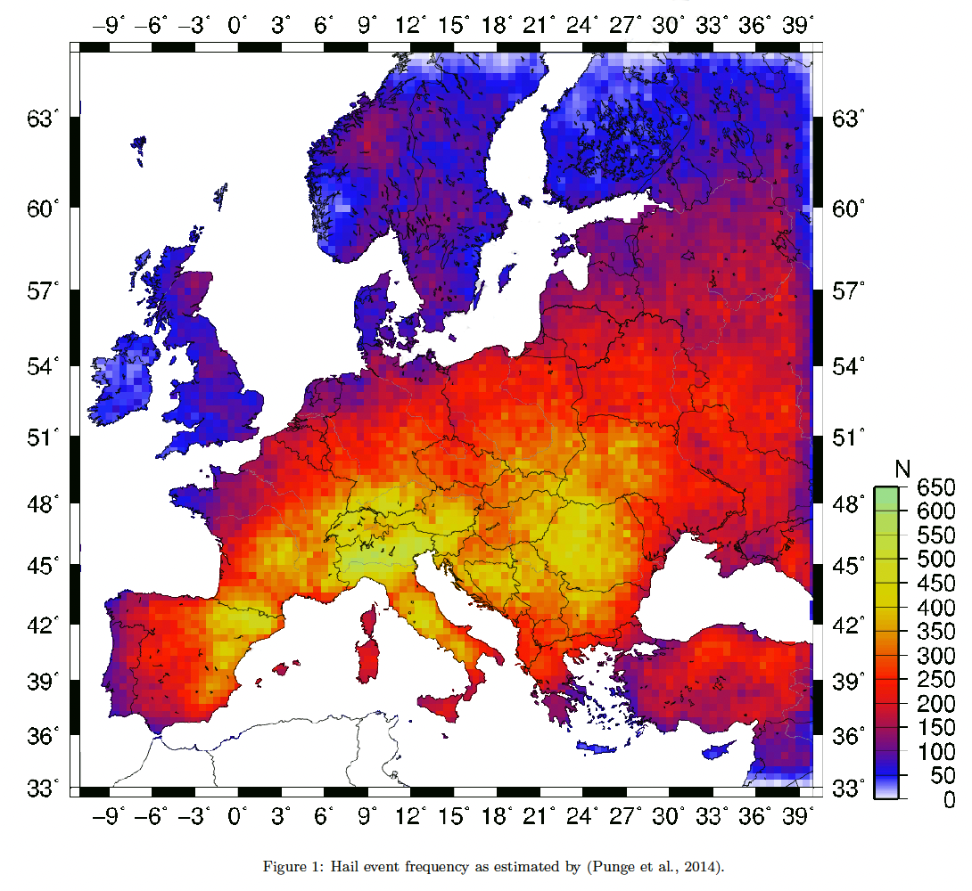
45 BILLIONS PER YEAR
is what EU will spend in 2050 annually for climate change and floods (Rojas et al., 2013)
Especially over the Alps
severe storms can cause landslides and flash floods (Punge and Kunz, 2016)
Orography triggers convection
2

Slide 3

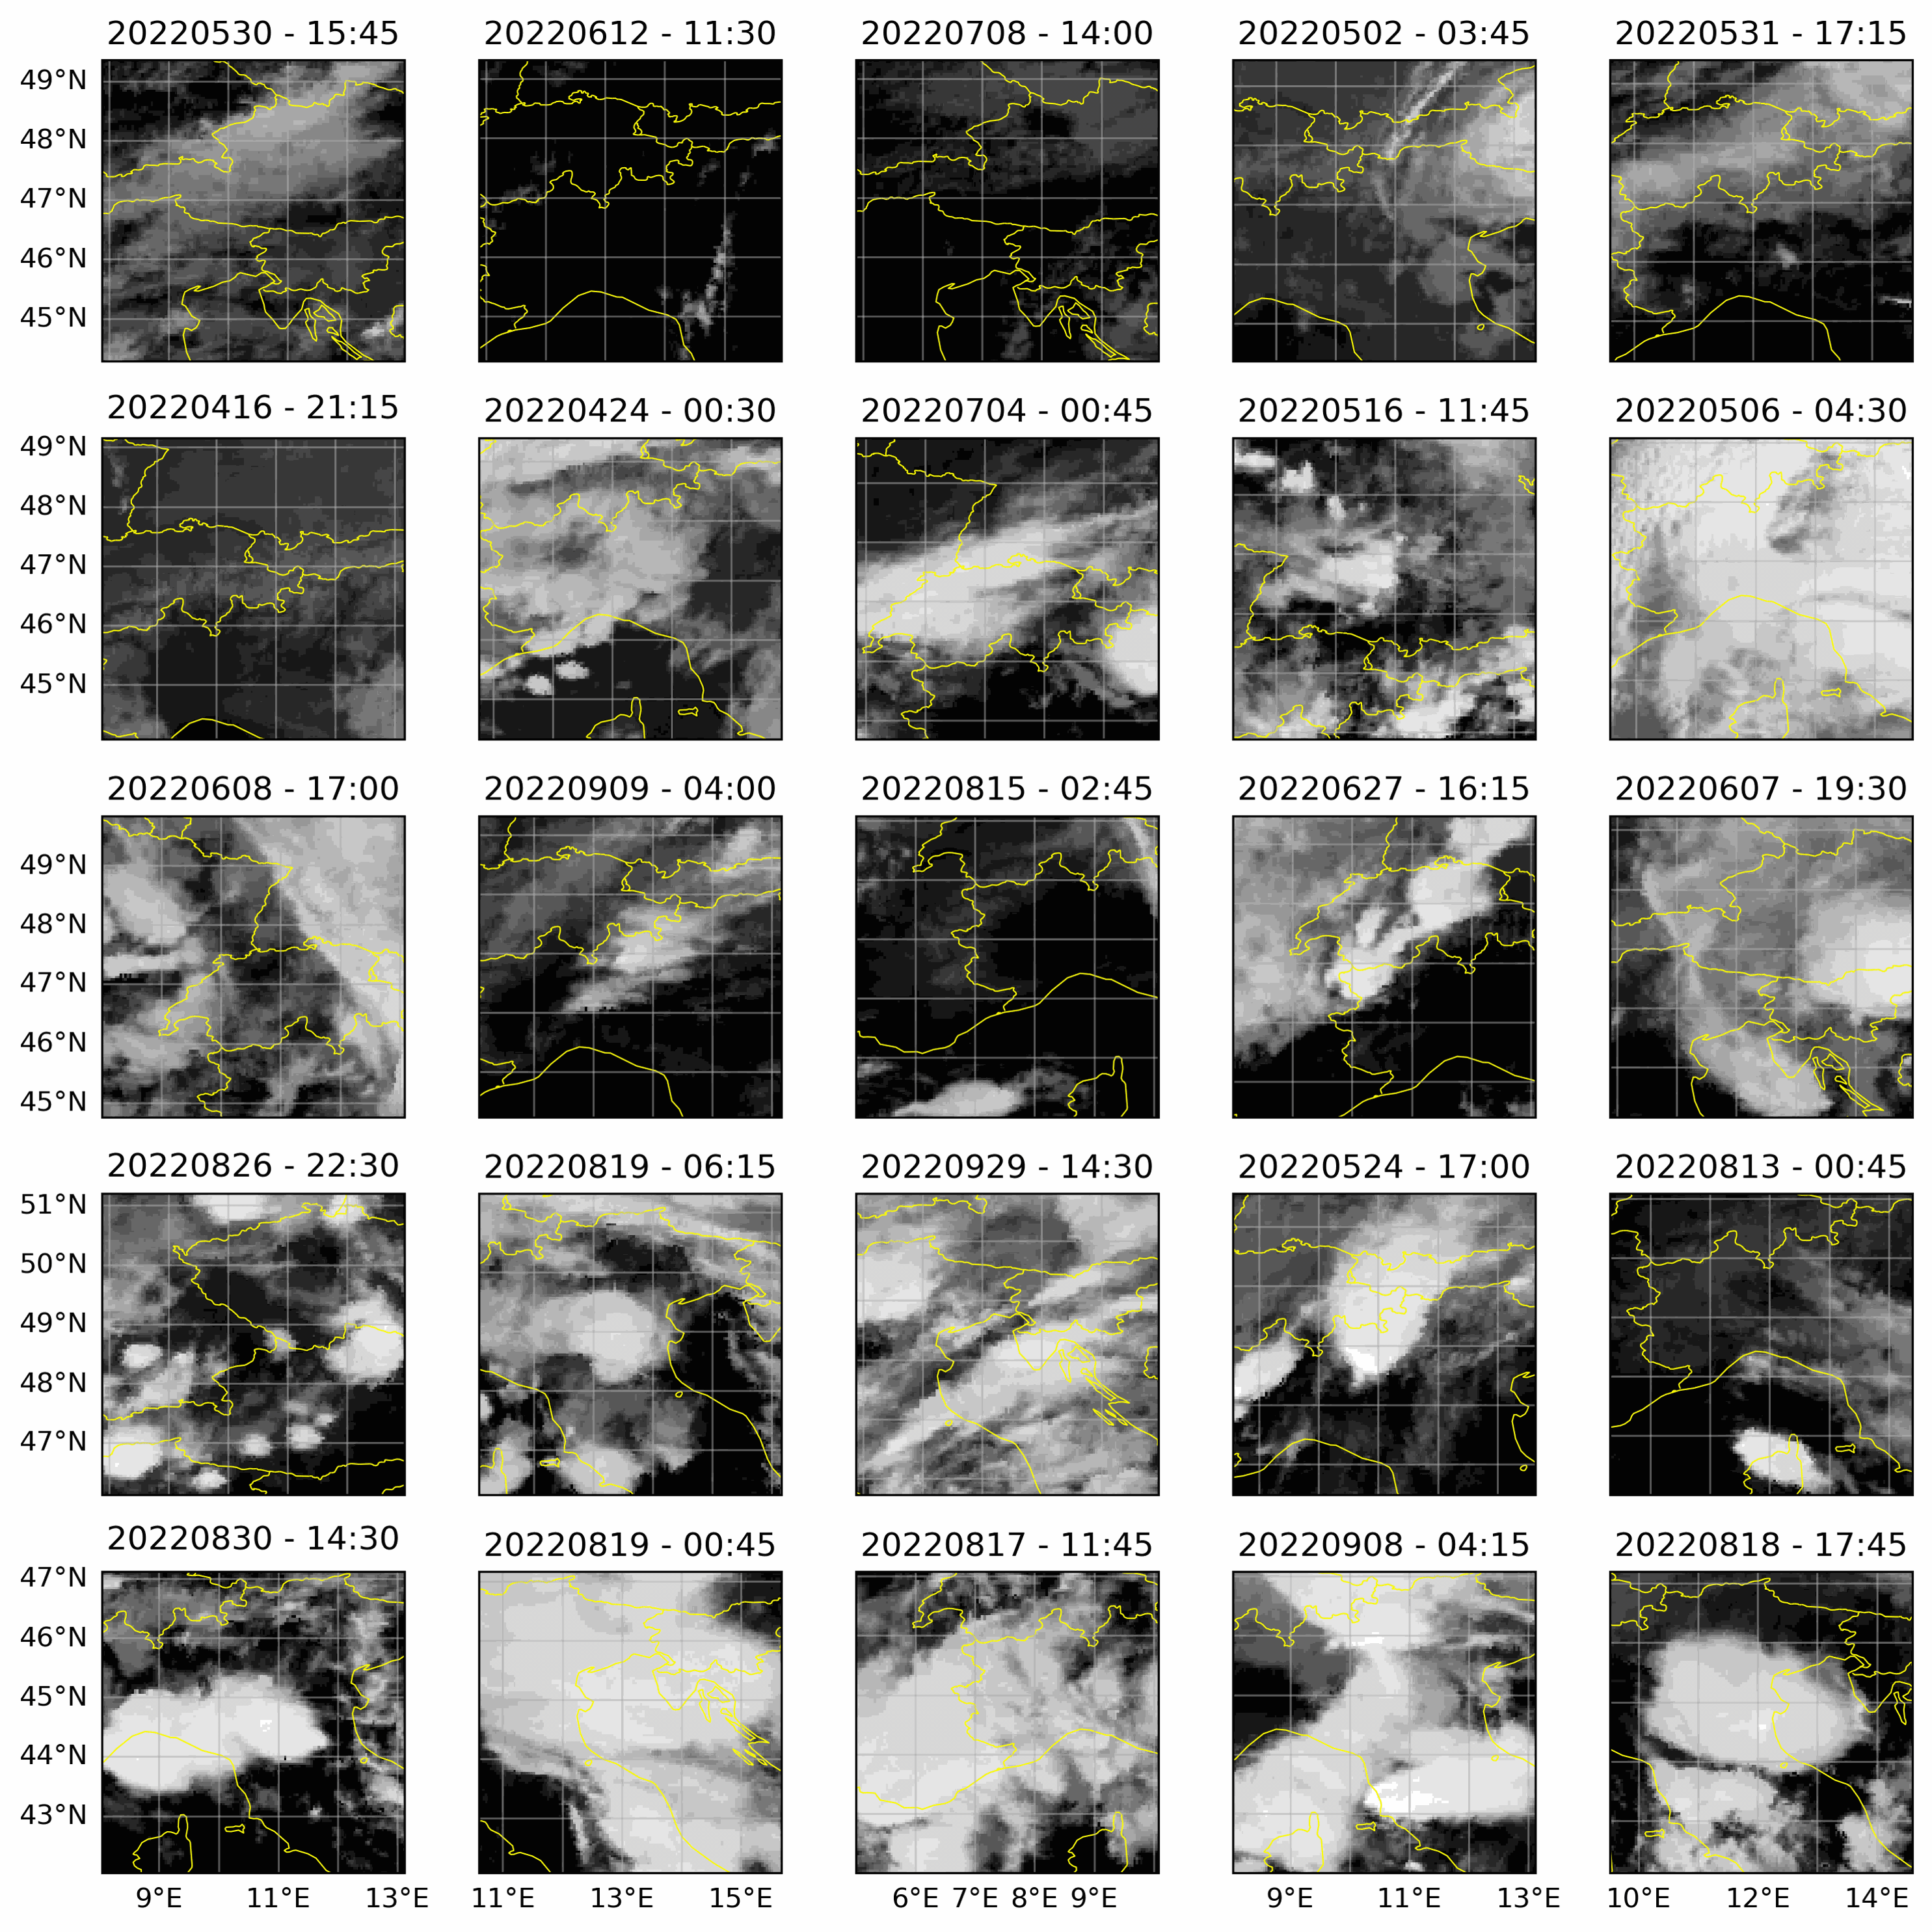
Mesoscale cloud organization matters?
Cloud patterns have scales ranging from 20 to 2,000 km.
---- > Mesoscale cloud organization not in GCM parametrizations,
---- > LES domains too small to represent it.
Cloud organization is key for convective aggregation
3
Notes:
Trade-cumuli warm the layer in which they form through condensation, but cool the subcloud layer and the trade inversion through the evaporation of falling raindrops and detrained droplets. In addition, the emission of infrared radiation to space produces an efficient cooling of the lower atmosphere in which clouds form. This radiative cooling contributes to generate shallow mesoscale circulations (Naumann et al. 2017) which, depending on local conditions and remote convective activity, can organize either randomly or into streets, arcs or circles of cloud clusters. In certain conditions, these mesoscale circulations can also triger remotely the aggregation of deep convection (Muller and Held 2012).
Do the cloud statistics depend on the form of spatiotemporal organization?
Do these patterns imprint differently on the radiation budget?

Slide 4
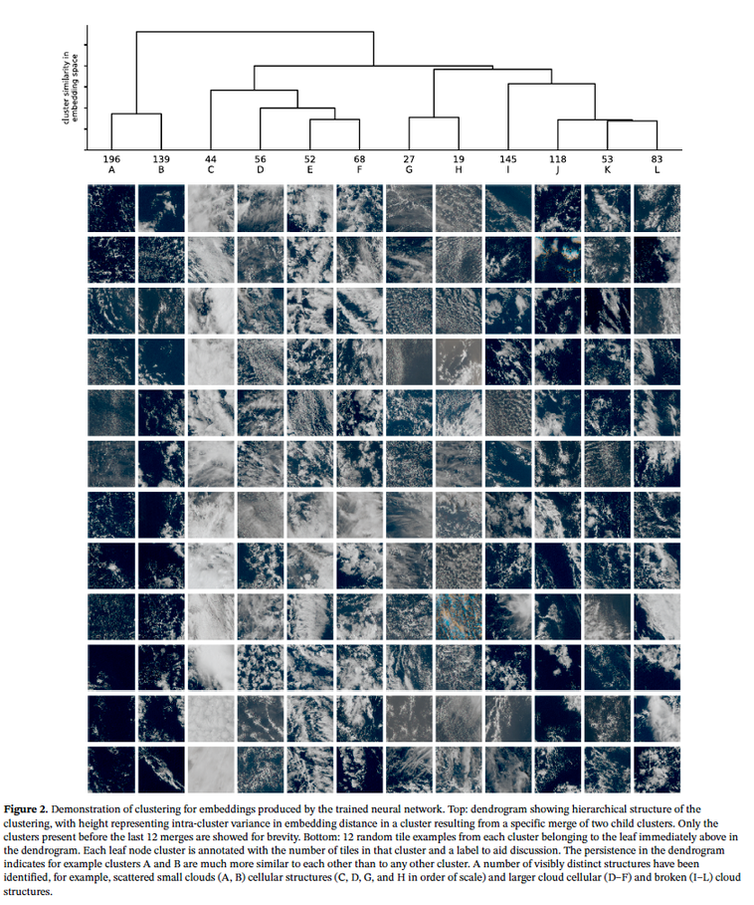
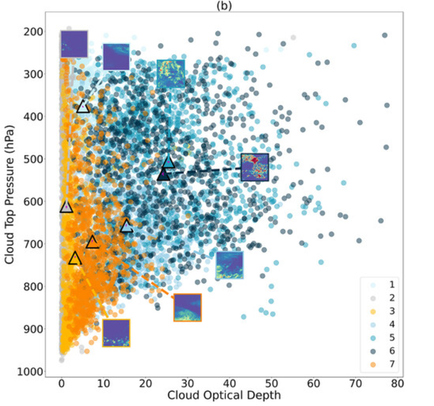
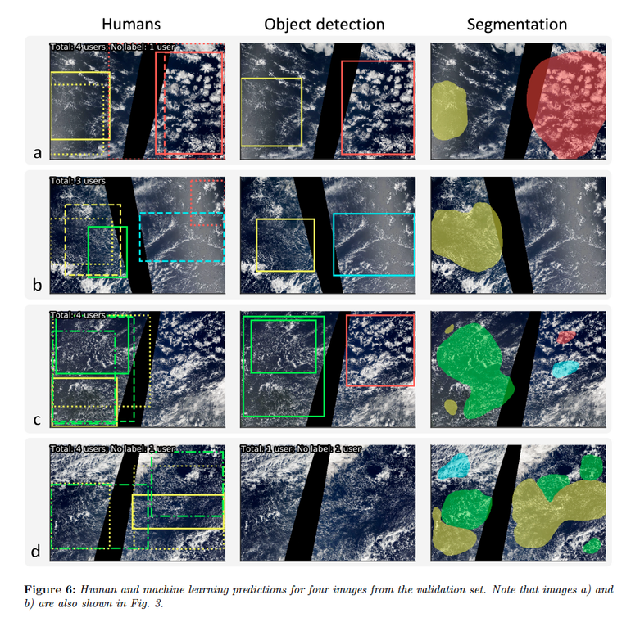
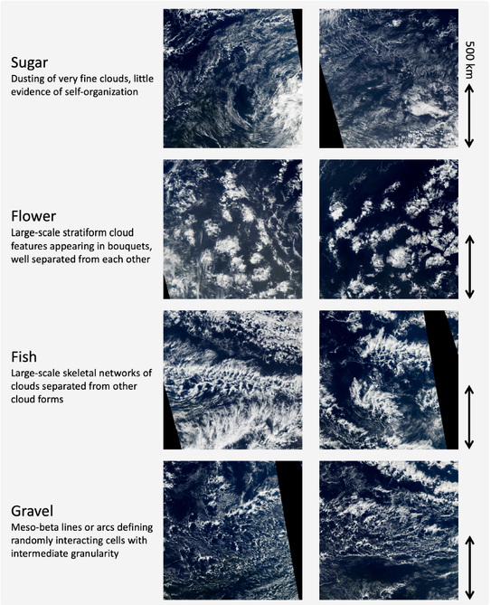
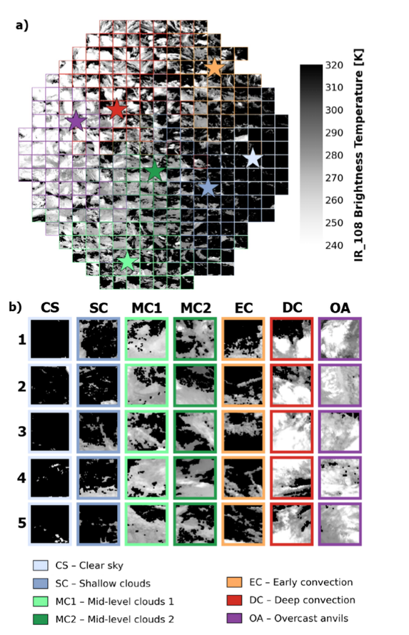
Unsupervised Deep learning methods learn spatial structures
Denby, 2019: Discovering the importance of mesoscale cloud organization through unsupervised classification
Rasp et al., 2019: crowdsourcing and deep learning to explore mesoscale organization of shallow convection
Chatterjee et al., 2022: Understanding Cloud Systems’ Structure and Organization Using a Machine’s Self-Learning Approach
Corradini et al., 2026, in prep: Self supervised deep learning over the Alps
Kurihana et al. 2022:
Cloud classification with unsupervised deep learning
Stevens et al., 2019: mesoscale patterns in trade winds
4

Slide 5
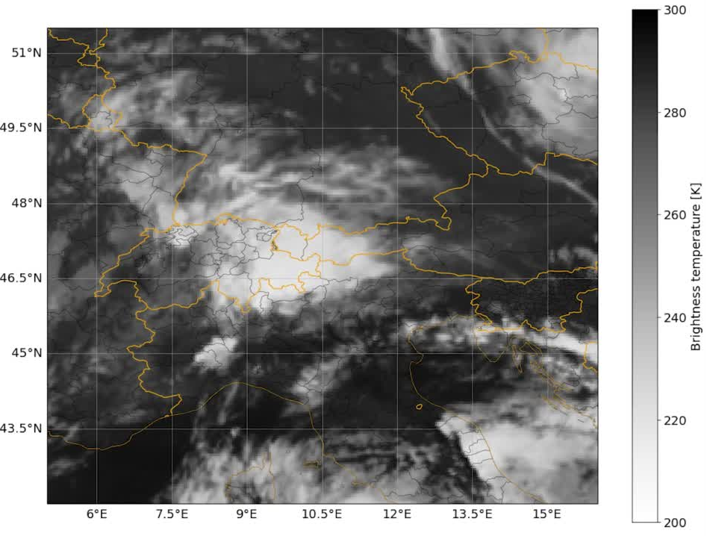
Research focus: time dimension!
RQ0: Can the time dimension add to our knowledge of convective storms?
RQ1: Can we identify convective storm development based on spatio-temporal evolution information?
RQ2: Can we identify some precursors able to detect
extreme events before they happen, compared to other convective storms?
5

Slide 6
Methods and data: dataset generation
CONSTRUCTION OF VIDEOS
  8 time stamps (2h)
  100x100 pixels cropped over the domain [42N, 5E, 52N, 16E]
  10.8 micron MSG METEOSAT with CMSAF cloud products and mask
  data coverage: 19 years from 2006 to 2025:
    test dataset: 6 years (2025, 2024, 2021, 2020, 2017, 2016)
    training dataset: 13 years remaining
6

Slide 7
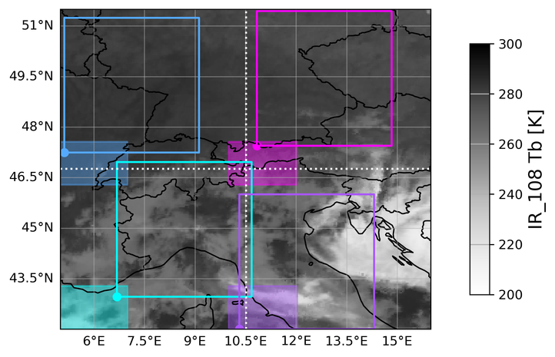
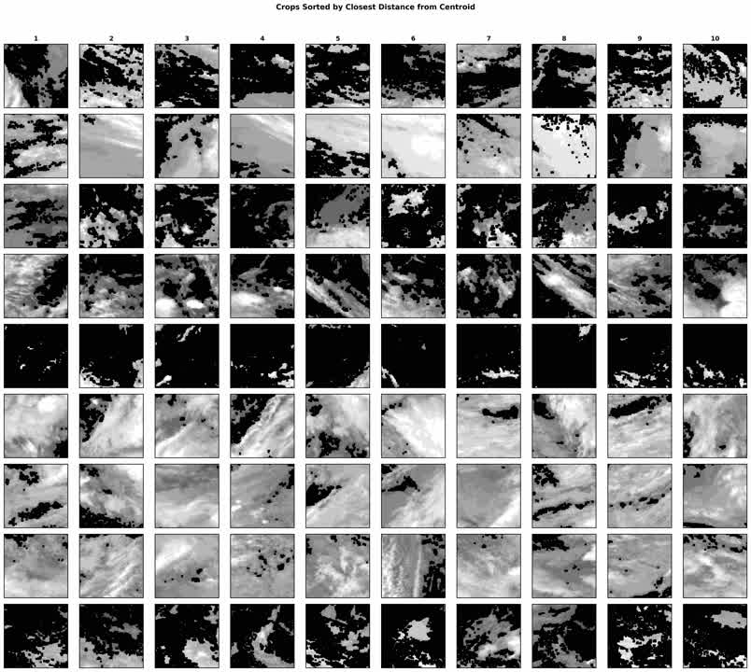
Methods and data: dataset generation
CONSTRUCTION OF VIDEOS
  8 time stamps (2h)
  100x100 pixels cropped over the domain [42N, 5E, 52N, 16E]
  10.8 micron MSG METEOSAT with CMSAF cloud products and mask
  data coverage: 19 years from 2006 to 2025:
    test dataset: 6 years (2025, 2024, 2021, 2020, 2017, 2016)
    training dataset: 13 years remaining
TRAINING DATASET
Space: videos sampled almost randomly across the entire domain;
Time: start times slightly jittered to increase temporal randomness
total training videos: 240216
t0
t0+2h
t0
45 min
t0+2h
7

Slide 8
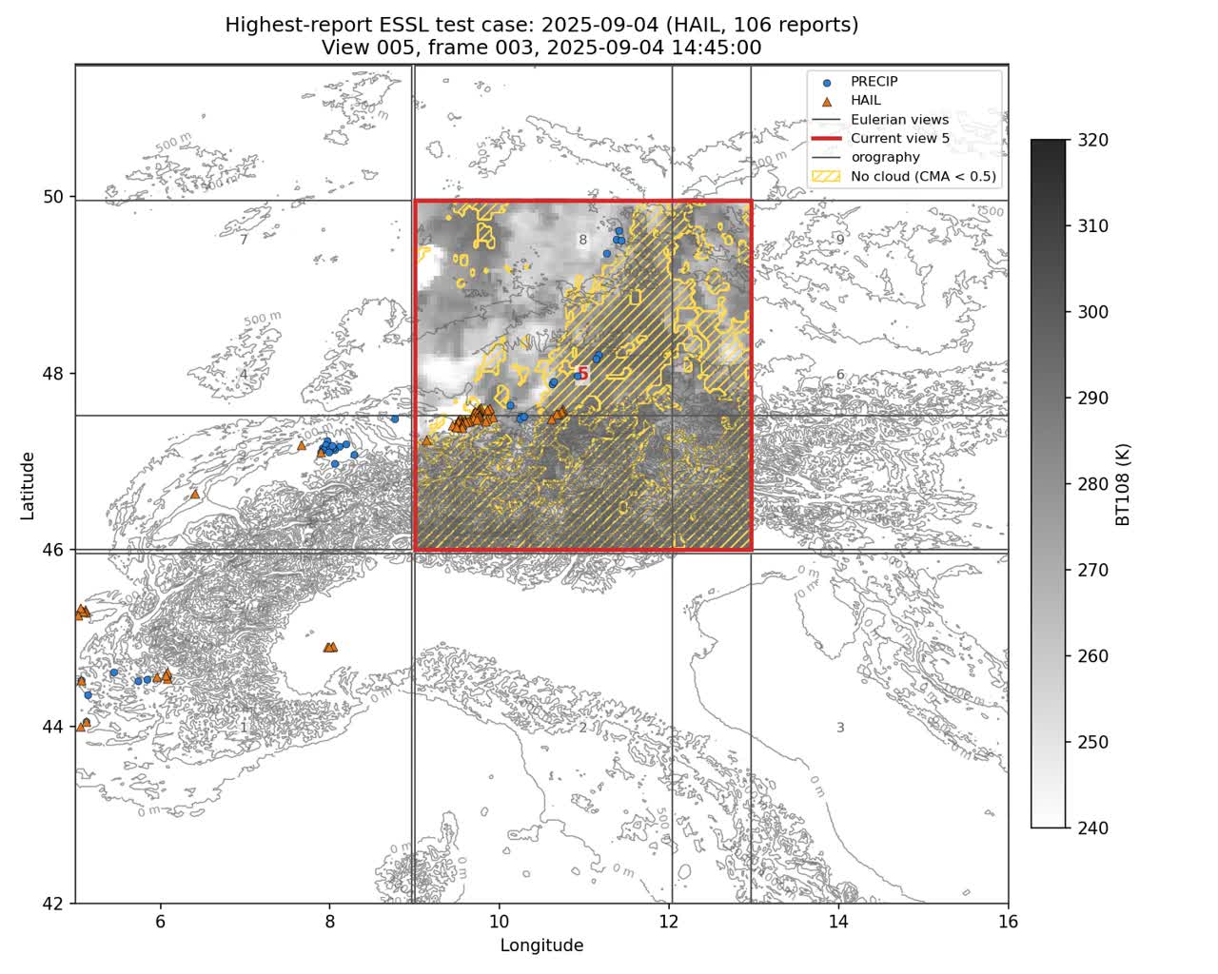
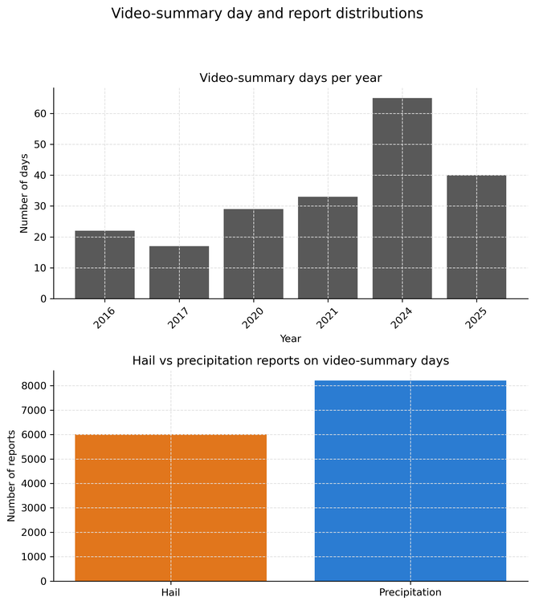
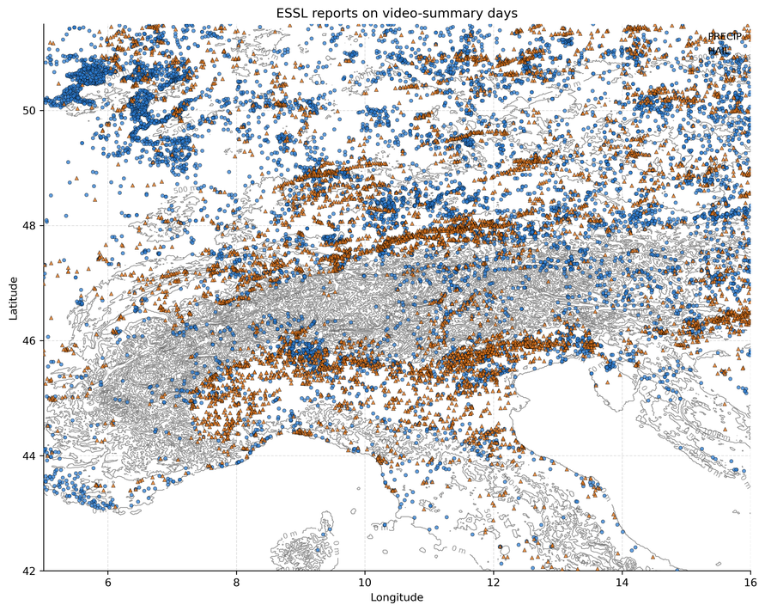
Methods and data: dataset generation
CONSTRUCTION OF VIDEOS
CONSTRUCTION OF THE TEST DATASET
  8 time stamps (2h)
  100x100 pixels cropped over the domain [42N, 5E, 52N, 16E]
  10.8 micron MSG METEOSAT with CMSAF cloud products and mask
  data coverage: 19 years from 2006 to 2025:
    test dataset: 6 years (2025, 2024, 2021, 2020, 2017, 2016)
    training dataset: 13 years remaining
Selecting ESWD reports on test years over the domain [42N, 5E, 52N, 16E] with more than 20 reports per day. For the resulting days (219):
    crop fixed views to tile the entire domain
    videos for all views for the entire day
    characterize mean evolution before and after the event statistically
TRAINING DATASET
Space: videos sampled almost randomly across the entire domain;
Time: start times slightly jittered to increase temporal randomness
total testing videos: 50095
Location and type of reports over selected days
total training videos: 240216
t0
t0+2h
t0
45 min
t0+2h
8

Slide 9
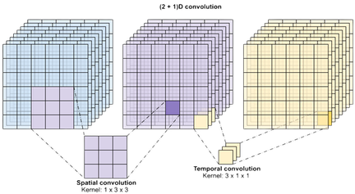

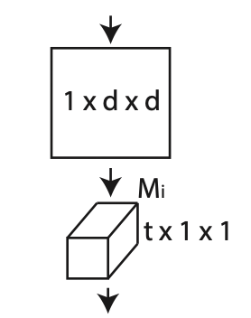
Methods and data: model setup
VISSL self-supervised approach, 10 classes
Spherical k-mean
(Hornik et al. 2012)
pseudo-label q, centroid C
goal: finding main features
goal: reducing number of features
goal: identify class (label and centroid)
Feature vector Z
Minimization of the cross entropy function
p = f(C,Z)
Multilayer- perceptron
(2+1)D ResNet
A (2+1)D convolutional block splits the computation into a spatial 2D convolution followed by a temporal 1D convolution.
(Tran et al. 2017)
goal: optimization of weights and calculation of parameter update
backpropagation and update of the weights
800 epochs
9

Slide 10
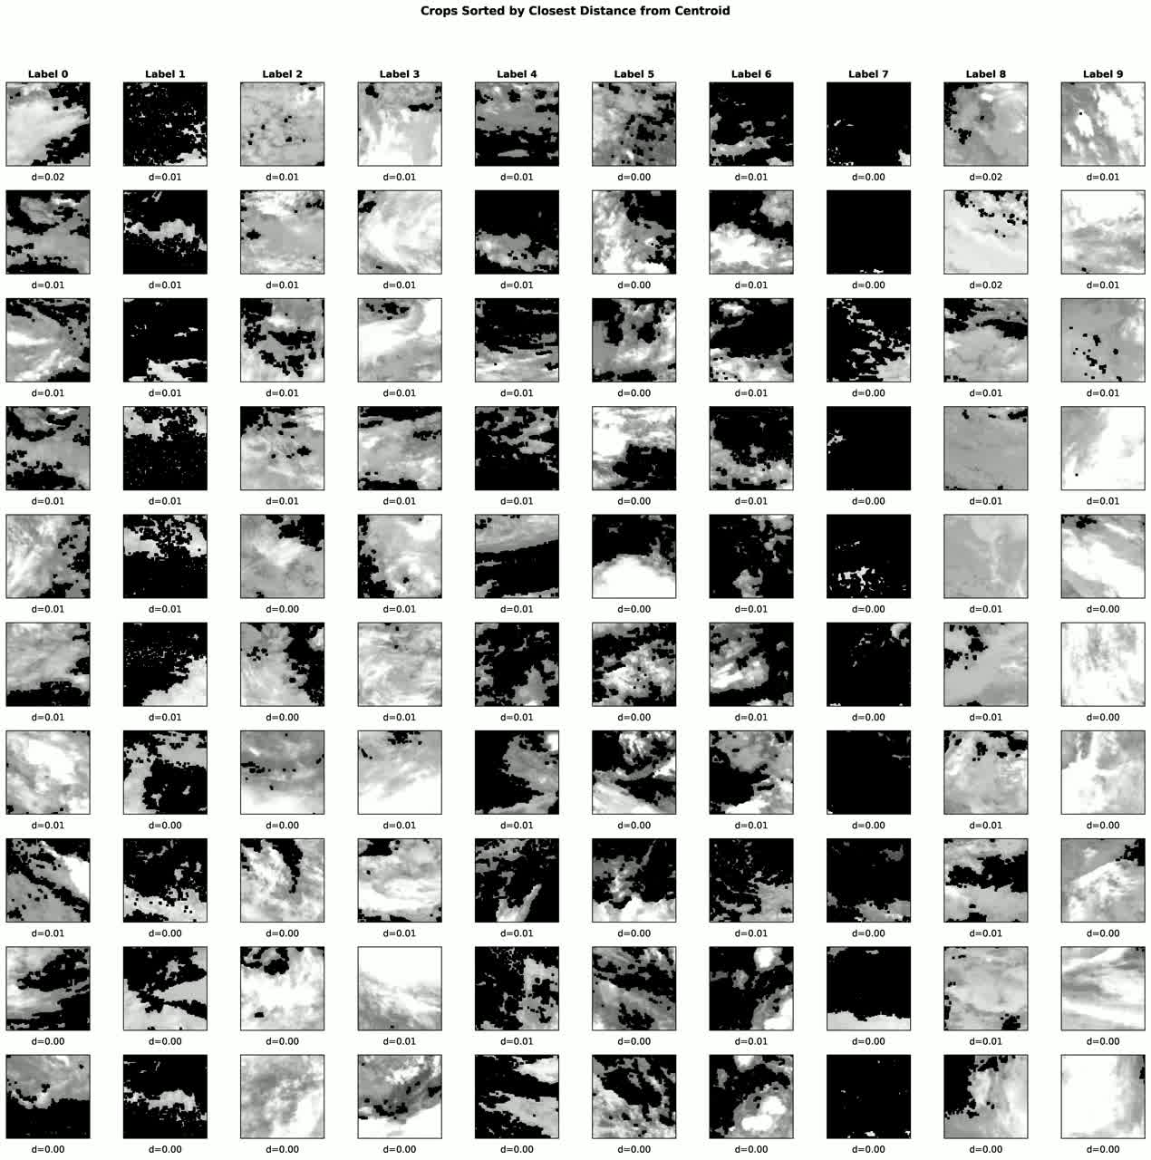
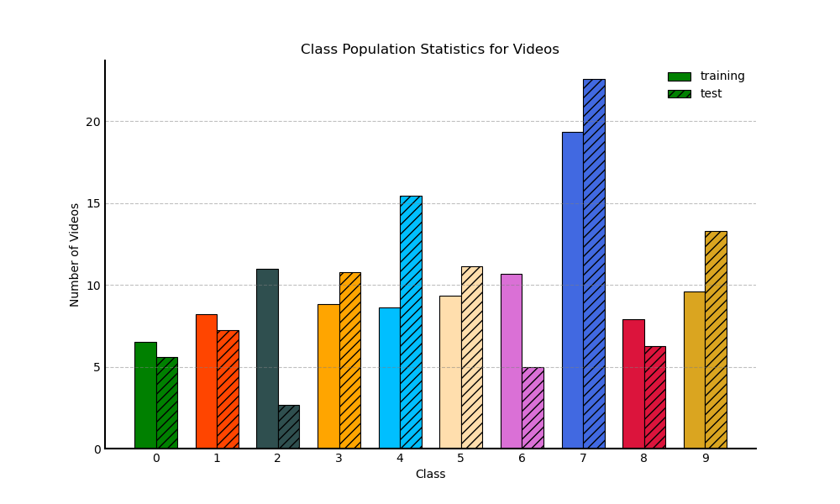
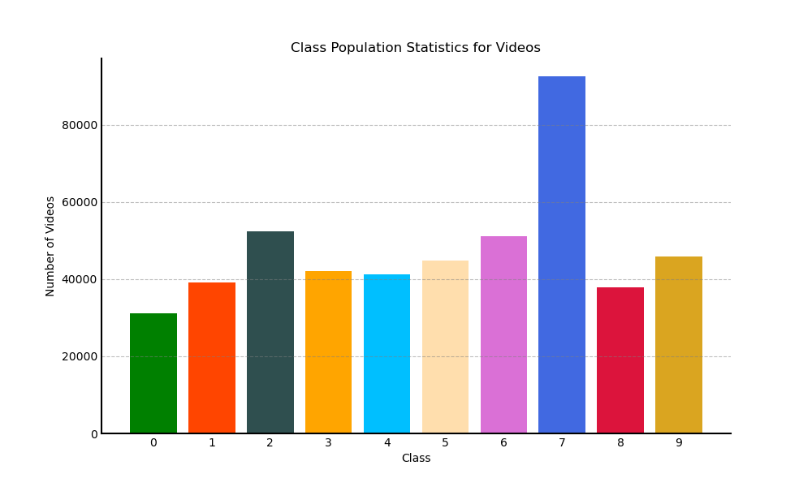
Results: qualitative evidence of model capabilities
VISSL identifies semantically different classes using spatial and temporal low-level features learned through self-supervision
% of video population
Statistics are solid: changes of class populations in test dataset are less than 10%
(-8.31% class 2, +6.82 % class 4)
10

Slide 11
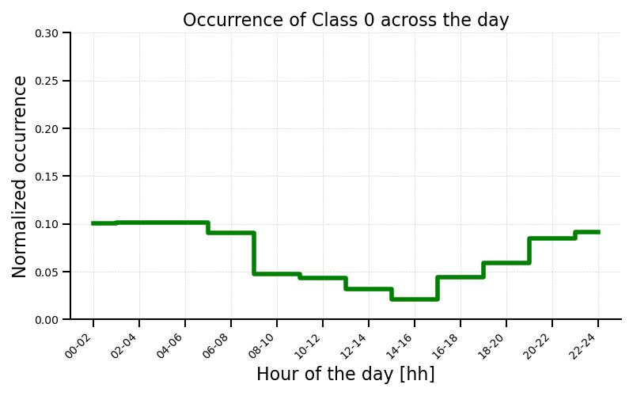
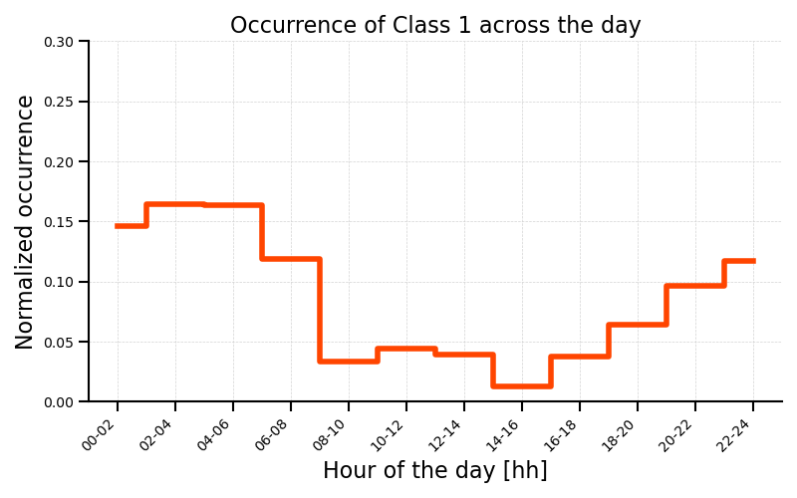
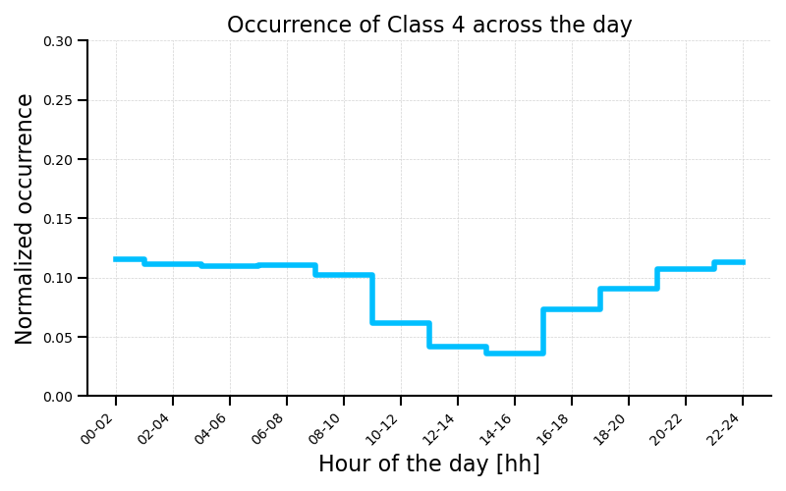
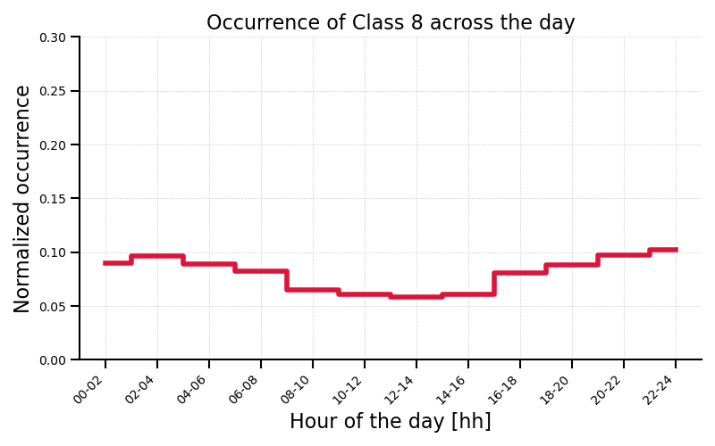
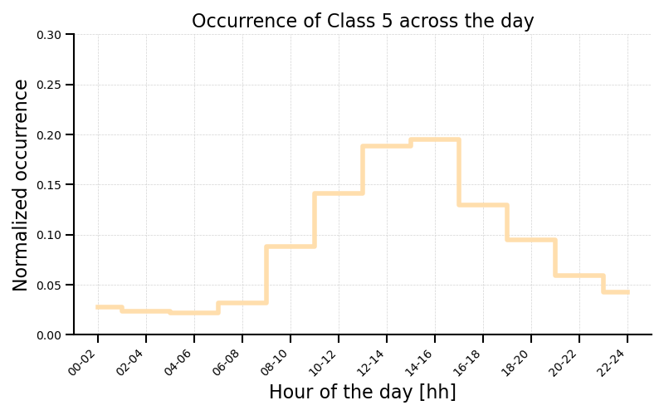
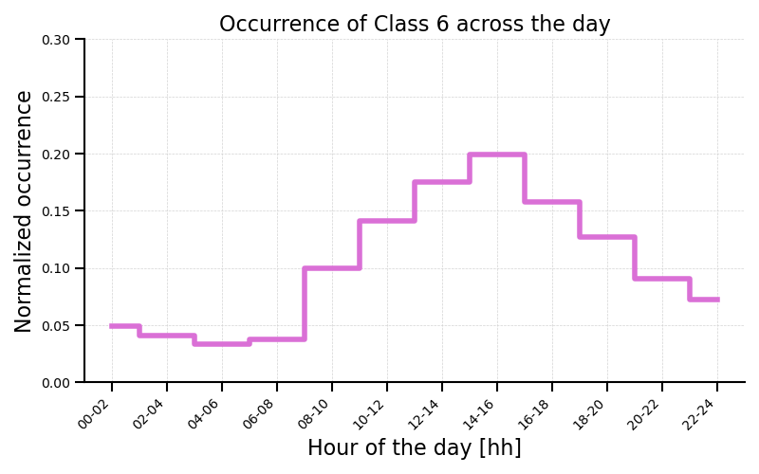
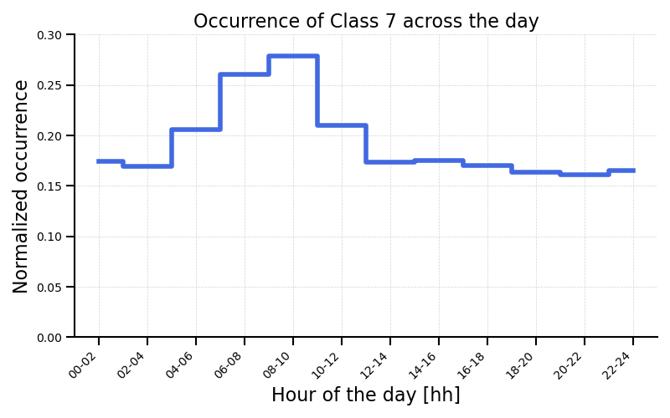
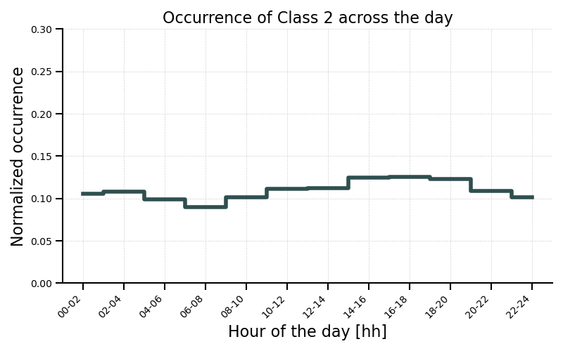
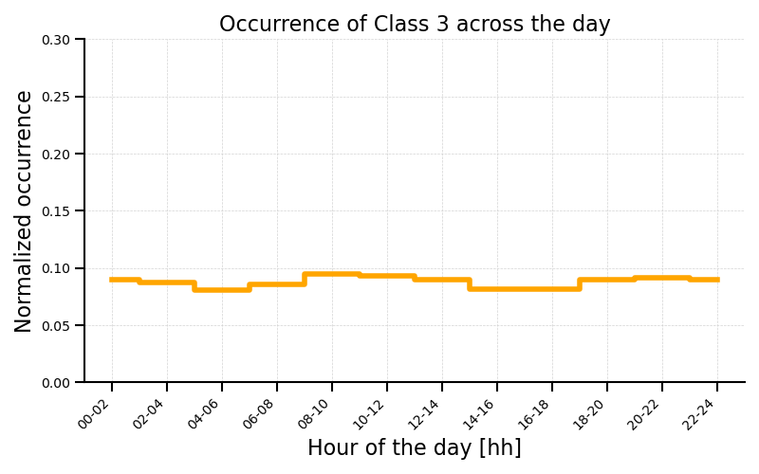

Results from training: quantitative evidence of model capabilities
Some classes (1, 4, 8 and 0) occur mostly at night..
....some (7, 5, and 6) during the day...
... and others (9, 2, 3) can be found at any time of the day.
11

Slide 12
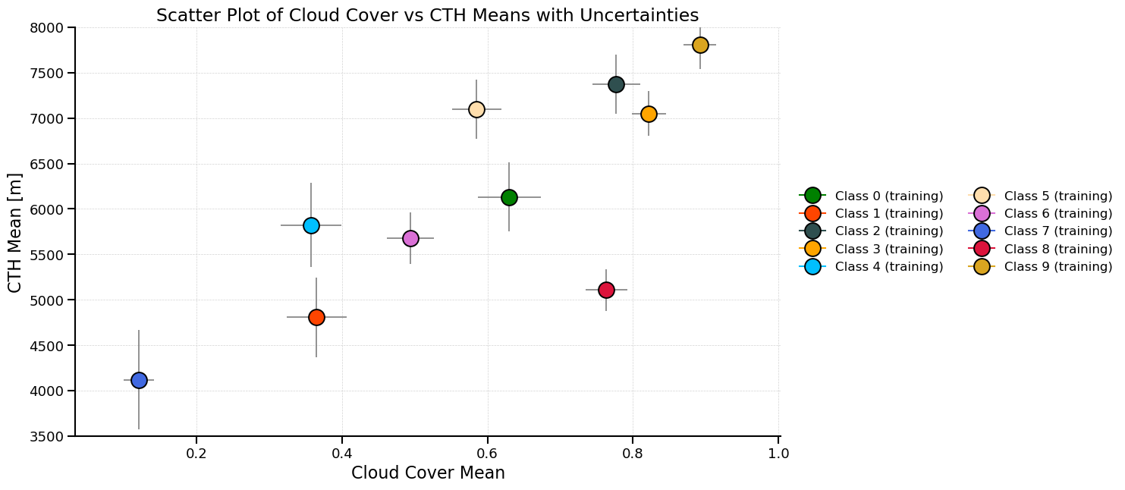
Results from training: quantitative evidence of model capabilities
  class 2, 9, 5 and 3:
    CTH >7000m,
    cloud cover >= 0.6
large extent, cloud overcast
nighttime classes
  class 8, 0 (mainly night):
    CTH > 5000m
    cloud cover > 0.6
mid level clouds with high cloud cover
  class 6 and 4 and 1:
    4500 m < CTH < 6000m
    0.3 < cloud cover < 0.5
mid level clouds with low cloud cover
  class 7:
    CTH < 4500m
    cloud cover < 0.15
small broken low level clouds
12
Notes:
But even if they occur at the same time, they might have different characteristics

Slide 13
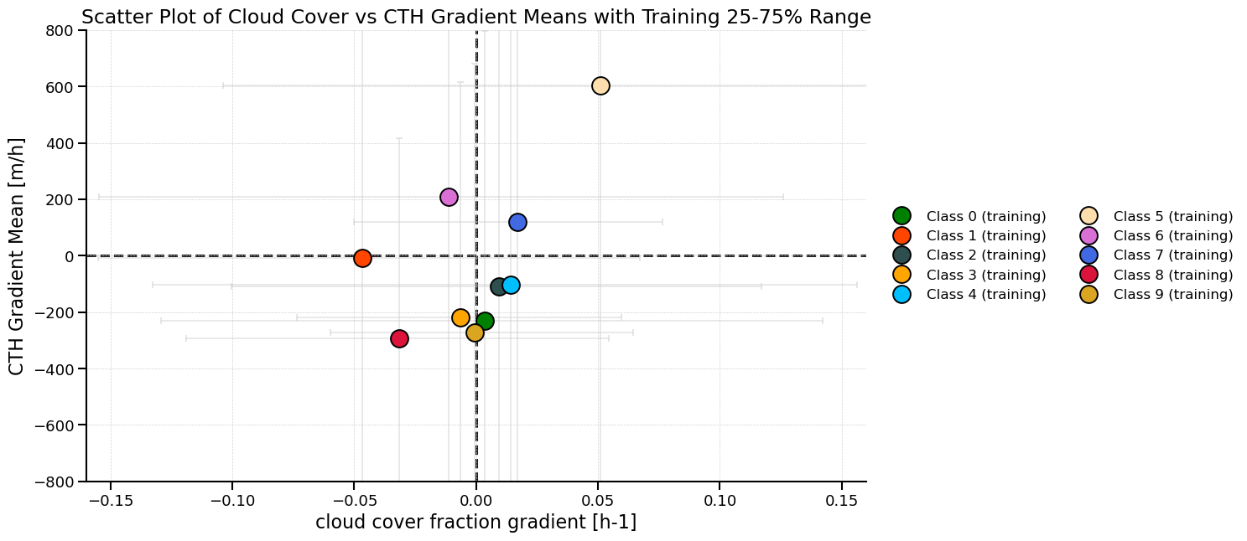
Results from training: quantitative evidence of model capabilities
convection growing: grad CTH > 0,
nighttime classes
stationary classes: gradients almost null
convection decaying gradients < 0
uncertainty bars are 25th and 75th percentiles
dissipating clouds:
grad cloud cover < 0, gradCTH = 0
  class 5 is convection growing and class 6 and 7 have grad CTH > 0
  class 0, 9, 8 and 3 are convection decaying.
  class 2 and 4 are the closest to null gradients (stationary) average, with large uncertainties.
  class 1 is dissipating grad cloud cover << 0, gradCTH very uncertain
13
Notes:
But even if they occur at the same time, they might have different characteristics

Slide 14
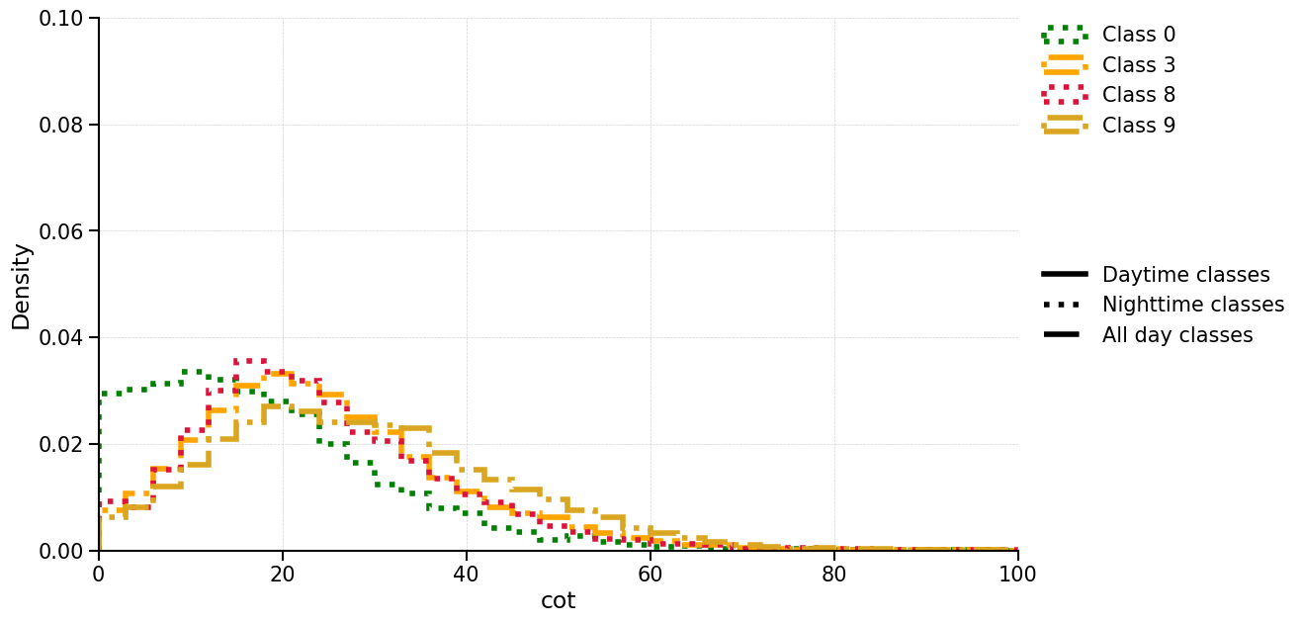
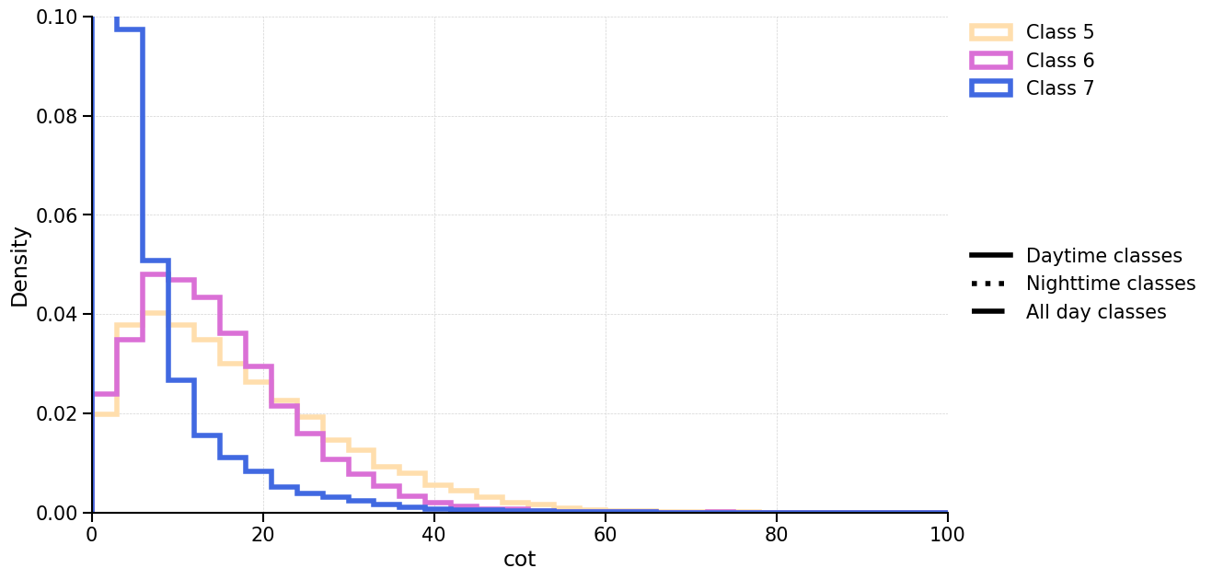
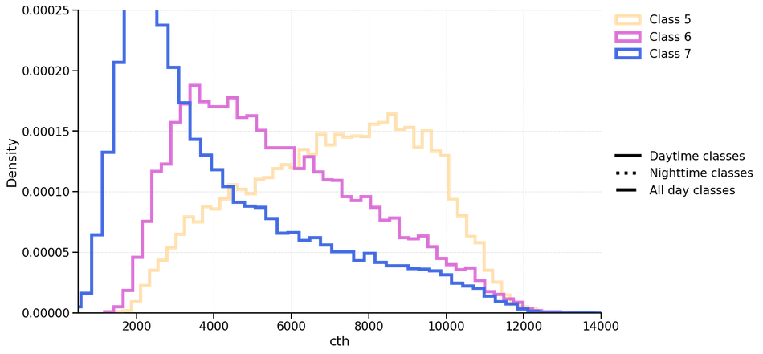
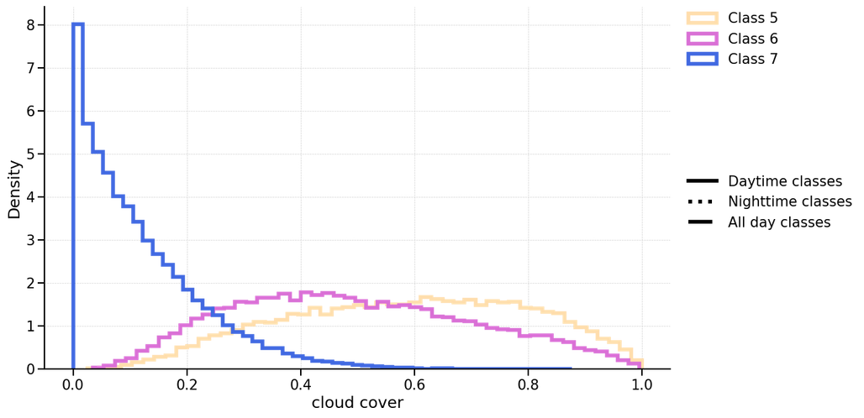
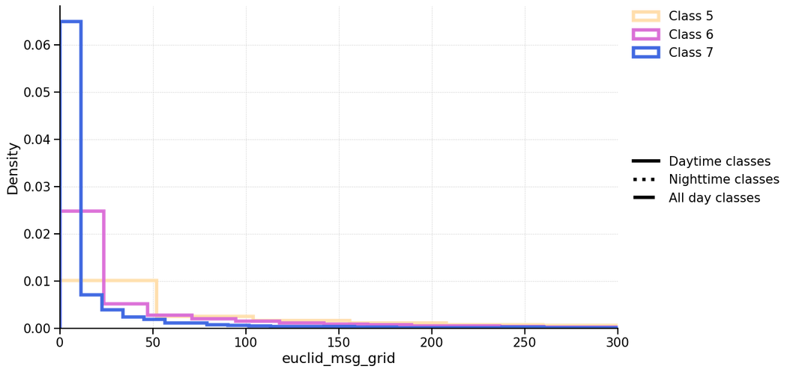
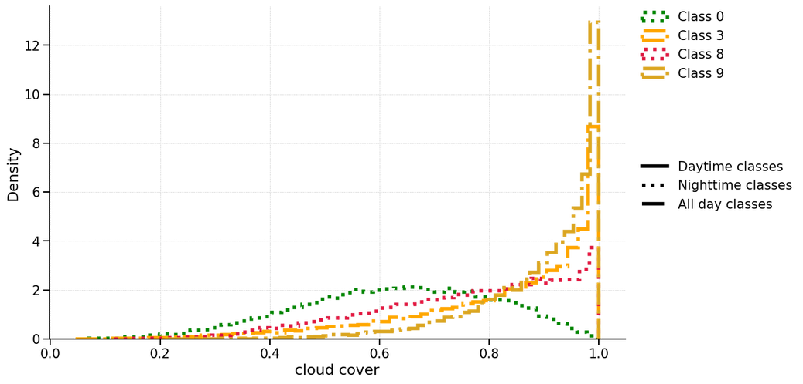
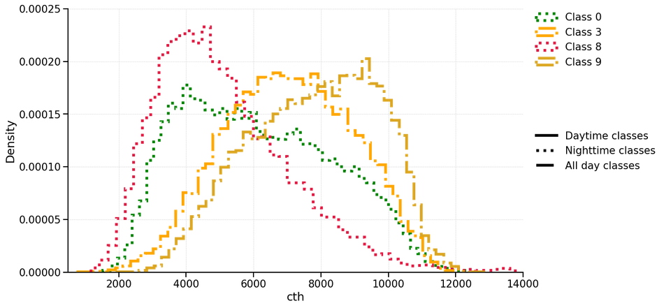
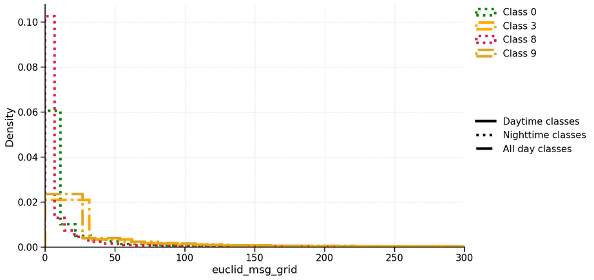
Results from training: identify convection in spacetime evolution
cloud top height [m]
cloud cover [%]
lightning (EUCLID) [#]
convection growing
convection growing
convection decaying
14
14

Slide 15
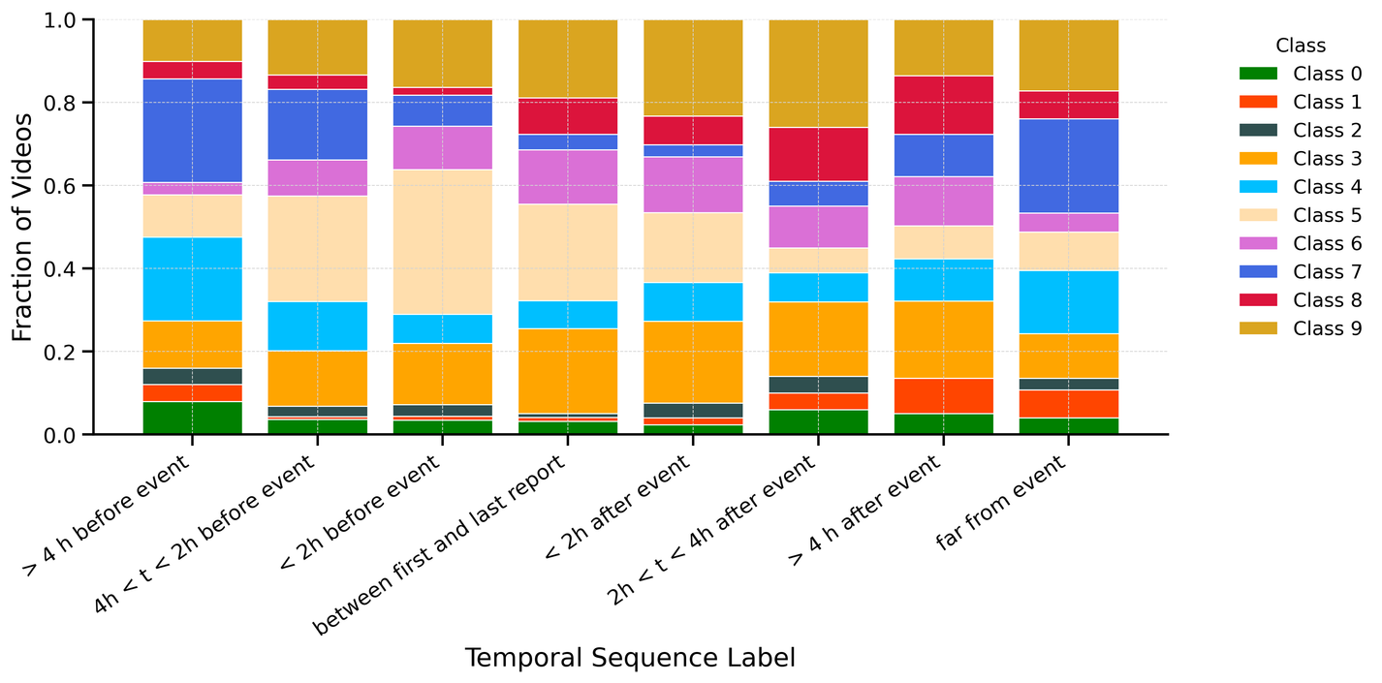
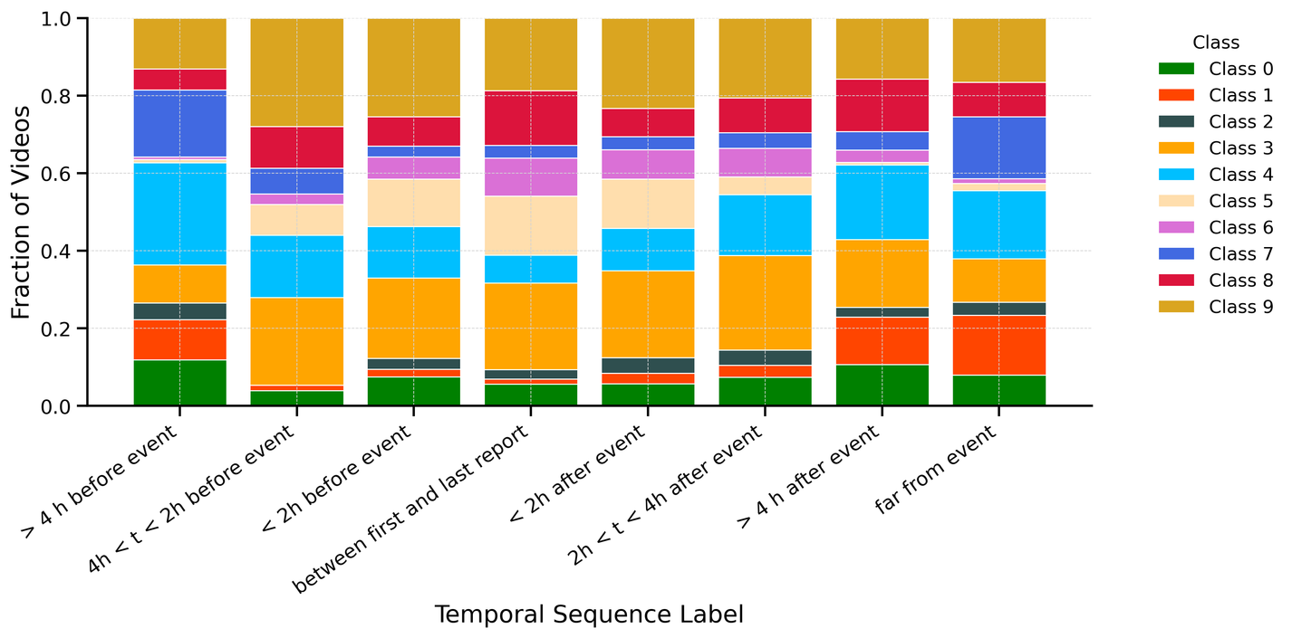
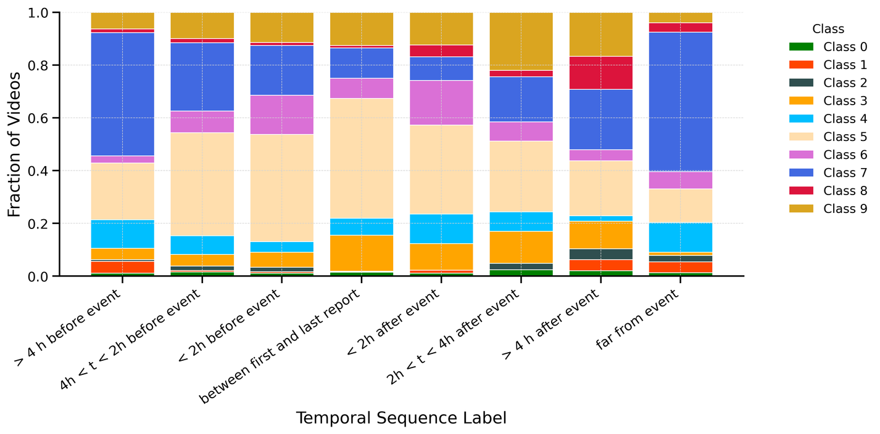
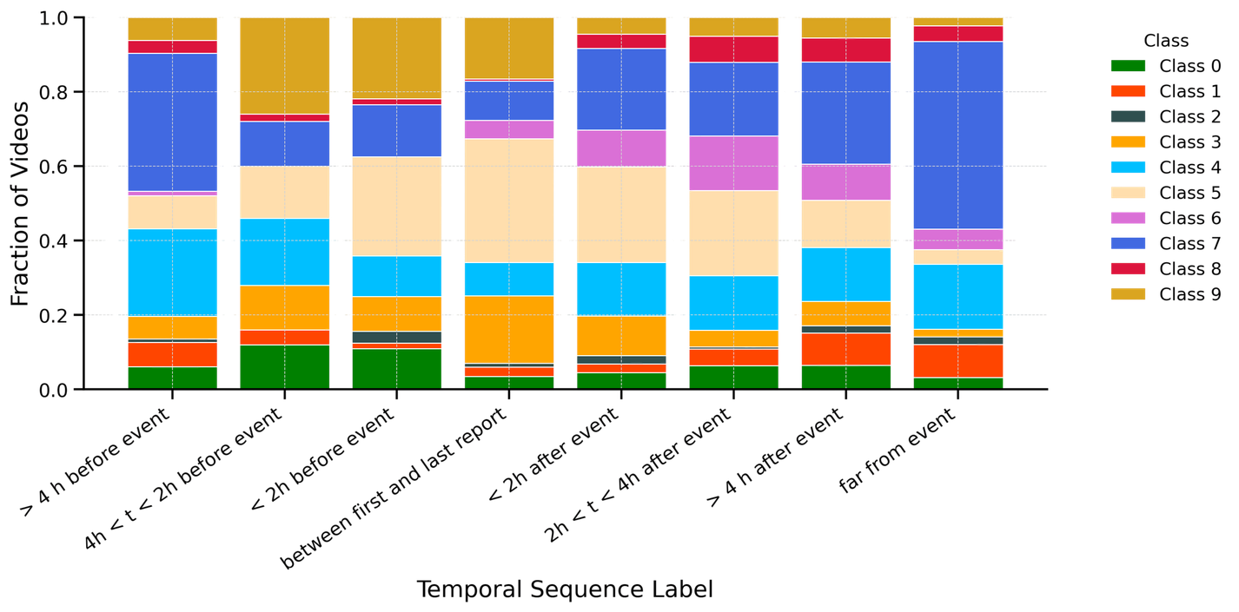
Results from testing: Occurrence of classes during the events
☀️
North - day
🌙
North - night
The occurrence of cloud patterns depends on the region and on the time of the day
☀️
South - day
🌙
South - night
15

Slide 16
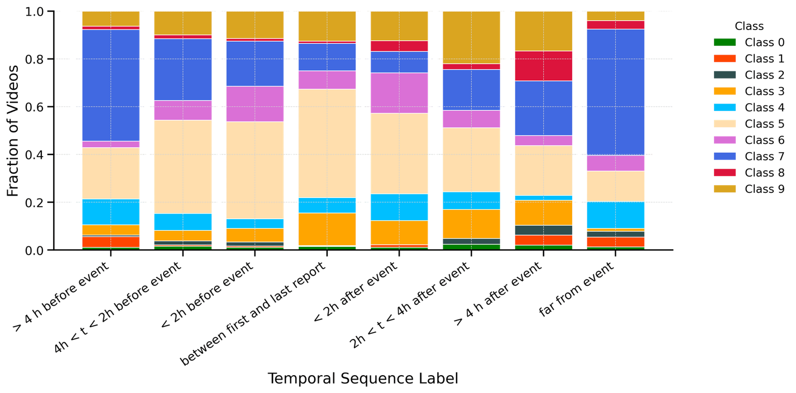
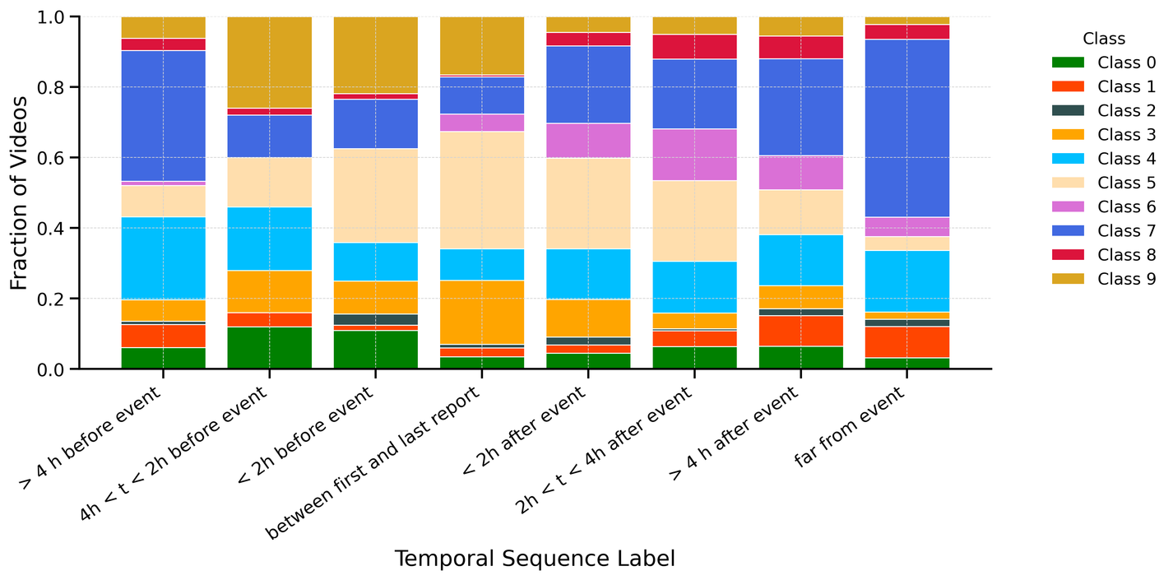
Results from testing: Occurrence of classes during the events
☀️
North - day
🌙
North - night
The occurrence of cloud patterns depends on the region and on the time of the day
☀️
South - day
🌙
South - night
for now we just focus on South-day and look at main classes present:
5,6,7,3, 4 and 9.

Slide 17

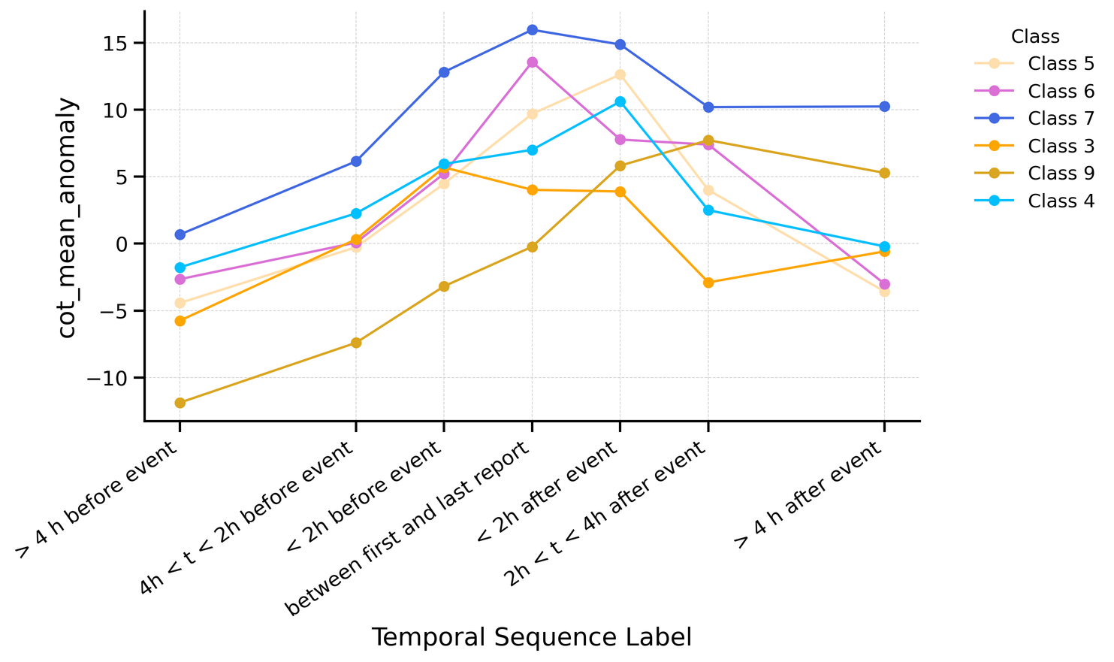
Results from testing: identify precursors
anomaly =
mean var from training
mean over test dataset calculated on each time interval
1) Search for precursor anomalies, i.e. variables that show significative anomalies if compared to the classes mean
16

Slide 18
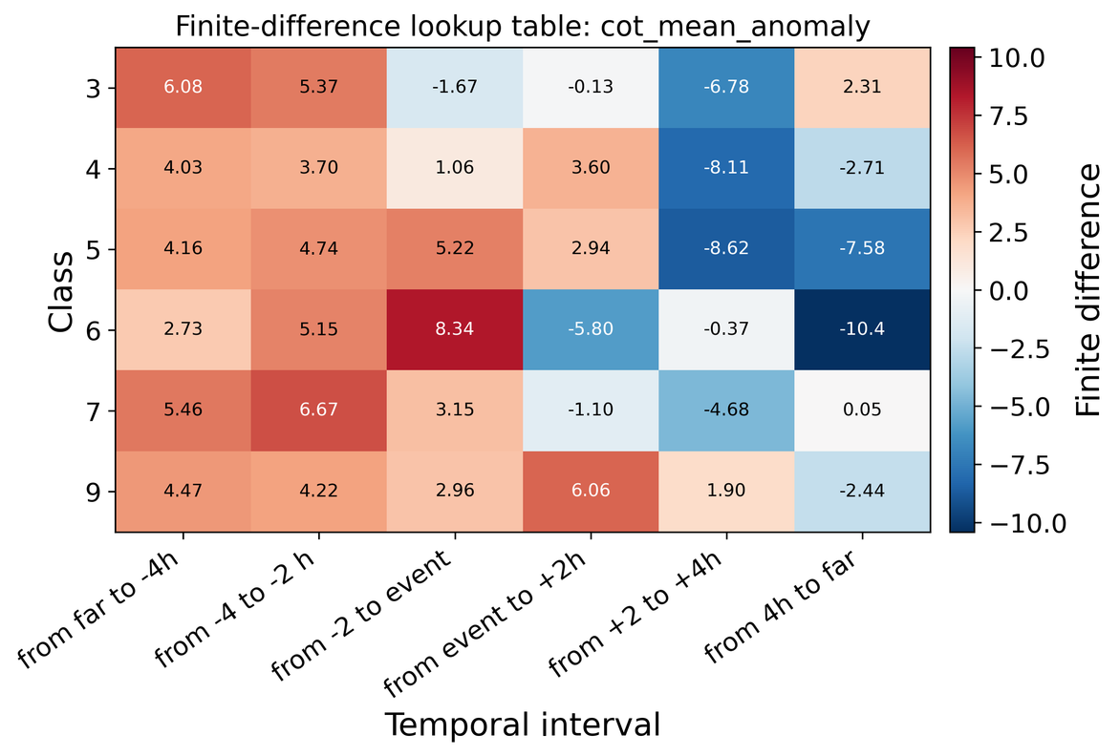
Results from testing: identify precursors
2) Identify warning thresholds for the predictor time series by calculating finite differences along the anomaly time series
anomaly =
mean var from training
mean over test dataset calculated on each time interval
1) Search for precursor anomalies, i.e. variables that show significative anomalies if compared to the classes mean
3) Select precursors with best performances
COT mean anomaly
COT 30+ mean anomaly
grad(CTH) anomaly
Euclid mean count anomaly
precipitation mean anomaly
identified precursors:
16

Slide 19
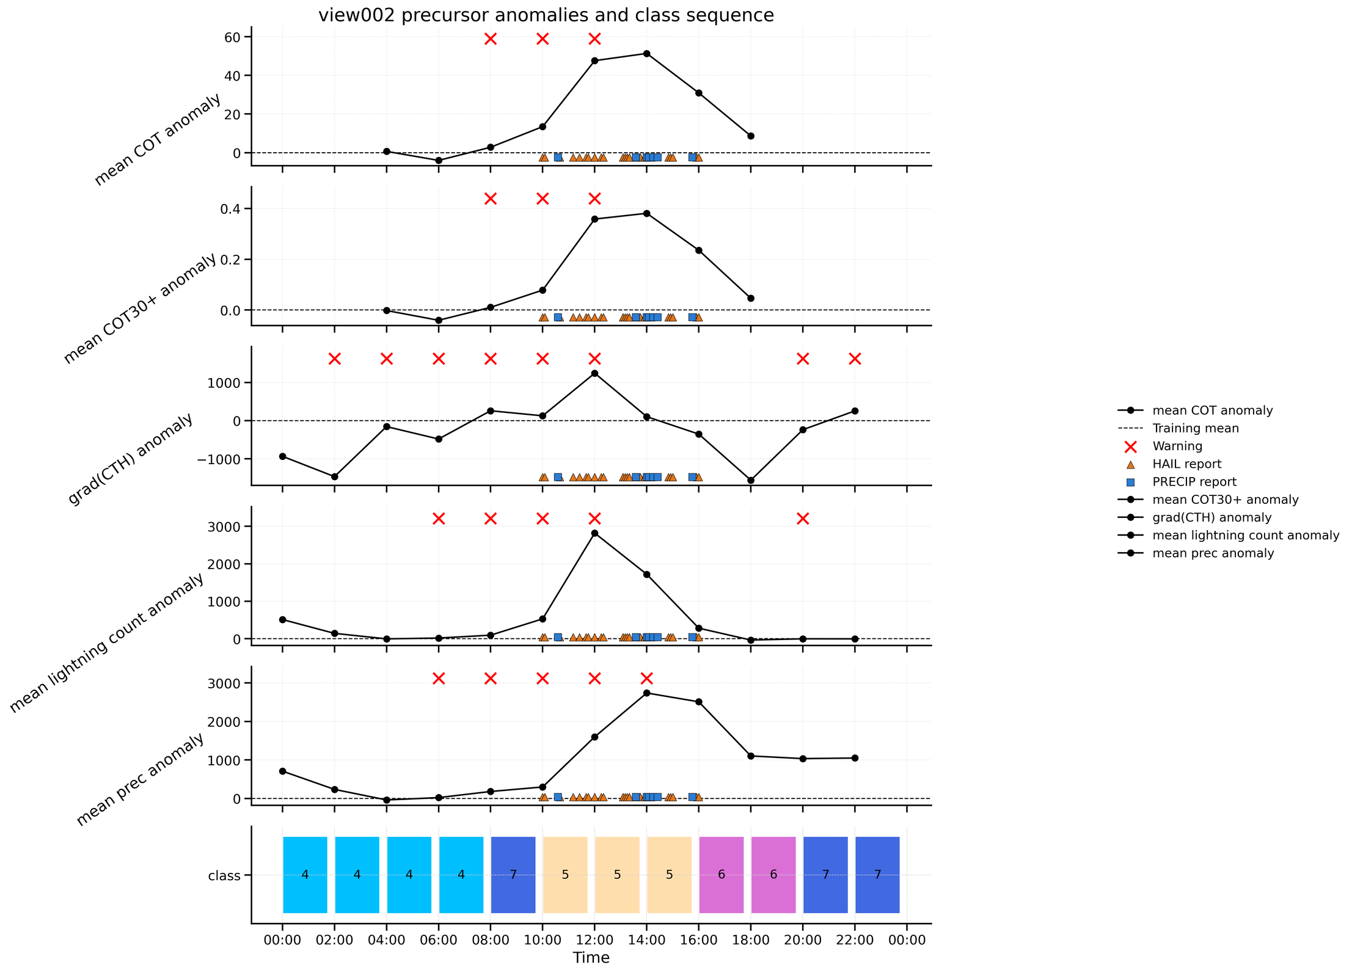
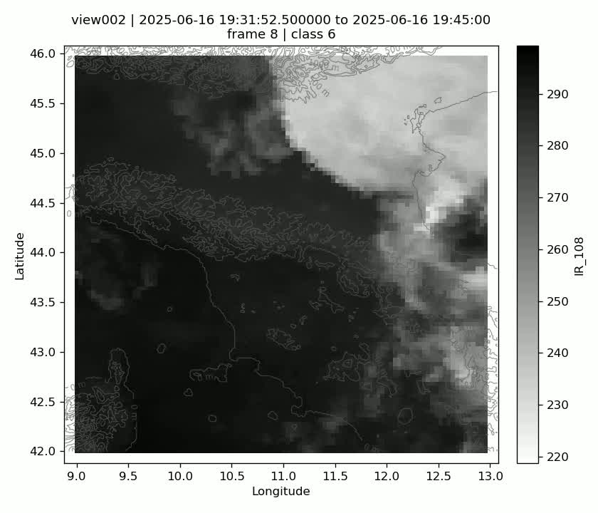
Results from testing: first tests of precursors on 20250616 (view 002)
1) All selected precursors detect the extreme event 2 to 4 h in advance with respect to the reports.
2) Some precursors are also activated after the end of the reports. More checks (sensitivity, uncertainties.. etc) to understand if it is a false alarm
17

Slide 20

Conclusions and outlook
RQ0: Can the time dimension add to our knowledge of convective storms?
  VISSL identifies semantically different convective classes using spatial and temporal low-level features learned through self-supervision; some classes might need further investigation (1, 4, 8, 0)
RQ1: Can we identify convective storm development based on spatio-temporal evolution information?
  Convective development characterizes some classes, depending on the region and on the time of the day
RQ2: Can we identify some precursors able to detect extreme events before they happen, compared to other convective storms?
  All selected precursors detect the extreme event 2 to 4 h in advance with respect to the reports, but more work is needed.
Other Applications and developments
  radar Ze and move soon to MTG as training data (in progress)
  new deep learning model and cluster
  classification of prec type leveraged by mesoscale organization stats
  Model evaluation of cloud organization and growth rates
15

Slide 21
References
  Caron, M., I. Misra, J. Mairal, P. Goyal, P. Bojanowski, and A. Joulin, 2020: Unsupervised learning of visual features by contrasting cluster assignments. arXiv, 2006.09882v5, https://doi.org/10.48550/arXiv.2006.09882.
  Chatterjee. D., Acquistapace C., Deneke H., Crewell S., 2023: Understanding cloud systems structure and organization using a machine’s self-learning approach, Art. Int for Earth Sys., accepted.
  Denby L. (2020). Exploring mesoscale cloud organisation through unsupervised classification. Geophysical Research Letters, 47. e2019GL085190https://doi.org/10.1029/2019GL085190
  Goyal et al., 2021,VISSL, https://github.com/facebookresearch/vissl
  He, K., Zhang X, Ren S., and Sun J., 2015: Deep residual learning for Image Recognition. http://arxiv.org/abs/1512.03385, arXiv:1512.03385
  Hornik, K., Feinerer I., Kober M., and Buchta C., 2012: Spherical k-means clustering. Jour. Stat. Software. 50, (10), 1-22, https://doi.org/10.18637/jss.v050.i10,
  Punge H.J., Kunz M., Reinbold A., 2017: Hail frequency estimation across Europe based on a combination of overshooting top detections and the ERA-INTERIM reanalysis, Atmospheric Research, Atmospheric Research, 198, 34-43, https://doi.org/10.1016/j.atmosres.2017.07.025
  Stevens B, Bony S, Brogniez H, et al. Sugar, gravel, fish and flowers: Mesoscale cloud patterns in the trade winds. Q J R Meteorol Soc. 2020;146:141–152. https://doi.org/10.1002/qj.3662
  Rasp, S., Schulz, H., Bony, S., & Stevens, B. (2020). Combining Crowdsourcing and Deep Learning to Explore the Mesoscale Organization of Shallow Convection. Bulletin of the American Meteorological Society, 101(11), E1980-E1995. https://doi.org/10.1175/BAMS-D-19-0324.1
  Tran et al. (2017) "A Closer Look at Spatiotemporal Convolutions for Action Recognition," doi: 10.1109/CVPR.2018.00675.
contact: claudia.acquistapace@unipd.it
20

Slide 22
Additional material
21

Slide 23
Results: Characterizations of convective classes
22

Slide 24
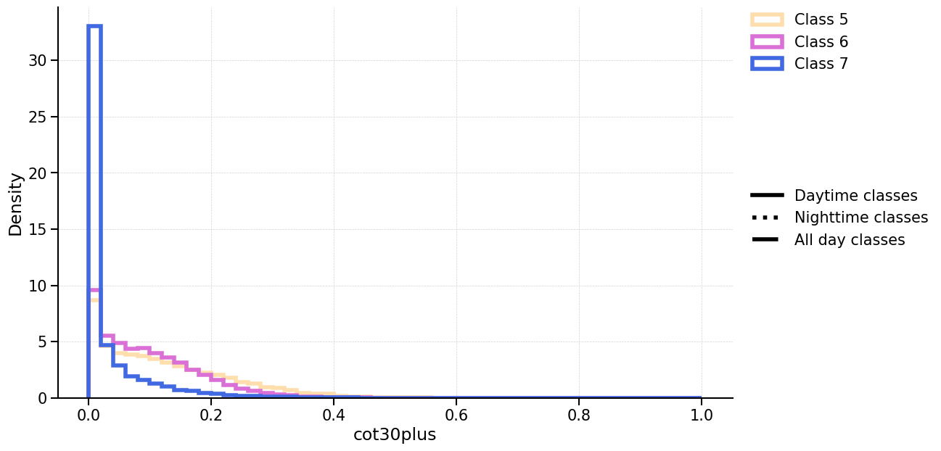
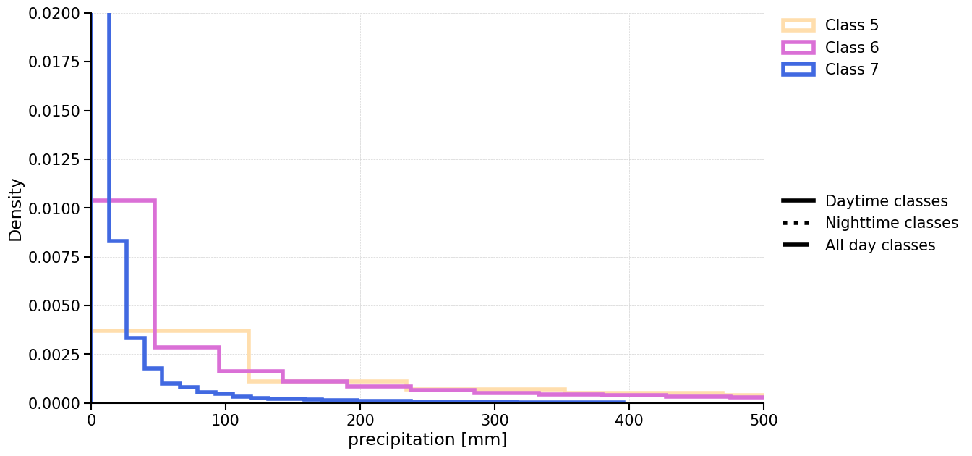


Results: Characterizations of convective classes
23

Slide 25


Results: analysis of test dataset
In test dataset, all mean variables for cloud properties migrate to higher values.
26

Slide 26

Results: analysis of test dataset
In test dataset, all mean variables for cloud properties migrate to higher values.
27

Slide 27





Results: Overview of predictor anomalies
anomaly = mean var from training - mean over test dataset calculated on each interval before, during and after the event
goal: identify variables that contain early indication of the risk associated to the event
28

Slide 28





Results: ... and of the corresponding thresholds
29

Slide 29


Results: Searching for precursors
Occurrence of classes before and after the events over different areas of the domain
30

Slide 30


Results: Searching for precursors
Occurrence of classes before and after the events over different areas of the domain
31

Slide 31


Results from testing: first tests of precursors for 20260616 (view001)
1) All selected precursors detect the extreme event 2 to 4 h in advance with respect to the reports.
2) Some precursors are also activated after the end of the reports. More checks (sensitivity, uncertainties.. etc) to understand if it is a false alarm
32

Slide 32

Results from training: quantitative evidence of model capabilities
  class 2, 9, 5 and 3:
    CTH >7000m,
    cloud cover >= 0.6,
    COT > 17 (except for class 2)
large extent, high optical thickness
  class 8, 0 (mainly night):
    CTH > 5000m
    cloud cover > 0.6,
    17 < COT < 25
mid level optically thick clouds
  class 6 and 4 and 1:
    4500 m < CTH < 6000m
    0.3 < cloud cover < 0.5
    10 < COT < 15
mid level clouds smaller and optically thinner
  class 7:
    CTH < 4500m
    cloud cover < 0.15,
    COT < 10
small broken low level clouds
nighttime classes
24
Notes:
But even if they occur at the same time, they might have different characteristics

Slide 33


Results from training: quantitative evidence of model capabilities
convection growing:
grad CTH > 0, grad CMA > 0
stationary classes:
gradients almost null
convection decaying
gradients < 0
dissipating clouds:
gradCMA < 0, gradCTH = 0
  class 5 is convection growing and class 6 and 7 have grad CTH > 0
  class 2 and 4 are quite stationary on average, with large uncertainties.
  class 0, 9, 8 and 3 are convection decaying.
  class 1 is dissipating with gradCOT << 0, gradCMA << 0, gradCTH very uncertain
25
Notes:
But even if they occur at the same time, they might have different characteristics

Slide 34


Results from testing: first tests of precursors for 20260616 (view003)
1) All selected precursors detect the extreme event 2 to 4 h in advance with respect to the reports.
2) Some precursors are also activated after the end of the reports. More checks (sensitivity, uncertainties.. etc) to understand if it is a false alarm
33

Slide 35


Results from testing: first tests of precursors for 20260616 (view004)
1) All selected precursors detect the extreme event 2 to 4 h in advance with respect to the reports.
2) Some precursors are also activated after the end of the reports. More checks (sensitivity, uncertainties.. etc) to understand if it is a false alarm
34

Slide 36


Results from testing: first tests of precursors for 20260616 (view005)
1) All selected precursors detect the extreme event 2 to 4 h in advance with respect to the reports.
2) Some precursors are also activated after the end of the reports. More checks (sensitivity, uncertainties.. etc) to understand if it is a false alarm
35

Slide 37


Results from testing: first tests of precursors for 20260616 (view006)
1) All selected precursors detect the extreme event 2 to 4 h in advance with respect to the reports.
2) Some precursors are also activated after the end of the reports. More checks (sensitivity, uncertainties.. etc) to understand if it is a false alarm
36

Slide 38


Results from testing: first tests of precursors for 20260616 (view007)
1) All selected precursors detect the extreme event 2 to 4 h in advance with respect to the reports.
2) Some precursors are also activated after the end of the reports. More checks (sensitivity, uncertainties.. etc) to understand if it is a false alarm
37

Slide 39


Results from testing: first tests of precursors for 20260616 (view008)
1) All selected precursors detect the extreme event 2 to 4 h in advance with respect to the reports.
2) Some precursors are also activated after the end of the reports. More checks (sensitivity, uncertainties.. etc) to understand if it is a false alarm
38

Slide 40


Results from testing: first tests of precursors for 20260616 (view009)
1) All selected precursors detect the extreme event 2 to 4 h in advance with respect to the reports.
2) Some precursors are also activated after the end of the reports. More checks (sensitivity, uncertainties.. etc) to understand if it is a false alarm
39

Slide 41


Mesoscale cloud organization matters?
High-res models struggle to reproduce the aggregation we see in the observations.
OBS
ICON
Figure: Becker, T., Takasuka, D., and Bao, J.: Characteristics of precipitating convection and moisture-convection relationships in global km-scale simulations, EGU General Assembly 2024, Vienna, Austria, 14–19 Apr 2024, EGU24-17683, https://doi.org/10.5194/egusphere-egu24-17683, 2024.,
paper in preparation “"On the influence of moisture-convection relationships on precipitating convection in global km-scale simulations” from Takasuka, Bao and Becker
IFS
NICAM
40
Becker, T., Takasuka, D., and Bao, J., 2024
Notes:
For example, we know that there are known issues with the convection parametrisation, i.e a strong dependence on triggering mechanism and closure, CAPE
nextGEMS project aims at running climate projections without introducing uncertainties due to the convection parametrisation by increasing resolution to Km scale (hohenegger et al., 2022, Rackow et al., 2024, Takasuka et al., 2024)

