Slide 1
13.2
Evaluation of EarthCARE/CPR simulation and preparation for data assimilation in the global NWP system of JMA
Kozo OKAMOTO¹
E. Oikawa¹, I. Okabe¹, R. Shimizu², T. Tanaka³, and T. Kubota³
1:JMA/MRI, 2:RESTEC, 3:JAXA/EORC
Notes:
Session 13 – Data Assimilation and Orographic Rainfall (13:30 – 14:30)
_{13:45-14:00}

Slide 2
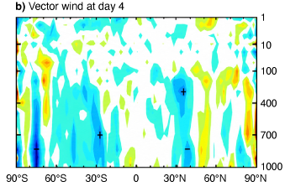

Background and Objectives
Cloud Profiling Radar (CPR)
  CloudSat/CPR (Apr 2006~ Dec 2023), EarthCARE/CPR (May 2024~)
  Have enhanced our understanding of cloud process and improved NWP/climate models
Assimilation of CPR
  Limited study: Small coverage, Challenges in model simulation and data assimilation processings
  Unique info that passive obs does not have: Vertically resolved cloud/precipitation
  Operational implementation at ECMWF (June 2026)
    Fielding & Janisková 2020; Janisková & Fielding 2020, ECMWF 2026
Objectives of this study
  Investigate feasibility of assimilation of EarthCARE/CPR reflectivity (Z)
  in JMA’s global system
Forecast error change at day 4 for wind vector @ECMWF
Improve
Degrade
Notes:
https://www.ecmwf.int/en/about/media-centre/news/2026/earthcare-cloud-radar-data-world-first
_{CloudSat/CPR}
_{NASA-CSA, 2006.4~}
94.05GHz, sampling 1100m(H),250m(V), min. detectable lev:-28dBZ
_{EarthCARE/CPR}
_{JAXA-NICT, 29 May 2024}
94.05GHz, sampling 500m(H),100m(V), 解像度 1km or 10km(H), 500m(V)
_{min. detectable level:-35dBZ}
Measure vertical Doppler velocity
_{Previous studies}
Understand cloud processes, evaluate and improve NWP models
Barker 2008; Delanoe et al. 2011; Jiang et al. 2012; Di Michele et. al. 2012; Suzuki et al. 2015; Kawai et al. 2014
Understand climate processes and evaluate and improve earth system models
Jiang et al. 2012; Su et al. 2013; McCoy et al. 2015, Kawai et al. 2015; Suzuki et al. 2015; Koshiro et al. 2018
_{Challenges in DA}
Sensitive to cloud microphysics and overlap assumption
High nonlinearity, Zero-gradient issue for cloudy obs but clear-sky model simulation
Fielding & Janisková 2020; Janisková & Fielding 2020
_{EarthCARE launch: 29 May 2024}
_{EarthCARE/CPR vs CloudSat/CPR}
_{衛星高度 393km vs 705km}
解像度 0.65 x 1km (H)x 500m(V) vs 1.4 x 3.5 km(H) x 500m(V)
https://space.oscar.wmo.int/instruments/view/cpr_earth_care
https://space.oscar.wmo.int/instruments/view/cpr_cloudsat
_{7dBZの感度向上 => 5倍の感度}
_{10^-2.8/10^-3.5 ~ 5.0}

Slide 3
Content
1. Comparison of obs and simulation (background)
2. Initial test of assimilation
3. Preparation for advanced data assimilation

Slide 4
Model, Simulator and Observation
Model: Global Spectral Model (GSM): JMA’s operational model (JMA 2026)
  Horizontal spacing of 13km, 128 layers up to 0.01 hPa
  Convection scheme： Prognostic Arakawa-Schubert → Convective clouds
  Large-scale cloud: Smith scheme (Smith 1990, QJRMS) → Stratus clouds
  Hydrometeor: cloud water+ice, rain flux, snow flux
Simulator: RTTOV ver13.0
  Optical parameters of cloud water, cloud ice, rain and snow (Geer 2021, AMT)
  Calculate attenuated reflectivity factor (Z), and its Jacobian
  The same fraction for all hydrometeors
Observations: EarthCARE/CPR L2A CPR_ECO
  version vBa, 10km integration data
  Create super-ob (~55 km based on 4DVar inner-loop scale) by averaging reliable data
    Vertically thin every other bin (~dH=200 m)
    Select reliable data over -30 dBZ, integrated_radar_reflectivity_flag_10km=0, and SNR>-10 [dB]
    Remove mirror-echo-flagged bins and multiple-scattering-flagged columns
Notes:
vAc:
vAe: Jan.2025, +2.4dBZ
vBa: Mar.2025, +1.6dBZ, mirror echo+multiscattering
SNRの単位は dBZではなくdBであることに注意

Slide 5
(Preliminary) Quality Control (QC)
Reliability
  Both observed and simulated Z ≥ -30 dBZ
  Higher than 1km in altitude to avoid ground clutter
Homogeneity
  Standard Deviation < 20 dBZ, cloud fraction > 50 % and effective data number (Npix) > 5
    These statistics are calculated from effective data composing a super-ob
Consistency btw obs and sim
  |Obs-Sim| < 24 dBZ
Notes:
O-Bcheckのしきい値はもっと厳しくする？
現在は 50dBZになっているが、ECでは20dBZ
ECでのQC
・cloud fraction > 0.2 for bath obs and model
閾値が緩すぎる： too loose, too lenient, too permissive
閾値が粗すぎる： too coarse, too crude, not fine enough
閾値が厳しすぎる： too strict, too tight, too severe
・

Slide 6
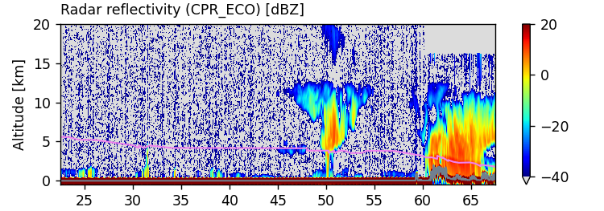
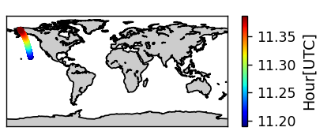
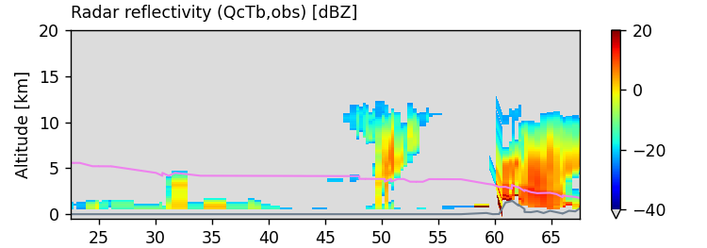
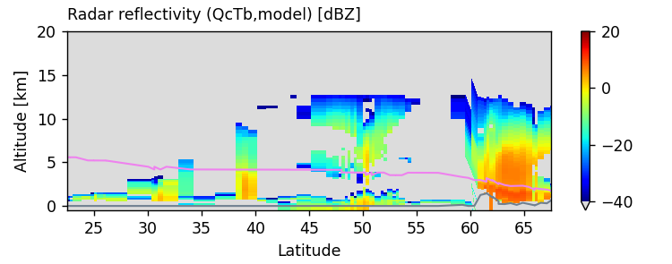
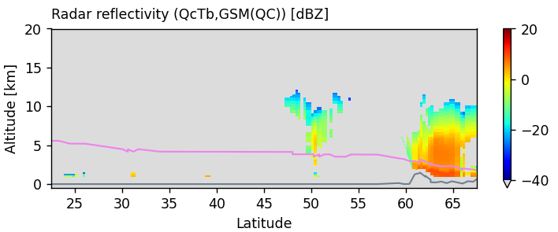
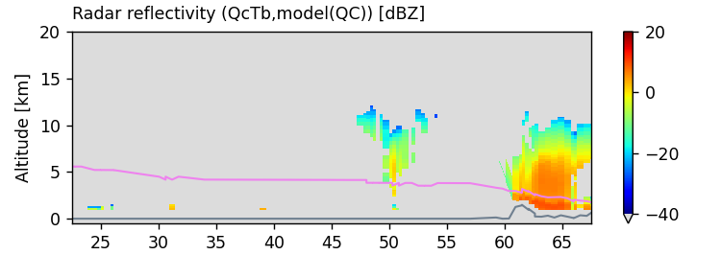
Example of obs and simulation for CPR Z [dBz]
Obs (original)
12UTC, 3 Aug, 2024
Obs (super-ob)
Sim (GSM)
Obs (super-ob) after QC
Sim (GSM) after QC

Slide 7
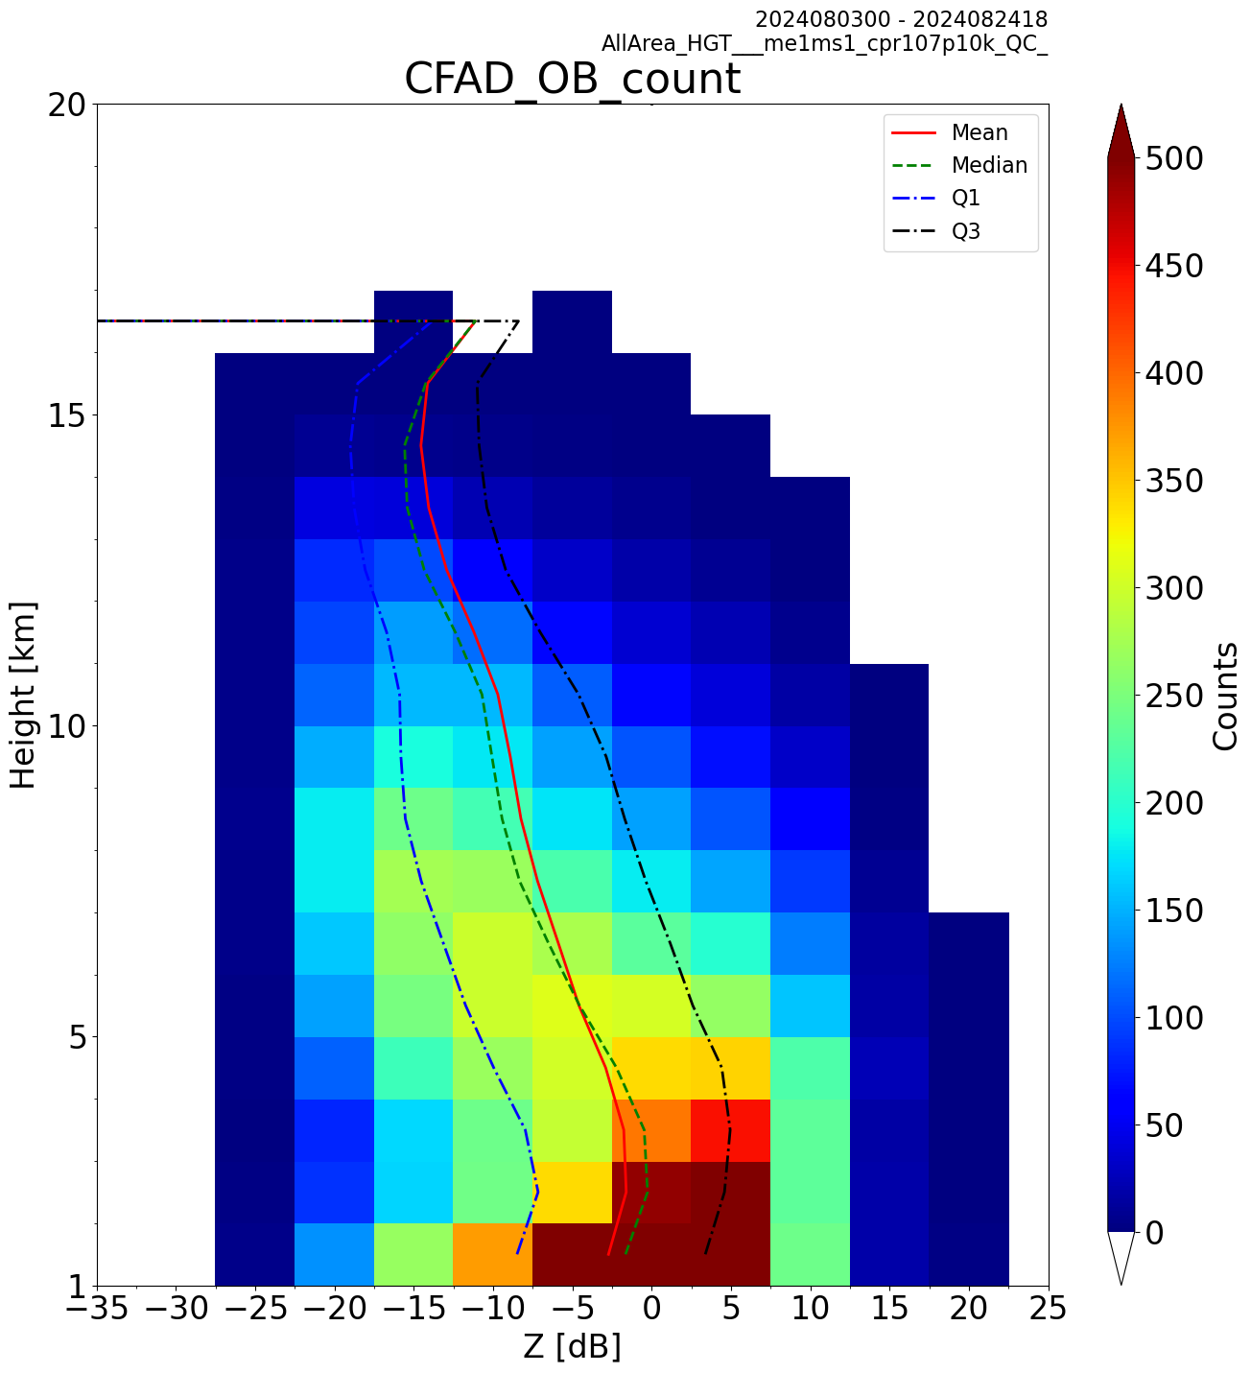
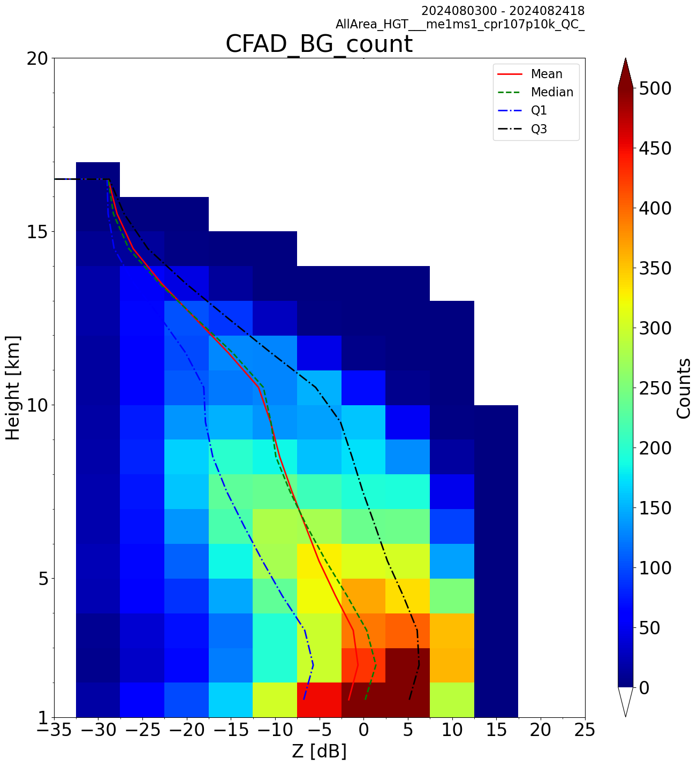
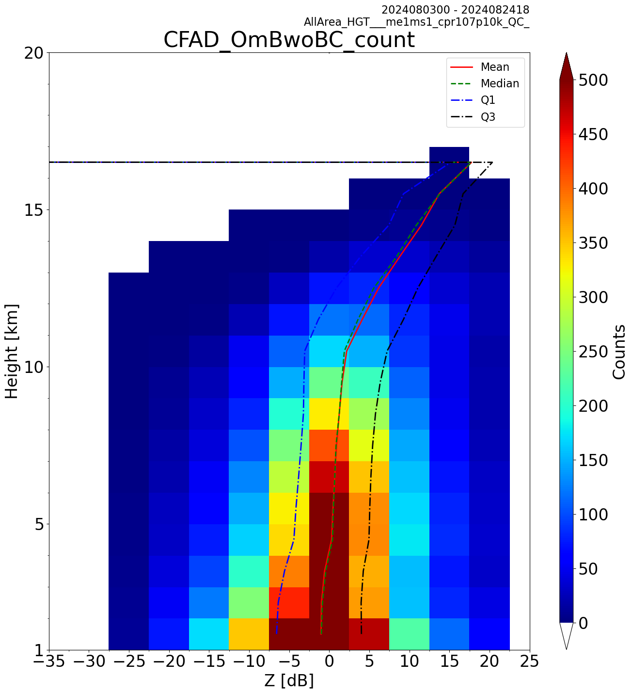
2D-histogram in Z and Height
3-24 Aug. 2024
Simulation underestimates Z above 10 km
  GSM underestimates high clouds (Okamoto et al. 2021, QJRMS)
Obs
Sim (GSM BG)
Obs-Sim (O-B)
Height [km]
0 5 10 15
-35 Z [dBZ] 0 10 25
-35 Z [dBZ] 0 10 25
-35 0 25 [dBZ]
Notes:
cpr10p10k

Slide 8
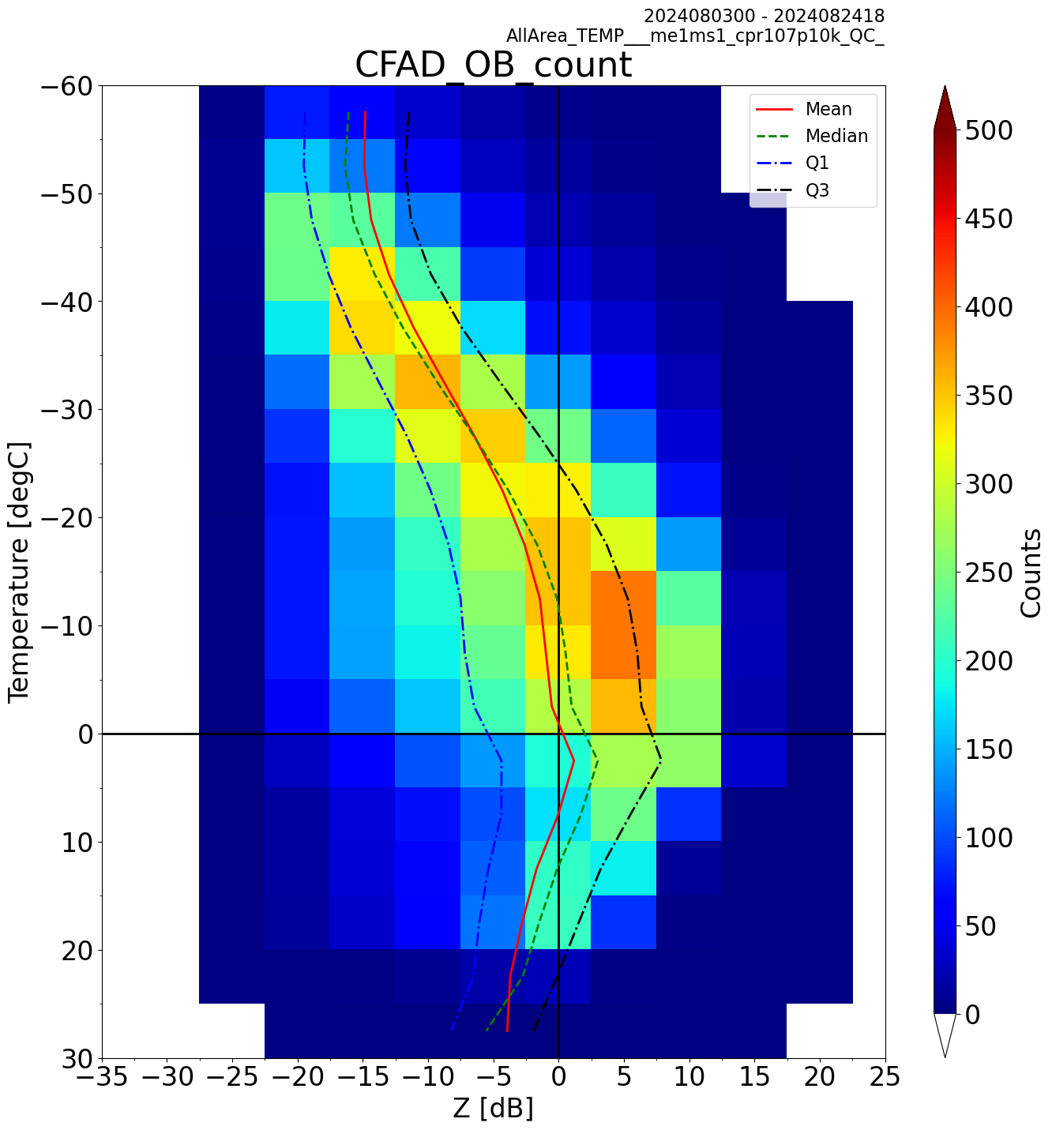
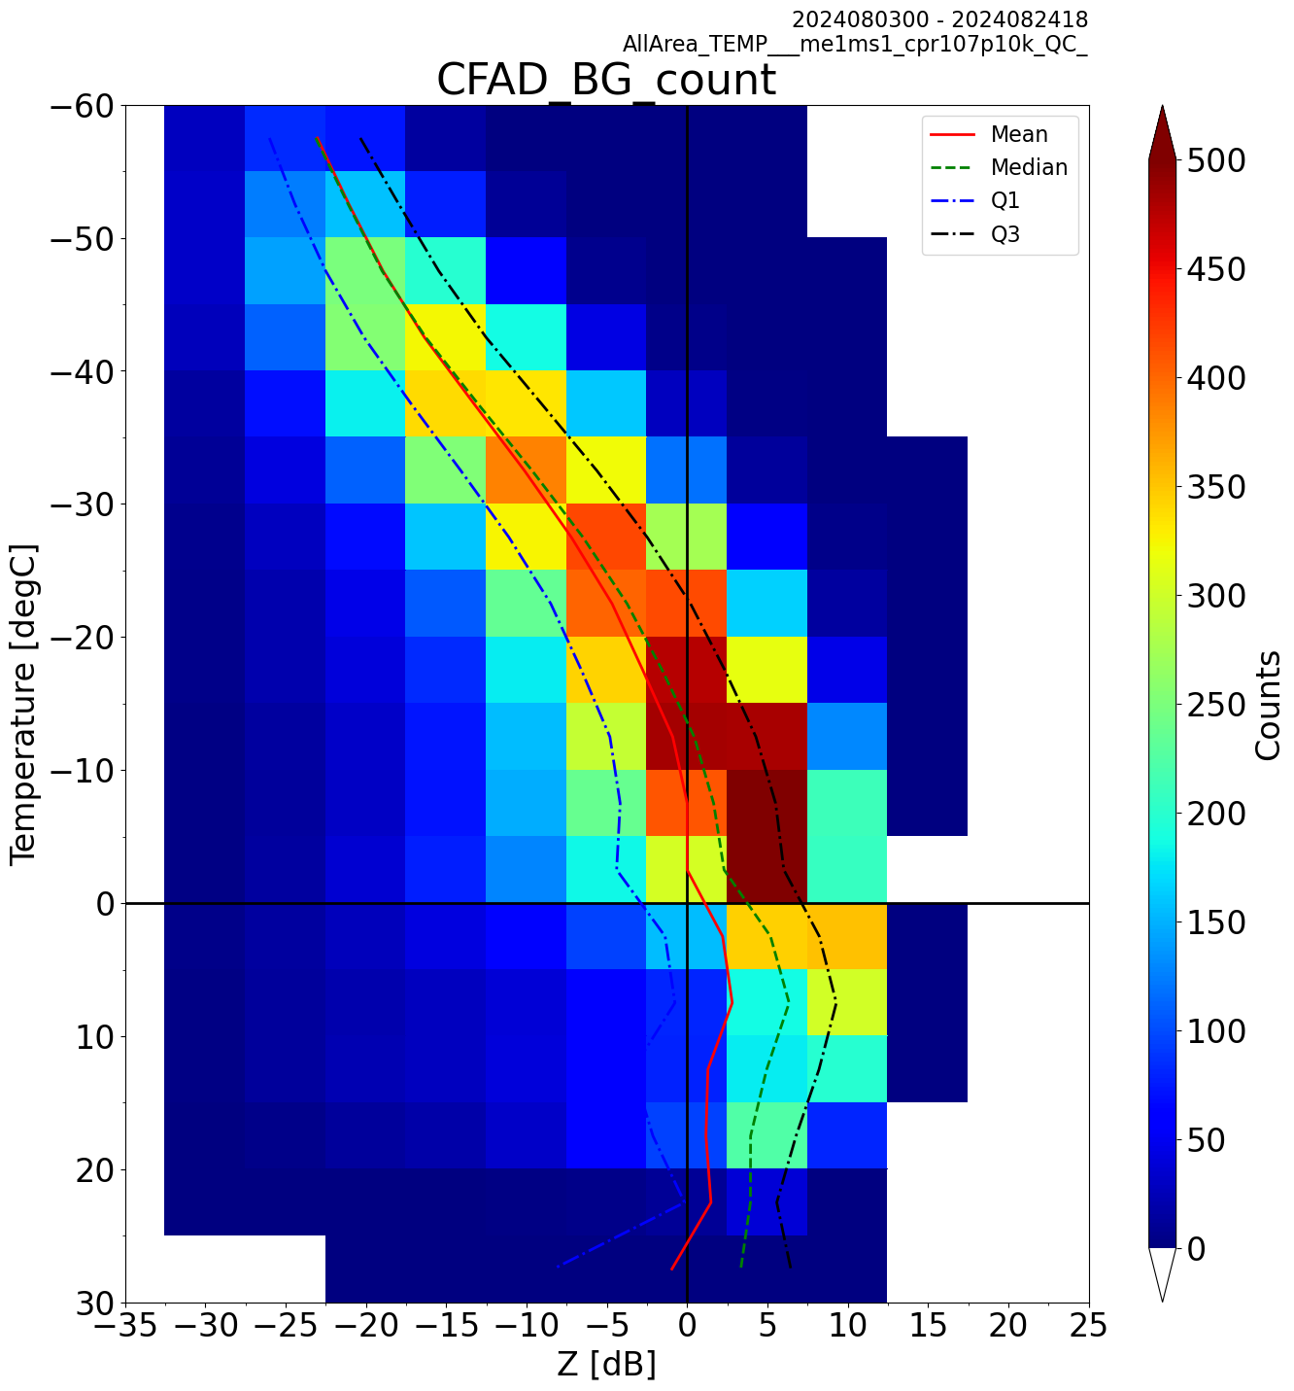
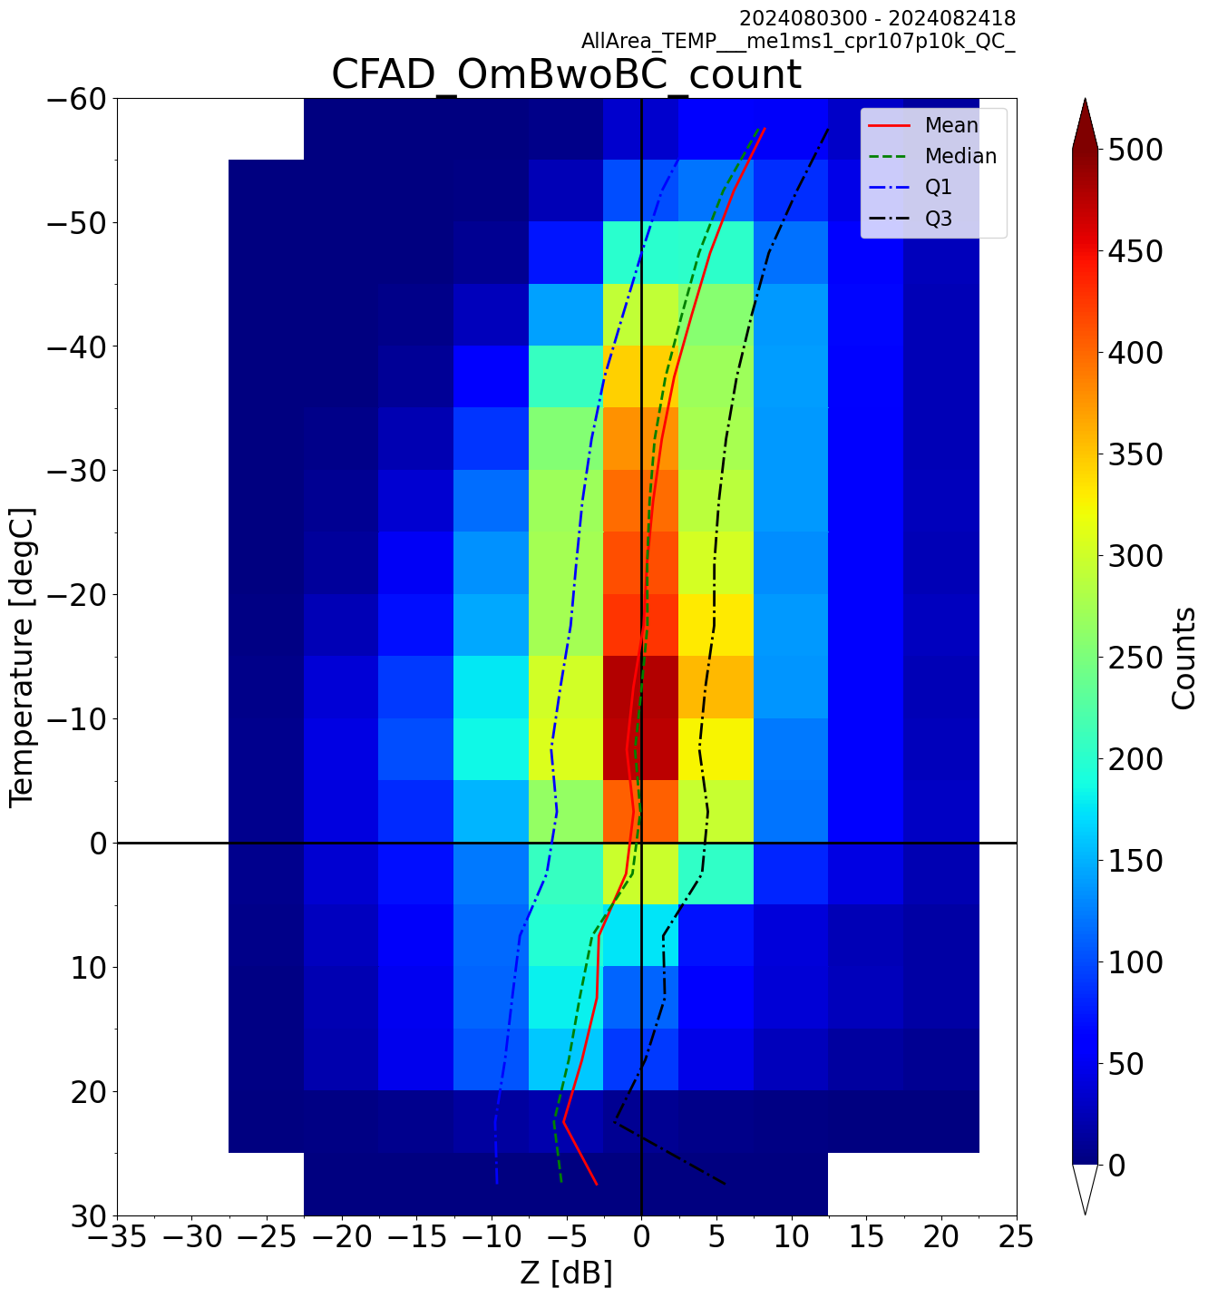
2D-histogram in Z and Temperature
Simulation underestimates Z below -40 deg C and overestimates above 0 deg C
What cause these biases?
Obs
Sim (GSM BG)
Obs-Sim (O-B)
-60
-40
Temperature [deg C]
-20
0
20
-30 0 20 Z[dBZ]
-30 0 20 Z[dBZ]
-30 0 20 Z[dBZ]
Notes:
cpr10p10k

Slide 9
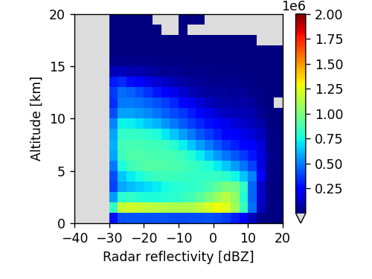
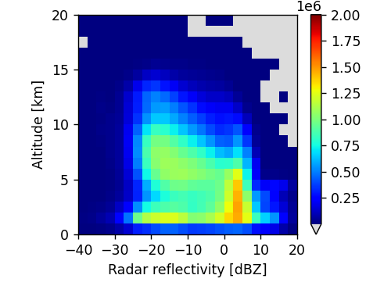
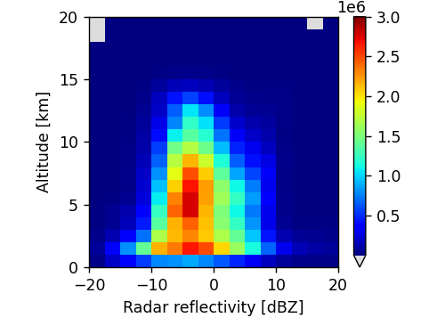
Investigate bias sources
Narrow down causes of the bias: obs, RTTOV, super-ob, sampling,,,
  Use more reliable cloud input (AC_CLP=CPR+ATLID) instead of GSM cloud
  Compare 1km obs and simulation from RTTOV and AC_CLP
    Classify cloud ice (water) into snow and cloud ice (rain and cloud water) according to particle radius and size distribution
However, strange peak in simulation around 5 dBz, and consistent negative O-B
  Issues with AC_CLP (cloud water) and/or its scattering calculation in RTTOV?
Obs
Sim (AC_CLP)
Obs-Sim
Notes:
11-24 Aug. 2024

Slide 10
Content
1. Comparison of obs and simulation (background)
2. Initial test of assimilation
3. Preparation for advanced data assimilation

Slide 11
Assimilation of CPR reflectivity
Adapt the global 4D-Var to assimilate Z
Initial test based on single analysis: 00UTC 11 Aug, 2024
Global DA
  JMA’s operational system as of 2026 (JMA 2025) + all-sky IR (geo)
  Hybrid 4DVar (incremental 4DVar + LETKF)
    Inner-loop (55km) + Outer-loop (13km)
    Cloud is not directly analyzed but adjusted by other variables (TQWP) through the linearized forecast model and outer-loop update
  Updated O-B at the 2nd outer-loop (O-B2) is used to see how Z assimilation adjust analysis variables and then forecast of clouds
Note: Preliminary setting
  Preliminary QC thresholds, fixed obs error (7dBz) and no vertical correlation, no bias correction

Slide 12
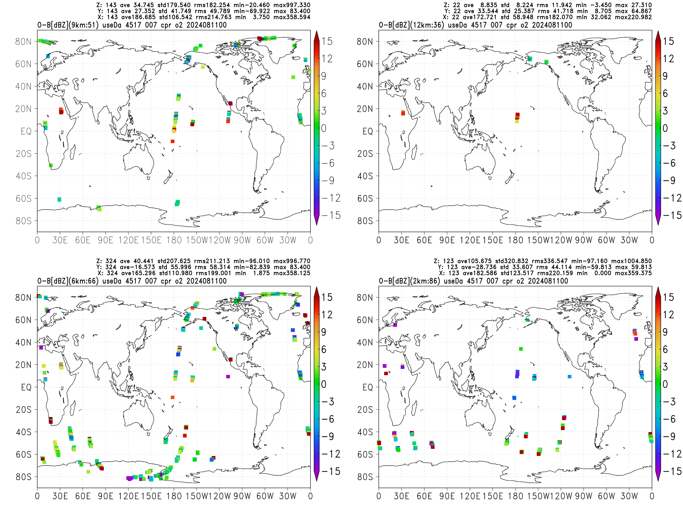
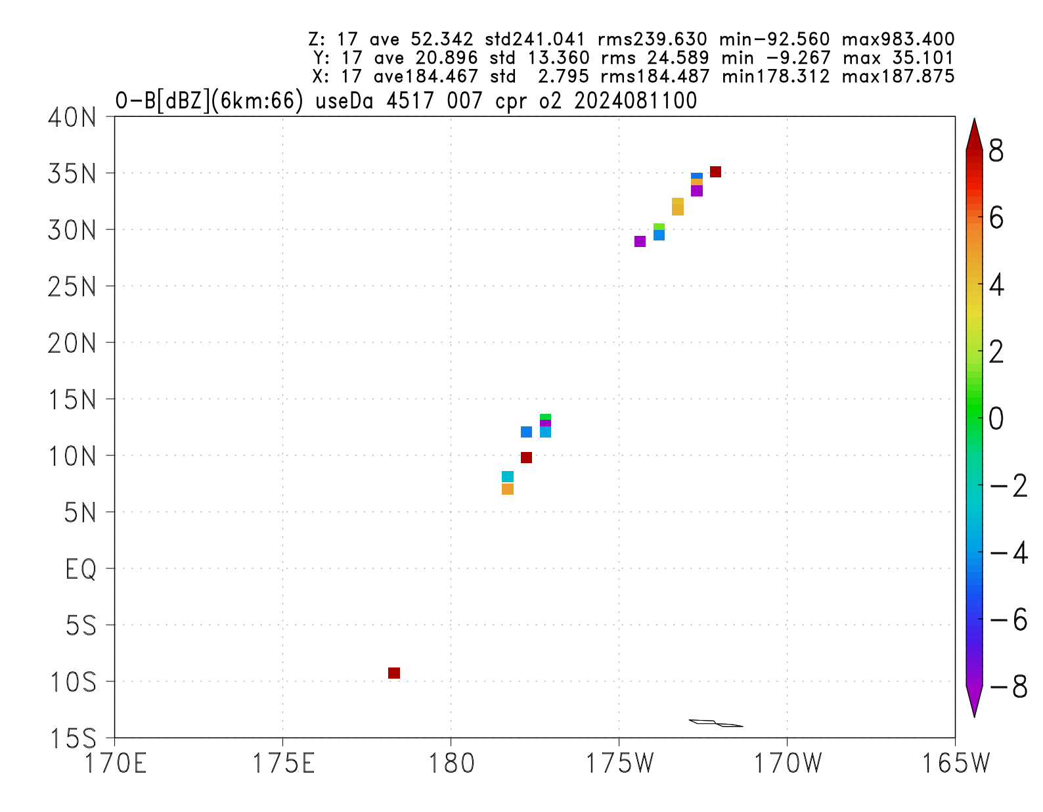
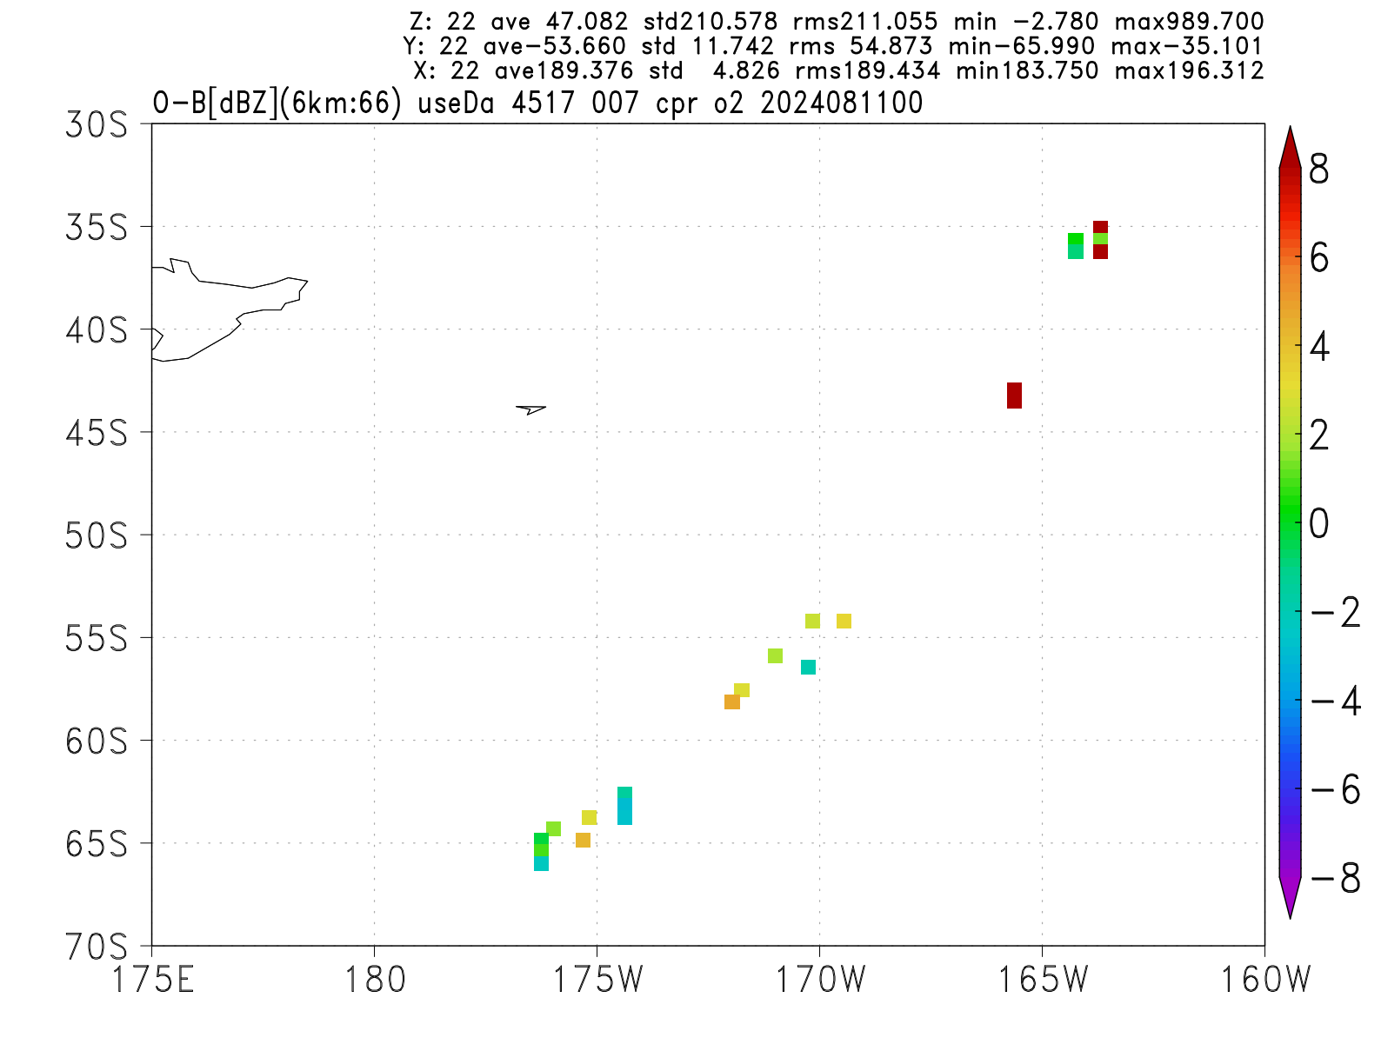
QC-passed data
9km(51L)
12km(36L)
2024.8/11.00UTC
  8/10.21UTC-8/11.03UTC)
Thinning H80km-V200m
QC-passed O-B (dBZ)
6km(66L)
2km(86L)
Notes:
O-B2, 20

Slide 13
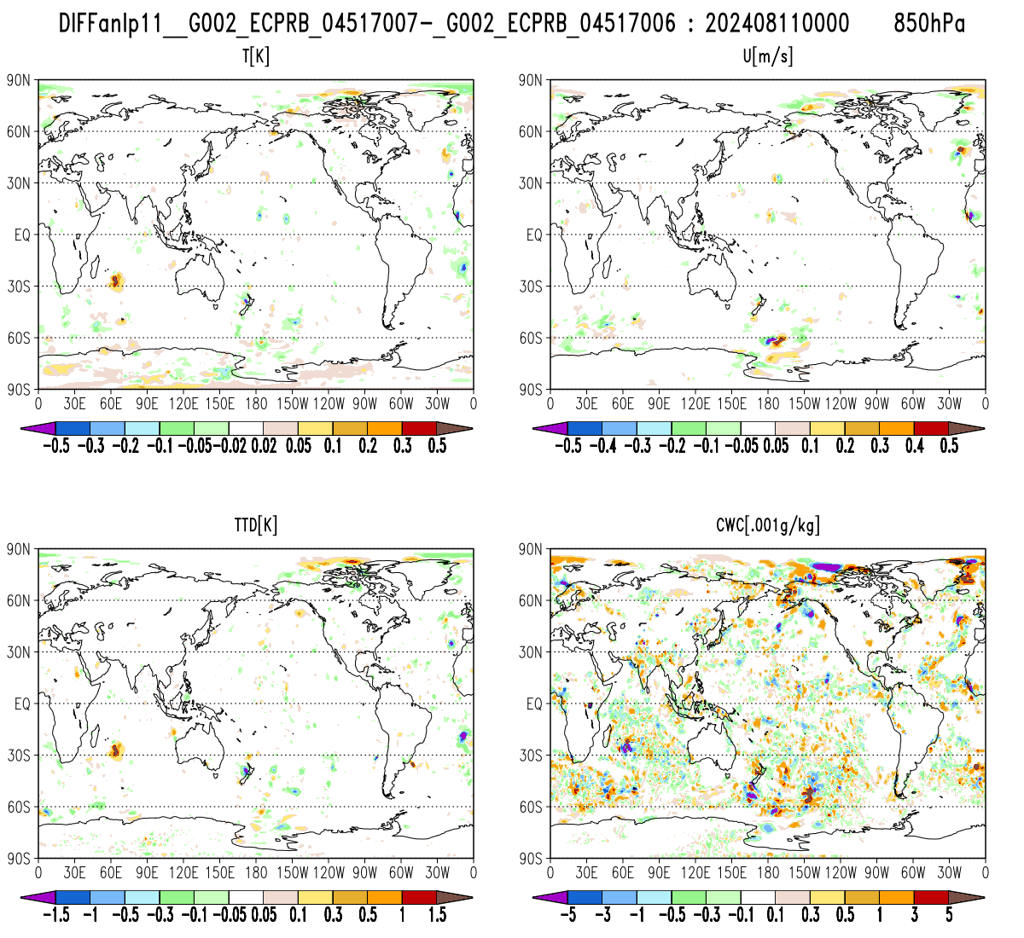
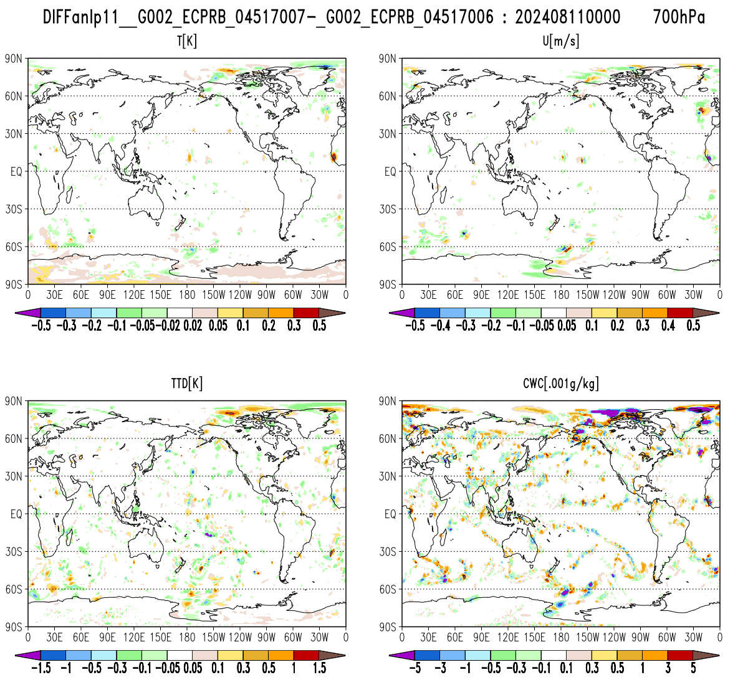
Analysis difference of CPR and noCPR
850hPa
T [K]
U [m/s]
700hPa
T [K]
U [m/s]
TTD [K]
CWC [g/1000kg]
TTD [K]
CWC [g/1000kg]
Notes:
anl_p: cpr- nocpr: ECPRB_04517007- 04517006, 2024081100

Slide 14
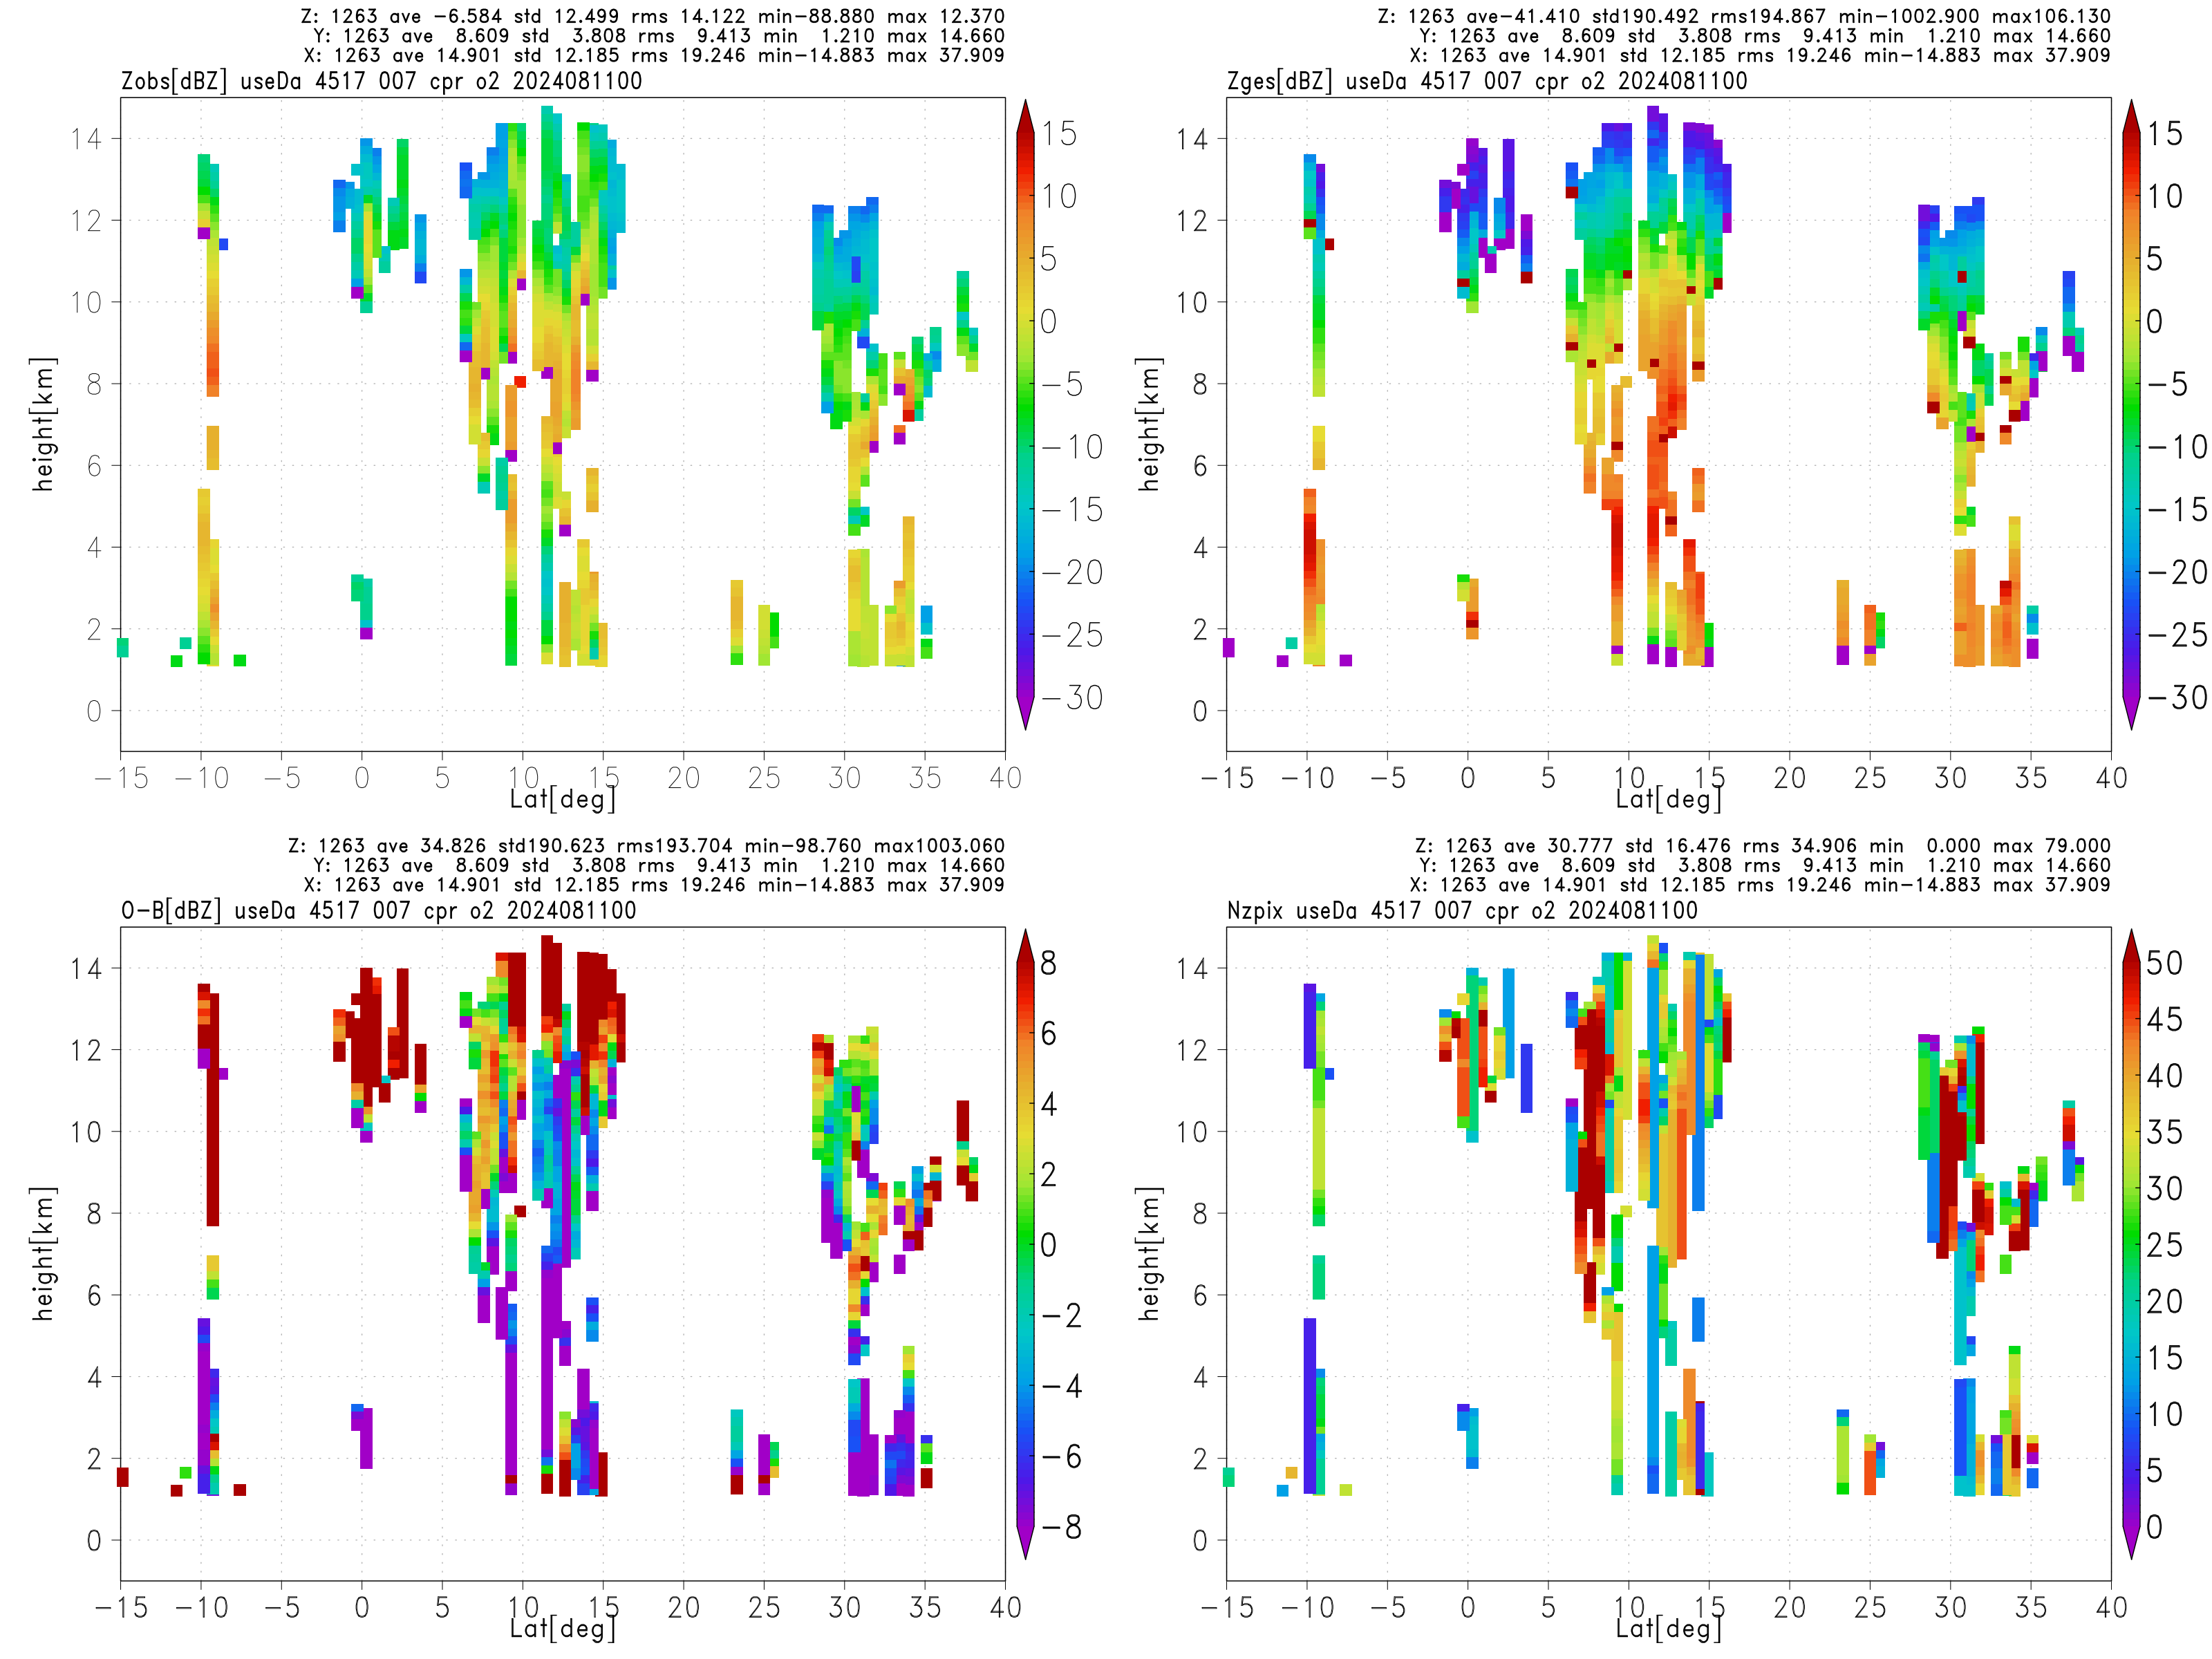
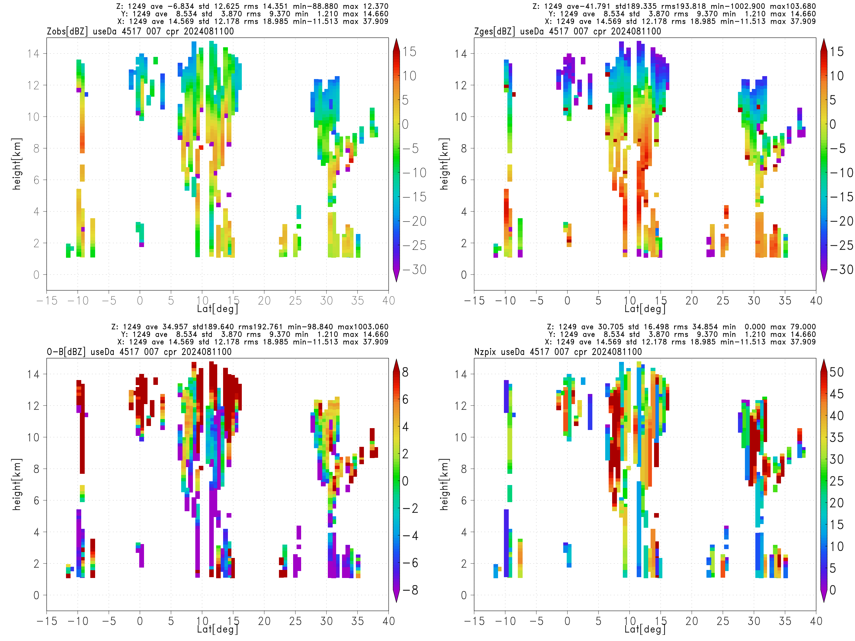
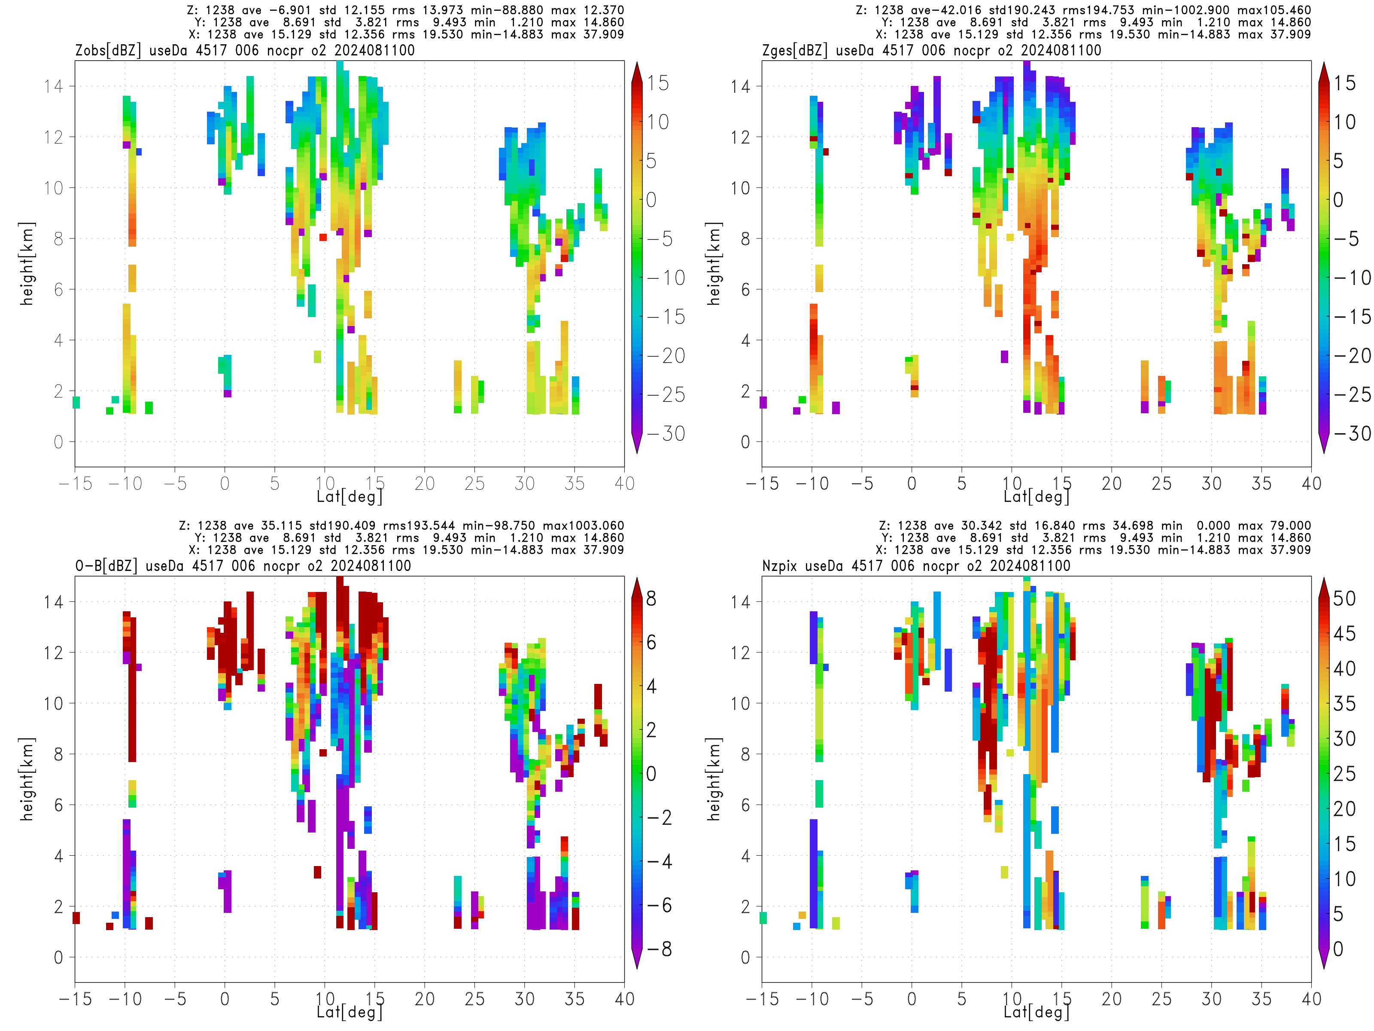
C.Pac
BG
OB
Negligible change by CPR assimilation
O-B1
nocpr, O-B2
cpr, O-B2

Slide 15
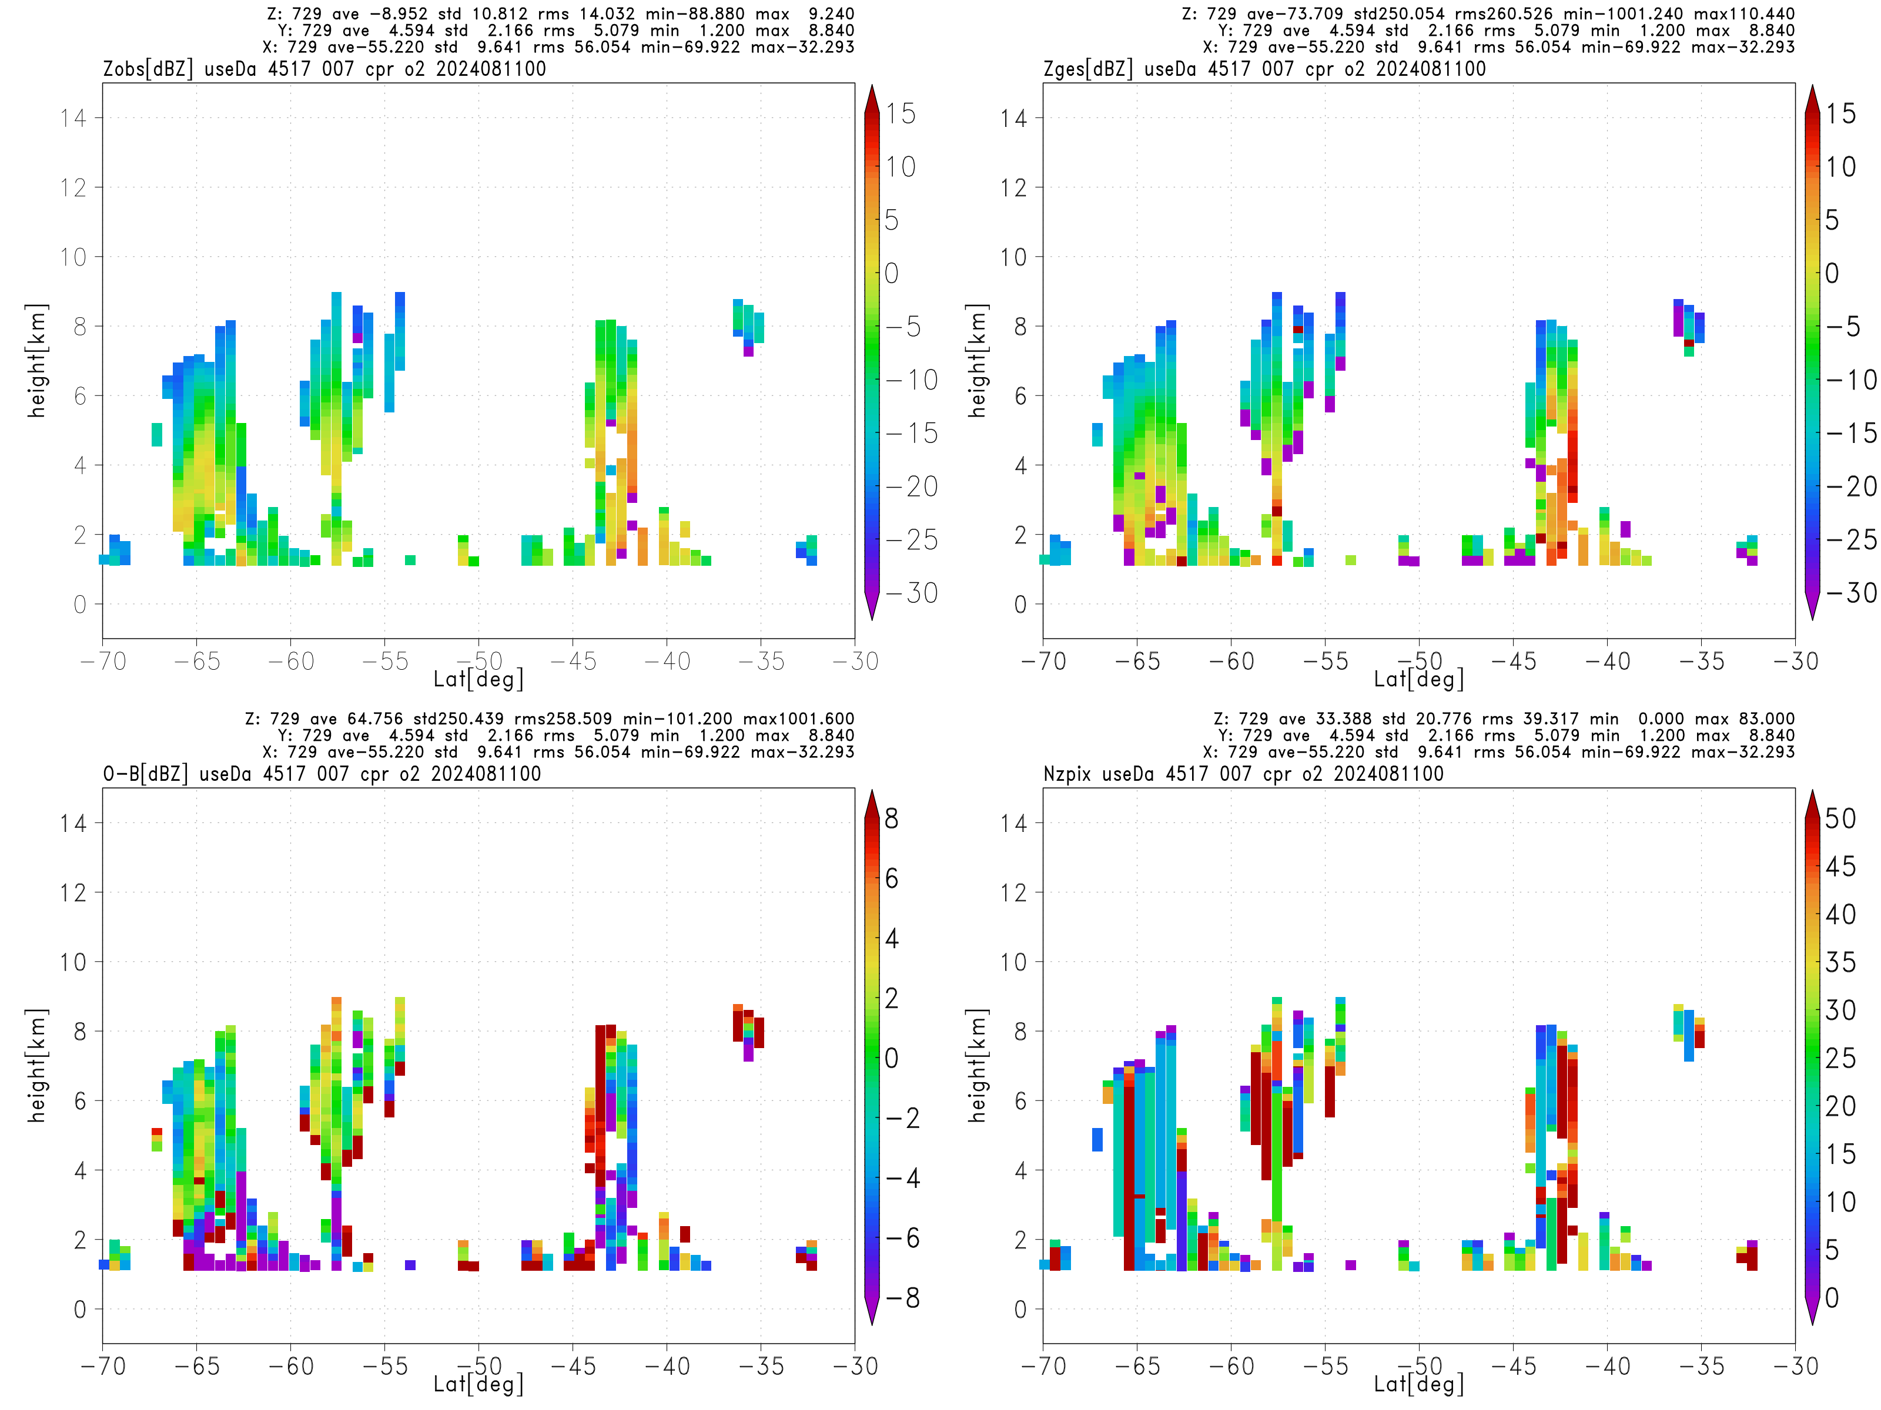
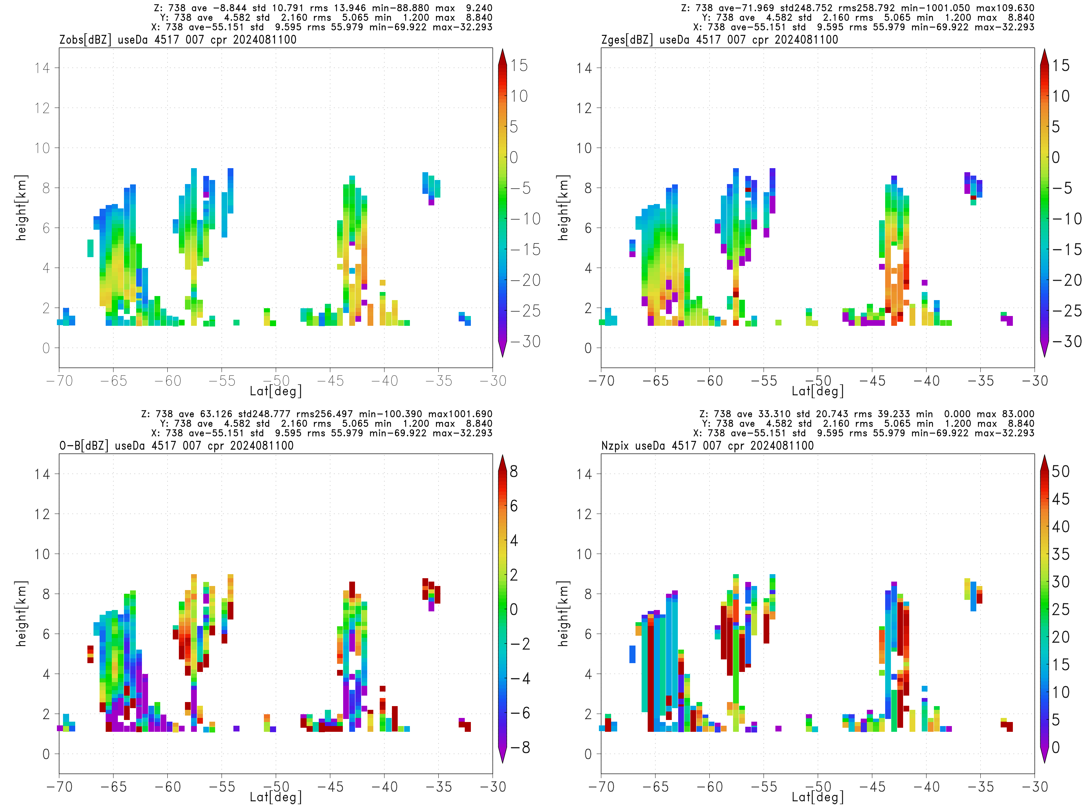
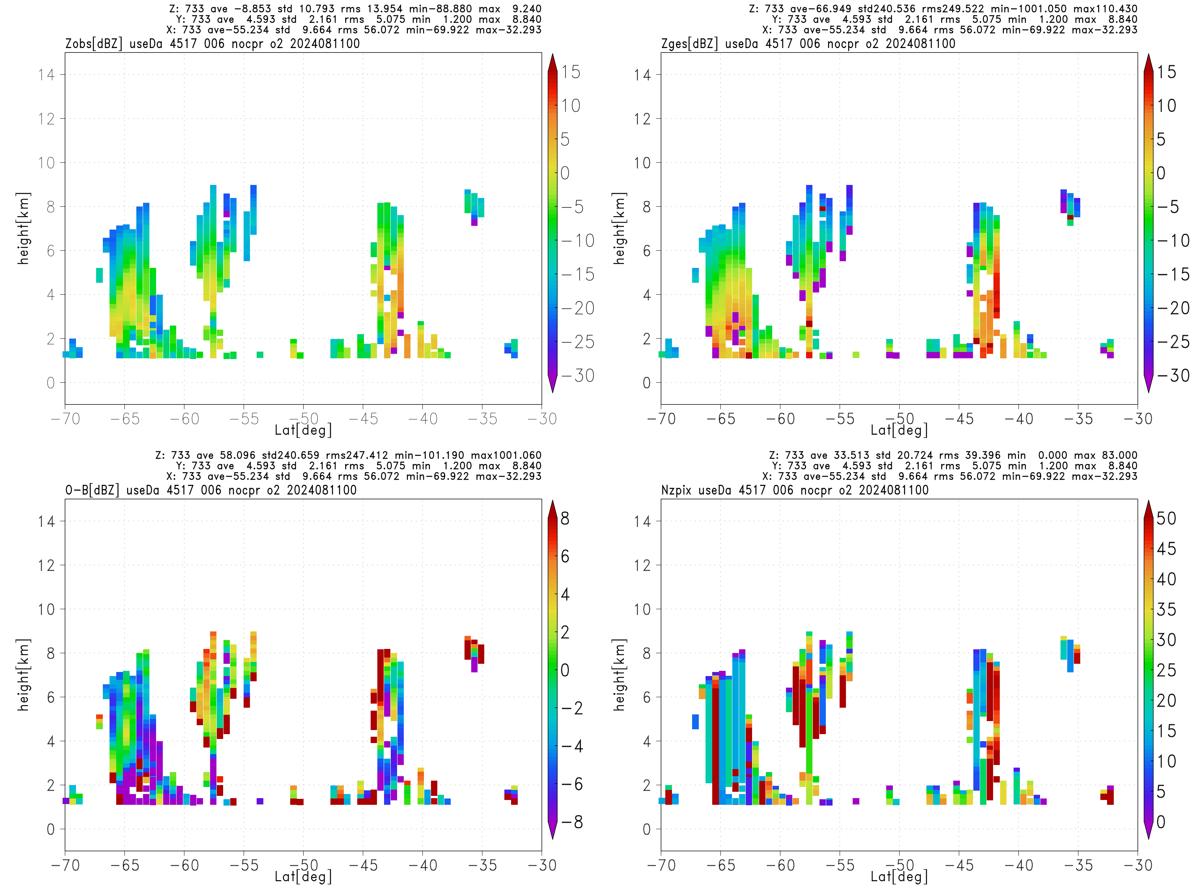
S.Ocean
BG
OB
Slightly better fit than background (O-B1) and No-CPR (O-B2)
O-B1
nocpr, O-B2
cpr, O-B2

Slide 16
Content
1. Comparison of obs and simulation (background)
2. Initial test of assimilation
3. Preparation for advanced data assimilation

Slide 17
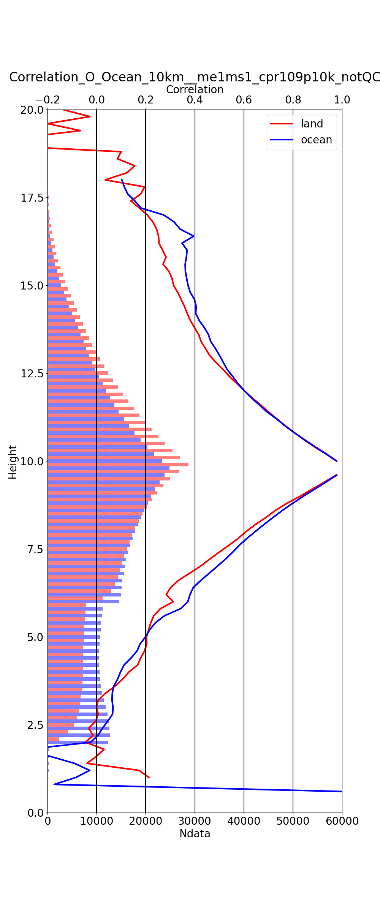
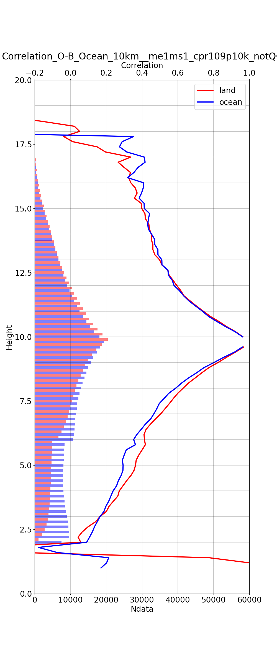
Vertical correlation for obs and O-B
Obs
O-B
Correlation for obs/O-B at 10 km height
Large vertical correlation length
  Distance with corr <0.2 is 5 km (obs) and 6.5km (O-B)
→ Need larger thinning distance and/or accounting for vertical error correlation
0.0 0.2 0.4 0.6 0.8 [corr]
0.0 0.2 0.4 0.6 0.8 [corr]
land
ocean
land —
ocean —
0 1 2 3 [Num*10,000]
0 1 2 3 [Num*10,000]
Notes:
grid間隔 500m(H),100m(V), 解像度 1km or 10km(H), 500m(V)

Slide 18
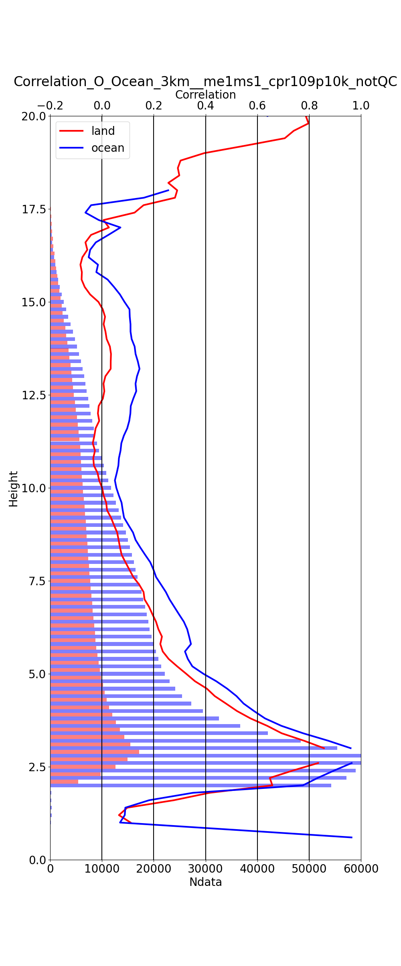
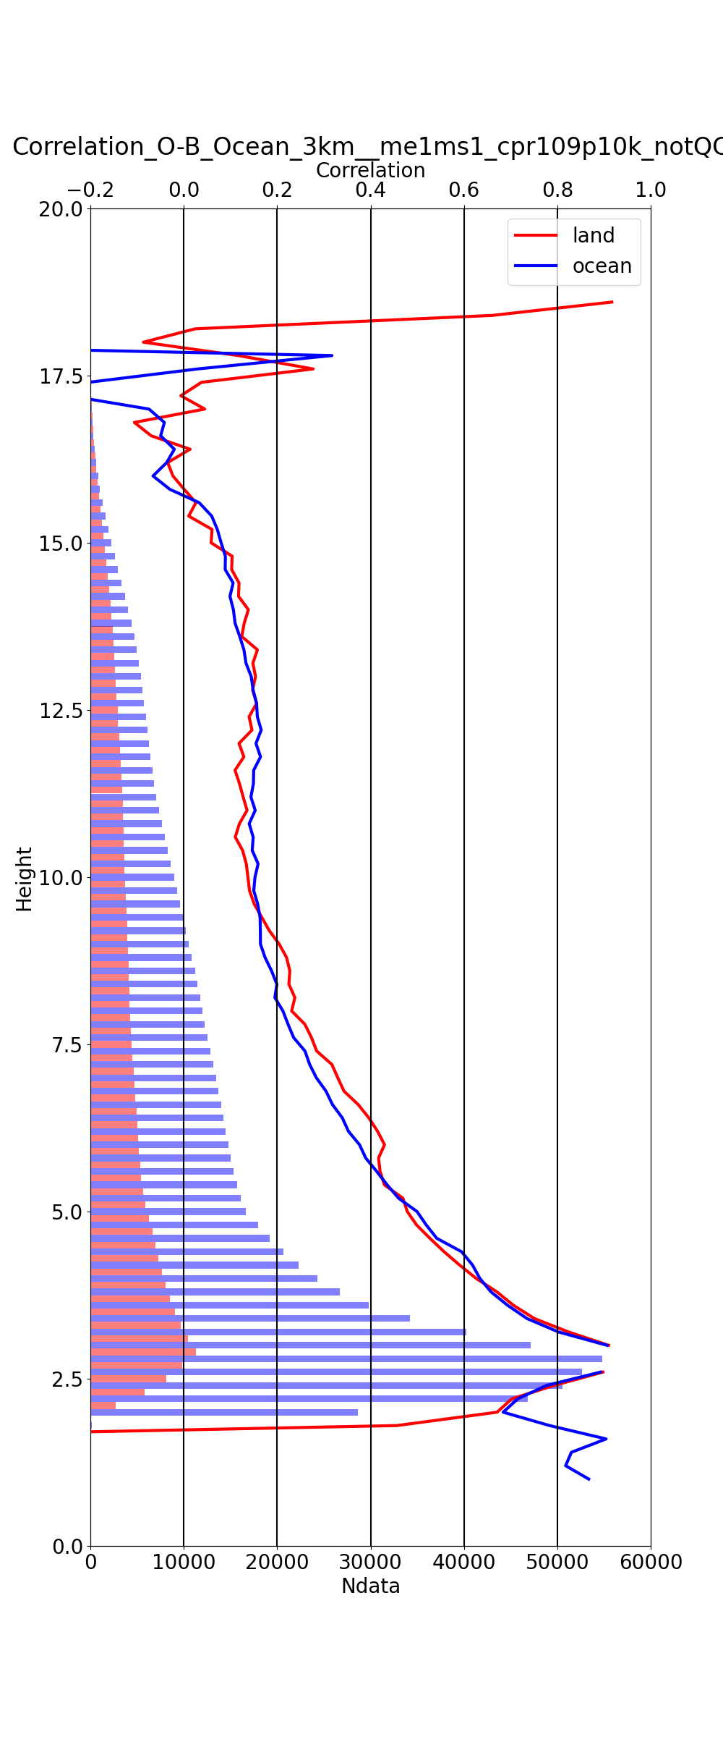
Vertical correlation for obs and O-B
Obs
O-B
Correlation for obs/O-B at 5 km height
Large vertical correlation length
  Distance with corr <0.2 is 4.5 km (obs) and 5.5km (O-B)
→ Need larger thinning distance and/or accounting for vertical error correlation
0.0 0.2 0.4 0.6 0.8 [corr]
0.0 0.2 0.4 0.6 0.8 [corr]
land —
ocean —
land —
ocean —
0 1 2 3 [Num*10,000]
0 1 2 3 [Num*10,000]
Notes:
grid間隔 500m(H),100m(V), 解像度 1km or 10km(H), 500m(V)

Slide 19
Summary and plans
Examine reflectivity simulation using the global DA system
  Generally well reproduced observation, but underestimated (overestimate) below -40 deg C (above 0 deg C)
  Simulation with AC_CLP and RTTOV shows strange peak at 5dBz and consistent overestimation (O-S<0)
Initial check of Z assimilation with preliminary setting
  Single analysis suggests small but reasonable impacts
Advanced data assimilation processing is under development
  Vertical error correlation should be accounted for
Plans
  Investigate bias sources and sensitivity to optical parameters in more detail
  Short cycle experiments after initial checks
  Develop cloud-dependent QC, obs error, and BC
Notes:
L2 (single sensor) products will be open to the public in March 2025

Slide 20
Supplemental slides

Slide 21
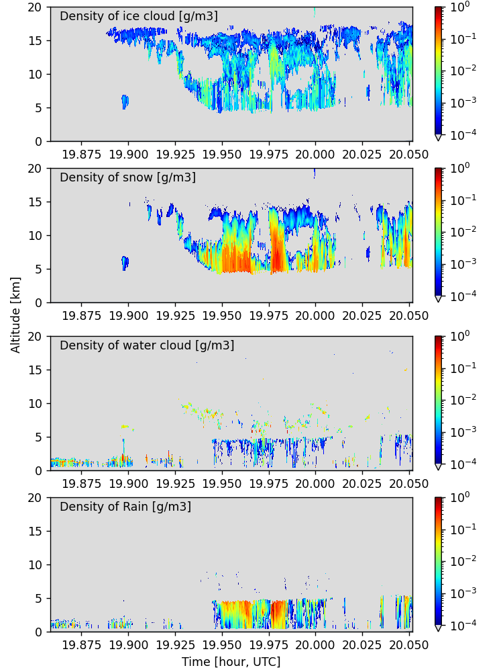
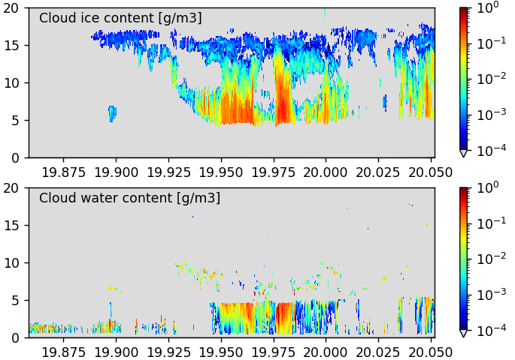
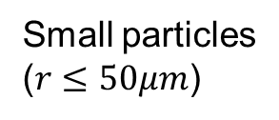
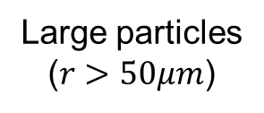
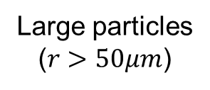
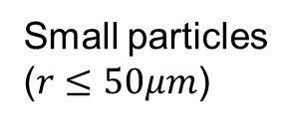
AC_CLP → RTTOV input
4 hydrometer types used in RTTOV
AC_CLP cloud product
Small particles
($r≤50μm$)
Cloud ice
Snow
Cloud water
Rain
Cloud ice [g m^{－3}]
Large particles
($r>50μm$)
Altitude [km]
Cloud water [g m^{－3}]
Small particles
($r≤50μm$)
Time [hour, UTC]
Large particles
($r>50μm$)
粒径に応じて雲氷（雲水）を、氷・雪（雲水・雨）に分類
  0/1の分類ではなく、粒径分布に基づき割合も考慮
Time [hour, UTC]

Slide 22
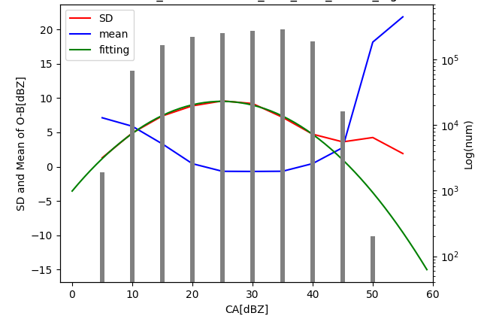
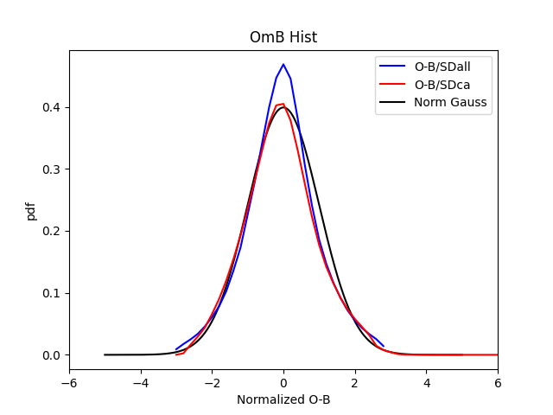
Cloud effect parameter and obs error in DA
Cloud effect parameter is a key to all-sky radiance (ASR) assimilation
  Cloud effect parameter for IR ASR: CA = (|O-Bclr| + |B-Bclr| )/2 (Okamoto et al. 2014)
    O: observation, B: all-sky simulation, B:clear-sky simulation, defined in brightness temperature [K]
  O-B standard deviation (SD) models used as obs error model (Geer and Bauer 2011; Okamoto et al. 2023, 2034)
Apply ASR’s CA to CPR Z
  CPR’s CA = (O+B)/2 + Bclr [dBZ], Sclr=-35dBZ
  O-B normalized by
  the obs model shows
  Gaussian form
EarthCARE/CPR Z
Log(num)
EarthCARE/CPR Z
O-B SD
O-B mean
sample num
O-B/SDall
O-B/SDca
Norm Gauss
O-B/SDall
O-B SD and mean [dBZ]
O-B/SDca
Obs Error model (quadratic fitting)
0 10 20 30 40 50 60
CA[K]
-6 -4 -2 0 2 4 6
Normalized O-B

Slide 23
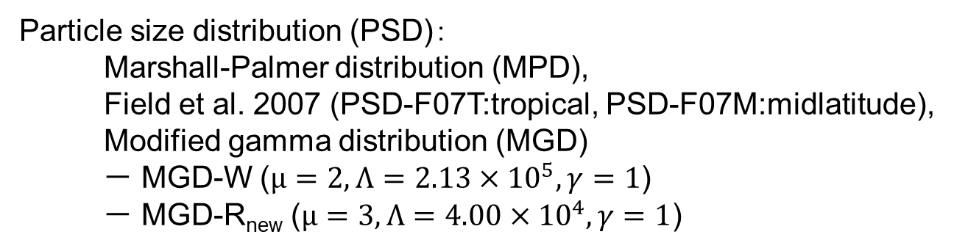

Dependence of PSD and particle shape
 | Rain | Snow | Cloud water | Cloud ice
Standard | Sphere, MPD | LPA, PSD-F07T | Sphere, MGD-W | LCA, PSD –F07T
R_{new} | Sphere, MGD-Rnew | LPA, PSD-F07T
S_{new} | Sphere, MPD | 8CA, PSD-F07M
R_{new}+S_{new} | Sphere, MGD-Rnew | 8CA, PSD-F07M
Large plate aggregate
(LPA)
Large column aggregate
(LCA)
8-column aggregate
(8CA)
Eriksson et al. 2018
Particle size distribution (PSD)：
Marshall-Palmer distribution (MPD),
Field et al. 2007 (PSD-F07T:tropical, PSD-F07M:midlatitude),
Modified gamma distribution (MGD)
－ MGD-W ($μ=2, Λ=2.13×{10}^{5}, γ=1$)
－ MGD-R_{new} ($μ=3, Λ=4.00×{10}^{4}, γ=1$)
MGD
$$n\left(D\right)=N_{0}D^{μ}\exp\left(−ΛD^{γ}\right)$$

Slide 24
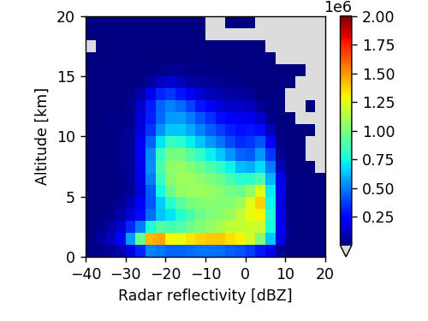
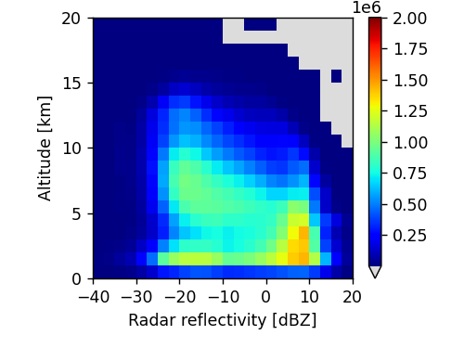
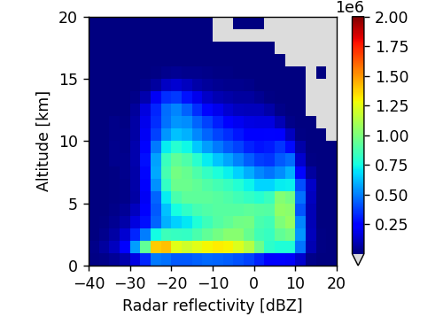
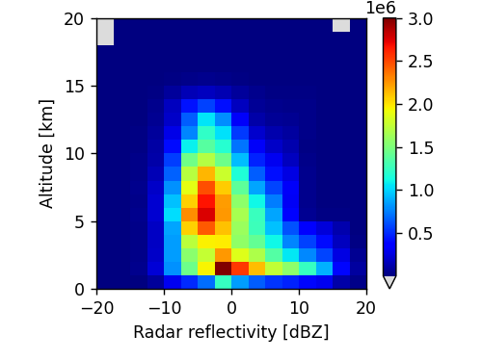
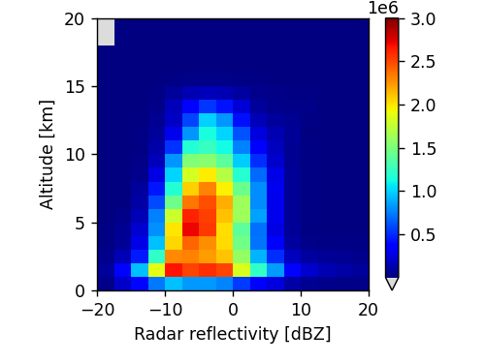
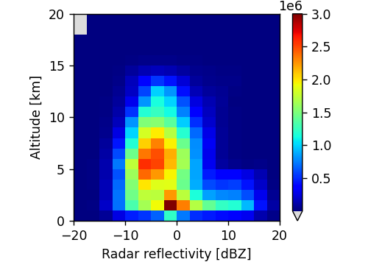
Dependence of PSD and particle shape
obs(1km)
sim(STD）
sim(R_{new}）
sim(S_{new}）
sim(R_{new}+S_{new}）
Altitude [km]
Reflectivity [dBZ]
obs－sim(STD)
obs－sim(R_{new})
obs－sim(S_{new})
obs－sim(R_{new}+S_{new})
Altitude [km]
Reflectivity [dBZ]
Reflectivity [dBZ]
Reflectivity [dBZ]
Reflectivity [dBZ]

