Slide 1
Assimilating precipitation-sensitive observations in global weather forecasting
Alan Geer, Niels Bormann, Elisa Chardon--Legrand, David Duncan, Mark Fielding,
Richard Forbes, Kamil Mroz, Sanjeevani Panditharatne, Nils Risse, Tracy Scanlon
International Precipitation Working Group
Kraków July 10th 2026
alan.geer@ecmwf.int

Slide 2
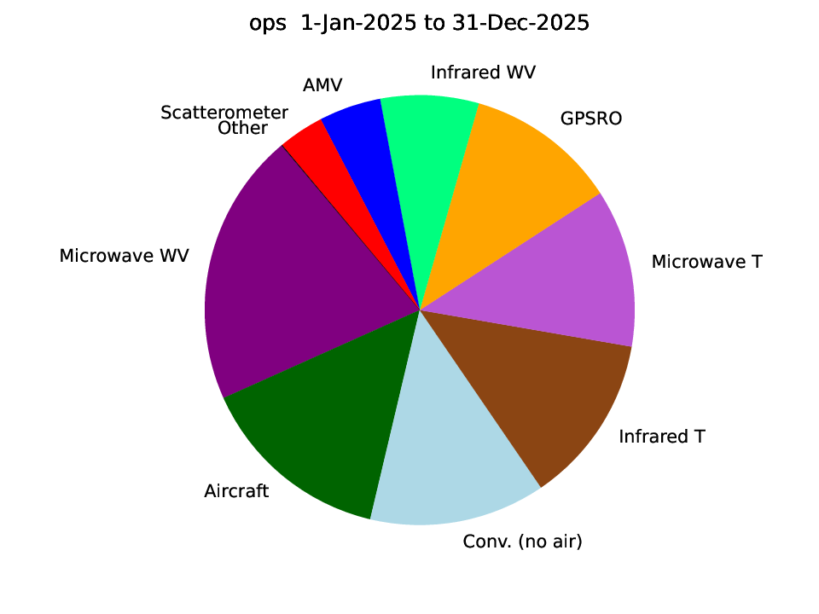
All-sky assimilation of passive microwave uses precipitation information
Relative Forecast Sensitivity to Observation Impact (FSOI) on ECMWF 24 h forecast for calendar year 2025
Temperature sounding channels of:
AMSU-A, AWS-MWR, ATMS*
Humidity and imaging channels of:
MHS, MWHS-2, SSMIS, GMI, AMSR2, AWS-MWR, ATMS*
* ATMS is still only assimilated in clear-sky, not all-sky

Slide 3
Extending the use of all-sky passive microwave
All-sky all-surface assimilation:
  Assimilation of AMSR2 and GMI observations from 10 GHz upwards over sea ice, activated 12th Nov. 2024
    Machine learning and physical modelling, using ”empirical state” method: https://doi.org/10.1002/qj.4797
Extended low frequency range :
  ECMWF now assimilates 6.9 GHz and 10 GHz radiances from AMSR2 and GMI with SST coupling in the DA
    Earlier work see Scanlon et al. (2026, https://doi.org/10.1002/qj.70087)
  In the context of ESA DANTEX project, preparing for Copernicus Imaging Microwave Radiometer (CIMR) at 1.4 – 37 GHz
    Precursors: SMAP 1.4 GHz -> developing sea ice thickness and salinity assimilation
    Precursors: AMSR2 6.9 GHz -> contribute to sea ice temperature and sea ice emission characterization
Extended high frequency range
  ESA’s Arctic Weather Satellite (AWS) has the first operational sub-mm channel: 325 GHz
    A ”new space” mission developed in just a few years, using a satellite the size of a small kitchen appliance
    The future EUMETSAT Sterna constellation will use AWS-like satellites
  EUMETSAT Ice Cloud Imager is expected early 2027 with channels up to 664 GHz

Slide 4
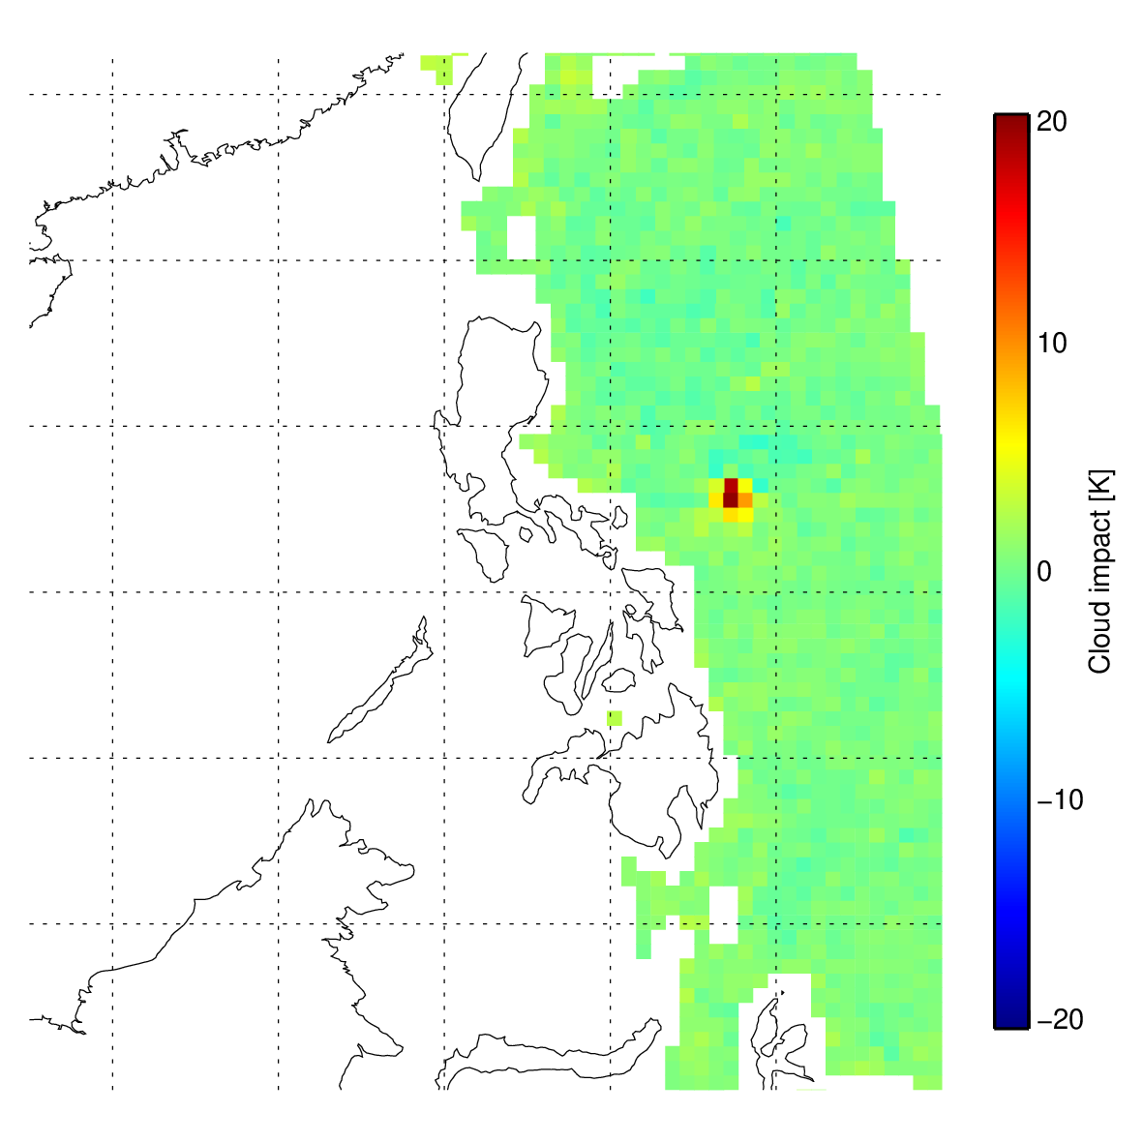
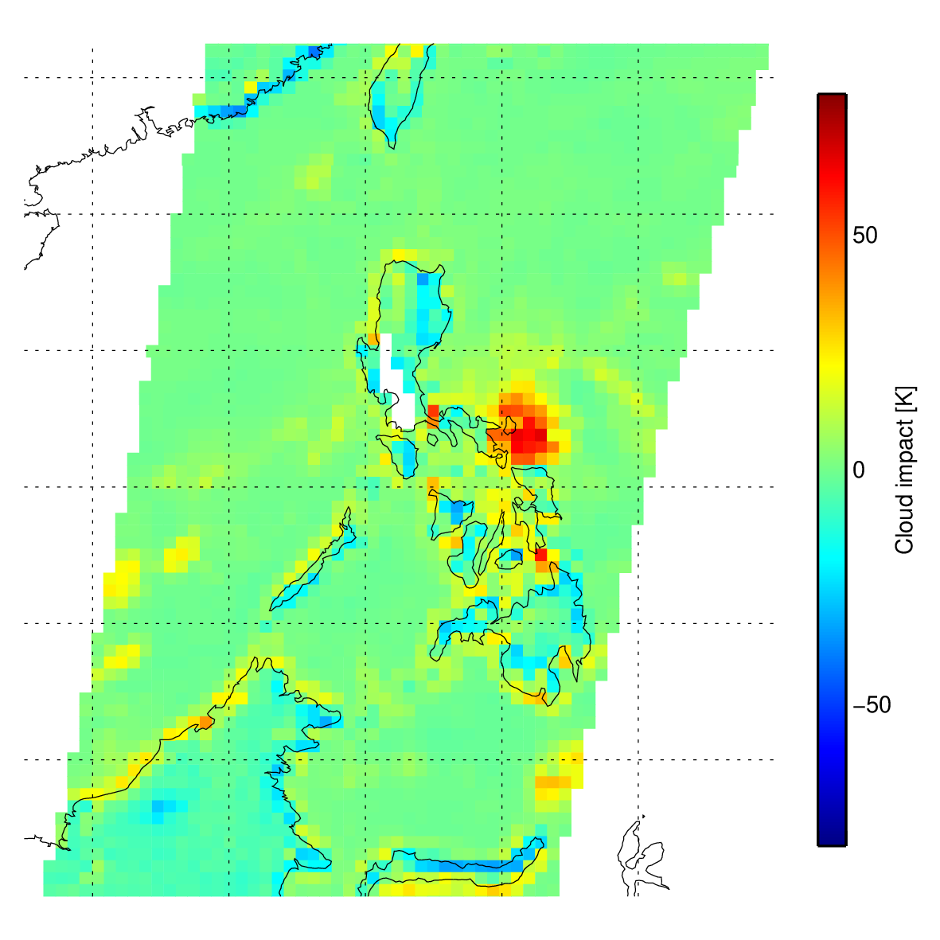
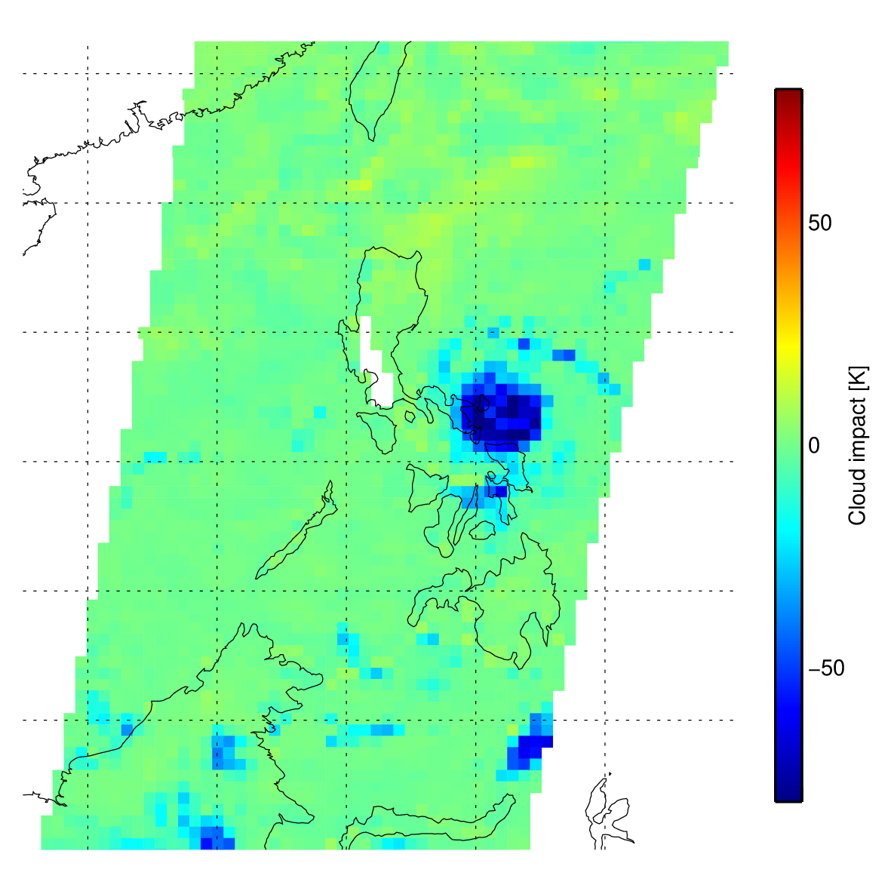
Low frequency microwave sees heavy / large rain: Typhoon Goni / Rolly
31st October 2020 as seen by SMAP (09:23 UTC) and AMSR2 (17:36 UTC)
Observations superobbed to 40 km; clear-sky background removed based on IFS / RTTOV simulation
SMAP 1.4h
AMSR2 6.9h
AMSR2 89v
SMAP 1.4 GHz sees eyewall with 20 K signal
AMSR2 6.9 GHz sees central precipitation area with 50 K signal

Slide 5
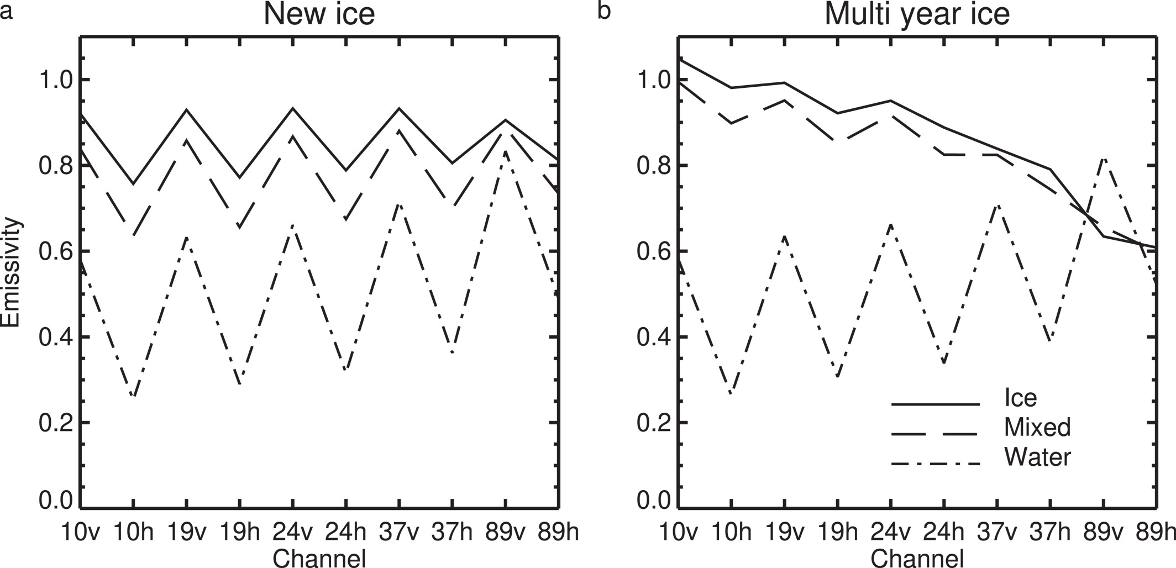
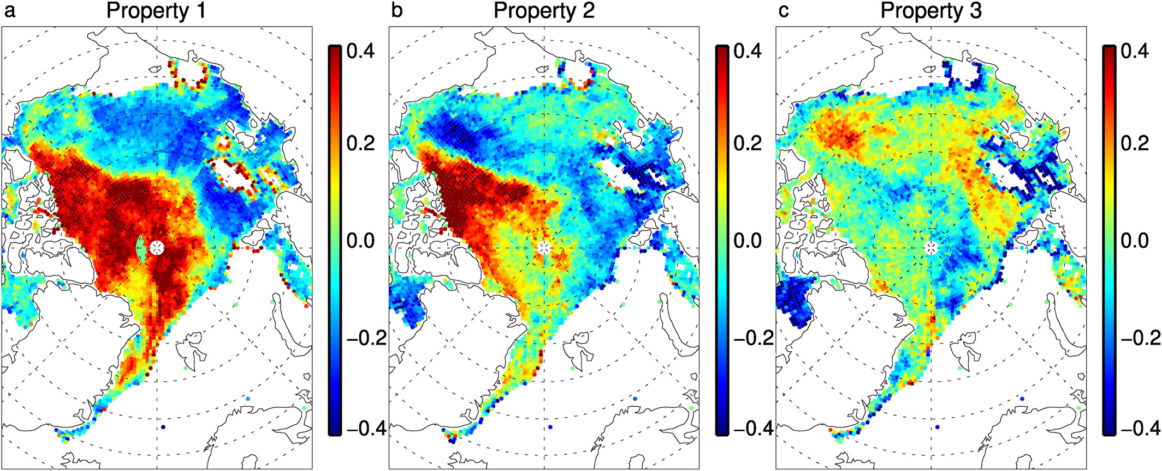
Low frequency microwave drives developments in hybrid empirical-physical surface emission modelling
Sea ice emissivity modelling
  Hybrid machine learning – data assimilation training framework
  Small neural network predicts sea ice surface emissivity based on three empirical properties – which are estimated from obs
  Supports assimilation of 10 – 183 GHz AMSR2 and GMI observations over sea ice
  Geer (2024, JAMES, https://doi.org/10.1029/2023MS004080)
Sea ice emission modelling in development
  Add more physics (two slab scattering snow/ice radiative transfer model) and remove some machine learning
Relevance to IPWG
  These techniques can be extended over land surfaces – this is likely the future of emission modelling for all-sky all-surface assimilation at ECMWF, maybe beyond?
  A small demonstration of hybrid ML – DA techniques (see later)
Empirical properties illustrating first and multi-year ice
over the Arctic

Slide 6
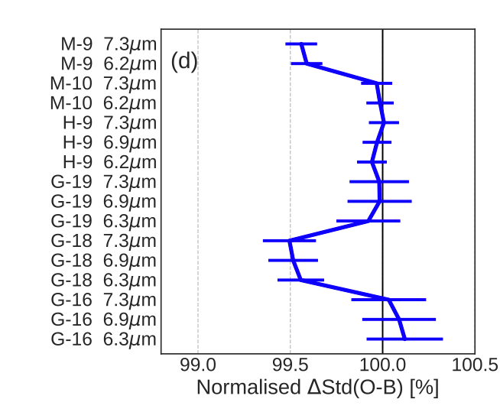
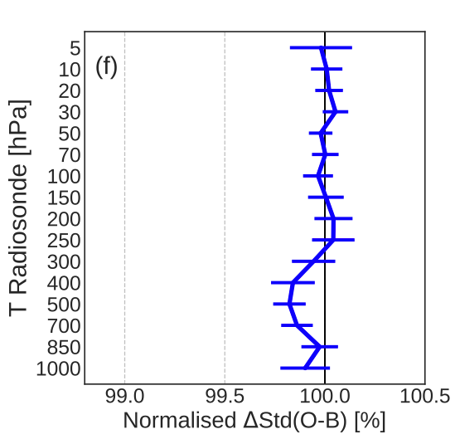
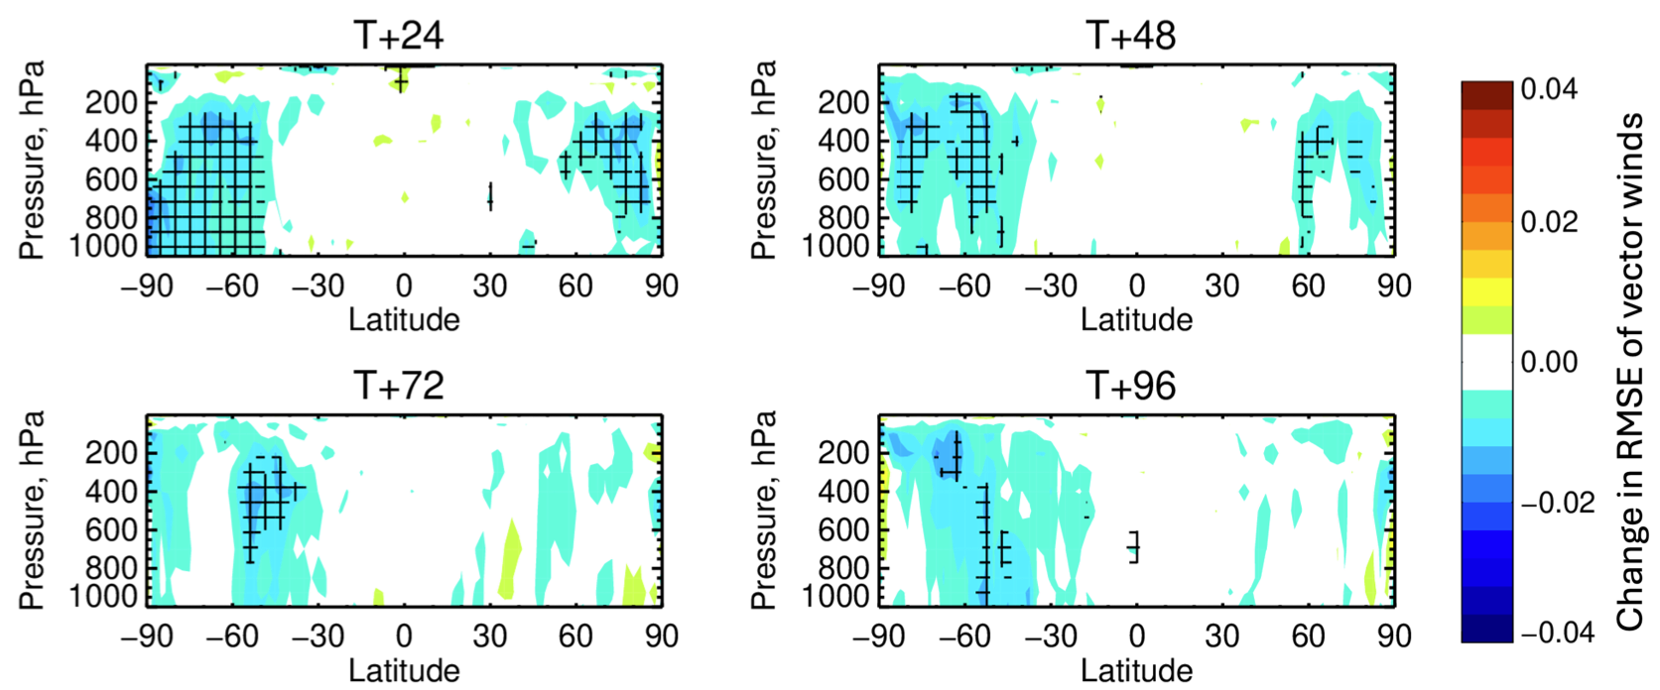
Assimilation of the Arctic Weather Satellite (AWS)
AWS is assimilated in the all-sky framework
  Duncan et al. (2026, AMT, https://doi.org/10.5194/amt-19-3581-2026)
ECMWF now operationally assimilates:
  Channels 4-7 (53-55 GHz)
  Channels 11-15 (183 GHz band)
  Channels 16-18 (325 GHz band)
Positive impact on short-range forecast as measured by fits to independent observations
Medium-range impact up to day 4 in 9 months of experimentation
Assimilated operationally since July 2025
👍
👍
GEO IR
T sondes
👍
👍

Slide 7
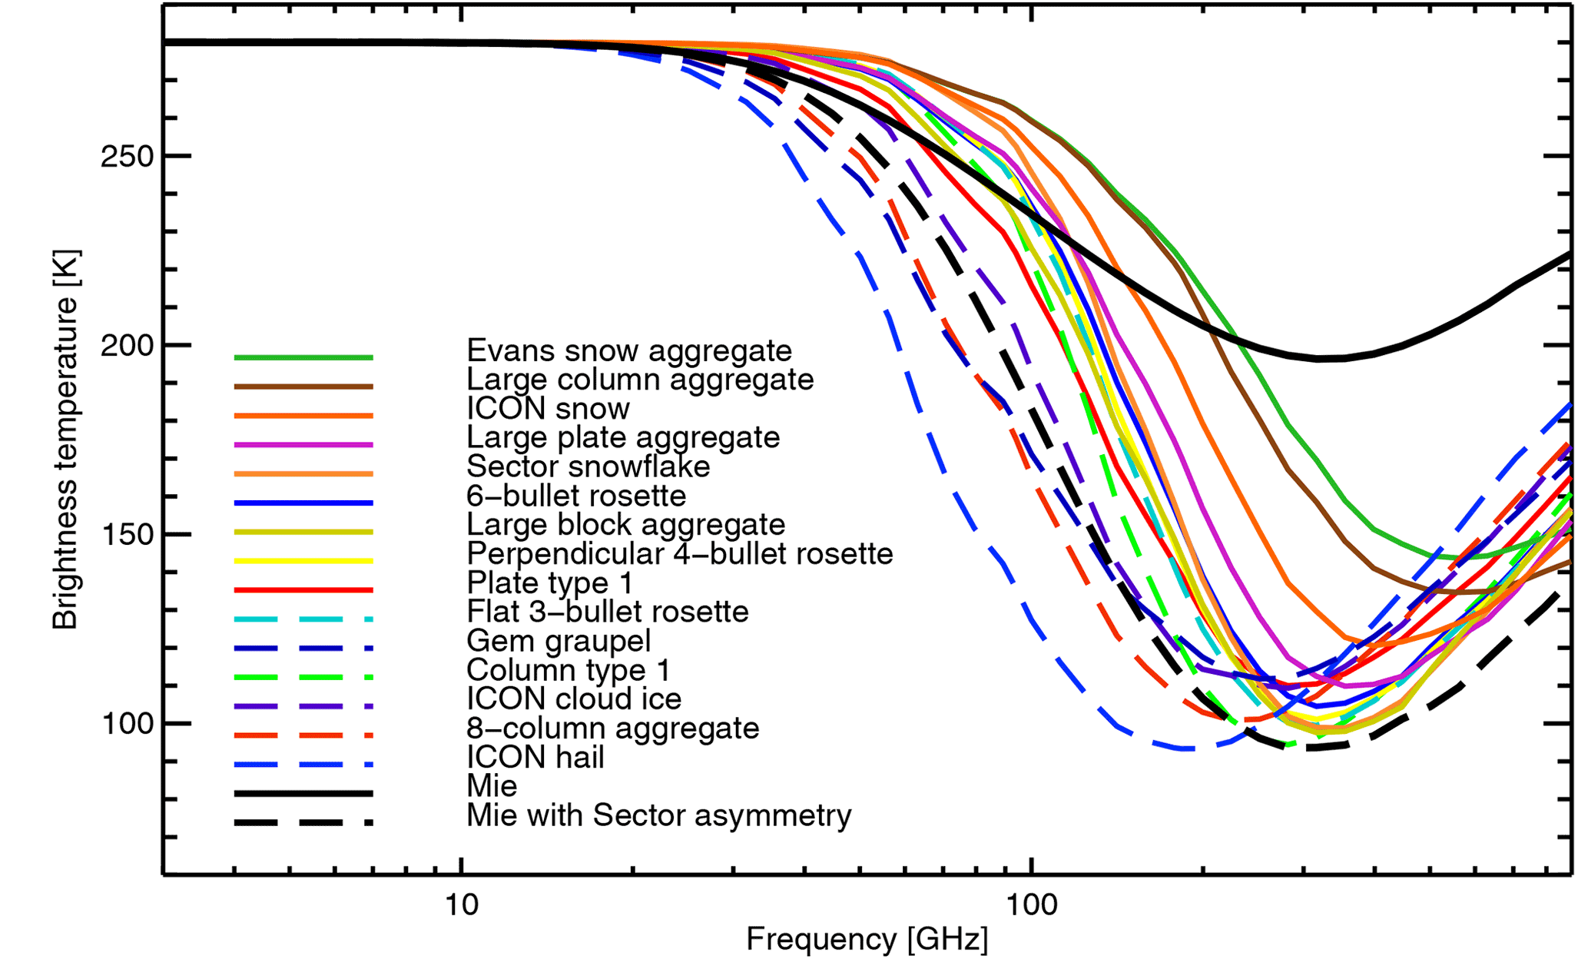
Sub-mm “turnaround” to identify microphysical properties
Single cloud layer with identical mass in each case, over 280K upwelling radiation - https://doi.org/10.5194/gmd-14-7497-2021
+ve difference in TB between 325 GHz and 183 GHz should indicate a “turnaround” for large hail or other dense large ice particles

Slide 8
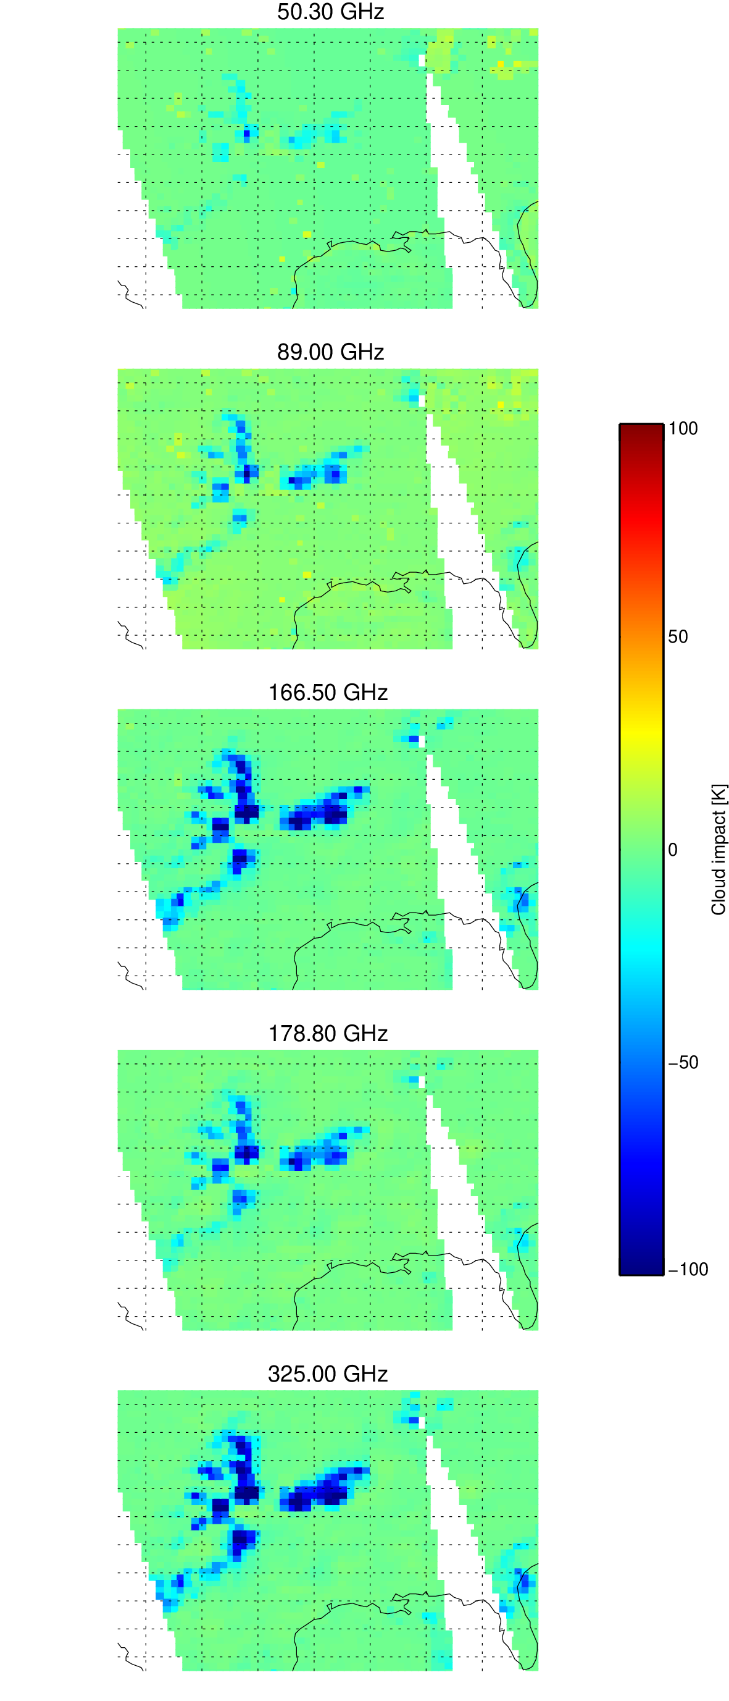
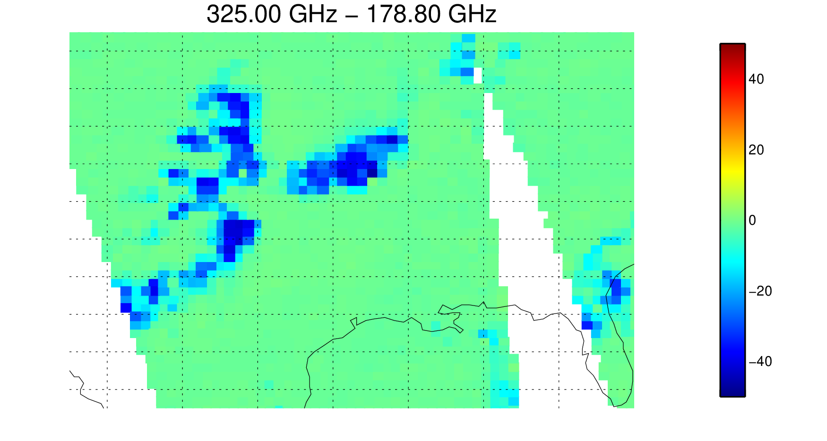
AWS observes turnaround over Sublette, Kansas: intense hail
23:43 CDT, 10th August 2025. 50 km superob resolution
Cloud impact (observed – simulated clear)
TB gradient
ΔTB [K]
Area of severe storms
+0.43K: 325 GHz TB is warmer than 178.8 GHz TB, despite intense scattering
Strong scattering signal at low frequencies
(~50 K depression at 50 GHz)

Slide 9
Radio frequency interference (RFI)
Well-known effects at 1.4, 6.9, 7.3, 10.65, 18.7 GHz
  E.g. ECMWF RFI screening: Scanlon et al. (2025, IEEE TGARSS, https://doi.org/10.1109/TGRS.2025.3627448)
  E.g. Onrubia et al. (2026, AMT, https://doi.org/10.5194/amt-19-4141-2026)
New patterns of RFI have been appearing in the 6.9 GHz observations since at least 2023, possibly earlier
  Possible reflected direct broadcast from LEO communication constellations?
New ways of screening RFI needed at 1.4 GHz
  RFI from very strong point sources in conflict zones (GPS jamming?)

Slide 10

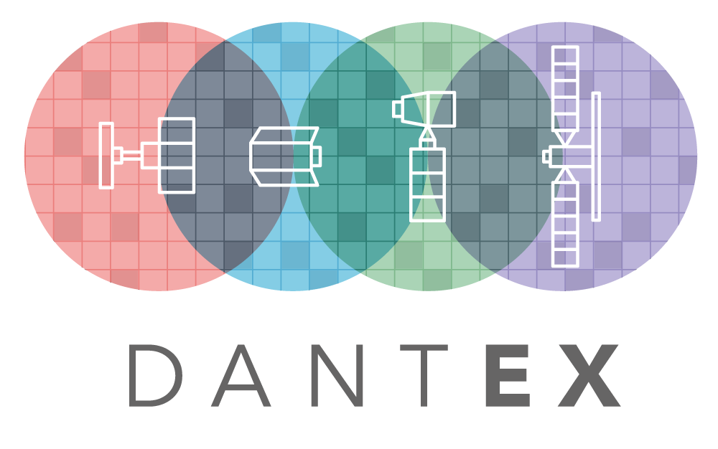
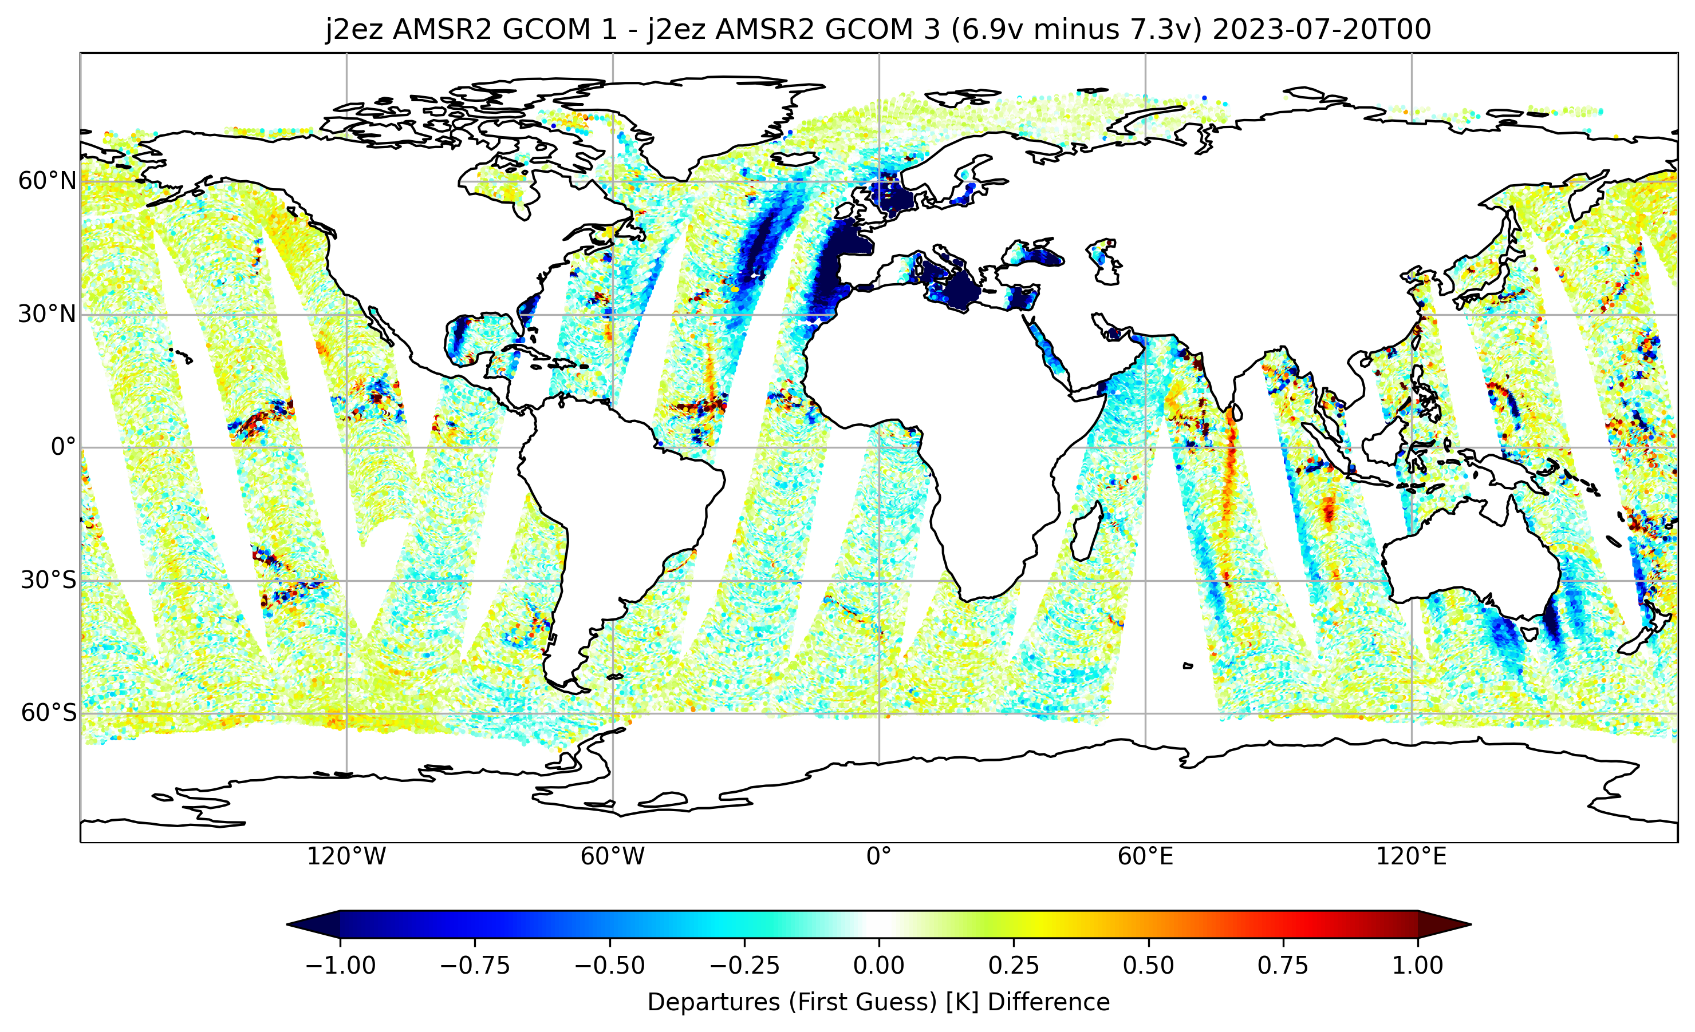
RFI management for AMSR2
Likely reflected geostationary broadcast RFI at 7.3 GHz
This makes it harder to use 7.3 GHz to identify point sources at 6.9 GHz
6.9 GHz – 7.3 GHz departure (no screening) from -3 to +9 UTC on 20/7/2023
New RFI signal appearing at 6.9 GHz since around 2023.
Possible RFI in 7.3 GHz
Possible RFI in 6.9 GHz

Slide 11
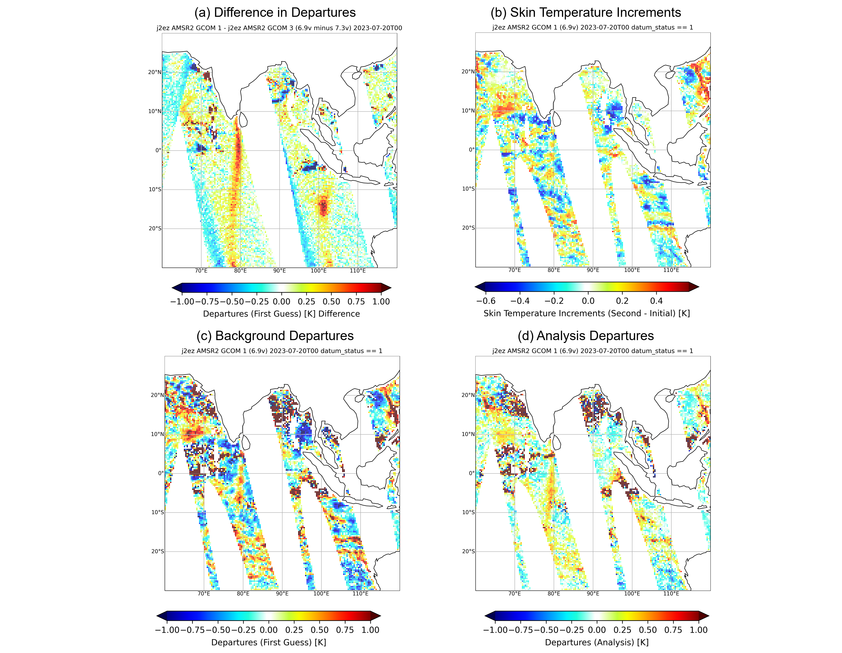
“Constellation” RFI at 6.9 GHz on AMSR2
6.9 GHz – 7.3 GHz departure (no screening)
6.9 GHz background departure (with screening)
New RFI signal appearing at 6.9 GHz since around 2023.
Can be explained by reflected broadcast from new large LEO constellations (based on simulations of their orbits)
Likely reflected geostationary broadcast RFI at 7.3 GHz
6.9 GHz not affected by geostationary RFI here
Sun glint screening (not seen in 6.9-7.3)
We cannot yet screen the constellation RFI signal – it gets assimilated

Slide 12
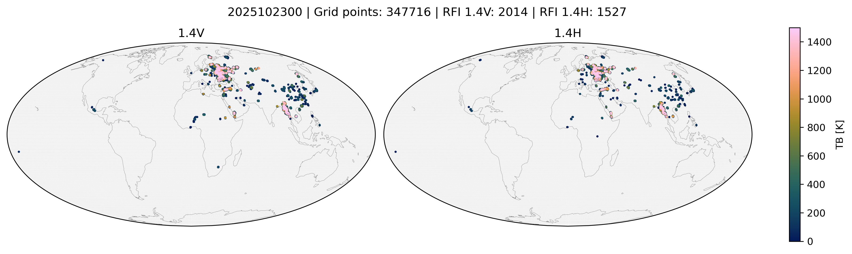
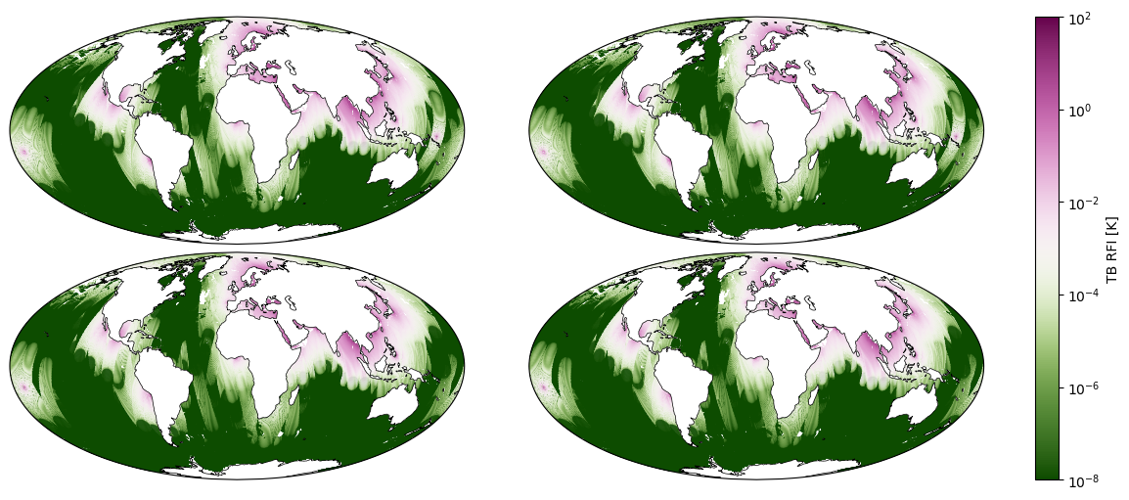
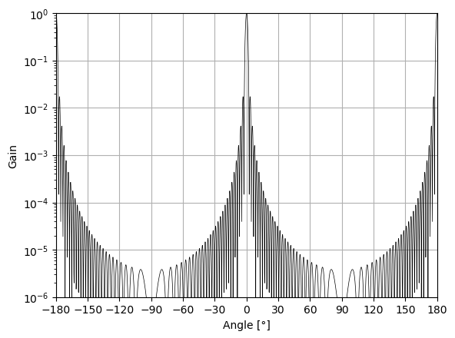
SMAP 1.4 GHz source mapping and RFI estimation
1.4 GHz v-pol source map based on last few days measurements
19th October 2025
Estimated RFI contamination TB (multiple orbits overlaid)
Integrate over estimated antenna pattern
Airy pattern used as current estimate
Apparently minor off-boresight sensitivity leads to RFI contamination over distant ocean

Slide 13
Radio frequency interference (RFI)
Well-known effects at 1.4, 6.9, 7.3, 10.65, 18.7 GHz
New patterns of RFI have been appearing in the 6.9 GHz observations since 2023
New ways of screening RFI needed at 1.4 GHz
  RFI from very strong point sources in conflict zones (GPS jamming?)
  Effects are seen over ocean, hundreds of kilometres away from the sources
    If RFI is strong enough, even very weak off-boresight sensitivity is enough to overwhelm the intended natural signal
  Solution: build our own RFI source maps and integrate the full antenna pattern over these maps
  New requirements for data providers:
    Please provide unscreened, RFI containing antenna TB measurements (up to >10,000 K) alongside the screened L1B TB
    Please provide measured antenna patterns to allow RFI source integrations for screening purposes
Possible machine learning approaches – to capture all RFI without detailed physical modelling

Slide 14
Radar assimilation
EarthCARE CPR radar reflectivity assimilation was activated in the ECMWF operational system on 10th June 2026
  Doppler and lidar reflectivity (ATLID) assimilation are under development
Benefits include:
  Improved analyses and forecasts through data assimilation
  Clear guidance for model improvements, in development:
    Possible move from Abel and Boutle (2012) to Marshall-Palmer PSD in cold rain
    Improved representation of high tropical cirrus cloud
    Revised snow terminal velocity parametrisation

Slide 15
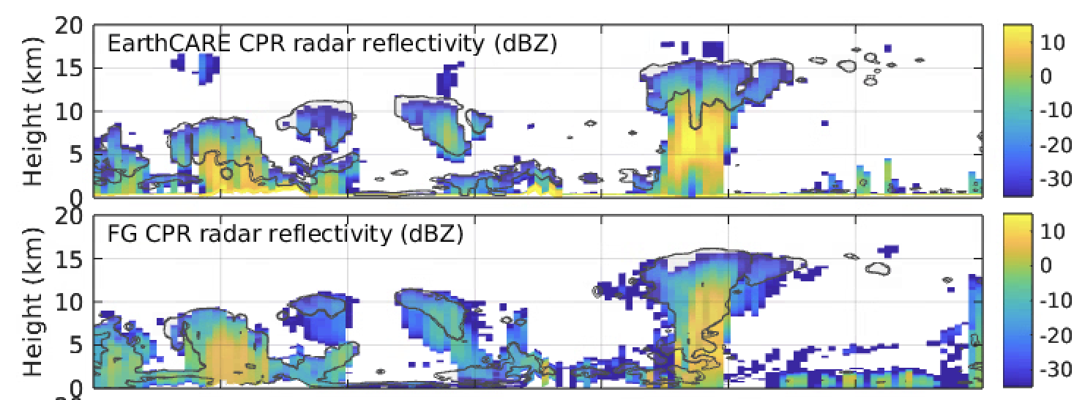
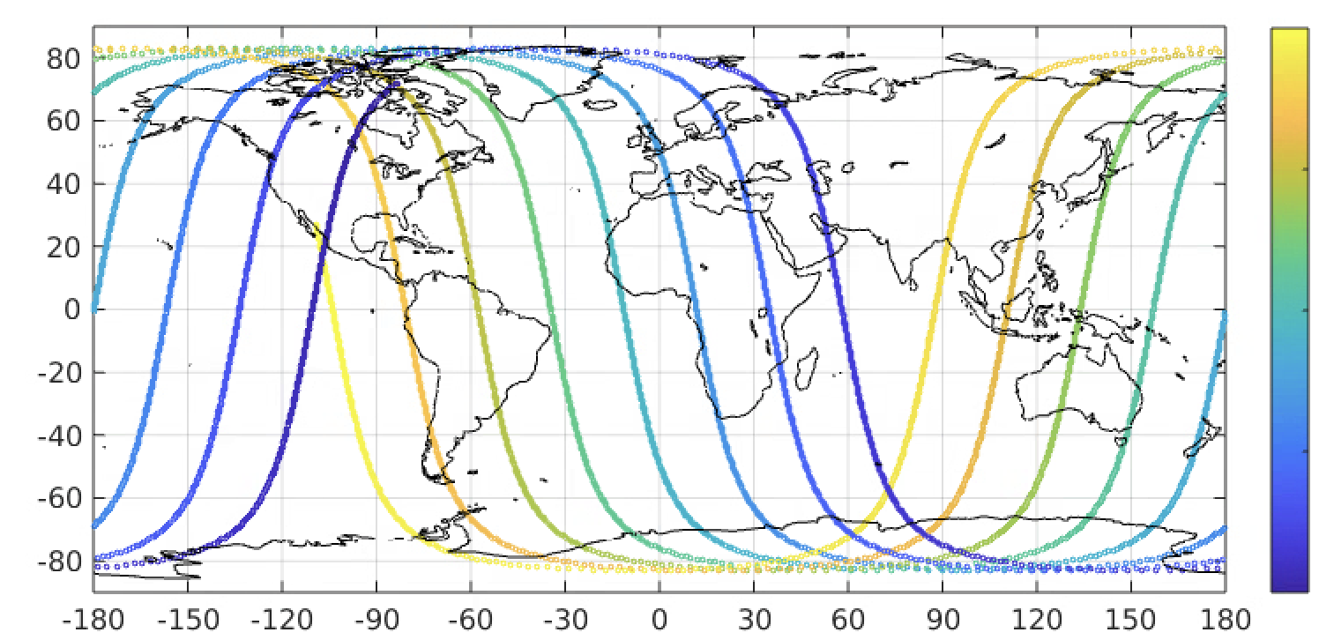
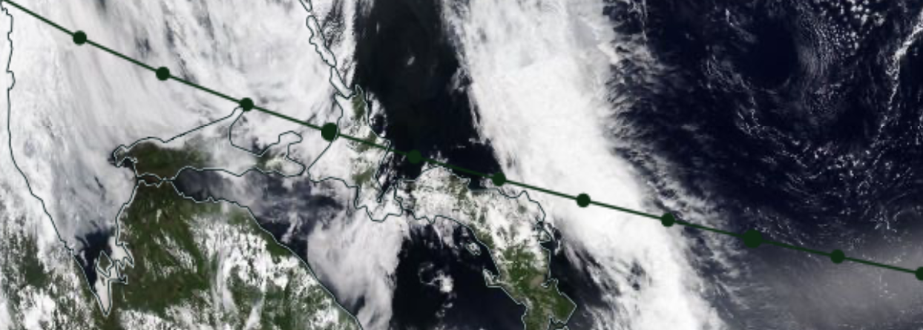
First 12 hours of EarthCARE reflectivity assimilation at ECMWF
10th June 2026: EarthCARE reflectivity assimilation activated in the ECMWF operational system
Observed reflectivity
Simulated (background) reflectivity
21:00 UTC 09:00 UTC

Slide 16
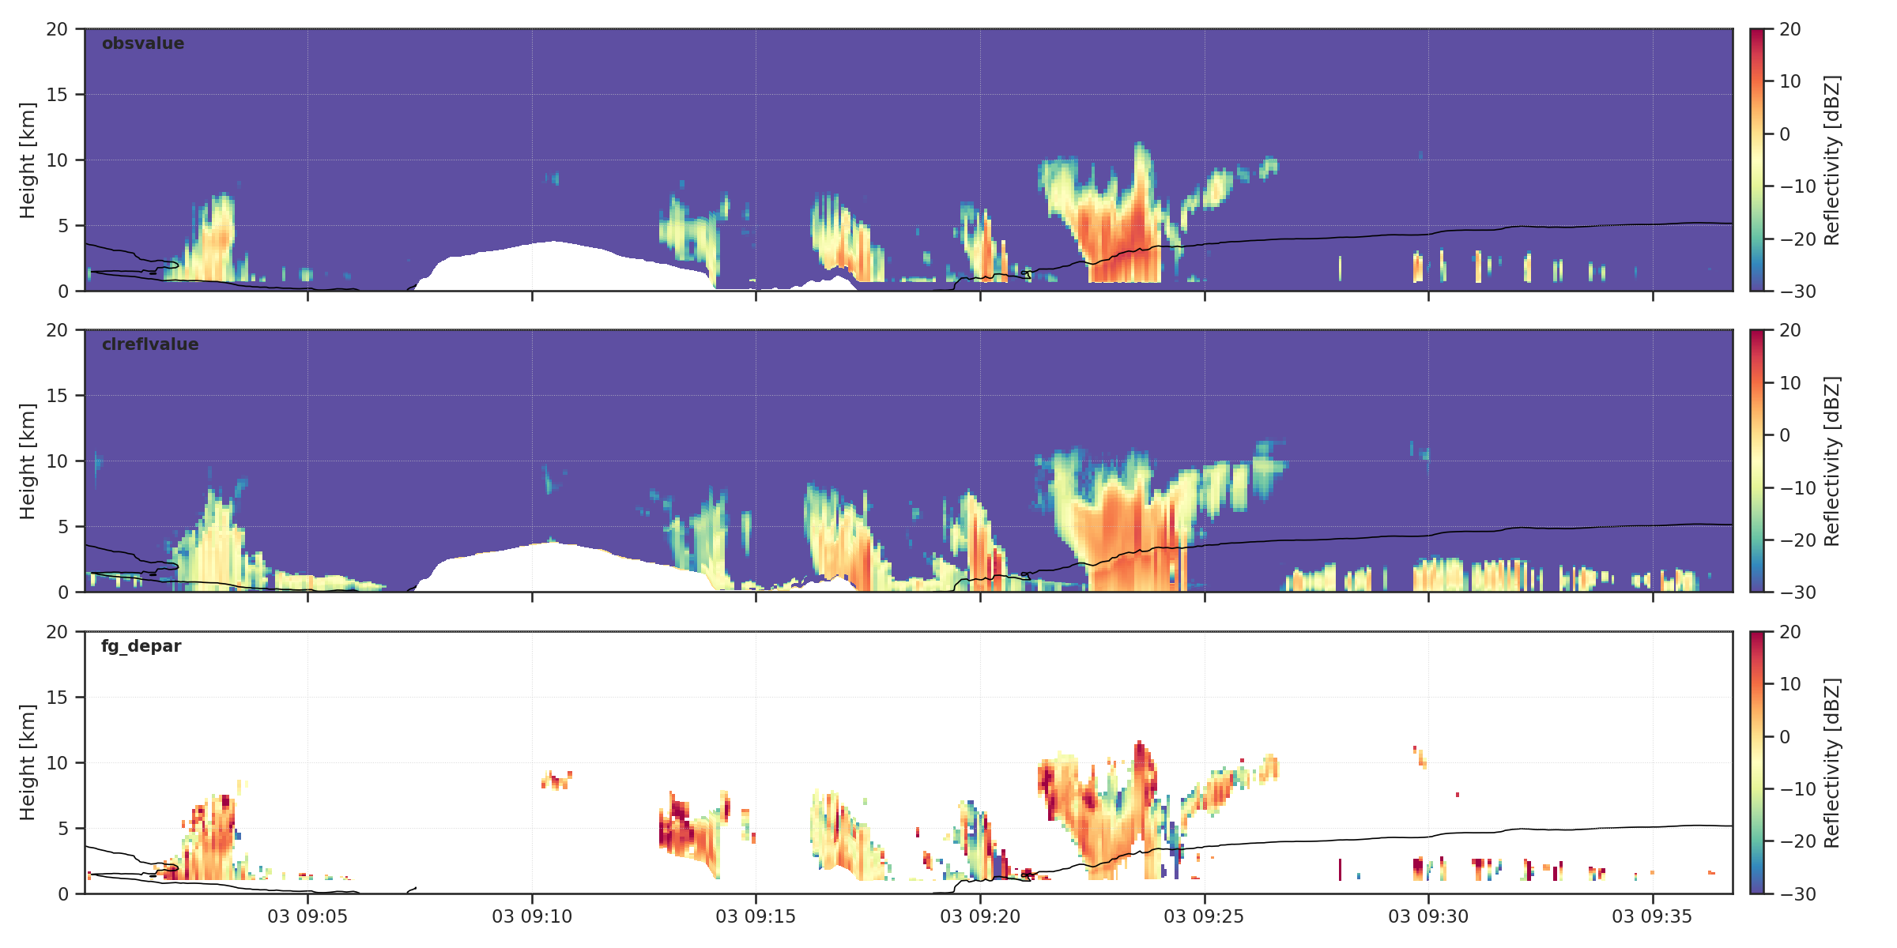
Reflectivity assimilation
Example: 3rd January 2026
Observation
Background simulation
Observation - background

Slide 17
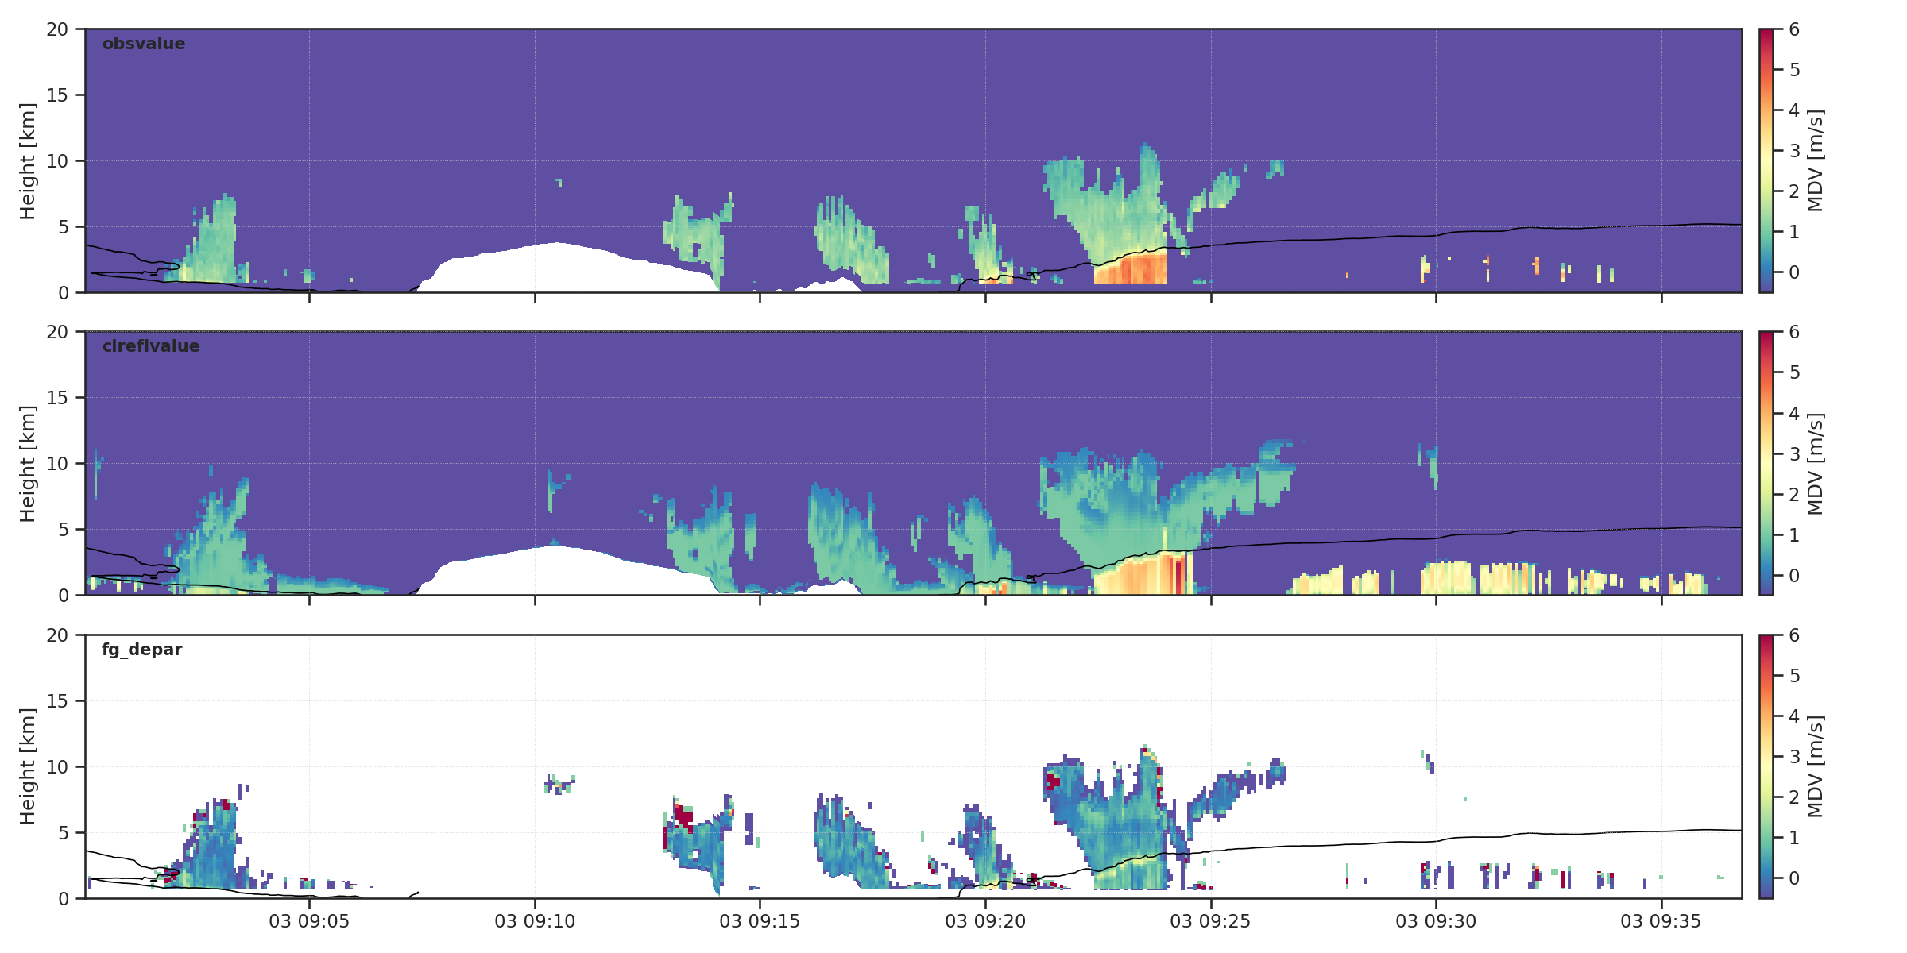
Doppler assimilation
Example: 3rd January 2026
Observation
Background simulation
Observation - background
Doppler assimilation is working, but not yet operational. It produces about 1/3 the impact of reflectivity assimilation

Slide 18
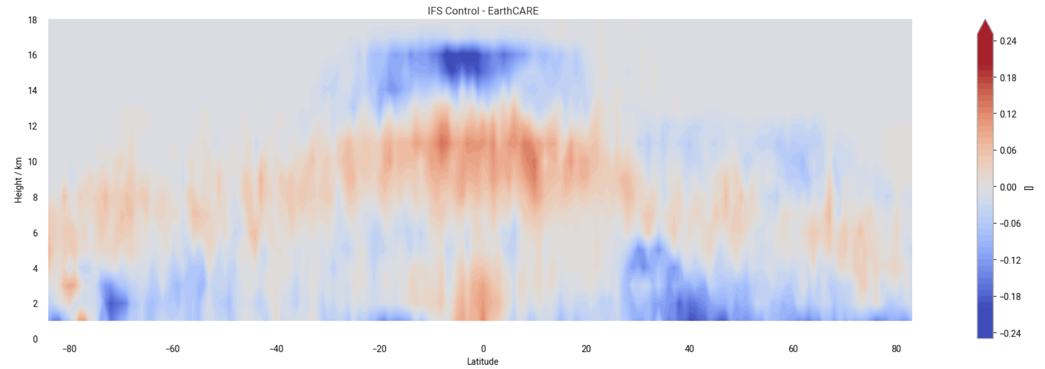
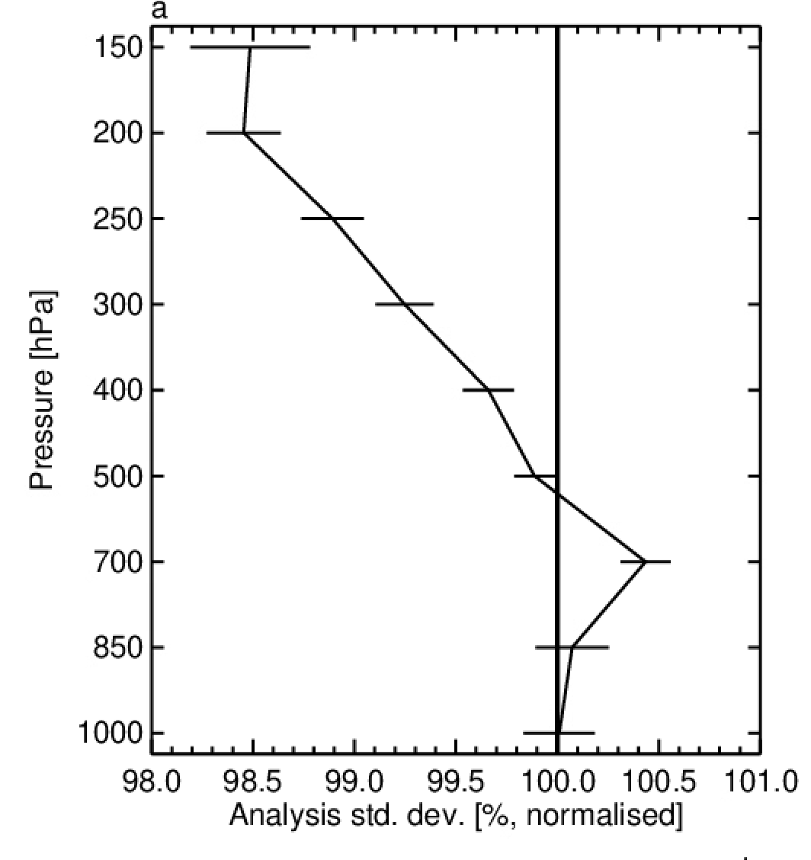
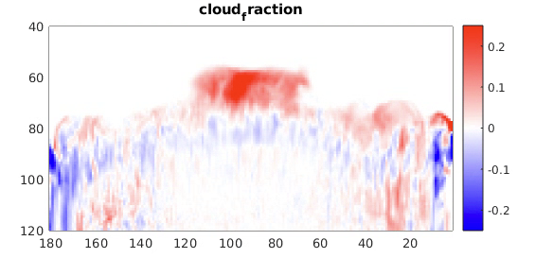
EarthCARE highlights the need for model improvements
Mixed results, but improved analysis fit to AMV (cloud winds)
Current IFS model – EarthCARE retrieval from Lidar + radar
Hydrometeor fraction zonal cross-section, week average
Missing high cirrus in the model in the tropics
Improved representation of cirrus formation - control
IFS model cloud fraction zonal cross-section, day average
Model improvements
New representation of ice supersaturation + heterogeneous nucleation

Slide 19
Learning model and state – and the impact of AI
Data assimilation or retrieval for geophysical state
Model is strongly constrained (equations are fixed)
Data assimilation for state and parameters
Fixed prior knowledge (equations) if possible but use machine learning if physics is not well-known
Hybrid data assimilation / machine learning for state and neural network model components
Machine learning assimilation or retrievals trained on reanalysis, DPR or gauge rain rates, etc.
Physical constraints and prior knowledge come from training data
No physical constraints – just the learned representation of the atmosphere
End-to-end direct observation machine learning, trained solely on observations

Slide 20
Conclusions
Extension of all-sky microwave assimilation to a broader frequency range
  Benefit of low frequencies (<10 GHz): surface emissivity and direct precipitation signal
  Benefit from high frequencies (>190 GHz): additional microphysical information; ice cloud
    AWS 325 GHz is being assimilated in all-sky conditions in operational system (alongside other AWS channels)
First direct assimilation of radar reflectivity in ECMWF operational system
  EarthCARE CPR reflectivities
  Work is ongoing on using the Doppler measurements
The increasing importance of RFI, especially at low frequencies
  Communication constellation reflected RFI signal in AMSR2 6.9 GHz channel – work needed
  Off-boresight RFI sources contaminate ocean data at L-band (SMAP)
    atlas technique – potential recommendation to CGMS:
    provide unscreened antenna temperatures and measured antenna patterns
How do we improve the models to better represent precipitation?
  This is a way to substantially improve the precipitation forecast throughout the forecast range.
  Data assimilation, parameter estimation, hybrid or pure machine learning?
  Physical consistency across frequencies, across components (RTMs and moist physics)

