Slide 1
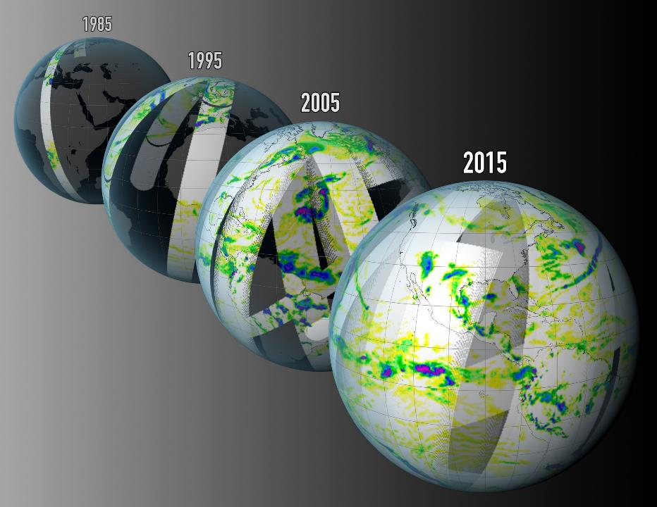
10.8
Quantitative precipitation measurements from satellites: where now?
Chris Kidd
University of Birmingham (UK)

Slide 2
Where are we?
Can satellite sensors observe precipitation? Yes (mostly)
the effect (most) precipitation has on the received radiation can be observed,
but some precipitation may have no discernable signal (detectability/masking).
Can satellite sensors measure precipitation? It depends…
what do we mean by ‘measure’ and by ‘precipitation’:
Where? – at the surface, within the atmosphere?
What? - liquid, mixed, solid?
When? - Instantaneous, daily, monthly, annual, climate-scale?
The ‘perfect’ retrieval scheme is illusive…
12th Workshop of International Precipitation Working Group · July 7-10, 2026, Kraków Poland.

Slide 3
To date…
50+ years of passive microwave observations (48 years digital data – and ongoing work to generate “L1C” for all data)
Solid knowledge of retrieval abilities and capabilities:
Radar provides the ‘best’ for retrieving hydrometeors (and it’s 3D!)
Passive microwave radiometers with wide frequency ranges allow the nuances of precipitation to be retrieved
High frequencies are crucial for light precipitation & snow
Low frequencies are crucial for oceanic and heavy precipitation
Good, mature schemes exist to provide precipitation estimates over a wide range of situations, resolutions and time scales.
12th Workshop of International Precipitation Working Group · July 7-10, 2026, Kraków Poland.

Slide 4
Managing expectations
Different sensors with different capabilities produce different results – all are potentially ‘correct’ – within their own capabilities.
Consistent, long-term measurements depend upon the observations early data sets will be less precise - reprocessing of legacy data sets to current data quality standards is underway.
Errors and uncertainties are problematic –different users have different criteria (atmospheric scientist vs hydrologist), but basic ‘fitness-for-use’ based upon channel selection and retrieval ability possible.
Sampling resolutions need to be commensurate with precipitation - temporal and spatial resolutions are intertwined
12th Workshop of International Precipitation Working Group · July 7-10, 2026, Kraków Poland.

Slide 5
What was the question?
CEOS
CGMS
Surface
Atmosphere
Hydrology
e.g. water resources
river management
industry/transport
crops & vegetation
fisheries
Meteorology
e.g. energy exchange
atmospheric dynamics
fundamental research
Etc…
precipitation
Satellite observations used to measure surface precipitation
Assimilation of radiances into models to produce precipitation
12th Workshop of International Precipitation Working Group · July 7-10, 2026, Kraków Poland.

Slide 6
Surface precipitation intensity retrieval capability
DMSP F16, F17, F18 [SSMIS]
MetOp-A,B,C [MHS]
FY-3A,B,C,D,G,I [MWRI]
Megha-Tropiques [SAPHIR]
Suomi NPP, NOAA-20,21, JPSS-3,4, Quicksounder [ATMS]
GCOM-W [AMSR2]
GPM Core [GMI/DPR]
TROPICS [TMS]
EarthCARE [CPR (EarthCARE)]
WSF-M1,2 [MWI]
AWS, EPS-Sterna [MWR]
GOSAT-GW [AMSR3]
MetOp-SG A1,2,3 [MWS]
MetOp-SG B1,2,3 [MWI/ICI]
Sentinel CIMR-A, B [CIMR]
AOS-PMM [SAPHIR-NG/PMM]
NEON series-1 [SMBA]
primary
very high
high
fair
marginal
legacy
current
evaluating
2020 2025 2030 2035 2040 2045 2050
VERSION 2.0 (after Takuji-san)
Passive microwave imagers – with a good range of frequencies remain the mainstay of surface precipitation retrievals over ocean and over land
12th Workshop of International Precipitation Working Group · July 7-10, 2026, Kraków Poland.

Slide 7
Precipitation intensity retrieval capability for models
DMSP F16, F17, F18 [SSMIS]
MetOp-A,B,C [MHS]
FY-3A,B,C,D,G,I [MWRI]
Megha-Tropiques [SAPHIR]
Suomi NPP, NOAA-20,21, JPSS-3,4, Quicksounder [ATMS]
GCOM-W [AMSR2]
GPM Core [GMI/DPR]
TROPICS [TMS]
EarthCARE [CPR (EarthCARE)]
WSF-M1 [MWI]
AWS, EPS-Sterna [MWR]
GOSAT-GW [AMSR3]
MetOp-SG A1,2,3 [MWS]
MetOp-SG B1,2,3 [MWI/ICI]
Sentinel CIMR-A, B [CIMR]
AOS-PMM [SAPHIR-NG/PMM]
primary
very high
high
fair
marginal
2020 2025 2030 2035 2040 2045 2050
Models rely (historically) more upon passive microwave sounding observations – temperature and humidity profiles rather than precipitation.
12th Workshop of International Precipitation Working Group · July 7-10, 2026, Kraków Poland.

Slide 8
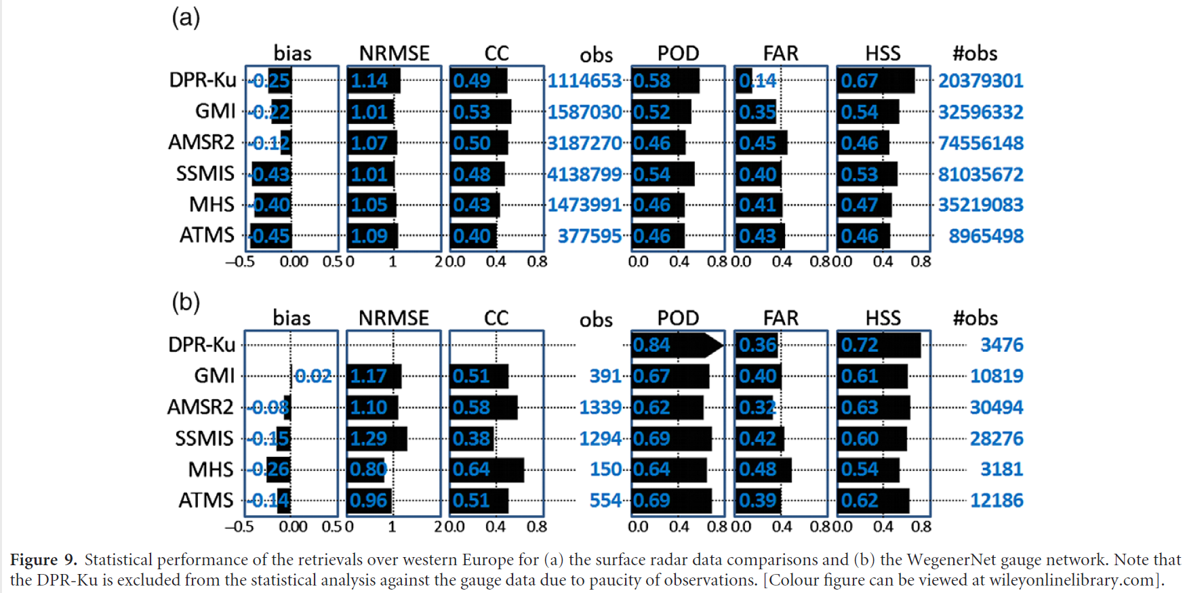
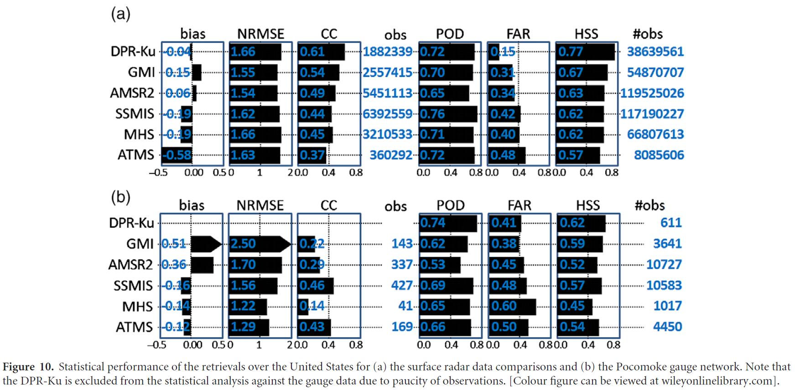
Channel selection: Instantaneous precipitation retrievals
Using surface radar as reference:
Precipitation radars (i.e. TRMM PR and GPM DPR) provide the most direct measure of instantaneous precipitation.
Wide-frequency range radiometers allow good retrievals (e.g.GPM GMI and GCOM-W AMSR2)
‘Operational’ microwave radiometers (e.g. SSMIS) provide moderate-good retrievals
Sounding instruments (e.g. ATMS or MHS) provide ‘adequate’ retrievals.
Cubesat sounding observations provide retrievals with similar results to the ATMS/MHS observations.
Europe
US
Kidd et al. 2018
Best PMW retrievals are produced from wide-frequency range radiometers
12th Workshop of International Precipitation Working Group · July 7-10, 2026, Kraków Poland.

Slide 9
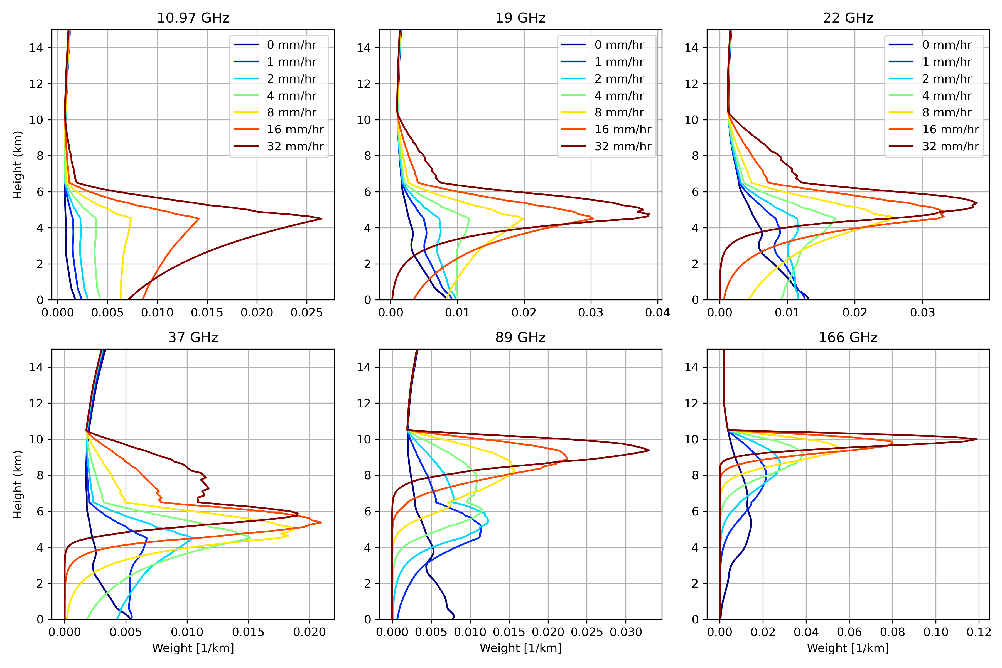
Sensitivity to precipitation by frequency
If you want to measure precipitation to the surface…
Atmospheric attenuation curves for different (surface) precipitation intensities for frequencies from 10.67 to 166 GHz. (Calculations are based upon a moist summer atmosphere, 4.5 km layer of constant intensity rain, transitioning to snow from 4.5 to 6.0 km with the precipitation intensity decreasing to 0.0 mmh⁻¹ at 10 km). Mircea Grecu
Low frequency channels are crucial for retrievals over both land and ocean
12th Workshop of International Precipitation Working Group · July 7-10, 2026, Kraków Poland.

Slide 10
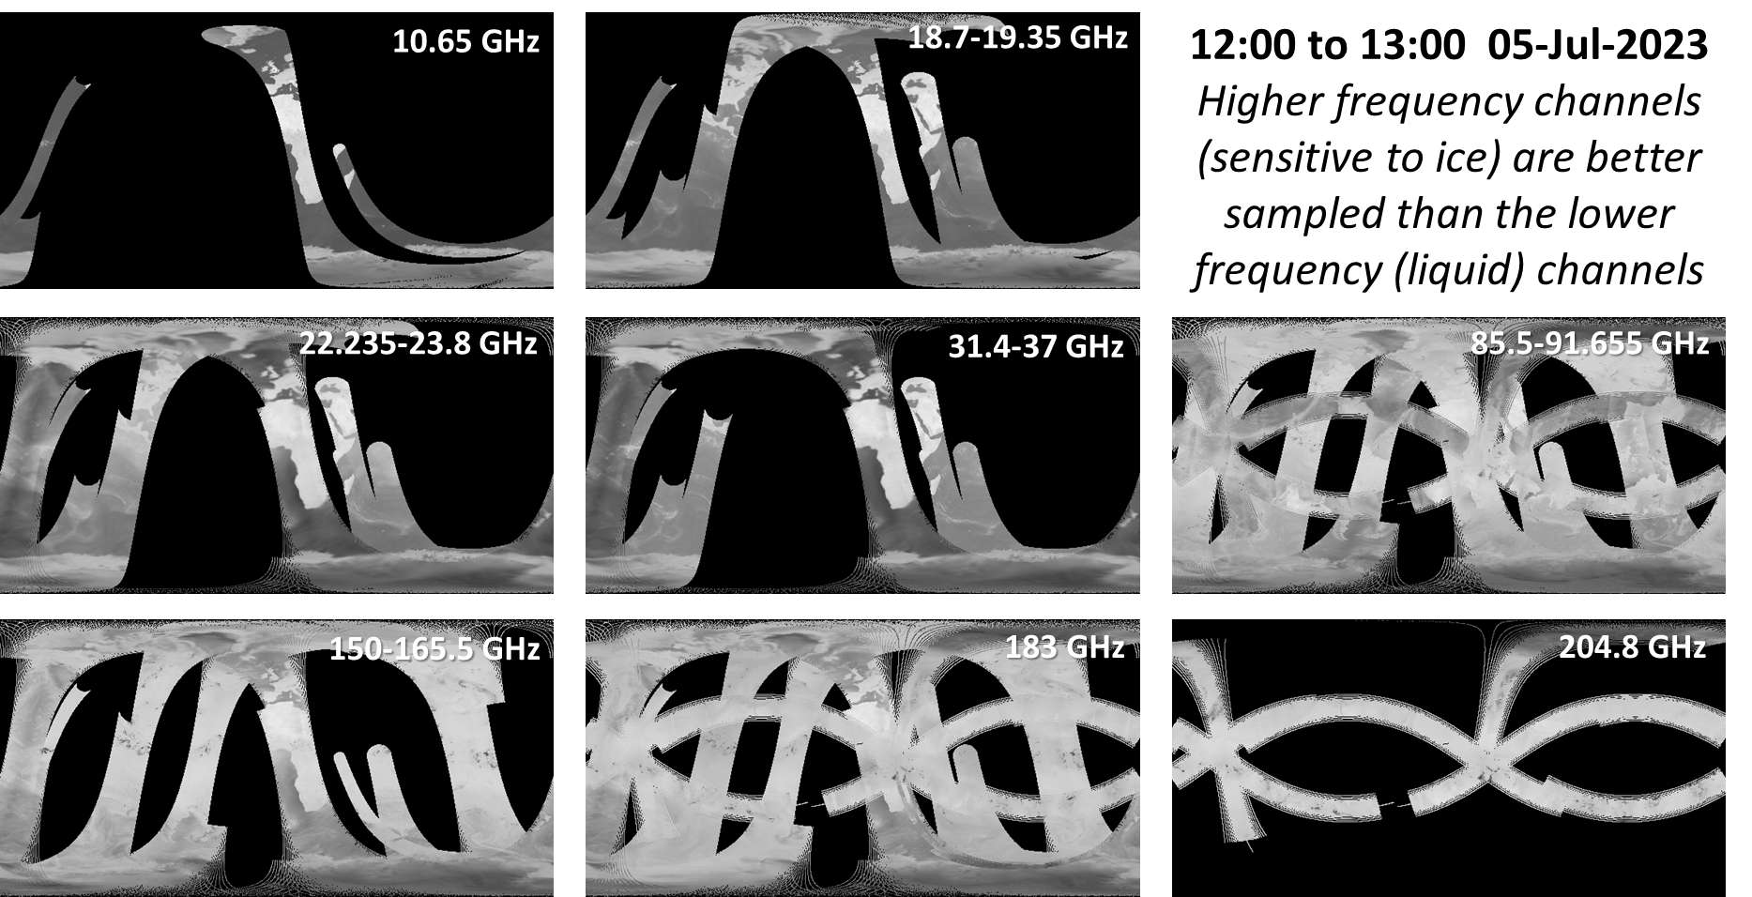
Global Coverage by PMW frequency
Low frequency channels have poor temporal sampling

Slide 11
Temporal sampling: bridging the observational gap
Significant development/deployment of small satellite sensors with microwave sounding instruments (e.g. TMS, 91-204 GHz):
Temporal sampling is poor → more sensors → more observations → improved products
However, increasing the number of poor observations doesn’t improve the products per se.
Accuracy
 | Radar | PMW imagers | PMW sounders
Instantaneous | Most direct observations (r²~0.85) | Reasonably direct (r²=0.70) | Less direct, poorer resolution (r²~0.45)
Daily | Too few samples | Currently poor sampling | Less direct and poor sampling
Monthly | Direct, but relatively few samples | Reasonably direct with good sampling | Less direct but good sampling
temporal sampling gap
imagers
accuracy
sounders
radar
Instantaneous daily monthly
Trade-off between number of gap-filling observations and the retrieval ability

Slide 12
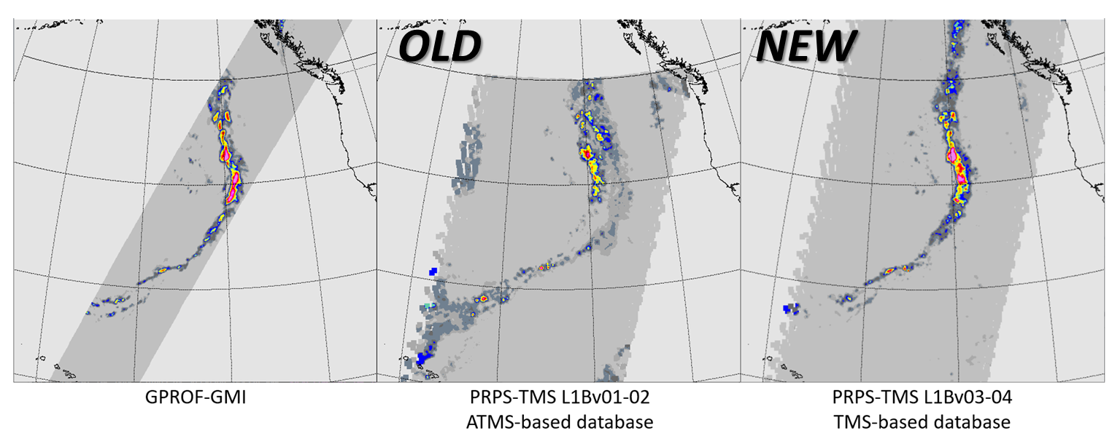
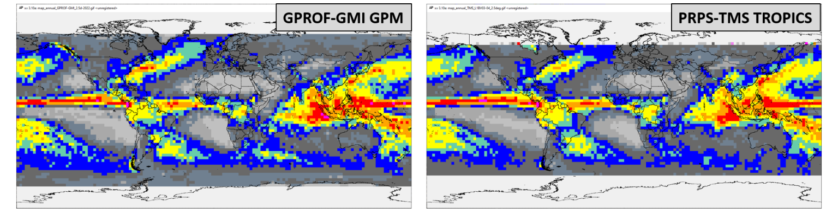
TROPICS TMS retrievals
Instantaneous TMS-type retrievals can look very good – when appropriate databases are available.
Even monthly estimates look convincing (!)
2022-09-27
TROPICS 01
1 year
2021.08.08
-
2022.07.31
12th Workshop of International Precipitation Working Group · July 7-10, 2026, Kraków Poland.

Slide 13
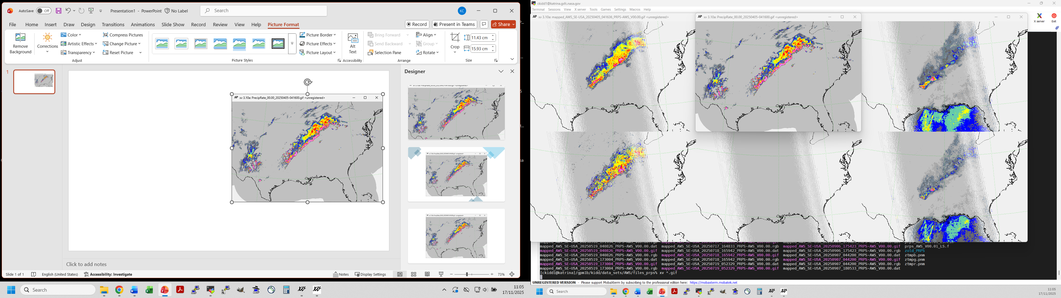
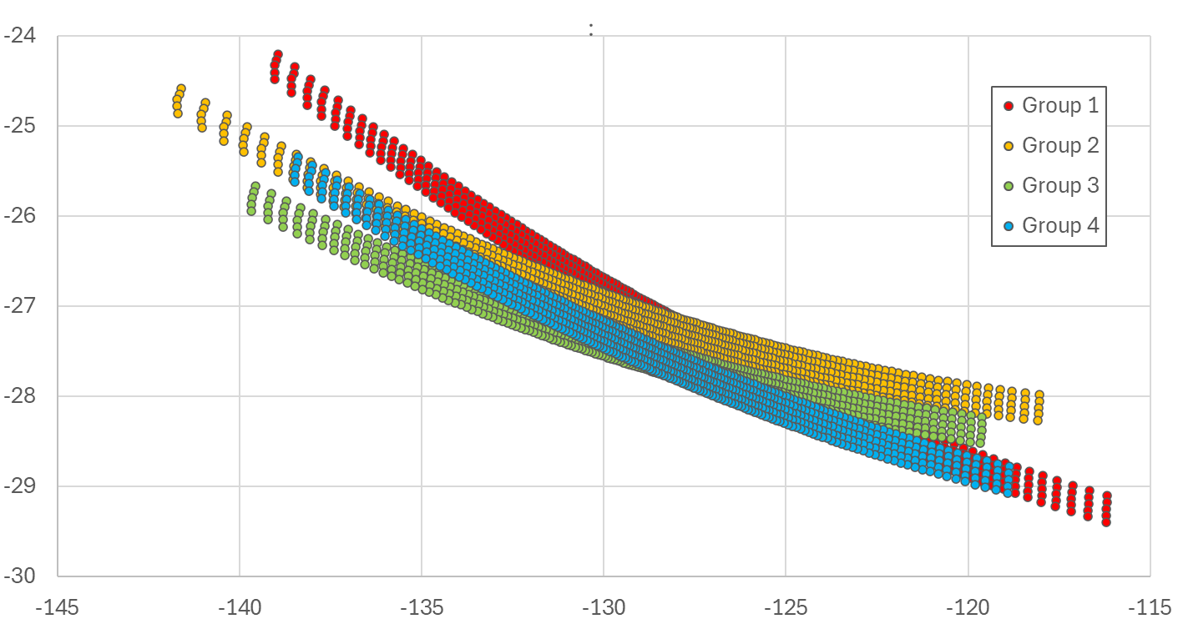
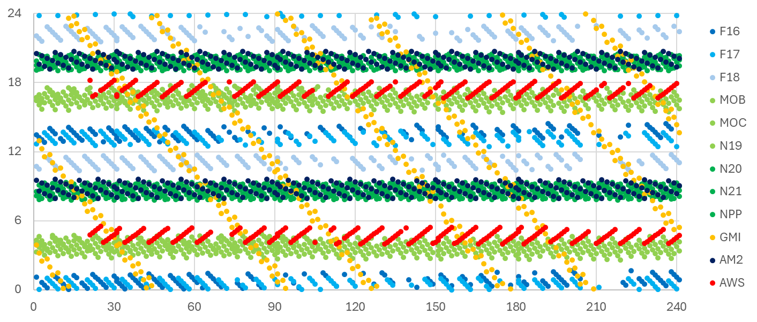
High frequencies are less direct
PRPS-AWS statistical performance similar to GPROF-ATMS
20250405-041636Z
Arctic
Weather
Satellite
(AWS)
PRPS-AWS (all channels)
MRMS
19 channels
4 groups
50.3-325 GHz
Hour (UTC)
Mar Apr May Jun Jul Aug Sept Oct 2025
12th Workshop of International Precipitation Working Group · July 7-10, 2026, Kraków Poland.

Slide 14
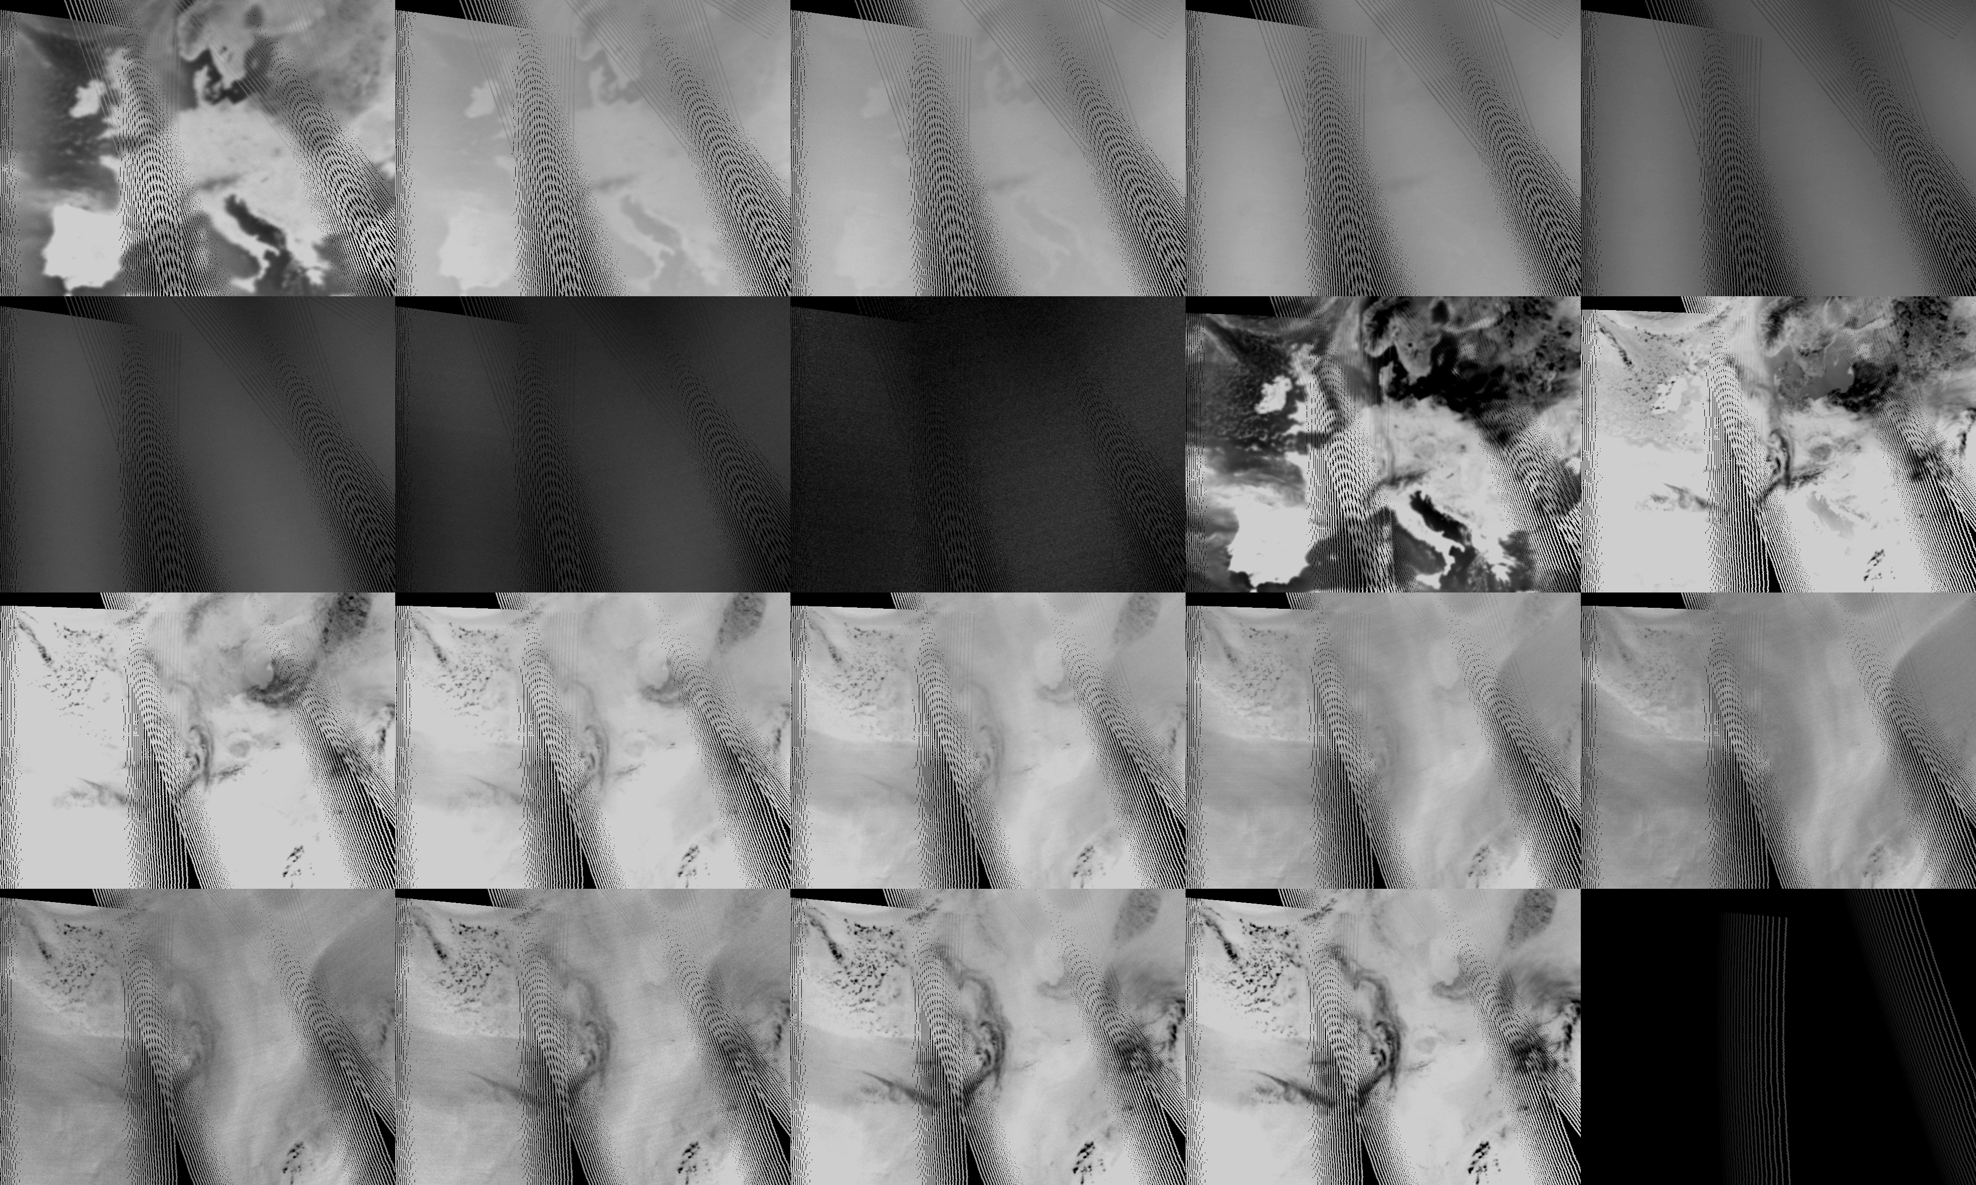
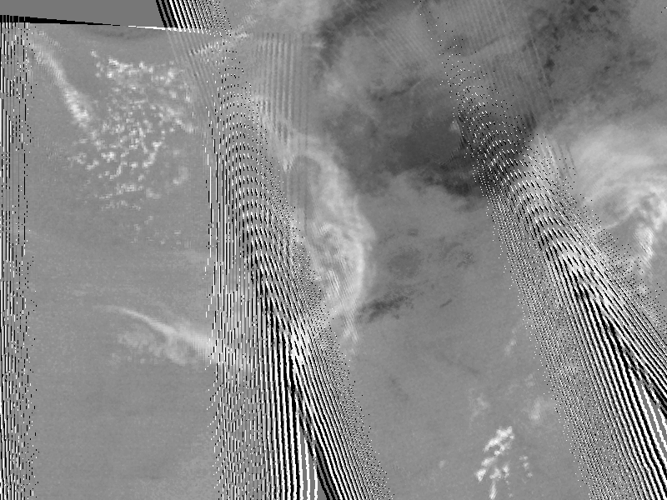
50.3 | 52.8 | 53.246 | 53.596 | 54.4
54.94 | 55.55 | 57.290344 | 89.0 | 165.5
176.311 | 178.811 | 180.311 | 181.511 | 182.311
325±1.2 | 325±2.4 | 325±4.1 | 325±6.6 | 176.311 - 325±6.6
FRA
AWS: 15 February 2026 evening overpasses
(2220 UTC & 2043 UTC)

Slide 15
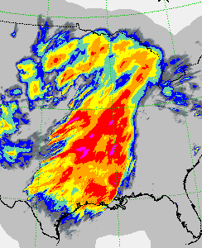
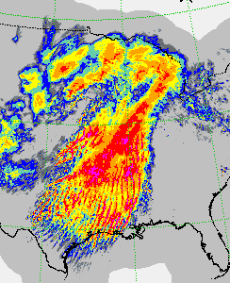
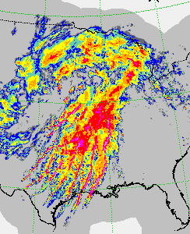
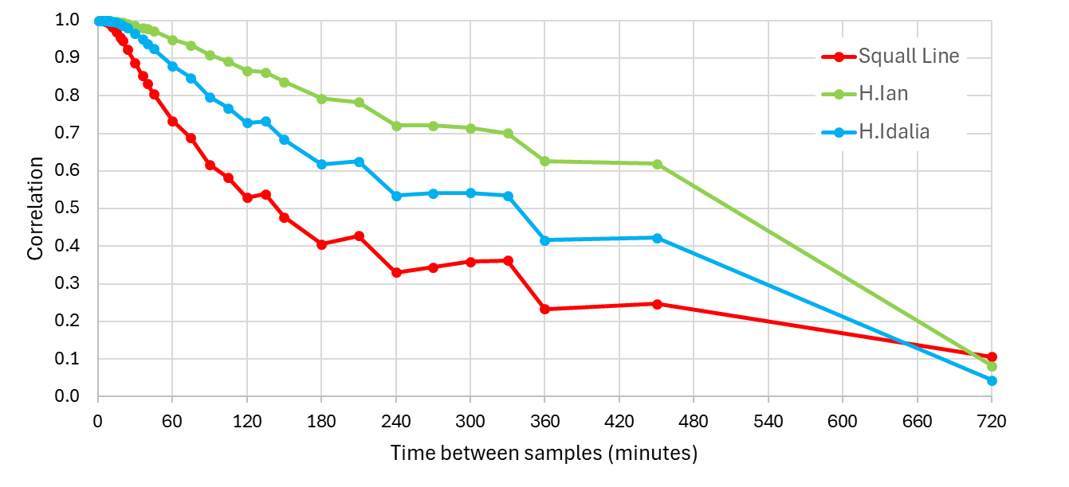
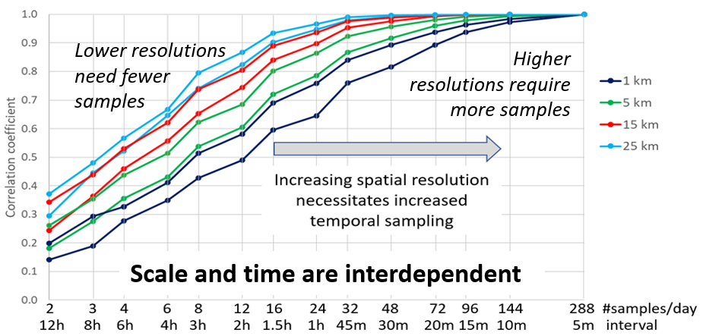
Temporal vs spatial?
There is pressing need for better temporal sampling – but at what cost?
- Less direct measurements?
- Poorer spatial resolution?
Impacts vary with meteorology… .
MRMS vs resampled MRMS
Temporal sampling – spatial resolution – frequency of observation

Slide 16
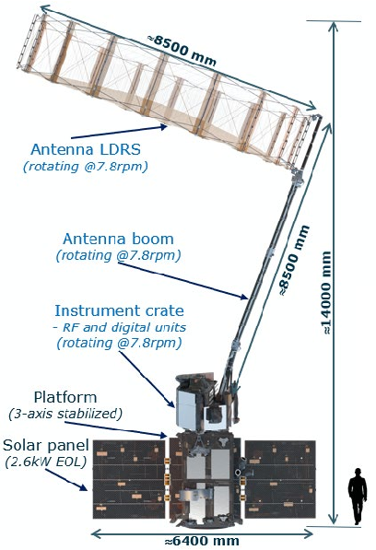
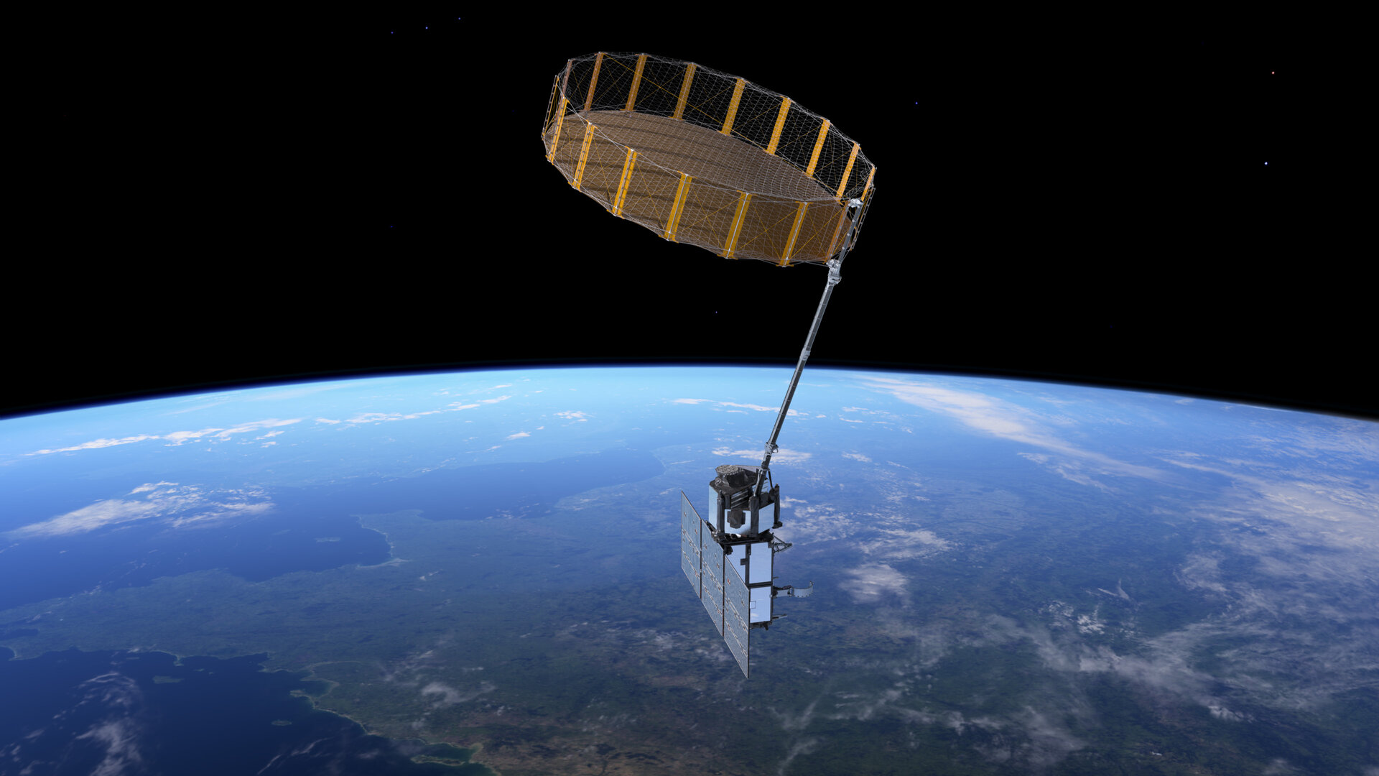
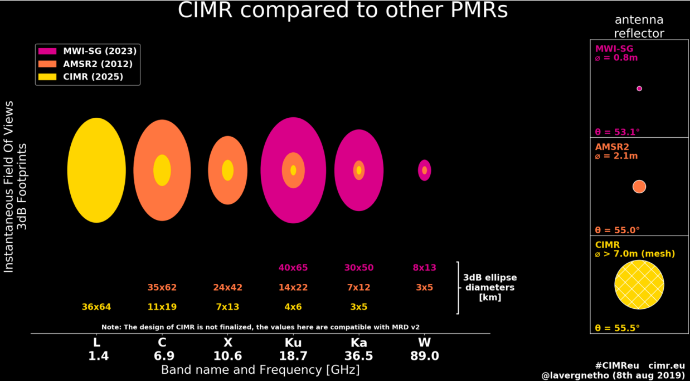
CIMR (Copernicus Imaging Microwave Radiometer)
50 channels at
1.4 GHz (L) 36x64 km
6.9 GHz (C) 11x19 km
10.65 GHz (X) 7x13 km
18.7 GHz (K) 4x6 km
36.5 GHz (Ka) 3x5 km
CIMR will provide high resolution low frequency observations that will greatly benefit precipitation retrievals
12th Workshop of International Precipitation Working Group · July 7-10, 2026, Kraków Poland.

Slide 17
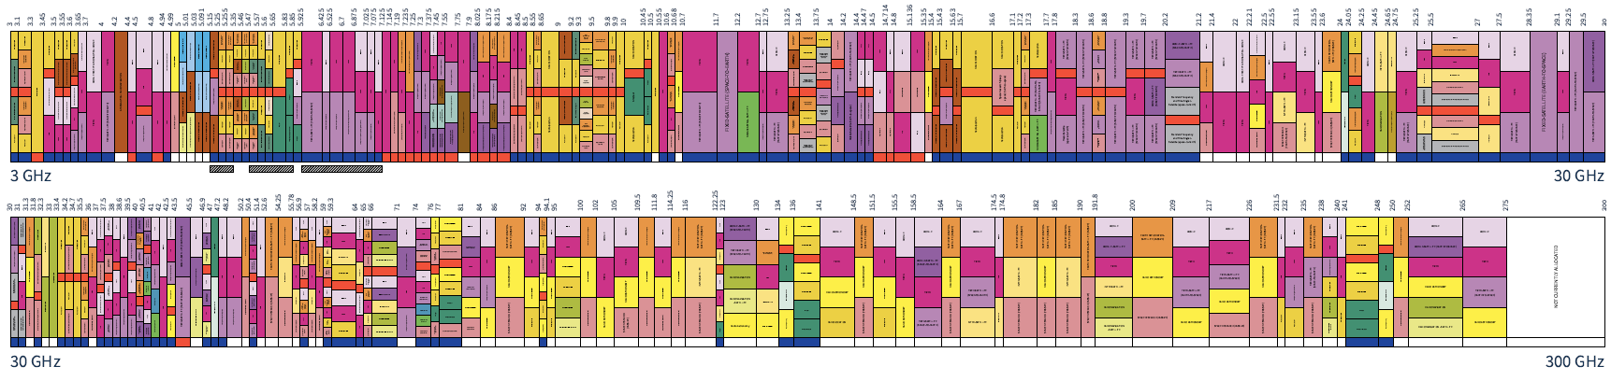
Managing and protecting our frequencies
The radio frequency spectrum is very valuable – with potential interference
Global: The UN International Telecommunication Union (ITU) coordinates global radio spectrums, satellite orbits, and telecommunication standards worldwide.
US: NASEM Committee on Radio Frequencies (CORF) Radio Astronomy and Earth Observation
EU: European Scientists on Spectrum for Earth Observation (ESSEO) led by ESA coordinates
US spectrum
‘Clean’ frequencies are fundamental to our retrievals
12th Workshop of International Precipitation Working Group · July 7-10, 2026, Kraków Poland.

Slide 18
Conclusions
Observations need to be:
commensurate with the dimensional variability of the variable being measured (i.e. < 5 mins < 10 km) – temporal/spatial scales are intertwined
sensitive to what we want to measure (e.g. precipitation near the surface vs atmospheric) – frequency dependent.
consistent over the long-term data record - to allow variations to be accurately depicted and assessed – individual satellite data records
Low frequency channels are important – not just for oceanic precipitation, but also for over land retrievals
Temporal sampling is important –such observations should be commensurate with other high-class precipitation sensors
Our spectrum needs protection – increasing pressure to use/reuse/co-use the frequencies we depend upon (no/little protection > 200 GHz)
12th Workshop of International Precipitation Working Group · July 7-10, 2026, Kraków Poland.

