Slide 1







The Tomorrow.io Microwave Sounder Constellation: Status and Data Products
S. Joseph Munchak*, Ethan Nelson, Forest Cannon, Teagan King
The Tomorrow Companies, Inc.
100 MOST
INFLUENTIAL
COMPANIES
MOST INNOVATIVE
COMPANY
*joe.munchak@tomorrow.io

Slide 2

AGENDA
Tomorrow.io Company and Space Program Introduction
2-5
Pathfinder Radar recap
Tomorrow.io Microwave Sounder (TMS) Constellation Overview
6-10
Orbital Configuration and Revisit Statistics
TMS Data Products
11-16
L1B Radiances,
L1C Constellation,
L2 Temperature/Humidity/Precipitation
Summary and Outlook
17
Data availability

Slide 3
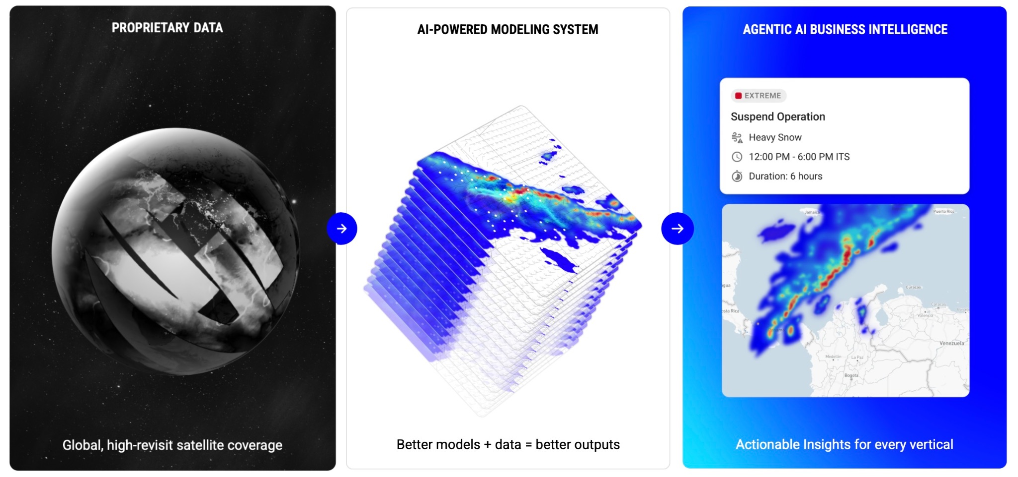
TOMORROW.IO: FROM DATA TO AI-DRIVEN DECISIONS

Slide 4


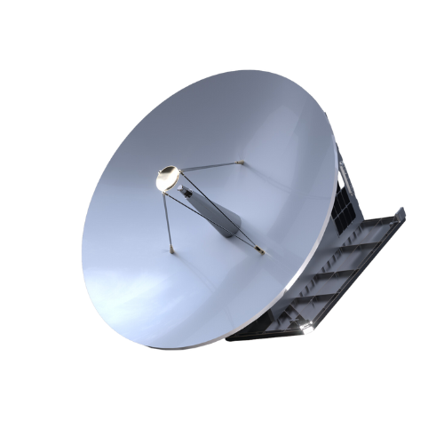
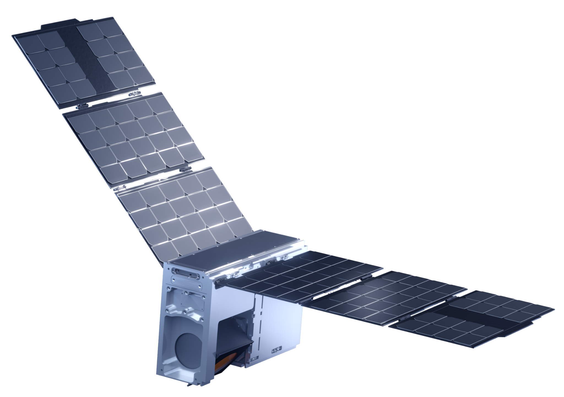
Tomorrow.io Space Program Timeline
GEN 1
GEN 2
2023-2026
2024-2029
2027-2030
2029-
Tomorrow.io Pathfinder Radar
TROPICS (TMS1.0) ->
TMS 1.1 Microwave Sounder
TMS 1.2 Microwave Sounder
TMS 2.0 Microwave Sounder
TRAKR Radar
6U Bus
Internal Cal Target
ASIC for F-band channels
Enhanced manufacturing processes
Improved reliability and data quality
Wide swath radar
Sounder: additional bands, better resolution, improved radiometric performance
April 2023
Tomorrow-R1 launch
June 2023
Tomorrow-R2 launch
April 2023
Tomorrow-R1 deorbit
June 2026
Tomorrow-R2 deorbit
April 2022
Tomorrow.io Microwave Sounder (TMS 1.1) Program Kickoff
August 2024 - First launch
TMS-01 and TMS-02
Current Status
Build and launch 17 sats total
11 launched to date
6 in build and test
Jan 2025
Tomorrow.io Microwave Sounder (TMS 1.2) Program Kickoff
April 2027 - Target 1st launch
TMS-18/19
Current Status
Build and launch 12+ sats
Procured 1st three launches
6 units already in build
1Q25-2Q25
Tomorrow.io Microwave Sounder (TMS 2.0) Concept Development
1Q26-3Q26
TMS2.0 Trade Studies
TRAKR Ground EDU
2029
Target 1st satellite launch

Slide 5
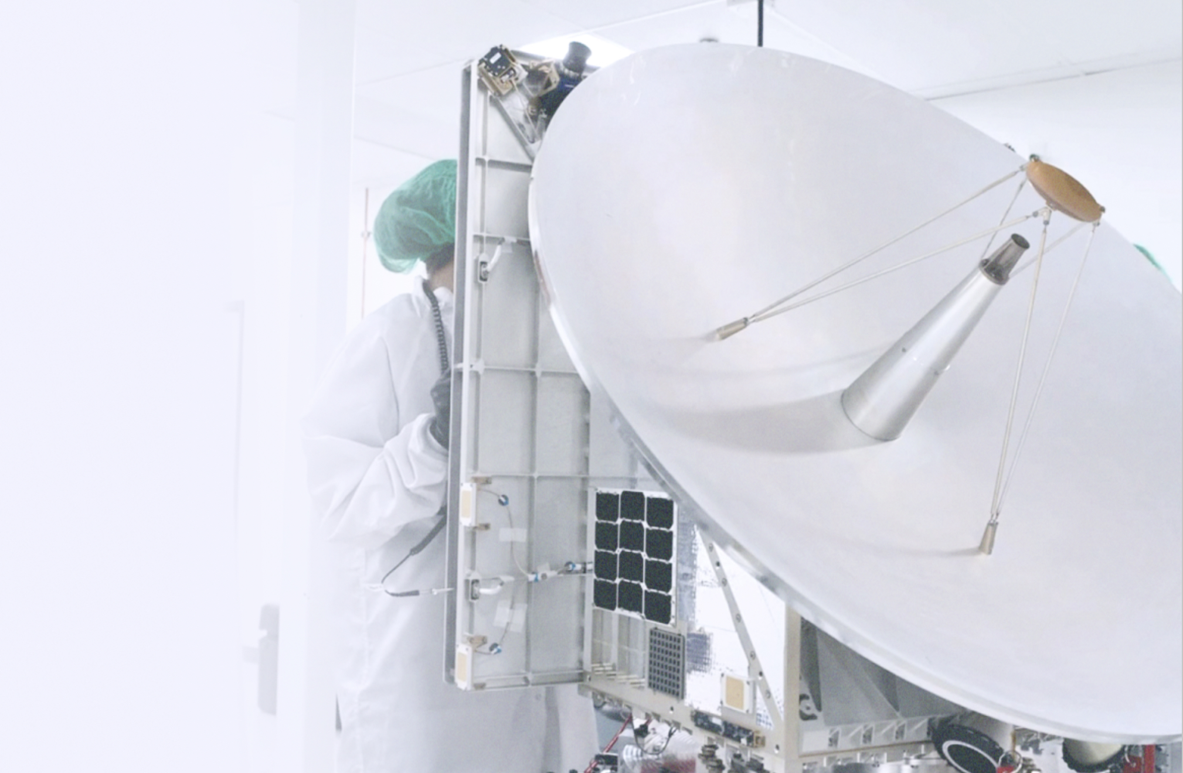
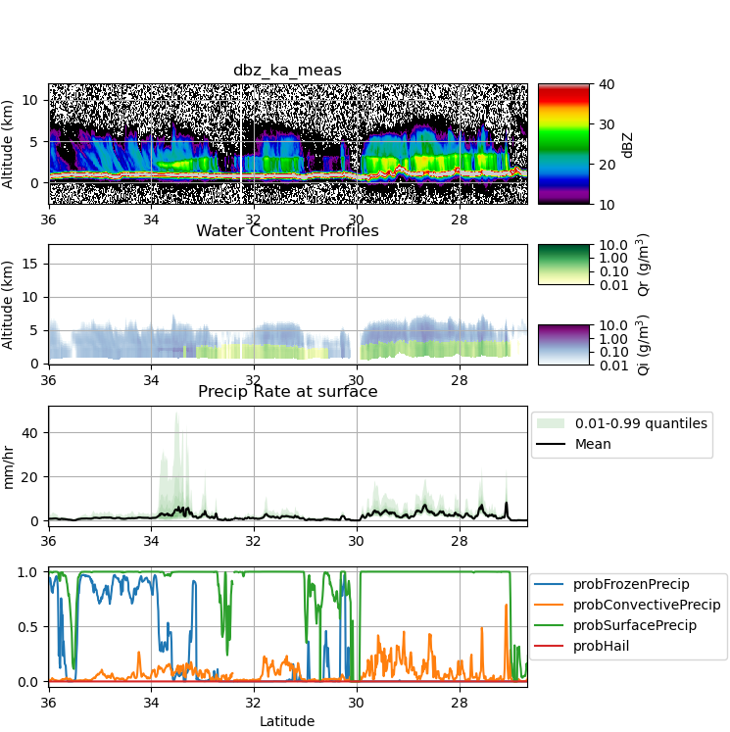
Tomorrow.io Radar Pathfinders
Tomorrow-R1 & Tomorrow-R2; launched in 2023, both deorbited
Purpose:
Risk reduction of radar payload; precursor to operational precipitation radar satellites
Demonstrate end-to-end development capabilities spanning payload, satellite, ground system, cal/val, data processing
Sensor:
Ka-band (35.5-36 GHz) transceiver based on rapidly reconfigurable software-defined radar.
Integrated into a small ESPA-class spacecraft. Duty cycle run at ~50%.
Antenna: Solid, fixed reflector (1.2 m) with single 5 km ground footprint
Capabilities:
Precipitation profiling: 250 m vertical resolution with <10 dBZ sensitivity
Radiometry: brightness temperature estimates using listen-only bandwidth
Altimetry: High-bandwidth (> 300 MHz) mode for sea surface height and state measurements
The entire Pathfinder archive is now available through the NASA CSDA archive:
https://science.nasa.gov/earth-science/csda/vendor-tomorrow-io/

Slide 6
Microwave Sounder Constellation

Slide 7

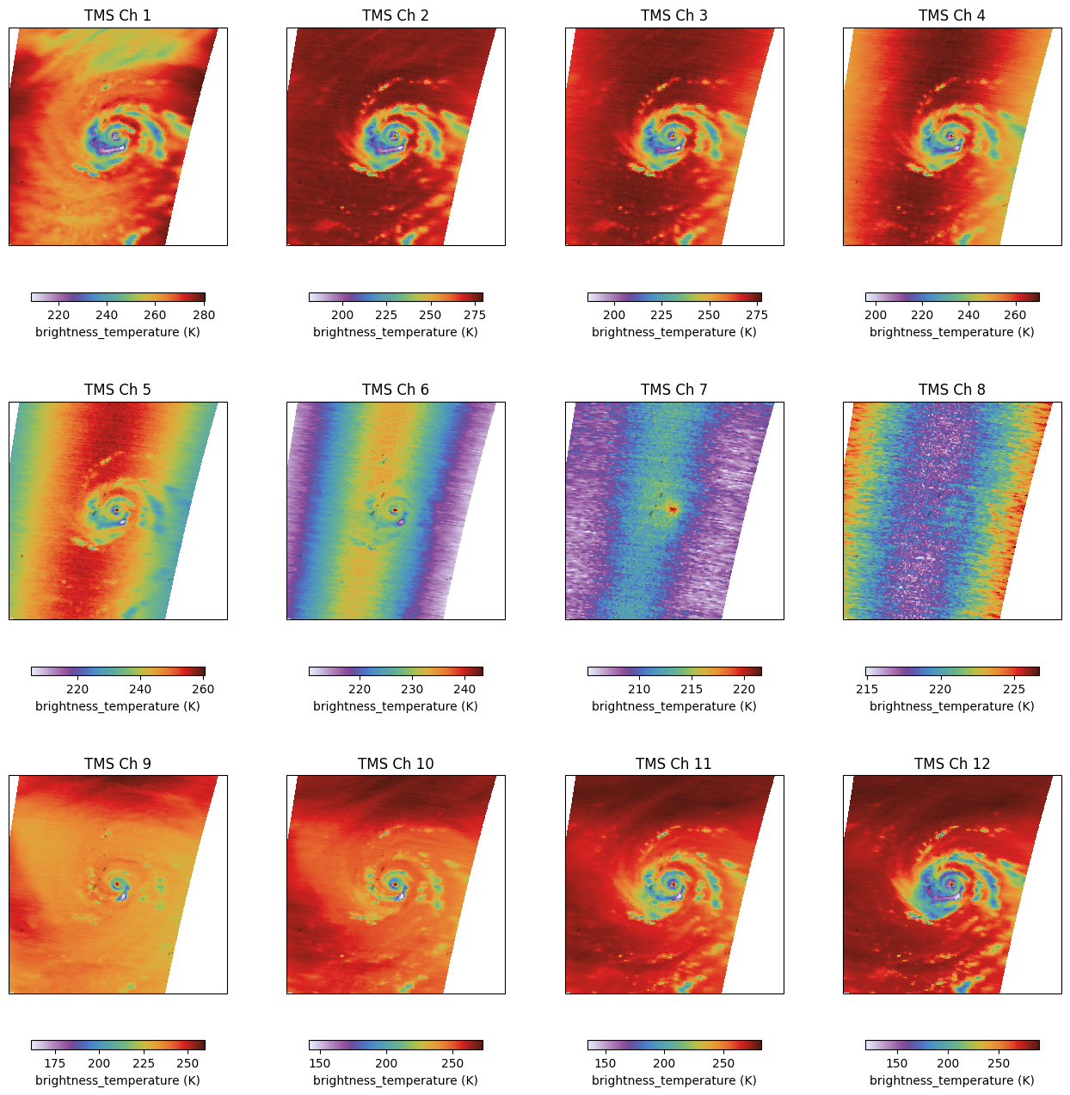
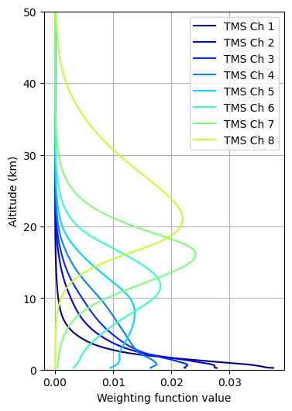
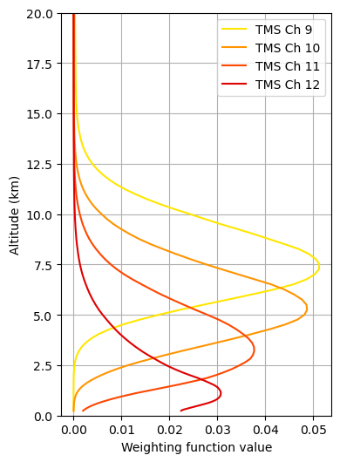
TMS at a Glance
12 channel (W – 91 GHz, F – 114-122 GHz, G – 184-204 GHz )
(S1-S4 currently operate in a reduced channel mode -W/G only)
2200 km swath width (+/- 60°)
High duty cycle excepting sun maneuvers, data transmits
Legacy in MIT-LL from TROPICS mission
11 units launched, 6 more built and preparing for launch in Gen1.1
TMS weighting functions
TMS L1 Observations of STY Bavi

Slide 8


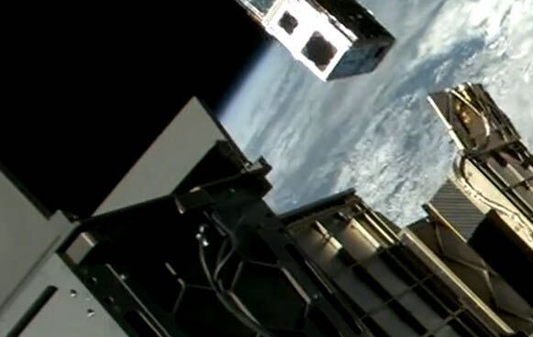

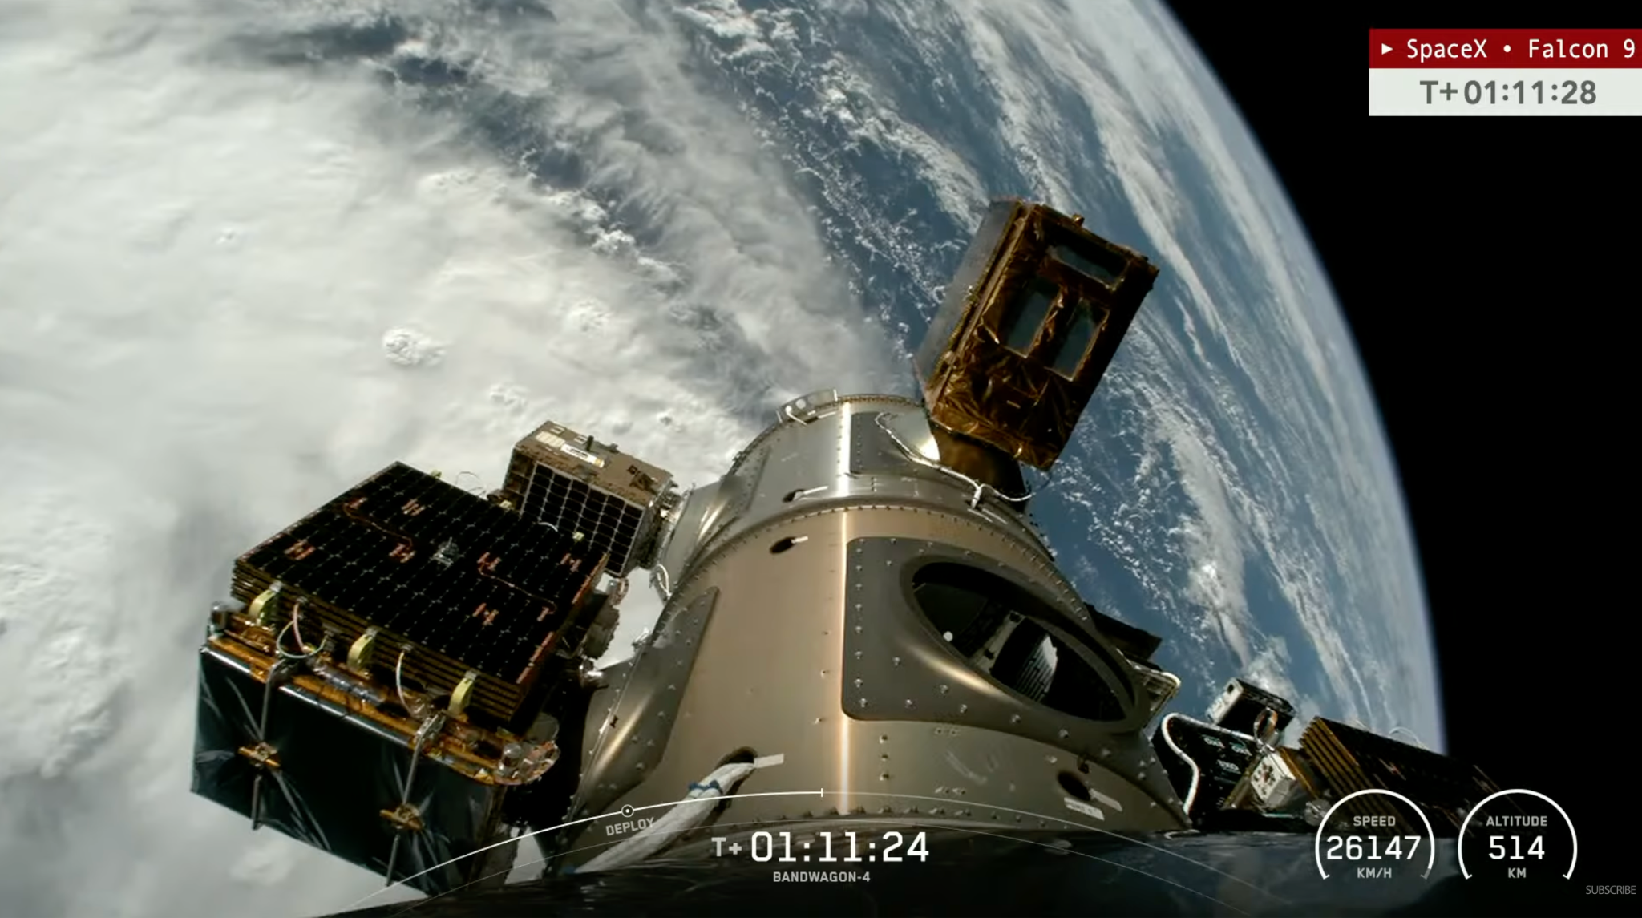
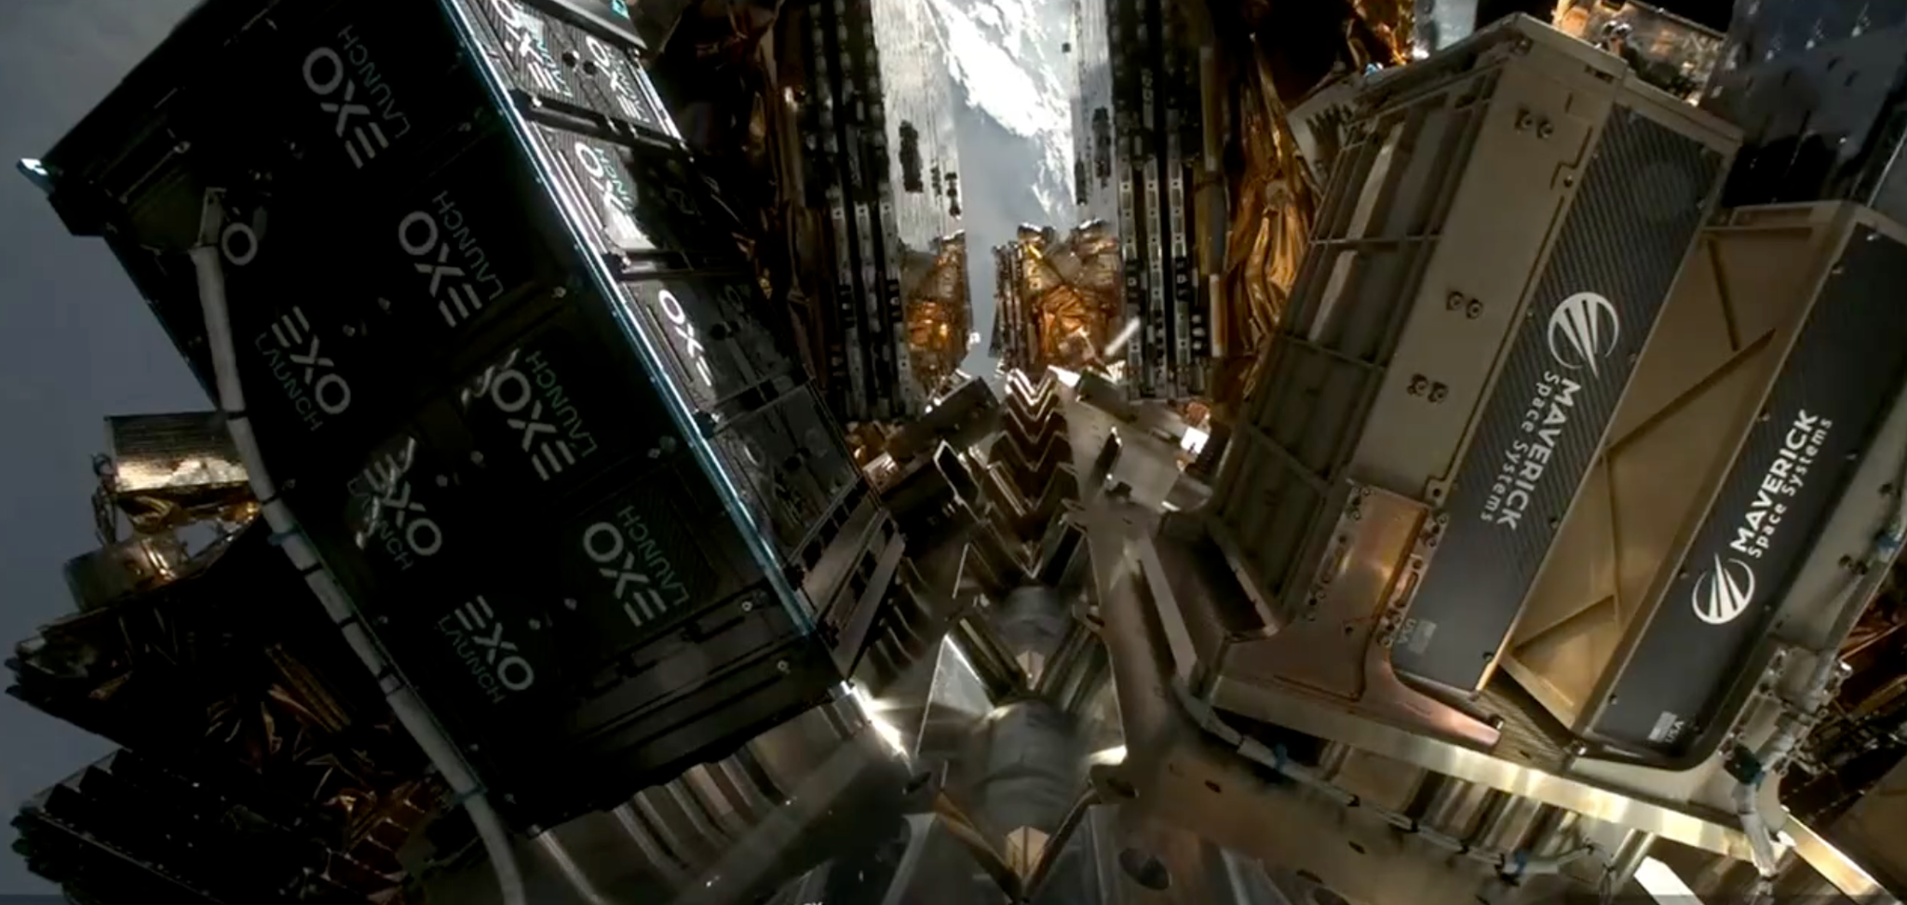
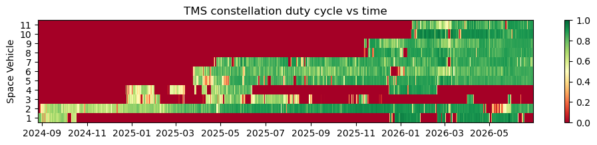
Sounders Constellation Performance to Date
3Q24
4Q24
1Q25
2Q25
3Q25
1Q26
S8 & S9 launch
BW-4 (11/2/25)
45deg
S1 & S2 Launch
TR-11 (8/16/24)
SSO : LTAN 22:47
S3 & S4 launch
BW-2 (12/21/24)
45deg
S5 & S6 launch
TR-13 (3/14/25)
SSO : LTAN 10:23
S7 launch
BW-3 (4/21/25)
45deg
S10 & S11 launch
Twilight (1/11/26)
SSO: LTAN 1727
Summary
11 TMS sounders have launched to date
Science data collection flowing through pipeline just days after launch
Aim to have an 85% duty cycle for individual satellites
Short outages typically due to recoverable bus events
Longer outages on S1, S3, and S4 due to use of refurbished slip ring component (S1 returned to operations after 14 month outage!)
Notes:
Update

Slide 9

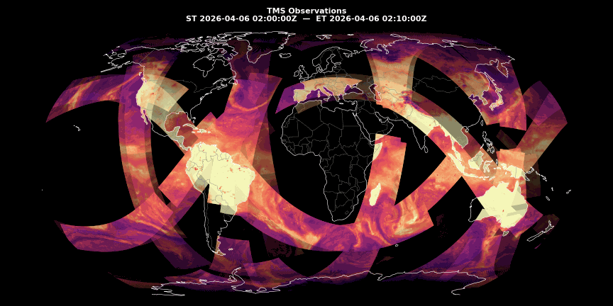
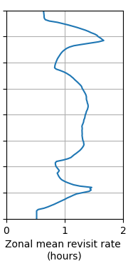
TMS Constellation Coverage
45°N
Equator
45°S
Notes:
Replace with animation

Slide 10
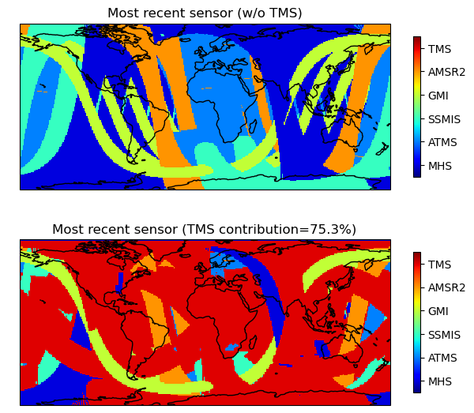
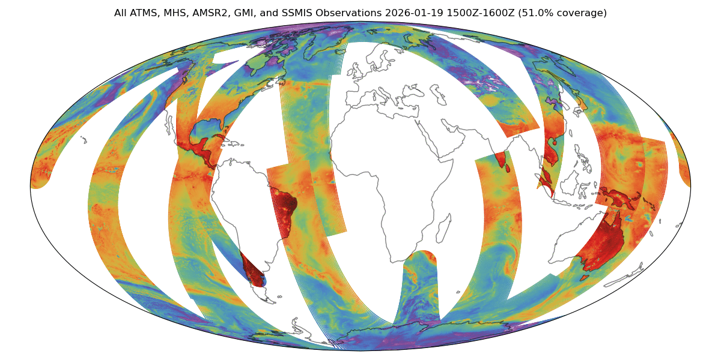
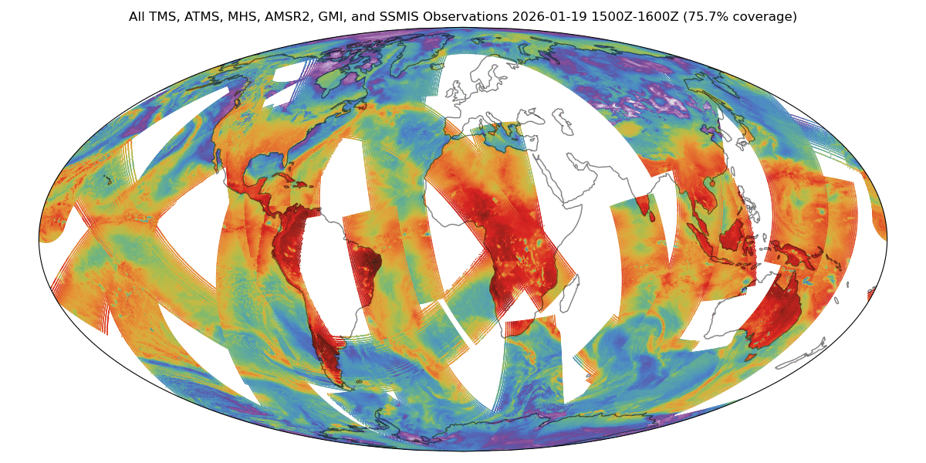
TMS complements government-operated backbone with rapid revisit and < 40 min median latency
GPM Constellation
Microwave sensors
+TMS
This chart (left) shows a snapshot of the track of the most recent PMW (imager or sounder) observation from the GPM multi-agency constellation on the morning of 19 January, 2026. The right hand side shows an animation of 88-91 GHz Tbs over a 6 hour window. The top rows shows GPM Constellation sensors only, and the bottom row shows the additional impact of the TMS constellation. The inclusion of these ten sensors lowers the average “age of data” by nearly 80 minutes, and the newest data comes from a TMS satellite over 75% of the globe.
Notes:
The 80-minute age reduction in the most-recent PMW observation is not evenly distributed. It is most pronounced west of the Dateline, which is exactly the AOR JTWC and 17 OWS forecast. This is the gap that motivated TROPICS; TMS at scale inherits and extends that mission commercially.

Slide 11
TMS Data Products and Applications

Slide 12
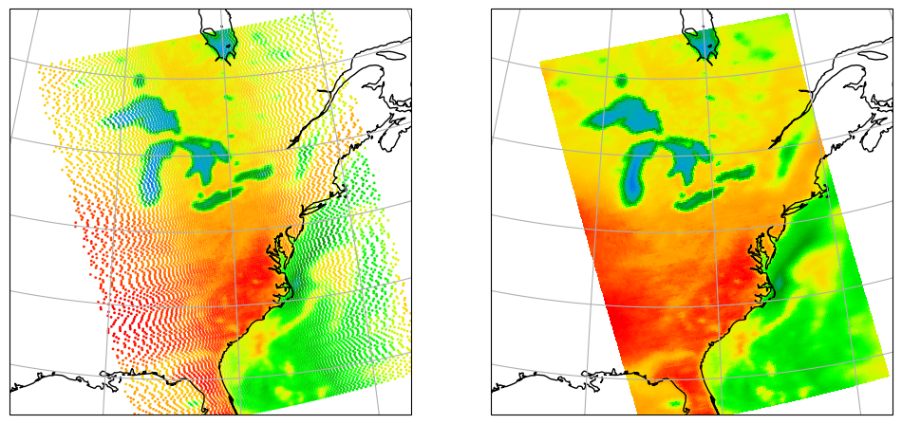
TMS Level 1 Products
Product | Spatial Resampling | Spectral Resampling
1B-TB | N | N
1B-TBR | Y (common FOV centers) | N
1C-TC | Y (common FOV centers) | Y (constellation harmonization)
1C-TCR | Y (equally-spaced grid) | Y (harmonization + limb adjustment)
Key Data fields:
Geolocation
Antenna/brightness temperatures
Ancillary data (land fraction, clear fraction, and surface elevation,
Quality flags
Spacecraft status (position/velocity/temperature)
Dimensions:
81 spots* x N scans (x 12 channels)
(where 30 <= N <= 512)
*1C-TCR is resampled to 128 equally-spaced ground locations per scan
1B-TB
1C-TCR

Slide 13
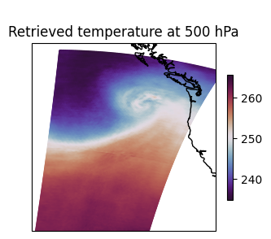
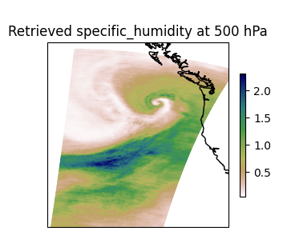
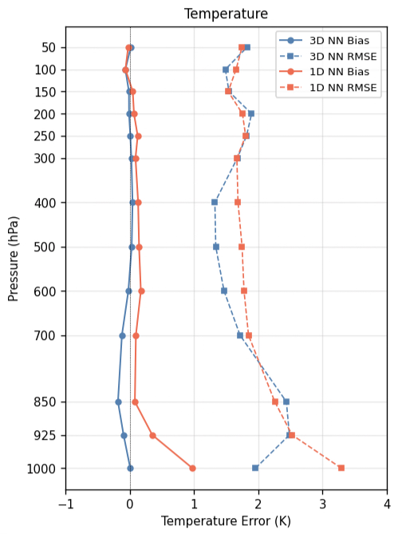
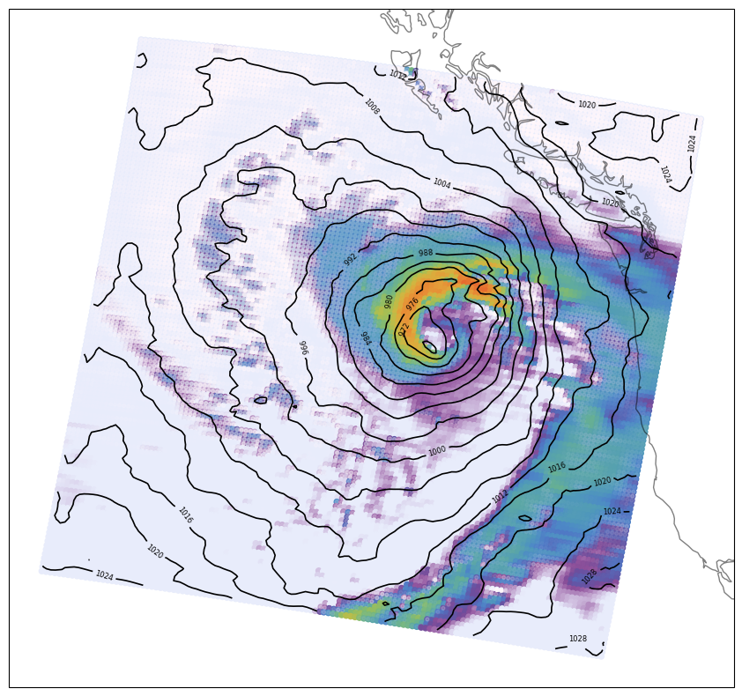
TMS L2 Products
Pacific bomb cyclone observed by TMS02 on 19 Nov 2024
L2A-ATVP (Atmospheric Thermodynamic Vertical Profile)
Key Data fields:
Geolocation
Temperature profile
Humidity profile
Total Ice Water Path
Total Liquid Water Path
Experimental: Geopotential height, sea level pressure
Standard deviation (for all parameters)
Retrieval method is Quantile Regression Neural Network trained on high-resolution global nature run simulations.
Inputs are 12 channel brightness temperatures, sensor zenith angle, land fraction, and surface elevation.
Currently moving from 1D to 3D inputs (significant reduction in temperature error).
Retrieved precipitation rate and mslp (no model background input!)

Slide 14
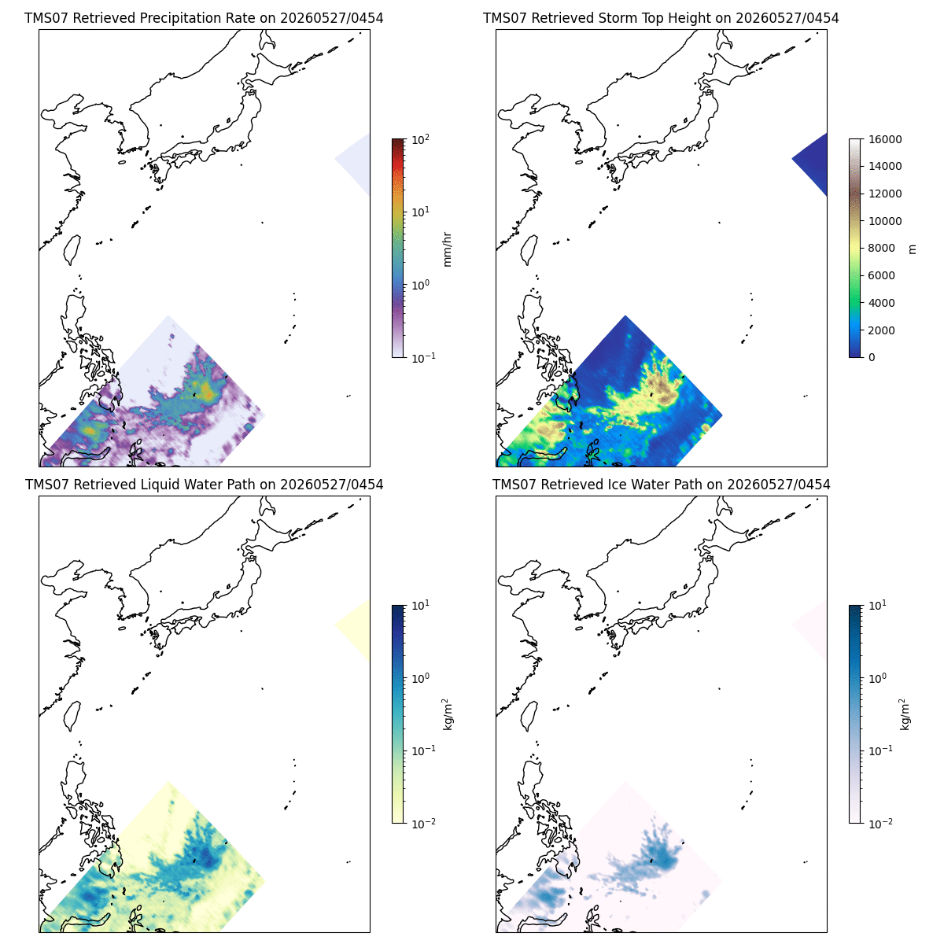
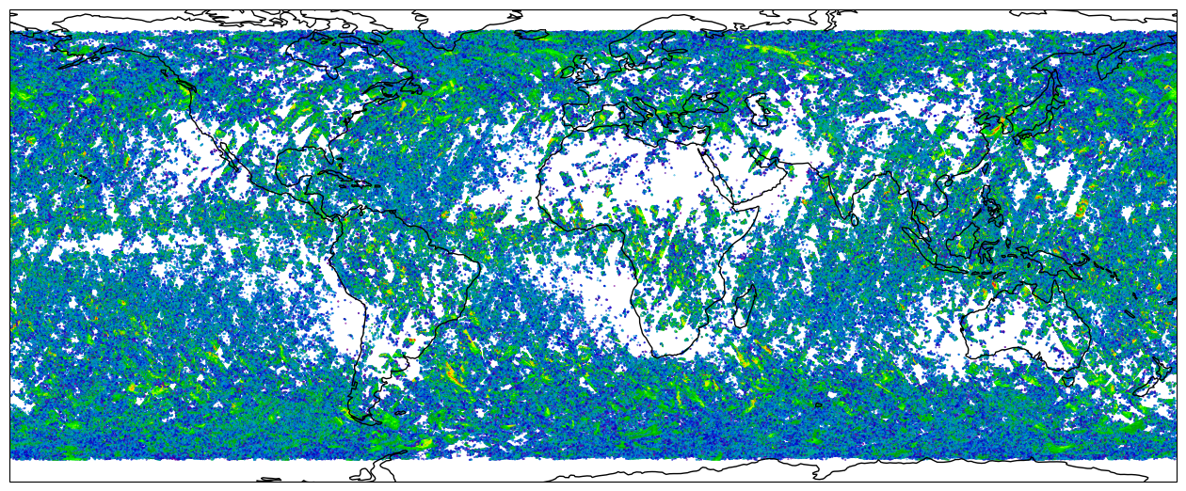
TMS L2 Products
L2B-HRPR (High-resolution Precipitation Rate)
Key Data fields (uniform 15km target resolution across scan):
Precipitation Ice Water Path
Precipitation Liquid Water Path
Total Precipitation Rate
Frozen (snow) Precipitation Rate
Storm top height
Precipitation water profile
Precipitation ice profile
All trained on coincident GPM DPR overpasses: 20M profiles within 15 minutes of TMS observation!
Typhoon Jangmi (27 May - 3 June 2026) TMS precipitation retrievals

Slide 15
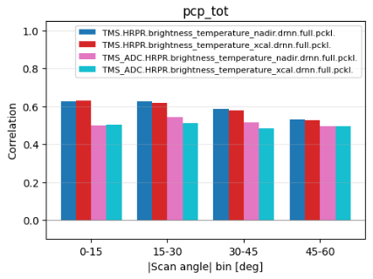
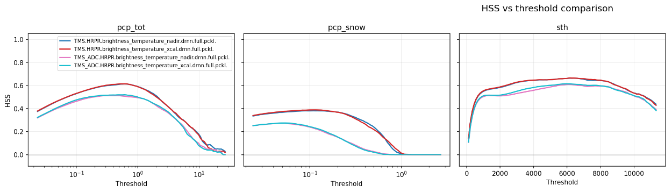
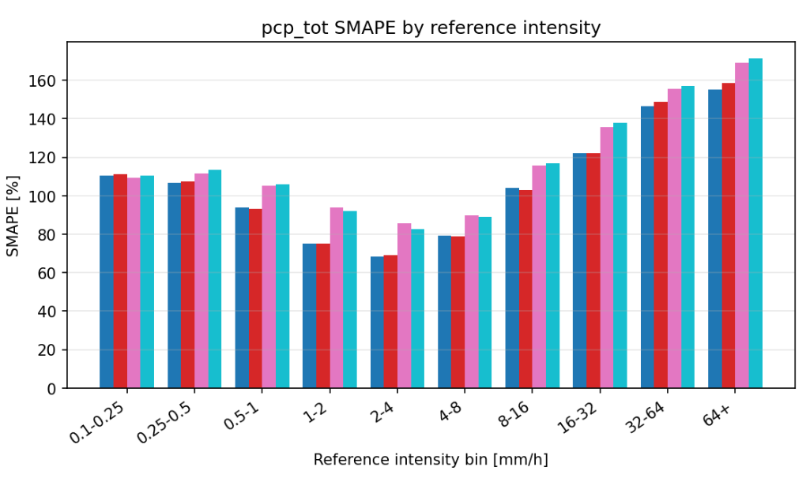
TMS L2 Validation
Statistics from held-out DPR coincidences
Initial validation findings:
No significant difference when using limb-adjusted Tbs to remove scan angle dependence, however, correlation shows dependence on scan angle (true resolution changes across scan; reference is always 15 km-averaged)
12-channel mode always performs better than 5-channel (just 91 + 183 GHz channels) - but 5-channel retrievals are still skillful
Impact of 118 GHz channels seems to improve snow retrievals the most - possibly due to temperature information for phase discrimination
Lowest relative errors between 0.5 and 10 mm/hr
Next step: fully independent validation (MRMS)

Slide 16
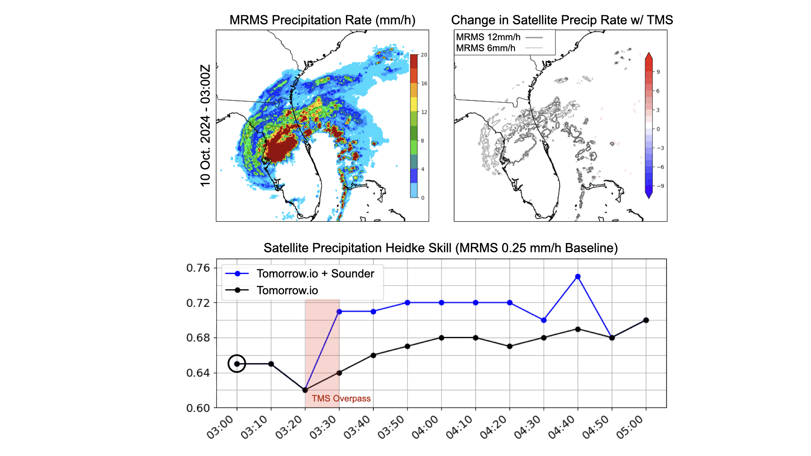
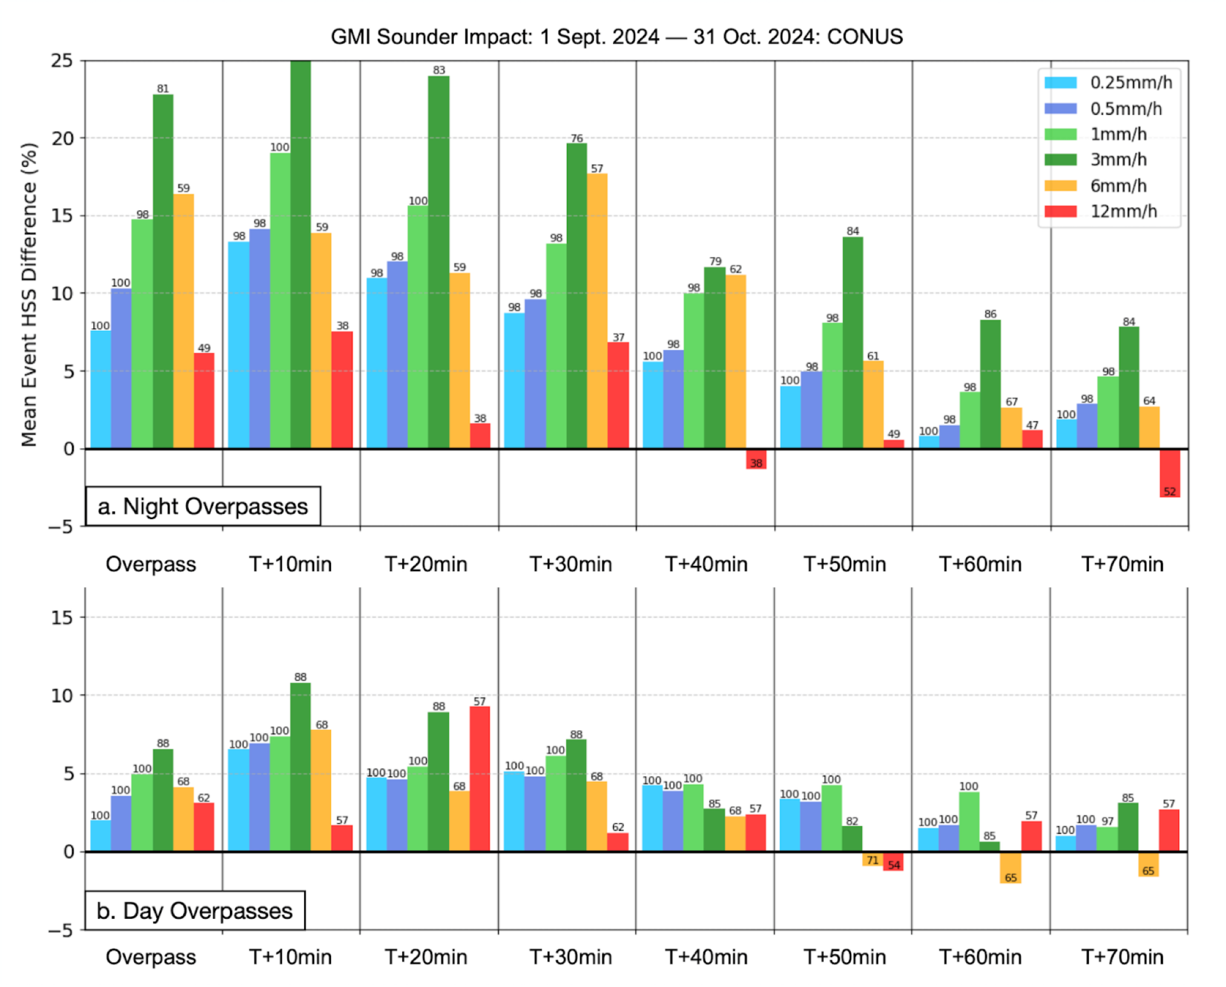
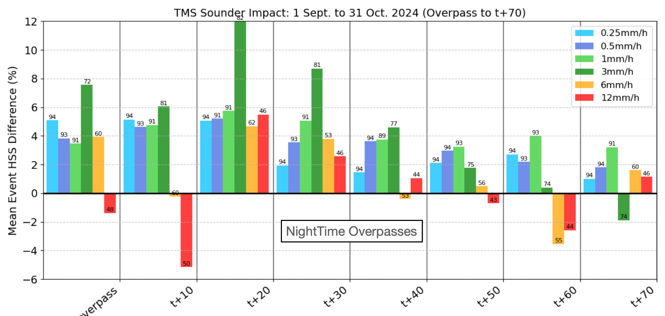

Impact of Tomorrow.io Data (TMS) on Precipitation Nowcast
Tomorrow-S1 (one of our microwave sounders) captured observations of Hurricane Milton on 10 October 2024.
Tomorrow.io Unified Precipitation ingests geostationary Vis+IR and passive microwave to derive real-time and nowcast (0-3hr) precipitation.
An increase in precipitation detection skill (validated against MRMS) was observed for 70 minutes after the TMS overpass.
The per-overpass impact is about 50% of GMI - but TMS observes 20x more frequently!
Forest Cannon, Simon Pfreundschuh, Brandon Taylor, et al. Deep Learning for Multi-Satellite Precipitation Retrievals: Impact of Tomorrow.io's Microwave Sounders. J. Hydrometeor., 27, 453–471, https://doi.org/10.1175/JHM-D-25-0007.1.
Notes:
Here is an example of how our own microwave data impacts the retrieval and nowcast. This is Hurricane Milton from 2024. When our own satellite overpasses the storm, you can see the skill of the forecast jump from an HSS of 0.62 to 0.7. We show many more cases and statistics in our paper in review which can be found at the citation on the slides.

Slide 17

Summary and Looking Ahead
We now have 11 microwave sounders on orbit, providing an hourly global average revisit rate
This rate of coverage will be maintained (or improve) through 2030 as constellation is replenished
Ongoing evaluation via NOAA Commercial Weather Data Pilot (data available to partner institutions)
  Sensor intercomparisons
  Latency assessment
  MiRS retrievals
  DA Experiments
Archived TMS data eligible for evaluation by NASA CSDA program
Continued improvements to L2 products and L1 calibration updates coming later this summer

Slide 18

THANK YOU

Slide 19
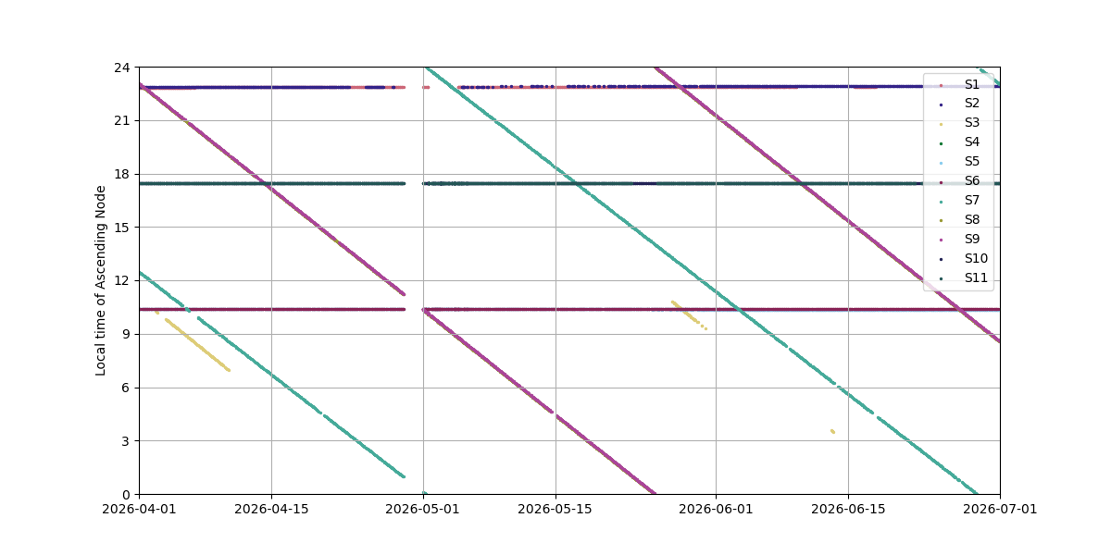
Tomorrow.io TMS1.1 LTANs (last 3 months)
A combination of sun-synchronous, 45°, and (future) 53°/88° inclined orbits provide round-the clock coverage
S1 & S2
S1 & S2
S4 & S7
S10 & S11
S8 & S9
S7
S7
S5 & S6
S5 & S6
S3 & S4
S8 & S9
S8 & S9
S3 & S4

Slide 20
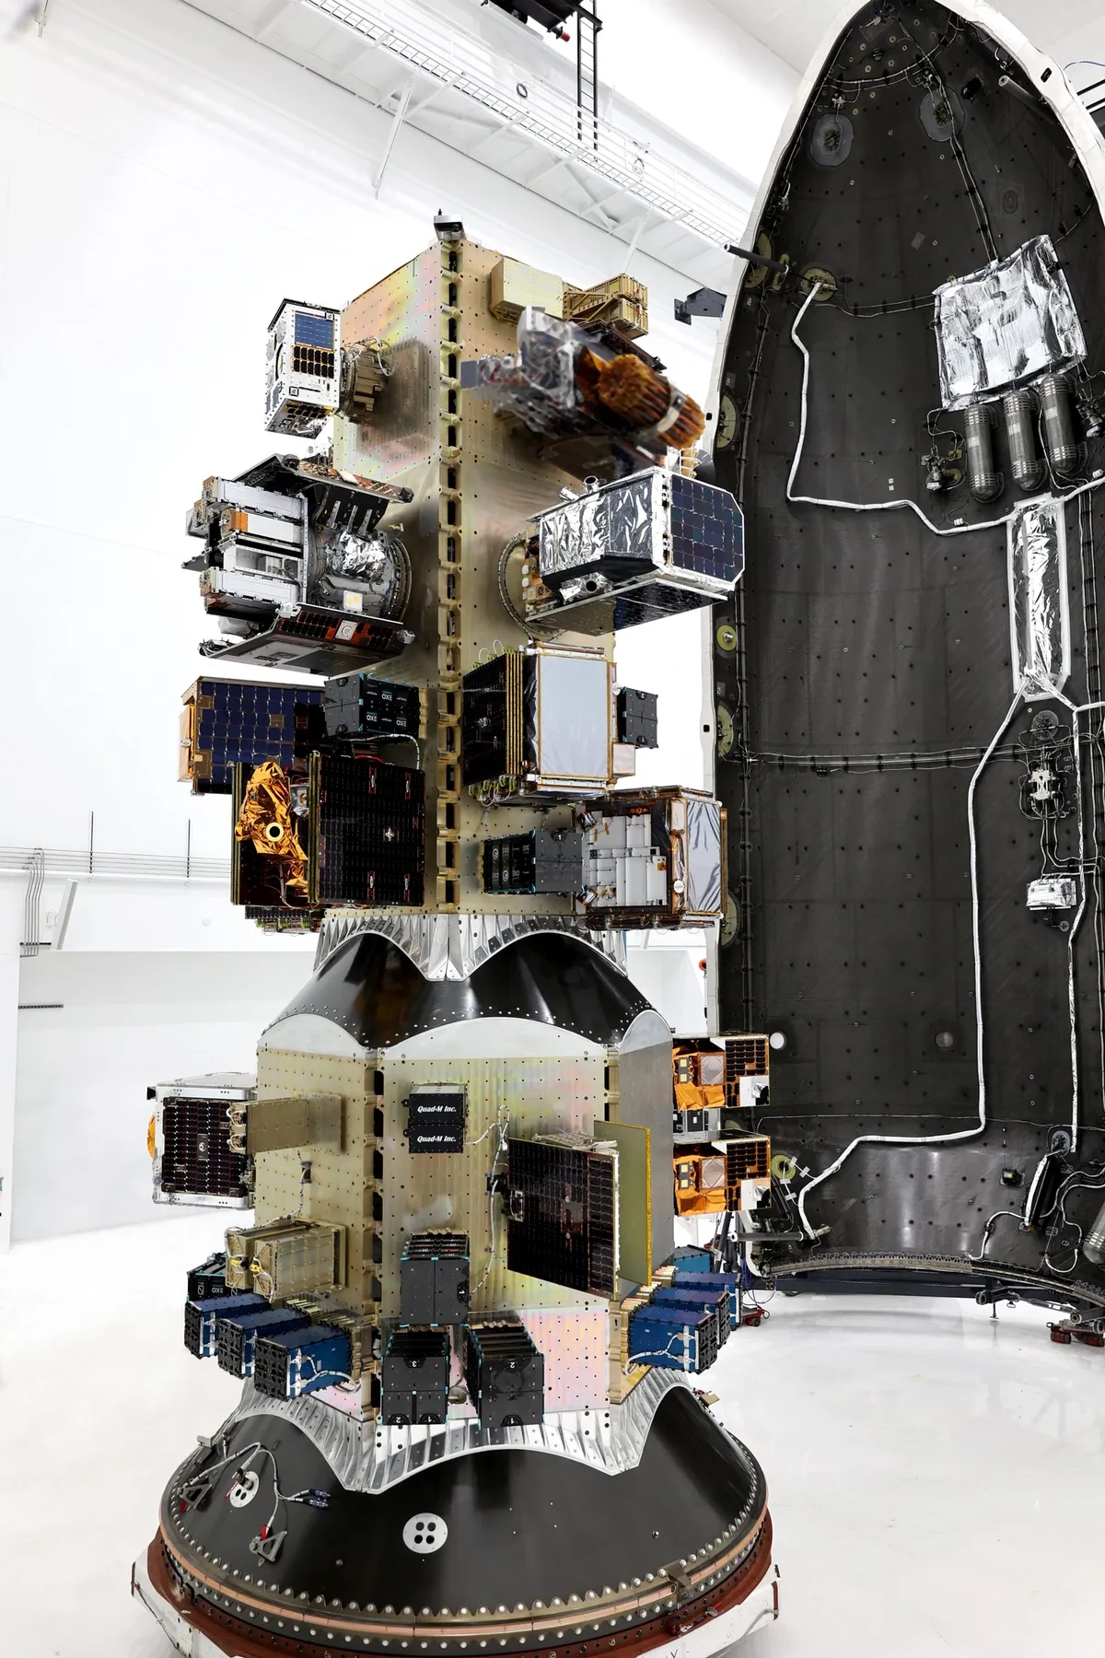
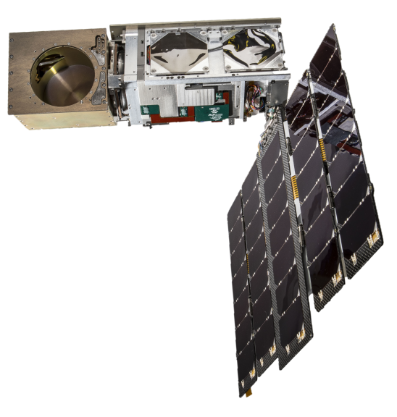
Tomorrow.io Microwave Sounder: Bus and Payload
Heritage: NASA/MIT-LL TROPICS Microwave Sounder
6U Bus
TMS Payload
12 channels from 91-204 GHz
Digital spectrometer (ASIC) for 7 F-band channels (114-122 GHz)
Direct detect W-band and G-band channels
Detectors rotate with antenna, giving constant polarization angle
Photo credit: SpaceX
Internal Calibration Target (ICT)
Pyramidal RF absorbing material
Characterized by 4 thermistors
Complements noise diodes (improves calibration stability and striping)

Slide 21
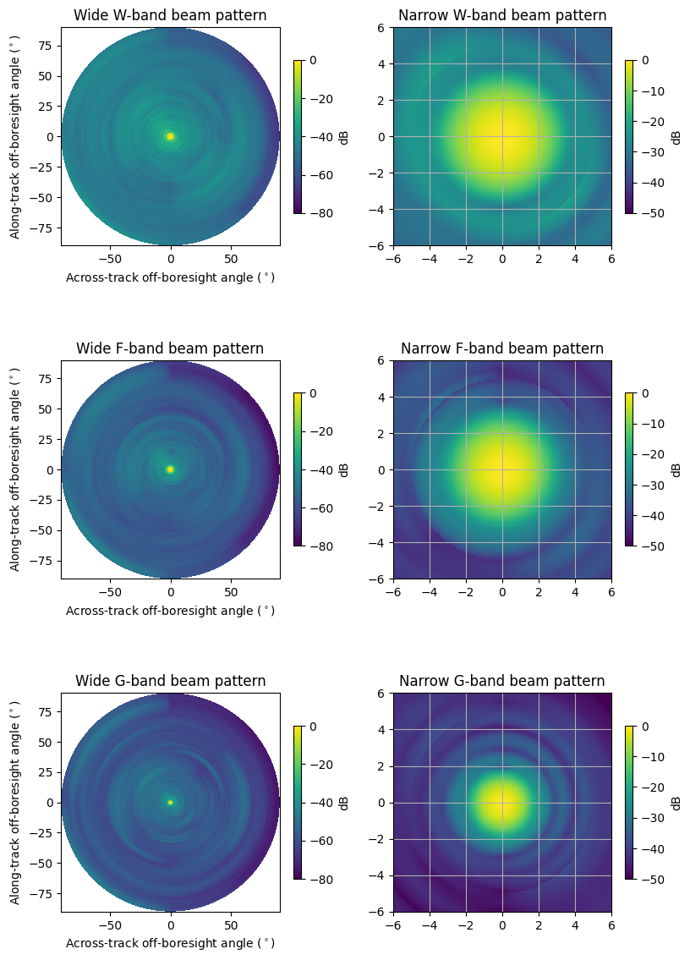
TMS Instrument Specifications
Channel | TMS Center Freq. (GHz) | TMS Bandwidth per sideband (GHz) | TMS NEDT Post-launch Average (K)
1 (W) | 91.65 | 2 | 0.35
2 (F1) | 118.75±3.5 | 1 | 0.60
3 (F2) | 118.75±2.625 | 0.75 | 0.68
4 (F3) | 118.75±1.875 | 0.75 | 0.64
5 (F4) | 118.75±1.25 | 0.5 | 0.72
6 (F5) | 118.75±0.75 | 0.5 | 0.72
7 (F6) | 118.75±0.375 | 0.25 | 0.98
8 (F7) | 118.75±0.125 | 0.25 | 0.95
9 (G1) | 184.41 | 2 | 0.40
10 (G2) | 186.51 | 2 | 0.45
11 (G3) | 190.31 | 2 | 0.44
12 (G4) | 204.8 | 2 | 0.43
Orbit Altitude | Swath Width
450 km | 1780 km
500 km | 2016 km
550 km | 2265 km
600 km | 2528 km
Band | Beamwidth | Beam Efficiency | FOV* @ nadir | FOV* (scan mean)
W (91 GHz) | 2.94° | 91.1% | 27.7 km | 44.3 km
F (114-122 GHz) | 2.47° | 97.6% | 23.5 km | 37.6 km
G (184-190 GHz) | 1.47° | 96.6% | 15.1 km | 24.2 km
G (204 GHz) | 1.44° | 97.7% | 14.9 km | 23.8 km
*geometric mean from 525 km altitude

