Slide 1


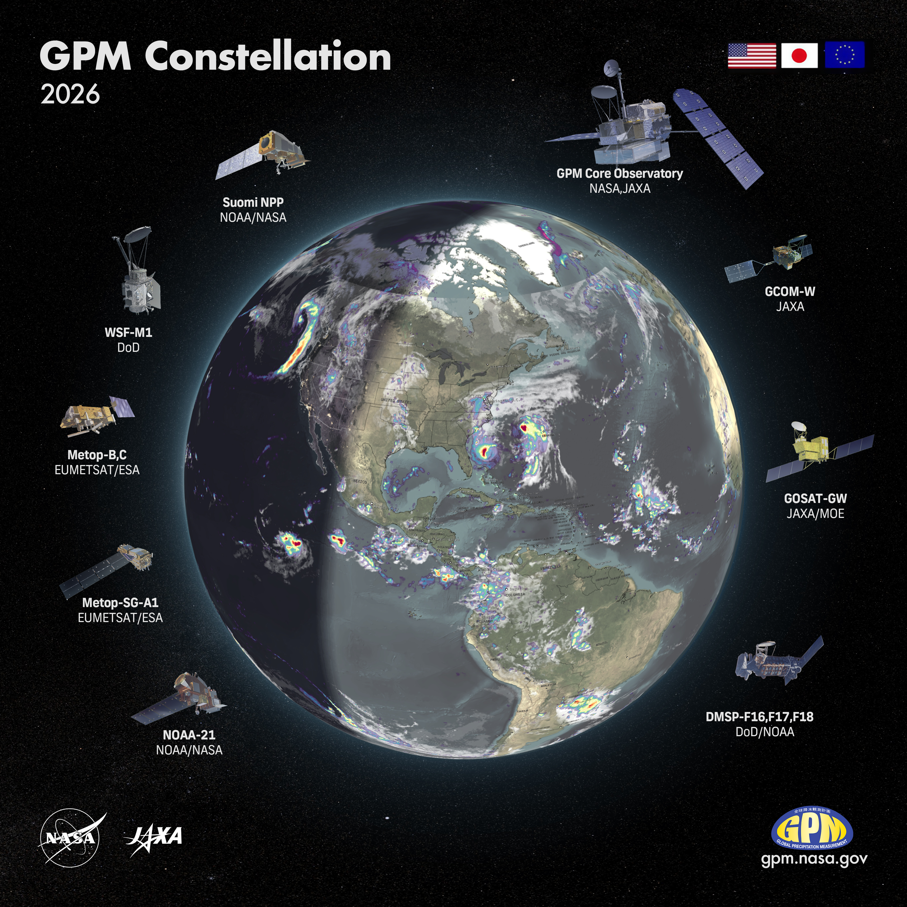
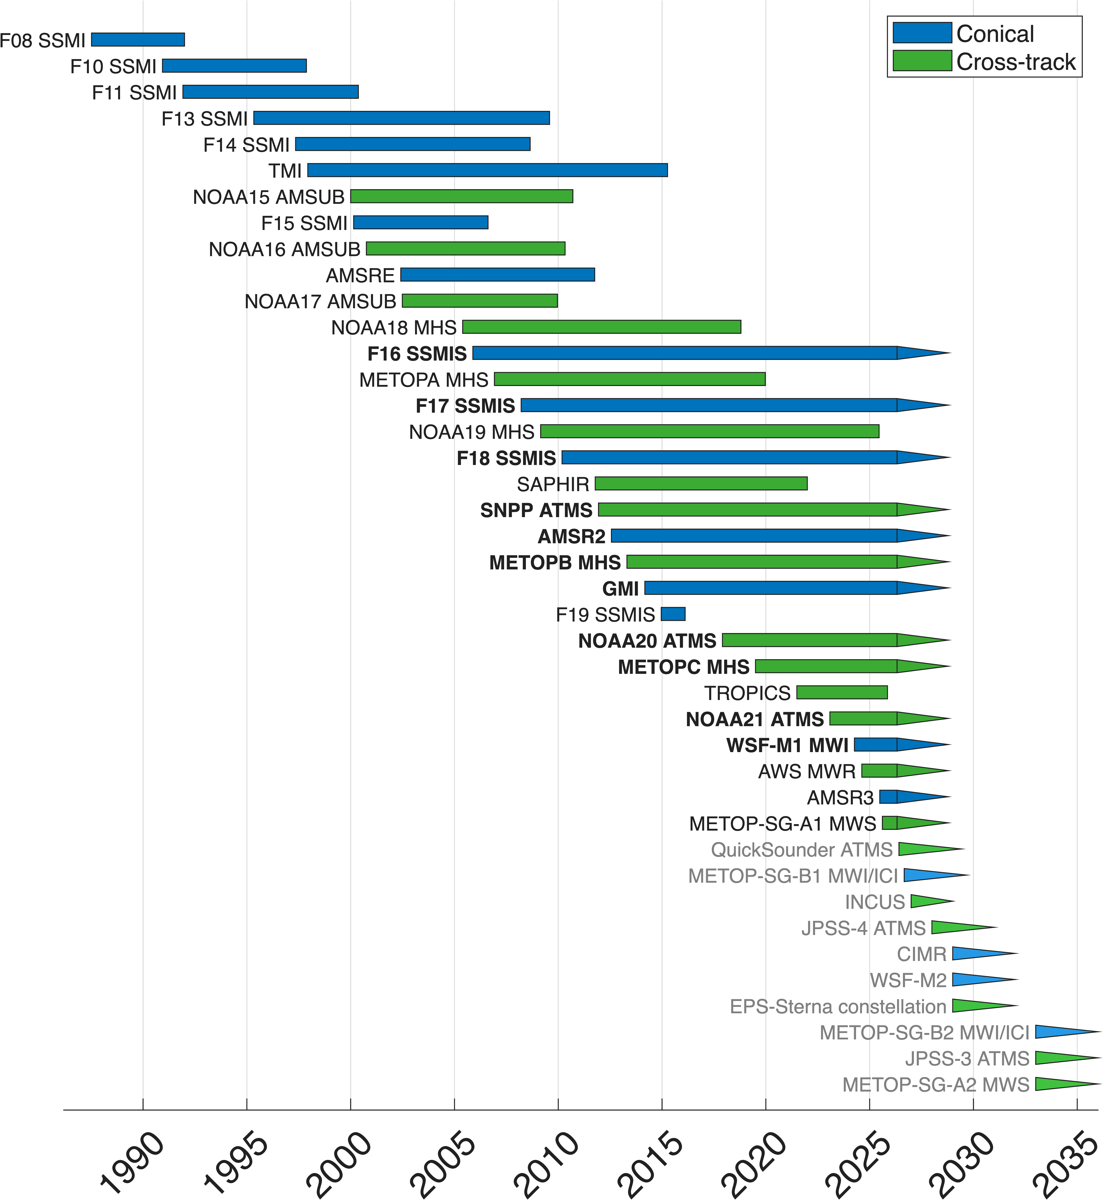
User and System Needs for the Future of
Global Precipitation Datasets
George J. Huffman¹, Sarah Ringerud¹, Jackson Tan^{1,2}
1: NASA Goddard Space Flight Center, Greenbelt, MD, USA
2: University of Maryland Baltimore County, Baltimore, MD, USA

Slide 2
0. The Workshop
The U.S. precipitation community is considering the transition from GPM to “what comes next”
• the next Decadal Survey is about to start, intended to guide NASA Earth Science for the next decade
• this is provoking a lot of work on what should happen next
• NASA is not planning another flagship mission for precipitation
The Future of Global Precipitation Workshop
• 23-24 March 2026
• University of Maryland College Park
• workshop steering committee:
Sarah Ringerud Ian Adams Scott Braun
George Huffman Veljko Petković Simon Pfreundschuh
Andrea Portier Jackson Tan Daniel Watters
• 48 in-person and 31 on-line participants (some intermittent, of course)
• 6 topic areas:
23rd: applications merged products machine learning
24th: constellation calibration validation
• each area had an introductory oral, then discussion in small breakout groups, then a plenary
A draft white paper is circulating

Slide 3
1. Applications
How do we shift toward a bottom-up, application-driven approach where stakeholder needs directly inform product development?
Latency
• operational forecasting and disaster management require "real-time" latencies – sub-hourly
• current latencies of several hours are often insufficient for fast-evolving systems like flash floods
• these are driven by agency downlink points and workflows … how much will change?
• do nowcasts need to be part of the mix?
Uncertainty
• users require tiered uncertainty information
• expert users require full probability density functions (PDFs) and spatially correlated error structures
• non-experts need simple metrics like "yes/no" rain flags or percentage confidence
• but these should be traceable to quantitative metrics
Fitness for purpose
• users need specific information that helps them determine which precipitation products best satisfy their needs
• in many cases the users’ focus include region, season, and other specifics, not a general “uncertainty”
• how does the precip community develop this curation?
Satellite observations provide unique, model-independent value, particularly in the tropics and at the mesoscale
• meanwhile, numerical products (reanalyses, short-interval forecasts) have value in cool-season settings
• merged observation/numerical products potentially provide benefit for some users

Slide 4
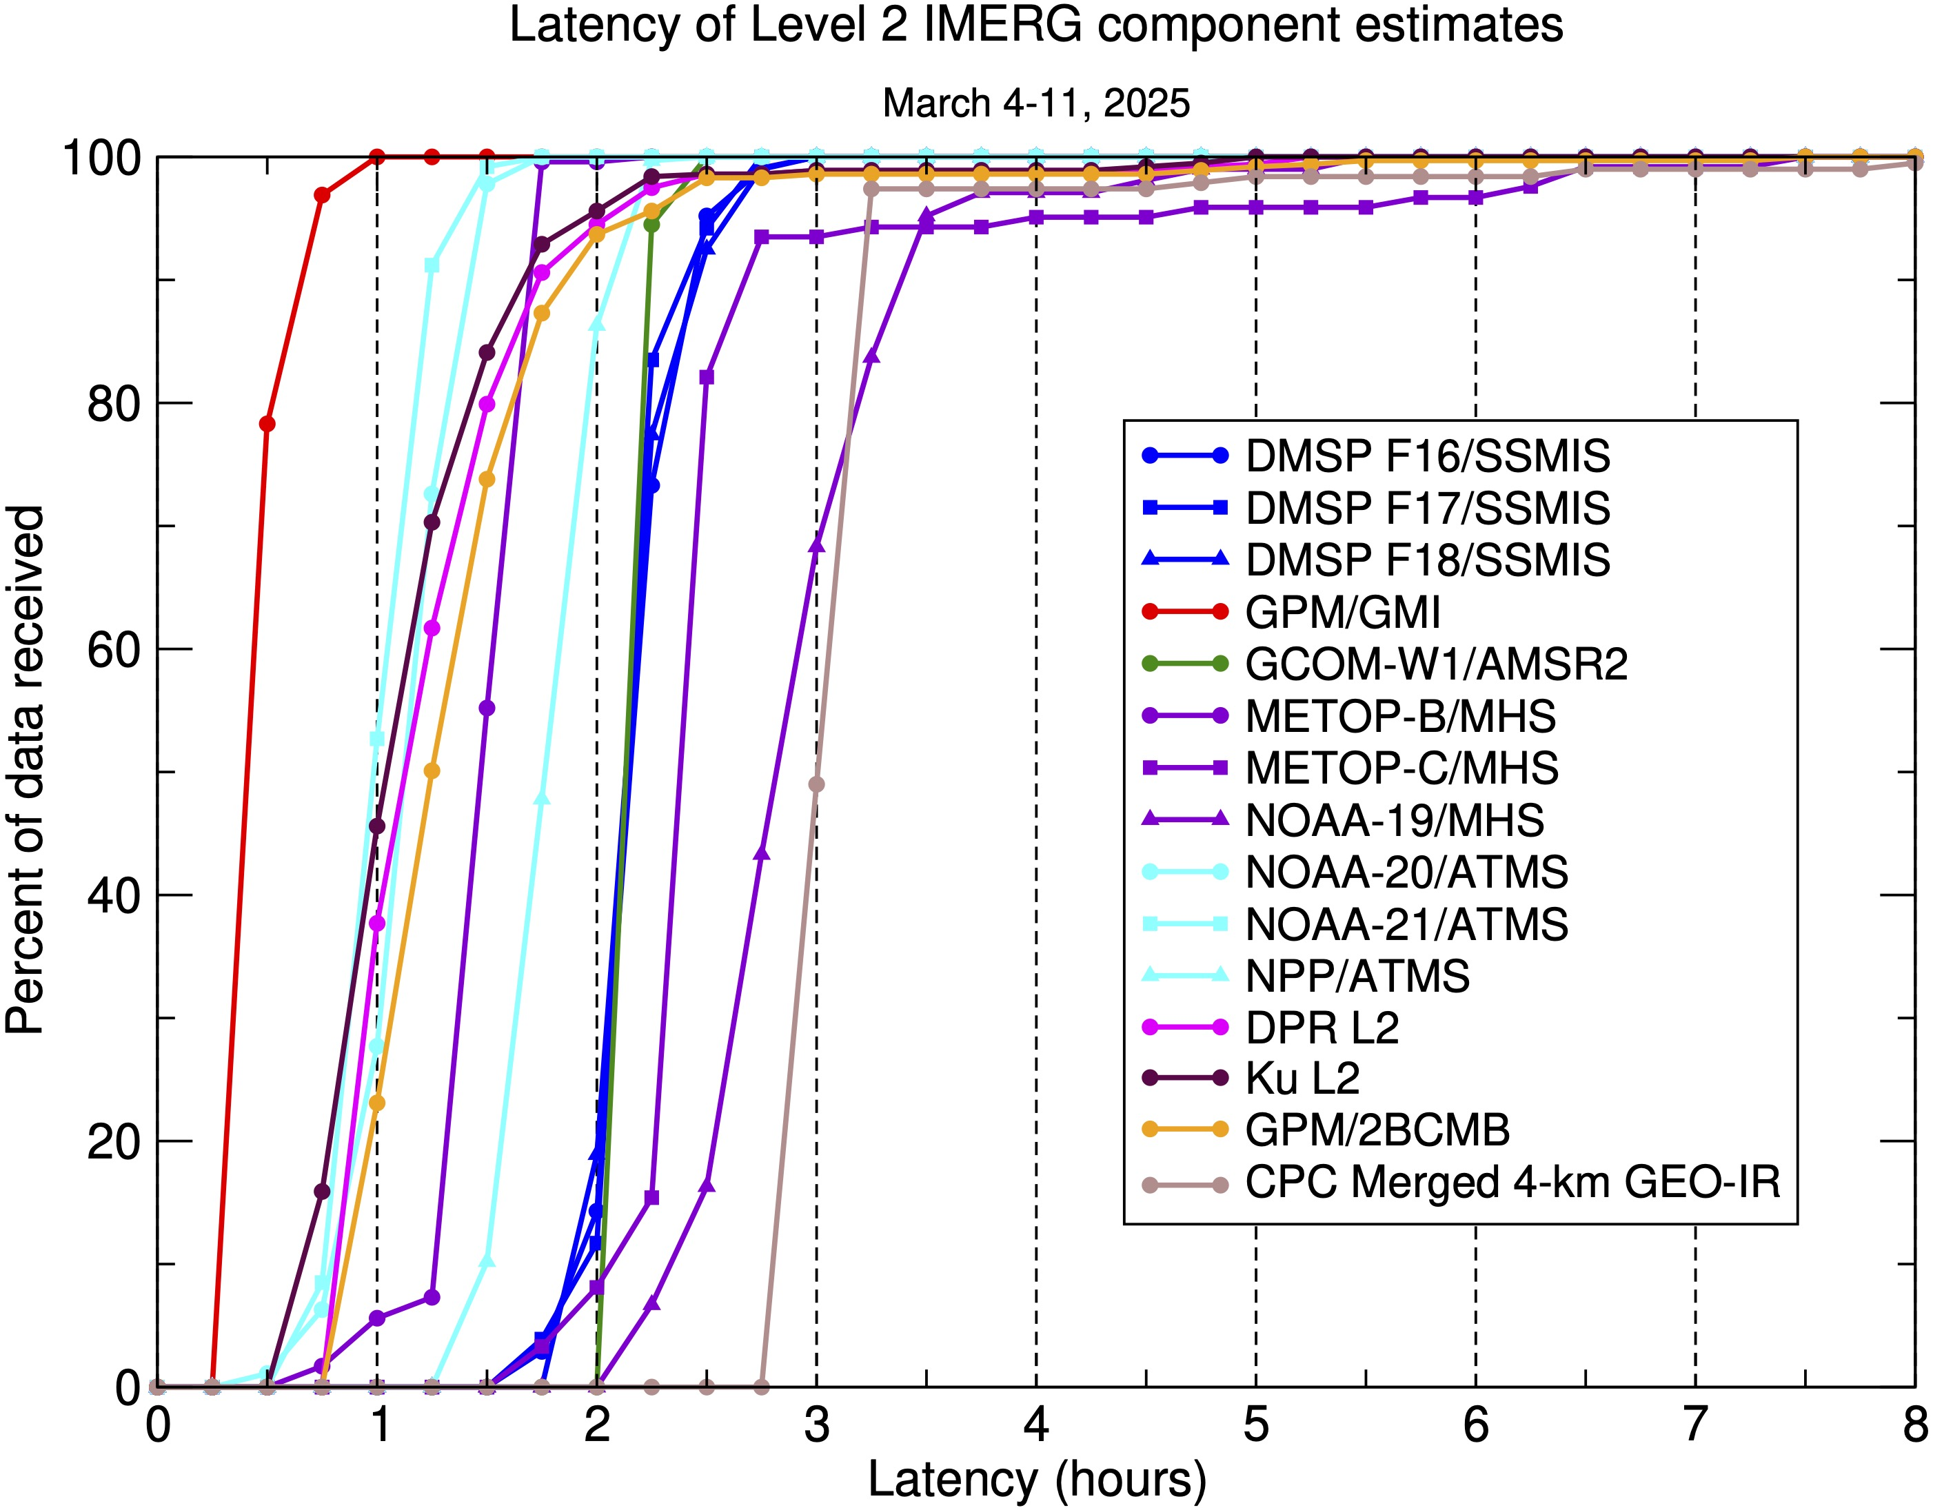
1. Applications
How do we shift toward a bottom-up, application-driven approach where stakeholder needs directly inform product development?
Latency
• operational forecasting and disaster management require "real-time" latencies – sub-hourly
• current latencies of several hours are often insufficient for fast-evolving systems like flash floods
• these are driven by agency downlink points and workflows … how much will change?
• do nowcasts need to be part of the mix?
Uncertainty
• users require tiered uncertainty information
• expert users require full probability density functions (PDFs) and spatially correlated error structures
• non-experts need simple metrics like "yes/no" rain flags or percentage confidence
• but these should be traceable to quantitative metrics
Fitness for purpose
• users need specific information that helps them determine which precipitation products best satisfy their needs
• in many cases the users’ focus include region, season, and other specifics, not a general “uncertainty”
• how does the precip community develop this curation?
Satellite observations provide unique, model-independent value, particularly in the tropics and at the mesoscale
• meanwhile, numerical products (reanalyses, short-interval forecasts) have value in cool-season settings
• merged observation/numerical products potentially provide benefit for some users
E. Nelkin (STC; GSFC)

Slide 5
2. Merged Products
Sources
• surface-based observations and numerical products have value for regional analysis, as well as validation
• commercial data is coming, but integrating it will require effort on both sides
• there is an on-going need for the agency sensors as a “backbone” of high-quality data
Hierarchy of products
• we continue to need a long-term homogeneous climate record (prioritizing trend detection and consistency)
• separately, we need a best-available high-resolution algorithm (prioritizing instantaneous accuracy)
• “homogeneity” should expand to include “higher-order” features: PDFs, consistency in space and time
• additional merged products are needed: observations+models, satellites+surface radars
Merging strategy
• there is strong interest in researching merging schemes working at Level 1 instead of Level 2
• merged products must allow users to trace errors and data back to their original sensor sources
• the next-generation system should have a testbed design that allows “easy” testing of new concepts
Enhanced content
• several “runs” are needed to provide multiple NRT latencies, and ending with a “research run”
• but expense and user confusion need to be minimized
• next-generation products should routinely provide variables beyond precipitation rate, such as precipitation phase (solid vs. liquid) and accumulation totals
What should be the division of responsibilities between the agencies and commercial sectors?

Slide 6
3. Machine Learning
On-going need to intercompare machine-learning techniques and full-fledged retrieval algorithms in a reproducible way
• the robustness of both approaches at the limits of the developmental dataset must be explored
• full range of regimes should be covered (oceans, land, tropics, high latitudes, orography, snowfall, etc.)
• IPWG SatRain database provides a benchmark data set
• this might lead to hybrid approaches
• in particular, uncertainty frameworks might apply a combination of ML and physical retrieval ideas
There was general agreement that generative AI (diffusion models) would be a suitable approach to represent retrieval uncertainties
ML requires relatively large amounts of high-quality reference data
• in particular, a successor to the current active/passive reference provided by the GPM Core Observatory is a high priority
• how quickly can new sensors be brought on-line under ML compared to existing retrievals?
ML developers must strive to provide interpretability for their systems
• this gives users confidence by providing physical insight into the performance of the algorithm across the range of regimes

Slide 7
4. Calibration and Reference Standards
Calibration strategies must adapt to the impending heterogeneous constellation of short-lived satellites
• how can these smallsats get calibrated soon enough to be useful in near-real time for “most” of their lifespan?
Backbone Sensors
• maintaining a "backbone" of high-quality, well-calibrated sensors (like GMI or AMSR3, plus radar) is a non-negotiable requirement for calibrating both the Tb’s and PDF’s of other sensors in the constellation
• in the upcoming JAXA PMM radar mission, flying companion radiometers that provide a wide range of frequencies in formation would satisfy this need
Inclined-Orbit Calibrators
• there is a strong recommendation for continued use of inclined-orbit calibrators to sample the diurnal cycle across different local solar times and provide calibration data for all regimes
Hybrid Calibration
• while ML can accelerate calibration for new sensors, it should not replace physics-based active calibration
• a reference standard is still required to avoid circularity or drift
• a government NIST-traceable “warm load” standard for passive microwave could be valuable

Slide 8
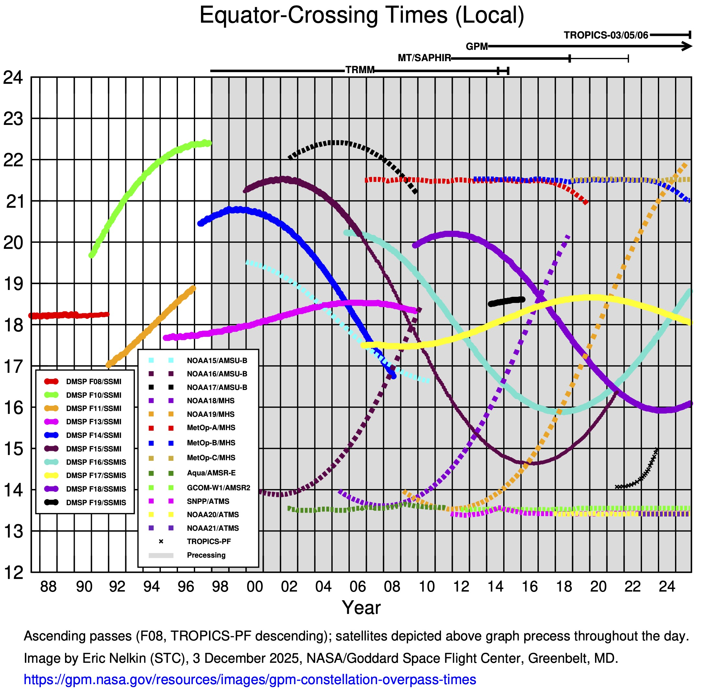
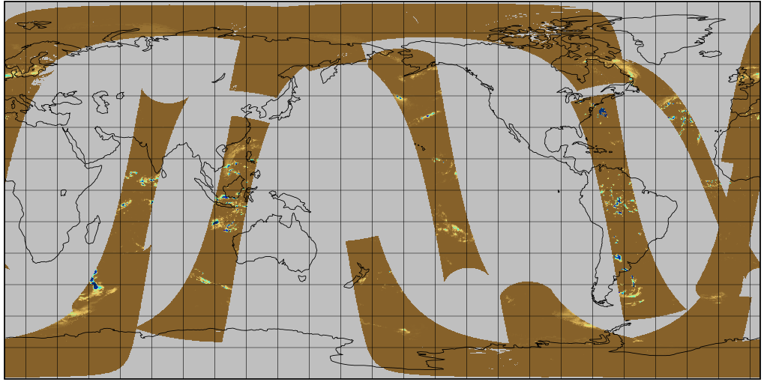
5. Constellation and Sampling Strategies (1/2)
The PMW constellation history (right)
• precessing satellites are shown at the top
• persistent multi-hour gaps inject uncertainty about the diurnal cycle
A typical half-hour coverage by the current constellation (below)
• the gaps are presently filled with a combination of “morphed” PMW and current-hour IR

Slide 9
5. Constellation and Sampling Strategies (2/2)
The workshop emphasized that the focus for future constellations should be on observation interval rather than specific orbits
• short-lived extreme events and storms driving flash floods require observation intervals of ~1-2 hours at every time of day
• this interval also adequately resolves the diurnal cycle of precipitation, which is a first-order requirement for climate studies
• the trade space encompasses observation interval, orbits, and mission/data buy costs
Complementarity of Sensors
• PMW sensors provide essential physical insights, but geosynchronous (GEO) data remain indispensable for their high space/time resolution and ability to track storm evolution
• the impending shift to multi-channel GEO algorithms will make GEO data more valuable
• this is being enabled by GEO-Ring
• the planned full (rescued!) GEO history *and* uniform processing for all channels is a powerful combination for advancing the field
• near-real-time access is critical for application work, but is a current administrative quandary
International and Commercial Collaboration
• a resilient "virtual constellation" requires sustained international partnerships (e.g., ESA, EUMETSAT, JAXA, NASA, NOAA) and the smart integration of emerging commercial smallsat data
• the cost of providing open access to products computed from commercial data remains to be negotiated
• should availability be tiered by latency?
• the precedent in TRMM and GPM is that “original” data are not open, only derived products
• in particular, GPM Level 1 is at L1C – intercalibrated – not the L1B that agencies provide

Slide 10
6. Validation
Validation must move beyond simple statistical metrics to evaluate impacts to sets of applications
• skill scores, variogram parameters, event statistics
• performance within applications, such as streamflow forecasts in hydrological models
• metrics for shifts in homogeneity and for distinguishing real changes from artifacts
Expanding global coverage
• avoid "chasing accuracy" only in data-rich regions like the U.S.
• prioritize expanding validation to under-represented regions
• expand international partnerships, including radar networks outside the U.S.
• use indirect methods such as soil moisture comparisons and water budget closure
• improve access to atoll gauges, buoys, PALs, shipborne radars
• atoll gauges currently paused – restart?
• sustained, long-term ground observation networks are often more beneficial for algorithm development and Level 2 validation than short-term, localized, process-oriented field campaigns
Specific research areas will require particular validation datasets

Slide 11
7. Other Considerations
Lessons learned and future issues for data systems
• users need to subset datasets by space, time, parameter from the archive
• parallel processing needed for multiple versions during upgrades
• the next-generation system should have a testbed design that allows “easy” testing of new concepts
• the next-generation system faces cost/speed/versatility tradeoffs among
• hardware – CPU-GPU-TPU
• platforms – servers-supercomputers-cloud
• the impact of cloud computing and storage is not yet well-characterized
• cloud vs. on-prem computing by researchers/dataset producers
• optimal data formats for each are different
• access and costs are unknown and might differ by class of user
• should highly-used products have a secondary archive outside the cloud to reduce egress charges?
MOU’s and other agreements for on-going data sharing among agencies (and with commercial providers) have very long lead times

Slide 12
8. Final Comments
Where does precipitation research need to focus? Collecting issues across the workshop:
• uncertainty
• extremes
• snowfall
• orographic enhancement
• coasts
• oceans
• hydrometeor phase
• product co-development with users
The GPM Core Observatory should last until 2034
• the Decadal Survey is giving the U.S. planning process a boost
• extending the merged satellite+ record will require
• robust support from the science and application communities
• planning
• international coordination of satellite assets
• funding

