Slide 1



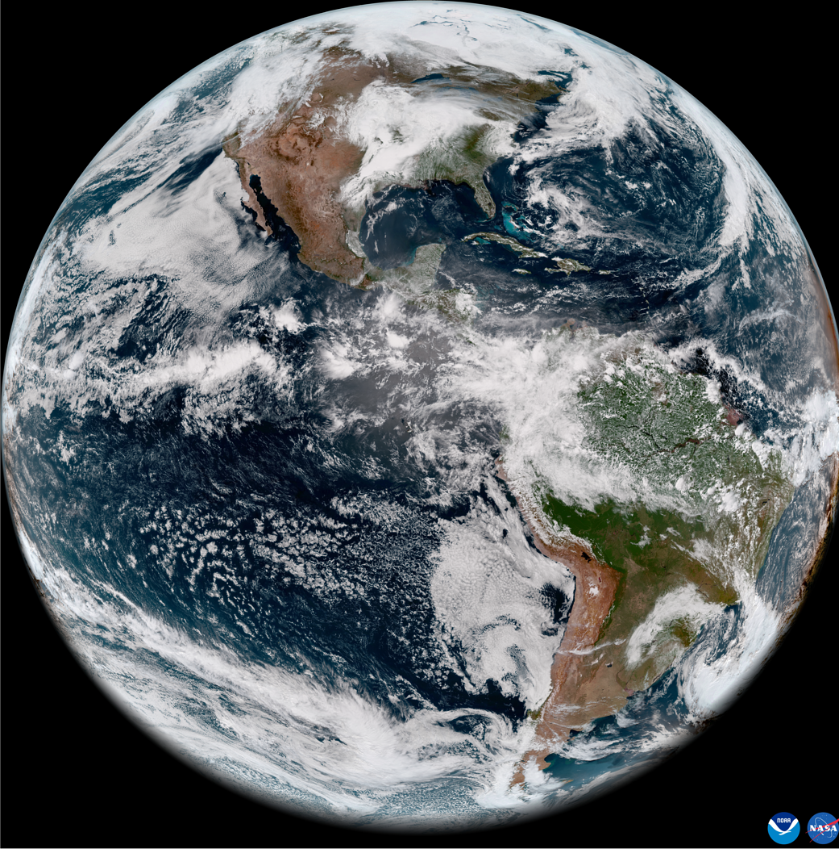
Geo-Ring FCDR
Viju John¹, Carlos Horn¹, Joerg Schulz¹, Jessica Matthews², Andrew Heidinger² , Steve Wanzong², Shin Koyamatsu³, Ken Knapp⁴, Frank Hogervorst⁵, Shibin Balakrishnan⁶, Ashim Kumar Mitra⁶
¹EUMETSAT , ²NOAA, ³JMA, ⁴KnappWeatherSat, ⁵S&T, ⁶IMD
Third Geo-Ring Workshop, 23 – 25, June 2026, EUMETSAT HQ

Slide 2
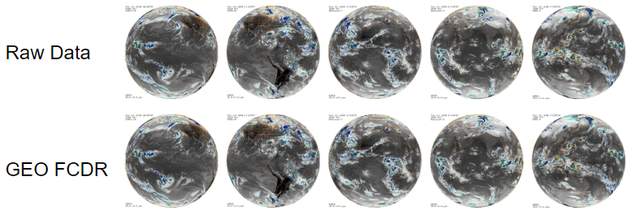
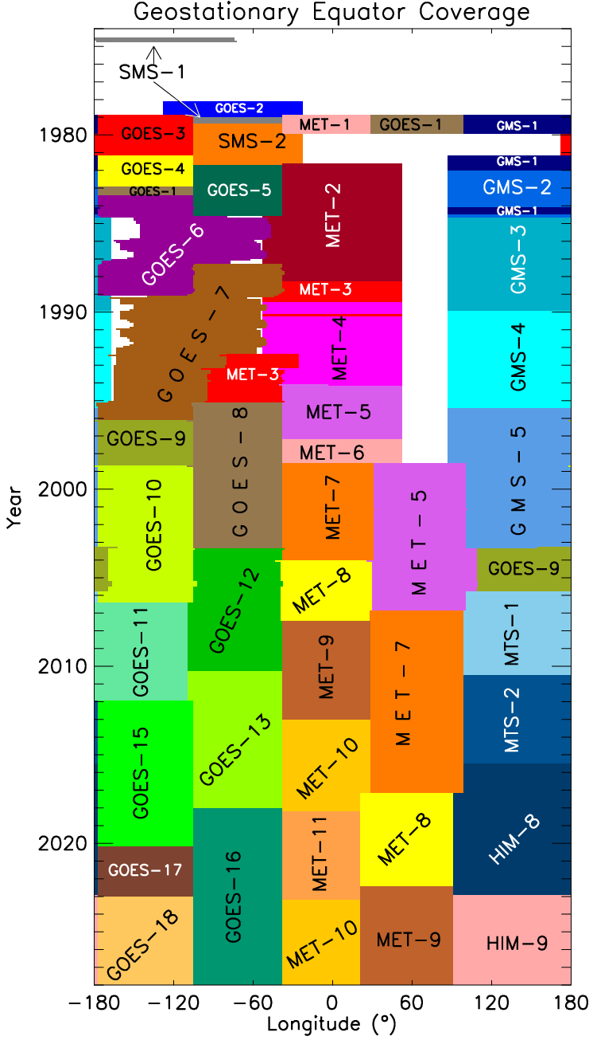
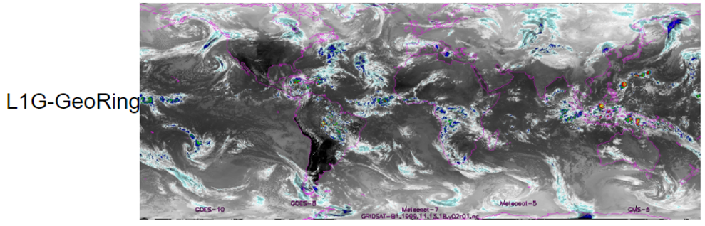
EUM-NOAA Joint project – HLWG – 2023 – 2027
        Discover and archive all available raw data – rescue and resilience
Consistent quality control
Consistent radiometric re-calibration
Consistent remapping – 30 minutes, ~5 km² resolution
Fill data gaps – collaboration with India MET Department
~1980 - 2026 and beyond
Notes:
Project runs 2023-2027 and aims at best and longest radiance climatology ever by addressing:
data rescue activities
radiometric anomaly detection
improved navigation
metadata analysis
uncertainty characterisation (EUMETSAT only)
channel re-calibration
channel cross-calibration
spectral band adjustment
validation
mapping on standard grid with fixed temporal sampling
combination of individual mapped satellites into quasi-global product
EUMETSAT and NOAA will co-develop and use their cloud infrastructures to enable the most efficient data processing
EUMETSAT and NOAA will both distribute from and into cloud infrastructure

Slide 3
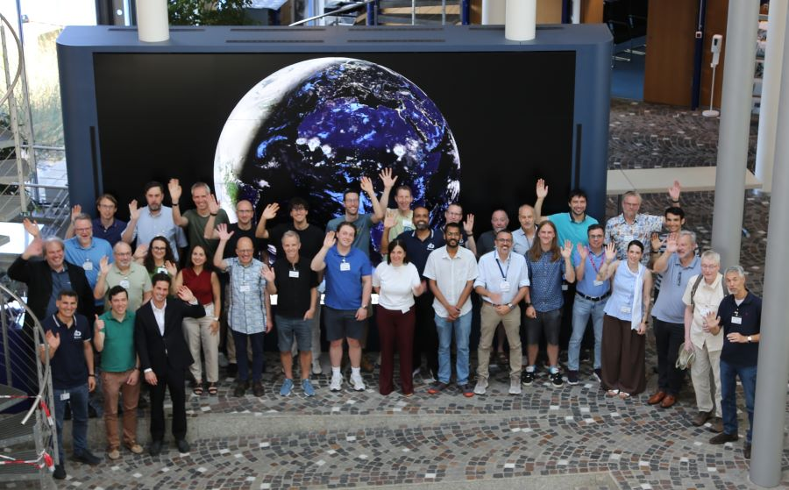
GEO-Ring Workshop #3, June 23-25 2026
Gathered developers and users
Discussed the status of the project
Discussed the test data
Gathered user requirements
Discuss plans for operational transition
  Data policy
  Governance
  Access methods
Discussed inclusion of historic GEO data
Discussed inclusion of LEO imager data and other LEO/GEO data types (lightning, sounders, ...)

Slide 4
Feedback from relevant applications – went far beyond L2
We learnt:
Spectrum of usage of the GEO-Ring radiances is very broad
  - LST, SST, Cloud and aerosols, precipitation, TOA/Surface radiation,
  Convection tracking, AI/ML weather forecasting, reanalysis,
  climate model evaluatio
Low latency availability down to NRT (~3 hours) is demanded by climate services, precipitation dataset developers, AI/ML weather forecasting
long series is required in many applications, from LST and many other data sets to climate model evaluation

Slide 5
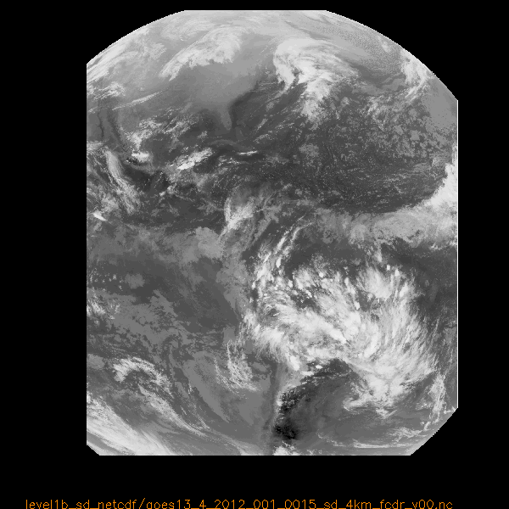
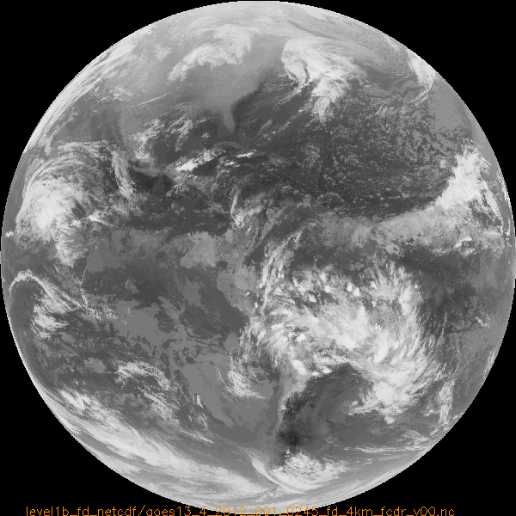
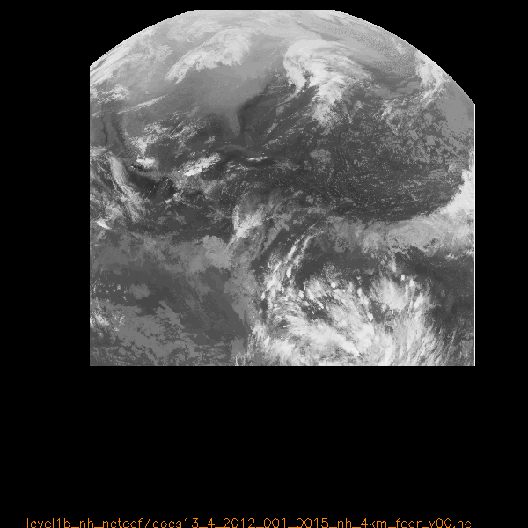
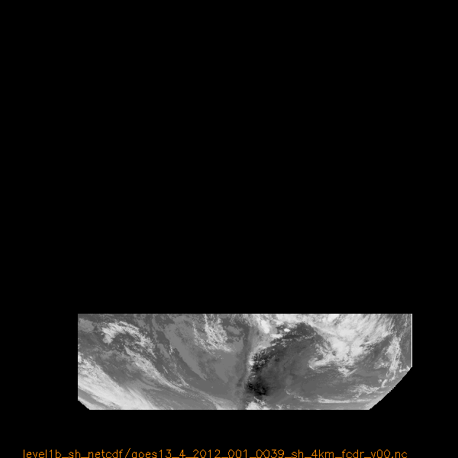
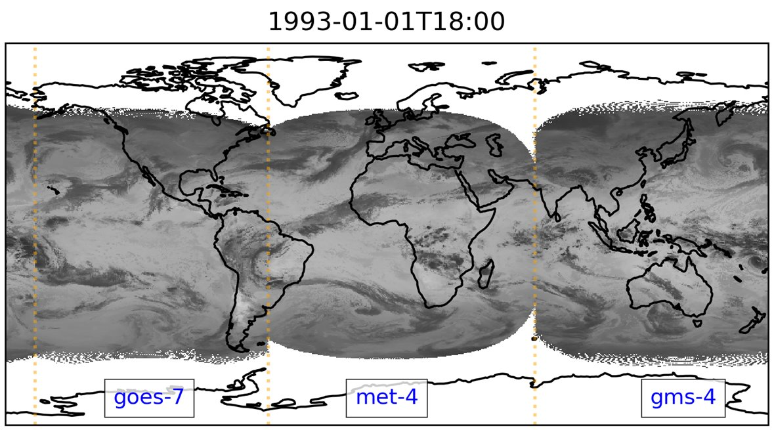
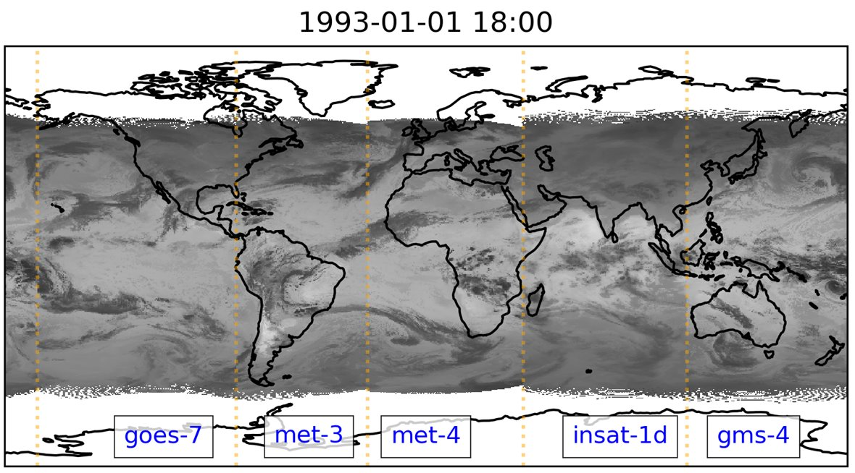
Data Rescue - Examples
Figure from Steve Wanzong, SSEC/CIMMS
=
+
+

Slide 6
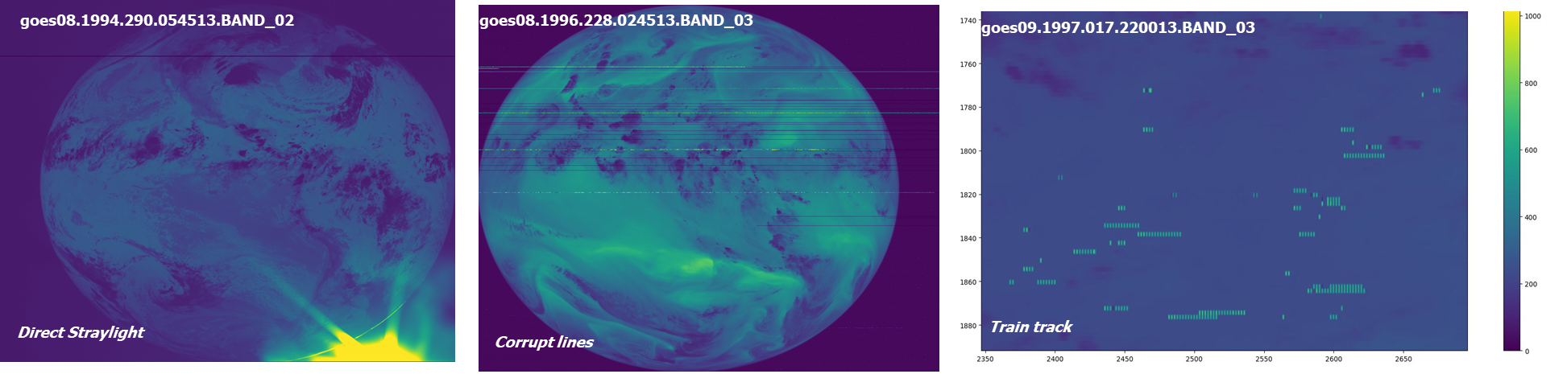
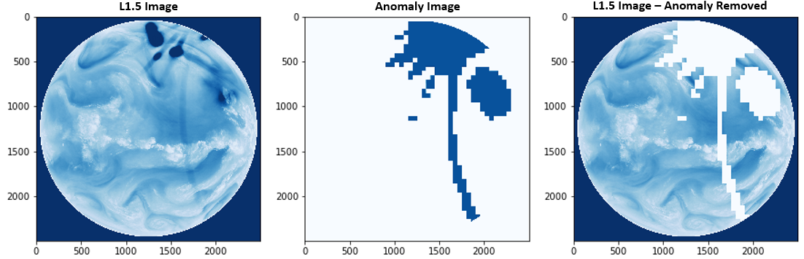
Data Quality Control Development
EUMETSAT developed QC tool to identify radiometric image anomalies in satellite images that are collated into a database
Complete for all Meteosat, Himawari, and GOES
Anomaly images are already available in MVIRI FCDR R2
Liefhebber, F., S. Lammens, P. Brussee, A. Bos, V. O. John, F. Rüthrich, J. Onderwaater, M. G. Grant, and J. Schulz (2020)
Automatic Quality Control of the Meteosat First Generation Measurements, Atmos. Meas. Tech., 13, 1167–1179. https://doi.org/10.5194/amt-13-1167-2020

Slide 7
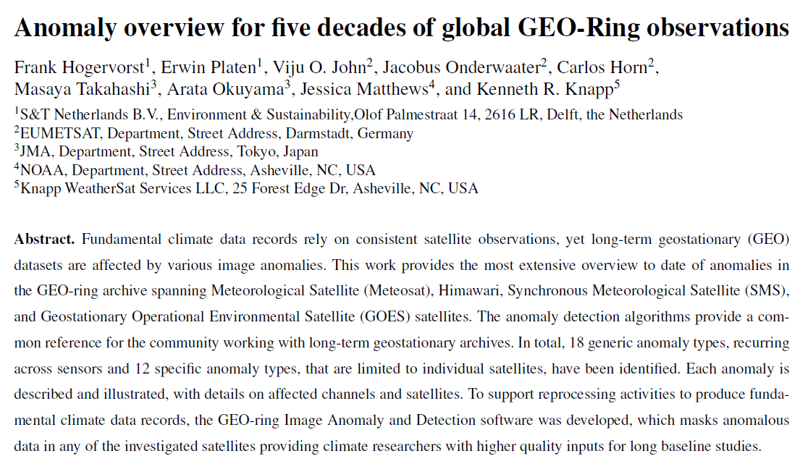
New Paper submitted on the anomaly work
Activities continue for recently rescues data, INSAT, MTG/FCI

Slide 8
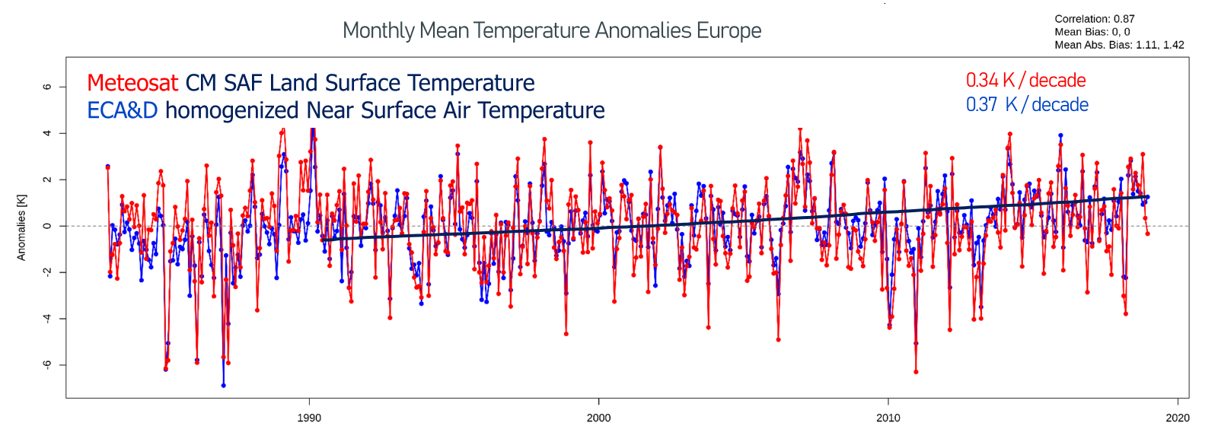
Re-calibration of infrared channels
IR channel radiometric calibration is anchored to modern hyperspectral instruments such as IASI/CrIS
Figure from Anke Tetzlaff, Meteo Swiss/CMSAF

Slide 9
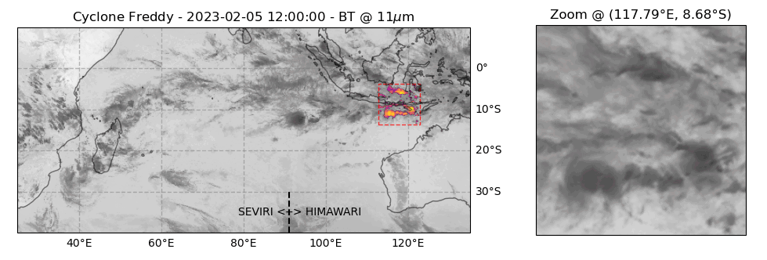
GEO-Ring: Seamless satellite data like model output
Test data set 2019-2024: https://user.eumetsat.int/resources/user-guides/geo-ring-test-data
Tools: https://gitlab.eumetsat.int/eumetlab/climate/geo-ring/level1gdemo
All spectral channels, three layers to cover data in the overlapping region
Cyclone Freddy from GEO-Ring data set on an equal area HEALPix grid with 5 km² spatial sampling and 30-minute temporal sampling

Slide 10
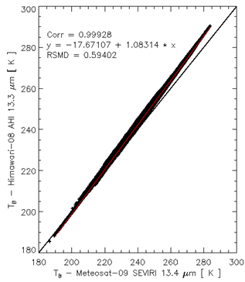
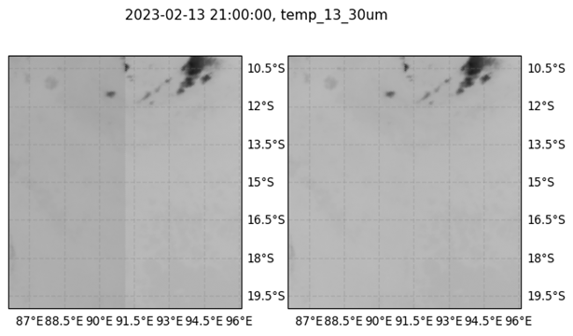
Spectral band adjustment, parallax correction, ...
IASI Spectra are used to derive spectral band adjustment factors (SBAF) for IR channels
Will be added as metadata

Slide 11

From Single Satellite Raw Data to Global Product
Raw data: rescue activities, radiometric anomaly detection, navigation
GEO FCDR: channel re-calibration, cross-calibration (rather easy for IR but complex for VIS), and spectral band adjustment, validation
L1G-GeoRing: combination of L1G-sat into quasi-global product to be distributed by EUMETSAT and NOAA with additional access for users within the cloud system if feasible
Final data record is still planned to be ready by end of 2027
Notes:
Agencies produce their own GEO FCDRs. GeoRing plan states that who produces the L1G-sat is still being determined. Agencies can share GEO-FCDRs and produce their own GeoRing from that using a common approach OR Agencies produce the L1G-sat that is then shared to other agencies for inclusion in the GeoRing.

Slide 12
THANK YOU

