Slide 1
IPWG MEETING, KRAKOW, 2026-07-08
A. DYBBROE¹, B. RYDBERG¹, P. KHALAJ¹, J. SÖDLING¹, AND S. PFREUNDSCHUH²
1. SWEDISH METEOROLOGY AND HYDROLOGICAL INSTITUTE
2. COLORADO STATE UNIVERSITY
SATELLITE–RADAR FUSION FOR OPERATIONAL PRECIPITATION ANALYSIS
USING DEEP LEARNING
IMPROVING SHORT-RANGE FORECASTING AT SMHI WITH CHIMP AND A LEAN ML-OPS WORKFLOW

Slide 2
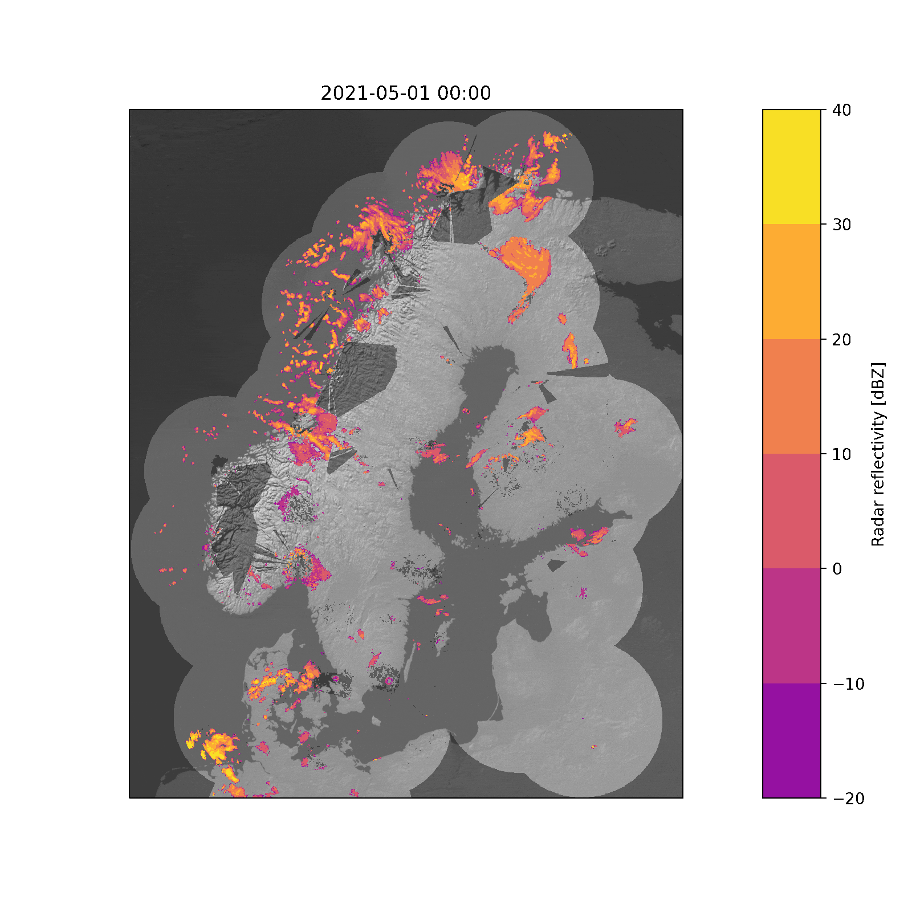
The Challenge: Limitations of Radar-Only Analysis
Coverage gaps:
  Limited radar reach in mountainous terrain
  and northern Sweden.
Data artifacts:
  Vulnerable to beam blockage, ground clutter,
  beam overshooting, melting layer,
  and anomalous propagation.
Operational goal:
  A continuous, high-resolution spatial estimate
  independent of terrain.
Notes:
Focus: Why ground radar alone is insufficient for robust national monitoring.

Slide 3
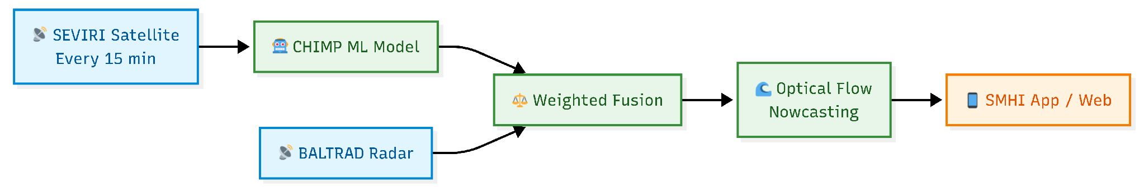
The Solution: Satellite-Radar Integration
Space-borne estimation: Geostationary observations processed every 15 minutes.
Dynamic blending: Weighted average merging based on geolocation and season.
Nowcasting propagation: Result moved forward in time using optical flow advection.
Notes:
Focus: High-level system architecture showing data flow from space to the end-user.

Slide 4
The Solution: Satellite-Radar Integration
Space-borne estimation: Geostationary observations processed every 15 minutes.
Dynamic blending: Weighted average merging based on geolocation and season.
Nowcasting propagation: Result moved forward in time using optical flow advection.
Notes:
Focus: High-level system architecture showing data flow from space to the end-user.

Slide 5
CHIMP ML MODEL
Notes:
Focus: Just point out we talk about chmip for some slides

Slide 6
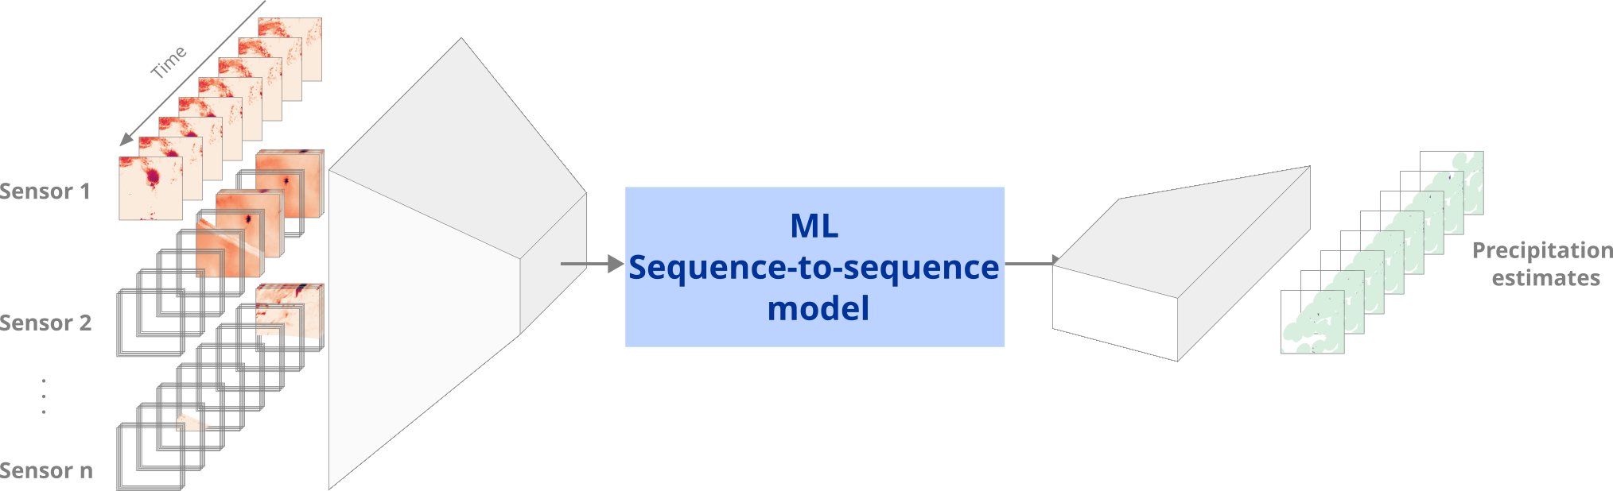
Chalmers/Colo State Integrated Multi-Satellite Retrieval Platform (CHIMP 🐒)
Framework origin: Developed at Chalmers University of Technology and Colorado State University.
Core design: Multi-stage Encoder/Decoder architecture.
Temporal and Spectral Fusion: 3D Convolutions with sensor-specific heads
Notes:
Focus: Explaining the core ML framework and its computational efficiency.

Slide 7
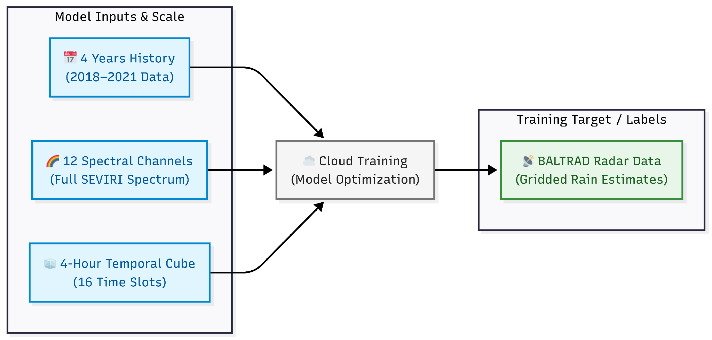
Model Training Setup
Dataset scale: 4 years of historical training data (2018–2021).
Target labels: Gridded BALTRAD weather radar data.
Model inputs: All 12 SEVIRI satellite channels.
Notes:
Focus: Input features, historical data volume, and the training target.

Slide 8
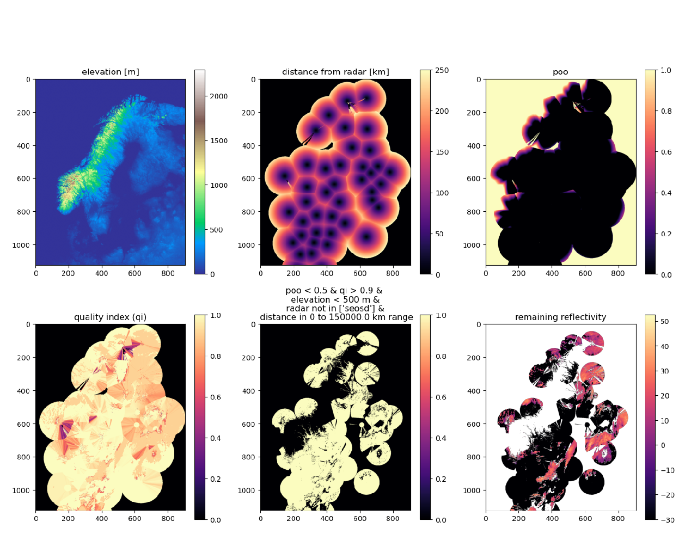
Radar Filtering Strategy for Training
Main development focus:
Quality control and aggressive filtering of BALTRAD data.
The threat:
Models easily memorize radar artifacts, beam blockage, and noise.
The strategy:
  Select only the cleanest, most reliable radar estimates for training.
Outcome:
  Prevented the ML model from replicating non-meteorological anomalies.
Topographic Elevation (DEM) Radar Range Distance Beam Overshooting Prob.
Baseline Radar Quality Index (RQI) Composite Multi-Criteria RQI Quality-Filtered BALTRAD Output
Notes:
Focus: Why filtering the training data was the most critical step for success.

Slide 9
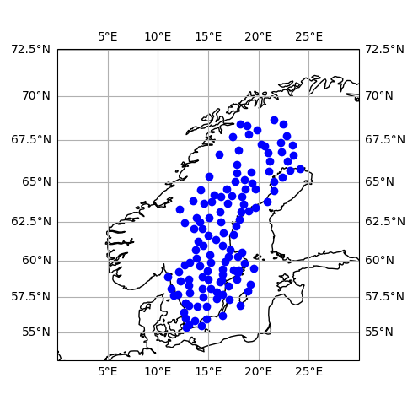
Rigorous Independent Verification
Validation period:
3 full years of independent data (2022, 2023, and July 2024–June 2025).
Independent baseline:
National network of rain gauge observations over Sweden.
High resolution:
Evaluated on a 4km spatial and 15-minute temporal grid.
PTHBV reference:
Gauge data adjusted and gridded using established SMHI hydrological modeling.
Notes:
Focus: How the model was tested using a completely separate gauge-based dataset.

Slide 10
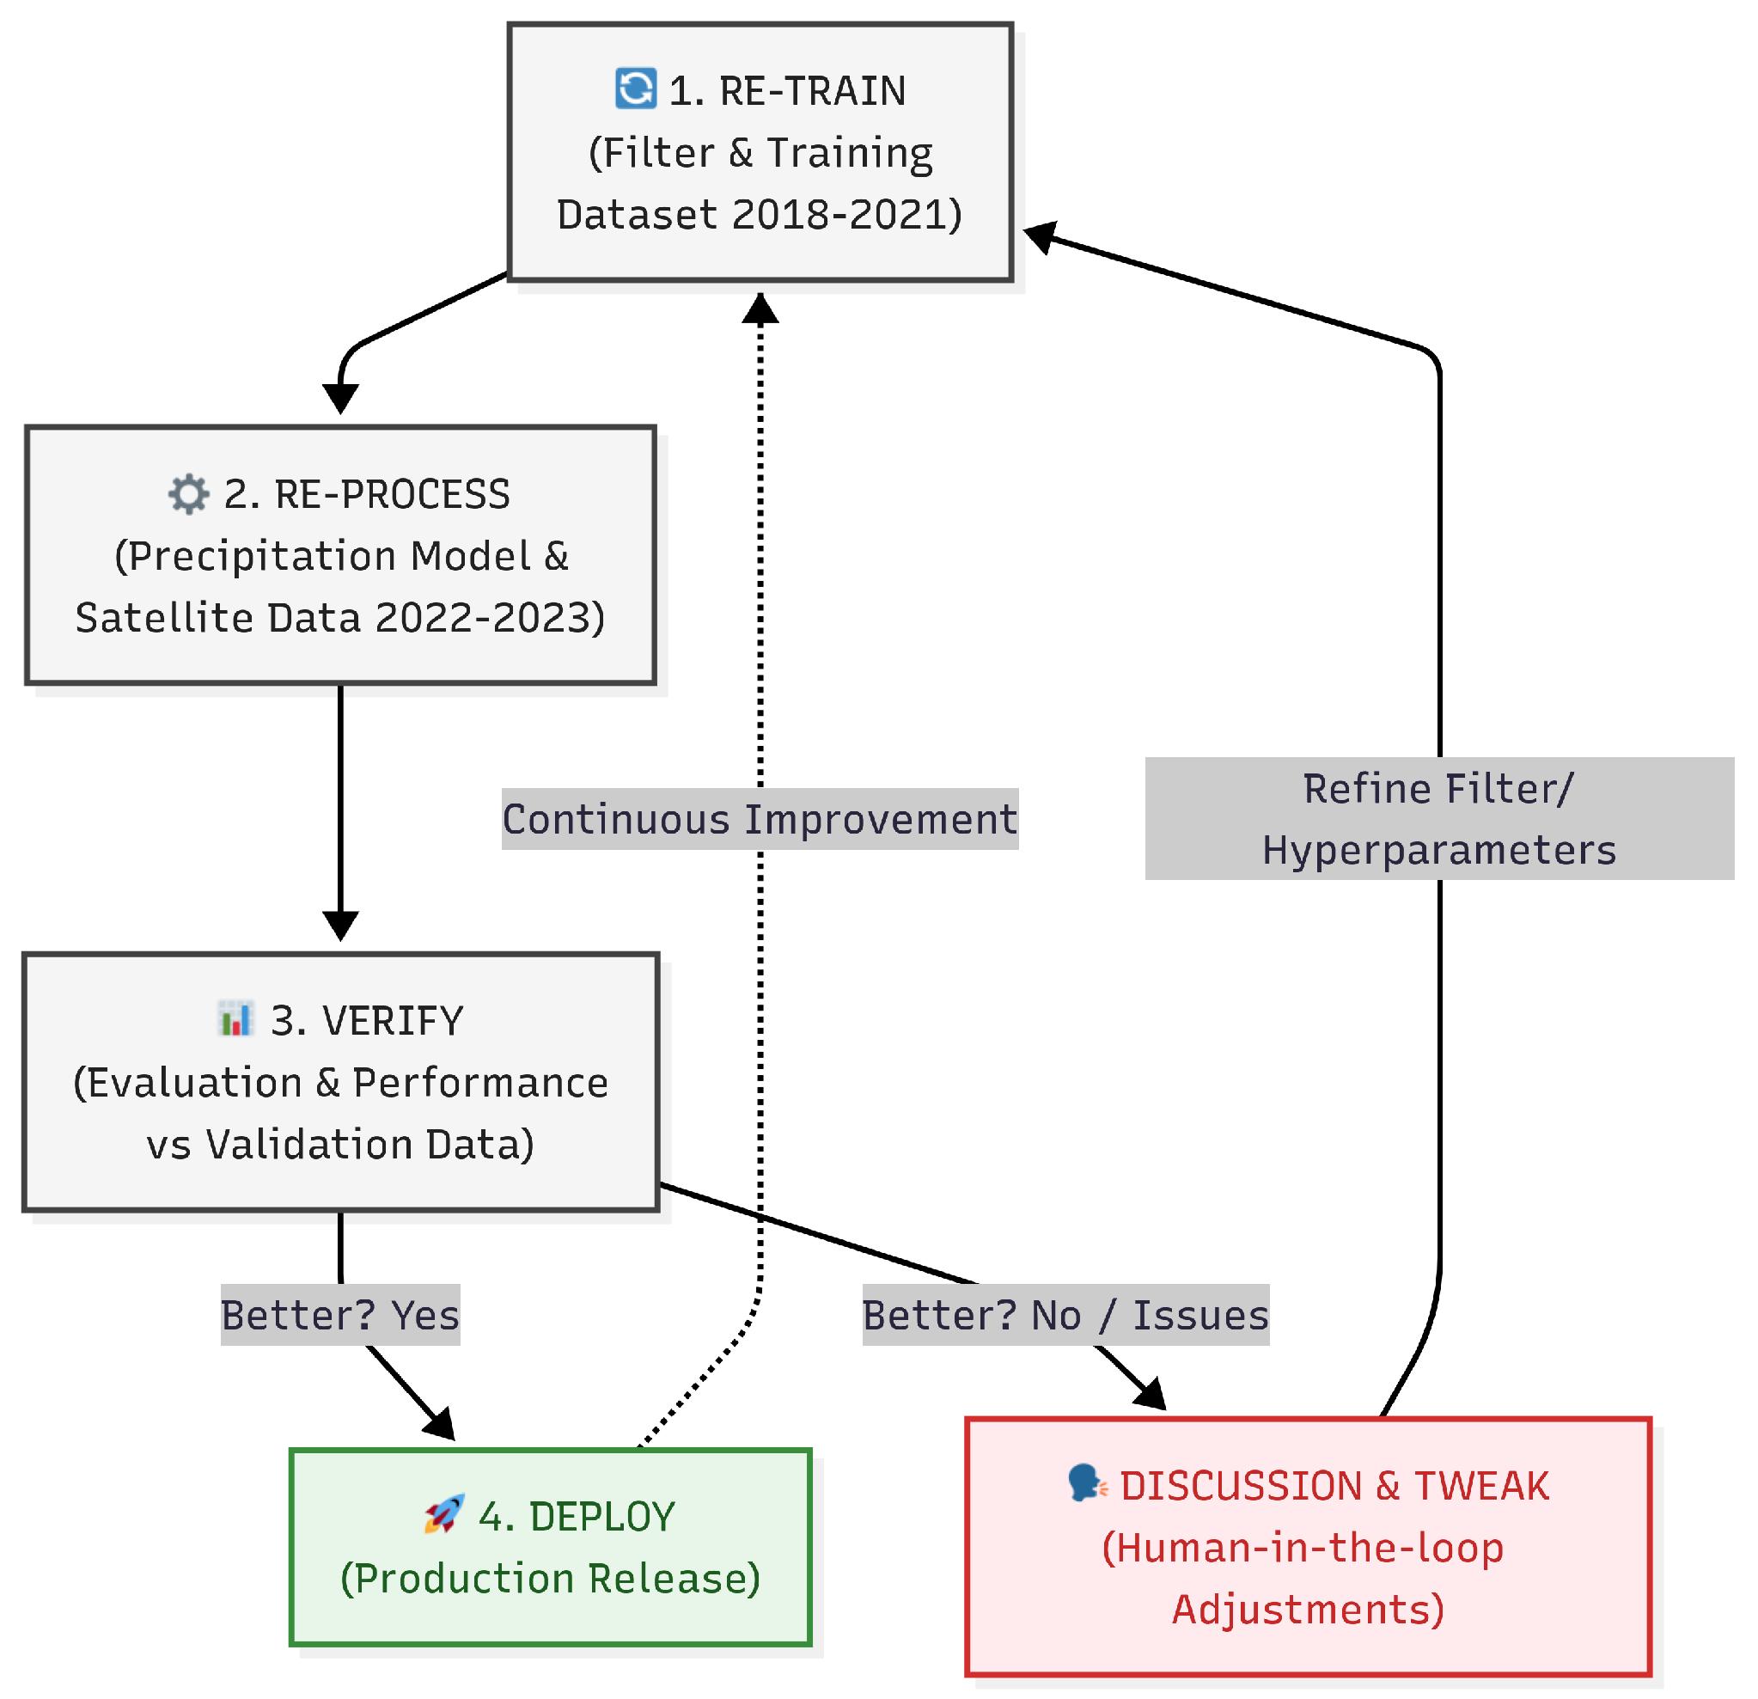
Continuous Deployment: The Lean ML Workflow
Operational challenge:
Weather patterns and satellite data evolve; models degrade.
SMHI solution:
  A customized, automated pipeline for continuous model lifecycles.
Core features:
  Seamless re-training, automated reprocessing, and instant verification.
Goal:
  Moving from a static model to continuous deployment of improved versions.
Notes:
Focus: The infrastructure built to keep the model updated.

Slide 11
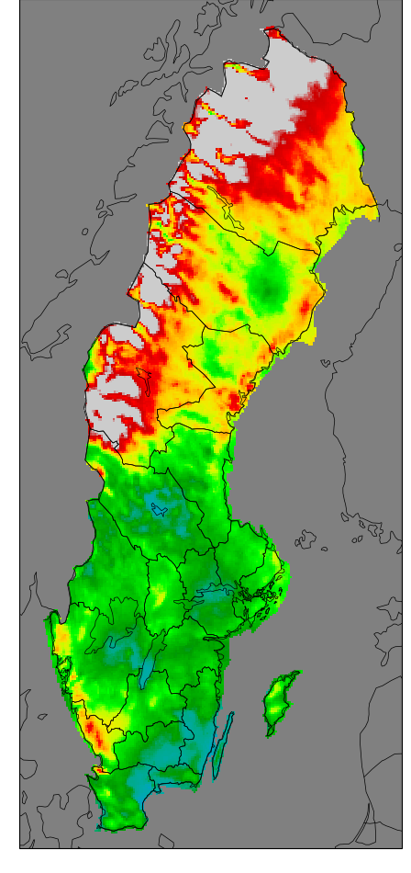
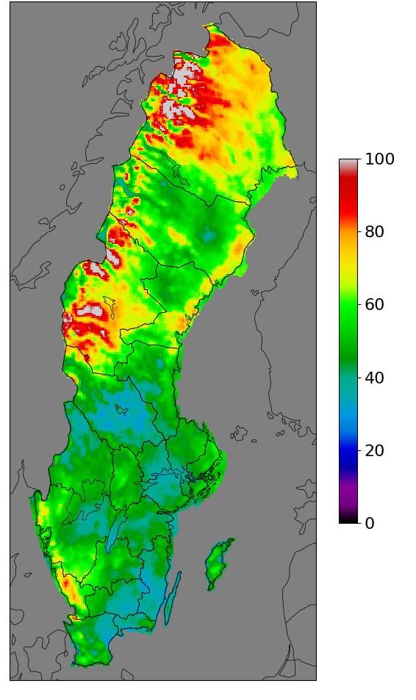
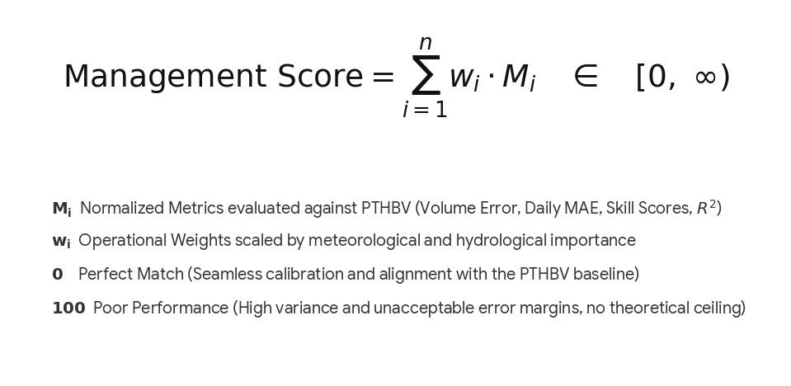
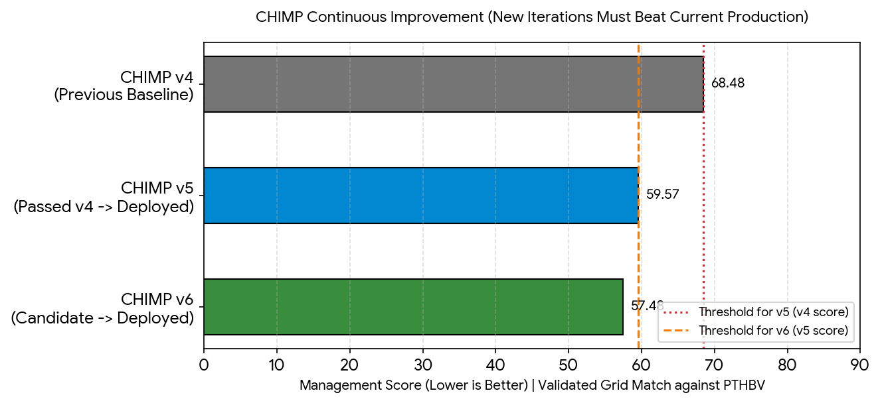
Making the Call: The Management Decision Score
CHIMP-v4
Regional mean = 68.68
CHIMP-v6
Regional mean = 57.48
The risk:
  New models can fix one type of error but introduce others.
Objective metric:
  Derived a single, mathematically robust 'Management Score'.
Data-driven governance:
  Eliminates guesswork in the deployment approval process.
Dynamic weighting:
  The same score determines the blending weights in production.
Notes:
Focus: The math and logic used to approve a model for production.

Slide 12
The Satellite/Radar weighted fusion

Slide 13
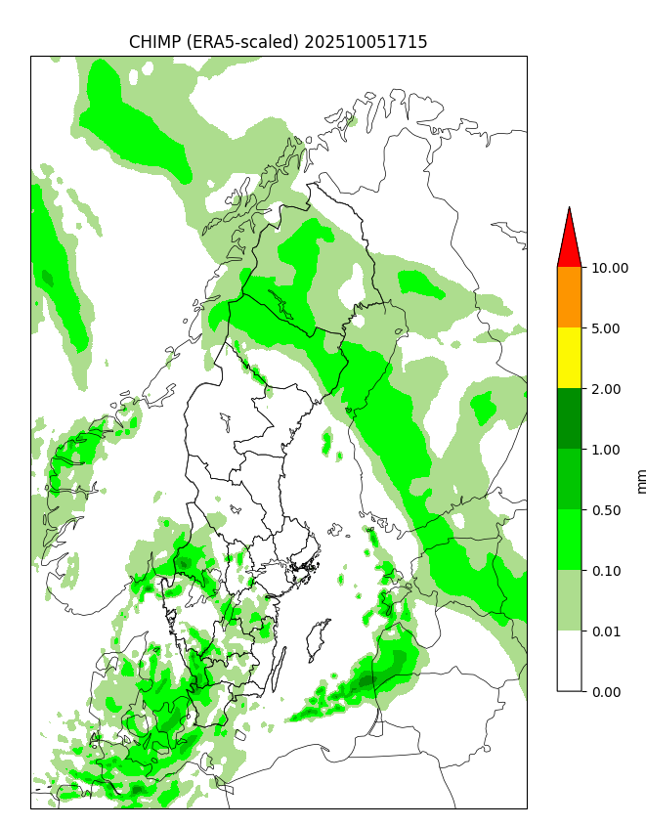
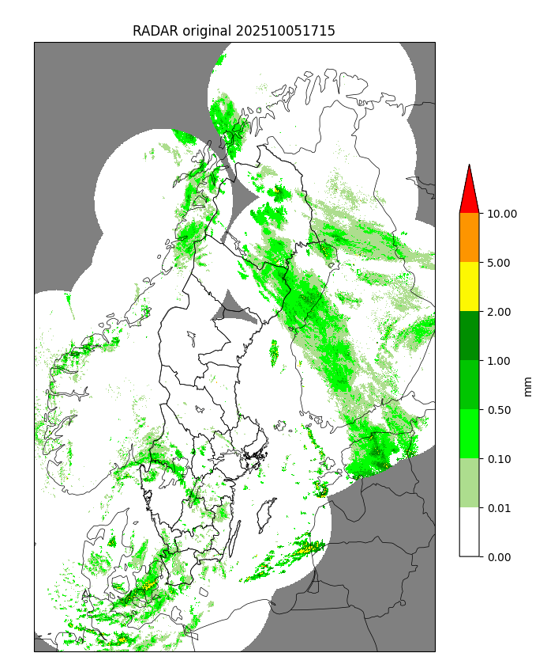
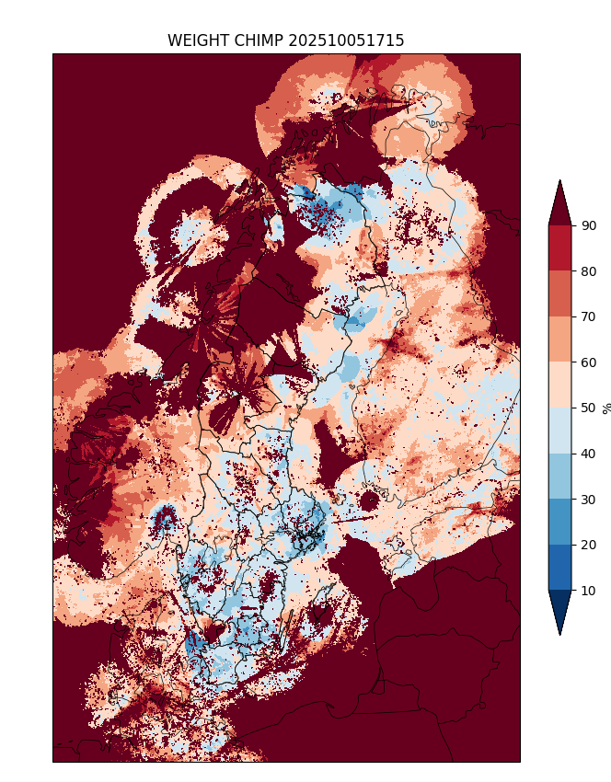
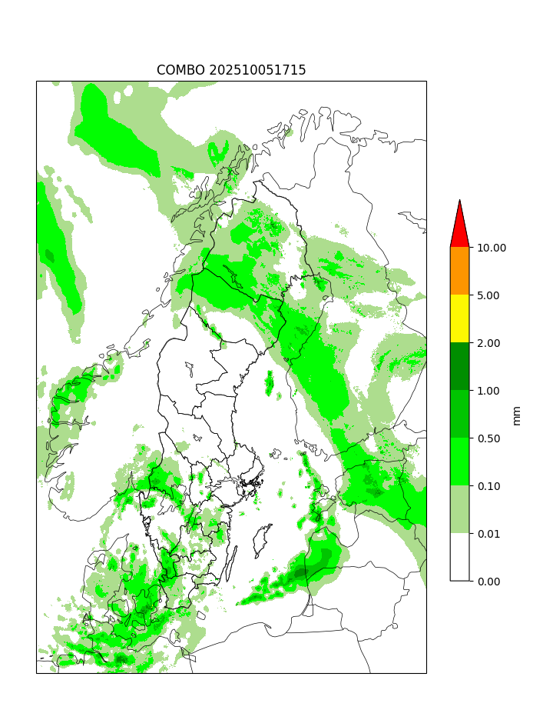
The Final Product: Weighted Fusion & Bias Correction
Dynamic blending: Calculated as a weighted average of the ML model and radar network.
Spatio-temporal weights: Weights vary automatically by geolocation and season.
Gauge adjustment: Real-time bias correction applied using active station data.
Operational output: Smoother, more accurate maps with significantly fewer blind spots.
Notes:
Focus: How the satellite ML output and radar are combined in real time.

Slide 14
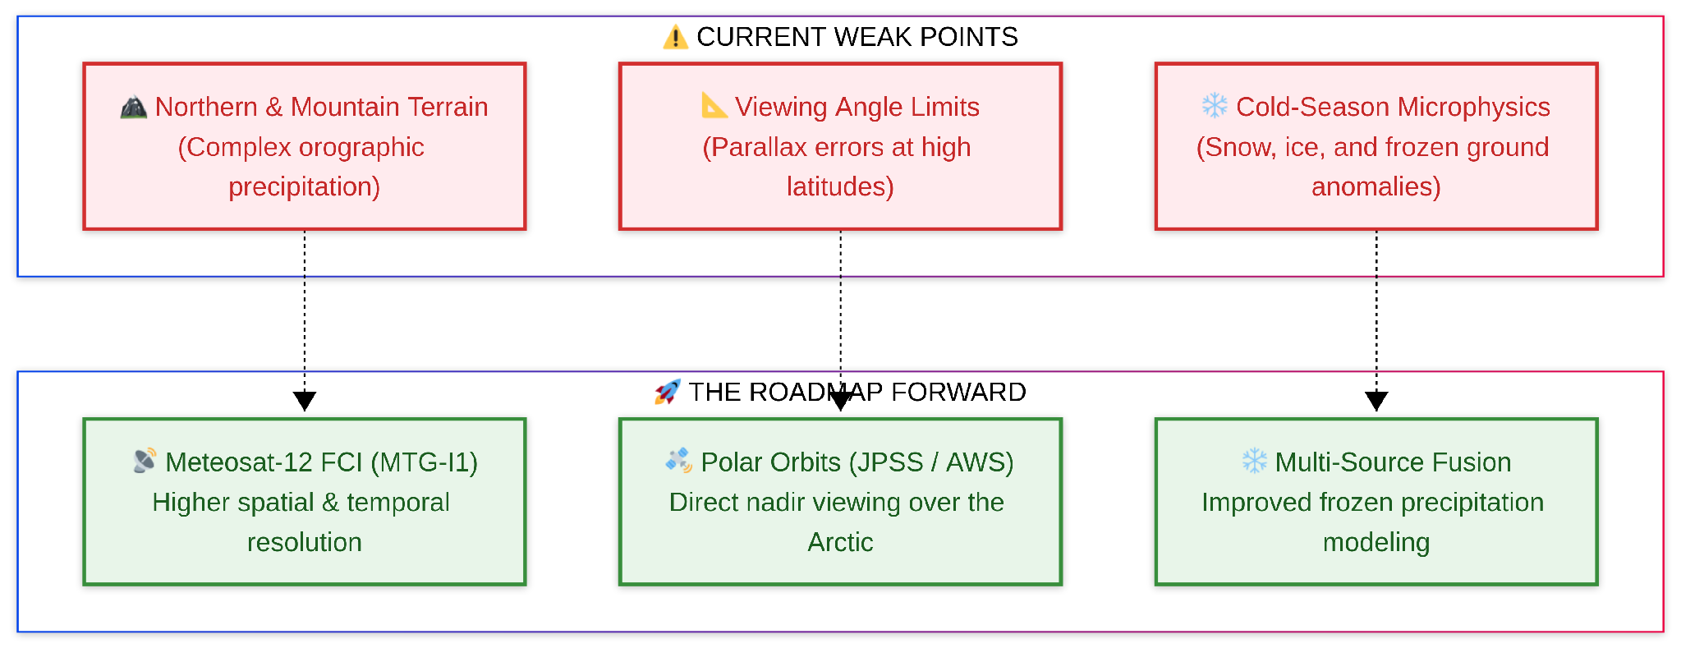
Future Work: Moving to Next-Gen Satellites
Remaining deficiencies: Lower accuracy persisting in mountain areas and northern Sweden.
Solution part 1: Integrating passive microwave data from polar-orbiting satellites (ATMS & AWS).
Solution part 2: Migration from SEVIRI to the next-generation Meteosat-12 FCI sensor.
Summary: Transitioning to higher resolution and multi-satellite inputs.
Notes:
Focus: Admitting current weak points and showing the roadmap forward.

Slide 15
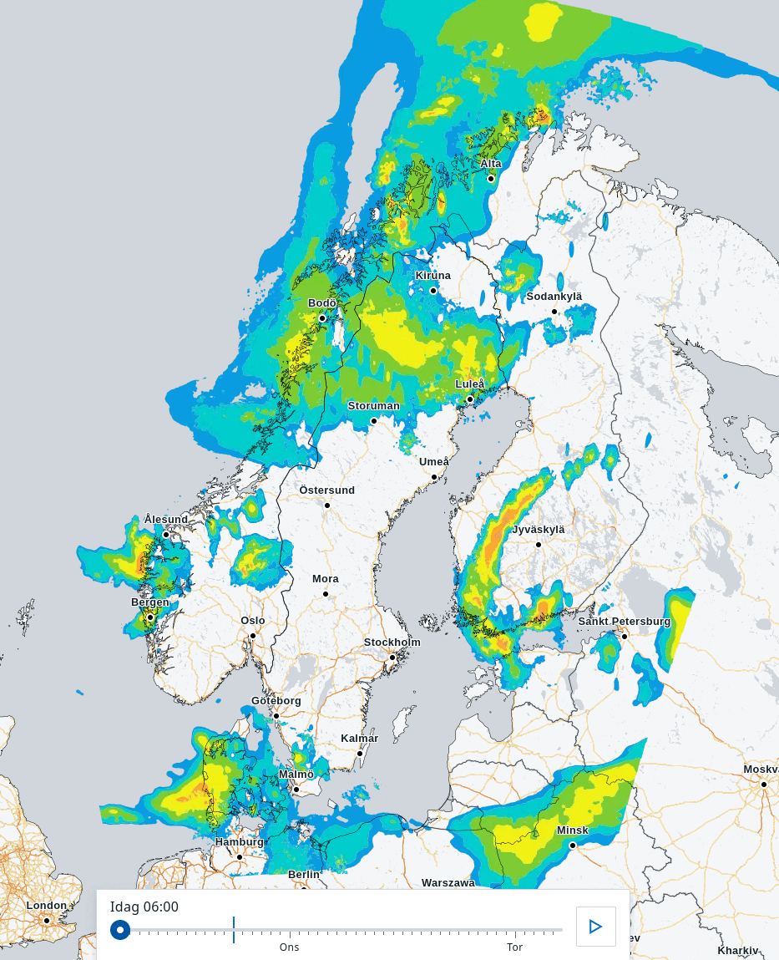
Final Product: Precipitation Analysis and Forecast
Notes:
Focus: Admitting current weak points and showing the roadmap forward.

